Slide 1
Air Pollution Forecasting using LSTM
DATS 6203 Machine Learning II
Group 3
Xiaoyang Chen, Julia Jin

Slide 2
Outline
Introduction & Background
Dataset Description & Preprocessing
Model Description
Results
Summary & Conclusion

Slide 3
1.1 Introduction
This project predicts air pollution using the Air Quality dataset from Kaggle.
This is a dataset that reports on the weather and the level of pollution each hour for five years at the US embassy in Beijing, China.
The data includes the date-time, the pollution called PM2.5 concentration, and the weather information as our features.

Slide 4
To predict the PM2.5 concentration using our dataset,
We choose a Long Short-Term Memory (LSTM) Recurrent Neural Network (RNN) model for its successful track record with time-series data.
We will establish a multivariate input model (multivariate) and a single variable input model (univariate).
We will compare the validation loss and results on both models and pick the best one.

Slide 5
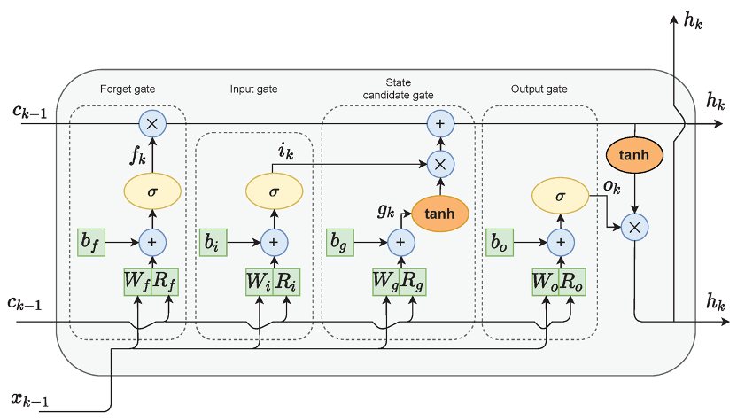
LSTM Network
Forget Gate: handles what information to throw away from the block
Input Gate: decides which values from the input to update the memory state
Output Gate: finally handles what to be in output based on input and the memory gate

Slide 6
2.1 Dataset Description
pm2.5: PM2.5 concentration (ug/m^3)
dew: Dew point
temperature: Temperature around the embassy (F)
pressure: Air pressure
wind_dir: Combined wind direction
wind_speed: Cumulated wind speed (m/s)
snow: Cumulated hours of snow
rain: Cumulated hours of rain

Slide 7
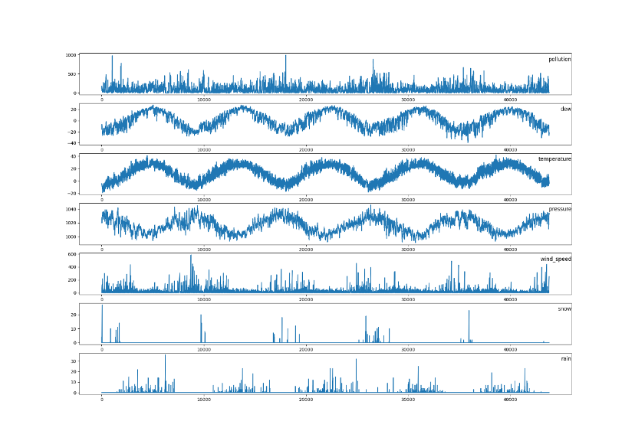
2.2 Visualization
High seasonality
Dew, temperature & pressure show high cyclicity

Slide 8
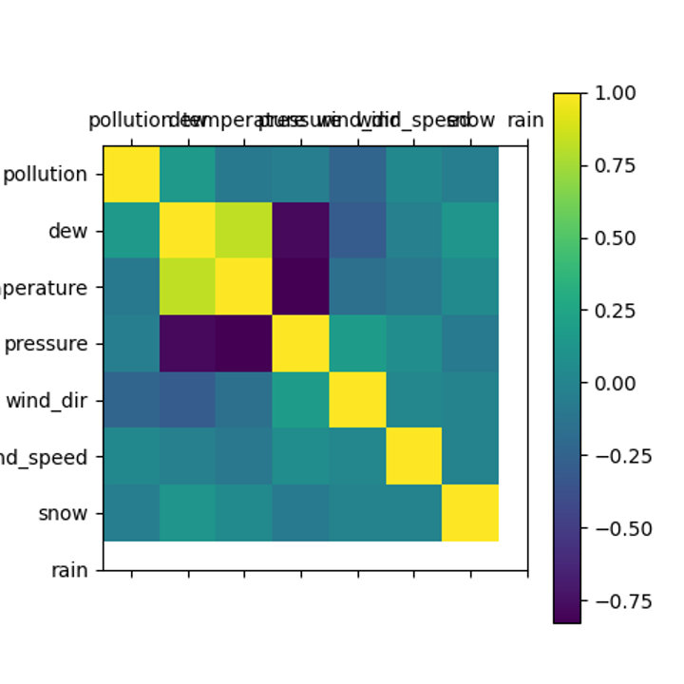
2.3 Correlation Matrix
Highly negative correlated: dew & pressure, temperature & pressure
Highly positive correlated: dew & temperature

Slide 9
2.4 Preprocessing
Use “LabelEncoder” from sklearn.preprocessing to change “wind_direction”, a string type, to float.
Use “MinMaxScaler” to normalize the data.
Reframe a time series problem as a supervised learning problem - from one sequence to pairs of input and output sequences. Use “series_to_supervised”.

Slide 10
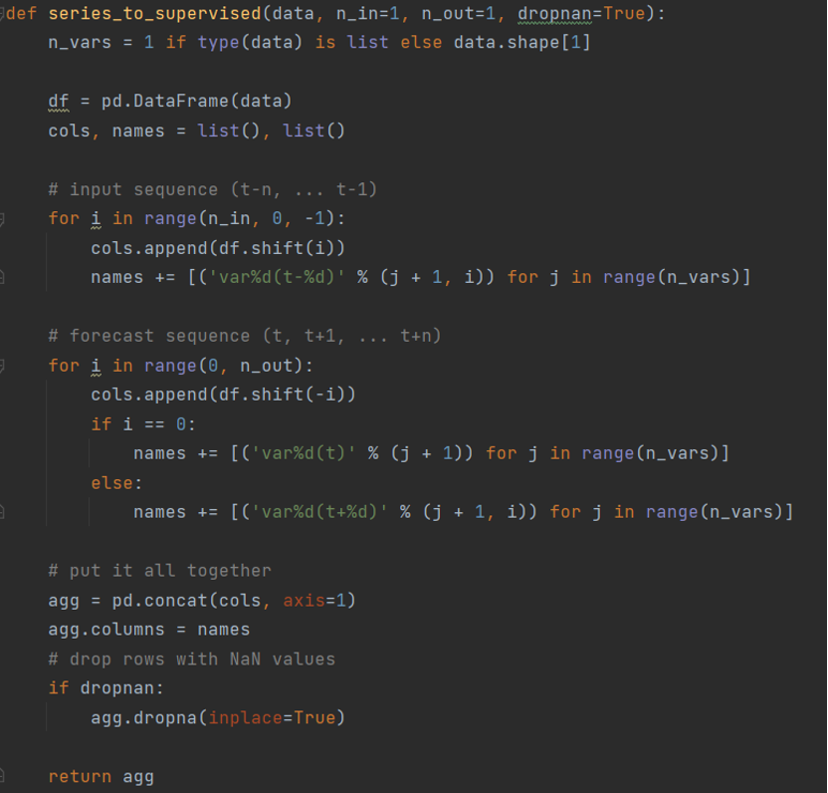
series_to_supervised
Takes a univariate or multivariate time series and frames it as a supervised learning dataset.
n_in: number of lag observations as input
n_out: number of observations as output

Slide 11
3.1 Multivariate Models
Divide our dataset into two parts. The dataset from 2010 to 2013 is used as the training part, and the dataset from 2014 is used as the validation part.
Use batch normalization to improve the convergence rate and overall performance of the network
Use dropout layer to prevent overfitting in our networks
Use built-in LSTM model in tensorflow.keras library

Slide 12
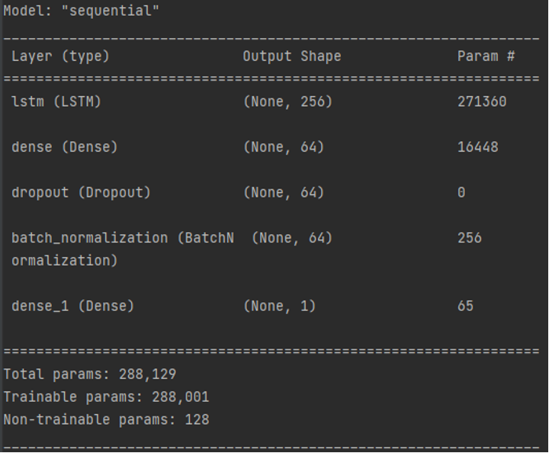

Slide 13
3.2 Univariate Model
The univariate model differs from the multivariate model in that multivariate model reads in all the features. In the data preparation for the univariate model, we only read the data of the pollution feature and preprocess it.
Again, we divide the dataset into two parts as we did for multivariate model.

Slide 14
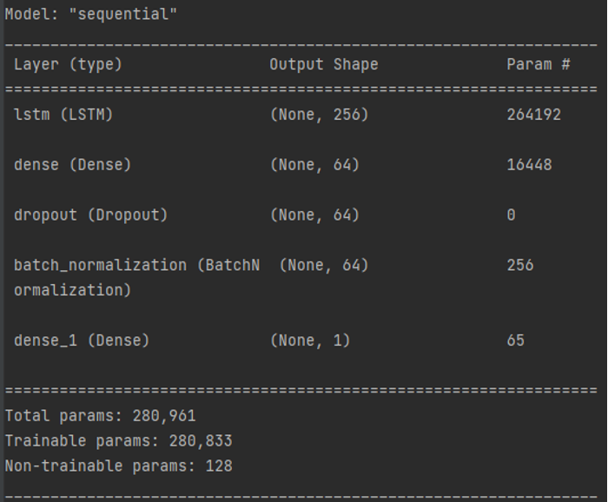
Parameters in LSTM layer are not the same as the ones in the multivariate model.
Parameters = ((embedding size + hidden size) * hidden size + hidden size) * 4

Slide 15
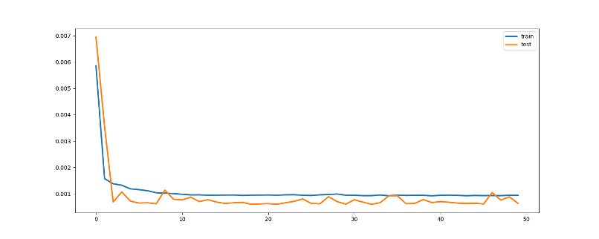
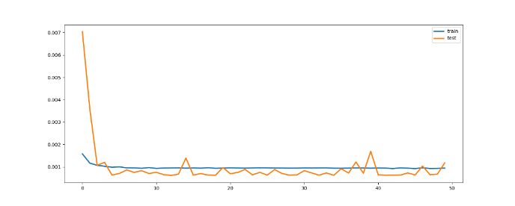
4.1 Validation Loss
Multivariate Model
Univariate Model

Slide 16
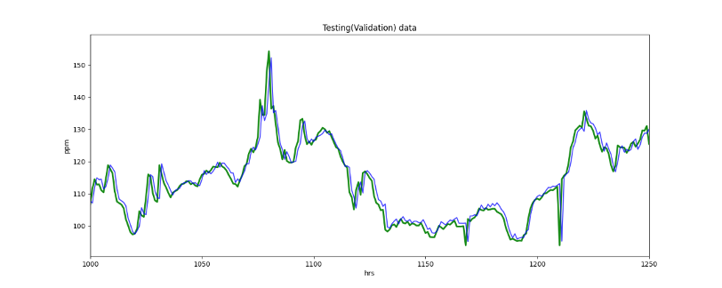
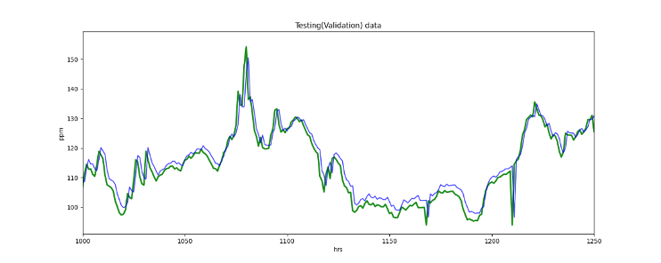
4.2 Output
Multivariate Model
Univariate Model

Slide 17
5.1 Conclusion
Best model: multivariate model
Problem: validation loss ups & downs
Overfitting?
Small dataset?

Slide 18
5.2 Improvement
Investigate further into the reasons behind the difference between actual data and model outputs at some certain interval
Deeper and wider LSTM network
Learning rate
Different algorithm
GRU

Slide 19
Reference
Tsai, Zeng, Y.-R., & Chang, Y.-S. (2018). Air Pollution Forecasting Using RNN with LSTM. 2018 16TH IEEE INT CONF ON DEPENDABLE, AUTONOM AND SECURE COMP, 16TH IEEE INT CONF ON PERVAS INTELLIGENCE AND COMP, 4TH IEEE INT CONF ON BIG DATA INTELLIGENCE AND COMP, 3RD IEEE CYBER SCI AND TECHNOL CONGRESS (DASC/PICOM/DATACOM/CYBERSCITECH), 1074–1079. https://doi.org/10.1109/DASC/PiCom/DataCom/CyberSciTec.2018.00178
Wikipedia, “Long short-term memory,” 2022. [Online] Available at: https://en.wikipedia.org/wiki/Long_short-term_memory, Accessed: 2022.
“A Complete Guide to LSTM Architecture and its Use in Text Classification,” 2022. [Online] Available at: https://analyticsindiamag.com/a-complete-guide-to-lstm-architecture-and-its-use-in-text-classification/, Accessed: 2022.
“sklearn.preprocessing.LabelEncoder.” [Online] Available at: https://scikit-learn.org/stable/modules/generated/sklearn.preprocessing.LabelEncoder.html, Accessed: 2022.
“How to Convert a Time Series to a Supervised Learning Problem in Python,” 2022. [Online] Available at: https://machinelearningmastery.com/convert-time-series-supervised-learning-problem-python/, Accessed: 2022.
“tf.keras.layers.LSTM” [Online] Available at: https://www.tensorflow.org/api_docs/python/tf/keras/layers/LSTM, Accessed: 2022.

