Slide 1

GroceDoor
Your Grocery Delivery
By Gaurav M

Slide 2
Problem Statement
People have to go out to the stores for purchasing groceries which some find tiresome.
Big retail ecommerce websites like Amazon and Wal-Mart do not provide any cost comparison between the ecommerce sites.
This app also allows to compare prices between the stores you have chosen.

Slide 3
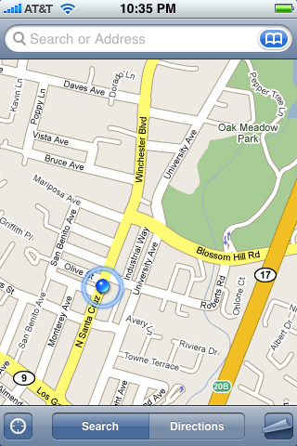
Solution
The users can search the
stores through GPS within
a particular radius they want.
Pin Points will indicate the
Stores nearby the user.

Slide 4
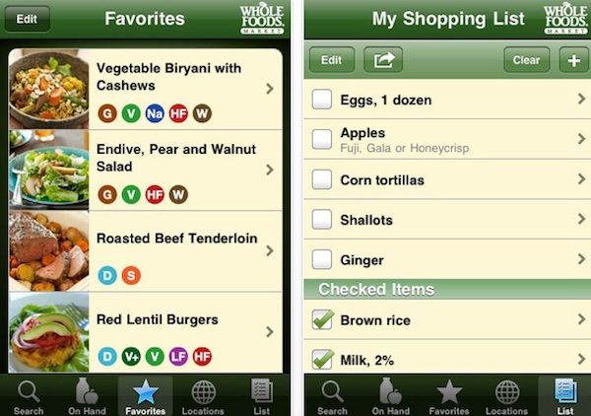
After selection of the store user will be given choice of selecting the good they want.
The user can also compare prices with the other stores.
User can search a particular
item from multiple stores.

Slide 5
Final list will be sent to the retailer and the retailer will call up for final confirmation for the delivery of goods.
The delivery can be set by seeing the current GPS location of the user.
It will be having minimum limit for order.

Slide 6
THANK YOU

