Slide 1
Review on
[MiniONN, 2017], [Gazelle, 2018] and [MPCViT, 2022]
Xue Yufei, Southeast University
03/31/2023
[MiniONN, 2017] Liu J, Juuti M, Lu Y, et al. Oblivious neural network predictions via minionn transformations[C]//Proceedings of the 2017 ACM SIGSAC conference on computer and communications security. 2017: 619-631.
[Gazelle, 2018] Juvekar C, Vaikuntanathan V, Chandrakasan A. {GAZELLE}: A low latency framework for secure neural network inference[C]//27th {USENIX} Security Symposium ({USENIX} Security 18). 2018: 1651-1669.
[MPCViT, 2022] Zeng W, Li M, Xiong W, et al. MPCViT: Searching for MPC-friendly Vision Transformer with Heterogeneous Attention[J]. arXiv preprint arXiv:2211.13955, 2022.

Slide 2
Content
1. MiniONN
Protocol for matrix-vector multiplication
Protocol for linear/non-linear operation (Sigmoid)
2. GAZELLE
FHE
SIMDScMult/Conv
3. MPCViT
Idea

Slide 3
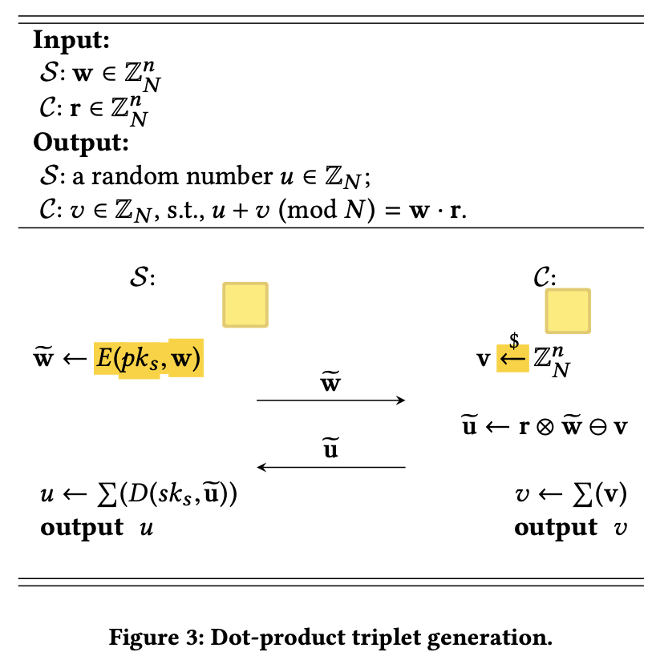
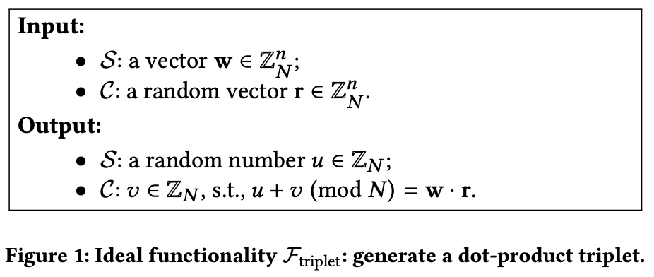
MiniONN: Multiplication
u → S
r, v → C

Slide 4
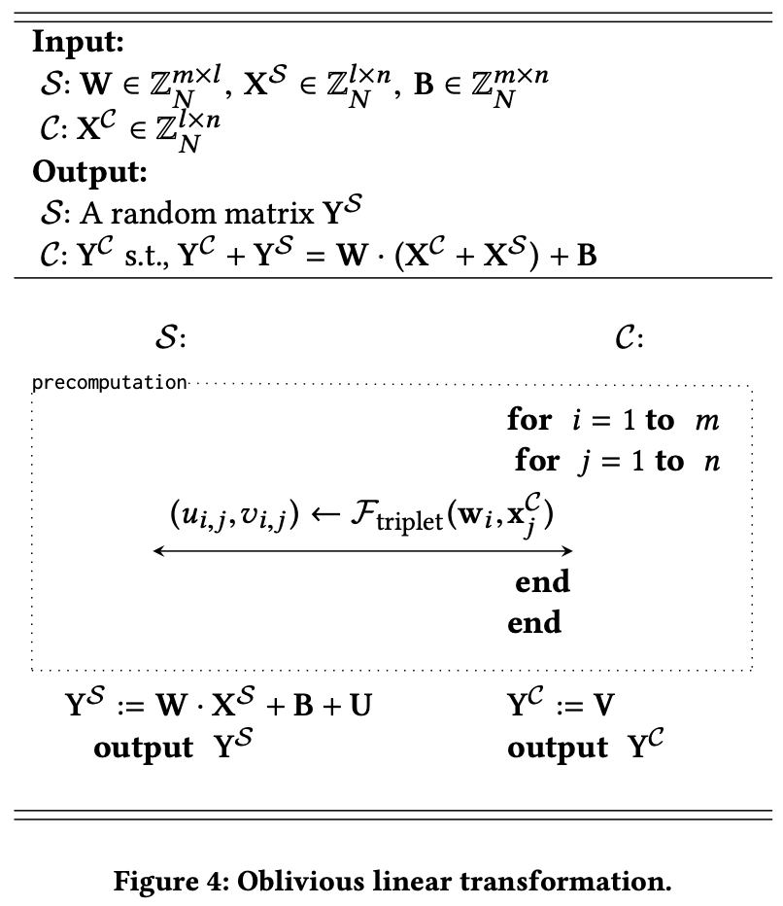

MiniONN: Linear operation
预生成三元组，节省开销
$$Y^{C}+Y^{S}=Y$$

Slide 5
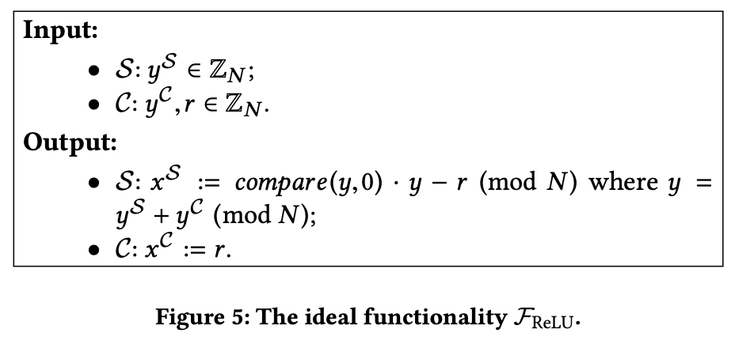
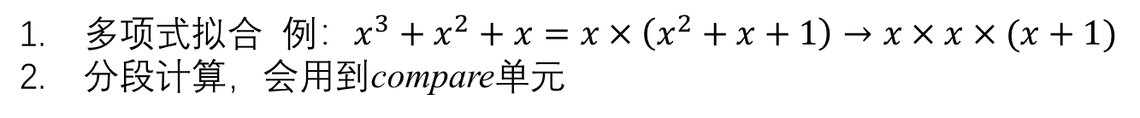
MiniONN: Activation functions
ReLU: garbled circuit
Sigmoid:
多项式拟合 例：$x^{3}+x^{2}+x=x×\left(x^{2}+x+1\right)→x×x×(x+1)$
分段计算，会用到compare单元

Slide 6

MiniONN: Sigmoid
1. 使用分段线性拟合
$$w_{1}$$
$$b_{1}$$
$$w_{i}$$
$$b_{i}$$
Fixed-point number
0.1234
Multiplexer
Output
…
$$w_{N}$$
$$b_{N}$$
2. 使用LUT计算非线性函数 ($A^{−1}$)
Memory (LUT)
Fixed-point number
0.1234
$$\left\lfloor ·\right\rfloor or \left\lceil ·\right\rceil$$
num2addr
0.12
0X1234
Cache
Output

Slide 7
MiniONN: Sigmoid
3. 复用计算单元
Memory (LUT)
{ $w_{1}, b_{1}$}
num2addr
{ $w_{2}, b_{2}$}
…
Fixed-point number
0.1234
Multiplexer
{ $w_{i}, b_{i}$}
$$w_{i}$$
$$b_{i}$$
…
Output

Slide 8




GAZELLE: FHE
加法同态：$En\left(x+y\right)=En\left(x\right)⊕En(y)$
v.s.
FFT$\left(x+y\right)=\text{FFT}\left(x\right)+\text{FFT}(y)$
乘法同态：$En(x×y)=En\left(x\right)⊗En(y)$
FFT$(x×y)=\text{FFT}\left(x\right)∗\text{FFT}(y)$
线性系统的线性性质

Slide 9
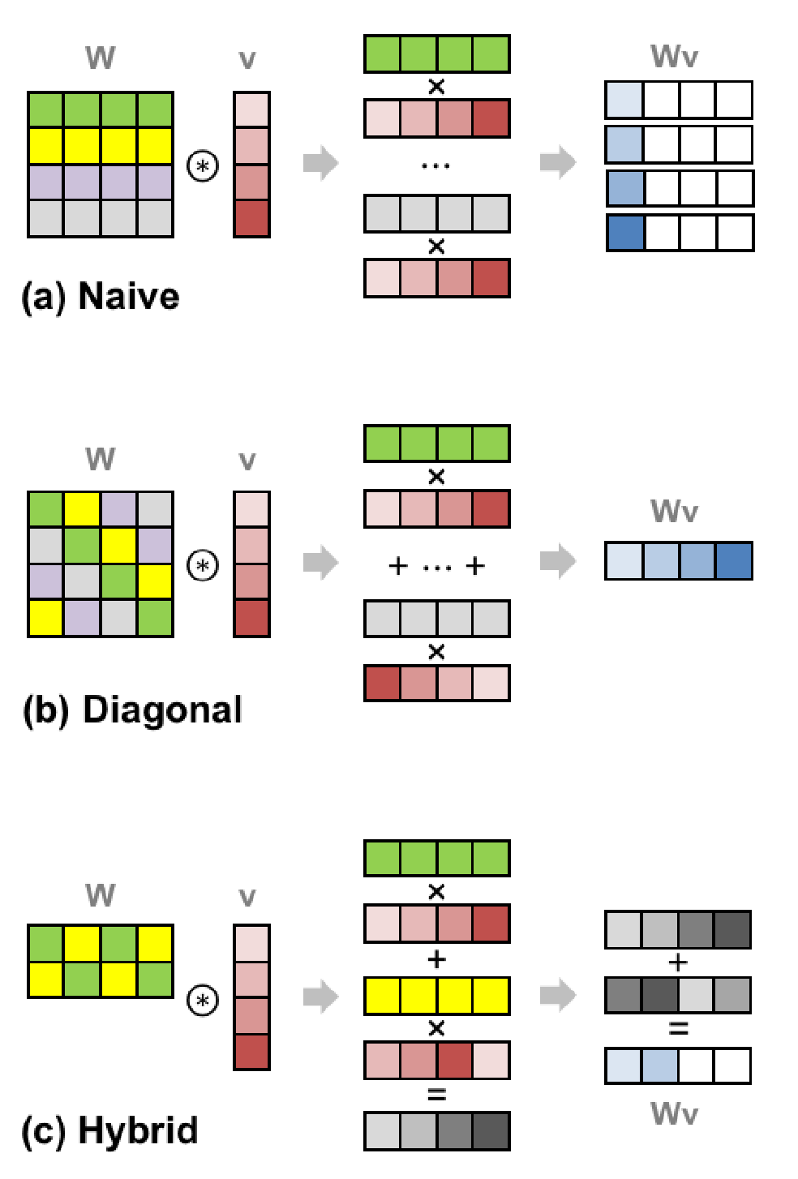
GAZELLE: SIMDScMult
How did the authors think about it?
Is there an optimization?
(To note)

Slide 10
GAZELLE: SIMDScMult

Slide 11
GAZELLE: SIMDScMult

Slide 12
GAZELLE: SIMDScMult

Slide 13
GAZELLE: SIMDScMult

Slide 14
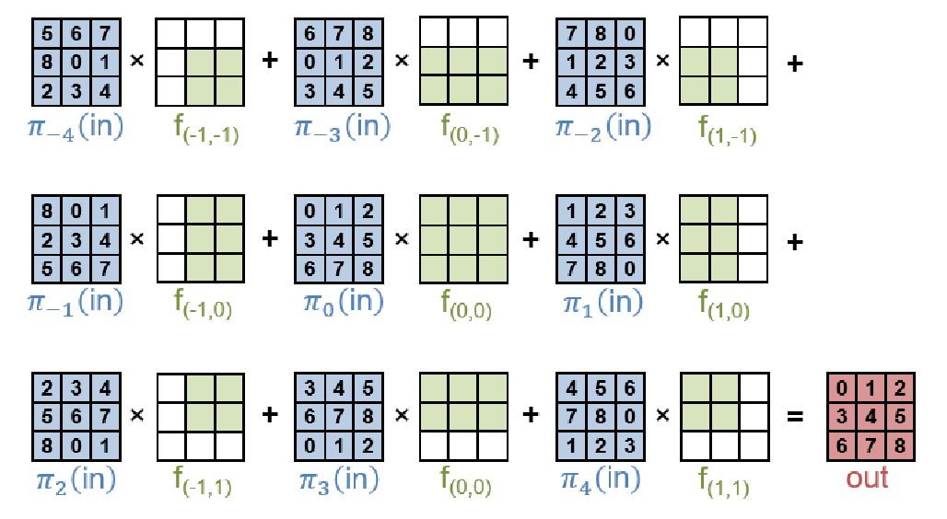
GAZELLE: Conv
Optimization for padding
的部分保留，其余部分置零
Channel Packing:
Input $c_{i}$, output $c_{o}$, integer $c_{n}$ → Input $\frac{c_{i}}{c_{n}}$, output $\frac{c_{o}}{c_{n}}$
计算结果一样吗？（to note）

Slide 15
GAZELLE: Conv

Slide 16
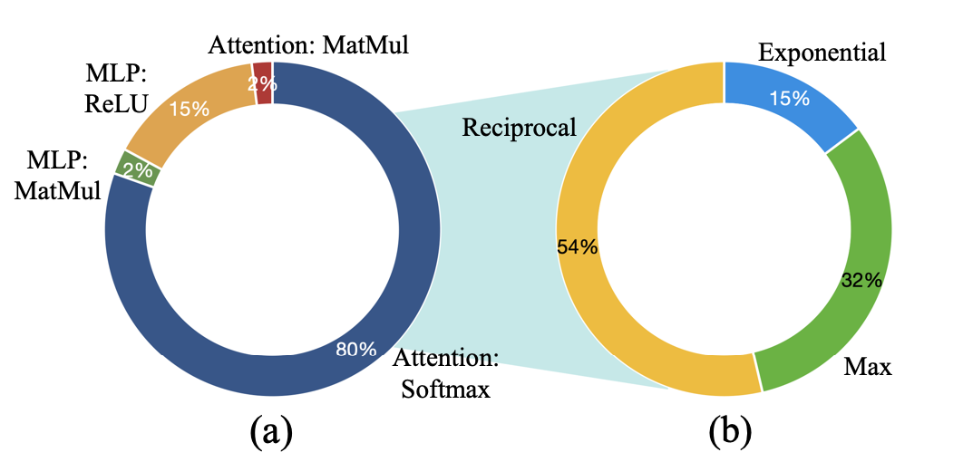
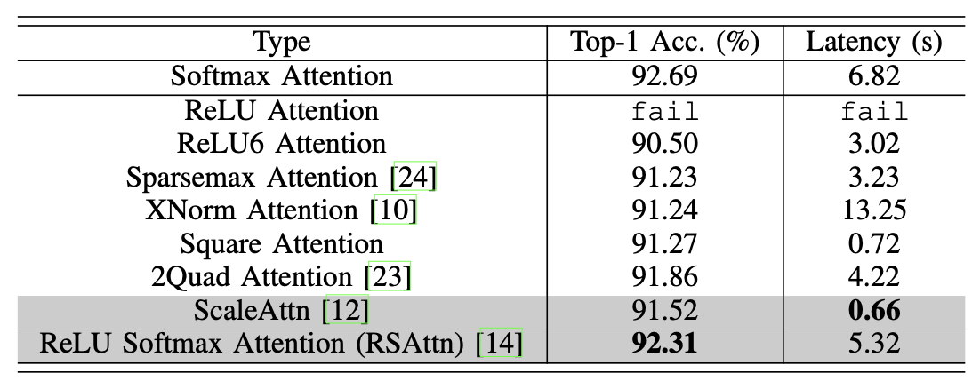


MPCViT:
General idea:
Low-latency
NLP skills → CV
$$αA+\left(1−α\right)B$$
Step:
1. find most time-consuming operation
2. get rid of $e^{x}$, replaced by ScaleAttn+RSAttn

Slide 17
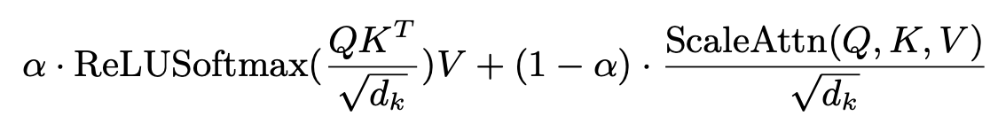
MPCViT:
1. Differentiable NAS
取RSAttn的准确性，取ScaleAttn的低时延，更倾向ScaleAttn
2. How to effectively train?
Token-wise feature-based KD

