Slide 1
About Cheetah
Xue Yufei, Southeast University
04/25/2023

Slide 2
Contents
Code：
一些验证性代码实现
Paper：
Cheetah: Lean and Fast Secure Two-Party Deep Neural Network Inference
Proposed 2PC protocols: Linear Layer (FC/Conv2D)
Cheetah: Optimizing and Accelerating Homomorphic Encryption for Private Inference
HE-PTune
Partial-aligend Scheduling
HE Inference Accelerator Architecture

Slide 3
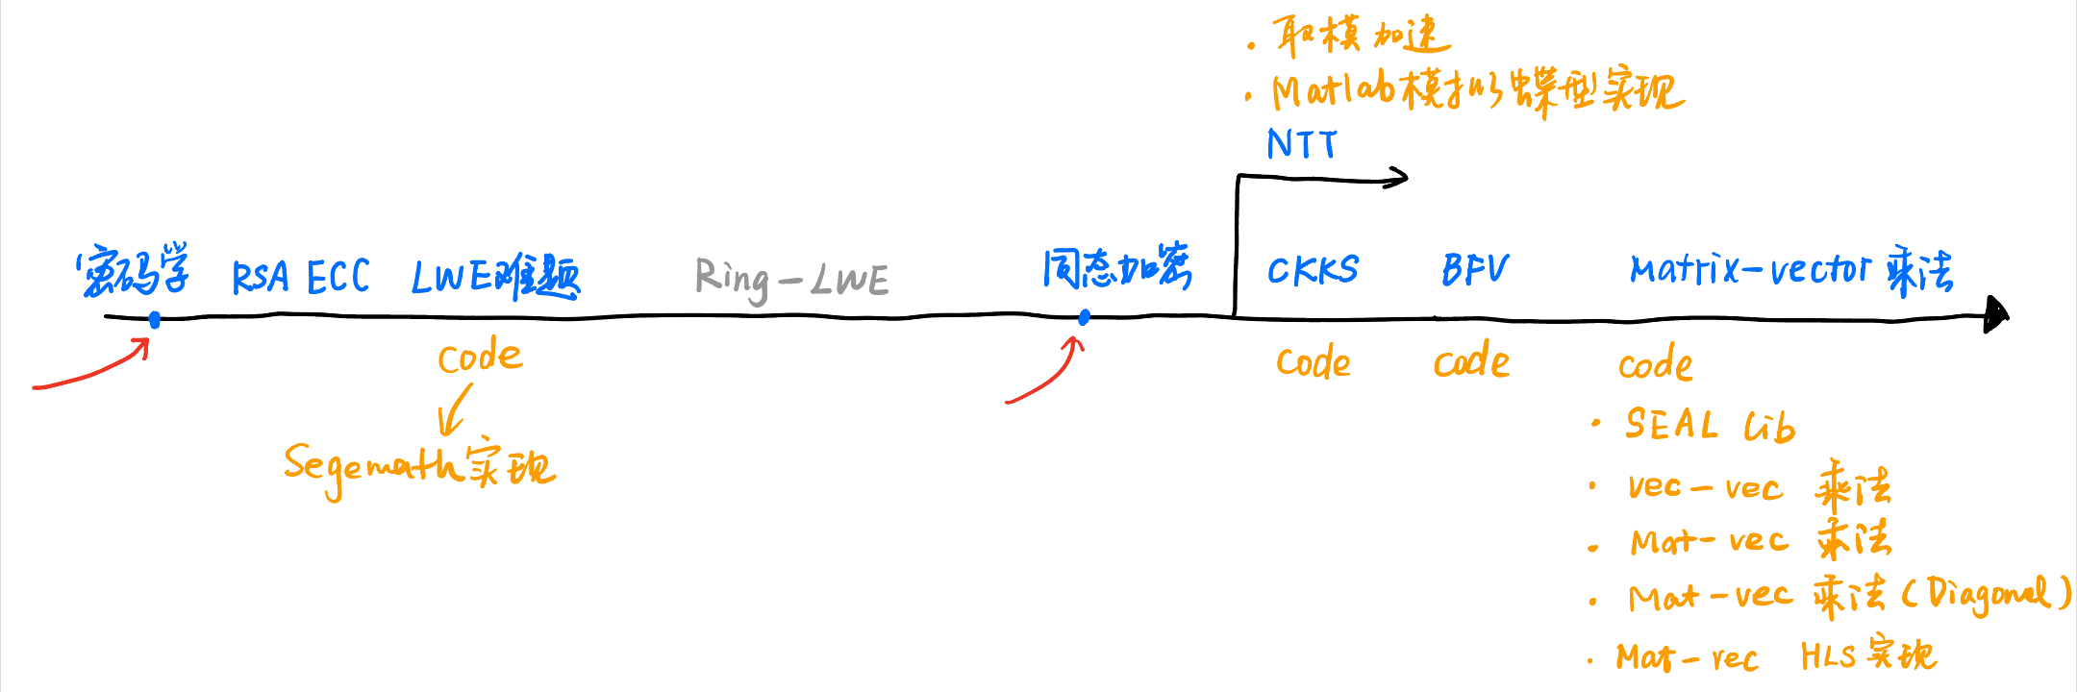
Learning line

Slide 4
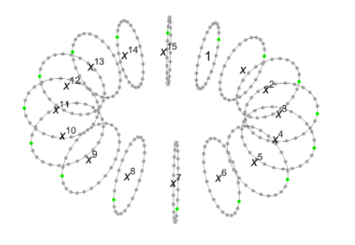
Based on SEAL Lib
Toy examples: CKKS & BFV
---------------------------------------------------------------------
BFV/CKKS.cpp
---------------------------------------------------------------------
1. 设置参数：
poly_modulus_degree
coeff_modulus
plain_modulus
2. 使用 KeyGenerator 生成 SecretKey 和 PublicKey
3. Encode
4. Encrypt
5. (Calculating…)
6. Decrypt
7. Decode
---------------------------------------------------------------------

Slide 5
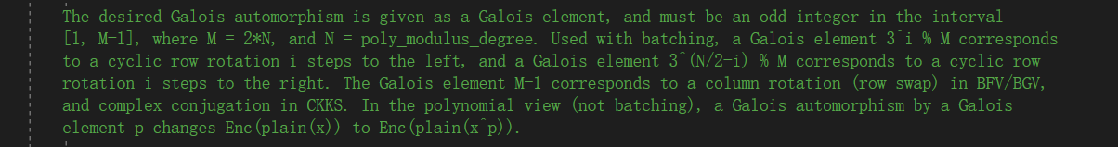
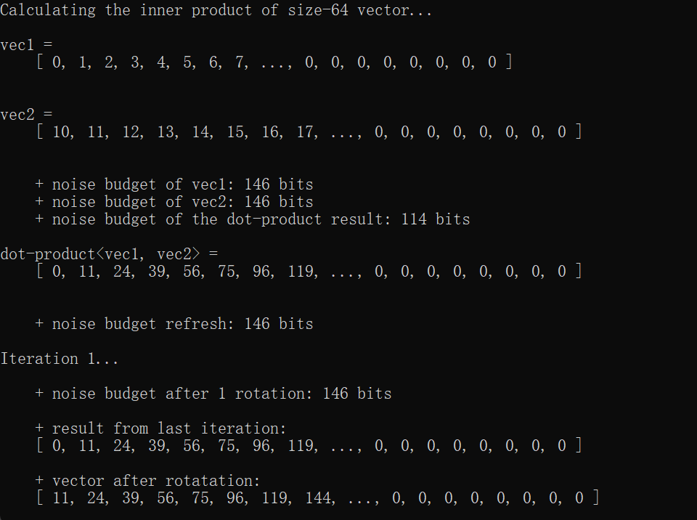
Based on SEAL Lib
Vector-vector multiplication
先计算element-wise product，再计算rotation-sum
SEAL lib里面的乘法和加法都是element-wise（SIMD）
Rotation（移位）的长度为poly_modulus_degree/2
Rotation在SEAL lib里不消耗noise budget

Slide 6
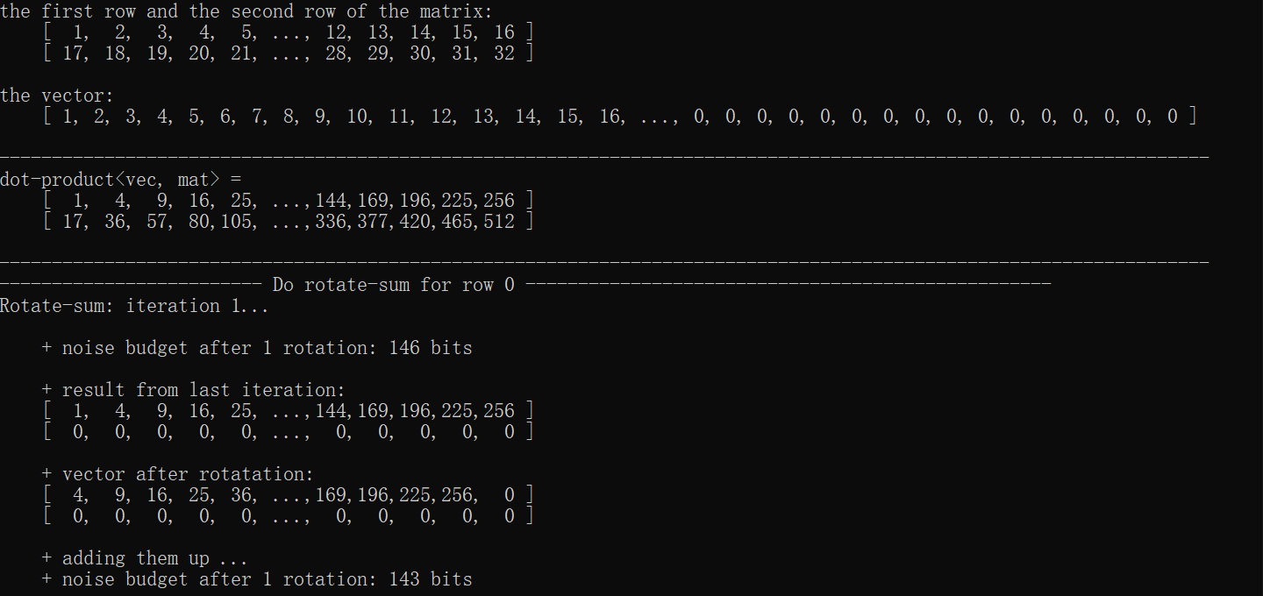
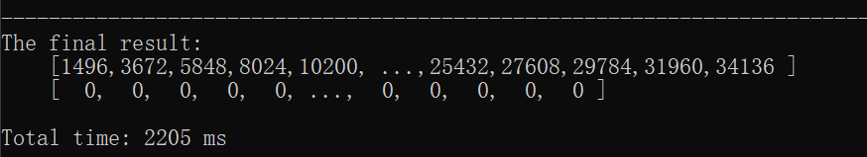
Based on SEAL Lib
Matrix-vector multiplication
←将size-N vector张成N x N的矩阵后点乘

Slide 7
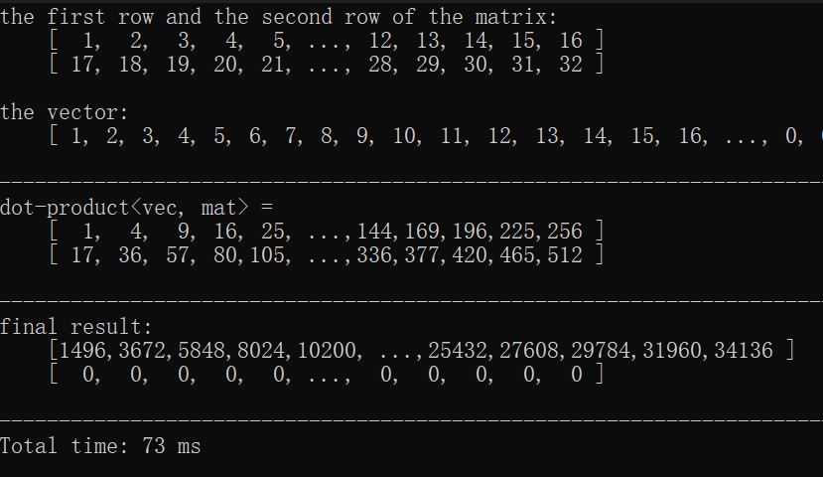
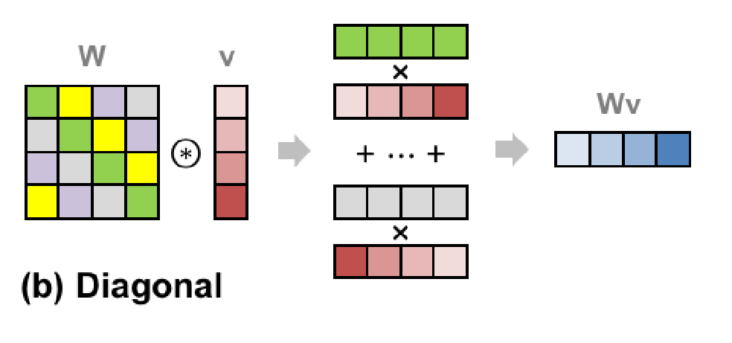
Based on SEAL Lib
Matrix-vector multiplication optimization (Gazelle: diagonal)
先将vector张成N x N，再计算element-wise product
取对角元素加在累加器
少了大量旋转，约30x加速
--------------------------------------------------------------------------------------------------------------------------------
for (int ii = 0; ii < column_size; ii++) {
for (int j = 0; j < row_size; j++) {
sub_result2[j] = temp[(ii + j) < row_size ? ii + j + row_size * j : ii + j + row_size * (j - 1)];
……
}
}
--------------------------------------------------------------------------------------------------------------------------------

Slide 8
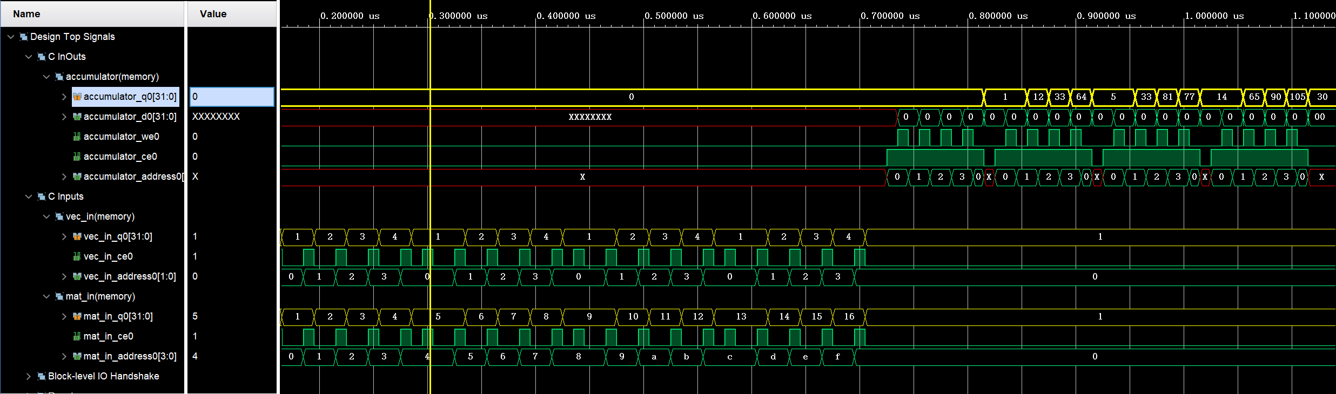
HLS
Matrix-vector multiplication optimization (Gazelle: diagonal)

Slide 9
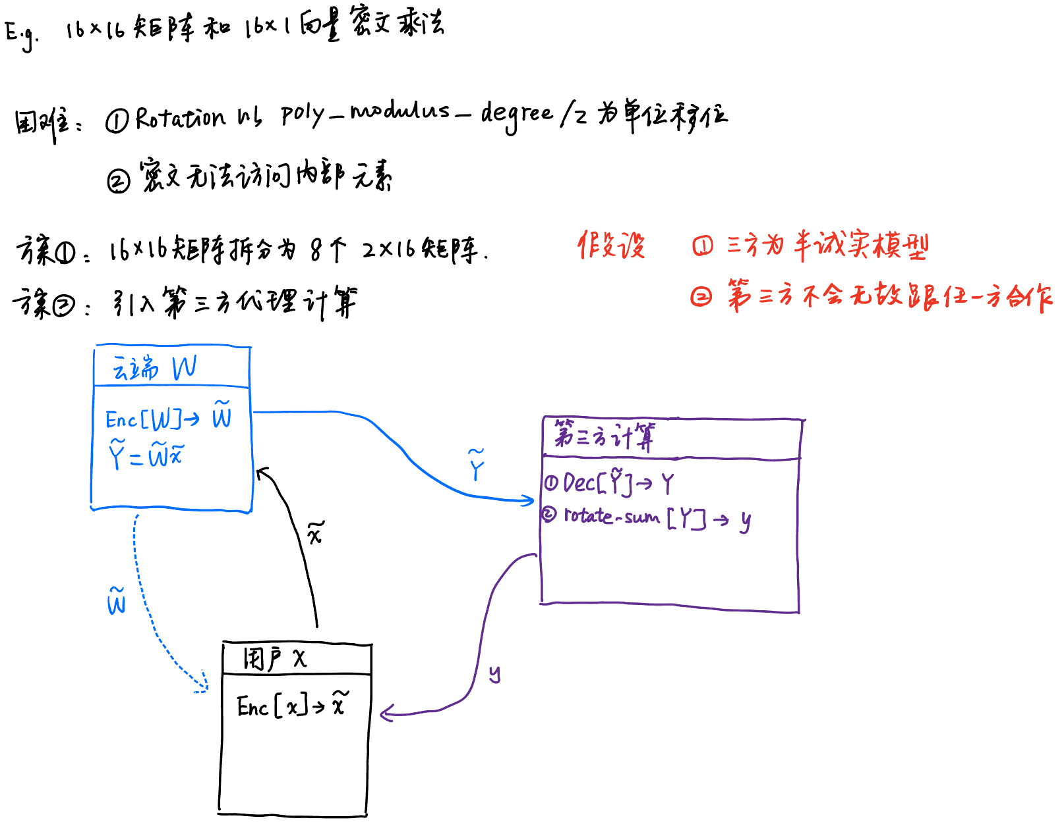
Protocols
密文-密文计算适用的场景
论文中：
明文-密文乘法
向量-向量乘法

Slide 10
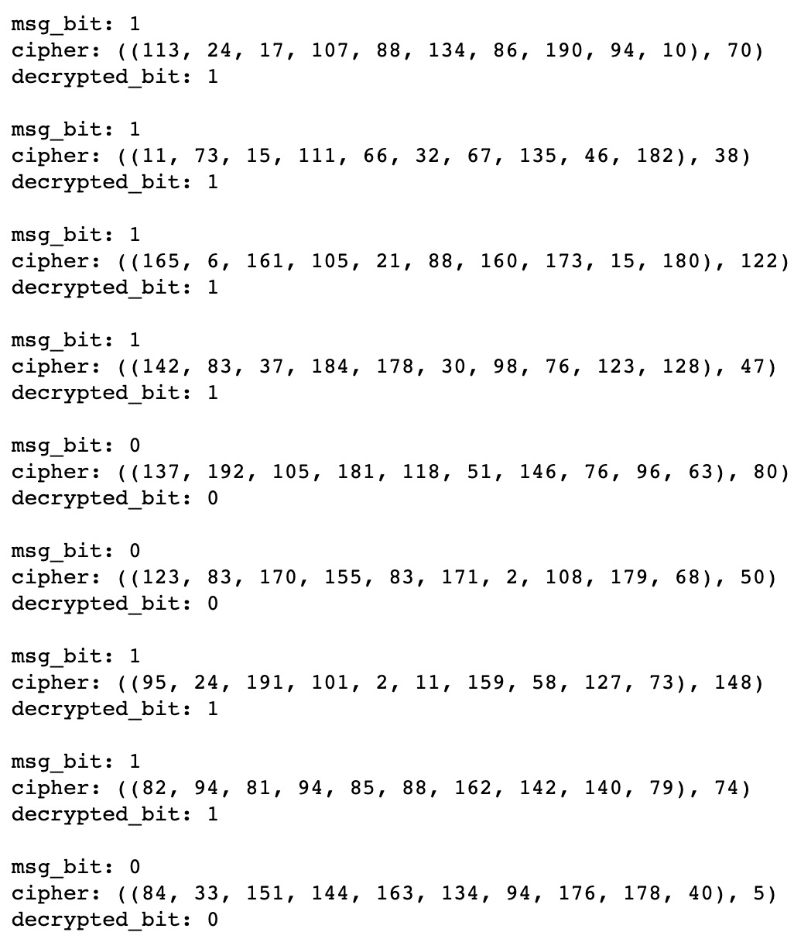
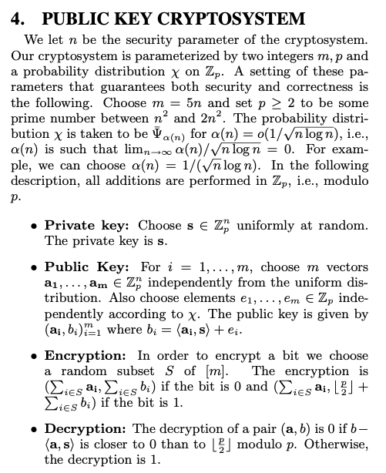
Based on Python
基于LWE问题的加密

Slide 11
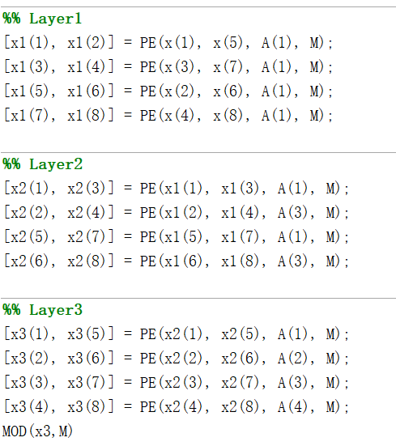
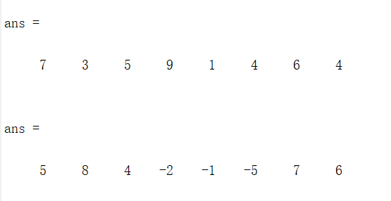
Based on MATLAB
8点NTT蝶形验证
NTT加速思路（算法层面）
使用蝶形计算
使用SIMD技术
加速乘法/加法/取模运算

Slide 12
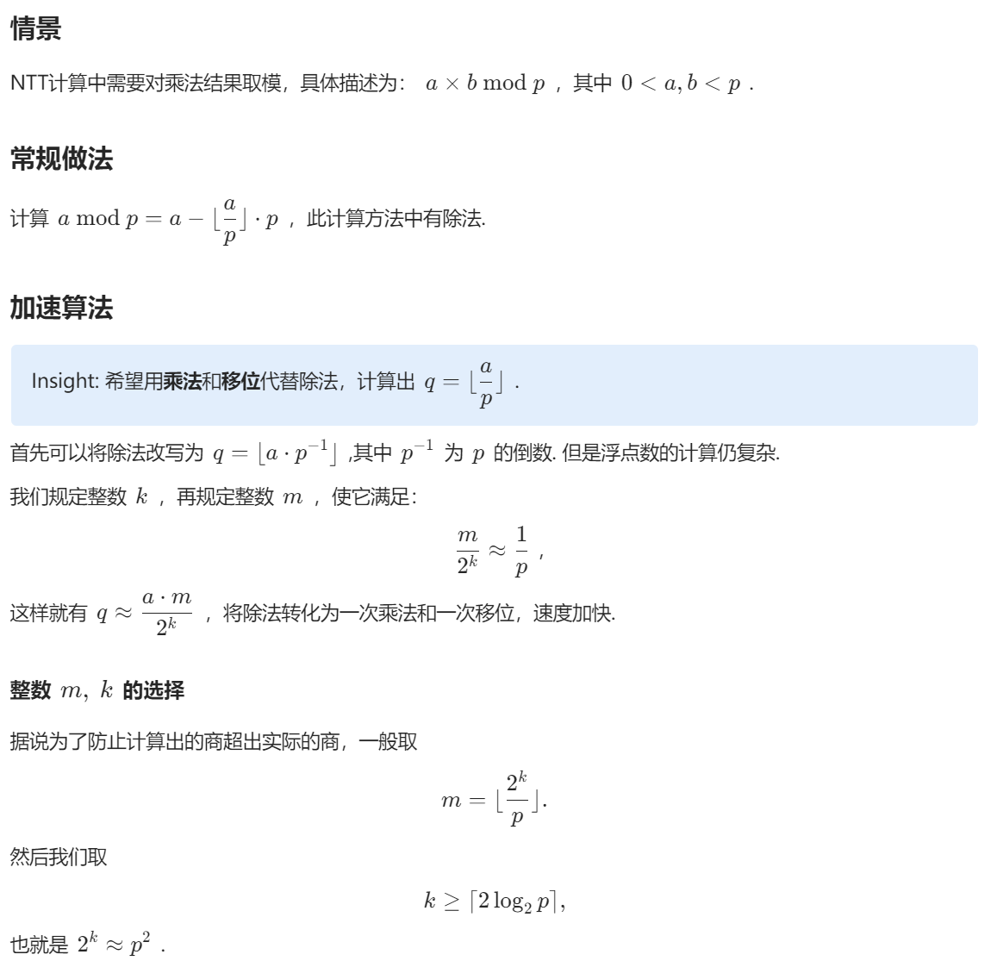
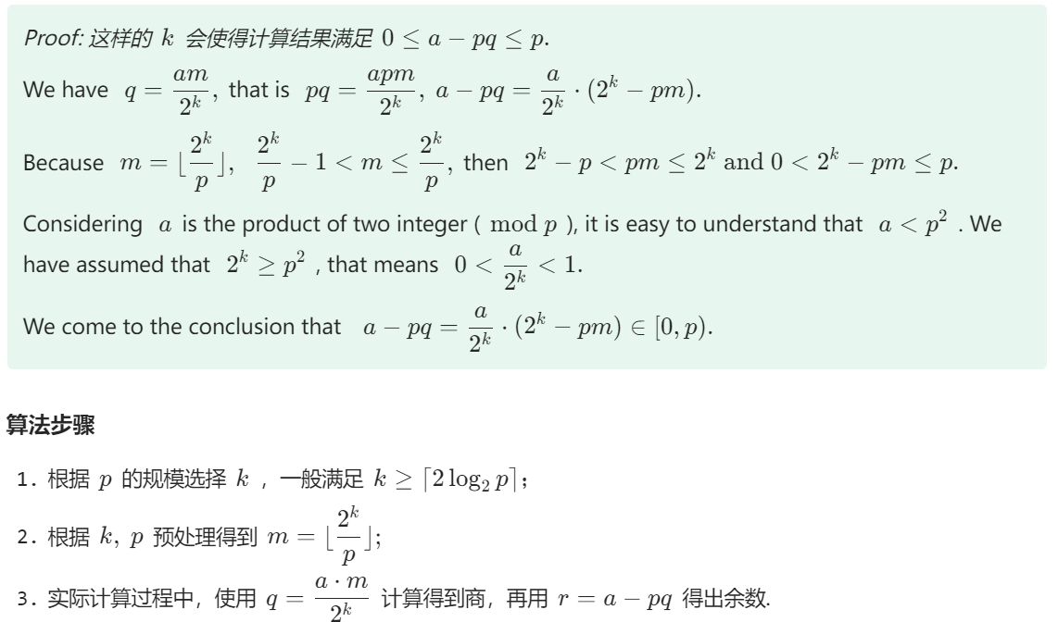
取模加速

Slide 13
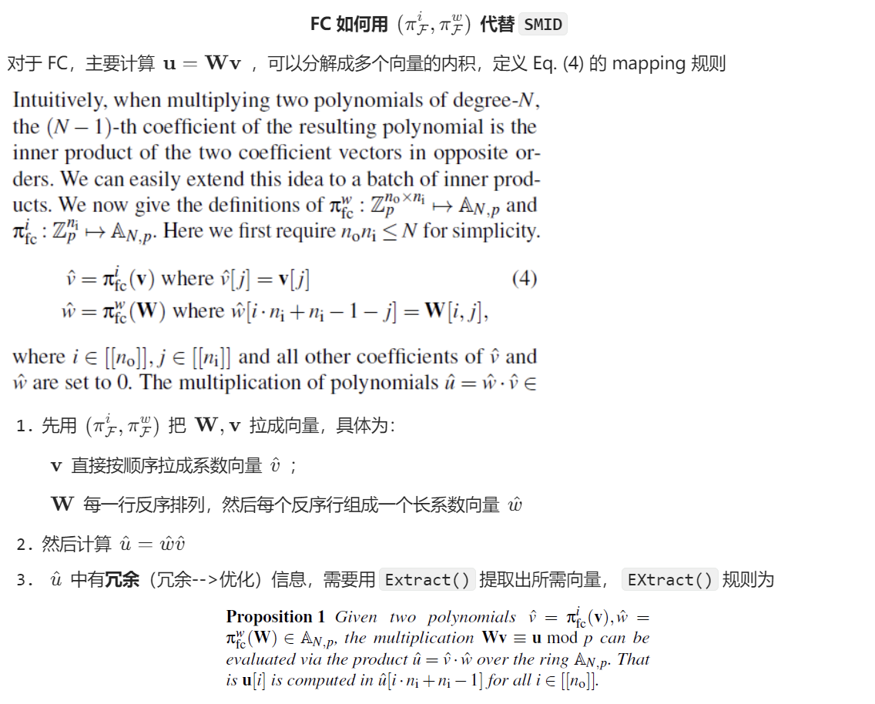
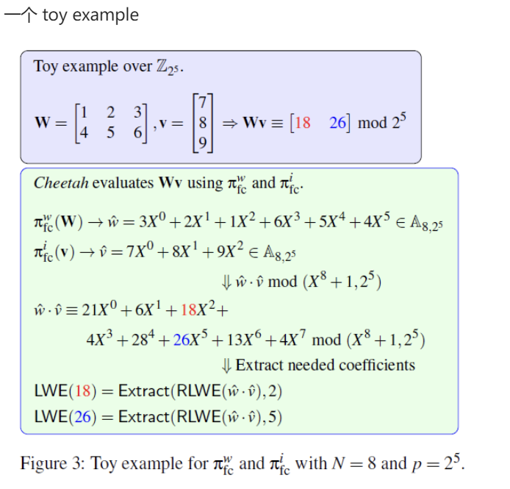
Proposed 2PC protocols: FC
Protocols: 利用三元组传输编码信息

Slide 14
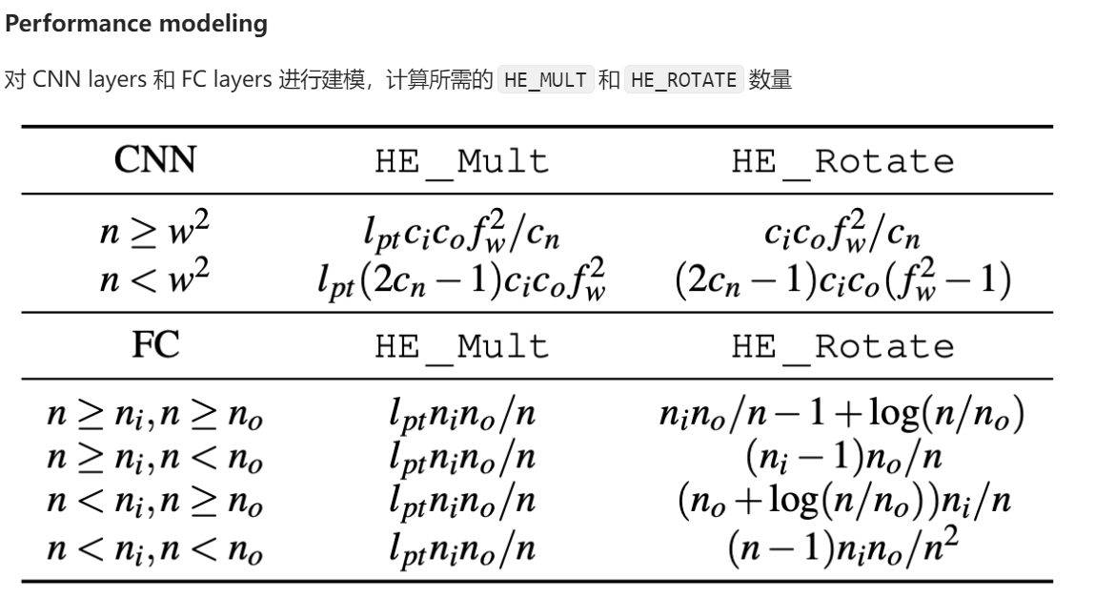
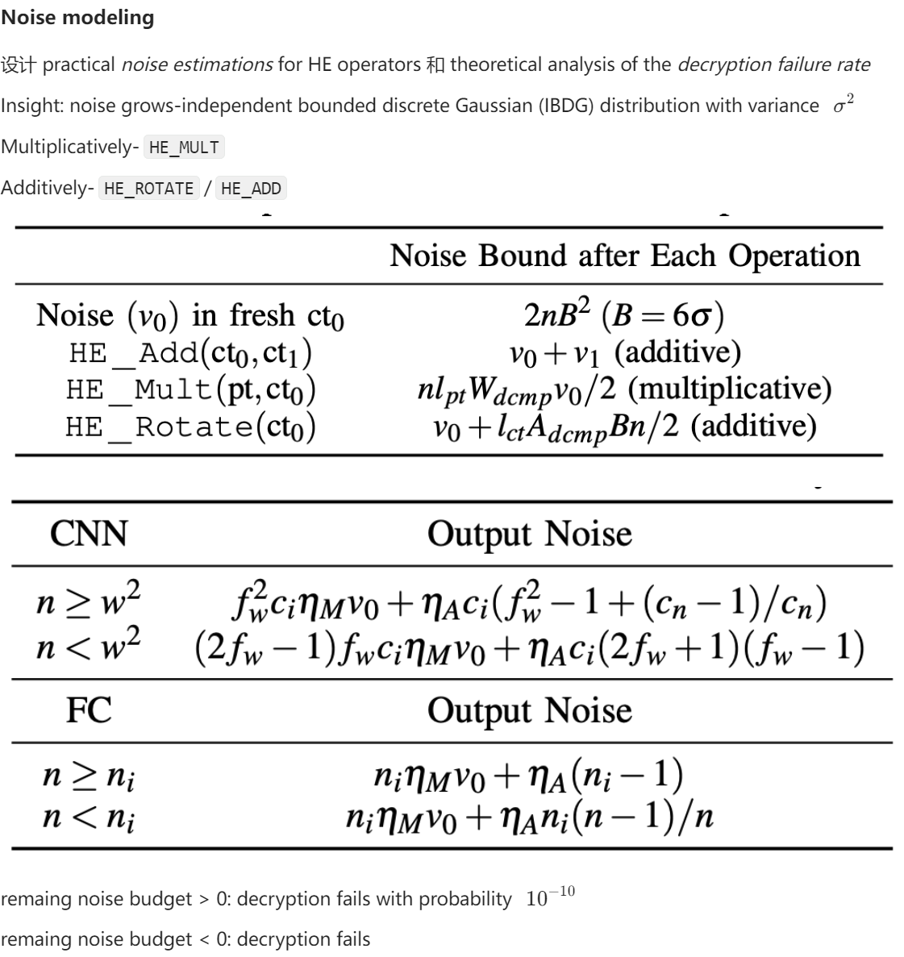
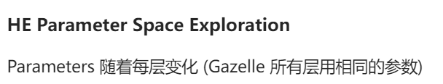
HE-PTune

Slide 15
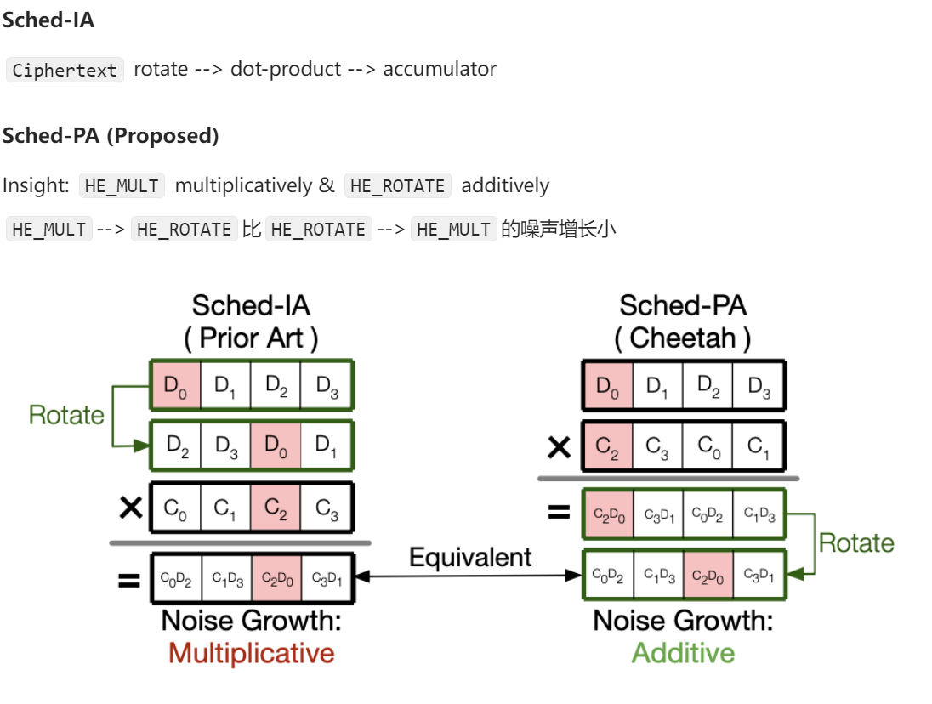
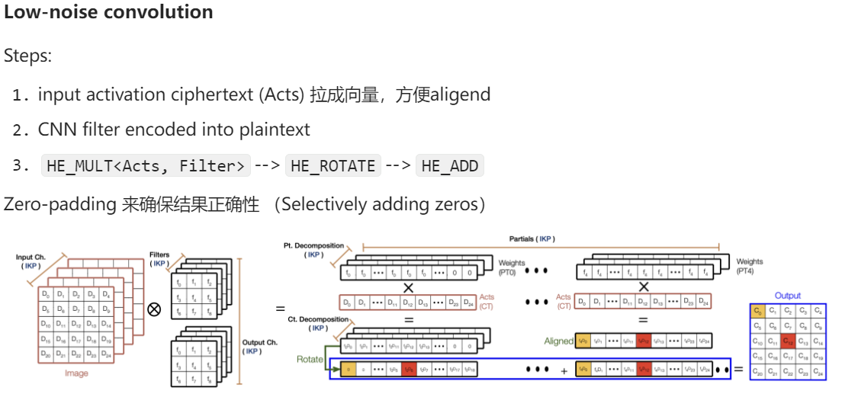
Partial-aligend Scheduling

Slide 16
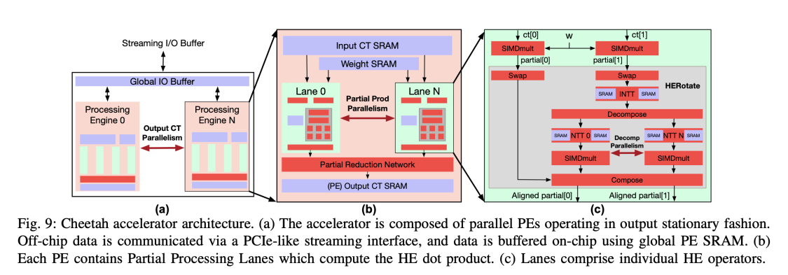
HE Inference Accelerator Architecture

