Slide 1


Computational Biology
计算生物学
Zhidong DENG
Department of Computer Science
Tsinghua University
邓志东
清华大学计算机系
清华大学 • 2019秋季

Slide 2
第七章 多重序列比对

Slide 3
第七章 多重序列比对
参考文献：
[1] D. Gusfield. Algorithms on Strings, Trees, and Sequences, Cambridge University Press, 1997.
[2] J. D. Thompson, D. G. Higgins, and T. J. Gibson. CLUSTALW: improving the sensitivity of progressive multiple sequence alignment through sequence weighting, position specific gap penalties and weight matrix choice, Nucleic Acids Res., vol.22, no.22, 1994, pp.4673-4680.
[3] J. D. Thompson, T. J. Gibson, F. Plewniak, F. Jeanmougin, and D. G. Higgins. The ClustalX windows interface: flexible strategies for multiple sequence alignment aided by quality analysis tools, Nucleic Acids Res., vol.24, 1997, pp.4876-4882.

Slide 4
第七章 多重序列比对
[4] M. Lain, I. M. Wallace, O. O'Sullivan, G. Desmond, D. G. Higgins, and C. Notredame. M-Coffee: combining multiple sequence alignment methods with T-Coffee, Nucleic Acids Res., vol.34, no.6, 2006, pp.1692-1699.
[5] R. Chenna, H. Sugawara, T. Koike, R. Lopez, T. J. Gibson, D. G. Higgins, and J. D. Thompson. Multiple sequence alignment with the Clustal series of programs, Nucleic Acids Res., vol.31, no.13, 2003, pp.3497-3500.
[6] I. M. Wallace, G. Blackshields, and D. G. Higgins. Multiple sequence alignments, Curr. Opin. Struct. Biol., vol.15, no.3, 2005, pp.261-266.

Slide 5
第七章 多重序列比对
[7] R. C. Edgar and S. Batzoglou. Multiple sequence alignment, Curr. Opin. Struct. Biol., vol.16, no.3, 2006, pp.368-373.

Slide 6
第七章 多重序列比对
7.1 Introduction
7.2 What a multiple alignment means
7.3 Scoring a multiple alignment
7.4 Multidimensional dynamic programming
7.5 Progressive alignment methods
7.6 More on multiple alignments

Slide 7
第七章 多重序列比对
7.1 Introduction

Slide 8
Development of multiple alignments
7.1 Introduction
1975 Sankoff
  Formulated multiple sequence alignment (MSA) problem and gave dynamic programming solution
1984 Biopat
  First completed MSA method
1987 Taylor: MULTAL
1988 Carrillo-Lipman: MSA
  Branch and bound approach for MSA

Slide 9
7.1 Introduction
1990 Feng-Doolittle:
  Progressive alignment
1994 Thompson, Higgins, Gibson: ClustalW
  Most popular multiple alignment program
1996 Notredame: SAGA
  Genetic algorithm (GA)
1998 Eddy: HMMER
  Hidden Markov Models

Slide 10
7.1 Introduction
1998 Morgenstern: DIALIGN
  Segment-based multiple alignment
1999 Heringa: Praline
2000 Notredame, Higgins, Heringa: T-coffee
  Using the library of pairwise alignments
2002 Lee, et al.: POA
2002 MAFFT
  Based on fast Fourier transform

Slide 11
7.1 Introduction
2004 MUSCLE
  Progressive alignment, pairwise profile alignment, position specific gap penalty
2005 PROBCONS
  Progressive alignment, probability table using HMM, probabilistic consistency-based MSA
2006 M-Coffee
  Combining multiple sequence alignment methods with T-Coffee
…

Slide 12
7.1 Introduction
Multiple alignments: Challenging problems and still an active area of research
  More than hundreds multiple alignment algorithms have been described over the last decades

Slide 13
7.1 Introduction
Phylogeny
Motifs and Patterns
Structure Prediction
Multiple Sequence Alignment
Function
Single Nucleotide Polymorphisms
mRNA Isoforms
Computation: What is a good alignment?
Biology: What is a good alignment?
Optimization of the objective function
Choice of an objective function

Slide 14
7.1 Introduction
Multiple alignments are essential tools in computational biology and bioinformatics
Multiple alignments can reveal subtle similarities that pairwise alignments do not uncover
  Create “consensus” sequence
  Create a profile
  Identify highly conserved regions
  Identify highly variable regions
  Help with identification of functional or structural motifs in protein

Slide 15
7.1 Introduction
The choice of an objective function
  Biological problem that lies in the definition of correctness: Very important
  What should a biologically correct/good alignment look like?
  The function defines a mathematical optimum, which rarely have an argument that this optimum will also be biologically optimal

Slide 16
7.1 Introduction
  In theory, an objective function should incorporate everything that is known about the sequences, including
    their structure
    function
    evolutionary history
  This information is rarely at hand and is hard to use. It is usually replaced with sequence similarity
  Sum of pairs (SP), entropy score, consistency based, …

Slide 17
7.1 Introduction
Optimization of the objective function
  Exact Algorithms (Dynamic Programming)
    Optimal solution but complexities
    exponential in number of sequences
    Greater reliance on (greedy) heuristics
  Progressive Alignment (ClustalW, ClustalX, Pileup, …): start with pairwise alignment of most similar sequences; adds to that next, …

Slide 18
7.1 Introduction
  Iterative Approaches (MultAlin, PRRP, SAGA): make an initial alignment of groups of sequences, adds to these
  Local Alignments: Profiles, Blocks, Patterns
  Statistical and Probabilistic Methods: include HMM training and simulated annealing or genetic algorithms: SAGA, PRRP, HMMER, SAM, GA, …

Slide 19
7.1 Introduction
Automatic Methods:
  “Score + optimization algorithm” methods: search the space of possible alignments to optimize a score function.
  Progressive methods build up the multiple alignment by adding one sequence at a time and/or combining sub-alignments.

Slide 20
7.1 Introduction
The key points:
  define a “scoring function” for evaluating the “goodness” of a multiple alignment.
  then try to find the multiple alignment that maximizes this function.

Slide 21
Most important sequence databases
7.1 Introduction
GenBank
  Maintained by USA National Center for Biology Information (NCBI)
    All biological sequences www.ncbi.nlm.nih.gov/Genbank/GenbankOverview.html
    Genomes www.ncbi.nlm.nih.gov:80/entrez/query.fcgi?db=Genome

Slide 22
Most important sequence databases
7.1 Introduction
Swiss-Prot
  Maintained by EMBL- European Bioinformatics Institute (EBI )
    Protein sequences
    www.ebi.ac.uk/swissprot/

Slide 23
Benchmark Databases for MSA
7.1 Introduction
Validation of a MSA program typically uses a benchmark dataset of reference alignments
  BAli-BASE
  OXBENCH
  PREFAB
  SABmark
  IRMBASE
  …

Slide 24
Multiple Alignment Websites
7.1 Introduction
Match-Box http://www.fundp.ac.be/sciences/biologie/bms/matchbox_submit.shtml
MUSCLE
http://cbcsrv.watson.ibm.com/Tmsa.html
T-Coffee http://www.ch.embnet.org/software/TCoffee.html

Slide 25
Multiple Alignment Websites
7.1 Introduction
MULTALIN http://www.toulouse.inra.fr/multalin.html
ClustalW
http://www.ebi.ac.uk/clustalw/
…

Slide 26
Classification of MSA Algorithms
7.1 Introduction
Carillo and Lipman:
  MSA, DCA
  Few small closely related sequence
  Do well when can run
Segment Based:
  DIALIGN, MACAW
  May align too few residues
  Good for long Indels

Slide 27
7.1 Introduction
Iterative
  HMMs, HMMER, SAM
  Slow, sometimes inaccurate
  Good profile generators
Progressive
  ClustalW, Pileup, Multalign…
  Fast and sensitive

Slide 28
7.1 Introduction
Global alignment
  Optimal – dynamic programming (MSA)
  Progressive – pairwise (PILEUP, ClustalW)
  Iterative progressive (MULTALIN)
  Block-based (DIALIGN)
Local alignment (motif finding)
  Patterns (MOTIF, PROTOMAT)
  Statistical profiles (HMMER2, PSI-BLAST)

Slide 29
Summary of Multiple Alignments
7.1 Introduction
ClustalW
  Uses less memory than other programs
  Less accurate or scalable than modern programs
DIALIGN
  Attempts to distinguish between alignable and non-alignable regions
  Less accurate than CLUSTALW on global benchmarks

Slide 30
7.1 Introduction
MAFFT, MUSCLE
  Faster and more accurate than CLUSTALW
  Good trade-off of accuracy and computational cost
  Options to run even faster, with lower average accuracy, for high-throughput applications
  For very large datasets (say, more than 1,000 sequences), select time- and memory-saving options

Slide 31
7.1 Introduction
PROBCONS
  Highest accuracy score on several benchmarks
  Computational time and memory usage is a limiting factor for large alignment problems (>100 sequences)
ProDA
  Does not assume global alignability
  Allows repeated
  Shuffled and absent domains
  High computational cost and less accurate than ClustalW on global benchmarks

Slide 32
7.1 Introduction
T-COFFEE
  High accuracy and the ability to incorporate heterogeneous types of information
  Computational time and memory usage is a limiting factor for large alignment problems (>100 sequences)

Slide 33
7.1 Introduction
The most commonly used methods use a progressive alignment algorithm (ClustalW)
Recent progress have focused on the design of iterative (Prrp, SAGA) and consistency based methods (T-Coffee, PROBCONS)
ClustalW, T-COFFEE, MAFFT, PROBCONS perform well on globally related sequences
DIALIGN superior for local similarities

Slide 34
How to choose multiple alignment tool
7.1 Introduction
2–100 sequences of typical protein length (maximum ~ 10,000 residues) that are approximately globally alignable
  Use PROBCONS, T-COFFEE, and MAFFT or MUSCLE
  For sequences with low percent identity, PROBCONS is generally the most accurate
  But incorporating structure information (where available) via 3DCoffee (a variant of T-COFFEE) can be extremely helpful

Slide 35
7.1 Introduction
A small number of unusually long sequences (>20,000 residues)
  Use ClustalW. Other programs may run out of memory
100–500 sequences that are approximately globally alignable
  Use MUSCLE or one of the MAFFT scripts with default options.

Slide 36
7.1 Introduction
>500 sequences that are approximately globally alignable
  Use MUSCLE with a faster option (we recommend maxiters-2) or one of the faster MAFFT scripts
2–100 sequences with conserved core regions surrounded by variable regions that are not alignable
  Use DIALIGN
2–100 sequences with one or more common domains that may be shuffled, repeated or absent
  Use ProDA

Slide 37
Future Work on Multiple Alignments
7.1 Introduction
Parameter selection for alignment tools remains an important problem
Further improvement in both scalability and accuracy
Develop new method to combine sequence alignment with other information, such as
  known structures of some of the proteins being aligned
  homology to a larger pool of proteins

Slide 38
7.1 Introduction
Better utilization of phylogenetic relationships and incorporation of models of protein sequence evolution hold promise for improved alignment performance

Slide 39
第七章 多重序列比对
7.2 What a multiple alignment
means

Slide 40
7.2 What a multiple alignment means
Definition:
Given strings X1, X2, …, XN, a multiple (global) alignment maps them to strings X’1, X’2, …, X’N that may contain spaces, where
  |X’1|= |X’2|=…= |X’N|;
  The removal of spaces from X’i leaves Xi

Slide 41
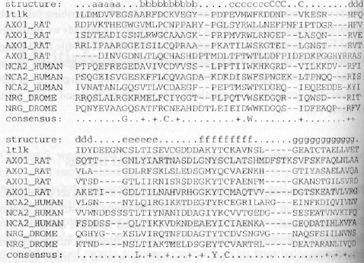
Manually aligned example: 10 imunoglobulin superfamily

Slide 42
7.2 What a multiple alignment means
For example:
  A crystal structure of 1tlk (telokin) is known
  The telokin structure and alignments to other related sequences reveal conserved characteristics of the I-set immunoglobulin superfamily fold, including eight conservedβ-strands and certain key residues in the sequences, such as two completely conserved cysteines in the b and f strands which form a disulfide bond in the core of the folded structure

Slide 43
7.2 What a multiple alignment means
In a multiple sequence alignment, homologous residues among a set of sequences are aligned together in columns:
  Homologous: structural and evolutionary
  Evolutionary homology: derived from the same ancestral residue
  Structural homology: residues are superposable when the protein structures are aligned

Slide 44
7.2 What a multiple alignment means
  Ideally, a column of aligned residues occupy similar three-dimensional structural positions and all diverge from a common ancestral residue

Slide 45
7.2 What a multiple alignment means
Except for trivial cases, it is not possible to create a single ‘correct’ multiple alignment:
  Do not expect two protein structures with different sequences to be entirely superposable
  For given pair of divergent but clearly homologous protein sequences (30% identical), usually only 50% of the individual residues were superposable

Slide 46
7.2 What a multiple alignment means
  The globin family, often used as a ‘typical’ problem in computational work, is in fact exceptional: almost the entire structure is conserved among divergent sequences
  Even the definition of ‘structurally superposable’ is subjective and can be expected to vary among experts

Slide 47
7.2 What a multiple alignment means
Ability to define a single ‘correct’ alignment will vary with the relatedness of the sequences being aligned
  An alignment of very similar sequences will generally be unambiguous, but these alignments are not of great interest to us
  For cases of interest (a family of protein with average pairwise 30% identity), there is no objective way to define an unambiguously correct alignment

Slide 48
7.2 What a multiple alignment means
A small subset of key residues will be identifiable which can be aligned unambiguously for all the sequences in a family almost regardless of sequence divergence

Slide 49
7.2 What a multiple alignment means
Core structural elements will also tend to be conserved and meaningfully alignable
Other regions may not be meaningfully alignable due to structural evolution and sequence divergence

Slide 50
Usage of multiple alignments
7.2 What a multiple alignment means
Phylogenetic analysis:
  Same protein from different species
  Optimal multiple alignment probably implies history
  Discover irregularities
  Essential for evolutionary analysis of proteins

Slide 51
7.2 What a multiple alignment means
Detection of functional regions and functionally important sites shared between proteins
  Local multiple alignment reveals conserved regions
  Conserved regions usually are key functional regions
  These regions are prime targets for drug developments

Slide 52
7.2 What a multiple alignment means
Characterization of protein families
  Determine the consensus sequence of aligned sequences
  Use conserved regions to guide search
  Identify that an uncharacterized sequence is really a member of protein family

Slide 53
7.2 What a multiple alignment means
Prediction of structure
  Insertions and deletions not tolerated in core of protein
  Different patterns of conservation of hydrophobic amino acids suggest alpha helix or beta strand
  Conserved glycines or prolines suggest a loop

Slide 54
7.2 What a multiple alignment means
Develop primers & probes: Use conserved region to develop
  Primers for PCR
  Probes for DNA microarrays
Search for weak but significant similarities in databases

Slide 55
7.2 What a multiple alignment means
Crucial for genome sequencing:
  Random fragments of a large molecule are sequenced and those that overlap are found by a multiple sequence alignment program

Slide 56
第七章 多重序列比对
7.3 Scoring a multiple
alignment

Slide 57
7.3 Scoring a multiple alignment
Scoring system must consider two important features of MSAs
  Some positions are more conserved than the others
  The sequences are not independent, but instead are related by a phylogenetic tree

Slide 58
7.3 Scoring a multiple alignment
An ideal scoring system of a multiple alignment:
  Specify a complete probabilistic model of molecular sequence evolution
  Given the correct phylogenetic tree, the probability of a multiple alignment can be calculated using this evolutionary model

Slide 59
7.3 Scoring a multiple alignment
  The real protein evolution is very complex
    point mutations
    duplications
    horizontal transfers
    fusions and other events

Slide 60
7.3 Scoring a multiple alignment
  The probabilities of evolutionary change depend on:
    Evolutionary times along each branch of the phylogenetic tree
    Position-specific structural and functional constraints imposed by natural selection

Slide 61
7.3 Scoring a multiple alignment
Not enough data to parameterize such a complex evolution model.
We have to make simplifying assumptions:
  Workable approximation: partially or entirely ignore the phylogenetic tree while doing some sort of position-specific scoring

Slide 62
7.3 Scoring a multiple alignment
Requirement of a good quality of alignment measure
  Additive function
  Function must be independent of order of arguments
  Should reward presence of many equal or strongly related symbols (in the same column) and penalize unrelated symbols and spaces

Slide 63
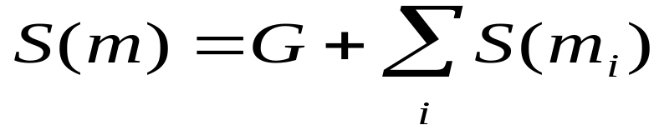
7.3 Scoring a multiple alignment
Assume for simplification:
columns of alignment are statistically independent
Scoring function S(m)
  m_{i} : the i-th column of the multiple alignment m
  Total score of alignment is the sum of column scores
  Each column score is a sum of all sequence pairs
Gaps score
Score for column

Slide 64
7.3 Scoring a multiple alignment
Scores
  Minimum entropy
  Sum of Pairs (SP), Weighted Sum of Pairs
  Maximum likelihood.

Slide 65
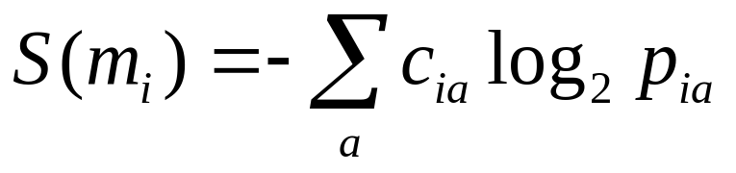
Minimum Entropy Score
7.3 Scoring a multiple alignment
The minimum entropy score is the sum of the entropy scores computed for each column
  i denotes a column
  cia the counts of letter a at column i
  pia the inferred probability (cia divided by the total number of characters in the column). Gap characters are treated as residue symbols

Slide 66
7.3 Scoring a multiple alignment
The entropy measures the variability of the residues in an aligned column: the more variable the column is, the higher the entropy.
The completely conserved column would score 0

Slide 67
Sum of Pairs (SP) Score
7.3 Scoring a multiple alignment
Note: A multiple alignment of N sequences implies N(N-1)/2 pairwise alignment
Definition: The SP score of a multiple sequence alignment is the sum of the scores of the pairwise alignments implied by the multiple alignment

Slide 68
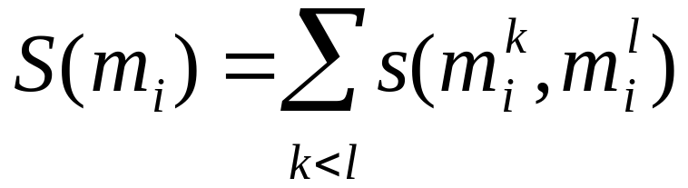
7.3 Scoring a multiple alignment
Treat gap as a separate symbol
  s(a, -) = s(-, a) = gap score
  s(-, -) = 0
  Use linear gap function or affine gap score separately
The sum of pairs (SP) scoring function for a column i
  Columns are scored by the SP function using a substitute scoring matrix
  Sum of N(N-1)/2 pairwise scores

Slide 69
Drawbacks of SP
7.3 Scoring a multiple alignment
The SP score is the foundation of many multiple algorithm methods, but has a number of drawbacks
SP score has no rigorous theoretical foundation and, in particular, fails to exploit phylogeny or incorporate an evolutionary model

Slide 70
7.3 Scoring a multiple alignment
No probabilistic justification of the SP score: each sequence is scored as if it descended from the N-1 other sequences instead of a single ancestor
  Substitute scores are usually derived as log-odds scores for pairwise
  Sum of scores are not probabilistic correct extension to log-odds score

Slide 71

7.3 Scoring a multiple alignment
Score
  For example: for three-way alignment
    Correct log-odds score extension:
    SP score:

Slide 72
7.3 Scoring a multiple alignment
Evolutionary events are over-counted, a problem which increases as the number of sequences increases
A weighting scheme designed to partially compensate for the defect of SP: Altschul, Carroll & Lipman, 1989

Slide 73
Examples: SP
7.3 Scoring a multiple alignment
Consider an alignment problem of N sequences, which all have leucine (L) at a certain position
  Using BLOSUM50: s(L, L) = 5
  The SP score of this column: 5N(N-1)/2
If instead there were one glycine (G) and (N-1) leucines (L)
  Using BLOSUM50: s(G, L) = -4
  The SP score of this column：
  5(N-1)(N-2)/2 – 4(N-1) = 5N(N-1)/2-9(N-1)

Slide 74
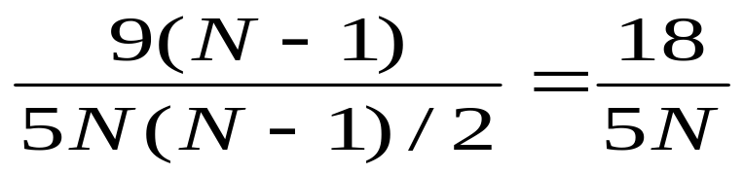
7.3 Scoring a multiple alignment
The relative difference:
  the inverse dependence on N:
    Relative difference between score between the correct and incorrect alignment decreases with the increase of sequences
    Relative difference ought to increase with the more evidence that L is conserved

Slide 75
第七章 多重序列比对
7.4 Multidimensional dynamic
programming for MSA

Slide 76
7.4 Multidimensional dynamic program-
ming for MSA
Sankoff, 1983; Murata, et al., 1985
Dynamic Programming can theoretically be used for aligning k > 2 sequences
  instead of 2-dimensional scoring matrix, a k-dimensional scoring matrix is used
  instead of 2-dimensional dynamic programming scheme, a k-dimensional one is used

Slide 77
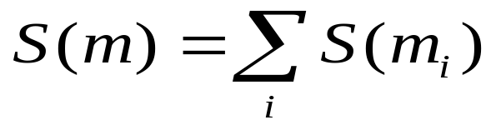
7.4 Multidimensional dynamic program-
ming for MSA
Assumptions:
  The columns of an alignment are statistically independent
  The gaps are scored with a linear gap cost
The overall score S(m) for an alignment:
Multidimensional dynamic programming guaranteed to find the optimal SP alignment

Slide 78

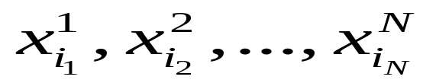
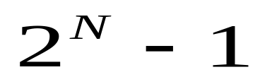
7.4 Multidimensional dynamic program-
ming for MSA
: max score of an alignment up to the sequences ending with
All combinations of gaps appear except the one where all residues are replaced by gaps
gap combinations

Slide 79
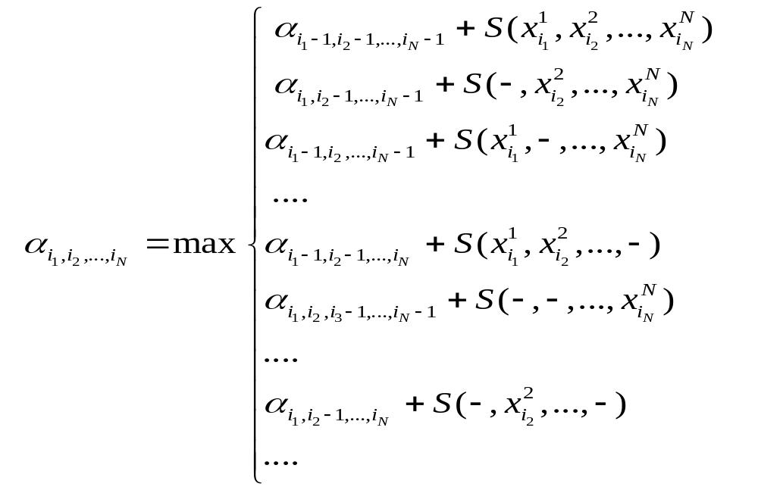
7.4 Multidimensional dynamic program-
ming for MSA

Slide 80


7.4 Multidimensional dynamic program-
ming for MSA
Multidimensional dynamic programming
  Very expensive, only possible for few sequences
  Time complexity , space complexity
Standard multiple sequence alignment problem: NP-hard!

Slide 81
Improvement: MSA
7.4 Multidimensional dynamic program-
ming for MSA
Bounded search (MSA): Faster DP for multiple alignment
  Carrillo and Lipman, 1988
  Apply heuristic alignment, use resulting SP to bound search
  Significant speed improvement, still limited to small values of N
  Can align about 7 relatively short (200-300) protein sequences in a reasonable amount of time; not much beyond that

Slide 82
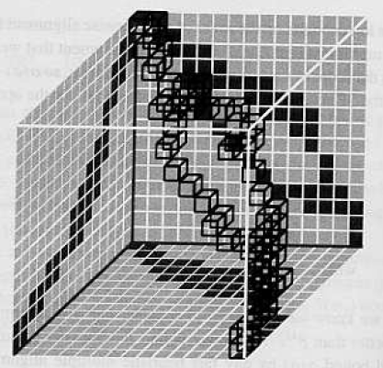
MSA

Slide 83
7.4 Multidimensional dynamic program-
ming for MSA
The MSA method is based on the property:
  If the strings are relatively similar, the alignment path would be close to the main diagonal
  Therefore not all the values in the multi-dimensional hypercube need to be calculated
  Assuming an upper bound on cost of the best alignment, discard some alignments that are a priori known to be more expensive than the bound on the cost

Slide 84
7.4 Multidimensional dynamic program-
ming for MSA
MSA restricts the amount of memory by computing bounds that approximate the centre of a multi-dimensional hypercube
Star and tree scoring system
  Altschul & Lipman, 1989
  Extend the theory of MSA: more realistic scoring systems based on evolutionary stars and trees instead of SP scores

Slide 85
第七章 多重序列比对
7.5 Progressive alignment
methods

Slide 86
7.5 Progressive alignment methods
In practice, the optimal solution for aligning multiple sequences is not feasible!
Progressive alignment
  Hopweg, 1984; Waterman, 1984; Feng-Doolittle, 1987; …
  Approximated method!
  The most widely used approach such as
  ClustalW, T-coffee, MUSCLE, …

Slide 87
7.5 Progressive alignment methods
Basic Idea of progressive alignment: utilizes phylogenetic information, constructing a succession of pairwise alignments
  Initially two sequences are chosen and aligned by standard pairwise alignment; this alignment is fixed
  Then a third sequence is chosen and aligned to the first alignment
  This process is iterated until all sequences have been aligned

Slide 88
7.5 Progressive alignment methods
Heuristic:
  It does not separate the process of scoring an alignment from the optimization algorithms
  It does not directly optimize any global scoring function
Advantages of progressive alignment:
  Fast and efficient
  Reasonable alignment results

Slide 89
Main Differences between progressive alignment approaches
7.5 Progressive alignment methods
The way that they choose the order to do the alignment
Whether the progression involves only alignment of sequences to a single growing alignment or whether subfamilies are built up on a tree structure and, at certain points, alignments are aligned to alignments
Procedure used to align and score sequences or alignments against existing alignments

Slide 90
Feng-Doolittle progressive multiple alignment
7.5 Progressive alignment methods
Feng-Doolittle, 1987
Implemented by PILEUP (from GCG package)

Slide 91
7.5 Progressive alignment methods
Algorithm:
  Calculate diagonal matrix of N(N-1)/2 distances between all pairs of N sequences by standard pairwise alignment, converting raw alignment scores to approximate pairwise “distances”
  Construct guide tree from the distance matrix by using appropriate clustering algorithm such as Fitch-Margoliash, 1996

Slide 92
7.5 Progressive alignment methods
  Starting with the first node (root) added to the tree, align the child nodes (which may be two sequences, a sequence and an alignment, or two alignments). Repeat for all other nodes in the order that they were added to tree, until all sequences have been aligned

Slide 93
7.5 Progressive alignment methods
Converting alignment scores to distances
  Only to create an approximate guide tree, not an evolutionary tree. So the conversion does not need to be especially accurate
  In approximate phylogenetic tree construction, more care must be taken
Clustering algorithm for building guide trees from distance matrices
  Fitch-Margoliash, 1996

Slide 94
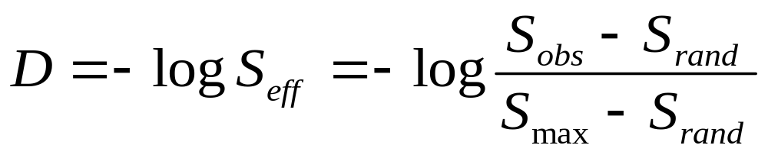
Feng-Doolittle distance D
7.5 Progressive alignment methods
The effective score: viewed as a
normalized percentage similarity
The conserved pairwise
alignment score
The maximum score
The expected score for alignment two random sequences of the same length and residue composition

Slide 95
7.5 Progressive alignment methods
Sequence-sequence alignments: Done with usual pairwise dynamic programming
  A sequence is added to an existing group by aligning it pairwisely to each sequence in the group in turn
  The (best) highest scoring pairwise alignment determines how the sequence will be aligned to the group

Slide 96
Remark of Feng-Doolittle Progressive Alignm.
7.5 Progressive alignment methods
Rule: Once a gap, always a gap
  After alignment is completed gap symbols replaced by “X”
  This rule allows pairwise sequence alignments to be used to guide
    the alignment of sequences to groups
    or groups to groups
    otherwise, any given pairwise sequence alignment would not necessarily be consistent with the pre-existing alignment of a group
  Desirable side effect:
    Encourages gaps to occur in same columns in subsequent alignments
Early mistakes cannot be corrected
Alignment order is important

Slide 97
Profile alignment
7.5 Progressive alignment methods
A problem with the Feng-Doolittle approach
  all alignments are determined by pairwise sequence alignments
  It is advantageous to use position-specific information from the group’s multiple alignment to align a new sequence to it
    Degree of sequence conservation at each position
    Mismatch at highly conserved positions penalized more stringently than at variable positions
    Gap penalties in positions with lots of gaps might be reduced and increased with no gap occurring
Motivate Profile Alignment

Slide 98
7.5 Progressive alignment methods
Many progressive alignment methods use pairwise alignment of sequences to profiles or of profiles to profiles as a subroutine which is used many times in the process

Slide 99
7.5 Progressive alignment methods
By linear gap scoring, profile alignment is simple
  s(-, a) = s(a, -) = -g and s(-, -) = 0
  Two profiles: sequence 1…n and n+1…N
  An alignment of the two profiles means:
    Gaps are inserted in whole column
    The alignment within one of the profiles is
    not changed

Slide 100
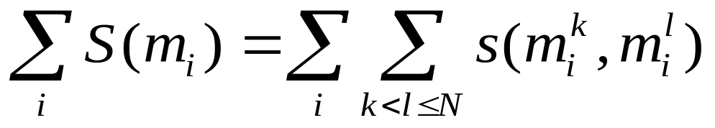
7.5 Progressive alignment methods
The score of the global alignment
Only concerning the two profiles: are
unaffected by the global alignment
Sum of containing all
cross terms

Slide 101
7.5 Progressive alignment methods
The optimal alignment of the two profiles can be obtained
  By only optimizing the last sum with the cross terms
  Which can be done exactly like a standard pairwise alignment

Slide 102
ClustalW
7.5 Progressive alignment methods
Thompson, Higgins, and Gibson, 1994
The widely used implementation of profile-based progressive multiple alignment
Similar to Feng-Doolittle method, except for use of profile alignment methods
ClustalW is unabashedly ad hoc in its alignment construction and scoring stage

Slide 103
7.5 Progressive alignment methods
Algorithm: ClustalW
  Calculate diagonal matrix of N(N-1)/2 distances between all pairs of N sequences by standard pairwise alignment, converting raw alignment scores to approximate pairwise “distances”.
  Construct guide tree from distance matrix by using an appropriate neighbour-joining clustering algorithm

Slide 104
7.5 Progressive alignment methods
Algorithm: ClustalW (cont.)
  3. Progressively align at nodes in order of decreasing similarity, using
    sequence-sequence
    sequence-profile
    profile-profile alignment

Slide 105
7.5 Progressive alignment methods
Various additional heuristics of ClustalW contribute to its accuracy
Heuristics used:
  Sequences are weighted to compensate for biased representation in large subfamilies (the defects of SP scores)
  The substitute matrix is chosen on the basis of the similarity expected of the alignment:
    Closely related sequences are aligned with hard matrices (BLOSUM80)
    Distant sequences are aligned with soft matrices (BLOSUM50)

Slide 106
7.5 Progressive alignment methods
  Position-specific gap-open penalties are used
    Hydrophobic residues (which are more likely to be buried) are given higher gap penalties than hydrophilic residues (which are more likely to be surface-accessible).
  Gap-open penalties are also decreased if the position is spanned by 5 or more consecutive hydrophilic residues.

Slide 107
7.5 Progressive alignment methods
  Both gap-open penalties and gap-extend penalties are increased if there are no gaps in a column but gaps occur nearby in the alignment
    This rule tries to force all gaps to occur in the same places in an alignment
  In the progressive alignment stage, if the score of an alignment is low, the guide tree may be adjusted on the fly to defer the low scoring alignment until later in the progressive alignment phase when more profile information has been accumulated

Slide 108
7.5 Progressive alignment methods
Key steps:
1. Pairwise distance calculation
2. Clustering analysis of the sequences
3. Iterated alignment of two most similar sequences or groups of sequences
  Step 2: the most important
  The relationships found here will create a serious bias in the final alignment
  The better your guide tree, the better your final alignment

Slide 109
Iterative Refinement
7.5 Progressive alignment methods
Problems of progressive multiple alignment
  Subalignments: frozen
    Once a group of sequences has been aligned, their alignment to each other cannot be changed at a later stage as more data arrive
Iterative refinement methods attempt to circumvent this problem
  Slightly change solution to improve score
  Converge to local optima

Slide 110
7.5 Progressive alignment methods
Iterative refinement method:
  An initial alignment is generated
  Then one sequence (or a set of sequences) is taken out and realigned to a profile of the remaining aligned sequences
  If a meaningful score is being optimized, this either increases the overall score or results in the same score

Slide 111
7.5 Progressive alignment methods
Iterative refinement method:
  3. Another sequence is chosen and realigned, and so on, until alignment does not change
  4. Guaranteed to converged to a local maximum, due to the finite sequence space

Slide 112
7.5 Progressive alignment methods
Algorithm: Barton-Sternberg (1987) multiple
alignment
Find the two sequences with the highest pairwise similarity and align them using standard dynamic programming alignment
Find sequence most similar to a profile of the alignment of the first two, and align it to first two by profile-sequence alignment. Repeat until all sequences have been included in the multiple alignment

Slide 113

7.5 Progressive alignment methods
Algorithm: Barton-Sternberg (1987) multiple
alignment
3. Remove sequence x¹ and realign it to a profile of the other aligned sequences by profile-sequence alignment. Repeat for these sequences
Repeat the previous alignment step for a fixed number of times, or until the alignment score converges

Slide 114
Progressive Alignment
7.5 Progressive alignment methods
Strengths:
  Speedy
  Progression biologically sensible
  (align using a guide tree)
Weaknesses:
  No global objective function
  No way of quantifying whether or not the alignment is good
  Local minima problem

Slide 115
第七章 多重序列比对
7.6 More on multiple
alignments

Slide 116
7.6 More on multiple alignments
T-Coffee:
  Tree-based Consistency Objective Function For Alignment Evaluation
  C. Notredame, D. Higgins, and J. Heringa, 2000
  Progressive method

Slide 117
7.6 More on multiple alignments
Motivation:
  For ClustalW, errors made in the early alignments cannot be rectified later as the rest of the sequences are added in. T-Coffee is an attempt to minimize the effect, and it allows for much better use of information in the early stages
  Combining the best properties of global and local multiple alignments might be very powerful

Slide 118
7.6 More on multiple alignments
T-Coffee:
  Can combine signals from heterogeneous sources into a unique consensus multiple sequence alignment.
    Heterogeneous sources:
    - sequence-alignment programs
    - structure alignments
    - threading
    - manual alignment
    - motifs and specific constraints

Slide 119
7.6 More on multiple alignments
T-Coffee:
  The main difference from traditional progressive alignment methods: instead of using a substitute matrix for aligning the sequences, a position-specific scoring scheme constructed is used

Slide 120
7.6 More on multiple alignments
Two Main Features of T-Coffee
  Using heterogeneous data sources: a library that was generated using a mixture of local and global pairwise alignments
  The second main feature of T-Coffee is the optimization method: T-Coffee is a progressive alignment with an ability to consider information from all of the sequences during each alignment step, not just those being aligned at that stage

Slide 121
Algorithm of T-Coffee:
7.6 More on multiple alignments
Generating a primary library of alignments
  Include information on each of the N(N-1)/2 sequence pairs, where N is the number of sequences.
  Use two alignment sources for each pair of sequences, one local and one global

Slide 122
7.6 More on multiple alignments
  The global alignments are constructed using ClustalW on the sequences, two at a time. This is used to give one full length alignment between each pair of sequences.
  The local alignments are the ten top scoring non-intersecting local alignments between each pair of sequences, gathered using the Lalign program of the FASTA package

Slide 123
7.6 More on multiple alignments
Derivation of the primary library weights
  Each alignment in the primary library is represented as a list of pair-wise residue matches.
  Each of these pairs is a constraint
  By using a weighting scheme, give priority to the most reliable residue pairs

Slide 124
7.6 More on multiple alignments
  An ideal primary weight will reflect the correctness of a constraint Libraries and are lists of weighted pairwise constraints
  Each constraint receives a weight equal to percent identity within the pairwise alignment it comes from

Slide 125
7.6 More on multiple alignments
  For each set of sequences, two primary libraries are computed along with their weights, one using ClustalW (global alignments) and the second using Lalign (local)

Slide 126
7.6 More on multiple alignments
Combination of the libraries
  Our aim is the efficient combination of local and global alignment information.
  pool the ClustalW and Lalign primary libraries in a simple process of addition.
  If any pair is duplicated between the two libraries, it is merged into a single entry that has a weight equal to the sum of the two weights.
  Otherwise, a new entry is created for the pair being considered

Slide 127
7.6 More on multiple alignments
  Increase the value of the information in the library by examining the consistency of each pair of residues with residue pairs from all of the other alignments.
  For each pair of aligned residues in the library, we can assign a weight that reflects the degree to which those residues align consistently with residues

Slide 128
7.6 More on multiple alignments
Extending the library
  Combine information in such a manner that the final weight, for any pair of residues, reflects some of the information contained in the whole library: using triplet approach
  It is based on taking each aligned residue pair from the library and checking the alignment of the two residues with residues from the remaining sequences

Slide 129
7.6 More on multiple alignments
  The weight associated with a pair of residues will be the sum of all the weights gathered through the examination of all the triplets involving that pair
  The final weight reflect a combination of
  ☺ The similarity of the pair of sequences or sequence segments that the residue pair comes from
  ☺ The consistency of that residue pair with all other residue pairs in the primary library

Slide 130
7.6 More on multiple alignments
  These weight can then be used to align any two sequences from our data set using conventional dynamic programming instead of the normal scoring matrix
    This will allow such alignment to consider
      the particular residues in the two sequences
      consistency with all of the other sequences in the data set
    This can avoid many of the local minima problems

Slide 131
7.6 More on multiple alignments
Progressive alignment strategy
  Pair-wise alignments are first made to produce a distance matrix between all the sequences
  The distance matrix is used to produce a guide tree (phylogenetic tree) using the neighbor-joining method
  The closest two sequences on the tree are aligned first using dynamic programming and using the weights obtained in the extended library

Slide 132
7.6 More on multiple alignments
  Then the next closest two sequences are aligned or a sequence is added to the existing alignment of the first two sequences, depending which is suggested by the guide tree
  The next two closest sequences or pre-aligned group of sequences are always joined

Slide 133
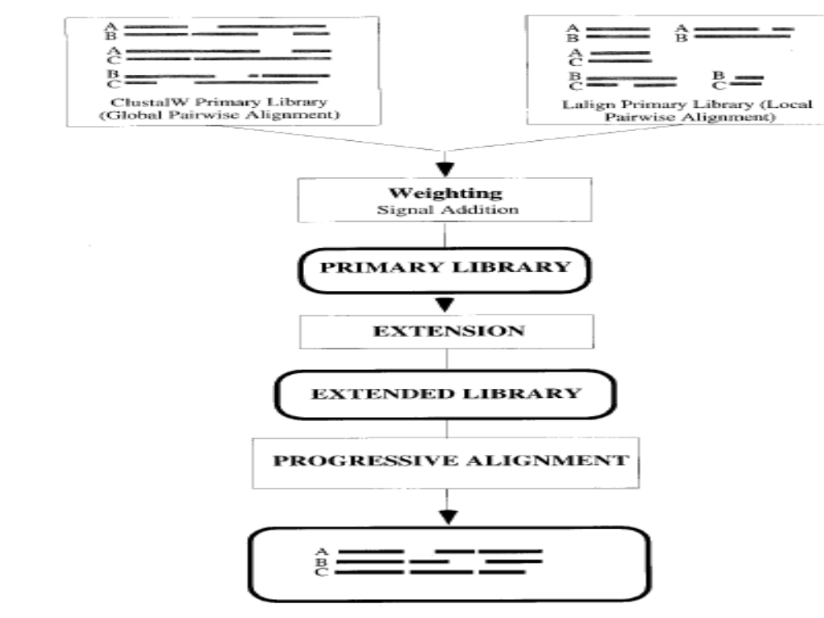
More Information
Can Be Combined
T-Coffee Layout
Important

Slide 134
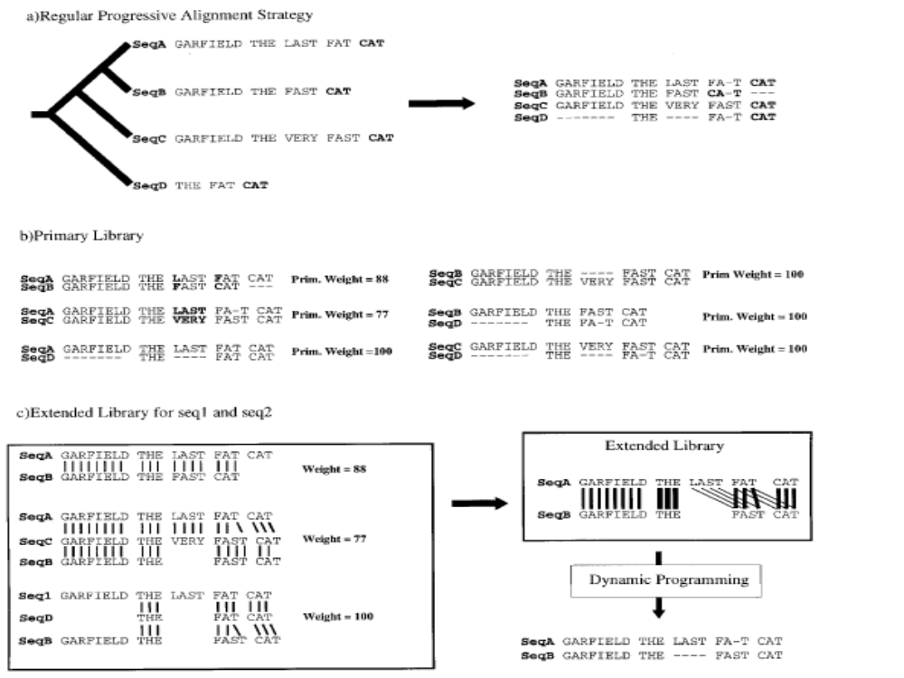
Library extension

Slide 135
7.6 More on multiple alignments
Multiple sequences alignment algorithm focus on
Speed vs. Accurate
Fast vs. Slow

Slide 136
7.6 More on multiple alignments
How integrate the different multiple sequences alignment algorithms to improve performance ?
Meta-method multiple alignment algorithm

Slide 137
7.6 More on multiple alignments
Clustal W
MAFFT
Meta-Method
MUSCLE
T-COFFEE
Multiple Sequence Alignment

Slide 138
7.6 More on multiple alignments
2006 M-Coffee
  Lain M. Wallace, Orla O’Sullivan, …
  Combine multiple sequences alignments with T-Coffee
  Much More …

Slide 139
第七章 多重序列比对
本章结束

