Slide 1


Computational Biology
计算生物学
Zhidong DENG
Department of Computer Science
Tsinghua University
邓志东
清华大学计算机系
清华大学 • 2019秋季

Slide 2
第五章 双序列比对: 概率模型方法

Slide 3
第五章 双序列比对: 概率模型方法
5.1 引言
5.2 隐马氏模型（HMM）
5.3 Pair HMM

Slide 4
第五章 双序列比对: 概率模型方法
建议参考：
[1] R. Durbin, S. Eddy, A. Krogh, and G. Mitchison. 生物序列分析－蛋白质与核酸的概率模型，剑桥大学出版社，清华大学出版社，2002.
[2] S. R. Eddy. Profile Hidden Markov Models, Bioinformatics, vol.14, no.9, 1998, pp.755-763.
[3] P. Baldi, S. Brunak, Y. Chauvin, C. Andersen, and H. Nielsen. Bioinformatics: the Machine Learning Approach, 2nd Eds. Cambridge, MA: MIT Press, 2000.
(皮埃尔⋅巴尔迪等著，张东晖等译，生物信息学－机器学习方法，中信出版社，2003.)

Slide 5
第五章 双序列比对: 概率模型方法
建议参考：
[4] L. R. Rabiner. A Tutorial on Hidden Markov Models and Selected Applications in Speech Recognition, Proceedings of the IEEE, vol.77, no.2, 1989, pp. 257–286.

Slide 6
第五章 双序列比对: 概率模型方法
5.1 引 言

Slide 7
5.1 引言
In the second half of the 1960s, HMM is first described in a series of statistical papers by Leonard E. Baum and other authors.
In 1975, applications of HMM in speech recognition (J. K. Baker, F. Jelinek).
In the mid-late 1980s, HMMs enter molecular biology.
In the 1990s, HMMs become popular in molecular biology.

Slide 8
Applications of HMM
5.1 引言
Speech recognition
Gesture and body motion recognition
Optical character recognition (OCR)
Image processing
Machine translation
Applications of HMM to Biology!

Slide 9
5.1 引言
Applications of HMM to Biology
Gene findings and prediction
Protein-profile analysis
Secondary structure prediction
Biological sequences alignment
Inferring evolutionary relationship
Analysis of gene expression data and tiling array data
Signal peptide prediction
Binding site recognition
Regulatory region discovery
Genome evolution
…

Slide 10
Profile HMM
5.1 引言
1987 Lander and Green: construct the genetic linkage maps using HMM
1989 Churchill: distinguish coding from non-coding regions in DNA
1990 Lawrence and Reilly /1992 Cardon and Stormo: model certain proteins
Recognize binding sites in DNA with simple HMM in conjunction with the EM algorithm

Slide 11
Profile HMM (contd.)
5.1 引言
1991 and 1993 White, Stultz, and Smith: model protein superfamilies
1992 Churchill: analysis of genome structure
1992 Morris: model the N-caps and C-caps of alpha helices in proteins
1993 Brown, Hughey, and Krogh: derive HMM for protein families
Haussler and Krogh: model globin protein with HMM

Slide 12
HMM Sequence analysis Tools
5.1 引言
HMMER (Eddy, 1998) WashU
Sequence analysis using profile HMM
  HMMbuild to build a model from a multiple alignment
  HMMalign to align sequences to a model
  HMMsearch to search a database against a model
  HMMpfam to scan a sequence against a database of models
SAM (Kevin Karplus and Krogh, 1998; 1999) UCSC
Protein secondary structure prediction using HMM

Slide 13

Database based on HMM
5.1 引言
Pfam 32.0 (Sep. 2018, 17,929 entries)
Prosite
SMART
Interpro
…

Slide 14
Gene Prediction
5.1 引言
1993 Asai Hayamizu and Onizuka: to predict the secondary
structure of proteins
1994 Fujiwara, Asogawa: to extract motif using HMM
Krogh: to find gene in E. coli DNA
1995 Eddy: multiple alignment using HMM/
maximum discrimination HMM of sequence consensus
1996 Churchill: variant among sites in rate of evolution
Pedersen: to characterize the promoters of P. and E.
with HMM
Yada: to detect short protein coding regions
Baldi: repeated patterns of sequence by HMM
1997 Henderson: to find genes in DNA with HMM
...

Slide 15
HMM-based Gene Findings Tools
5.1 引言
GENSCAN (Burge, 1997) : one of the best
FGENESH (Solovyev, 1997) : one of the best
HMMgene (Krogh, 1997)
GENIE (Kulp, 1996)
GENMARK (Borodovsky & McIninch, 1993)
VEIL (Henderson, Salzberg, & Fasman, 1997)
…

Slide 16
5.1 引言
Baldi and Brunak define three main groups of problems in computational biology for which HMMs have been proven especially useful.
HMMs can be used for multiple alignments of DNA sequences, which is a difficult task to perform using a naïve dynamic programming approach.
The structure of trained HMMs can uncover patterns in biological data.

Slide 17
5.1 引言
The large set of classification problems
- Structure prediction: the problem of classifying each nucleotide according to which structure it belongs.
- HMMs protein profiling to discriminate between different protein families and predict a new protein's family or subfamily.
- Gene findings in DNA.

Slide 18
第五章 双序列比对: 概率模型方法
5.2 隐马氏模型（HMM）

Slide 19
5.2 隐马氏模型
Markov Model
Hidden Markov Model

Slide 20
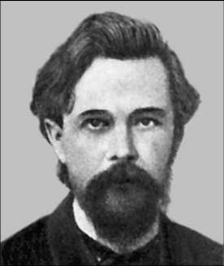
Andrei A. Markov
5.2 隐马氏模型
Gifted Russian mathematician
June 14, 1856 ~July 20, 1922
St. Petersburg University
Doctoral Advisor: Pafnuty Chebyshev

Slide 21
5.2 隐马氏模型
Andrei A. Markov
Research field:
    number theory
    continuous fraction theory
    differential equations
    probability theory
    statistics
  Markov is best known for his work in probability and for stochastic processes, especially Markov chains.

Slide 22
5.2 隐马氏模型
Andrei A. Markov
At the age of 30, Markov became a professor at St. Petersburg University and a member of St. Petersburg Academy of Sciences
More than 120 scientific papers
Classical textbook “Calculus of Probabilities”

Slide 23
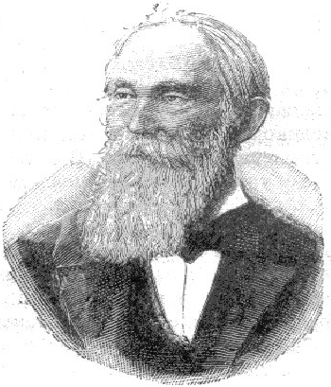
Pafnuty Chebyshev
5.2 隐马氏模型
One of the founding fathers of Russian mathematics
His famous students :
  Dmitry Grave
  Aleksandr Korkin,
  Aleksandr Lyapunov
  Andrei Markov
  …

Slide 24
Pafnuty Chebyshev
5.2 隐马氏模型
According to the Mathematics Genealogy Project, Chebyshev has about 4,000 mathematical descendants.
His famous work in the field of probability, statistics and number theory.

Slide 25
Markov Model
5.2 隐马氏模型
What is a Markov chain? (1906-1912)
A Markov chain is a discrete-time stochastic process with the Markov property.
What is a Markov property
Discrete sequences of random variables in which the future variable is determined by the present variable but is independent of the way in which the present state arose from its predecessors.

Slide 26
Markov Model
5.2 隐马氏模型
What is a Markov Model?
Based on Markov chains
- Observable state sequences (state is known from data)

Slide 27
5.2 隐马氏模型
Markov chain
  A Markov chain describes the states of a system at successive times.
  At these times, the system may have changed from the state it was in the moment before to another or stayed in the same state. The changes of state are called transitions.
  The Markov property means that the conditional probability distribution of the state in the future, given the state of the process currently and in the past, depends only on its current state and not on its state in the past.

Slide 28



Example of Markov Model
Weather: A Markov Model
Sunny
Rainy
Snowy

Slide 29
5.2 隐马氏模型
60%
80%
38%
15%
5%
75%
5%
2%
状态转移关系
20%

Slide 30
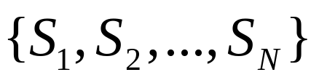
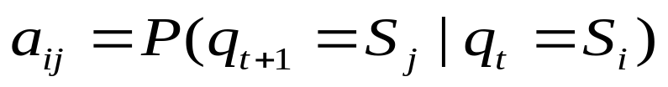
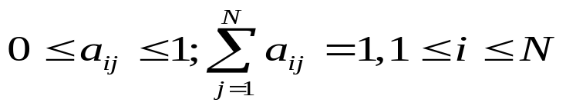
Markov Model
5.2 隐马氏模型
State set:
State transition probabilities:
represents the probability of moving from state i to state j

Slide 31
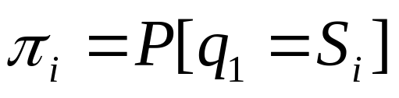
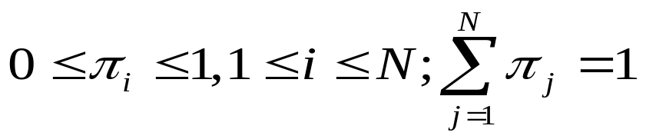
5.2 隐马氏模型
Initial state distribution:

Slide 32
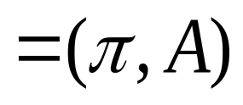
5.2 隐马氏模型
Markov Model
  Begin ( t = 1) in some initial state(s).
  At each time step (t = 1,2,…), the system moves from current to next state (possibly the same as the current state) according to transition probabilities associated with current state.

Slide 33
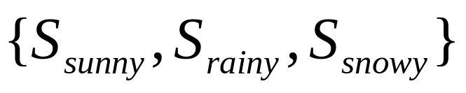
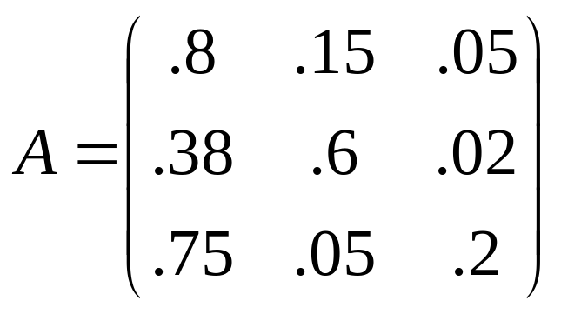
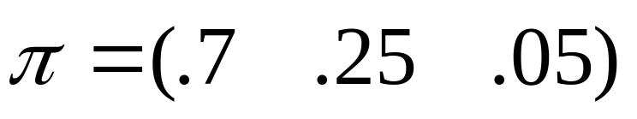
Weather Markov Model
5.2 隐马氏模型
State set:
State transition probability matrix:
Initial state distribution:

Slide 34
Basic Calculations -1
Given the weather on the first day , what is the joint probability that the weather for consecutive six days?
t=1 t=2 t=3 t=4 t=5 t=6
Sunny
Rainy
Rainy
Rainy
Snowy
Snowy

Slide 35
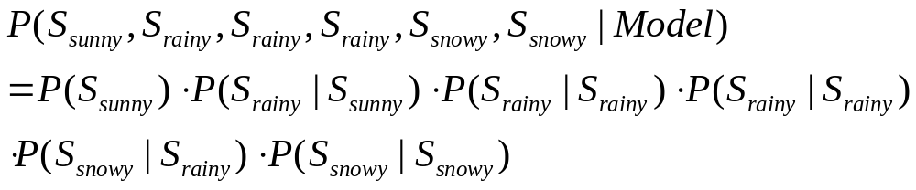
5.2 隐马氏模型

Slide 36

Basic Calculations -2
Given that the system is in a known weather
, e.g., , what is the joint probability that it stays in the same weather for consecutive d days?

Slide 37
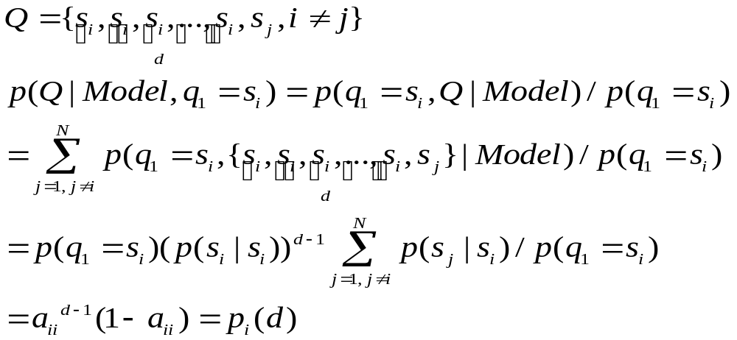
5.2 隐马氏模型

Slide 38
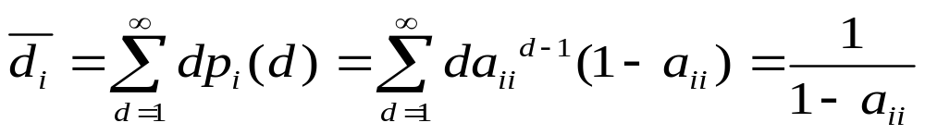
Basic Calculations -3
Conditioned on starting the weather e.g., , compute the expected number of duration in weather
Expected number of consecutive days is 5.

Slide 39
5.2 隐马氏模型
The World is not
fully observable!!!
Hidden Markov Model

Slide 40



Example of Hidden Markov Model
60%
Not Observable
（Hidden）
5%
80%
60%
30%
30%
38%
15%
10%
75%
5%
5%
2%
65%
20%
50%
0%
50%

Slide 41
From Markov to Hidden Markov
5.2 隐马氏模型
Markov Model
Each state can be uniquely associated with an observable event.
Hidden Markov Models (HMM)
  To make the model more flexible, assume the outcomes or observations of the model are a probabilistic function of each state.

Slide 42
5.2 隐马氏模型
Hidden Markov Models (HMM)
  The Hidden Markov Model is a finite set of states, each of which is associated with a (generally multidimensional) probability distribution. Transitions among the states are governed by a set of probabilities called transition probabilities. For a given state, an outcome or observation can be generated, according to the associated probability distribution.

Slide 43
5.2 隐马氏模型
Hidden Markov Models (HMM)
  Each state can produce a number of outputs (observations) according to a unique probability distribution, and each distinct output can potentially be generated at any state.
  The state sequence is not directly observable. It can only be approximated from the sequence of observations produced by the system.
A HMM can be considered as the simplest dynamic Bayesian network!

Slide 44
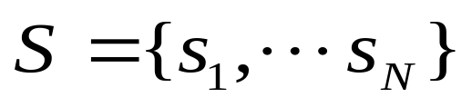
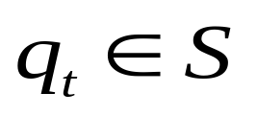
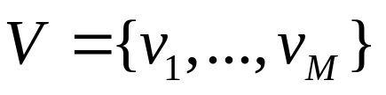

A General Definition of HMM
5.2 隐马氏模型
N: the number of states in the model
– state set
– state at time t
M: the number of observation symbols
– observation symbol set
– observation at time t

Slide 45
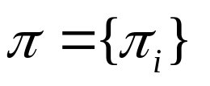
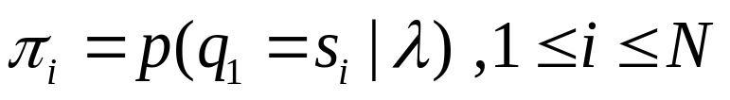
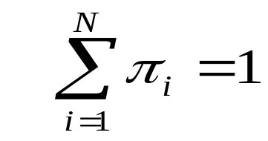
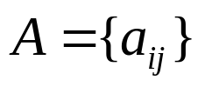

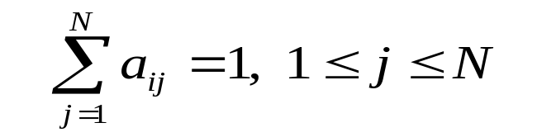
5.2 隐马氏模型
- Initial state probability
- state transition probability matrix

Slide 46
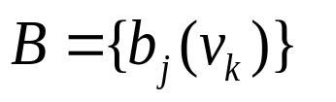
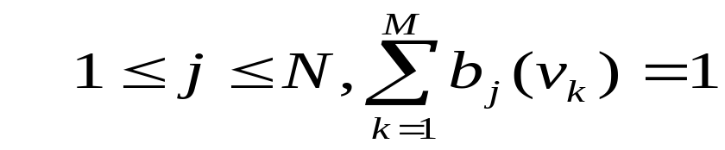
5.2 隐马氏模型
- Output probability matrix
(Emission/Production prob.)

Slide 47
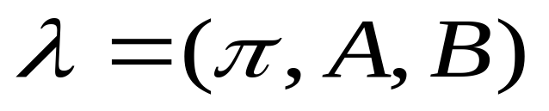
5.2 隐马氏模型
HMM Model:

Slide 48
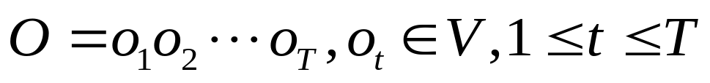

5.2 隐马氏模型
Observation sequence
State sequence (Path)
where T is the number of observations in the stochastic sequence (also the number of state pass through)

Slide 49
5.2 隐马氏模型
Stochastic sequence
Time/Index: t₁ t₂ t₃ … t_{T}
Data: o₁ o₂ o₃ … o_{T}
Sequential data
Random
variables/
process
Observation variable: O₁ O₂ O₃ … O_{T}
Hidden state variable: q₁ q₂ q₃ … q_{T}

Slide 50
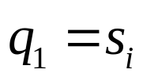

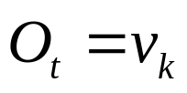
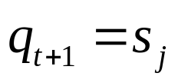
Generation of HMM Observations
1 Choose an initial state , based on the initial state distribution
2 From t = 1 to T
  Choose according to the emission probability distribution in state j
  Transition to a new state according to the state transition probability for state i to j
3 Increment t by 1, return to step 2 if t ≤ T ; else terminate.
doubly stochastic processes
  Markov chain of hidden states
  A chain of observable sequence whose probability depends on the hidden state

Slide 51
5.2 隐马氏模型
Init state distr.
Hidden
Observable
State trans. prob.
Output prob.

Slide 52
5.2 隐马氏模型
Hidden States
Dependent only on the previous state;
The future state is determined by the present state but is independent the past state
Observations
Dependent only on their corresponding hidden state

Slide 53
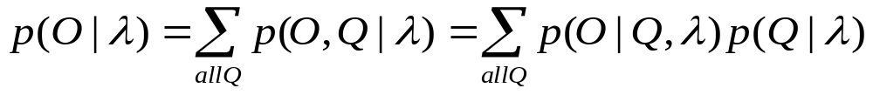
Some Formulation:
5.2 隐马氏模型

Slide 54
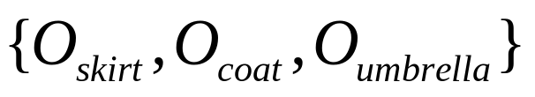
5.2 隐马氏模型
Ingredients of Our HMM in the example
States:
Observations:
State transition probabilities:

Slide 55
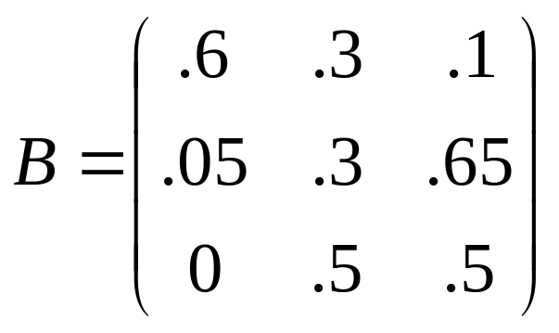
5.2 隐马氏模型
Initial state distribution:
Observation probabilities:

Slide 56

5.2 隐马氏模型
Given: O=
Estimation: What is the joint probability of this observation sequence if the model λ is known ?
– Scoring /Evaluation Problem

Slide 57
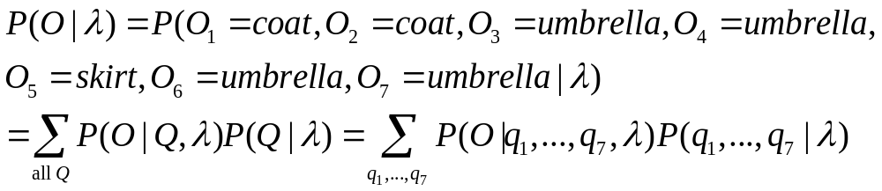

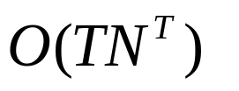
5.2 隐马氏模型
Complexity:

Slide 58
5.2 隐马氏模型
Given the model λ and this observation sequence O,
How can the underlying state sequence Q be estimated?
(The most likely state sequence)
– Decoding /Inference Problem
The model parameters are reliable? How to adjust them more reasonably?
– Training /Learning Problem
??????

Slide 59
Three Basic HMM Problems
MATCHING: -Decoding
Given an observation sequence O and a model λ = {π, A, B},
How do we choose a state sequence Q, which is optimal in some sense? --> Viterbi Algorithm
SCORING: -Evaluation
Given an observation sequence O and a model λ = {π, A, B}, How do we compute P(O| λ), the joint probability of the observation sequence? --> Forward-Backward Algorithm
TRAINING: -Modeling
Given an observation sequence O,
How to adjust the model parameters λ = {π, A, B} to
maximize P(O| λ)? --> Baum-Welch Re-estimation Procedure

Slide 60
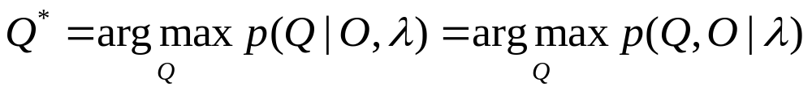
5.2 隐马氏模型
Matching: Decoding – finding the most likely path
Have: model, observations (data)
Find: the most likely states sequence

Slide 61
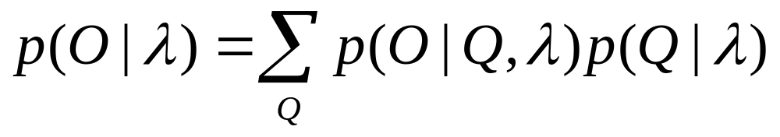
5.2 隐马氏模型
Scoring: Evaluation – computing the observation likelihood
Have: model, observations (data)
Find: the likelihood to generate the observed data

Slide 62

5.2 隐马氏模型
Training – Re-estimating parameters
  Supervised
Have: marked data (data + states sequence)
Find: re-estimating parameters
  Unsupervised
Have: model, data
Find: Re-estimating parameters

Slide 63
MATCHING: -Decoding
Optimal Inference/Prediction
Viterbi Algorithm
Given an observation sequence O and a model λ = {π, A, B},
How do we choose a state sequence Q, which is optimal in some sense?

Slide 64
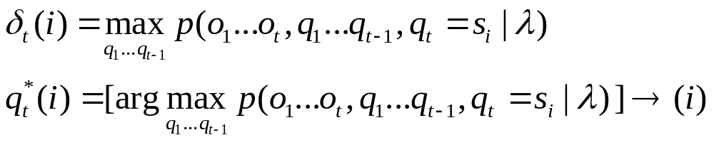
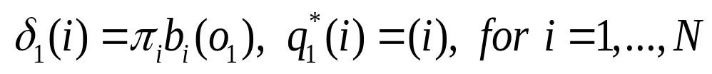
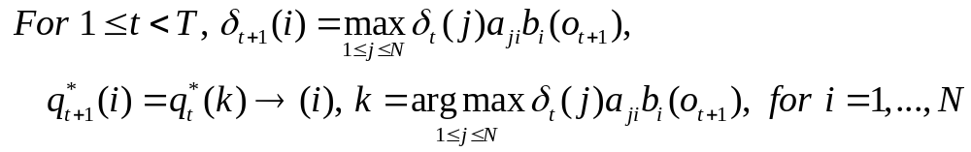
Viterbi Algorithm - Dynamic programming
Observation:
The highest probability along a single path from 1 to t with states i at time t Generating o₁…o_{t}
Algorithm:

Slide 65
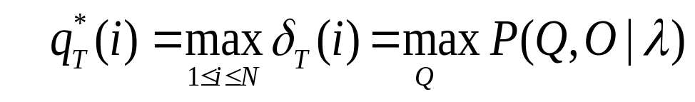
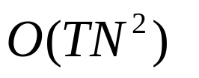
5.2 隐马氏模型
The Best Path is
Complexity:

Slide 66
SCORING: -Evaluation
Find Likelihood
Forward-Backward Algorithm
Given an observation sequence O and a model λ = {π, A, B}, How do we compute P(O| λ), the joint probability of the observation sequence?

Slide 67
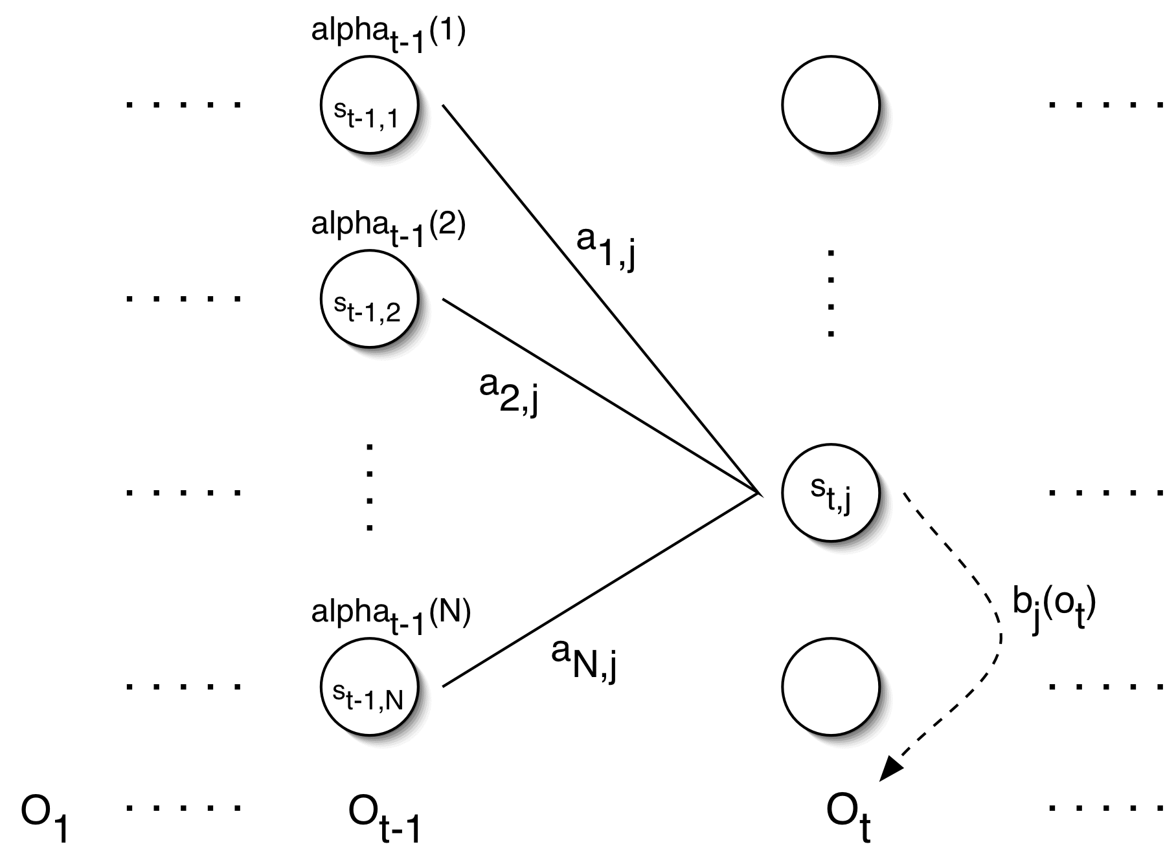
5.2 隐马氏模型
The Forward Algorithm-1

Slide 68
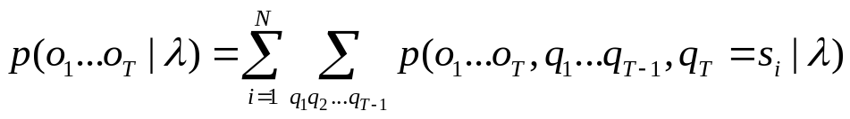
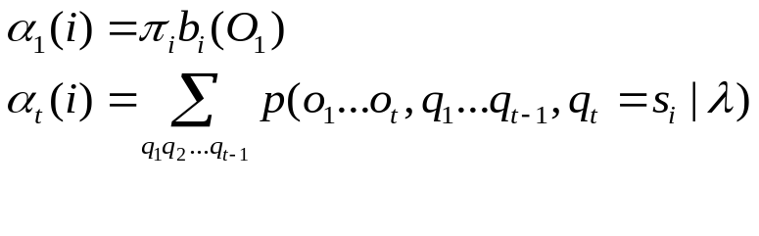
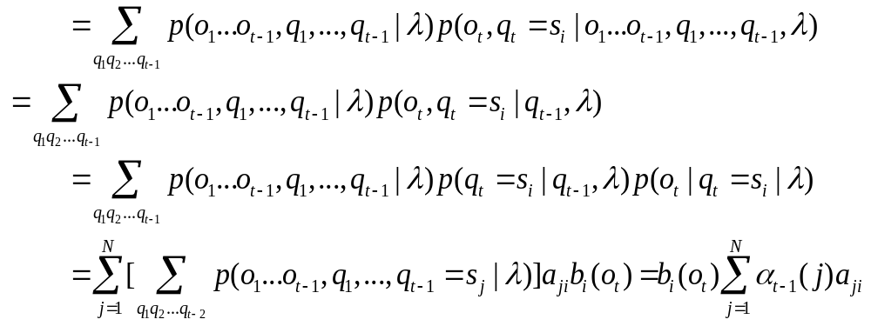
The Forward Algorithm-2
Observation:
Generating o₁…o_{t}
With at time t ending state s_{i}
Algorithm:

Slide 69
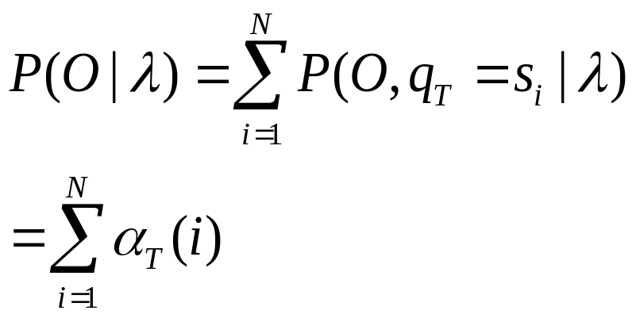
The Forward Algorithm-3
The data likelihood is
Complexity:

Slide 70
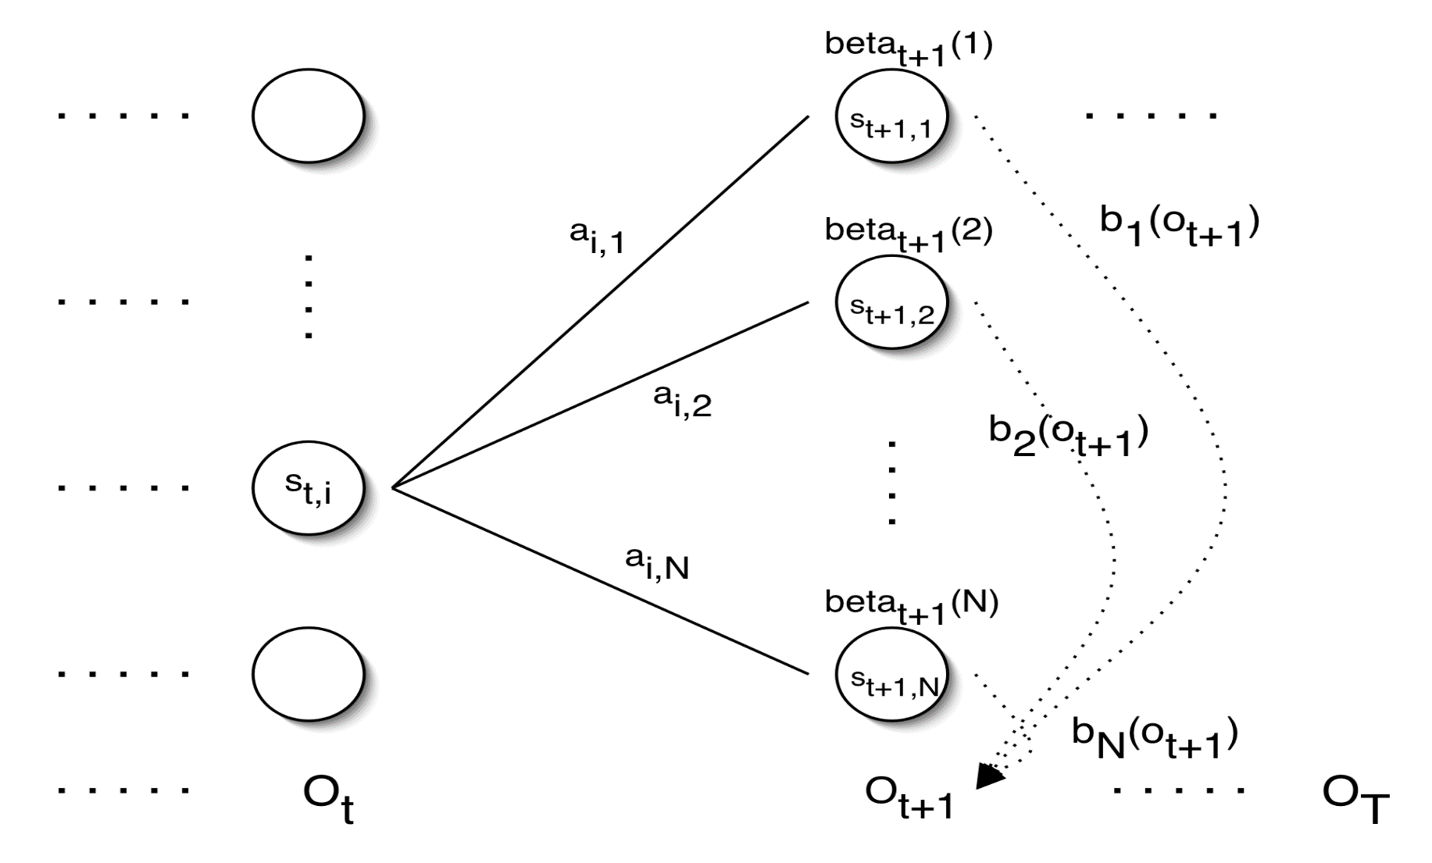
5.2 隐马氏模型
The Backward Algorithm-1

Slide 71
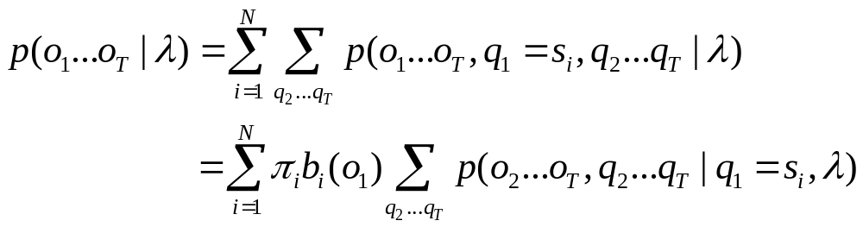
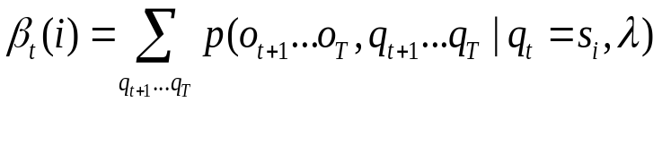
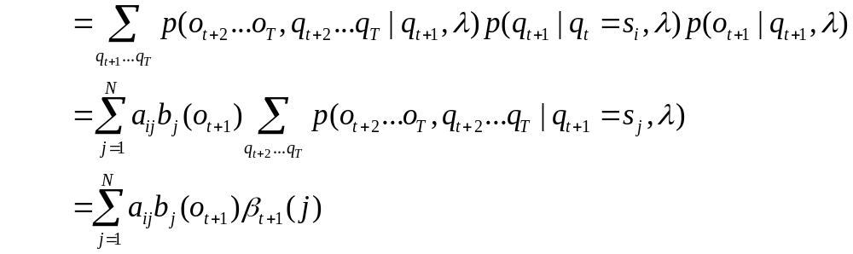
The Backward Algorithm-2
(o1…ot already generated)
Starting from at time t state s_{i}
Generating o_{t+1}…o_{T}
Observation:
Algorithm:

Slide 72

The Backward Algorithm-3
The data likelihood is
Complexity:

Slide 73
5.2 隐马氏模型
Modeling: Training
Re-estimating Parameters
Where do we get the probability values for all parameters?
Supervised vs. Unsupervised

Slide 74
Supervised Training-1
Given:
  N – the number of states, e.g., 2, (s1 and s2)
  V – the symbols, e.g., V={&,@}
  O – observations, e.g., O=&&&&&@@@@@
  State sequences, e.g., S=1121122222

Slide 75
Supervised Training-2
Task: Estimate the following Parameters:
1. π₁, π₂
2. a₁₁, a₁₂, a₂₂, a₂₁
3. b₁(&), b₁(@), b₂(&), b₂(@)

Slide 76
Supervised Training-3
0.5
0.8
P(s1)=1
P(s2)=0
0.5
1
2
0.2
P(&|s1)=1
P(@|s1)=0
P(&|s2)=0.167
P(@|s2)=0.833
π₁=1/1=1; π₂=0/1=0
a₁₁=2/4=0.5; a₁₂=2/4=0.5
a₂₁=1/5=0.2; a₂₂=4/5=0.8
b₁(&)=4/4=1.0; b₁(@)=0/4=0;
b2(&)=1/6=0.167; b2(@)=5/6=0.833

Slide 77
Unsupervised Training-1
Given:
1. N – the number of states, e.g., 2, (s1 and s2)
2. V – the symbol set, e.g., V={&,@}
3. O – observations, e.g., O=&&&&&@@@@@@

Slide 78
Unsupervised Training-2
Task: Estimate the following parameters:
1. π1, π2
2. a11, a12, a22, a21
3. b1(&), b1(@), b2(&), b2(@)
λ ???
How could this be possible?
Maximum Likelihood:

Slide 79
Unsupervised Training-3
Intuition…
O=&&&&&&@@@@, λ
Q₁=1111111111
Q₂=11111112211 …
Q_{K}=2222222222
New λ
P(O,Q₁|λ)
P(O,Q₂|λ) …..
P(O,Q_{K}|λ)
Now -- Supervised Training
Expensive Computation
Efficient training algorithm ?

Slide 80
5.2 隐马氏模型
Baum-Welch Algorithm
Given: the model and the observation sequence
Baum-Welch re-estimation uses the EM algorithm to determine Maximum Likelihood parameters

Slide 81


Baum-Welch Algorithm
Basic “counters”:
Being at state s_{i} at time t
Being at state s_{i} at time t and at state s_{j} at time t+1
E-Step: Compute for given model
M-Step: Compute new model under these expectations

Slide 82


E-Step-1
Do Computation:

Slide 83


E-Step-2
Computation of counters:
Complexity:

Slide 84



M Step-1
Generate:

Slide 85

M Step-2
Overall complexity for each iteration

Slide 86

Summary for Learning Problem
Given an observation sequence O
Guess an initial model
Iterate:
  Calculate expected times in state S_{i} at time t (and in S_{j} at time t+1) using forward-backward algorithm
  By frequency counts, find new model

Slide 87

Other Training Criterion
Maximum state optimized likelihood criterion
where Q* is the Viterbi path given O and model λ
Method: Segmental K means

Slide 88

Other Training Criterion
Maximum Mutual Information
Method: Gradient descent

Slide 89
Remark
Prevent underflow :
      Scaling
      Log
Prevent over-fitting:
      Complex Prior probability
      Pseudo count
Key problem: how to get “suitable”
      The number of states
      Structure

Slide 90
HMM
Advantages | Disadvantages
Statistics Theory | State independence
Modularity | Over-fitting
Transparency of Model | Local Maxima
Incorporation of Prior Knowledge | Low Speed

Slide 91
Two “extreme” types of HMM sequence models-1
Completely connected models
    use groups of states to model different regions of sequence
      CpG islands
      alpha helices
      genes
      promoter regions
      ……
    connect the groups in all possible ways to allow “switching” between different types of sequence

Slide 92
Two “extreme” types of HMM sequence models-1: examples
Gene Regions
5’ UTR
3’ UTR
Exon
Begin
End
Intron

Slide 93
Two “extreme” types of HMM sequence models-1: examples
Protein Secondary Structure
a_{HH}
a_{HE}
a_{BB}
a_{HL}
S
a_{SH}
a_{BE}
Helix
(H)
a_{BH}
Beta
(B)
E
a_{SB}
^
e_{H}
a_{LH}
e_{B}
$
a_{LL}
a_{HL}
a_{LB}
a_{SL}
Loop
(L)
a_{LE}
a_{BL}
e_{L}

Slide 94
Two “extreme” types of HMM sequence models-2
Left-right models (profile HMM)
D₁
D₂
D₃
D₄
I₀
I₁
I₂
I₃
I₄
Start
M₁
M₂
M₃
M₄
End

Slide 95
第五章 双序列比对: 概率模型方法
本讲结束

