Slide 1


Computational Biology
计算生物学
Zhidong DENG
Department of Computer Science
Tsinghua University
邓志东
清华大学计算机系
清华大学 • 2019秋季

Slide 2
第五章 双序列比对：概率模型方法

Slide 3
第五章 双序列比对: 概率模型方法
5.1 引言
5.2 隐马氏模型（HMM）
5.3 Pair HMM

Slide 4
第五章 双序列比对: 概率模型方法
5.3 Pair HMM

Slide 5
5.3 Pair HMM
5.3.1 Pair HMM: FSAs
5.3.2 The Full Probability of x and y,
Summing over All Paths
5.3.3 Suboptimal Alignment
5.3.4 The Posterior Probability that x_{i} is
Aligned to y_{j}
5.3.5 Pair HMM vs. FSAs for Searching

Slide 6
5.3.1 Pair HMM: FSAs
FSAs (Finite States Automatons)
X
(+1,+0)
-e
s(x_{i},y_{j})
s(x_{i},y_{j})
-d
M
(+1,+1)
-d
s(x_{i},y_{j})
Y
(+0,+1)
-e
A finite state machine diagram for affine gap alignment

Slide 7
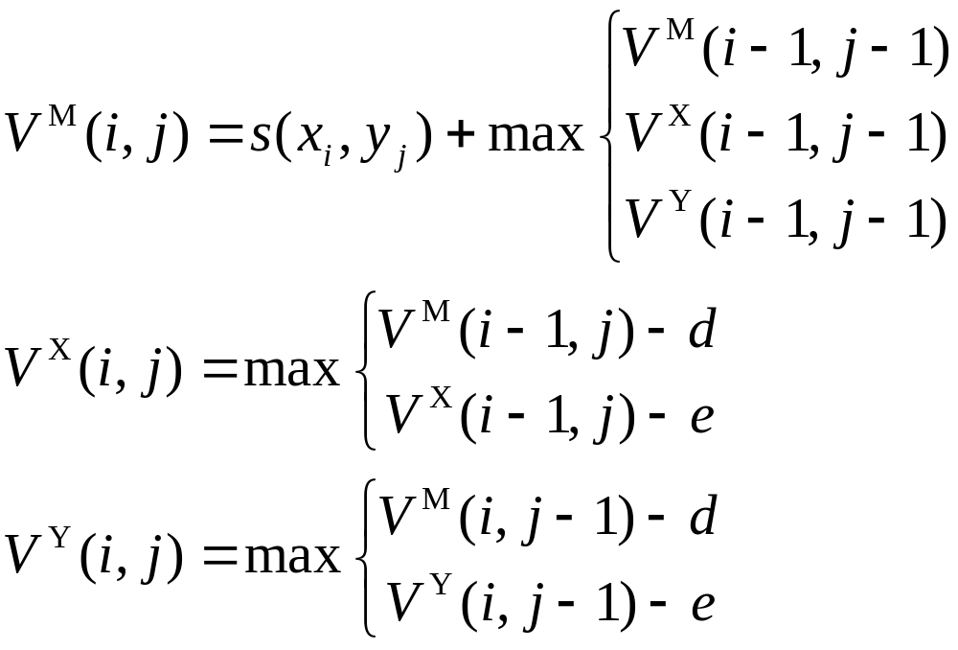



FSAs: Recursion relation
the best score up to (i, j)
given that is aligned to
the best score up to (i, j)
given that is aligned to a gap
(in an insertion with respect to y)
the best score up to (i, j)
given that is in an insertion
with respect to x

Slide 8
From FSAs to HMM
5.3.1 Pair HMM: FSAs
FSA + Probabilistic Interpretation
    Explore suboptimal alignment;
    Score the similarity independent of any specific alignment;
    Build more specialized probabilistic models from simple pieces
HMM

Slide 9
5.3.1 Pair HMM: FSAs
From FSAs to HMM: How to change?
  Give probabilities for emissions of symbols from each state
  Give probabilities for transitions between states

Slide 10
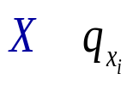


5.3.1 Pair HMM: FSAs
ε
1-ε
δ
δ
1-2δ
1-ε
ε
Probabilistic model corresponding to a finite state machine diagram for affine gap alignment

Slide 11
5.3.1 Pair HMM: FSAs
Introduction of Begin & End states
  To provide a full probability distribution over all possible sequences
  Formalize the initialization and termination conditions
  Complex arrangement of Begin & End state corresponds to local and other types of alignment
Pair HMM
  Probabilistic model
  Emit two sequences simultaneously, and their alignment.

Slide 12
Pair HMMs
5.3.1 Pair HMM: FSAs
Appropriate for global alignment
ε
δ
1-2δ-τ
δ
τ
1-ε-τ
Begin
τ
End
1-ε-τ
τ
1-2δ-τ
δ
ε
δ
τ

Slide 13
5.3.1 Pair HMM: FSAs
Hidden States:
  Match: M
  Insertion in x: X
  Insertion in y: Y

Slide 14
5.3.1 Pair HMM: FSAs
Symbols emitted
  @ Match: M
  {(a, b) | a, b in ∑ }
  @ Insertion in x: X
  {(a, -) | a in ∑ }
  @ Insertion in y: Y
  {(-, a) | a in ∑ }

Slide 15
5.3.1 Pair HMM: FSAs
Output Probabilities
  @ Match: M
  (a, b) with pab only from M states
  @ Insertion in x: X
  (a, -) with qa only from X state: x matched a gap
  Insertion in y: Y
  (-, a) with qa only from Y state: y matched a gap

Slide 16
5.3.1 Pair HMM: FSAs
Pair HMM
Emit a pairwise alignment instead of a single sequence
x: AGACCTAAC
y : AGAAAGC
States MMMXXXMMYM
Output A G A CC TA A - C
A G A - - - A AG C

Slide 17
5.3.1 Pair HMM: FSAs
δ = Transition prob. to the 1st gap
ε = Transition prob. to the tailing gap
τ = Transition prob. to End state
(which assume expected sequence length of 1/τ)
Remarks:
  Forbidden any transitions between X and Y !

Slide 18
5.3.1 Pair HMM: FSAs
Transitions probability matrix
M
X
Y
End
M
1 - 2δ- τ | δ | δ | τ
1 - ε - τ | ε | / | τ
1 - ε - τ | / | ε | τ
 |  |  | 1
X
Y
End

Slide 19
5.3.1 Pair HMM: FSAs
The Procedure of Pair HMM:
Start with the Begin state and repeat the following two steps:
Pick the next state according to the transition probabilities leaving the current state
Pick a symbol pair to be added to the alignment according to the emission probabilities in the new state
Stop when a transition is made into the End state

Slide 20



5.3.1 Pair HMM: FSAs
Pair HMM — Results
Reliability of the alignment
Generate the joint probabilities
Score similarity of two sequences independently of any particular alignment

Slide 21
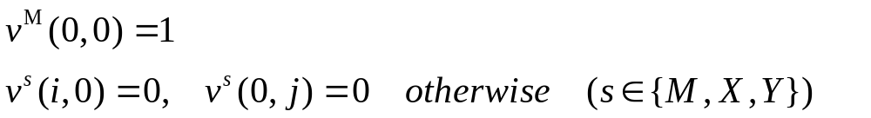
The most probable alignment
5.3.1 Pair HMM: FSAs
Viterbi algorithm for pair HMMs
  Initialization:

Slide 22
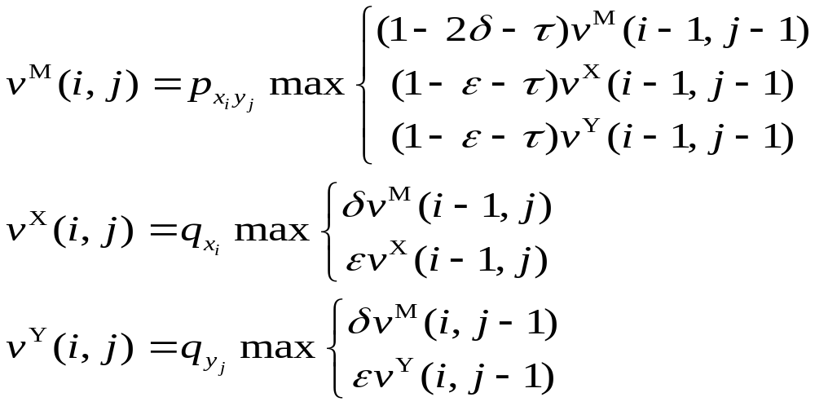
Viterbi algorithm for pair HMMs
5.3.1 Pair HMM: FSAs
  Recursion: i = 1, …, n, j = 1, …, m

Slide 23
5.3.1 Pair HMM: FSAs
Probability of the most probable alignment of x(1..i-1) and y(1..j-1), which ends with a match
Probability of the most probable alignment of x(1..i-1) and y(1..j-1), which ends with an insertion to x
Probability of the most probable alignment of x(1..i-1) and y(1..j-1), which ends with an insertion to y
Take the max of ①②③
Obtain the most probable alignment of x(1..i) and y(1..j) by a recursive argument

Slide 24
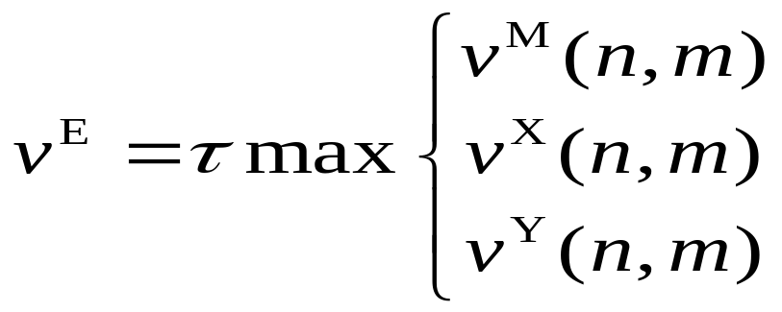
5.3.1 Pair HMM: FSAs
Termination:

Slide 25
5.3.1 Pair HMM: FSAs
Small probabilities resulted
Avoid arithmetic underflow errors
- Use the logarithm transformation: multiplication becomes addition
Wish to know if the alignment score is above or below the score of random alignment
how is the exact correspondence?
- Key: transform into log-odds ratios
* Compare the probabilities computed in the Viterbi algorithm to those of the random model

Slide 26
Log-odds alignment
5.3.1 Pair HMM: FSAs
- Random model
1-η
η
Begin
η
End
1-η
1-η
η
η
1-η
Silent States

Slide 27
5.3.1 Pair HMM: FSAs
Silent States
Silent states ( ) do not emit any symbol
Be used to reduce the number of transitions in a model
By connecting the silent states in series the model can skip any or all of the emitting states
The silent state between X &Y is used to gather inputs from both X & Begin states

Slide 28
5.3.1 Pair HMM: FSAs
Main states: X and Y
  Emit the two sequences in turn, independently of each other
  Each has a probability 1 -η back onto itself
η controls the length of the generated sequences

Slide 29
5.3.1 Pair HMM: FSAs
X
Y
End
X
1 - η | η
 | 1 - η | η
 |  | 1
Y
End
Random model

Slide 30
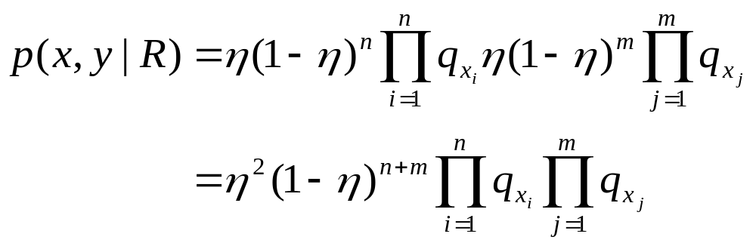
5.3.1 Pair HMM: FSAs
Probability of a pair of sequences x and y according to the random model:

Slide 31
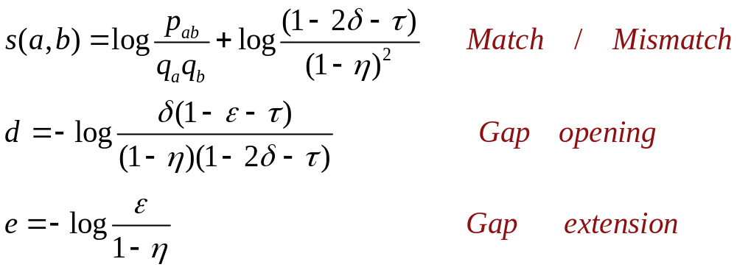
5.3.1 Pair HMM: FSAs
s(a, b) can be used for any match, whether following another match or returning back from insertion

Slide 32
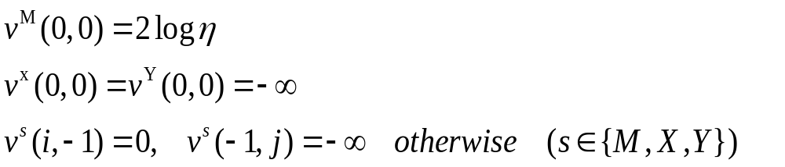
5.3.1 Pair HMM: FSAs
Optimal log-odds alignment
  Initialization:

Slide 33

5.3.1 Pair HMM: FSAs
  Recursion:
  i = 0,…,n, j = 0,…,m except(0, 0)

Slide 34
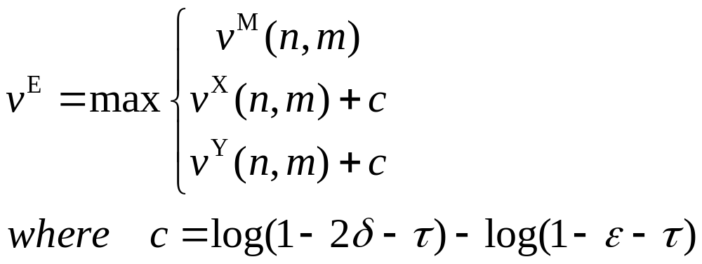
5.3.1 Pair HMM: FSAs
  Termination:

Slide 35
5.3.1 Pair HMM: FSAs
Remark:
  In the termination step, c compensates for the adjustment in d
  The correction is result of having used the same exit probability for match and insertion states
  If allow the exit probability is different for gap states:
    set it to be (1 − ε)τ / (1 − τ ), then c =0.

Slide 36
5.3.1 Pair HMM: FSAs
ADAVANTAGE:
  Shows for a pair HMM how to derive an equivalent FSA for obtaining the most probable alignment.
  Allows us to see a rigorous probability-based interpretation of the terms used in ‘standard dynamic programming’ sequence alignment.

Slide 37
A pair HMM for local alignment
5.3.1 Pair HMM: FSAs
- Pair HMM for local alignment
Adding states and transitions
- A complete probabilistic model must account:
1. Local alignment between sequence x and y
2. Unaligned flanking sequences: random model

Slide 38




two random model
(States: RX1,RY1 & RX2,RY2 )
Global model (States: M,X,Y )
1-η
1-η
1-η
1-η
1-η
δ
η
η
ε
1-2δ-τ
δ
η
1-η
τ
η
η
η
End
1-ε-τ
τ
Begin
1-η
η
1-ε-τ
τ
1-2δ-τ
δ
ε
δ
1-η
τ

Slide 39
5.3.2 The Full Probability of x and y,
Summing over All Paths
The scores from the Viterbi algorithm and the log-odds algorithm:
  Reflect the significance of the best alignment of x and y
  When the similarity is weak, it is hard to identify correct alignment to score and test for significance

Slide 40
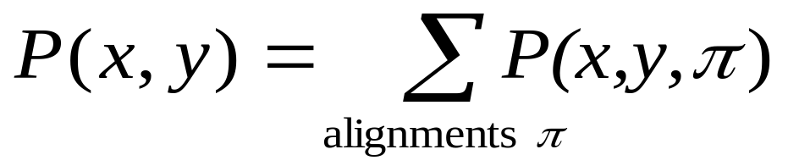
5.3.2 The Full Probability of x and y,
Summing over All Paths
Method:
By calculating the probability that a given pair of sequences are related to the HMM by any alignment
Sum over all alignments:

Slide 41
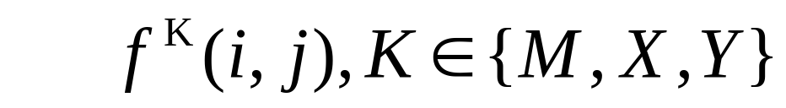
5.3.2 The Full Probability of x and y,
Summing over All Paths
How to calculate?
using the Forward algorithm
  the combined probability of all alignment up to (i, j) that ends in state K

Slide 42
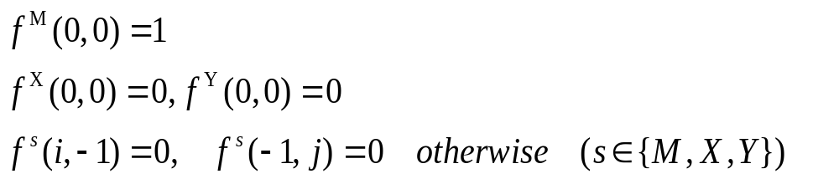
Forward calculation for pair HMMs
5.3.2 The Full Probability of x and y,
Summing over All Paths
Initialization:

Slide 43
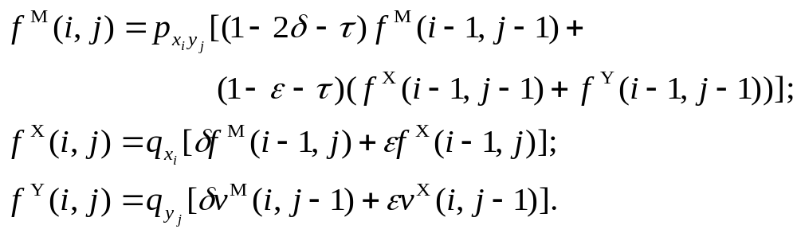
5.3.2 The Full Probability of x and y,
Summing over All Paths
Recursion:
i = 0, ⋅⋅⋅, n, j = 0, ⋅⋅⋅, m except (0, 0)

Slide 44
5.3.2 The Full Probability of x and y,
Summing over All Paths
Termination:

Slide 45
5.3.2 The Full Probability of x and y,
Summing over All Paths
the sum of the probabilities of all alignments of x(1..i-1) and y(1..j-1), which end with a match
the sum of the probabilities of all alignments of x(1..i-1) and y(1..j-1), which end with insertion to x
the sum of the probabilities of all alignments of x(1..i-1) and y(1..j-1), which end with insertion to y
At last step: add the three terms
The total probability of all alignments is:
the sum of the above terms when pass finished

Slide 46
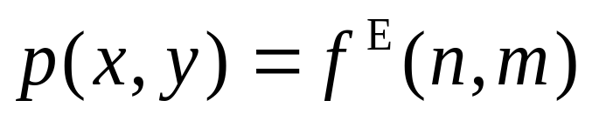
5.3.2 The Full Probability of x and y,
Summing over All Paths
P(x, y) gives similarity of two sequences independently of any particular alignment

Slide 47
5.3.2 The Full Probability of x and y,
Summing over All Paths
MAIN DIFFERENCE between Viterbi algorithm and the Forward algorithm: the maximum be replaced with a summation
  If there is an unambiguous ‘best’ alignment, then its score will dominate the sum
  But if there are many comparable alternative alignments, then the scores can be significantly different.

Slide 48
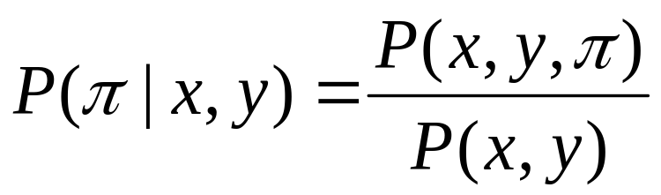
5.3.2 The Full Probability of x and y,
Summing over All Paths
An important use of the full probability is to define the posterior probability of an alignment.

Slide 49
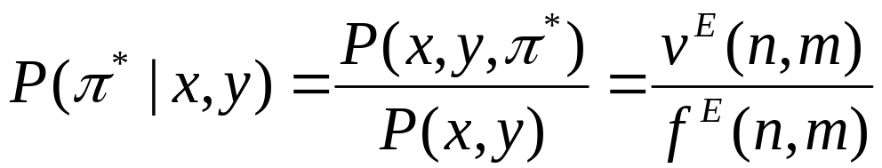

5.3.2 The Full Probability of x and y,
Summing over All Paths
Viterbi algorithm
Forward algorithm
If is the Viterbi path, this can be interpreted as the probability that the optimal alignment is ‘correct‘. Frequently, this is vanishingly small!
Reason: there are many small variants of the best alignment that have nearly the same score

Slide 50
5.3.3 Suboptimal Alignment
Suboptimal alignment:
  Alignments with nearly the same probability as the best alignment
Natural interest:
  Finding such suboptimal alignment

Slide 51
5.3.3 Suboptimal Alignment
Type of suboptimal alignment
  Only different from optimal alignment in the following aspects:
    Minor variance can be independently combined
    The number of ‘local’ variance grows exponentially as the difference in score from the optimal alignment score increases
    Sampling method to illustrate typical variance
  Substantially or completely different
    Repeats in one or both of the sequences

Slide 52
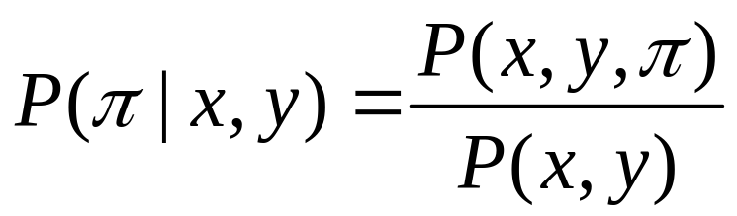
5.3.3 Suboptimal Alignment
Probabilistic sampling of alignments
  Sampling from the posterior distribution
    the posterior probability: the probability that the path corresponding to alignment was chosen by the HMM when generating the sequences x and y
    Use of the forward algorithm and the forward matrix computed by forward algorithm
    generate samples of alignments according to the posterior probability

Slide 53
5.3.3 Suboptimal Alignment
  To generate a sample alignment, we trace back through the forward matrix F, but instead of taking the highest scoring choice at each step
  Make a probabilistic choice based on the relative strengths of the three componts

Slide 54
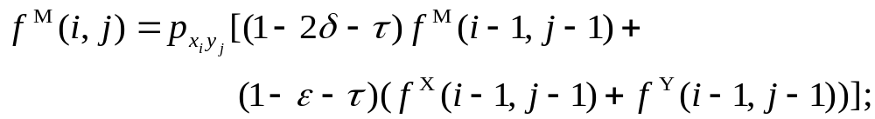
5.3.3 Suboptimal Alignment
  Trace back through f ^{k} (i, j)

Slide 55
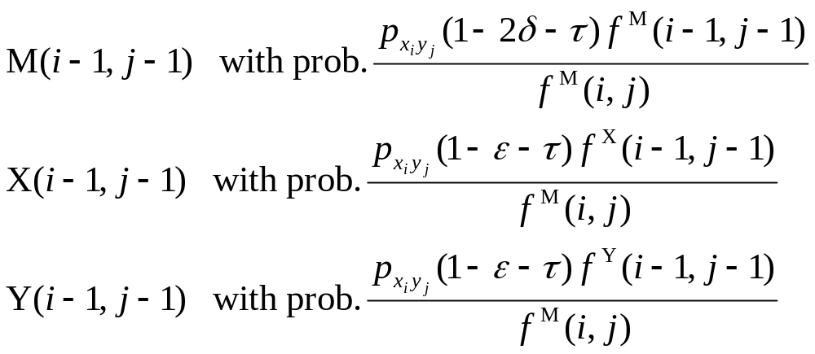
5.3.3 Suboptimal Alignment

Slide 56
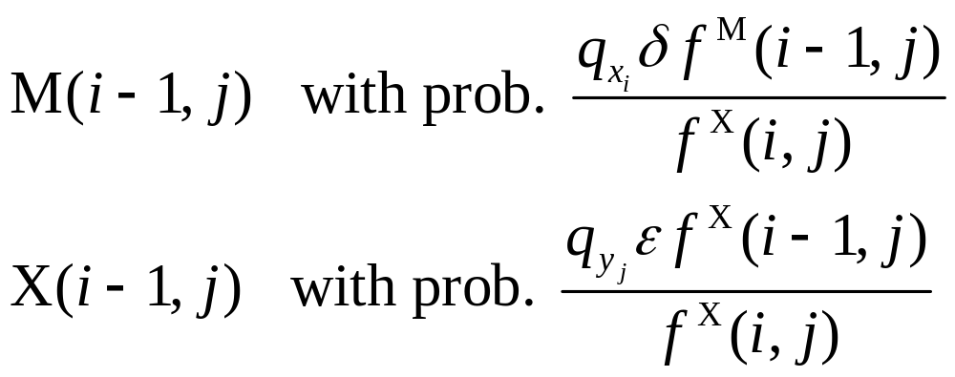
5.3.3 Suboptimal Alignment

Slide 57
5.3.3 Suboptimal Alignment
Finding distinct suboptimal alignments
  the ‘repeat’ algorithm
  Find the optimal set of high-scoring matches between one sequence and multiple non-overlapping segment of the other sequence

Slide 58
5.3.3 Suboptimal Alignment
  The most widely used method : (Waterman & Eggert, 1987)
  Finding the next best alignment
  No aligned residue pairs in common with any previously determined alignment

Slide 59
5.3.4 The Posterior Probability that x_{i} is Aligned to y_{j}
If the probability of any single complete path being entirely correct is small, what is the local accuracy of an alignment?
  there can be regions where the alignment is fairly clear
  other regions (e.g., loops regions of a protein) cannot be aligned reliably
Be useful for reliability measure for each part of an alignment: to estimate the local accuracy of an alignment

Slide 60
5.3.4 The Posterior Probability that x_{i} is Aligned to y_{j}
The basic idea:
  Compute the probability of all alignments that pass through a specified matched pair (xi, yj) of residues
  This probability can then be compared to the full probability of all alignments of the pair of sequences
  If the ratio is near to 1, the match is highly reliable, if near 0, the match is unreliable

Slide 61
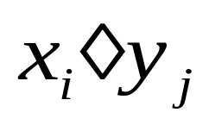


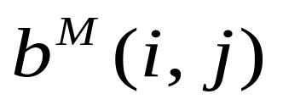
5.3.4 The Posterior Probability that x_{i} is Aligned to y_{j}
The method used:
  a variant of posterior decoding
  a combination of the forward and the backward algorithm
is aligned to
backward probability

Slide 62
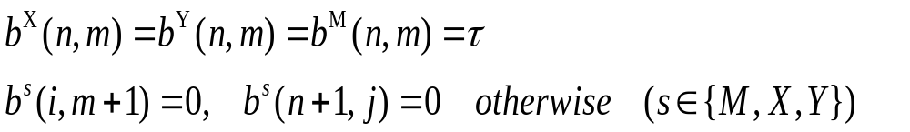
5.3.4 The Posterior Probability that x_{i} is Aligned to y_{j}
Backward calculation for pair HMMs
  Initialization:

Slide 63
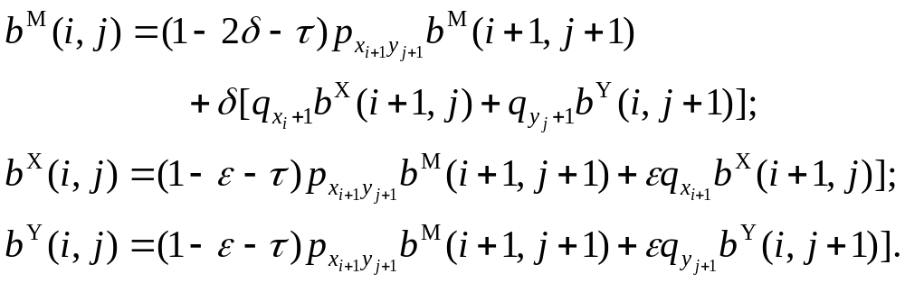
5.3.4 The Posterior Probability that x_{i} is Aligned to y_{j}
  Recursion:
  i = 1, ⋅⋅⋅, n, j = 1, ⋅⋅⋅, m except (n, m);

Slide 64
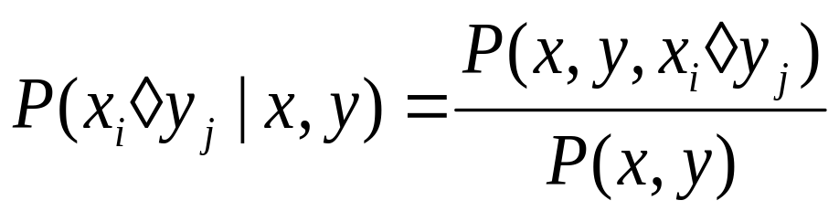
5.3.4 The Posterior Probability that x_{i} is Aligned to y_{j}
Use the Bayesian rule to obtain
where P(x, y) is computed by the Forward algorithm.

Slide 65
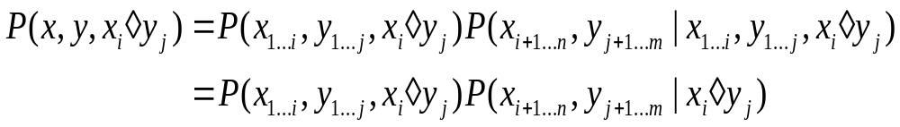
5.3.4 The Posterior Probability that x_{i} is Aligned to y_{j}
P(x, y, x_{i} ◊y_{j}): the first term is computed by the forward algorithm, and the second done by the backward algorithm
Forward algorithm
Backward algorithm

Slide 66
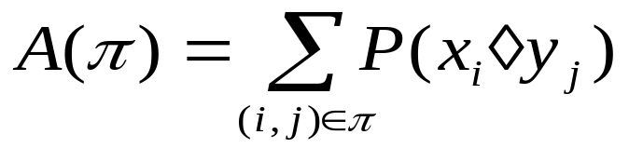
The expected accuracy of an alignment
5.3.4 The Posterior Probability that x_{i}
is Aligned to y_{j}
  A(π): Expected overlap between π and paths sampled from the posterior distribution
  Equivalently, the expected number of correct matches in π, which is a natural measures of the overall accuracy of π
  where the sum is over all aligned pairs in π.

Slide 67
5.3.5 Pair HMM vs. FSAs for Searching
Benefit of probability modeling
  If data D correspond to samples from a model M
  then in the limit of infinitely large amount of data, for any other model N, we have
  P(D|M) > P(D|N)

Slide 68
5.3.5 Pair HMM vs. FSAs for Searching
Two difficulties of conventional methods in searching
  Regarded as FSAs, not a probabilistic models for searching,
  No computable full probability P(x, y|M)

Slide 69
5.3.5 Pair HMM vs. FSAs for Searching
Turning FSA into probabilistic model
  Probabilistic models may underperform standard alignment methods if Viterbi is used for database searching
  Buf if the forward algorithm is used, it would be better than those standard methods.

Slide 70
第五章 双序列比对: 概率模型方法
本讲结束

