Slide 1


Computational Biology
计算生物学
Zhidong DENG
Department of Computer Science
Tsinghua University
邓志东
清华大学计算机系
清华大学 • 2019秋季

Slide 2
第八章 RNA的最优折叠算法

Slide 3
第八章 RNA的最优折叠算法
参考文献:
[1] R. Durbin, S. Eddy, A. Krogh, and G. Mitchison. 生物序列分析－蛋白质与核酸的概率模型，剑桥大学出版社，清华大学出版社，2002.
[2] H. F. Noller. RNA structure: reading the ribosome, Science, vol.309, 2005, pp.1508-1514.
[3] M. S. Waterman. Introduction to Computational Biology Maps, Sequence and Genomes, CRC Press, 2000.
[4] D. H. Mathews, M. D. Disney, J. L. Childs, S. J. Schroeder, M. Zuker, and D. H. Turner. Incorporating chemical modification constraints into a dynamic programming algorithm for prediction of RNA secondary structure, Proc. Natl. Acad. Sci. (PNAS, USA), vol.101, 2004, pp.7287-7292.

Slide 4
第八章 RNA的最优折叠算法
[5] M. Zuker and P. Stiegler. Optimal computer folding of large RNA sequences using thermodynamics and auxiliary information, Nucleic Acids Research (NAR), vol.9, 1981, pp.133-148.
[6] Y. Ding and C. Lawrence. A statistical sampling algorithm for RNA secondary structure prediction, Nucleic Acids Research (NAR), vol.31, no.24, 2003, pp.7280-7301.
[7] B. Knudsen and J. Hein. RNA secondary structure prediction using stochastic context-free grammars and evolutionary history, Bioinformatics, vol.15, no.6, 1999, pp.446-454.

Slide 5
第八章 RNA的最优折叠算法
[8] J. Ruan, G. Stormo, and W. Zhang. An iterated loop matching approach to the prediction of RNA secondary structures with pseudoknots, Bioinformatics, vol.20, 2004, pp.58-66.
[9] P. P. Gardner and R. Giegerich. A comprehensive comparison of comparative RNA structure prediction approaches, BMC Bioinformatics, vol.5, 2004, pp.1471-2105.
[10] S. R. Eddy. How do RNA folding algorithms work? Nature Biotechnology, vol.22, 2004, pp.1457-1458.

Slide 6
第八章 RNA的最优折叠算法
8.1 RNA world
8.2 What is RNA secondary structure
8.3 Comparison of main RNA folding algorithms
8.4 Classical RNA folding algorithms
8.4.1 Base-pair maximization
8.4.2 Minimum free energy
8.4.3 Inferring structure by comparative
sequence analysis
8.4.4 SCFG-based RNA folding

Slide 7
第八章 RNA的最优折叠算法
8.1 RNA world

Slide 8
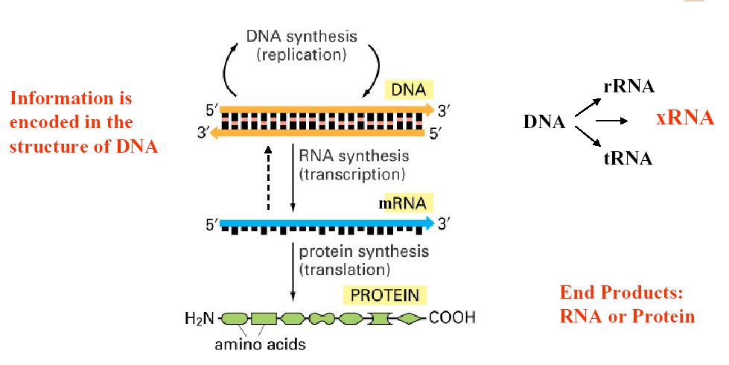
Central Dogma of Molecular Biology

Slide 9
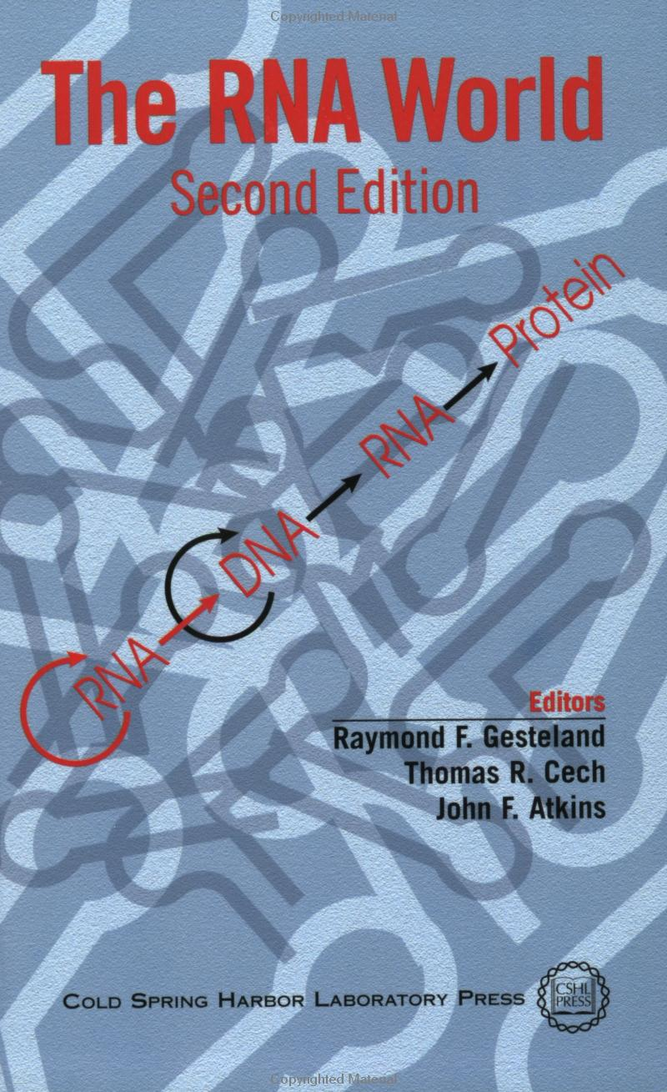
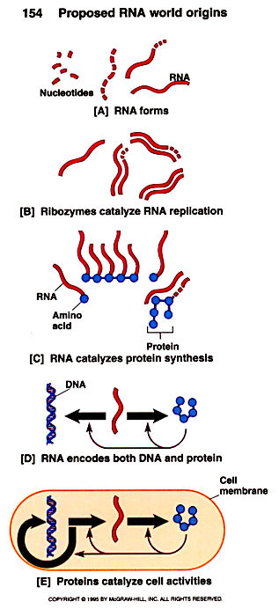

Slide 10
8.1 RNA world
In a putative RNA world, RNA is both the
information molecule (as opposed to DNA) and
the enzymatic machinery (as opposed to
proteins).
RNA can be protein-like
  Ribozymes (核酶) can catalyze enzymatic reactions by RNA secondary fold
  Small RNAs can play structural roles within the cell
  Small RNAs play versatile roles in gene regulatory

Slide 11
8.1 RNA world
RNA can be DNA-like
  Made of digital information, can transfer to progeny by complementarity
  Viruses with RNA genomes (single/double stranded)
  RNA can catalyze RNA replication
RNA world is possible
  Proteins are more efficient (larger alphabet)
  DNA is more stable (double helix, less flexible)

Slide 12

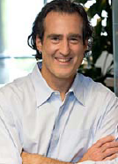
8.1 RNA world
2006 Nobel Prize in Medicine:
  Andrew Fire and Craig C. Mello,
  For their discovery of RNA interference: Gene silencing by double-stranded RNA

Slide 13
8.1 RNA world
Remark:
What is RNA interference ?
  Function: immune system for the genome
  Can be used to do knock-down –induced silencing of genes
  Result: loss of function

Slide 14
8.1 RNA world
Storage/transfer of genetic information
RNA processing and editing
Cellular localization
Catalysis
Pre-mRNA splicing
Regulation of transcription and translation

Slide 15
Some Features
8.1 RNA world
RNA
  In single stranded folding, it is mostly determined by base-pairing A-U and G-C, while other bases will sometimes pair, especially G-U
  The base-paired structure is referred to as the secondary structure of RNA
  Related RNAs often have homologous secondary structure without significant sequence similarity

Slide 16
8.1 RNA world
Canonical Watson-Crick base-pairing:
  G-C and A-U form complementary hydrogen bonded base pairs
  G-C base pairs being more stable (3 hydrogen bonds)
  A-U base pairs less stable (2 bonds) than G-C
Non-canonical base pairs: “wobble” pairing
  most common is G-U
  Less stable
  rules for these not yet understood
G C; A U ; G U
－hydrogen bond

Slide 17
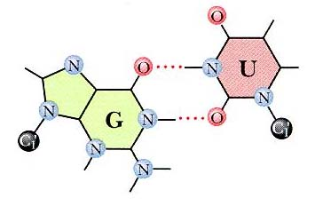
8.1 RNA world
“wobble” pairing: G-U

Slide 18
8.1 RNA world
RNA secondary structure = nested base pairing

Slide 19
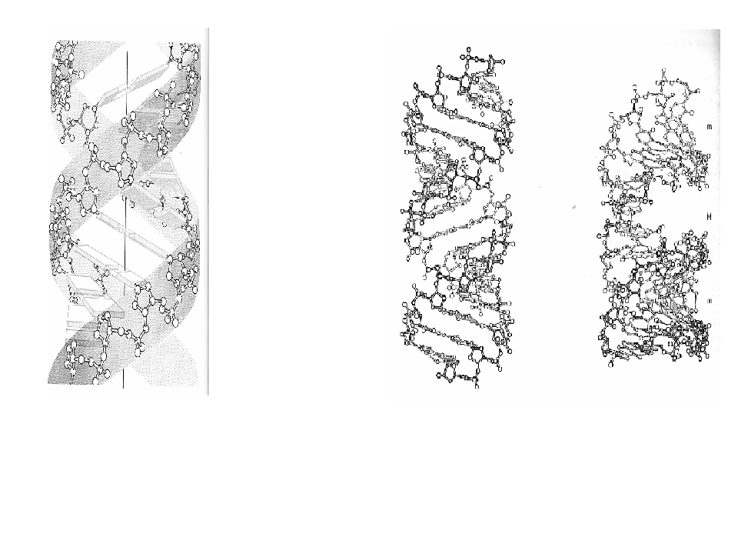
RNA Helix
A-form RNA helix
Grooves Binding sites

Slide 20
Terms of RNA
8.1 RNA world
General
  mRNA:
    messenger RNA (1kb-10kb) is translated into
    protein
  rRNA:
    ribosomal RNA (1kb-3kb) in the ribosome
    catalyzes the formation of the peptide bonds

Slide 21
8.1 RNA world
  tRNA:
    transfer RNA (~75 bases) is the adapter that reads the three-letter genetic code and places the correct amino acid in the sequence
  ncRNA:
    non-coding RNA
  fRNA:
    functional RNA, another name for ncRNAs

Slide 22
8.1 RNA world
Bacteria
  sRNA:
    small RNAs
Eukaryotes
  miRNA:
    micro RNAs (20-25 bases) target mRNAs for
    degradation, and silence gene expression
    microRNA forms a putative translational
    regulatory gene family

Slide 23
8.1 RNA world
  stRNA:
    small temporal RNA, some are also called
    miRNAs
  siRNA:
    short dsRNA which silence genes by base pairing to their mRNAs
    halting transcription ->RNA interference
  snmRNA:
    small non-mRNA
    mostly the same as small RNAs

Slide 24
8.1 RNA world
  snoRNA:
    small nucleolar RNAs
    involved in rRNA modification
  snRNA:
    small nuclear RNA
    includes eukaryote spliceosomal RNAs

Slide 25
8.1 RNA world
Some RNAs are genomes, bad genomes
  HIV
    HIV (10 kb) is an RNA retrovirus. It
    replicates by first being reverse transcribed
    into DNA
    The DNA replicates along with the host DNA,
    then the viral DNA is transcribed into RNA

Slide 26
8.1 RNA world
Types of Functional RNAs
  RNaseP
  SRP RNA
  tmRNA
  snRNAs
  miRNAs
  snoRNAs
  siRNAs

Slide 27
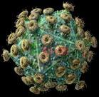
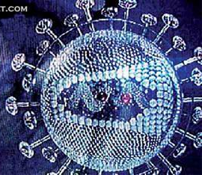
8.1 RNA world
HIV
SARS

Slide 28
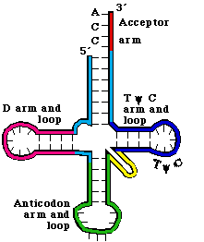
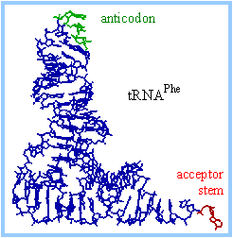
tRNA
Cloverleaf/三叶草tRNA结构

Slide 29
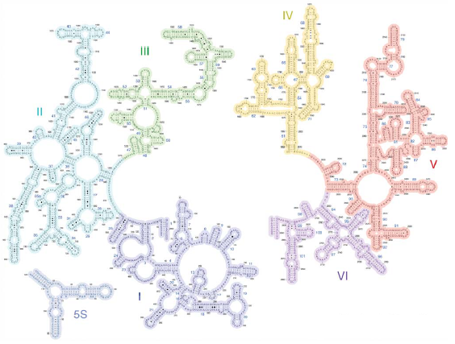
rRNA

Slide 30
RNA Variations
8.1 RNA world
Covariation
  Variations in RNA sequence maintain base-pairing patterns for secondary structures
  When a nucleotide in one base changes, the base it pairs to must also change to maintain the same structure

Slide 31
Known RNA Structures
8.1 RNA world
Rfam
  database of RNA alignments and secondary structure models
Scor
  database of RNA experimentally solved structures

Slide 32
Computational Analysis of RNAs
8.1 RNA world
RNA sequence analysis ought to model RNA secondary structure
Protein vs. RNA: from sequence similarity to structure

Slide 33
For Protein
8.1 RNA world
Mostly satisfied with primary sequence analysis tools like BLAST
  For proteins, for the task of similarity searching, BLAST analysis has substantial power, routinely identifying significant homologies down to 20-30% amino acid sequence identity
  Many proteins are conserved at this level across billions of years of divergence

Slide 34
8.1 RNA world
Though protein structure clearly constrains primary sequence, but
  can not yet predict very well which sequences will fold into active structures
  do not know how to compute efficiently: most existing protein folding or “threading” algorithms are very computational intensive

Slide 35
8.1 RNA world
For RNA
Most primary sequence analysis tools like BLAST is often unsatisfactory
  Significant nucleic acid sequence alignments are only detected down to about 60-70% nucleotide sequence identity
  Many conserved RNAs will diverge below a 60-70% identity threshold in just tens or hundreds of millions of years
  BLAST comparisons of RNAs are often unable to see reliably across important evolutionary divergences

Slide 36
8.1 RNA world
RNA structure is dominated by base pairs, and base pairs induce highly predictable patterns of long distance pairwise base complementarity in RNA primary sequence
Many (though not all) functional RNAs conserve a base-paired secondary structure

Slide 37
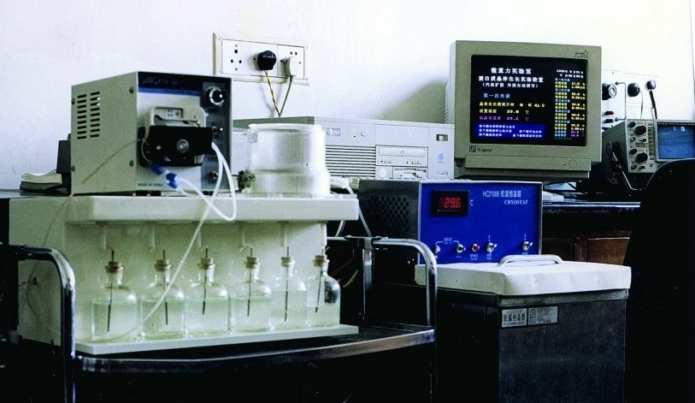
Experimental methods
8.1 RNA world
X-ray crystallography

Slide 38
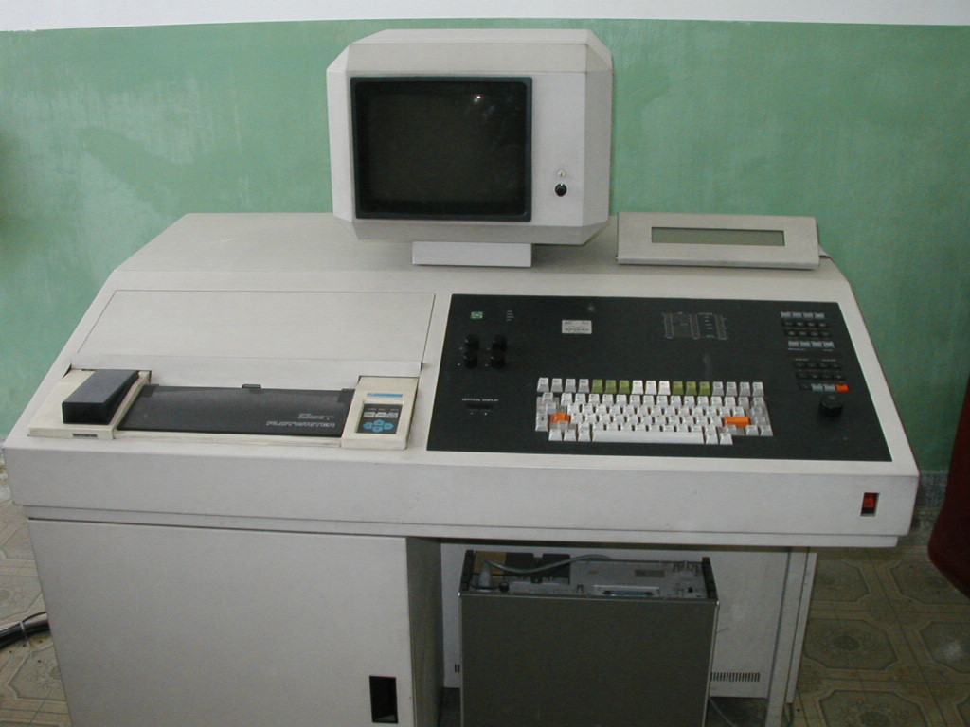
Experimental methods
8.1 RNA world
NMR spectroscopy

Slide 39
Sequencing and structure
8.1 RNA world
Sequencing is easy and structure is hard
  1,000 nucleotides takes less than 1 hour
  Determining the atomic resolution structure of 1,000 nucleotides takes months

Slide 40
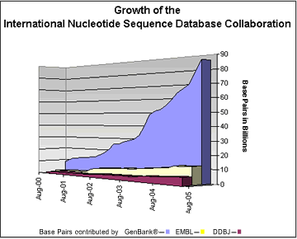
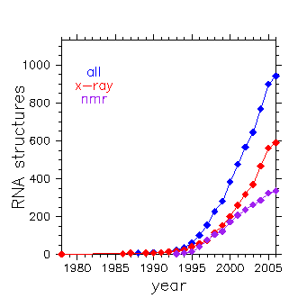
8.1 RNA world

Slide 41
第八章 RNA的最优折叠算法
8.2 What is RNA secondary
structure

Slide 42
Definition: RNA secondary structure
8.2 What is RNA secondary structure
A Secondary Structure of RNA a=a1a2…an is a
graph which satisfied the following:
  ai and ai+1 are linked for 1≤i ≤ n-1
  For each fixed i, there is at most one ak paired to ai, for k≠i±1
  If ai pairs with aj and ak is paired with am with i<k<j, then i ≤ m≤ j

Slide 43
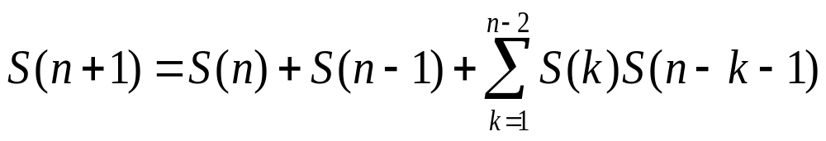
Number of RNA Secondary Structures
8.2 What is RNA secondary structure
Let S(n) be the number of secondary structures for the RNA sequence [1, n]. Then S(0) =0, S(1) =S(2) =1, and for n≥2,

Slide 44
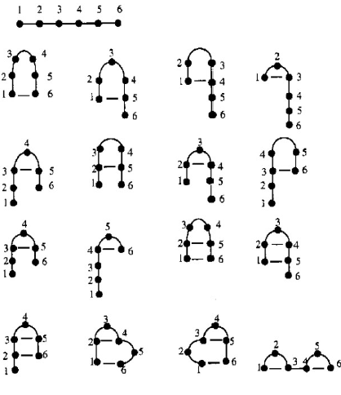
17 Secondary Structures for [1, 6]

Slide 45
8.2 What is RNA secondary structure
Proof:
  For n=1, the only structure is
  While for n=2, the only structure is
  therefore, S(1) =S(2) =1
1
●
1 2
●＿●

Slide 46
8.2 What is RNA secondary structure
  Assume S(k) is known for 1 ≤ k ≤ n. Consider the sequence [1, n+1]. Either n+1 is not base paired or n+1 is paired with j for 1 ≤ j ≤ n-1
    when n+1 is not base paired there are S(n) structures
    when n+1 is paired with j, [1, j-1] and [j+1, n] can each form secondary structures, S(j-1) and S(n-j), respectively

Slide 47
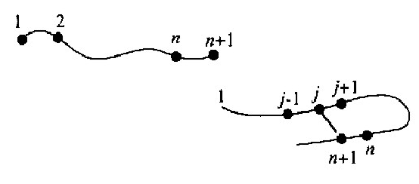
8.2 What is RNA secondary structure

Slide 48
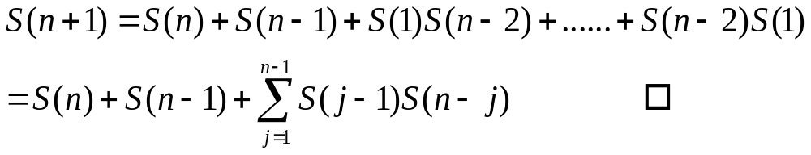
8.2 What is RNA secondary structure
Thus,

Slide 49
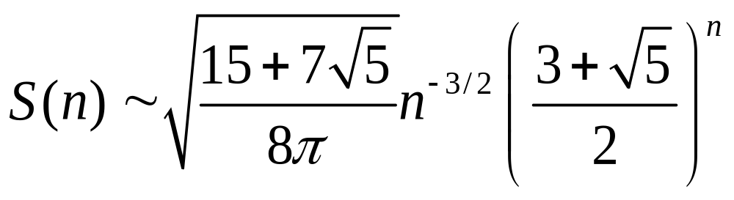
8.2 What is RNA secondary structure
When n→∞,
=

Slide 50
Basic structural elements of RNA SS
8.2 What is RNA secondary structure
Stem
Hairpin loop
Bulge loop
Interior (internal) loop
Multi-branched loop (bifurcation/junction)
Single stranded (dangling)

Slide 51
8.2 What is RNA secondary structure
Stem (double helix): stacked base-pairs
  Stems in nested or parallel pattern
Loop: strand of unpaired-bases
  Hairpin loop
    Loops are generally at least 4 bases long
  Bulge loop
    Occur when bases on one side of the structure cannot form base pairs
  Interior loop
    Occur when bases on both sides of the structure cannot form base pairs

Slide 52
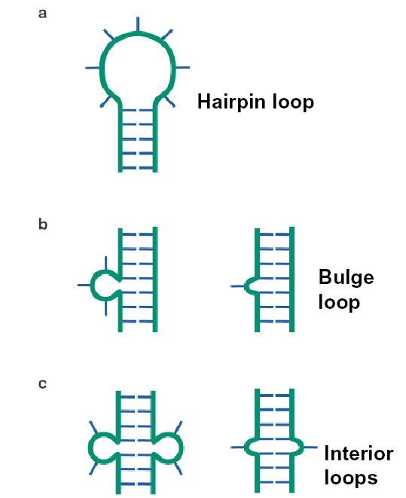
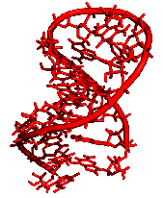

Slide 53
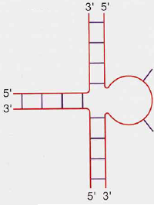
8.2 What is RNA secondary structure
Multi-branched loop (Junction)
  Three or more double-stranded regions converge to form a closed structure

Slide 54
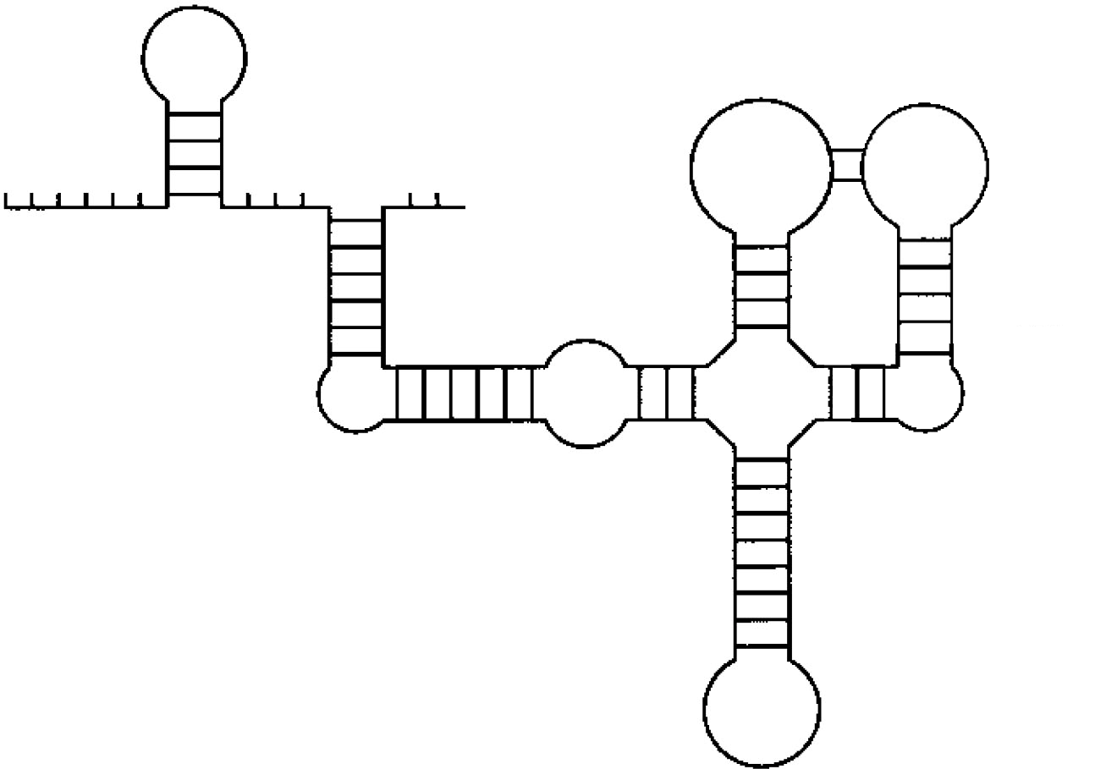
Pseudoknot
Stem
Single-stranded
Interior Loop
Bulge Loop
Multi-branched loop
Hairpin loop

Slide 55
8.2 What is RNA secondary structure
c
guu
aga
aac
c
ucu
cccc
acc
gc
gca
ggg
ugc
acc
ggu
cc

Slide 56
Tertiary Interactions
8.2 What is RNA secondary structure
Kissing Hairpins
  Unpaired bases of two separate hairpin loops base pair with one another

Slide 57
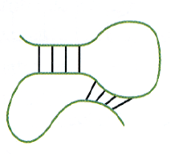
8.2 What is RNA secondary structure
Pseudo-knots: crossing patterns of stems
c
guu
aga
aac
c
ucu
cccc
acc
gc
gca
ggg
ugc
acc
ggu
cc
RNA pseudo-knots can form due to greater flexibility in base pairing

Slide 58
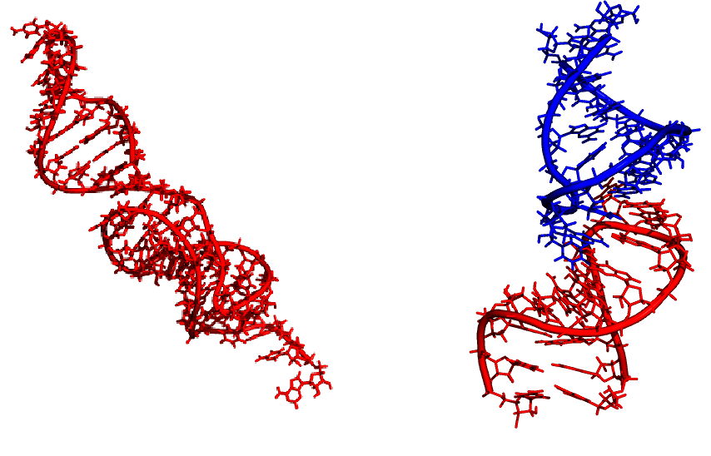
Pseudo-knot
Kissing hairpin

Slide 59
8.2 What is RNA secondary structure
Hairpin-Bulge Interactions

Slide 60
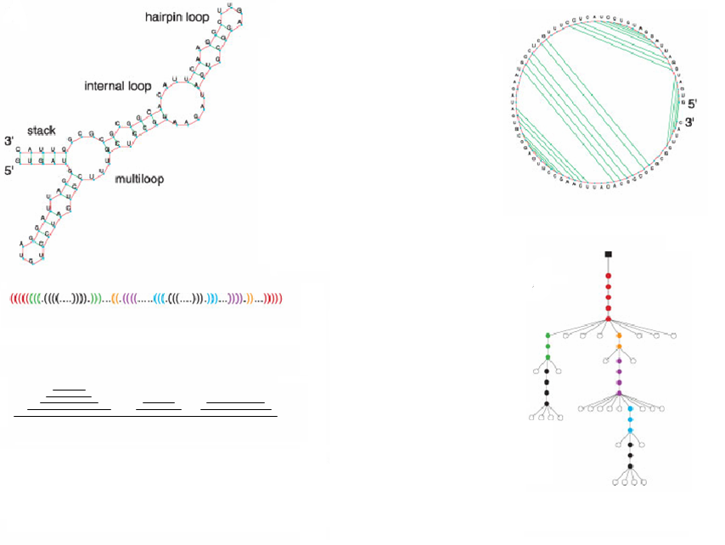
Circle with chords
Full Description
Ordered Tree
Balanced Nested Parenthesis
Ordered Tree
Mountains
RNA Structure Representations

Slide 61
第八章 RNA的最优折叠算法
8.3 Comparison of main RNA
folding algorithms

Slide 62
Main RNA Folding Algorithms
8.3 Comparison of main RNA folding
algorithms
Dot plot algorithm (Tinoco, 1971):
  Measured energy associated with regions of SS, a new energy-based dot plot algorithms were developed
  A dot is placed to represent a base pair
First DP algorithm: Nussinov algorithm
  Nussinov, Pieczenik, Griggs, Kleitman, 1978
  Problem: Find the RNA structure with the maximum (weighted) number of nested base-pairings
  Unfortunately, while this does maximize the base pairs, it does not create viable secondary structures

Slide 63
8.3 Comparison of main RNA folding
algorithms
Minimum free energy: Zuker algorithm
  Zuker and Stiegler, 1981; Zuker, 1989
  The correct structure is assumed to have the lowest equilibrium free energy
  Main ideas:
    Instead of base pairs, pairs of base pairs (more accurate)
    Separate score for bulges
    Separate score for different-size and composition loops
    Separate score for interactions between stem and
    beginning of loop
  Software: mfold

Slide 64
8.3 Comparison of main RNA folding
algorithms
Partition function algorithm (McCaskill, 1990)
  Pioneered a dynamic programming algorithm that can determine the partition function for secondary structure formation in O(N³) time and O(N²) storage where N is the number of nucleotides in the sequence
  This partition function calculation provides the base pairing probability for each possible base pair in the sequence, which can be displayed in a probability dot plot
  ViennaRNA package

Slide 65
8.3 Comparison of main RNA folding
algorithms
Comparative methods:
  Motivation
    Assume that RNA molecules of a similar function will have similar structures.
    Look for changes consistent with conservation of a helix, since structure can be conserved without conserving sequence
    Align sequences and look for regions where WC base pairings are conserved
  Look for covariance
  A helix is usually considered to exist if two or more covariations are found in it

Slide 66
8.3 Comparison of main RNA folding
algorithms
Problems of phylogenetic methods
  Only for RNAs that are fairly conserved (sequences differ 20-40% give best results) between species, phylogenetic comparisons can be used
  Not good for predicting non-canonical pairs (non-WC)

Slide 67
I. Single Sequence Methods:
Minimization of Free Energy
8.3 Comparison of main RNA folding
algorithms
mfold
  Zuker, 1981
  http://www.bioinfo.rpi.edu/applications/mfold/rna/form1.cgi
ViennaRNA package
  Partition function algorithm (McCaskill, 1990)
  RNAfold (part of ViennaRNA package)
    Hofacker, 1994
    http://rna.tbi.univie.ac.at/cgi-bin/RNAfold.cgi

Slide 68


8.3 Comparison of main RNA folding
algorithms
  Algorithm of Mfold and RNAfold
    Both implement the Zuker-Stiegler algorithm for
    computing minimal free energy (MFE) structures
    Assuming a "nearest neighbor model"
    Using empirical estimates of thermodynamic
    parameters for neighboring interactions and
    loop entropies to score structures
    in time and in memory

Slide 69
8.3 Comparison of main RNA folding
algorithms
RNAstructure: Mathews
Sfold:
  Ding & Lawrence, 2003
  http://www.bioinfo.rpi.edu/applications/sfold/srna.pl
  Algorithm of Sfold
    Energy-based single sequence folding algorithm
    For a given RNA, Sfold stochastically samples all possible structures in the Boltzmann ensemble of secondary structures using conditional probabilities
    The conditional probabilities are computed with the partition function
    Clustering techniques could then be used to obtain representative ' likely' structures

Slide 70
8.3 Comparison of main RNA folding
algorithms
Intrinsic limitations of single sequence methods
The thermodynamic model itself is only an simple estimate of the real physics of RNA folding, which ignore
  Sugar methylation, pseudouridine, dihydrouracil: which chemically modify many bases of structural RNAs
  Kinetics of folding
The thermodynamics may not be accurate, as some parameters are extrapolated
Parameter measuring conditions in vitro are different from in vivo conditions

Slide 71
8.3 Comparison of main RNA folding
algorithms
Given only a single sequence, no way to distinguish base-pairs and structure elements important for the consensus from those that are peculiar for the given sequence
The optimal MFE structure is biologically meaningless
  Some functional RNAs have bistable structures
  While in others, the structure is irrelevant, hence not conserved
comparative methods

Slide 72
II. Comparative Methods:
There are Three Schemes (Plans)
8.3 Comparison of main RNA folding
algorithms

Slide 73
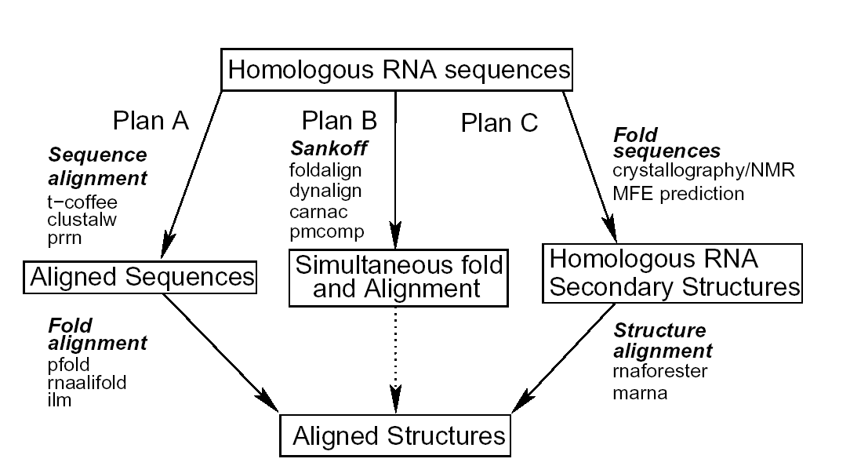
comparative methods

Slide 74
8.3 Comparison of main RNA folding
algorithms
Scheme A: Alignment Folding
- Main Idea:
sequnces -> align -> consensus structure
  Align sequences:
    Multiple sequence alignment tools: ClustalW, T-coffee, PRRN
  Fold to obtain a consensus structure:
  . Mutual information measure
  . Using Pfold, RNAalifold, ILM

Slide 75
8.3 Comparison of main RNA folding
algorithms
Evaluation:
  A highly successful approach
  A consensus secondary structure from the evolutionary and energetic information in an alignment
  Limit datasets with
    sequence homology high enough for the alignment step
    divergent enough for detection of structurally consistent mutations

Slide 76
8.3 Comparison of main RNA folding
algorithms
Software and Algorithm:
RNAalifold
  I. Hofacker, M. Fekete, P. Stadler, 2002
  http://www.tbi.univie.ac.at/~ivo/RNA/
  - Idea of RNAalifold
  An extension of the Zuker-Stiegler algorithm
  Compute an averaged energy matrix and a covariation score matrix, augmented with penalties for inconsistent sequences
  Recover a consensus structure with the optimal sum-of-average-energy-and-covariation-score

Slide 77


8.3 Comparison of main RNA folding
algorithms
  - Evaluation of RNAalifold
  in time and in memory
  Sensitivity: 57– 91%
  Selectivity: 57–100%
  Correlation: 0.57–0.95

Slide 78
8.3 Comparison of main RNA folding
algorithms
Pfold
  B. Knudsen and J. Hein, 1999
  http://www.daimi.au.dk/~compbio/rnafold/
  - Idea of Pfold
  SCFG & evolutionary history
  Input: an RNA alignment
  A prior probability distribution of RNA structures with SCFG designed
  A maximum-likelihood phylogeny tree to weight posterior probabilities

Slide 79
8.3 Comparison of main RNA folding
algorithms
    - Evaluation of Pfold
    The algorithm is generally accurate and efficient
    Sensitivity: 66– 100%
    Selectivity: 89–100%
    Correlation: 0.77–1
ILM
  J. Ruan, G. Stormo, W. Zhang, 2004
  http://www.cs.wustl.edu/~zhang/projects/rna/ilm/

Slide 80
8.3 Comparison of main RNA folding
algorithms
    - Idea of ILM (Iterated loop matching)
    Return pseudoknotted structures
    A combination of thermodynamic and mutual information content scores
    Generate and rank all possible stems ("small" internal loops and bulges inclusive)
    Select the stem with maximal score, update scores and remove stems conflicting the selection
    Select the next highest scoring stem
    Iterate until no stems remain

Slide 81
8.3 Comparison of main RNA folding
algorithms
    - Evaluation of ILM
    Still under development
    Generally ranks low in terms of selectivity
    Not as sensitive as either RNAalifold or Pfold on the high similarity data
    Improve on the medium similarity datasets
    Sensitivity: 44–100%
    Selectivity: 37–75%
    Correlation: 0.4–0.86

Slide 82
8.3 Comparison of main RNA folding
algorithms
Scheme B: Simultaneous Sequence
Alignment and Folding
Main Idea:
  Simultaneously align and infer a consensus structure with Sankoff, Foldalign, Dynalign, Carnac algorithm
  Requires extreme amounts of memory and time

Slide 83


8.3 Comparison of main RNA folding
algorithms
Algorithm and Software:
Sankoff Algorithm
  D. Sankoff, 1985
  - Idea of Sankoff
  Obtain a common base-pair list with maximal sum of base-pair weights with dynamic programming approach
  Combination of sequence alignment & Nussinov maximal-pairing methods
  Obtain both an alignment and consensus structure
  in time, and in space
  (n: sequence length, m: sequences)

Slide 84
8.3 Comparison of main RNA folding
algorithms
Restricted implementations of Sankoff algorithm:
  Foldalign
  Dynalign
  PMcomp
Innovation: Carnac
  Designed to detect conserved stems in unaligned sequences

Slide 85

8.3 Comparison of main RNA folding
algorithms
Foldalign
  J. Gorodkin, L. Heyer, G. Stormo, 1997
  http://www.bioinf.au.dk/FOLDALIGN/
  - Idea of Foldalign
  Combination of local alignment & maximum number of base-pairs
  Combination of "clustal" and "consensus“ heuristics to build multiple sequence alignments from pair-wise comparisons
  Restricting maximum motif size and forbidding bifurcating structures (multi-loops)
  Time
    (N: number of sequences, n: length of the longest sequence)

Slide 86
8.3 Comparison of main RNA folding
algorithms
  - Evaluation of Foldalign
    Specifically designed for the location of short
    regulatory motifs, which the motifs related
      at the level of (non-bifurcating) structure
      not at the level of sequence
    Not recommended for the prediction of global,
    multi-branched loop secondary structures
    Relatively poor sensitivity, selectivity, and
    correlation

Slide 87
8.3 Comparison of main RNA folding
algorithms
Dynalign
  D. Mathews, 2002
  http://rna.urmc.rochester.edu/
  - Idea of Dynalign
  Pairwise implementation of the Sankoff algorithm
    locate common low energy structure with full energy model
    align two structural RNAs:
      compute all pairwise foldings
      compute sequence with the reference structure

Slide 88

8.3 Comparison of main RNA folding
algorithms
  Complexity:
    restricting the difference in the indices i and j of aligned nucleotides to less than M
    limiting the size of internal loops
  - Evaluation of Dynalign
  better on tRNA, medium sequence homology data-set
Carnac Algorithm
  O. Perriquet, H. Touzet, M. Dauchet, 2003
  Software: caRNAc http://bioinfo.lifl.fr/carnac/

Slide 89
8.3 Comparison of main RNA folding
algorithms
  - Idea of Carnac
  Scan Sequences for stems
  Identified "high similarity" regions of sequences
  ("anchor points")
  Select conserved stems using anchor point and covariation information based on dynamic program
  - Evaluation of Carnac
  Low sensitivity
  Comparable correlation coefficient to RNAalifold and Pfold

Slide 90
8.3 Comparison of main RNA folding
algorithms
Scheme C: Alignment of Predicted
Structures
  Aligns RNA structures rather than sequences
  May exclude the sequence alignment step. Predict secondary structures for each sequence (or sub-group of sequences) separately, and directly make alignment of the structures
  Can be used in the rare situation where reliable structures are known

Slide 91
8.3 Comparison of main RNA folding
algorithms
RNA forester
  M. Hohsmann, T. Toler, R. Giegerich, S. Kurtz, 2003
  http://bibiserv.techfak.uni-bielefeld.de/rnaforester/
  - Idea of RNA forester
  Tree alignment model
  Computes pairwise alignments of two input structures
  Produce either global or local alignments

Slide 92
8.3 Comparison of main RNA folding
algorithms
MARNA
  S. Siebert and R. Backofen, 2003
  http://www.bio.inf.uni-jena.de/Software/MARNA/ index.html
  - Idea of MARNA
  Constructing edge weights between nucleotides in a pairwise fashion
  Weights are structure-enhanced-sequence-similarities
  Resultant alignments influenced by structure, not strictly structural alignments

Slide 93
第八章 RNA的最优折叠算法
8.4 Classical RNA folding
algorithms

Slide 94
第八章 RNA的最优折叠算法
8.4.1 Base-pair maximization
8.4.2 Minimum free energy
8.4.3 Inferring structure by
comparative sequence analysis
8.4.4 SCFG-based RNA folding

Slide 95
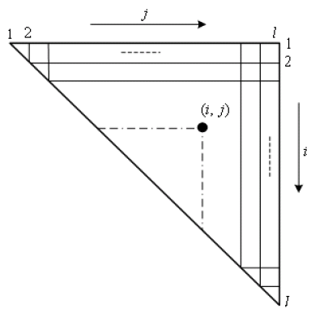
Nussinov Algorithm (Nussinov, et al., 1978)
8.4.1 Base-pair maximization

Slide 96
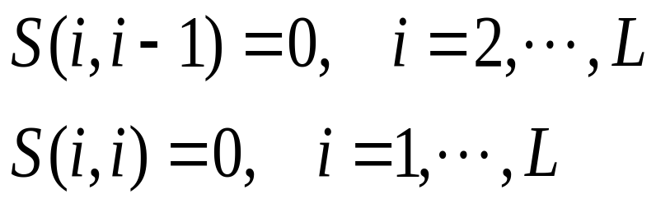
8.4.1 Base-pair maximization
Initialization

Slide 97
8.4.1 Base-pair maximization
A A
A ● U
G ● C
G ● C
G G G A A A U C C
G
G
G
A
A
A
U
C
C
0
0
0
0
0
0
1
2
3
0
0
0
0
0
1
2
3
0
0
0
0
1
2
2
GAAAUC
0
0
0
1
1
1
0
0
1
1
1
AAUC
0
1
1
1
0
0
0
AU
0
0
0

Slide 98
8.4.1 Base-pair maximization
There are only four possible ways that a secondary structure of nested base pairs can be constructed on a RNA strand from position i to j

Slide 99
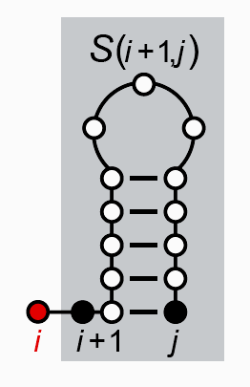
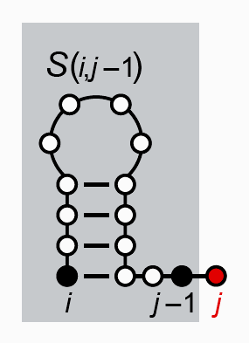
8.4.1 Base-pair maximization
Unmatched at i
Umatched at j
i is unpaired, added on
to a structure for [i+1…j]
j is unpaired, added on to
structure for [i…j-1]

Slide 100
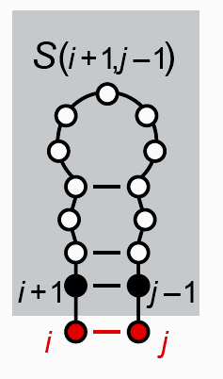
8.4.1 Base-pair maximization
Base pair at i and j
(i, j) paired, added on to a
structure for [i+1…j-1]

Slide 101
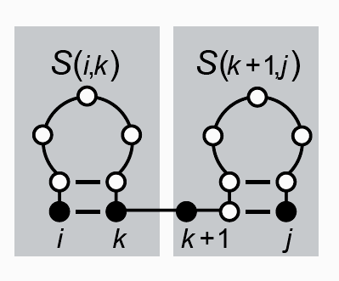
8.4.1 Base-pair maximization
Bifurcation
(i, j) paired, but not to each other; the structure for
[i…j] adds together structures for 2 sub
regions: [i…k] and [k+1…j]

Slide 102
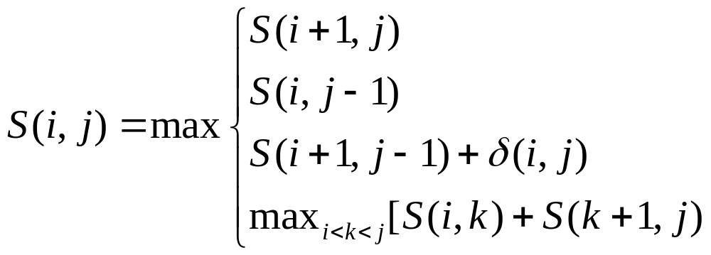
8.4.1 Base-pair maximization
Recursion
the folding of the subsequence of the RNA strand from index i to index j which results in the highest number of base pairs

Slide 103
8.4.1 Base-pair maximization
Problems of base pair maximization
  Not biologically reasonable
  Not necessarily lead to the most stable structure
    May create structure with interior loops or hairpins which are energetically unfavorable
  Not availble to pseudo-knots
    Pseudo-knots cause a breakdown in the Dynamic Programming Algorithm.

Slide 104
第八章 RNA的最优折叠算法
8.4.1 Base-pair maximization
8.4.2 Minimum free energy
8.4.3 Inferring structure by
comparative sequence analysis
8.4.4 SCFG-based RNA folding

Slide 105
Zuker Algorithm (1981; 1989)
8.4.2 Minimum free energy
Zuker and Stiegler, 1981; Zuker, 1989
Thermodynamic stability
Uses dynamic programming
Not produce pseudo-knots
Attempts to minimize free energy
mfold and ViennaRNA

Slide 106
8.4.2 Minimum free energy
RNA folding is determined by biophysical properties
Assumptions
  Most likely structure corresponds to energetically most stable structure
  Energy associated with any position is only influenced by local sequence and structure

Slide 107
Energy Calculations
8.4.2 Minimum free energy
Free energy calculated as sum of individual contributions of SSEs
Negative energies (stacking energy) to these between base pair regions: energies of stems
  Energy is influenced by the previous base pair (not by the base pairs further down)
  These energies are estimated experimentally from small synthetic RNAs

Slide 108
8.4.2 Minimum free energy
Positive energies for destabilizing regions such as
  Internal loops
  Bulge loops
  Hairpin loops
  Multi-branched loops

Slide 109
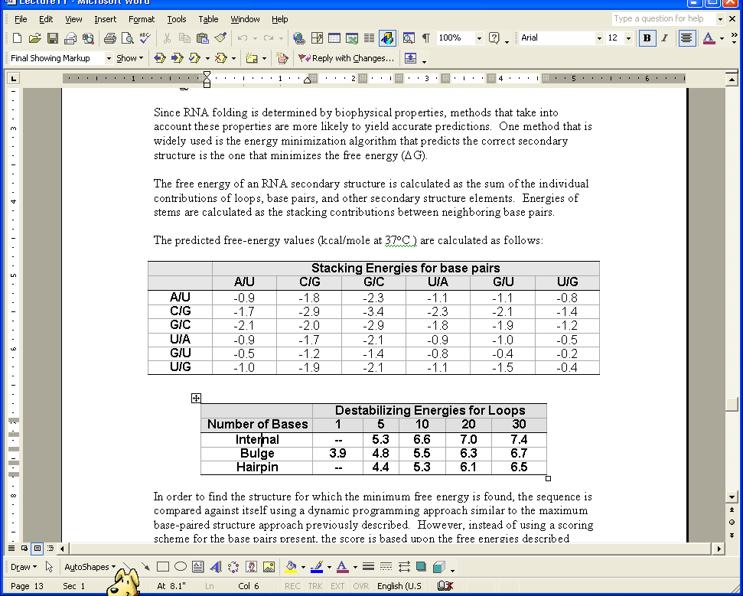

Slide 110
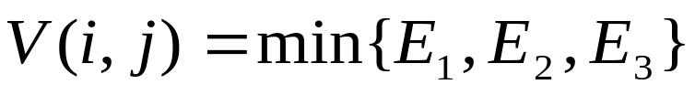
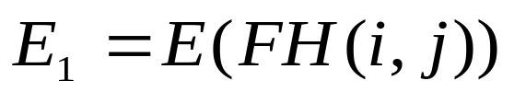
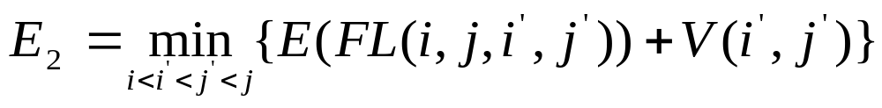
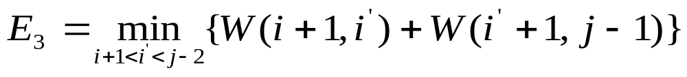
8.4.2 Minimum free energy

Slide 111
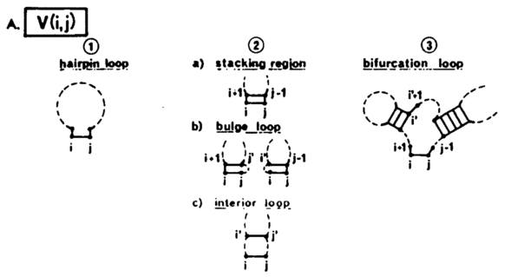

Slide 112
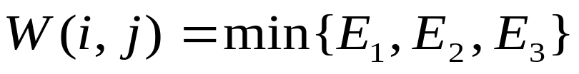

8.4.2 Minimum free energy

Slide 113
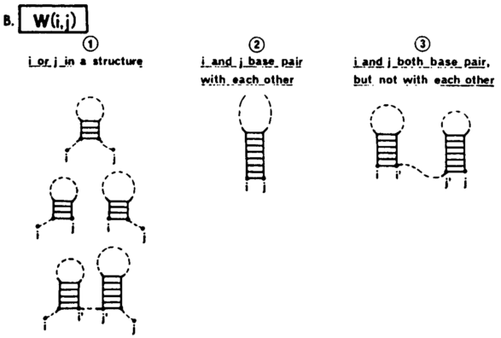

Slide 114
8.4.2 Minimum free energy
W(1, N)
j
1
N
1
Si,Sj
i
N
O(N³) in time O(N²) in memory (N: the sequence length)

Slide 115
8.4.2 Minimum free energy
Zuker and Stiegler Algorithm
  Predict the native structure by finding the folding with the minimum energy
Modified Zuker Algorithm
  Predict optimal and suboptimal solutions
McCaskill Algorithm
  The frequency of intra-chain contact occurrences in an ensemble of all possible structures
  Predict optimal and suboptimal solutions
  ViennaRNA package

Slide 116
第八章 RNA的最优折叠算法
8.4.1 Base-pair maximization
8.4.2 Minimum free energy
8.4.3 Inferring structure by
comparative sequence analysis
8.4.4 SCFG-based RNA folding

Slide 117
8.4.3 Inferring structure by comparative
sequence analysis
Multiple sequence alignment
  Conditions of the aligned sequences
    Similar enough to be aligned
    Dissimilar enough for covarying substitutions
    to be detected

Slide 118
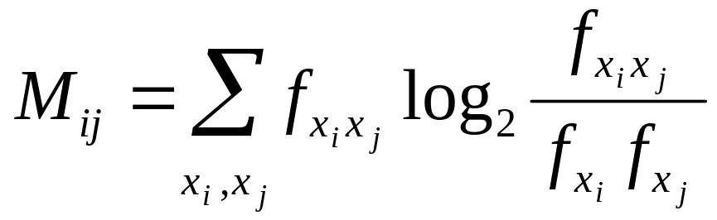
8.4.3 Inferring structure by comparative
sequence analysis
Mutual Information
f_{xi} : Frequency of a base x in column i
f_{xiyj} : Joint (pair-wise) frequency of base pair (x, y)
between columns i and j

Slide 119
8.4.3 Inferring structure by comparative
sequence analysis
Mutual information measures how much the joint frequency distribution derivates from the distribution that is expected if the two column vary independently
Mutual information for RNA (four letters) varies from 0 to 2 bits (比特)
Mutual information is maximal if i and j are perfect correlated and i and j individually appear completely random
If i and j are uncorrelated, mutual information is 0
If either i or j is highly conserved positions, little or no mutual information

Slide 120
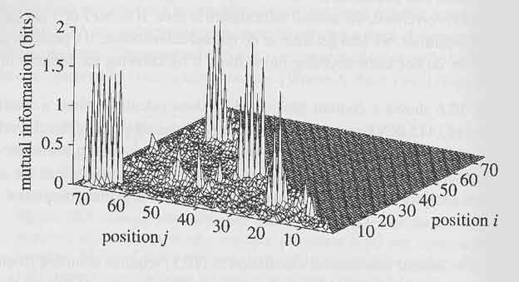
Mutual information plot of tRNA alignment

Slide 121
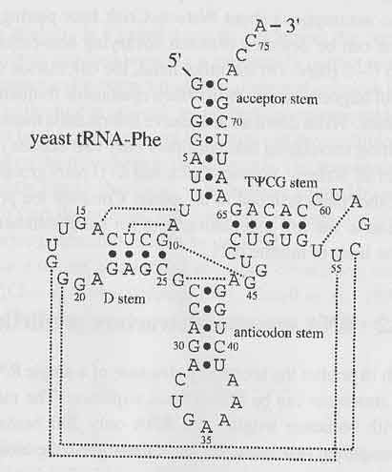

Slide 122
8.4.3 Inferring structure by comparative
sequence analysis
Use mutual information M_{i,j} as pairing “energy” and treat the multiple alignment as a generic sequence

Slide 123
第八章 RNA的最优折叠算法
本讲结束

