Slide 1


Computational Biology
计算生物学
Zhidong DENG
Department of Computer Science
Tsinghua University
邓志东
清华大学计算机系
清华大学 • 2019秋季

Slide 2
第八章 RNA的最优折叠算法

Slide 3
第八章 RNA的最优折叠算法
本小节(SCFG)建议阅读如下参考文献:
[1] R. Durbin, S. Eddy, A. Krogh, and G. Mitchison. 生物序列分析－蛋白质与核酸的概率模型，剑桥大学出版社，清华大学出版社，2002.
[2] Y. Sakakibara, M. Brown, R. Hughey, I. S. Mian, K. Sjölander, R. C. Underwood, D. Haussler. Stochastic Context-Free Grammars for tRNA modeling. Nucleic Acids Research (NAR), vol.22, 1994, pp.5112-5120.
[3] Y. Sakakibara, M. Brown, R. Underwood, I. S. Mian, and D. Haussler, Stochastic Context-Free Grammars for Modeling RNA, Proceedings of the 27th Hawaii International Conference on System Sciences, Honolulu, USA, 1994, pp.284-283.

Slide 4
第八章 RNA的最优折叠算法
[4] S. R. Eddy and R. Durbin. RNA sequence analysis using covariance models, Nucleic Acids Research (NAR), vol.22, 1994, pp.2079-2088.
[5] B. Knudsen and J. Hein. RNA secondary structure prediction using stochastic context-free grammars and evolutionary history, Bioinformatics, vol.15, no.6, 1999, pp.446-454.
[6] R. D. Dowell, S. R. Eddy. Evaluation of several lightweight stochastic context-free grammars for RNA secondary structure prediction, BMC Bioinformatics, vol.5, 2004, pp.71-71.

Slide 5
第八章 RNA的最优折叠算法
8.1 RNA world
8.2 What is RNA secondary structure
8.3 Comparison of main RNA folding algorithms
8.4 Classical RNA folding algorithms
8.4.1 Base-pair maximization
8.4.2 Minimization of free energy
8.4.3 Inferring structure by comparative
sequence analysis
8.4.4 SCFG-based RNA folding

Slide 6
第八章 RNA的最优折叠算法
8.4.4 SCFG-based RNA folding

Slide 7
8.4.4 SCFG-based RNA folding
Mainly include:
  1. Transformational Grammars
  2. SCFG for RNA Folding
  3. SCFG-based RNA Similarity Search
  (CMs)

Slide 8
8.4.4 SCFG-based RNA folding
  1. Transformational Grammars

Slide 9
8.4.4 SCFG-based RNA folding
General assumption for biological sequences:
  One dimensional strings of independent, uncorrelated symbols
  Computationally convenient
  Not structurally realistic
Three dimension foldings of proteins and nucleic acid sequences involve:
  Extensive physical interactions between bases /residues that are not adjacent in primary sequence
  Long range interaction

Slide 10
8.4.4 SCFG-based RNA folding
RNA secondary structure = base pairing
  Base-pairs in RNA (long range interaction)
  ▪ Methods for proteins don’t work well for RNA
  ▪ Requires superior method beyond regular
  languages and HMM

Slide 11
8.4.4 SCFG-based RNA folding
Theory of modeling strings of symbols
  Computational linguistics:
    Chomsky Hierarchy of
    Transformational Grammars
      Four types of model with increasing complexity and descriptive power
  Chomsky, 1956; 1959

Slide 12
8.4.4 SCFG-based RNA folding
Transformational Grammars
  Attempt to understand the structure of natural languages
Language of Biology vs. Natural Language

Slide 13
8.4.4 SCFG-based RNA folding
Language of Biology | Natural language
Nucleotides / Bases | Alphabet
Amino Acids | Words
Exons | Phrases
Proteins | Word Senses
Protein Circuits | Sentences
Folding | Syntax
Regulation of Gene Expression | Language Generation
Biological Functions | Semantics

Slide 14
8.4.4 SCFG-based RNA folding
IDEA: take a set of outputs (sentence, RNA structure) and determine if it can be produced using a set of rules
Using transformational grammars

Slide 15
8.4.4 SCFG-based RNA folding
Transformational Grammars
= ( {symbols}, {production rules} )
where
{symbols} = {nonterminal} U {terminal}

Slide 16
8.4.4 SCFG-based RNA folding
Example:
  Terminals:
      A = {x, y}
  Nonterminals:
      V = {S}
  Production Rules:
      R = {S→xSx, S→ySy, S→x, S→y, S→ε}
  Derivation (parse tree):
      S → xSx → xySyx → xyyx

Slide 17
8.4.4 SCFG-based RNA folding
The Chomsky Hierarchy
  Chomsky, 1959
  A hierarchy of grammars defined by restrictions on productions

Slide 18
The Chomsky Hierarchy
8.4.4 SCFG-based RNA folding
unrestricted
context-sensitive
context-free
regular

Slide 19
8.4.4 SCFG-based RNA folding
Notation:
  W: nonterminal
  a: terminal
  α and γ : strings of nonterminals and/or terminals including the null string
  β: strings of nonterminals and/or terminals excluding the null string

Slide 20
8.4.4 SCFG-based RNA folding
Regular grammars:
  W → aW or W → Wa or W → a
Context-free grammars:
  W → β
Context-sensitive grammars:
  α ₁W α ₂ → α ₁ β α ₂
Unrestricted (phrase structure / recursively enumerable, REG) grammars:
  α ₁W α ₂ → γ

Slide 21
8.4.4 SCFG-based RNA folding
Each grammar corresponds an abstract computational device (automaton)
  Grammars are described as generative models
  Automatons are described as parser that accept or reject a given sequence

Slide 22
8.4.4 SCFG-based RNA folding
Advantage of Automaton
  Intuitively more easy to describe and understand than their equivalent grammars
  Give a more concrete idea of how we might recognize a sequence using a formal grammar

Slide 23
8.4.4 SCFG-based RNA folding
Grammar | Parsing Automaton
Regular grammars | Finite state automaton
Context-free grammars | Push-down automaton
Context-sensitive grammars | Linear bounded automaton
Unrestricted grammars | Turing machine

Slide 24
8.4.4 SCFG-based RNA folding
Regular grammars
  Generate sequence from left to right
  Do not efficiently describe long-range correlations between the terminal symbols
  linear models
  can capture a fair amount of complexity, e.g., deal with insertions and deletions in a profile

Slide 25
8.4.4 SCFG-based RNA folding
Regular language:
  a b a a a b
Regular grammars can describe regular language, but can not efficiently describe:
  Palindrome language
  Copy language

Slide 26
8.4.4 SCFG-based RNA folding
Palindrome language:
  a a b b a a
  This language contains all the strings of the form of aa, bb, abba, baab, abaaba, etc. that read the same forwards as backwards
  The interactions in palindrome language are nested
  Can be described by context-free grammars

Slide 27
8.4.4 SCFG-based RNA folding
Copy language:
  a a b a a b
  This language contains all the strings of the form of aa, abab, aabaab that consist of two identical halves
  In copy language the crossing interactions
  can occur
  Can be described by context-sensitive grammars

Slide 28
8.4.4 SCFG-based RNA folding
Context-free grammar
  Context-free grammars generate sequence outside-in, rather than left to right
  Efficiently model nested, long-distance base-pairing correlations in strings of symbols (palindrome language)
  Not available for other tertiary structural interactions
    non-pairwise interactions (base triples)
    pseudo-knots

Slide 29
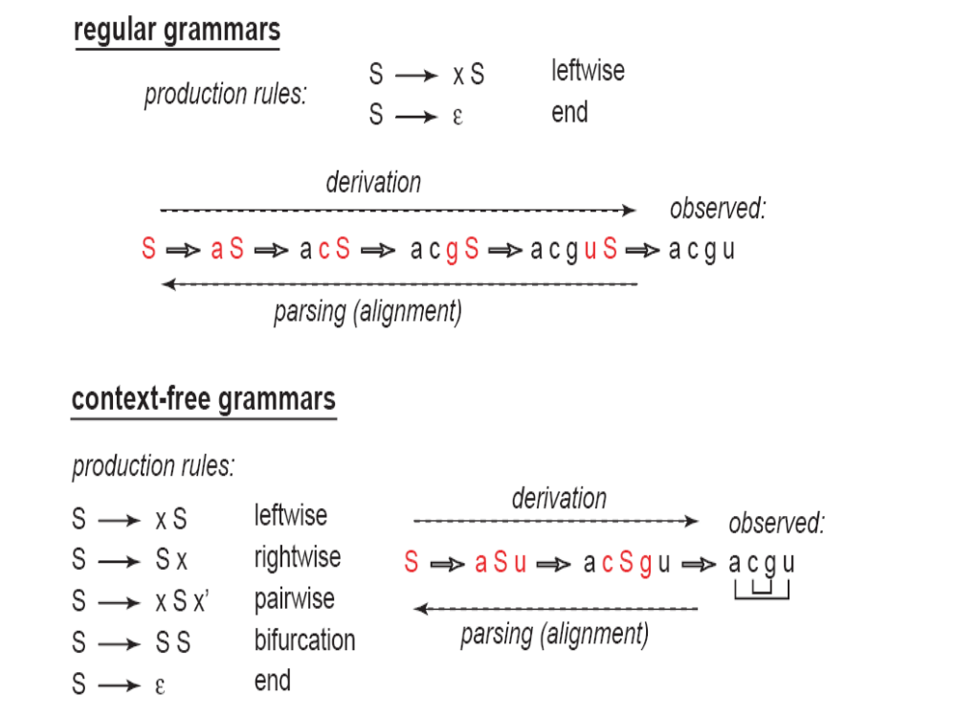

Slide 30
8.4.4 SCFG-based RNA folding
Nonstochastic CFGs are used in pattern search applications
  Represent an RNA structural consensus as a CFG
  Ask if a particular sequence matches or doesn’t match that query
  Not useful for structure prediction.

Slide 31
8.4.4 SCFG-based RNA folding
Stochastic grammars
  Any grammar in the Chomsky hierarchy can be used in a stochastic form as a basis for a probabilistic modelling system for sequence
  Each production has an associated probability
  A stochastic grammar model ө generates different strings x with probabilities P(x| ө)

Slide 32
8.4.4 SCFG-based RNA folding
  In a stochastic regular grammar or stochastic context-free grammar, the sum of the probabilities of all the possible productions from any given non-terminal is 1

Slide 33
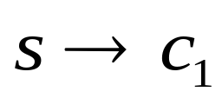
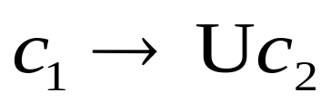
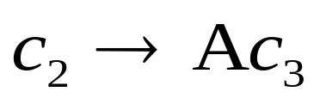
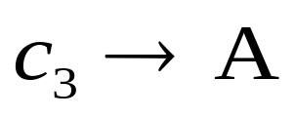
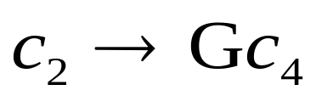
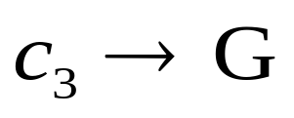
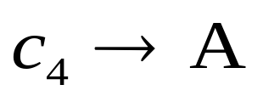
8.4.4 SCFG-based RNA folding
Example-1:
1.0
1.0
0.7
0.2
0.3
0.8
1.0

Slide 34
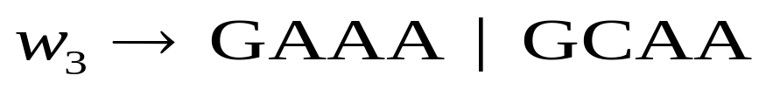
8.4.4 SCFG-based RNA folding
Example-2:
0.3
0.2
0.2
0.3
0.1
0.4
0.4
0.1
0.25
0.25
0.25
0.25
0.8
0.2

Slide 35
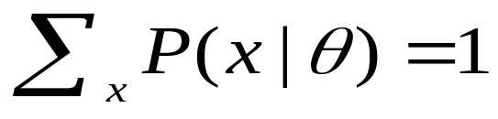
8.4.4 SCFG-based RNA folding
  The notion “probability of a sentence” is an entirely useless one, under any known interpretation of this term
  The resulting stochastic grammar defines a probability distribution over sequences x, i.e.

Slide 36
8.4.4 SCFG-based RNA folding
Probabilistic models of biological sequences:
  Many primary sequence analysis methods including
    similarity search
    motif identification
    gene finding applications
    …
  Hidden Markov Model (HMM) is equivalent to Stochastic Regular Grammar!

Slide 37
8.4.4 SCFG-based RNA folding
Advantage of HMM
  HMMs make it straightforward to make more complex yet consistent models that combine multiple information sources
  A key point is that any HMM, no matter how complicated, can be optimally aligned to a target sequence the Viterbi algorithm derives

Slide 38
8.4.4 SCFG-based RNA folding
  Adopting an explicit HMM framework has the advantage of splitting a sequence analysis problem into three pieces:
    (1) specifying the structure of the HMM
      where one decides what biological information to capture
    (2) calculating the probability parameters
    (scores) of an HMM
      which is standard probability theory
    (3) how to aligning HMMs to target sequences
      which is done with the standard Viterbi algorithm

Slide 39
8.4.4 SCFG-based RNA folding
But HMM
  Still just a primary sequence analysis method
  Scoring linear sequence one (or a few) residues at a time
  Cannot efficiently capture the long-distance pairwise correlations in RNA secondary structure
  Treat 2 positions base-paired as having independent distributions

Slide 40
8.4.4 SCFG-based RNA folding
In computational linguistics:
  HMMs = stochastic regular grammars
  The lowest level of Chomsky’s hierarchy

Slide 41
8.4.4 SCFG-based RNA folding
  2. SCFG for RNA Folding

Slide 42
8.4.4 SCFG-based RNA folding
  Stochastic Context-Free Grammars (SCFG)
    Probabilistic form of Context-Free
    Grammars (CFG)
    The next level of Chomsky’s hierarchy
    Increasing complexity and description
    power

Slide 43
8.4.4 SCFG-based RNA folding
  Stochastic Context-Free Grammars (SCFG)
  A SCFG model G can be defined by G = (V, T, P, S) where:
  • V is a finite set of nonterminal symbols (“states”),
  • T is a finite set of terminal symbols (for RNA: {a, u, g, c}),
  • P is a finite set of production rules, and
  • S is the initial (start) nonterminal (S∈V).

Slide 44
8.4.4 SCFG-based RNA folding
Application of SCFG
SCFGs are a general toolkit for probabilistic modeling of RNA sequence and secondary structure
  RNA structure prediction
  RNA gene finding
  Structure search
    Search for a specific family RNAs (structures)
    Profile the family RNAs
  Sequence-structure alignment

Slide 45
8.4.4 SCFG-based RNA folding
With different kinds of SCFGs
  Strong RNA similarity search methods (Eddy and Durbin, 1994; Eddy, 2002; Klein and Eddy, 2003)
  Reasonable ncRNA genefinding methods (Rivas and Eddy, 2001; Rivas, et al., 2001)
  Promising prototypes of RNA structure prediction methods (Durbin, et al., 1998; Dowell and Eddy, 2004, 2006)

Slide 46
8.4.4 SCFG-based RNA folding
Stochastic context-free grammars for RNA folding
  Sakakibara, et al., 1993, 1994
  Begin with an initial meta-grammar
  Train probabilities of production rules using training sequences
  Use prior knowledge
    To construct initial grammar
    Dirichlet prior probability densities to reduce number of parameters

Slide 47
8.4.4 SCFG-based RNA folding
Covariance models (CMs)
  Eddy and Durbin, 1994; Eddy, 2002
  Equivalent to SCFG
  Train from (randomly) aligned sequences to determine structure and probabilities of grammar
  SCFG-based RNA similarity search programs

Slide 48
8.4.4 SCFG-based RNA folding
Context-free grammars for RNA secondary structure
  RNA Sequence: AUCAGGGAAGAUCUCUUG
  How to modeling RNA folding?
  Key:
    Production rules: P
    Derivation (parse tree)

Slide 49
8.4.4 SCFG-based RNA folding
Grammar Production Rules:
For instance,
  S → a S b base-paired
  S → a S unpaired base
  S → a unpaired base
  S → S S multi-branched

Slide 50
8.4.4 SCFG-based RNA folding
  S → S
    Skip production
    For gaps in multiple sequence alignment
    Equivalent to delete state in HMM

Slide 51
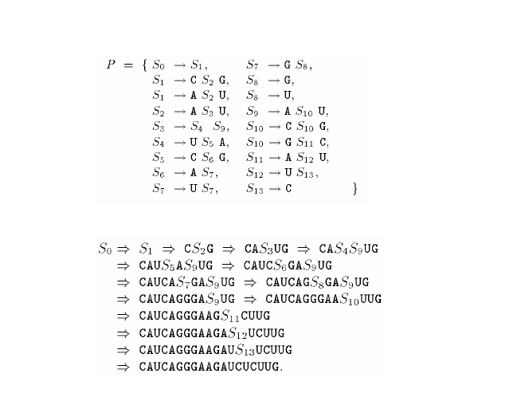
Production Rules P:
Derivation:

Slide 52
8.4.4 SCFG-based RNA folding
A stochastic context-free grammar can be aligned to a sequence using a parse tree
  Root of the tree is the non-terminal start symbol, S₀
  Leaves are terminal symbols
  Internal nodes are the nonterminals
  Leaves can be parsed from left to right to view the results of production
Each parse tree corresponds to a secondary structure

Slide 53
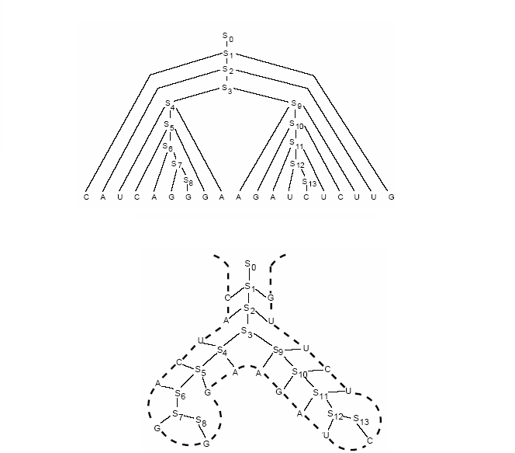
Parse Tree:
Secondary Structure:

Slide 54
8.4.4 SCFG-based RNA folding
Three Key Questions of SCFG
  How likely is a given sequence to SCFG?
    the Inside algorithm
  What is the most probable parse tree for a given sequence?
    the Cocke-Younger-Kasami (CYK) algorithm
  How can we learn the SCFG parameters given a grammar structure and a set of sequences?
    the Inside-Outside algorithm

Slide 55
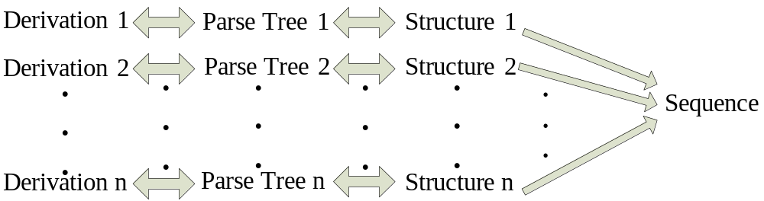
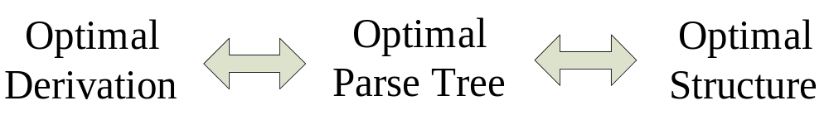
8.4.4 SCFG-based RNA folding
How to Obtain the Optimal Structure?
Stochastic Context-Free Grammar (SCFG) !
The Derivation with Maximal Likelihood

Slide 56
8.4.4 SCFG-based RNA folding
SCFG:
  Nonterminals
  Terminals
  Production Rules
  Parameters
Training：
  Inside-outside EM algorithm
Prediction：
  The CYK algorithm
Evaluation (Likelihood)：
  Inside algorithm

Slide 57
8.4.4 SCFG-based RNA folding
The inside-outside algorithm for SCFG is the natural counterpart of the forward-backward algorithm for HMM

Slide 58
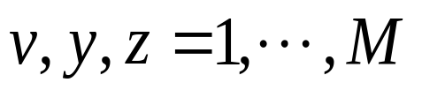
8.4.4 SCFG-based RNA folding
For Example
  M nonterminals W₁, W₂, ···, W_{M} start from W₁
  Terminals: a
  Production rules: W_{v} → W_{y}W_{z} and W_{v} → a
  Probability parameters for the productions are: t_{v}(y, z) and e_{v}(a), respectively, where

Slide 59


8.4.4 SCFG-based RNA folding
The Inside Algorithm: Determining the likelihood of a sequence x
  Algorithm calculates the probability
  of a parse subtree rooted at nonterminal W_{v} for subsequence x_{i}, ···, x_{j} for all i, j and v
  The calculations requires an three-dimensional dynamic programming matrix

Slide 60
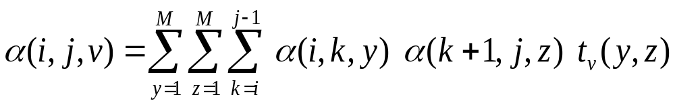
8.4.4 SCFG-based RNA folding
v
y
z
1
i
k
k+1
j
L
M is the number of nonterminals in the grammar

Slide 61

8.4.4 SCFG-based RNA folding
j
1
L
1
i
Inside Algorithm
L

Slide 62
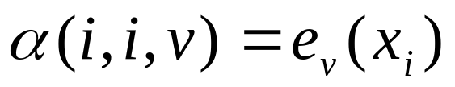
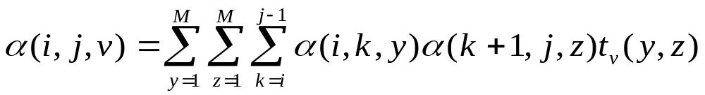
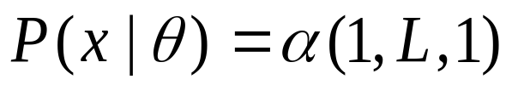
8.4.4 SCFG-based RNA folding
Inside Algorithm
  Initialization: for i = 1 to L, v = 1 to M:
  Iteration: for i = 1 to L-1, j = i+1 to L, v = 1 to M:
  Termination:

Slide 63

8.4.4 SCFG-based RNA folding
The Outside Algorithm
  Algorithm calculates the probability
  of a complete parse tree rooted at the start nonterminal for the sequence x₁,…,x_{L} excluding all parse subtrees for sequence x_{i},…,x_{j} rooted at nonterminal W_{v} for all i, j and v

Slide 64



8.4.4 SCFG-based RNA folding
The Outside Algorithm
  The calculations requires an three-dimensional dynamic programming matrix (like the inside algorithm)
  Calculating requires the results
  from a previous inside calculation

Slide 65
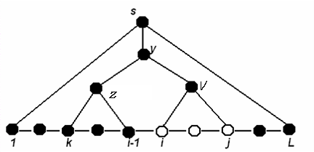
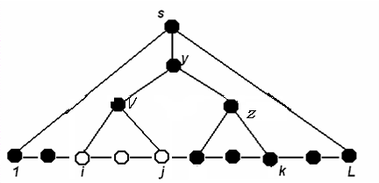
8.4.4 SCFG-based RNA folding
Iteration step of the outside algorithm

Slide 66

8.4.4 SCFG-based RNA folding
j
1
L
1
i
The Outside Algorithm
L

Slide 67
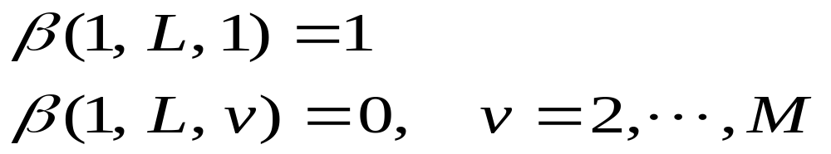
8.4.4 SCFG-based RNA folding
The Outside Algorithm
  Initialization:

Slide 68
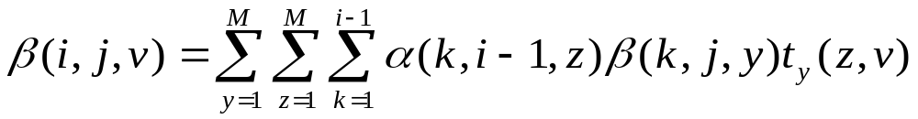
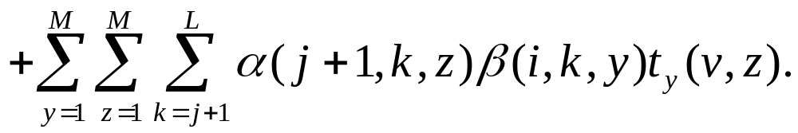
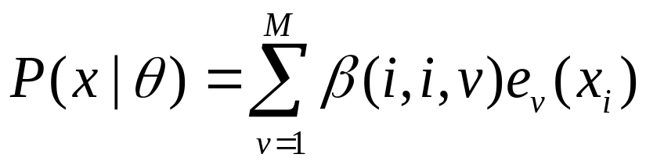
8.4.4 SCFG-based RNA folding
  Iteration: for i = 1 to L, j =L to i, v =1 to M:
  Termination:

Slide 69
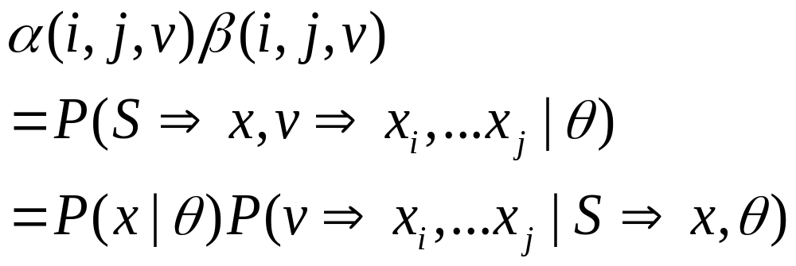
8.4.4 SCFG-based RNA folding
Inside-outside algorithm: Parameter Re-estimation by Expectation Maximization (EM)

Slide 70
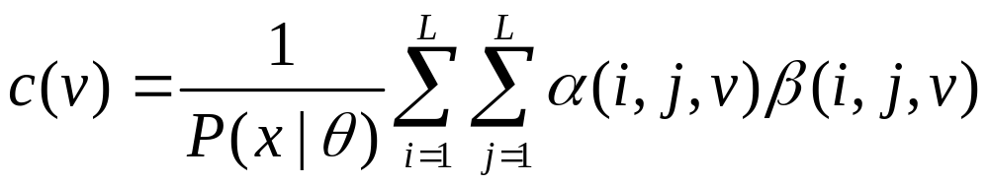
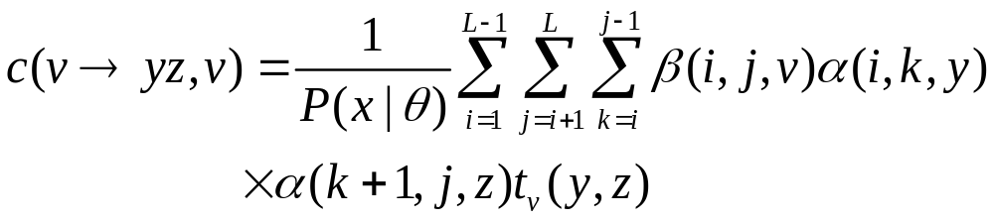
8.4.4 SCFG-based RNA folding

Slide 71
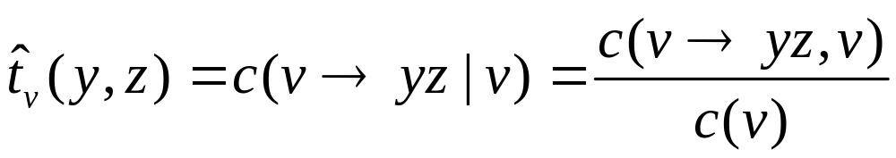
8.4.4 SCFG-based RNA folding
Re-estimation equation for probabilities of the production rules W_{v} -> W_{y}W_{z} is

Slide 72
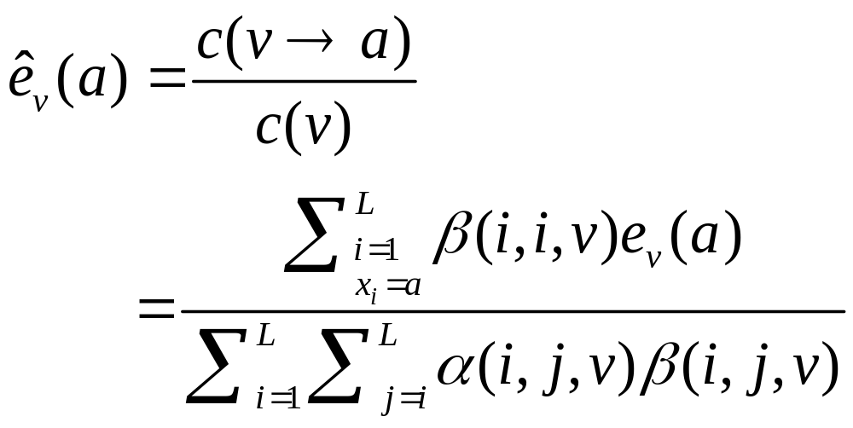
8.4.4 SCFG-based RNA folding
Production rule: W_{v} -> a:

Slide 73
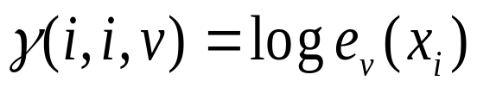

8.4.4 SCFG-based RNA folding
The CYK Algorithm: Find an optimal parse tree
  Initialization: for i =1 to L, v =1 to M:
  Iteration: for i =1 to L-1, j = i+1 to L, v =1 to M
  Termination:

Slide 74

8.4.4 SCFG-based RNA folding
j
1
L
1
i
The CYK Algorithm
L

Slide 75

8.4.4 SCFG-based RNA folding
Goal | HMM Algorithm | SCFG Algorithm
Optimal alignment / secondary structure | Viterbi | CYK
Likelihood | Forward | Inside
EM parameter re-estimation | Forward-backward | Inside-outside
Memory complexity | O(LM) | O(L²M)
Time complexity | O(LM²) | O(L³M³)

Slide 76
8.4.4 SCFG-based RNA folding
SCFG methods can also capture more sophisticated folding features:
  Base-paired stacking and explicit loop lengths are the most important two features!
    Base-paired Stacking
    The 1st order Markov chain dependency
    Can be modeled in a grammar by capturing a
    limited amount of context dependency (called
    lexicalization in natural language processing)

Slide 77
8.4.4 SCFG-based RNA folding
    Loop Lengths
    The simplest (and most common) model of loop lengths in a grammar uses recursive rules like S → aS, implying a geometric length distribution
    Explicit loop length distributions can be modeled by enumerating a set of production rules, one for each possible length
  Parameterizing stacked terminal mismatches for hairpin and internal loops, dangling bases, and stable tetraloops and coaxial stacking can also be dealt with SCFG

Slide 78
8.4.4 SCFG-based RNA folding
There is usually more than one possible parse tree for a sequence
Interested in looking at all possible base paired structures for the sequence, we can represent them as a set of possible parse trees
Finding the optimal (highest probability) one
  Using the CYK algorithm, we can find the mathematically optimal parse tree

Slide 79
8.4.4 SCFG-based RNA folding
The optimal parse tree gives us the optimal secondary structure if and only if there is a one-to-one correspondence between parse trees and secondary structures
Unfortunately, a given secondary structure does not necessarily have a unique parse tree
Sequence ↔ Parse Tree ↔ Secondary Structure

Slide 80
8.4.4 SCFG-based RNA folding
Grammar structurally ambiguous
  A grammar is structurally ambiguous if there exists a secondary structure that can be generated by more than one possible parse tree
Ideally, the design of SCFG should be formally unambiguous with respect to both secondary structure and alignment
Structural ambiguity appears to be a practical concern

Slide 81
8.4.4 SCFG-based RNA folding
The consequence of using an ambiguous grammar:
  Cannot equate the probability of a parse tree with the probability of the SS
  The probability of a single alignment or SS may be spread across many parse trees that describe the same set of aligned residues or base pairs
  Therefore, an optimal parse tree could represent a less optimal alignment or SS that merely has fewer alternative parse tree representations

Slide 82
8.4.4 SCFG-based RNA folding
For structurally ambiguous
  Either have to use grammars that are structurally unambiguous
  Or have to assume that it is a valid approximation to consider an optimal parse tree gives us the optimal secondary structure
  The CYK algorithm often does not give the optimal secondary structure if one is using a structurally ambiguous grammar

Slide 83
8.4.4 SCFG-based RNA folding
For nonprobabilistic scoring systems that simply seek to maximize an arbitrary score, grammar ambiguity is usually not an issue

Slide 84
8.4.4 SCFG-based RNA folding
COMPARISON OF SEVERAL SCFG MODELS
Two Ambiguous Grammars:
  G1: S → aSa’ | aS | Sa | SS | ε
  G2: S → aP^{aa’}a’ | aS | Sa | SS | ε
  P^{bb’} → aP^{aa’}a’ | S

Slide 85
8.4.4 SCFG-based RNA folding
  P^{bb’} → aP^{aa’}a’
    The probability of emitting a new pair (a, a’) is dependent on the previous base pair (b, b’)
    The notation P^{aa’} indicates that the P nonterminal will “remember” that it just generated a (a, a’) pair
    In the productions, this means that we have 16 P^{aa’} nonterminals
    16x16 table for base stacking parameters (each P^{aa’} generate 16 possible pairs)

Slide 86
8.4.4 SCFG-based RNA folding
In particular, Nussinov algorithm can be converted to a G1: S → aS | Sa | aSa’ |
SS | ε.
It follows
  S → aS | cS | gS | uS (i unpaired)
  S → Sa | Sc | Sg | Su (j unpaired)
  S → aSu | cSg | uSa | gSc (i, j pair)
  S → SS (bifurcation)
  a structurally ambiguous grammar

Slide 87
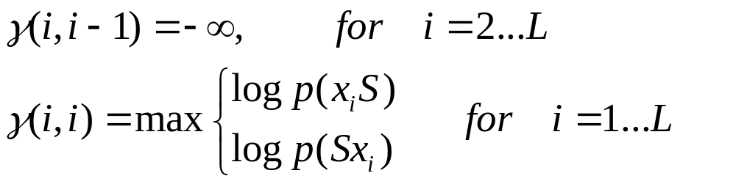
8.4.4 SCFG-based RNA folding
CYK algorithms for Nussinov-style RNA SCFG model (G1):
  Initialization

Slide 88
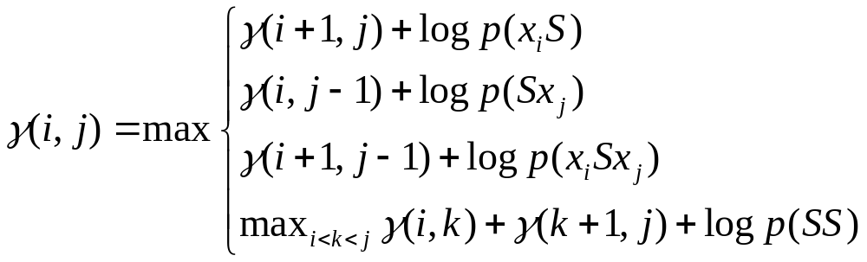
8.4.4 SCFG-based RNA folding
  Recursion: for i = 1,…,L-1, j = i+1,…,L

Slide 89
8.4.4 SCFG-based RNA folding
Four Unambiguous Grammars:
G3, G4, G5, and G6
    4 probabilities for unpaired bases
    16 probabilities for base pairs
  Each grammar imposes slightly different restrictions on the “language” of possible secondary structures

Slide 90
8.4.4 SCFG-based RNA folding
  G3:
    S → aSa’ | aL | Ra | LS
    L → aSa’ | aL
    R → Ra | ε
  Developed by Robin D. Dowell
  G3 imposes a minimum hairpin loop length of one nucleotide
  S can not emit an empty string ε

Slide 91
8.4.4 SCFG-based RNA folding
  G4:
    S → aS | T | ε
    T → Ta | aSa’ | TaSa’
  Developed by Mitchison
  S can emit an empty string ε
  Do not impose minimum hairpin loop lengths

Slide 92
8.4.4 SCFG-based RNA folding
  G5:
    S → aS | aSa’S | ε
  Developed by Ivo Hofacker
  S can emit an empty string ε
  Do not impose minimum hairpin loop lengths

Slide 93
8.4.4 SCFG-based RNA folding
  G6 (BJK Grammar):
    S → LS | L
    L → aFa’ | a
    F → aFa’ | LS
  The Knudsen/Hein grammar utilized in the Pfold package: simple and effective
  Imposes a minimum hairpin loop length of two nucleotide
  S can not emit an empty string ε

Slide 94
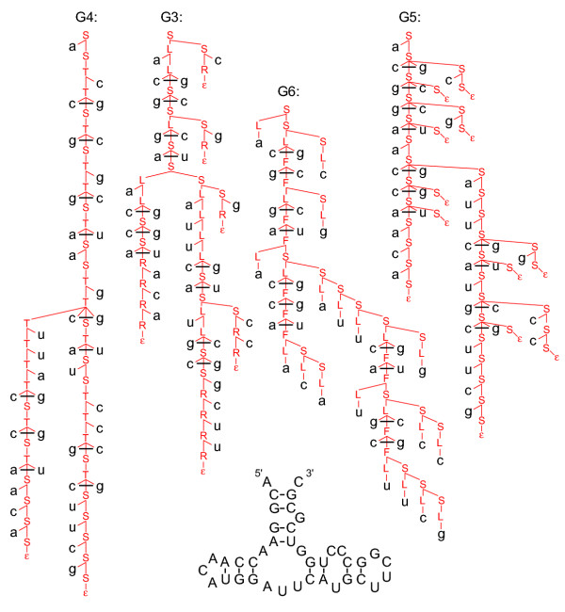

Slide 95
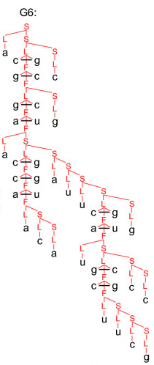
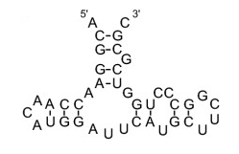
8.4.4 SCFG-based RNA folding
G6:
L -> aFa’
L -> a
S -> LS
S -> L
F -> LS
F -> aFa’

Slide 96
8.4.4 SCFG-based RNA folding
Three Unambiguous Stacking Grammars:
  G6^{S}:
  Extend G6 grammar to include stacking parameters, by changing the F nonterminal parameterization to the following 1st order Markov chain:
  F^{bb’} → aF^{aa’}a’ | LS

Slide 97
8.4.4 SCFG-based RNA folding
  G7 & G8:
  Restructured two of the simple backbones (G3 and G4) to include base pair stacking parameters
  G7:
  S → aP^{aa’}a’ | aL | Ra | LS
  L → aP^{aa’}a’ | aL
  R → Ra | ε
  P^{bb’} → aP^{aa’}a’ | aNa’
  N → aL | Ra | LS

Slide 98
8.4.4 SCFG-based RNA folding
  G8:
  S → aS | T | ε
  T→ Ta | aP^{aa’}a’ | TaP^{aa’}a’
  P^{bb’} → aP^{aa’}a’ | aNa’
  N→ aS | Ta | TaP^{aa’}a’

Slide 99
8.4.4 SCFG-based RNA folding
SCFG algorithms vs. Zuker & Nussinov algorithms
  SCFG algorithms are essentially the same as the existing other RNA folding algorithms
  Scoring system:
    The scoring system of SCFG is probabilistic, based on factoring the score for a structure down into a sum of log probability terms
    Zuker & Nussinov algorithms is based on factoring the structure into a sum of energy terms or arbitrary base-pair scores

Slide 100
8.4.4 SCFG-based RNA folding
  Scoring parameters:
    The thermodynamic scoring parameters for energy minimization are largely derived by experimental melting studies of secondary structure elements
    SCFG log probability parameters are derived from frequencies observed in training sets of known RNA secondary structures

Slide 101
8.4.4 SCFG-based RNA folding
  Scoring parameters:
      ▪ Instead of scoring a G-C pair stacked on a C-G base pair, Zuker algorithm adds a term for the free energy contribution of the GC/CG stack
      ▪ An SCFG would add a log probability that GC/CG stacks are observed in known RNA secondary structures

Slide 102
8.4.4 SCFG-based RNA folding
  3. SCFG-based RNA Similarity Search
  (CM algorithm)

Slide 103
8.4.4 SCFG-based RNA folding
SCFG-based RNA similarity search:
Given either a single RNA sequence and its secondary structure, or a RNA multiple alignment and a known consensus secondary structure, search a sequence database for sequence-structure similarity.
  A position-specific SCFG is constructed which
  has
    a set of 4 scores for each unpaired-base position
    16 scores for each base-pair
    appropriate extra states and state transitions that allow for insertions and deletions

Slide 104
8.4.4 SCFG-based RNA folding
Many ways can deal with insertions and deletions
  Convert a RNA secondary structure query into SCFG production rules in terms of where to allow them and how to score them

Slide 105
8.4.4 SCFG-based RNA folding
One general method for building SCFGs for similarity searching:
  Covariance Models (CMs) (Eddy and Durbin, 1994; Eddy, 2002):
  ▪ An RNA Secondary Structure Counterpart of Profile HMM. It describes consensus secondary structures of an RNA family
  ▪ The alignment of one RNA sequence to an CM and the calculation of a probability score
  ▪ Seven states like S, P, L, R, D, B, and E are included in an ordered tree

Slide 106
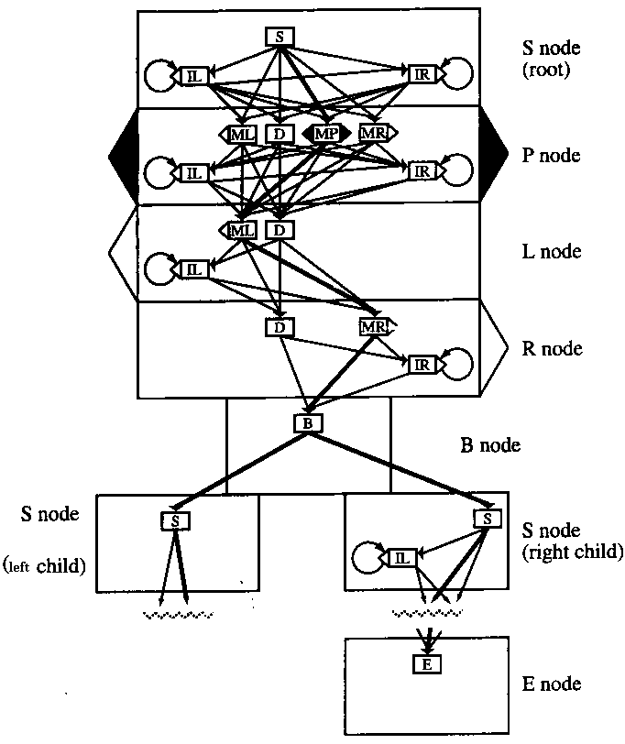
The states of an CM (small box) are grouped
according to the nodes of a consensus RNA
structure tree (large boxes)

Slide 107
8.4.4 SCFG-based RNA folding
Calculate the probability score of aligning RNA sequence to CM
  For each calculation, consider
    Transition probability to next state, and
    Emission probability in the state as determined by training data

Slide 108
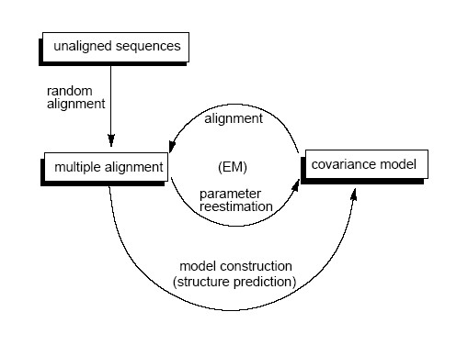
8.4.4 SCFG-based RNA folding
The CM training algorithm

Slide 109
8.4.4 SCFG-based RNA folding
Problems of CMs
  Not suitable for searches of large RNA
    Structural complexity of large RNA
    Memory requirements
  Needs to be well trained

Slide 110
8.4.4 SCFG-based RNA folding
In order to make RNA similarity searching practical
  Improved memory usage
    The most serious barrier: the memory requirement of CMs
    A divide-and-conquer variant of the CYK algorithm (Eddy, 2002)
      reduces the cubic O(L³) dynamic programming lattice for CMs to O(L² logL)

Slide 111
8.4.4 SCFG-based RNA folding
  Improved parameterization
    For CMs built from single RNA query structures, using the RIBOSUM substitution matrices (Klein and Eddy, 2003)
    4x4 matrices for scoring single base alignments
    6x16 for scoring base pair alignments
    For CMs built as profiles of a multiple RNA sequence alignment of known consensus SS, using informative mixture Dirichlet priors from known RNA structural alignments (E. P. Nawrocki and S. R. Eddy, unpublished)

Slide 112
8.4.4 SCFG-based RNA folding
  Local structural alignment
    Extend CMs to allow local structure alignment (Eddy, 2002; Klein and Eddy, 2003)
    The basic idea is in two parts:
    allow a parse tree to start at any consensus position, instead of always starting at the root of the tree
    allow the model to end prematurely from any consensus state, and generate zero or more nonhomologous random bases before stopping

Slide 113
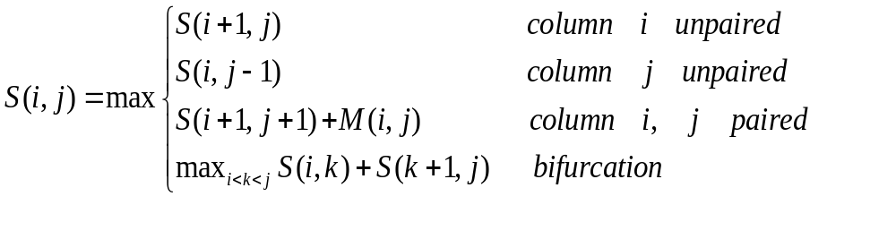
8.4.4 SCFG-based RNA folding
‘Automated’ comparative sequence using Covariance Model (CM)
  S(i, j): Score at indices i and j in RNA when aligned to the Covariance Model
  M(i, j): Mutual information

Slide 114
8.4.4 SCFG-based RNA folding
  Speed improvements
  Improve several CM search algorithms:
    “Rigorous filter” approach (Weinberg and Ruzzo, 2004, 2006)
    A banded dynamic programming algorithm specific to CMs (E. Nawrocki and S. Eddy)

Slide 115
8.4.4 SCFG-based RNA folding
▪ Limitations of SCFGs
  High computational complexity
    SCFG-based RNA analysis algorithms require time and memory proportional to at least L³ (L: the length of sequence)
  Only model nested pairwise correlations
    RNA pseudo-knots, which involve non-nested interactions, cannot be described by SCFG formalisms

Slide 116
8.4.4 SCFG-based RNA folding
    RNA pseudo-knots typically account for something like 5-10% of the base pairs in most RNA structures
    Find a more efficient computational model to be able to capture most of the pairwise correlation!!!
  Converting the promise of SCFG formalisms to practice in RNA analysis and requiring practical software implementations still need a lot of work

Slide 117
8.4.4 SCFG-based RNA folding
  For RNA similarity search, many practical issues except the computational time are viewed as remaining barrier
  There are more serious barriers in many areas such as
      SCFG-based noncoding RNA genefinders
      SCFG-based RNA structure prediction by comparative analysis
      SCFG-based RNA structural motif discovery in unaligned sequences

Slide 118
第八章 RNA的最优折叠算法
本章结束

