Slide 1


Computational Biology
计算生物学
Zhidong DENG
Department of Computer Science
Tsinghua University
邓志东
清华大学计算机系
清华大学 • 2019秋季

Slide 2
第六章 Profile HMM与数据库搜索

Slide 3
第六章 Profile HMM与数据库搜索
参考文献：
[1] R. Durbin, S. Eddy, A. Krogh, and G. Mitchison. 生物序列分析－蛋白质与核酸的概率模型，剑桥大学出版社，清华大学出版社，2002.
[2] S. R. Eddy. Profile Hidden Markov Models, Bioinformatics, vol.14, no.9, 1998, pp.755-763.
[3] P. Baldi, S. Brunak, Y. Chauvin, C. Andersen, and H. Nielsen, Bioinformatics: the Machine Learning Approach, 2nd Eds. Cambridge, MA: MIT Press, 2000.
(皮埃尔⋅巴尔迪等著，张东晖等译，生物信息学－机器学习方法，中信出版社，2003.)

Slide 4
第六章 Profile HMM与数据库搜索
[4] Park, Teichmann, Hubbard, Chothia. Intermediate Sequences Increase the Detection of Homology between Sequences, JMB, 1997.
[5] Park, Karplus, Barrett, Hughey, Haussler, Hubbard, Chothia. Sequence Comparisons Using Multiple Sequences Detect Twice as Many Remote Homologues as Pairwise Methods, JMB, 1998.
[6] Karchin, Hughey. Weighting Hidden Markov Models for Maximum Discrimination, Bioinformatics, 1998.
[7] M. Maderaa and J. Gough. A Comparison of Profile Hidden Markov Model Procedures for Remote Homology Detection, Nucleic Acids Res., vol.30, no.19, 2002, pp.4321-4328.

Slide 5
第六章 Profile HMM与数据库搜索
[8] Karchin, et al.. Using Dirichlet Mixtures for Hidden Markov Models, Bioinformatics, 2002.
[9] M. Wistrand and E. Sonnhammer. Improved Profile HMM Performance by Assessment of Critical Algorithmic Features in SAM and HMMER, BMC Bioinformatics, vol.6, 2005, p.99.

Slide 6
第六章 Profile HMM与数据库搜索
6.1 Introduction
6.2 Profile HMMs
6.3 Deriving profile HMMs from multiple
alignments
6.4 Searching with profile HMMs
6.5 Profile HMM Variants for non-global
alignments
6.6 More on estimation probabilities
6.7 Optimal model construction
6.8 Weighting training sequences
6.9 HMMer vs. SAM

Slide 7
第六章 Profile HMM与数据库搜索
6.1 Introduction

Slide 8
6.1 Introduction
Sequences in a family will have diverged from each other in their primary sequence during evolution, but normally maintain the same or a related function
  Separated by a duplication in the genome
  Separated by speciation giving rise to corresponding sequences in related organisms

Slide 9
6.1 Introduction
Interested in sequence families
  Functional biological sequences typically come from families
  Identifying that a sequence belongs to a family tells about its function

Slide 10
Notation on Family
6.1 Introduction
Motif
  highly similar regions in alignments of protein segments
  conserved parts in domains module
  one or more motifs in a contiguous sequence segment

Slide 11
6.1 Introduction
Domain
  Independent structural unit, evolutionarily related
  A discrete portion assumed to fold independently of the rest of the protein and possessing its own function
Domain architecture
  linear arrangement of domains within a polypeptide chain

Slide 12
6.1 Introduction
Family
  groups of evolutionarily related proteins that may share one or more domains/repeats in common
  Lead to great diversity
  Close Homologs (Clear evolutionary relationship)
  Generally, pairwise residue identities greater than 30% between all pairs in a given family
  Particularly, many globins form a family though some members have sequence identities of only 15%.

Slide 13
6.1 Introduction
Superfamily
  Two or more well-characterized families bear a distant relationship to each other
  Low sequence identity
  Structural and functional features suggest a common evolutionary origin

Slide 14
6.1 Introduction
Midnight zone
Twilight zone
Safe zone
0
20
40
60
80
100
Sequence identities
Important but not easy

Slide 15
6.1 Introduction
Pairwise searching may not find sequences distantly related
Improve the alignment
  Concentration on features that are conserved in the whole family
  Characterizing Family
    Compare the sequence and structure patterns of the family members to reveal shared characteristics that potentially describe common biological properties

Slide 16
6.1 Introduction
A sequence feature is a pattern that is observed to occur in more than one sequences and (usually) to be correlated with some function

Slide 17
6.1 Introduction
How to represent such features?
  Representing sequence features, and finding sequence features using consensus sequences and frequency matrices
  A consensus sequence is a sequence that summarizes or approximates the pattern observed in a group of aligned sequences containing a sequence feature
  The most common pattern representation
    Regular expressions
    Profiles (standard profile, Profile HMM)

Slide 18
6.1 Introduction
Profile is an efficient way to represent pattern and characterize a family of proteins

Slide 19
6.1 Introduction
Profile:
  A description of the consensus of a multiple sequence alignment
  A position-specific scoring system to capture information about the degree of conservation at various position of the multiple alignment

Slide 20
Regular expressions vs. Profiles
6.1 Introduction
Regular expressions
  do not capture the statistics of the variation in sequence patterns
  just tell what letters are permissible at each position in the pattern
Profiles
  capture the frequency of each letter at each position in the pattern
  tell how well a potential site matches the pattern
  probability information of the site

Slide 21
6.1 Introduction
Advantage of Profile:
  Finding and aligning distantly related sequences (or protein family)
  Identifying known sequence domains in new sequences
  Profile can be used in database searches
  Find new sequences that match the profile
  Improve search sensitivity
  Improve search accuracy

Slide 22
6.1 Introduction
Profile (Gribskov and McLachlan, 1987)
  A Gribskov profile is a weighting matrix of the probabilities of appearance of amino acids in a certain position in a multiple alignment.
Profile HMMs (Krogh, 1994)
  Consensus modeling of the family using a probabilistic model
  Built from a given multiple alignment

Slide 23
Potential application fields of Profile HMM
6.1 Introduction
Protein families could be modeled as an profile HMM
New protein sequences could be aligned with stored models to detect remote homology
  aligning a sequence with a stored profile HMM

Slide 24
6.1 Introduction
Align two or more protein family profile HMMs to detect homology
  finding statistical similarities between two profile HMM models

Slide 25
6.1 Introduction
Profile HMMs can be used to do sensitive database searching using statistical descriptions of a sequence family's consensus
Protein structure prediction
Gene prediction
Signal peptide prediction

Slide 26
6.1 Introduction
Profile HMMs allow for more information to be incorporated
  active site residues
  structural information
  different probabilities for insertions at different positions
  different probabilities of amino acid type at different residues

Slide 27
Sequence-profile methods
6.1 Introduction
PSI-BLAST
ClustalW /ClustalX
T-Coffee
Two Popular Profile HMM Sequence Alignment and Modeling Systems:
HMMER /SAM

Slide 28
6.1 Introduction
HMMER
  Sean Eddy, 1995
  HMMER is a freely distributable implementation of profile HMM software for protein sequence analysis. (Washington Univ.)
  http://hmmer.wustl.edu
SAM (Krogh, et al., 1994; Hughey and Krogh, 1996)
  http://www.cse.ucsc.edu/research/compbio/sam.html
  SAM is a collection of software tools for creating, refining and using linear HMM for biological sequence analysis (University of California)

Slide 29
Sequence-profile methods
6.1 Introduction
PSI-BLAST
  Fast
  Partial dynamic programming
ClustalW /ClustalX
  Slow
  Dynamic programming

Slide 30
6.1 Introduction
T-Coffee
  Much slower
  Requires preprocessing
  Genetic Algorithm
SAM/HMMer
  Slow
  Requires preprocessing
  Hidden Markov Model
  Very accurate

Slide 31
Profile Databases
6.1 Introduction
BLOCKS
  http://blocks.fhcrc.org/
  Ungapped multiple alignments of segments of related protein sequences that correspond to the most conserved regions of proteins among a protein family or superfamily
  Data as alignments and as PSSMs

Slide 32

6.1 Introduction
PRINTS
  http://bioinf.man.ac.uk/dbbrowser/PRINTS/
  Groups of conserved motifs (protein fingerprint)
  A fingerprint can characterize a protein family
  Fingerprints can encode protein folds and functionalities more flexibly and powerfully than single motifs

Slide 33

6.1 Introduction
ProDom
  http://prodom.prabi.fr/prodom/current/html/home.php
  Automatic compilation of homologous domains
  Built using a novel procedure based on recursive PSI-BLAST searches

Slide 34

6.1 Introduction
PROSITE
  http://www.expasy.ch/prosite/
  Consists of biologically significant sites, patterns, and profiles
  Help to reliably identify to which known protein family (if any) a new sequence belongs to

Slide 35

6.1 Introduction
eMOTIF
  http://brutlag.stanford.edu/emotif-scan/
  Derived from the multiple sequence alignments in the BLOCKS, PRINTS
  A collection of more than 170,000 highly specific and sensitive protein sequence motifs
  Representing conversed biochemical property and biology functions

Slide 36

6.1 Introduction
Pfam
  http://www.sanger.ac.uk/Software/Pfam/
  May 2006, 8,296 families, 74% of protein sequences have at least one match to Pfam
  Pfam is a collection of protein families and domains.
  Pfam contains multiple protein alignments and profile-HMMs of these families.
  Pfam is a semi-automatic protein family database
  Protein family alignments generated semi-automatically using probabilistic method
  Data available as "profile HMM" for entire sequence alignment covering many common protein domains

Slide 37
6.1 Introduction
Profile Hidden Markov Models:
  Creations of a position-specific profile from a set of aligned sequences
    Includes gap probabilities
  Provides a formal probabilistic basis for the creation of the profile
    Residue frequencies
    Gap insertion/deletions

Slide 38
6.1 Introduction
Advantages of Profile HMM:
  Good profiling method
  Transparent method
    can view and interpret the model produced
  Very effective at detecting remote homologs
  Statistical method with well established formal probabilistic basis
  Can be trained from unaligned sequences, if a trusted alignment isn't yet known

Slide 39
6.1 Introduction
Disadvantages of Profile HMM:
  Slow
  Have to avoid over-fitting and locally optimal issues
  Needs a higher number of sequences to give a satisfactory result

Slide 40
第六章 Profile HMM与数据库搜索
6.2 Profile HMMs

Slide 41
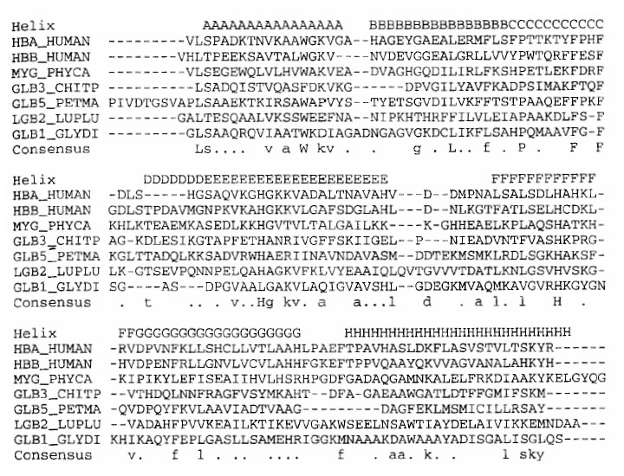
6.2 Profile HMMs
Sequences From A Globin Family

Slide 42
6.2 Profile HMMs
General feature of protein family multiple alignment
  Gaps tend to line up with each other
  Leaving solid blocks in which there are no insertion or deletion in any of the sequences

Slide 43
1. Ungapped score matrices
6.2 Profile HMMs
Only considering ungapped regions
  Probability model
A natural probabilistic model for a conserved region would be to specify independent probabilities e_{i}(a) of observing amino acid a in position i

Slide 44
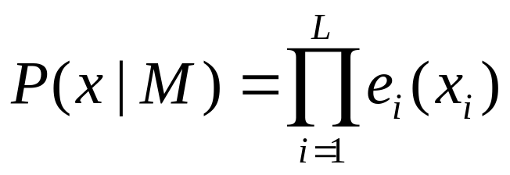
6.2 Profile HMMs
The probability of a new sequence x according to this model is

Slide 45
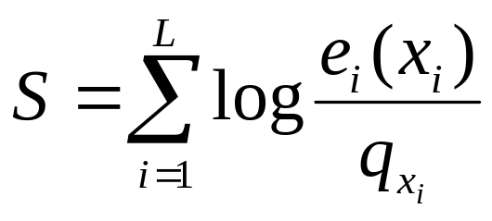
6.2 Profile HMMs
Log-odd Ratio: The ratio of the probability of x to the probability of x under the random model
  where q indicates the probability under a random model
  They behave like elements in a score matrix
  PSSM (Position-specific Score Matrix)
  Log-odd ratio is more important

Slide 46
Converting a PSSM to a HMM
6.2 Profile HMMs
Converting a PSSM for a block to a HMM is trivial, due to the absence of insertions and deletions
Begin state, End state and Match states, one for each column in PSSM
Match states are represented by squares in a diagram of a profile HMM
Transition probabilities between match states in the HMM would be 1 (can only have transition to the next match state)
Emission probabilities for match state calculated based on the PSSM

Slide 47
6.2 Profile HMMs
PSSM
M₁
....
M_{j}
....

Slide 48
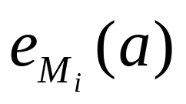
The Simplest Profile HMM
6.2 Profile HMMs
Linear HMM with “match” states
Match states M
  - Emission probabilities
- Initial state distribution: P(M1) = 1.0
- Transition probabilities: P(Mi->Mj) = 1.0
Begin
....
M_{j}
....
End

Slide 49
2. Adding insert and delete states to obtain a full profile HMM
6.2 Profile HMMs
For The Simplest Profile HMM
  Problem: No gap is allowed, but gap is quite common in protein motifs
Consideration of gaps
  Henikoff & Henikoff, 1991
    Combining the multiple ungapped block models
  Allowing gaps at each position using the same gap scores γ (g) at each position

Slide 50
6.2 Profile HMMs
More complex profiles involve modifications to such simple HMM by adding additional states of insertions and deletions to model, leading to a full Profile HMM

Slide 51
Components of profile HMMs: Insert
6.2 Profile HMMs
Add Insert states
I_{j}
Begin
M_{j}
End
I_{j}
Insert states
denoted by diamonds in a HMM

Slide 52
6.2 Profile HMMs
Transitions are needed from:
  last match state in a block to the insertion
  insertion to itself (to allow for multiple length insertions)
  insertion to the first match state of the next block

Slide 53
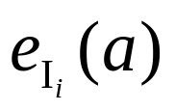
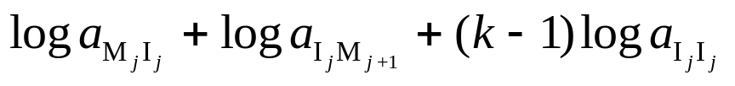
6.2 Profile HMMs
Insert States
  Emission prob.
    Usually set it to the background distribution q_{a}
  Transition prob.
    M_{i} to I_{i}, I_{i} to itself, I_{i} to M_{i+1}
  Log-odds score of a gap of length k (no log-odds from emission)
Gap open
Gap extension

Slide 54
Components of profile HMMs: Delete
6.2 Profile HMMs
Add Delete states
D_{j}
Begin
M_{j}
End
D_{j}
Delete states
denoted by circles in a HMM

Slide 55
Components of profile HMMs: Delete
6.2 Profile HMMs
Delete States
  No emission prob.
  Cost of a deletion
    M→D, D→D, D→M
    Each D→D might be different
Handled by introducing silent states between matches
do not emit a residue ( “silent” state)

Slide 56
6.2 Profile HMMs
For the delete states
  sequentially linked, in a similar manner to the match states
  are also interleaved with the match states
The cost of a deletion is analogous to the cost of an insertion, although the path through the model looks different

Slide 57
6.2 Profile HMMs
Combining all parts
D_{j}
I_{j}
Begin
M_{j}
End
The transition structure of a profile HMM

Slide 58
6.2 Profile HMMs
For a profile HMM, insertions and deletions are treated separately
Repetitive structure of states
Different probabilities in each position
Full probabilistic model for sequences in the sequence family

Slide 59
6.2 Profile HMMs
Theoretically, it is possible that the D → D transitions for one deletion will have different probabilities, and thus contribute differently to the score
All the I → I transitions for one insertion involve the same state, and thus have the same cost
We have added transitions between insertion and deletion states, as in the original model, although these are usually very improbable

Slide 60
3. Profile HMMs for Pairwise Alignments
6.2 Profile HMMs
Generalize pairwise alignments, similar to the dynamic programming approach
States correspondence
Emission probabilities:
  Match /mismatch probabilities
  or probabilities of matching two amino acids in a scoring matrix

Slide 61
6.2 Profile HMMs
Transition probabilities from a match state to an insert or delete state is equivalent to a gap-open score
Transition probabilities within an insertion state or between delete states equivalent to a gap extension penalty

Slide 62
第六章 Profile HMM与数据库搜索
6.3 Deriving profile HMMs from
multiple alignments

Slide 63
6.3 Deriving profile HMMs from multiple
alignments
Want to build a model representing:
  The consensus sequence for a family rather
  than the sequence of any particular member

Slide 64
6.3 Deriving profile HMMs from multiple
alignments
Good model of these proteins must reflect:
  highly conserved positions in the alignment
  variable regions in the alignment
  varying lengths of protein sequences
Non-probabilistic profiles
Profile HMMs

Slide 65
Non-probabilistic profiles
6.3 Deriving profile HMMs from multiple
alignments
HBA_HUMAN ...VGA--HAGEY...
HBB_HUMAN ...V----NVDEV...
MYG_PHYCA ...VEA--DVAGH...
GLB3_CHITP ...VKG------D...
GLB5_PETMA ...VYS--TYETS...
LGB2_LUPLU ...FNA--NIPKH...
GLB1_GLYDI ...IAGADNGAGV...
*** *****
Ten columns from the multiple alignment of seven globin protein sequences shown
The starred columns are ones that will be treated as ‘matches’ in the profile HMM.

Slide 66
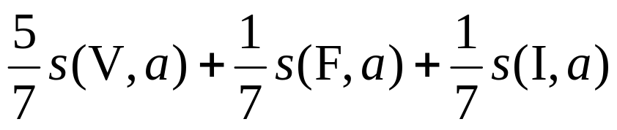
6.3 Deriving profile HMMs from multiple
alignments
Non-probabilistic profiles
  Gribskov, Mclachlan & Eisenberg [1987]
    E.g., score for residue a in column 1
    where s(a, b) is a standard substitution matrix

Slide 67
6.3 Deriving profile HMMs from multiple
alignments
Assign position specific scores for each match state and gap penalty
- Set the score for each consensus position to the average of the standard substitution scores from all the residues in the corresponding multiple sequence alignment column
- Set gap penalties for each column using a heuristic equation that decrease the cost of a gap according to the length of the longest gap observed in the multiple alignment spanning the column

Slide 68
6.3 Deriving profile HMMs from multiple
alignments
Problem of Non-probabilistic profiles
  If we had an alignment with 100 sequences, all with a cysteine (C), at some position, the probability distribution for that column for an “average” profile would be exactly the same as would be derived from a single sequence
  Doesn’t correspond to our expectation that the likelihood of a cysteine should go up as we see more confirming examples

Slide 69
6.3 Deriving profile HMMs from multiple
alignments
Disadvantages
  More conserved region might be corrupted
  Intuition about the likelihood can’t be maintained
  The score for gaps do not behave as expected

Slide 70
Build a HMM from Multiple Alignments
6.3 Deriving profile HMMs from multiple
alignments
Decide the consensus region
Decide which columns are ‘match’ states and which are ‘insert’ states.
Gaps in the match states are marked as ‘delete’
Build a HMM using supervised training

Slide 71
6.3 Deriving profile HMMs from multiple
alignments
HBA_HUMAN ...VGA--HAGEY...
HBB_HUMAN ...V----NVDEV...
MYG_PHYCA ...VEA--DVAGH...
GLB3_CHITP ...VKG------D...
GLB5_PETMA ...VYS--TYETS...
LGB2_LUPLU ...FNA--NIPKH...
GLB1_GLYDI ...IAGADNGAGV...
*** *****
Delete
Match
Insert

Slide 72
Model construction
6.3 Deriving profile HMMs from multiple
alignments
From initial alignment
  Most common method
  Start from an initial multiple alignment of a protein family
Iteratively
  By successive database searches incorporating new similar sequences into the model
Algorithm-inspired
  The model is trained using some continuous minimization algorithm, such Baum-Welsh

Slide 73
Basic Profile HMM Parameterization
6.3 Deriving profile HMMs from multiple
alignments
A profile HMM defines a probability distribution over the whole space of sequences
The aim of parameterization is to make this distribution peak around members of the family

Slide 74
6.3 Deriving profile HMMs from multiple
alignments
Parameters
  probabilities
  the length of the model

Slide 75
Choosing Model Length
6.3 Deriving profile HMMs from multiple
alignments
Length of the model:
  heuristics way
  or systematic way
A simple rule that works well in practice is that columns that are more than half gap characters should be modeled by inserts

Slide 76
Assigning Probabilities
6.3 Deriving profile HMMs from multiple
alignments
Assign the transition and emission probability parameters
The simplest solution is to take the frequencies

Slide 77

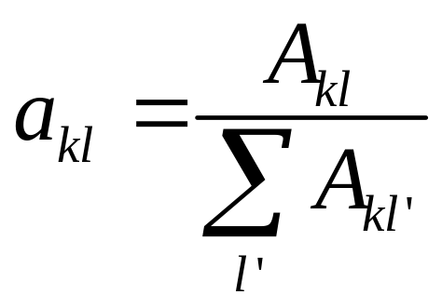
Transition probability
6.3 Deriving profile HMMs from multiple
alignments
Each state has three possible transitions leaving from itself
Transition probability from state k to state can be calculated as:
A_{kl}: transition frequencies

Slide 78
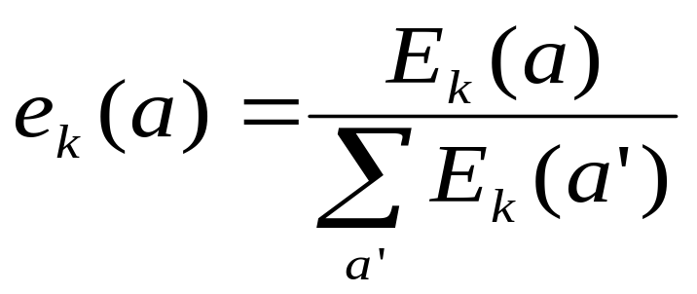
Emission probability
6.3 Deriving profile HMMs from multiple
alignments
Emission probability of residue a at state k can be calculated:
Ek(a): emission frequencies

Slide 79
第六章 Profile HMM与数据库搜索
6.4 Searching with profile HMMs

Slide 80
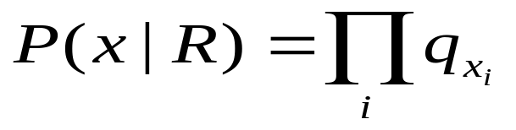
6.4 Searching with profile HMMs
Main purposes of profile HMMs
  Detecting potential membership in a family
  Matching a sequence whether or not they belong to a particular family of sequences described by the profile HMM
  Log-odd ratio, compared with random model given by

Slide 81
6.4 Searching with profile HMMs
Search Method
  Viterbi algorithm to get the most probable alignment
  Forward algorithm to calculate the full probability of the sequence summed over all possible paths

Slide 82
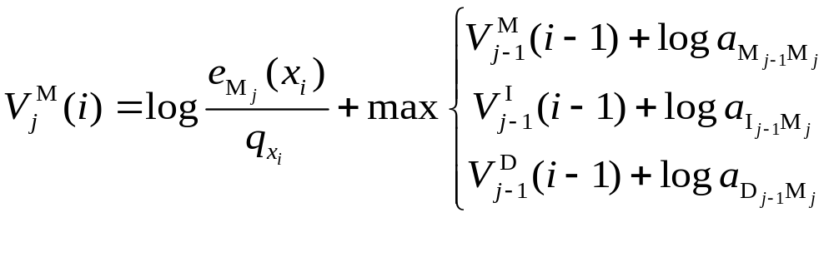
6.4 Searching with profile HMMs
To align the sequence x with length m against a profile HMM P of length L. For each 1 ≤ j ≤ L and 1 ≤ i ≤ m
Viterbi algorithm
The log-odds score of the best path subsequence
x[1…i] to the model (profile HMM) ending with xi
being emitted by state Mj

Slide 83
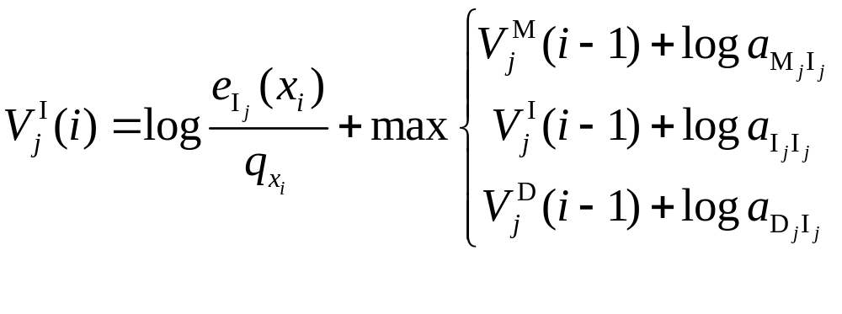
6.4 Searching with profile HMMs
The log-odds score of the best path subsequence
x[1…i] to the model (profile HMM) ending with xi
being emitted by state Ij

Slide 84
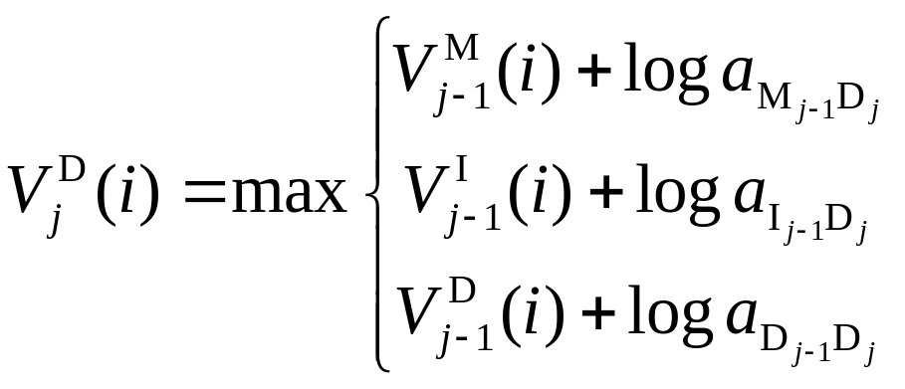
6.4 Searching with profile HMMs
The log-odds score of the best path subsequence
x[1,…i] to the model (profile HMM) ending with state Dj

Slide 85
6.4 Searching with profile HMMs
Complexity:
  O(L·m) time complexity
  O(L·m) space complexity

Slide 86
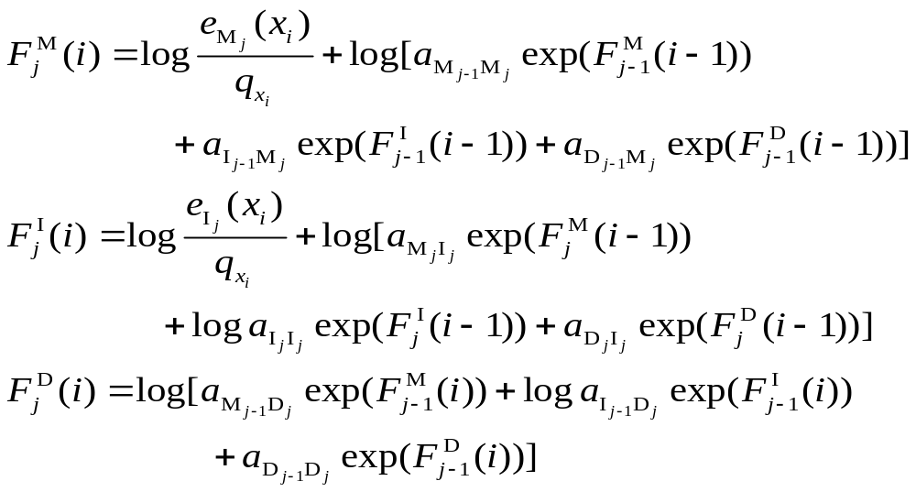
6.4 Searching with profile HMMs
Forward algorithm

Slide 87
第六章 Profile HMM与数据库搜索
6.5 Profile HMM Variants for
non-global alignments

Slide 88
6.5 Profile HMM Variants for non-global
alignments
1. Local alignments (Smith-Waterman style)
Local alignments (flanking model)
  Emission prob. in flanking states use background values q_{a}
  Looping prob. close to 1, e.g., (1- η) for some small η

Slide 89
6.5 Profile HMM Variants for non-global
alignments
1. Local alignments (Smith-Waterman style)
D_{j}
I_{j}
M_{j}
Begin
End
Q
Q

Slide 90
6.5 Profile HMM Variants for non-global
alignments
2. Overlap alignments
  If all the probability is assigned to the first model state, then it forces this model to match only the copies of the profile in the searched sequences
  Only transitions to the first model state are allowed
  For example, when the HMM represents a protein domain that you expect to find either present as a whole or absent
  Transition to first delete state allows missing first residue

Slide 91
2. Overlap alignments
6.5 Profile HMM Variants for non-global
alignments
D_{j}
Q
I_{j}
Q
Begin
M_{j}
End

Slide 92
6.5 Profile HMM Variants for non-global
alignments
3. Repeat alignments
  Join the two background states
  Allow multiple matches
  Transition from right flanking state back to random model
  Can find multiple matching segments in query string

Slide 93
3. Repeat alignments
6.5 Profile HMM Variants for non-global
alignments
D_{j}
I_{j}
M_{j}
Begin
Q
End

Slide 94
第六章 Profile HMM与数据库搜索
6.6 More on estimation
probabilities

Slide 95
6.6 More on estimation probabilities
Parameters estimation at greater length
The most straightforward way
  Give the Maximum Likelihood (ML) estimation for the parameters

Slide 96
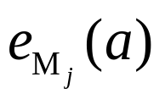
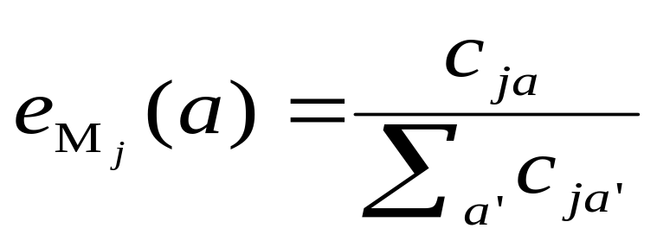
6.6 More on estimation probabilities
Maximum Likelihood (ML) estimation
  Given observed frequency c_{ja} of residue a in position j, ML estimation for

Slide 97
6.6 More on estimation probabilities
Problem of ML estimation
  Often: the observed samples of a particular outcome are absent, then its probability is estimated as zero
  Especially, when observed examples are somewhat few, then over-represented

Slide 98
6.6 More on estimation probabilities
If a large number of sequences is given in our training alignment, this will give us an accurate and consistent estimate of the parameters
if not enough sequences are used
  some residues will be underrepresented (or not represented at all) : some transitions or emissions may not be seen in the training alignment lead to zero probability
  others will be overrepresented

Slide 99
6.6 More on estimation probabilities
Solution if not enough sequences are used :
  Add pseudocounts to the observed frequencies
  Dirichlet mixtures
  Substitution matrix mixtures
  Estimated based on an ancestor
  ……

Slide 100
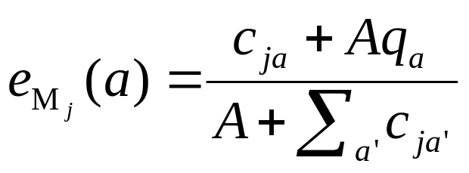
6.6 More on estimation probabilities
Simple Pseudocounts
  q_{a}: background distribution
  A: weight factor
  Simplest pseudocount method -Laplace’s rule:
    add one to each frequency, e.g., Aq_{a} = 1

Slide 101
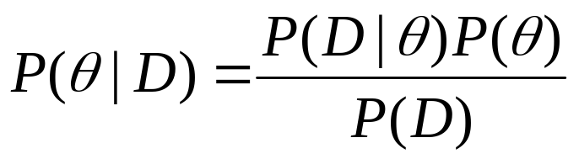
6.6 More on estimation probabilities
Adding Pseudocounts amounts to adding some prior information based on the knowledge of protein family
For parameter estimation, Bayesian framework can be used

Slide 102
6.6 More on estimation probabilities
  Parameters (model probabilities): ө
  Data: D
  Prior probability distribution over the parameters: P(θ)
Bayesian framework can combine data D with prior probability to give a posterior probability over θ, then take the maximum or mean as the best estimation
  Dirichlet prior distribution: Aq_{a}

Slide 103
6.6 More on estimation probabilities
Dirichlet mixtures
  Brown, 1993
  Mixtures of Dirichlet prior : better than single Dirichlet prior
    Given the counts cjk
    With K pseudocount priors
    Prior distribution K

Slide 104
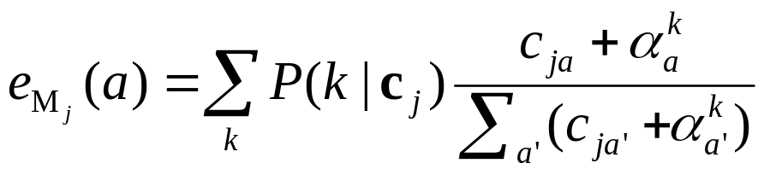
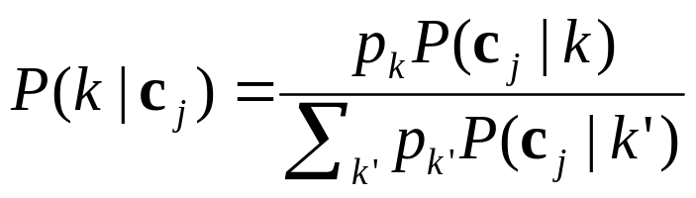
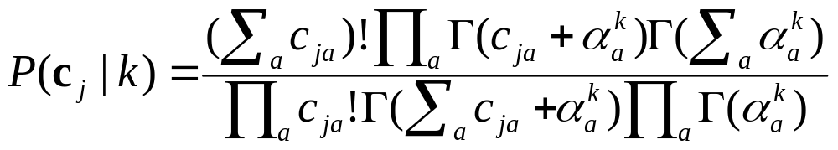
6.6 More on estimation probabilities

Slide 105
6.6 More on estimation probabilities
Dirichlet mixture
  Consists of a number of Dirichlet components, which are distributions over probability parameters
  Each component typically captures
    a specific feature of columns observed in multiple sequence alignments, i.e., hydrophobicity or polarity
    the degree of conservation to certain amino acids
  During model building
    Dirichlet components are weighted probabilistically for each column in the multiple alignment (optimally given the amino acid frequencies of the column)
    Combine with the observed amino acid frequencies to obtain the posterior emission probabilities

Slide 106
第六章 Profile HMM与数据库搜索
6.7 Optimal model construction

Slide 107
6.7 Optimal model construction
Model construction
  How to determine which columns to insert states or which to match states?
  If marked multiple alignments have no errors, the optimal model can be constructed
  2^{L} combinations for markings of an alignment of L columns

Slide 108
6.7 Optimal model construction
⋅ Three ways to determine the marking
  Manual construction
    Marks alignment by hand
  Heuristic construction
    Columns with low entropy are more likely ‘match’ (threshold-based): A rule
    e.g., when the proportion of gap symbols in a column is below a certain threshold, this column is marked as ‘match’

Slide 109
6.7 Optimal model construction
  Bayesian model selection: choose a model that fits the data the best and is consistent with our prior,
    MAximum a Posteriori (MAP) construction
    A maximum posterior choice is determined by dynamic programming

Slide 110
An example of model construction
6.7 Optimal model construction
(a) A Small DNA Multiple Alignment
x x . . . x
A G - - - C
A - A G - C
A G - A A -
- - A A A C
A G - - - C
1 2 . . . 3
Three columns are marked

Slide 111
6.7 Optimal model construction
(b) Profile-HMM Structure
D
D
D
I
I
I
I
beg
M
M
M
end
0
1
2
3
4

Slide 112
6.7 Optimal model construction
(c) The symbol emission & state transition counts
0 1 2 3
A - 4 0 0
C - 0 0 4
G - 0 3 0
T - 0 0 0
A 0 0 6 0
C 0 0 0 0
G 0 0 1 0
T 0 0 0 0
M-M 4 3 2 4
M-D 1 1 0 0
M-I 0 0 1 0
I-M 0 0 2 0
I-D 0 0 1 0
I-I 0 0 4 0
D-M - 0 0 1
D-D - 1 0 0
D-I - 0 2 0
match
emissions
insert
emissions
state
transitions

Slide 113
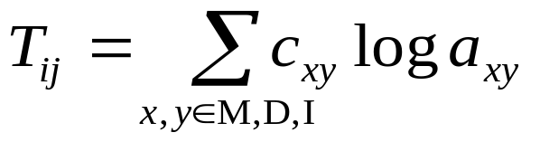
6.7 Optimal model construction
MAP match-insert assignment
Recursive calculation of a number S_{j}
  S_{j}: log prob. of the optimal model for alignment up to and including column j, assuming j is marked.
  T_{ij}: summed log prob. of all the state transitions between marked i and j
  c_{xy} are obtained from partial state paths implied by marking i and j

Slide 114
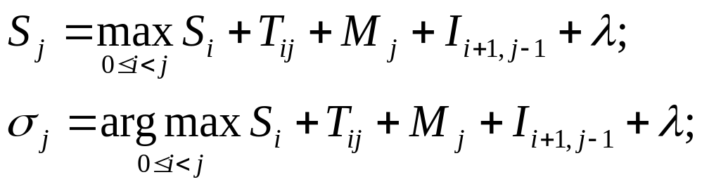
6.7 Optimal model construction
Algorithm: MAP model construction
  Initialization:
    S₀ = 0, M_{L+1} = 0.
  Recurrence: for j = 1,..., L+1:
  Traceback: from j = σ_{L+1}, while σ_{j} > 0:
    Mark column j as a match column
    j = σ_{j}

Slide 115
第六章 Profile HMM与数据库搜索
6.8 Weighting training sequences

Slide 116
6.8 Weighting training sequences
Common assumption of random model:
  all examples are independent samples
  might be incorrect
How to construct a good random sample from all the sequences that belong to one family?
Solution: Assign weights to sequences

Slide 117
6.8 Weighting training sequences
Simple weighting schemes derived from a tree
Root weights from Gaussian parameters
Voronoi weights
Maximum discrimination weights
Maximum entropy weights

Slide 118
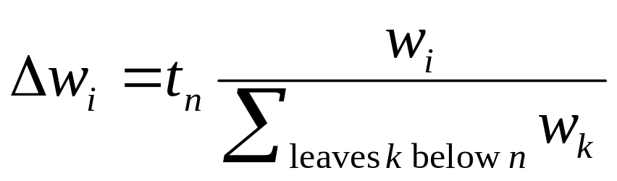
6.8 Weighting training sequences
Simple weighting schemes derived from a tree
  Given Phylogenetic tree
  Thompson, Higgins & Gibson, 1994: Kirchohoff’s law
  Gerstein, Sonnhammer & Chothia, 1994

Slide 119
6.8 Weighting training sequences
Root weights from Gaussian parameters
  Lipman, 1990
  Influence of leaves on the root distr.
  Altchul-Carroll-Lipman wieghts
    Create Gaussian distribution
    Mean μ: linearly combination of x_{i}
    Combination weights represent the influences of leaves

Slide 120
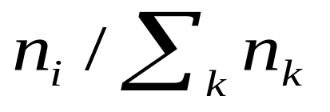
6.8 Weighting training sequences
Voronoi weights
  Sibbald & Argos, 1990
  Proportional to the volume of empty space
  Sequence family in sequence space
  Algorithm
    Random sample: choosing at the k-th position uniformly from the set of residues occurring the k-th position
    n_{i}: count of samples closest to the i-th family
    Define the i-th weight

Slide 121
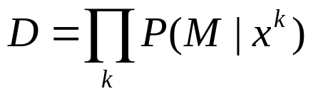
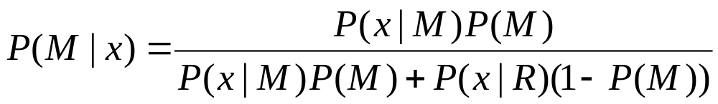
6.8 Weighting training sequences
Maximum discrimination weights
  Eddy, Mitchison & Durbin, 1995
  Focus: How to decide whether sequences are members of the family or not
  Discrimination
  Weight: 1-P(M|x_{i})
  Maximizing D leads to giving the effect of emphassing performance on distant or difficult members of the family

Slide 122

6.8 Weighting training sequences
Maximum entropy weights
  Intuition
    k_{ia}: number of residues of type a in column i of a multiple alignment
    m_{i}: number of different types of residues in column I
    Uniform as possible
      Weight for sequence k:
      ML estimation under the weights:
      p_{ia} = 1/m_{i}

Slide 123
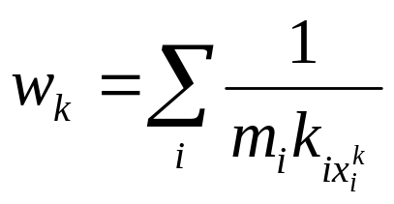
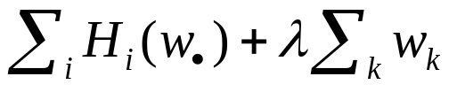
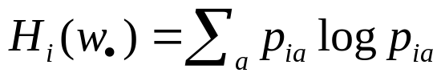
6.8 Weighting training sequences
  Averaging over all columns
    - Henikoff, 1994
  Entropy: an measure of the uniformity
  - Krogh & Mitchison, 1995
  - Maximize

Slide 124
6.8 Weighting training sequences
Weighting training sequence
  Determines the sequence influence on the final HMM
  Without sequence weighting, the model skewed and it would not recognize under-represented sequences

Slide 125
6.8 Weighting training sequences
Two-step process of the sequence weights: relative weights & total weight
  Relative weights
    determine the influence of one sequence relative to the others
    assign less weight to similar sequences and more to the divergent but still trusted family members
    do not sum to any particular value, but are scaled to add up to the total weight

Slide 126
6.8 Weighting training sequences
  Total weight
    governs the weight of the multiple sequence alignment relative to the prior probabilities

Slide 127
第六章 Profile HMM与数据库搜索
6.9 HMMer vs. SAM

Slide 128
6.9 HMMer vs. SAM
HMMer
  Create and manipulate profile HMMs and database of profile HMMs (HmmerBuild, HmmerConvert)
  Performs searches of sequence and profile HMM databases (HmmerSearch, HmmerPfam)
  Create multiple sequence alignments (HmmerAlign)

Slide 129
6.9 HMMer vs. SAM
SAM
  The models are trained on a family of protein or nucleic acid sequences using an Expectation-Maximization algorithm and a variety of algorithmic heuristics
  A trained model can then be used to both generate multiple alignments and search databases for new members of the family

Slide 130
6.9 HMMer vs. SAM
Sequence Alignment and Database Search using HMMER
Multiple Alignment
Build a Profile HMM
Database search
Query against Profile HMM database
(PFAM database)
Multiple alignments

Slide 131
6.9 HMMer vs. SAM
Profile HMM Architecture
  SAM architecture allowed transitions between all states, which gives 3×3 = 9 possible transitions for each node.
  While HMMER since version 2.0 allows seven transitions only. In the HMMER architecture, transitions from insert to delete states, and transitions from delete to insert states are forbidden

Slide 132
6.9 HMMer vs. SAM
Profile HMM Construction
  Both HMMER and SAM allow the user to "label" columns in the multiple alignment to tell the program which columns should be seen as match/delete states and which seen as insert states
  If such information is missing:
    SAM will assign every column to a match state and produce a HMM with one node per column, which leads to longer model
    HMMER assigns columns to match or insert states so as to maximize the posterior probability of the aligned sequences, which leads to shorter models

Slide 133
6.9 HMMer vs. SAM
3. Prior Probability Alternatives
  The strength of priors is in compensating for small sample size and to distribute probability also to unseen events
  SAM and HMMer both use Dirichlet mixtures to model emission prior probabilities
    SAM 's default emission prior is currently a mixture of 20 components
    HMMer 's is a mixture of 9 components!

Slide 134
6.9 HMMer vs. SAM
4. Sequence Weighting: Relative & Total Weights
  The relative weights determine the influence of one sequence relative to the others.
    HMMER default algorithm derives weights from a sequence tree relating the sequences
    SAM use algorithm based on relative entropy

Slide 135
6.9 HMMer vs. SAM
  The total weight thus governs the weight of the multiple sequence alignment relative to the prior probabilities.
    HMMER applies an algorithm that groups sequences by single-linkage clustering and counts the number of clusters above a specified level of identity.
    SAM scales the weights according to an entropy target that specifies the number of bits per column to save during model building, i.e., the information content of the final model compared to a background model.

Slide 136
6.9 HMMer vs. SAM
Global or Local Scoring
  A sequence can be scored locally to the entire profile HMM (global/local) or to a part of it (local/local).
    For HMMER, the search mode is specified at the time of HMM model building. Two HMMs can thus be built from the same alignment, one global/local and one local/ local, and both are scored using the same algorithm.
    SAM estimates only one HMM for each multiple alignment, and the search mode is instead specified at the time of model scoring.

Slide 137
第六章 Profile HMM与数据库搜索
本章结束

