Slide 1


Computational Biology
计算生物学
Zhidong DENG
Department of Computer Science
Tsinghua University
邓志东
清华大学计算机系
清华大学 • 2019秋季

Slide 2
第四章 双序列比对: 串模型方法

Slide 3
第四章 双序列比对: 串模型方法
建议参考：
[1] R. Durbin, S. Eddy, A. Krogh, and G. Mitchison, 生物序列分析－蛋白质与核酸的概率模型，剑桥大学出版社，清华大学出版社，2002.
[2] D. Gusfield. Algorithms on Strings, Trees, and Sequences, Cambridge University Press, 1997.
[3] Neil C. Jones and Pavel A. Pevzner. An Introduction to Bioinformatics Algorithms, Cambridge, MA: MIT Press, 2004.
[4] S. F. Altschul, W. Gish, W. Miller, E. W. Myers, and D. J. Lipman, Basic local alignment search tool. J. Mol. Biol., 215: 403-410, 1990.

Slide 4
第四章 双序列比对: 串模型方法
[5] M. Dayhoff and R. Schwartz, Matrices for detecting distant relationship, Atlas of Protein Sequences, pp.353-358, 1979.
[6] S. F. Altschul et al.. Gapped BLASTand PSI-BLAST: a new generation of protein database search programs, Nucleic Acids Res.(NAR), 25(17): 3389-402, 1997.
[7] S. Henikoff and J. G. Henikoff. Amino acid substitution matrices from protein blocks, Proceedings of the National Academy of Science (PNAS), USA, 89(22): 10915-10919, November 1992.
[8] D. Lipman and W. Pearson. Rapid and sensitive protein similarity searches, Science, 227: 1435-1441, 1985.
[9] D. Lipman and W. Pearson. Improved tools for biological sequence comparison, Proceedings of the National Academy of Science (PNAS), USA, 85: 2444-2448, 1988.

Slide 5
第四章 双序列比对: 串模型方法
4.1 引言
4.2 序列的相似性、同源与比对
4.3 评分模型
4.4 比对算法
4.5 具有更复杂模型的动态规划
4.6 启发式比对算法
4.7 线性空间比对
4.8 评分的意义
4.9 从比对数据推出评分参数

Slide 6
第四章 双序列比对: 串模型方法
4.1 引言
4.2 序列的相似性、同源与比对
4.3 评分模型
4.4 比对算法
4.5 具有更复杂模型的动态规划
4.6 启发式比对算法
4.7 线性空间比对
4.8 评分的意义
4.9 从比对数据推出评分参数

Slide 7
第四章 双序列比对: 串模型方法
4.1 引言/Introduction

Slide 8
Sequence alignment
Alignment:
A correspondence between elements of
two sequences with order (topology) kept
to find how close two sequences are
Pairwise alignment
2 sequences aligned
Multiple alignment
alignment of 3 or more sequences

Slide 9
Basis for Sequence alignment
Theory of evolution:
  gene sequences have evolved /derived from a common ancestor
  trace history of mutations /evolutionary changes
Proteins that are similar in sequence are likely to have similar structure and function?

Slide 10
Basis for Sequence alignment
Organisms evolve through mutation events that modify sequence.
DNA can be modified by:
  insertions, deletions, substitutions
  repeats, rearrangements

Slide 11
Role of Sequence alignment
Comparing DNA/RNA/protein sequences for
  Similarity
  Homology
Prediction of structure
Prediction of function
Shotgun assembly
Construct evolutionary trees
Finding motif
… comparative genomics

Slide 12
4.2 序列的相似性、同源与比对
/Similarity, Homology, and
Alignment of Sequences

Slide 13
Variation: Why
Nucleotide substitution
  Replication error
  Chemical reaction
Insertions or deletions
  Unequal crossing over
  Replication slippage

Slide 14
Variation: Why
• Duplication
  a single gene (complete gene duplication)
  part of a gene (internal or partial gene duplication)
    Domain duplication
    Exon shuffling
  part of a chromosome
  an entire chromosome
  the whole genome (polyploidy)

Slide 15
Variation: Where
Functional /selective constraints
Variation among different gene regions with different functions (different parts of a protein may evolve at different rates)
Within proteins, variations are
observed between

Slide 16
Variation: Where
  surface and interior amino acids in proteins (order of magnitude difference in rates in haemoglobins)
  charged and non-charged amino acids
  protein domains with different functions
  regions which are strongly constrained to preserve particular functions and regions which are not
  different types of proteins -- those with constrained interaction surfaces and those without

Slide 17
Homology
Homology: similar sequences in two different organisms derived from a common ancestor sequence.
Homologous sequences: Derived from a common sequence ancestor
Homology can also refer to evolutionarily related structures

Slide 18
Homology
Homologous proteins:
(may be encoded by)
Same genes in different species
Genes that have transferred between the species
Genes that have originated from duplication of ancestral genes

Slide 19
Homologues
• Homologues are similar sequences in two different organisms that have been derived from a common ancestor sequence.
Homologues can be described as either orthologues (直系同源物) or paralogues (旁系同源物).

Slide 20
Homologues
  Orthologues are similar sequences in two different organisms that have arisen due to a speciation event. Orthologs typically retain identical or similar functionality throughout evolution.
      Divergence follows speciation
      Similarity can be used to construct phylogeny between species
  Paralogues are similar sequences within a single organism that have arisen due to a gene duplication event.
      Divergence follows duplication

Slide 21
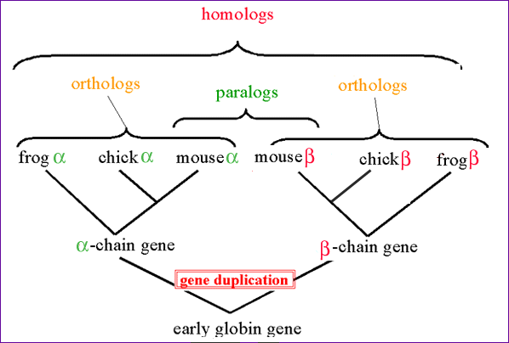
Homology

Slide 22
Similarity
Protein similarity could be due to –
Evolutionary relationship
Similar two or three dimensional structure
Common Function

Slide 23
Similarity
Globally similar sequences are likely to have the same biological function or role
Locally similar sequences are likely to have some physical shape or property with similar biochemical roles

Slide 24
Distance
The notion of distance derives its definition from the concept of mutations by assigning weights to each mutation:
Given two sequences, the distance between them is the minimal sum of weights for a set of mutations transforming one into the other.

Slide 25
Alignment
An alignment of two sequences S and T is obtained by first inserting chosen spaces, either into, at the ends of or before S and T, and then placing the two resulting sequences one above the other so that every character or space in either sequence opposite a unique character or a unique space in the other sequence.

Slide 26
Homology vs. Similarity
Similarity does not necessarily imply Homology.
Homology has a precise definition: having a common evolutionary origin.
Since homology is a qualitative description of the relationship, the term “% homology” has no meaning.
Supporting data for a homologous relationship may include sequence or structural similarities, which can be described in quantitative terms,
  % identities and E-value

Slide 27
4.3 评分模型/Scoring Model

Slide 28
Factors of Sequence Alignment
Scoring model:
a measure of similarity between elements
  Gap penalty function
  Scoring matrix
Elements =nucleotides, amino acids, gaps
Confidence assessment of alignment result

Slide 29
1. Gap Penalty Function

Slide 30
Gap (空位)
Maximal consecutive run of spaces in alignment
  Matching mRNA (cDNA) to DNA
  Shortening of DNA/protein sequences
  Slippage during replication
  Unequal crossing-over during meiosis
  …
We need to have a scoring function that considers gaps.

Slide 31
Importance of Gap
The concept of a gap in an alignment is important in many biological application
  More than just point mutations
  Genomic re-arrangement
  Introns /exons
An alignment with two large gaps may provide better/accurate insights on the evolutionary relation of two proteins as opposed to an alignment that contains many single spaces sprinkled in it.

Slide 32
Gap
Nature favors small number of long gaps compared to large number of short gaps.
Using a good gap penalty model will prevent us from giving a very low score for these alignments (since they have many consecutive indel’s in them) and allow us to find the true alignment.

Slide 33
Gap
Gap penalties
By having different gap opening and gap extension penalties.
Gap penalty models
  Constant
  Affine
    Gap open penalty
    Gap extension penalty
  Convex
  Arbitrary

Slide 34
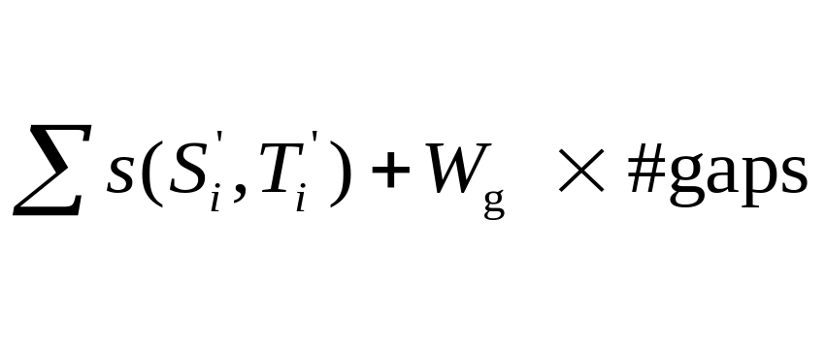
Constant Gap Penalty Model
Each individual gap (space) is free (has no weight), and each gap is given a weight of Wg independent of its length
Accounts for only the number of gaps
  Let s denote the weights of match and mismatch only ( ∀x , s(x,−) = s(−, x) = 0 )
  Let S’ and T’ represent S and T after inserting spaces.
  To find an alignment that maximizes:

Slide 35
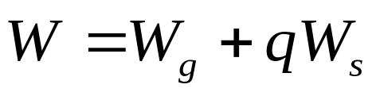
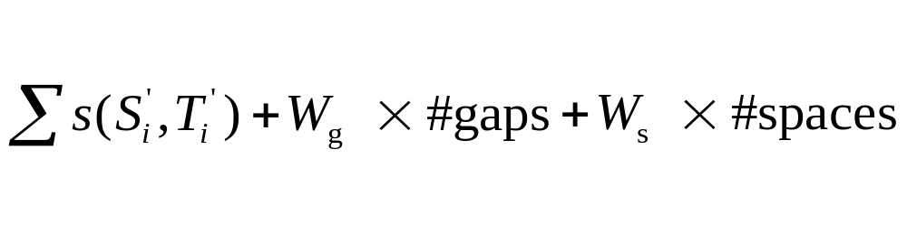
Affine Gap Penalty Model
A gap is given two weights:
    Wg is the weight to open the gap
    Ws is the weight to extend the gap with
    one more space.
The total penalty for a gap of length q is:
To find an alignment that maximizes:

Slide 36
Convex Gap Penalty Model
Each additional space in a gap contributes less to the gap weight than the previous space.
This model is said to better describe biological behavior.
Example: Wg log(q), where q is the length of the gap.

Slide 37
Arbitrary Gap Penalty Model
Any gap weight function is acceptable (this is the most general case).
Weight of a gap is an arbitrary function of its length w(q).

Slide 38
2. Scoring Matrix

Slide 39
Scoring Matrix
Scoring Matrix:
Quality of an alignment
Detection of signal above background
Detection of similarities beyond what would be observed by chance alone

Slide 40
Scoring Matrix
Amino Acid Substitution Matrices (20*20) account for probability of one amino acid being substituted for another:
  frequency of substitution - genetic code
  tolerance for changes - natural selection
penalize residues pairs with a low probability of mutation in evolution and rewards pairs with a high probability

Slide 41
Scoring Matrix
empirically derived from observed amino acid substitutions that occur between aligned residues in homologous sequences

Slide 42
Scoring Matrix
Instead of having a single match/mismatch score for every pair of nucleotides or amino acids, consider chemical, physical, evolutionary relationships:
  e. g.
  Alanine vs. valine or alanine vs. lysine? Alanine and valine are both small and hydrophobic, but lysine is large and charged.
  which substitutions occur more in nature?
Assign scores to each pair of symbol
  Higher score means more similarity

Slide 43
Scoring Matrix
Scoring Matrix: Substitution weights replacement of one residue by another:
  similar -> high score (positive)
  different -> low score (negative)

Slide 44
Scoring Matrix
DNA Scoring Matrices
  DNA is less conserved than protein sequences
  Less effective to compare coding regions at nucleotide level
Amino Acid Scoring Matrices
  PAM
  BLOSUM

Slide 45
Identity matrix for nucleic acids: simplest
Scoring Matrix for nucleic acids
 | A | C | G | T
A | 1 | 0 | 0 | 0
C | 0 | 1 | 0 | 0
G | 0 | 0 | 1 | 0
T | 0 | 0 | 0 | 1

Slide 46
Others matrix for nucleic acids
Scoring Matrix for nucleic acids
Transversion
Purine | A | G
Pyrimidine | C | T
Transition
 | A | C | G | T
A | 10 | -5 | 0 | -5
C | -5 | 10 | -5 | 0
G | 0 | -5 | 10 | -5
T | -5 | 0 | -5 | 10

Slide 47
Scoring matrix for amino acids
Not all amino acids are equal
  Some are more easily substituted than others
  Some mutations occur more often
  Some substitutions are kept more often

Slide 48
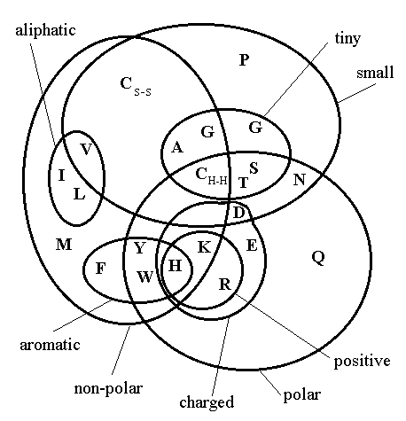
Physical Bases of Mutation Matrix
Geometry nature
Physical nature:
  Charged
  Hydrophobic…
Chemical nature
Frequencies of amino acids

Slide 49
PAM --Point Accepted Mutation
PAM
The first substitution matrices derived by Dayhoff et al. (1978)
PAM distance: Two sequences are defined to have diverged by one PAM unit if they show in average one accepted point mutation (i.e. one amino acid change) per hundred amino acids.
Derived from the pairwise alignment of sequences less than 15% divergent.

Slide 50
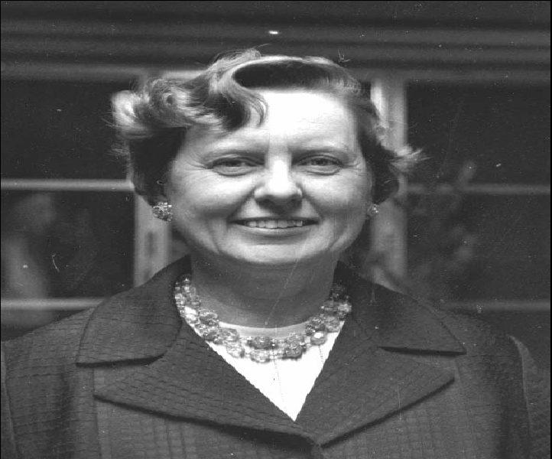
PAM
Dr. Margaret Oakley Dayhoff (1925-1983)
A Pioneer in Bioinformatics

Slide 51
PAM
PAM matrix series (PAM1, ..., PAM250):
  derived from alignment of very similar sequences
  PAM1 = mutation events that change 1% of AA
  PAM2, PAM3, ..., extrapolated by matrix multiplic.
  e.g.: PAM2 = PAM1*PAM1; PAM3 = PAM2 * PAM1
Problems with PAM matrices:
  incorrect modelling of long time substitutions, since conservative mutations dominated by single nucleotide change
  e.g.: L <–> I, L <–> V, Y <–> F
  long time: any AA change

Slide 52
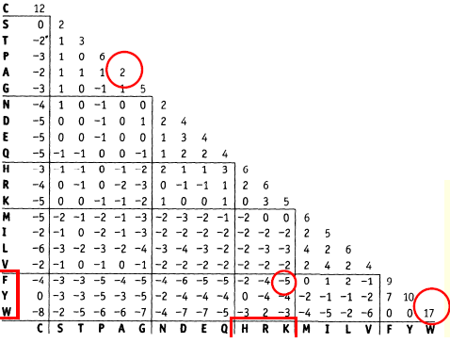
PAM250

Slide 53
BLOSUM-- BLOck SUbstitution Matrices
BLOSUM
BLOSUM (Henikoff & Henikoff, 1992)
Blocks: highly conserved regions in a set of aligned protein sequences (local multiple alignment)
Number of BLOSUM matrix (e.g., BLOSUM 62) indicates the cutoff of percent identity that defines the clusters - lower cutoffs allow more diverse sequences

Slide 54
BLOSUM
BLOSUM series (BLOSUM50, BLOSUM62, ...)
derived from alignments of distantly related sequence
BLOCKS database:
  ungapped multiple alignments of protein families
  at a given identity
BLOSUM50: better for gapped alignments
BLOSUM62: better for ungapped alignments

Slide 55
BLOSUM62 Matrix
A
R
N
D
C
Q
E
G
H
I
L
K
M
F
P
S
T
W
Y
V
4
-1 5
-2 0 6
-2 -2 1 6
0 -3 -3 -3 9
-1 1 0 0 -3 5
-1 0 0 2 -4 2 5
0 -2 0 -1 -3 -2 -2 6
-2 0 1 -1 -3 0 0 -2 8
-1 -3 -3 -3 -1 -3 -3 -4 -3 4
-1 -2 -3 -4 -1 -2 -3 -4 -3 2 4
-1 2 0 -1 -3 1 1 -2 -1 -3 -2 5
-1 -1 -2 -3 -1 0 -2 -3 -2 1 2 -1 5
-2 -3 -3 -3 -2 -3 -3 -3 -1 0 0 -3 0 6
-1 -2 -2 -1 -3 -1 -1 -2 -2 -3 -3 -1 -2 -4 7
1 -1 1 0 -1 0 0 0 -1 -2 -2 0 -1 -2 -1 4
0 -1 0 -1 -1 -1 -1 -2 -2 -1 -1 -1 -1 -2 -1 1 5
-3 -3 -4 -4 -2 -2 -3 -2 -2 -3 -2 -3 -1 1 -4 -3 -2 11
-2 -2 -2 -3 -2 -1 -2 -3 2 -1 -1 -2 -1 3 -3 -2 -2 2 7
0 -3 -3 -3 -1 -2 -2 -3 -3 3 1 -2 1 -1 -2 -2 0 -3 -1 4
A R N D C Q E G H I L K M F P S T W Y V

Slide 56
PAM vs. BLOSUM
PAM | BLOSUM
Built from global alignments | Built from local alignments
Built from small amount of Data | Built from vast amount of Data
Counting is based on minimum replacement or maximum parsimony | Counting based on groups of related sequences counted as one
Perform better for finding global alignments and remote homologs | Better for finding local alignments
Higher PAM series means more divergence | Lower BLOSUM series means more divergence

Slide 57
PAM vs. BLOSUM
Close Homolog: High cutoffs for BLOSUM (up to BLOSUM90) or lower PAM values
BLAST default: BLOSUM62
Remote Homolog: Lower cutoffs for BLOSUM (down to BLOSUM 10) or high PAM values (PAM 200 or PAM 250)
A best performer in structure prediction:
PAM250

Slide 58
4.4 比对算法/Alignment
Algorithm

Slide 59
4.4 比对算法（Alignment Algorithm）
Dotplot
Edit distance
Alignment
  Global alignment
  Local alignment
  End space free alignment
  …

Slide 60
Dot Plots
A comparison matrix n × m of sequences s and t
  n = the length of sequence s
  m = the length of sequence t
  For each coordinate, if the character in the sequence s matches the one in the sequence t , fill in the matrix.

Slide 61
Role of Dot Plots
Regions of similarity: diagonals
Insertions /deletions: gaps
  can determine intron /exon structure
Repeats: parallel diagonals
Inverted repeats: perpendicular diagonals

Slide 62
Dot Plots
A    
T    
T    
C   
A    
C   
A    
T    
A    
T A C A T T A C G T A C
Sequence 2
Sequence 1
Each diagonal corresponds to a possible (ungapped) alignment

Slide 63
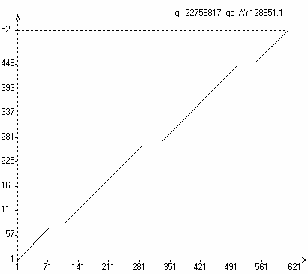
Insertions-Deletions

Slide 64
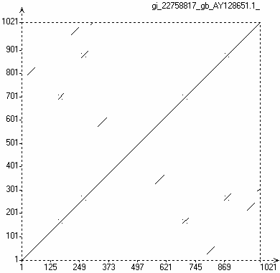

Repeats-Inverted Repeats

Slide 65
How to find optimal distance ?

Slide 66
Simplest Model: Edit Distance
Introduced by Levenshtein in 1966
Binary: match 1 / mismatch 0 (Identity Matrix)
Edit operations
  Symbol insertion
  Symbol deletion
  Symbol substitution

Slide 67
Find the optimal edit string (sequence) that achieves the desired transformation.
Optimal:
  the least number of edits?
  an edit sequence that prefers certain edit operations over others?
  an edit sequence that tries to match certain characters more often than others?
  In general, the notion of optimal depends on the particular application.

Slide 68
Edit Distance
  The edit distance between two sequences is the minimal number of edit operations (insertions, deletions, and substitutions) needed to transform one sequence into the other
  A type of global alignment
  The definition of edit distance implies that all operations are done on one sequence only

Slide 69
Example: Given two sequences
a c c t g a
a g c t a
the minimal number of edit operations required to transform one into the other is 2:

Slide 70
How do I find their optimal edit distance
Dynamic programming algorithm
Edits vs. alignments
  A sequence of edits can be converted into a global alignment.
  An alignment can be converted into a sequence of edits

Slide 71
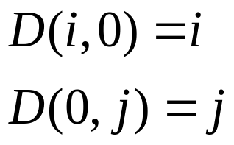
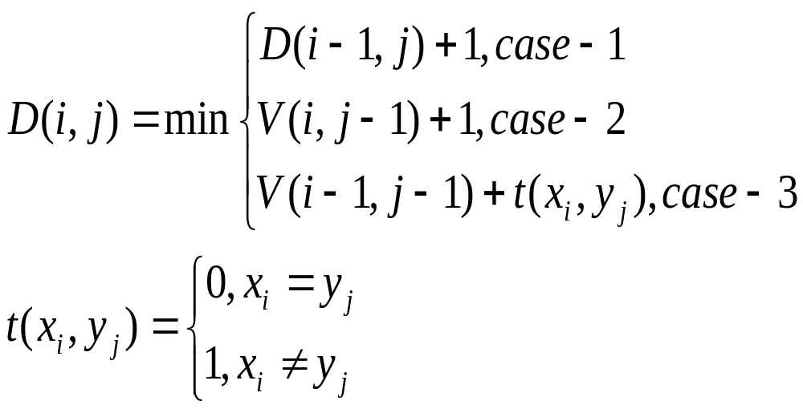
Initialization
Recurrence

Slide 72
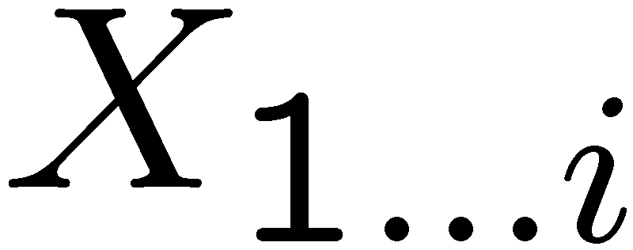
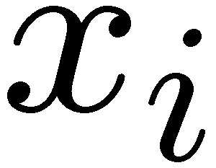
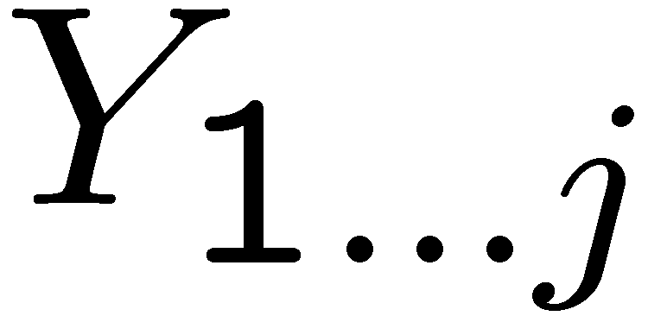

Case-1
Case-2
Case-3

Slide 73
Weighted Edit Distance
Operation-weight edit distances
Alphabet-specific edit distances

Slide 74
Operation-weight Edit Distances
Operation-specific distances
  InsCst - Insertion Cost
  DelCst- Deletion Cost
  SubstCst - Substitution Cost

Slide 75
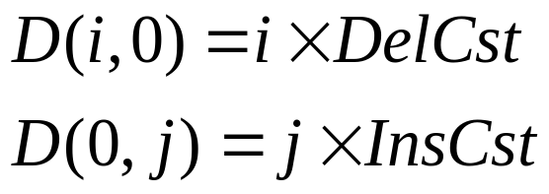
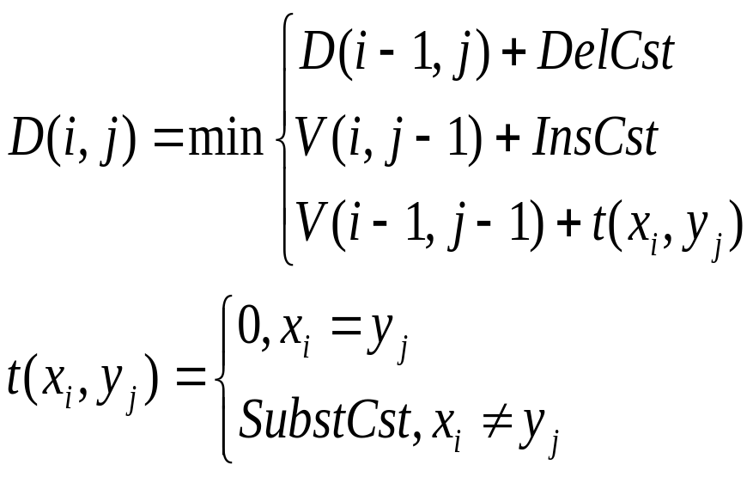
Operation-weight Edit Distances
Initialization
Recurrence

Slide 76
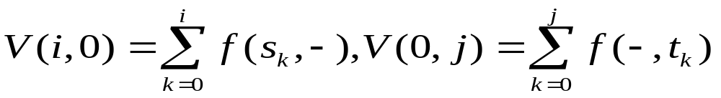
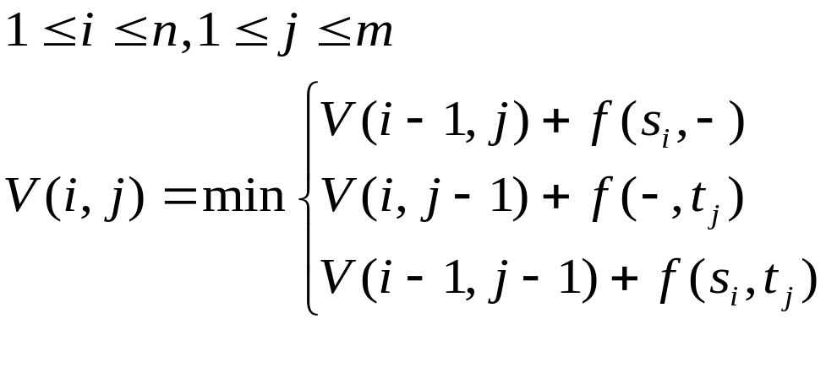
Alphabet-weight Edit Distances
Let f (s, t) the distance between characters s & t.
Initialization
Recurrence

Slide 77




Edit Graphs
An alternate solution to the edit distance problem is based on paths in a graph.
Question:
What is the shortest path from u to v?
a
p
p
l
i
e
d
p
r
i
n
c
e
weight 0
weight 1

Slide 78
How to find optimal alignment ?

Slide 79
Optimal
• One definition of optimal: an alignment in which each aligned sequence residue descended from the same ancestral residue.
• Another definition: each aligned sequence residue plays the same functional role for the two proteins.
• Typically, these two definitions are closely related.

Slide 80
Sequence alignment has optimal substructure property
  Subproblem: alignment of subsquences of two sequences
  Each subproblem is solved once and stored in a DP matrix
Dynamic Programming:
  Guaranteed to provide optimal alignment

Slide 81
Keys of DP
Initialization
Tables Filling-in
- How to Scoring ?
Traceback
- Optimal Path (alignment )

Slide 82
Global Alignment
INPUT: Two sequences S and T of roughly the same length.
QUESTION: What is the maximum similarity between them? Find the best alignment.
Local Alignment
INPUT: Two sequences S and T.
QUESTION: What is the maximum similarity between a subsequence of S and a subsequence of T? Find the most similar subsequences.

Slide 83
End-space Free Alignment
INPUT: Two sequences S and T (possibly of different length).
QUESTION: Find the best alignment between subsequences of S and T when at least one of these subsequences is a prefix of the original sequence and one (not necessarily the other) is a suffix

Slide 84
Global Alignment vs. Local Alignment
Global Alignment: the alignment of complete sequences.
  Good for comparing members of the same protein family
  Needleman and Wunsch, 1970

Slide 85
Global Alignment vs. Local Alignment
Local Alignment: the alignment of segments of sequences.
  Ignore areas that show little similarity
  Smith and Waterman, 1981
  Modified from the Needelman-Wunsh algorithm
  Can be done with heuristics (FASTA and BLAST)

Slide 86
Compute a “mini” Global Alignment to get Local
Local alignment
Global alignment

Slide 87
Needleman-Wunsch Algorithm

Slide 88
Global Alignment
Needleman-Wunsch Algorithm
INPUT: Two sequences S = s1...sn and T = t1...tm (n and m are approximately the same)
QUESTION: Find the optimal alignment.

Slide 89
Global Alignment
(0,0)
Operations:
  insertion/deletion (s(s_{i}, -) or s(-, t_{j}))
  substitution (s(s_{i}, t_{j}))
Gap penalty: h + gk
simple case: h = 0
Optimal path from (0, 0) to (n, m)
(n, m)

Slide 90
Let s(a, b) = score/weight of the alignment of character a with character b (including space)
Let V (i, j) = optimal alignment score of S1...i and T1...j (0 ≤ i ≤ n, 0 ≤ j ≤ m).

Slide 91
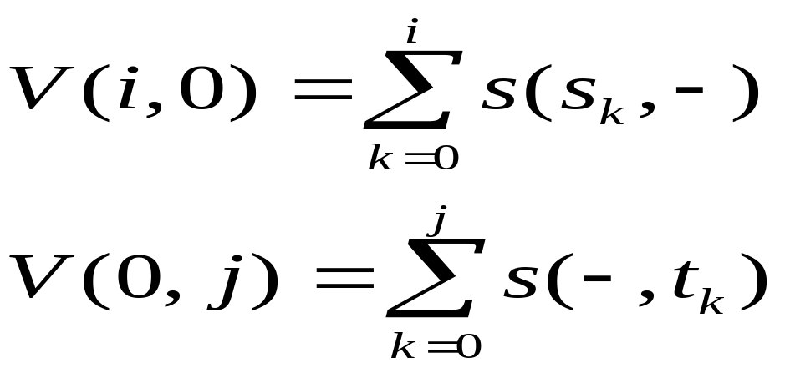
Initialization (boundary condition)

Slide 92
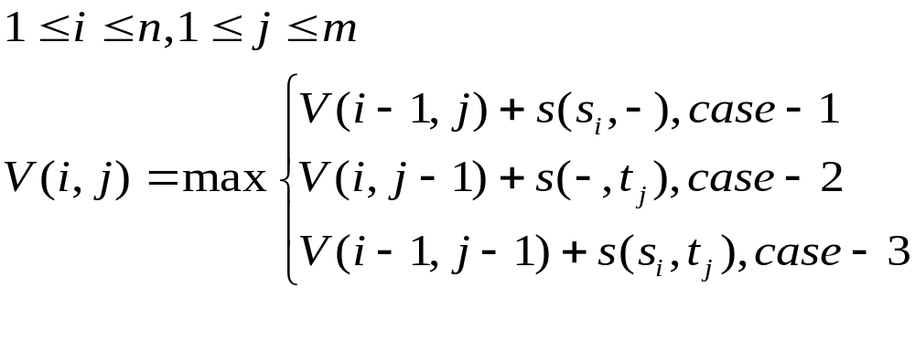
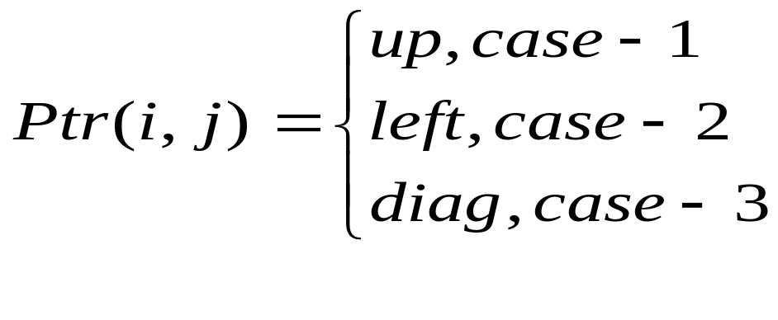
Recurrence relation:

Slide 93
Calculate V (i, j) in three ways:
Case-1: Vertical (up)
Aligning si with a space character in sequence T:
The score in this case is the score s(si, −) of aligning si with indel plus the score of aligning the previous i−1 elements of S with j elements of T (Since the space is not an original character of T)
Case-2: Horizontal (left)
Aligning tj with a space character in sequence S:
Similar to the previous case

Slide 94
Calculate V (i, j) in three ways:
Case-3: Diagonal
Aligning si with tj
The score in this case is the score s(si, tj) of aligning si with tj plus the score of aligning i−1 elements of S with j−1 elements of T

Slide 95
Moving vertically in the matrix introduces a gap in the sequence along the top edge(sequence T)
Tj
 |  | tj
 | V(i-1, j-1) | V(i-1, j)
si | V(i, j-1) | V(i, j)
Si
Moving horizontally in the matrix introduces a gap in the sequence along the left edge (sequence S)

Slide 96
Diagonal arrow:
si
tj
Vertical arrow:
si
- tj
Horizontal arrow:
- si
tj

Slide 97
Termination:
V(n, m) is the optimal score, and from Ptr(n, m) can trace back the optimal alignment

Slide 98
Time complexity: O(nm)
Space complexity:
  O(n + m): if only V (S, T) is required
  O(nm): for the reconstruction of the alignment.

Slide 99
P-value or E-value
The probability that a variate would assume a value greater than or equal to the observed value strictly by chance P(z>zo)
If the E-value found for an alignment is low (<0.001), then the alignment is probably biologically meaningful.
Pre-compute the parameters based on a statistical model

Slide 100
Example: I
A
A
C
.
.
.
0
-1
-2
-3
.
.
.
A
-1
T
-2
C
-3
.
.
.
.
.
.
-- (AAC)
AT (C)

Slide 101
A
A
C
.
.
.
0
-1
-2
-3
.
.
.
A
-1
1
T
-2
C
-3
.
.
.
.
.
.
A(AC)
A(TC)
A-(AC)
-A(TC)
-A(AC)
A-(TC)

Slide 102
A
A
C
.
.
.
0
-1
-2
-3
.
.
.
A
-1
1
0
-1
T
-2
C
-3
.
.
.
.
.
.

Slide 103
Traceback:
A
A
C
.
.
.
C
C
A C
T C
A A C
A T C
0
-1
-2
-3
.
.
.
A
-1
1
-1
0
T
-2
0
1
0
C
-3
-1
0
2
.
.
.
.
.
.

Slide 104
Example: II
Source Squence:
P A W H E A E
Target Sequence:
H E A G A W G H E E

Slide 105
Creation of an alignment path matrix
H E A G A W G H E E
0
P
A
W
H
E
A
E
-8 -16 -24 -32 -40 -48 -56 -64 -72 -80
-8
-16
-24
-32
-40
-48
-56
Boundary conditions
V(i, 0) = -i d, d=8
V(j, 0) = -j d

Slide 106
Creation of an alignment path matrix
H E A G A W G H E E
0 -8 -16 -24 -32 -40 -48 -56 -64 -72 -80
P -8
A -16
W -24
H -32
E -40
A -48
E -56
-2
-9
V(i-1, j-1) + s(s_{i} ,t_{j})
V(i, j) = max V(i-1, j) - d
V, j-1) - d
Scoring
P-H=-2
E-P=-1
H-A=-2
E-A=-1
-10
-3
V(0,0) + s(s_{i} ,t_{j}) = 0 -2 = -2
V(1,1) = max V(0,1) - d = -8 -8= -16 = -2
V(1,0) - d = -8 -8= -16
V(1,0) + s(s_{i} ,t_{j}) = -8 -1 = -9
V(2,1) = max V(1,1) - d = -2 -8 = -10 = -9
V(2,0) - d = -16 -8= -24
-8 -2 = -10
V(1,2) = max -16 -8 = -24 = -10
-2 -8 = -10
-2 -1 = -3
V(2,2) = max -10 -8 = -18 = -3
-9 -8 = -17

Slide 107
Traceback
H E A G A W G H E E
0 -8 -16 -24 -32 -40 -48 -56 -64 -72 -80
P -8 -2 -9 -17 -25 -33 -42 -49 -57 -65 -73
A -16 -10 -3 -4 -12 -20 -28 -36 -44 -52 -60
W -24 -18 -11 -6 -7 -15 -5 -13 -21 -29 -37
H -32 -14 -18 -13 -8 -9 -13 -7 -3 -11 -19
E -40 -22 -8 -16 -16 -9 -12 -15 -7 3 -5
A -48 -30 -16 -3 -11 -11 -12 -12 -15 -5 2
E -56 -38 -24 -11 -6 -12 -14 -15 -12 -9 1
0
-8
-16
-17
-25
-20
-5
-13
-3
3
-5
1
H
-
E
-
A
P
G
-
G
-
H
H
E
E
A
A
-
A
Optimal global alignment:
W
W
E
E

Slide 108
Smith-Waterman Algorithm

Slide 109
Local Alignment
Smith-Waterman Algorithm
Local alignment: Ignore badly aligning regions
Local Alignment Problem
Finding the subsequencesαof S and β of T, whose similarity (optimal global alignment) is maximal (over all such pairs of subsequences)

Slide 110
Local Alignment: Why
Ignore stretches of non-coding DNA and matching exons in DNA only
  Non-coding regions (introns) are more likely to be subjected to mutations than coding regions (exons)
  When searching for a local alignment between two stretches of DNA (from 2 different species), finding that the best match is likely to be between 2 exons.

Slide 111
Local Alignment: Why
Protein functional domain
  Proteins of different kind and of different species, often exhibit local similarities called homeoboxes. These local similarities are most probably “functional subunits” of the protein.

Slide 112
Local Alignment: Why
  Example:
    Homeobox genes have a short region called the homeodomain that is highly conserved between species.
    A global alignment would not find the homeodomain because it would try to align the ENTIRE sequence

Slide 113
Computing Local Alignment
local suffix alignment problem
Given two sequences S and T, and two indices i and j, the local suffix alignment problem is to find a (possibly empty) suffix α of S1...i and a (possibly empty) suffix β of T1...j such that the value of their alignment is maximal over all alignments of suffixes of S1...i and T1...j

Slide 114
Computing Local Alignment
Local alignment problem = the maximal solution to the local suffix alignment problem over all indices i and j of S and T

Slide 115
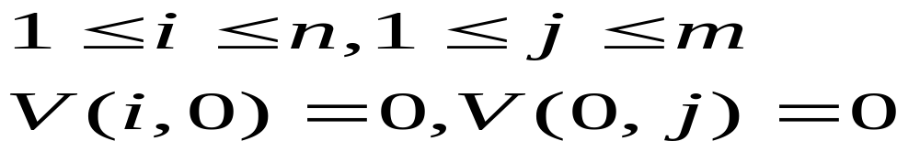
V (i, j) :
denote the value of the optimal local suffix alignment for a given pair i, j of indices.
Initialization

Slide 116
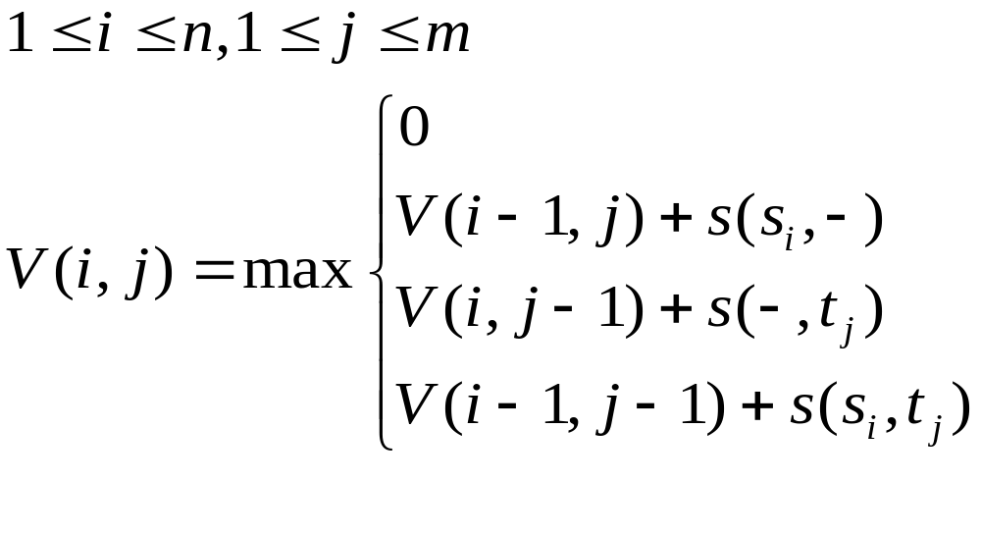
Recurrence relation:

Slide 117
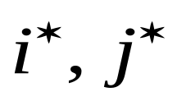
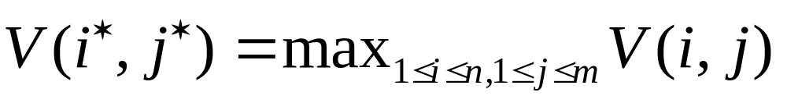
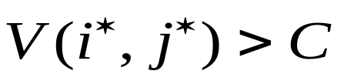
Termination:
  If want the best local alignment, compute :
  If want all the local alignments with scoring > C, compute all :

Slide 118
Traceback:
  When (i∗, j∗) is obtained
  By tracing back the pointers from cell (i∗, j∗) until reaching an entry (i, j) that has value zero, the subsequences α and β giving the optimal local alignment of S and T are found.
  Then the optimal local alignment subsequences are α = S i...i∗ and β = T j...j∗ .

Slide 119
Difference from global alignment:
  Inclusion of zero in the case of local suffix alignment
  The zero in the base conditions and in the recurrence relation allows the alignment to start anywhere in the sequences

Slide 120
Local alignment algorithm Complexity
Time complexity: O(nm)
Space complexity: O(n+m)

Slide 121
Smith-Waterman alignment
H E A G A W G H E E
0 0 0 0 0 0 0 0 0 0 0
P 0 0 0 0 0 0 0 0 0 0 0
A 0 0 0 5 0 5 0 0 0 0 0
W 0 0 0 0 2 0 20 12 4 0 0
H 0 10 2 0 0 0 12 18 22 14 6
E 0 2 16 8 0 0 4 10 18 28 20
A 0 0 8 21 13 5 0 4 10 20 27
E 0 0 6 13 18 12 4 0 4 16 26
0
5
20
12
22
28
AA
WW
G-
HH
Optimal local alignment:
E
E

Slide 122
End–space Free Alignment
(无端-空格惩罚比对)

Slide 123
End–space Free Alignment
Any number of indel operations at the end or at the beginning of the alignment contribute zero weight
End-spaces should be free is in the shotgun sequence assembly procedure
Two subsequences that are from different parts of the original sequence:
  low global alignment score
  low end-space free alignment score

Slide 124
End–space Free Alignment
Two overlapping subsequences from the set are unlikely to have the same starting position along the original sequence:
  low global alignment score
  high end-space free alignment score
  The overlap can be detected

Slide 125
End-space free alignment algorithm:
A Variant of the global alignment algorithm

Slide 126
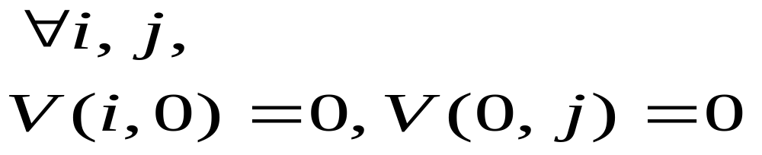
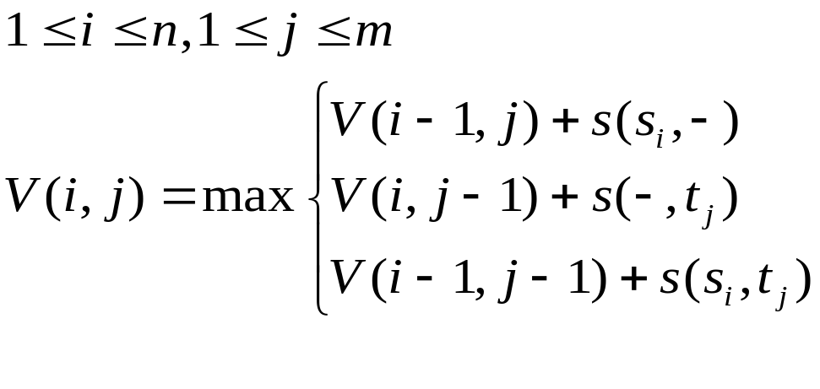
Initialization
Recurrence relation:

Slide 127

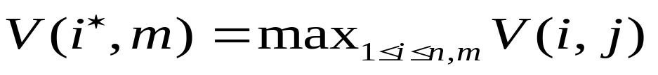
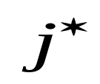
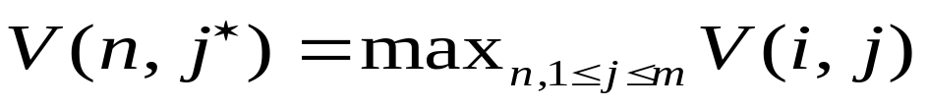
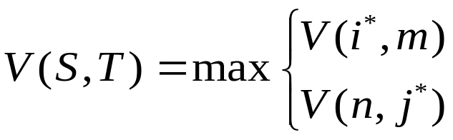
Search:
  Compute :
  Compute :
Define alignment score:

Slide 128
Complexity
Time complexity: O(nm)
Space complexity: O(n+m)

Slide 129
End–space Free Alignment
Example: Consider the two sequences:
  S = c a c t g t a c
  T = g a c a c t t g
Assigning value of 2 for match, and -1 for indel/substitution
The best global alignment will have value 1 and will look like this:
  S’ = c a c - - t - g t a c
  T’ = g a c a c t t g - - -
End-space free alignment will have value 9 and will look like this:
  S’ = - - c a c - t g t a c
  T’ = g a c a c t t g - - -

Slide 130
下周内容
4.5 具有更复杂模型的动态规划
4.6 启发式比对算法
4.7 线性空间比对
4.8 评分的意义
4.9 从比对数据推出评分参数

