Slide 1


Computational Biology
计算生物学
Zhidong DENG
Department of Computer Science
Tsinghua University
邓志东
清华大学计算机系
清华大学 • 2019秋季

Slide 2
第四章 双序列比对: 串模型方法

Slide 3
第四章 双序列比对: 串模型方法
4.5 具有更复杂模型的动态规划
4.6 启发式比对算法
4.7 线性空间比对
4.8 评分的意义
4.9 从比对数据推出评分参数

Slide 4
4.5 具有更复杂模型的动态规划

Slide 5
4.6 启发式比对算法（Sequence
Alignment Heuristics）

Slide 6
Given a query sequence, search for similar sequences in a database,
which is very important !
Use of optimal algorithms based on dynamic programming requires O(n²L) time complexity
  n is size of the query sequence
  L is the size of the database
For the current size of a sequence databases, use of optimal algorithms based on dynamic programming is not practical for database search.

Slide 7
More efficient methods are needed !!!!
  Local alignment
    Local alignment methods are more useful due to no assumption that the query protein and database sequence have similar length
  ‘Hit and extend’ sequence searching
    Useless calculations by comparing regions that have nothing in common
    Regions that are similar between two sequences are likely to share short identical segments
    Look for similar regions only near short segments that match exactly

Slide 8
A heuristic method is an algorithm that gives only approximate solution to a given problem
But heuristic methods are commonly used because they are much faster than exact
algorithms
Heuristic techniques: BLAST, FASTA, MUMmer, PatternHunter, ...

Slide 9
Ideas of heuristic method
Good alignment includes short identical, or similar fragments
Break entire string into substrings, index the substrings
Search for matching short substrings and use as seed for further analysis
Extend to the seed string and find the most significant local alignment segment

Slide 10
FASTA

Slide 11
FASTA (Fast All) algorithm
  1985 Lipman & Pearson proposed
  1988 Lipman & Pearson improved
Identify regions of the sequences with the highest density of matches.
In this step exact matches of a given length (by default 2 for proteins, 6 for nucleic acids) are determined and regions (fragments of diagonals) with a high number of matches selected.

Slide 12
Inputs
  k (word or k-tuple) size
  Scoring matrix
Compares query sequence pairwisely with each sequence in the database
Good local alignment is likely to have exact matching subsequences. FASTA uses this property and focuses on segments in which there will be an absolute identity between the two compared strings

Slide 13
Basic Definitions of FASTA
K-tup
  An integer parameter specifies the length of the matching substrings
  The standard k-tup values:
    4-6 for DNA sequences matching
    1-2 for protein sequence matching
  K-tup controls the trade-off between speed and sensitivity

Slide 14
hot spots (hit)
  The matched substrings with k-tup length
  Consecutive hot spots are located along the alignment:
    Dot-Plot matrix diagonals
    Dynamic programming matrix diagonals

Slide 15
diagonal run
  A sequence of nearby hot spots on the same diagonal
    Not necessarily adjacent along the diagonal Dynamic programming matrix diagonals
    i.e. Spaces between these hot spots are allowed

Slide 16
init1
  the best scoring run: a diagonal segment in the dynamic programming matrix
initn
  the best local alignment found by combining ‘good’ diagonal runs with indels (insertion or deletion) in between

Slide 17
Stages of FASTA
Look for hot spots
  Done efficiently by using a lookup table or a hash . For example:
    Preprocess the database and store for each possible k-tup exactly where it appears along the database sequence
    Scan the query by shifting a k-tup-long window and access each k-tup in the hash for retrieving locations in the database sequence

Slide 18
Find some (10) best diagonal runs
  In order to evaluate the diagonal runs, FASTA gives :
    each hot spot a positive score
    the space between consecutive hot spots in a run is given a negative score that decreases with distance
  The score of the diagonal run is the sum of the hot spots scores and the interspot scores.
  FASTA finds the highest scoring diagonal runs under this evaluating scheme

Slide 19
Compute init1 and diagonal runs filtration
  A diagonal run specifies an alignment
    which is composed of matches (the hot spots) and mismatches (from the interspot regions)
    but does not contain any indels because it is derived from a single diagonal
  Evaluate the diagonal runs using an amino acid (or nucleotide ) substitution matrix, and select the best scoring run: init1
  Discard diagonal runs with relatively low scores

Slide 20
  Notation:
In 1-3 stages, do not allow any indels in the sub-alignments
Combine close diagonal runs and compute initn
  Combine ‘good’ diagonal runs from close diagonals into a single larger high-scoring alignment that allows some spaces
    good diagonal runs : whose score is above some specified threshold

Slide 21
Compute initn
  Consider a narrow diagonal band in the dynamic programming matrix, centered along the init1 substrings
  The band width is dependent on the k-tup choice
  Compute the optimal local alignment in this band using dynamic programming constrained to that band
  Assuming the best local alignment is indeed within the defined band, the local alignment algorithm essentially merges diagonal runs found in the previous stages to obtain a local alignment which may contain indels

Slide 22
The database sequences are ranked according to initn scores and the full dynamic programming is used to align the query sequence against each of the highest ranking result sequences

Slide 23
Example
A-FTFWSYAIGL--PSSSIVSWKSCHVLHKVLRDGHPNVLHDCQRYRSNI
| |||||| || || |||| | | |... | :
AIPQFWSYAIERPLNSSWIVVWKSCITTHHLMVYGNERFIQYLAS-RNTL

Slide 24
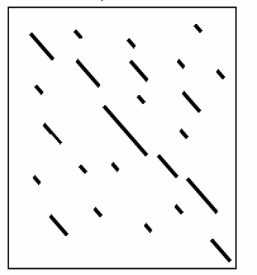
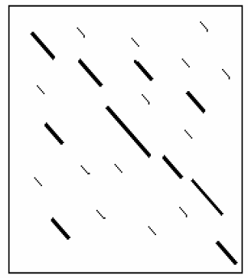
Look for hot spots
Find some (10) best diagonal runs

Slide 25
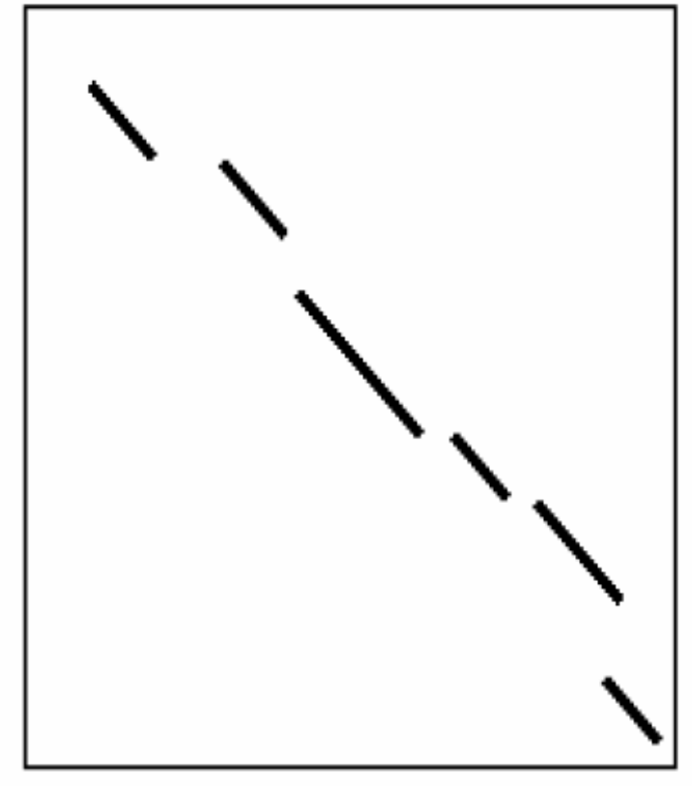
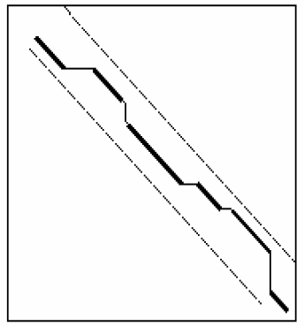
Combine close diagonal runs
with gap and diagonal runs filtration
A narrow diagonal band in the dynamic programming matrix

Slide 26
Notation:
Larger k-tuple according to
  fewer ‘hits’
  faster speed
  lower sensitivity for finding similar but not identical sequences

Slide 27
FASTA may miss some significant biology similarity
  For proteins, similar sequences do not have to share identical residues
    Asp-Lys-Val quite similar to Glu-Arg-Ile
    For 1 ≤ k-tup, don’t match
  For nucleic acids, exist codon “wobble”
  Gly-Ser-Thr-Lys
  Derived from GGU UCU ACG AAG or GGC UCC ACA AAA
  For 3≤k-tup, don’t match

Slide 28
BLAST

Slide 29
BLAST
BLAST: Basic Alignment Search Tool
  1990 Altschul proposed
  1997 Altschul improved BLAST algorithm that allows indels in the alignment
  Motivation of the development of BLAST was the need to increase the speed of FASTA by finding fewer and better hot spots
  Key concept: Seems similar to FASTA, but search for words which score at least T rather than that match exactly

Slide 30
  Key Idea of BLAST was to integrate the substitution matrix in the first stage of finding the hot spots
  Emphasis of BLAST was to find regions of high local similarity in alignments without gaps, evaluated by an alphabet-weight scoring matrix

Slide 31
Basic Definitions of BLAST
segment pair
  A pair of equal length substrings of sequence S1 and sequence S2, aligned without gaps
locally maximal segment
  A segment whose alignment score (without gaps) cannot be improved by extending it or shortening it.

Slide 32
maximum segment pair (MSP)
  A segment pair with the maximum score over all segment pairs in sequence S1 and S2
HSP: high scoring segment pair
  BLAST algorithm extends the initial “seed” hit into an HSP

Slide 33
Stages of BLAST
Given a length parameter w & a threshold T
  w: rarely varied
    for nucleotides w =∼ 12
    for amino acids w = 3 ∼ 5
  T: critical parameter determining speed and sensitivity
    Increasing T makes the number of background word hits go down and the program run faster
    Reducing T allows more distant relationships to be found

Slide 34
Finds all the w-length substrings (words) of database sequences that align with words from the query with an score at least T
  Instead of requiring words to match exactly, a word hit was made if the word taken from the database has a score of at least T when a substitution matrix is used to compare the word from the query
    Notation:
      the word size (w) to be kept high (for speed) without sacrificing sensitivity

Slide 35
Extend each hit to a locally maximal segment and check if this sequences pair is high scoring segment pair (HSP).
  Since pair score matrices typically include negative values, extension of the initial w-mer hit may increase or decrease the score.
  Extension of a hit can be terminated when the reduction in score (relative to the maximum value encountered) exceeds certain score drop-off threshold

Slide 36
Improved BLAST
1997 Altschul improved
3 times faster than the original algorithm due to much less expansions made

Slide 37
Stages of Improved BLAST
Search along each diagonal for two w-length words such that the distance between them is≤ A and their score is ≥ T.
  T can be lower than in the previous algorithm
  Expansion is done only to such pairs of hits

Slide 38
Two local alignments from different diagonals merge into a new local alignment composed of the first local alignment followed by some indels and then the second local alignment.
  This new local alignment is essentially a path in the dynamic programming matrix, composed of two diagonal sections and a path connecting them which may contain gaps
  Allow local alignments from different diagonals to merge as long as the resulting alignment has a score above some threshold
  Notation: in FASTA, only allow the diagonal to have local shifts, restricted to a band

Slide 39
Basic BLAST Algorithm
Program | Query | Database
BLASTP | Protein | Protein
BLASTN | DNA | DNA
BLASTX | Translated DNA | protein
TBLASTN | protein | Translated DNA
TBLASTX | Translated DNA | Translated DNA

Slide 40
PSI-BLAST
Position-Specific Iterated BLAST (1997)
  Distant relationships are often best detected by motif or profile searches rather than pairwise comparisons
  PSI-BLAST is a rather permissive alignment tool finding more distantly related sequences than FASTA or BLAST

Slide 41
Profile
  the vector of characters in the same position in the aligned sequences when aligning a group of amino acid sequences

Slide 42
Position-specific Score Matrix (PSSM)
  For highly conserved residues at a particular position, a high positive score is assigned, and others are assigned high negatives.
  For a weakly conserved position, a value close to zero is assigned to all the amino acid types.

Slide 43
Building a Profile
First, get multiple sequence alignments using substitution matrix, S_{jk}.
Second, count the number of occurrences of amino acid k at position i, C_{ik}.
(1) Average-score method:
W_{ij} = S_{k} C_{ik}S_{jk} / N.
(2) log-odds-ratio formula:
W_{ij} = log(q_{ij}/p_{j}).
q_{ij} = C_{ij} / N.
p_{j} : background probability of
residue j.

Slide 44
Basic idea of PSI-BLAST
  Use results from BLAST query to construct a profile matrix
  Search database with profile instead of query sequence

Slide 45
Stages of PSI-BLAST
PSI-BLAST first performs a BLAST search
PSI-BLAST uses the information from significant BLAST alignments returned to construct a position specific score matrix (PSSM), which replaces the query sequence for the next round of database searching
PSI-BLAST may be iterated until no new significant alignments are found

Slide 46
4.7 线性空间比对

Slide 47
The trackbacking algorithm requires the entire tables to be saved. The space complexity is O(nm).
The most limiting resources of string alignment is space but not time especially for comparative genomes ( the huge length of DNA sequences).
Space complexity?

Slide 48
1977 Hirschberg developed a more practical space reduction method for solving the longest common subsequence problem based on the dynamic programming
  reduce the space complexity
  from O(nm) to O(min(n, m))

Slide 49
1988 Miller & Myers obtained an optimal alignment in linear space based on the ideal of Hirschberg
  Key: align two sequences using only ‘linear space’
  The idea for the linear-space optimal alignment algorithm is to apply a divide-and-conquer strategy:
  find the “middle column” in the alignment in order to divide the alignment problem into two sub-problems which can be solved recursively

Slide 50




Global Alignment in Linear Space
For any string , let denote the reverse of string
For strings S and T, Vr(i, j) denote an optimal alignment value of the first i characters of the string against the first j characters of the string
= an optimal alignment value of the last i characters in sequence S against the last j characters in sequence T.
Let n<m.

Slide 51
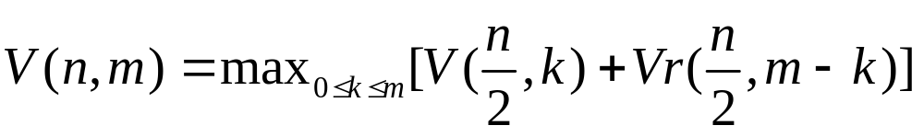
Lemma:
Split S into half, and look for a way to split T such that the left part of T aligns with the first half of S, and the right part of T aligns with the second half of S.
By finding the split point k* of T so that V(n/2, k)+Vr(n/2, m-k) , k=0,1,...,m, are maximized. Then we can obtain V(n, m).

Slide 52
Proof:
For any fixed position k in T, there is an alignment of S and T consisting of an alignment of S[1 ,. . .,n/2] and T[1, . . .,k] followed by a disjoint alignment of S[n/2 +1, . . .,n] and T[k+1, . . .,m].
By definition of V and Vr, the best alignment of the first type has value V (n/2, k) and the best alignment of the second type has value Vr(n/2,m − k ), then the combined alignment has value V (n/2, k) + Vr(n/2,m− k) ≤ V (n,m). It follows
maxk=0,1…m [V (n/2, k) + Vr(n/2,m − k)] ≤ V (n,m)

Slide 53
Conversely, for an optimal alignment of S and T, let k be the right-most position in T that is aligned with a character at or before position n /2 in S.
Then the optimal alignment of S and T consists of an alignment of S[1, . . .,n/2] and T[1, . . .,k] followed by an alignment of S[n/2 +1, . . .,n] and T[k+1, . . .,m].
Let the value of the first alignment be denoted by f and the value of the second alignment be denoted by g.

Slide 54
Then f must equal to V (n/2, k), for if f < V(n/2, k) we could replace the alignment of S[1,. . . ,n/2] and T[1 ,. . ., k] with an alignment of S[1, . . . ,n/2] and T[1, . . .,k] with value V (n/2, k ). That would create an alignment of S and T whose value is larger than the claimed optimal.
By similar reasoning, g = Vr(n/2,m − k ).
So V(n, m)=V(n/2,k)+Vr(n/2,m−k)≤maxk[V(n/2,k)+ Vr(n/2,m−k)].
We conclude that V (n,m)=maxk[V(n/2,k)+Vr(n/2,m−k)]

Slide 55
Algorithm
Compute V(n/2,k), for k=0,1,…,m, and save the value of V(n/2,k ) and the normal traceback pointers for the cell in the n/2 row.
Compute Vr(n/2,m-k), for k=0,1,…,m, and save the value of Vr(n/2,m-k ) and the normal traceback pointers for the cell in the n/2 row.
Find k* from 0 to m such that V(n/2,k) + Vr(n/2,m-k ) are maximized

Slide 56
Recursively partition the problem to two sub problems:
(i) Find the path from (0, 0) to (n/2 , k∗).
(ii) Find the path from (n, m) to (n/2 , m − k∗).
Divide-and-conquer algorithm

Slide 57
Divide-and-conquer Algorithm
  Divide problem into sub-problems.
  Conquer by solving sub-problems recursively. If the sub-problems are small enough, solve them in brute force fashion.
  Combine the solutions of sub-problems into a solution of the original problem (tricky part).

Slide 58
n/2

Slide 59
n/4
n/2

Slide 60
n/8
n/4
3n/8
n/2
5n/8
3n/4
7n/8
n

Slide 61
Compute
V(n/2,k), k=0,m
Time complexity : O(nm)
At the first Iteration,
pass through the
entire area nm
n/2
Compute
Vr(n/2,m-k), k=0,…,m

Slide 62
At the second Iteration,
pass through the area
nm/2
n/4
n/2
n/4
n

Slide 63
At the third, pass through
the area nm/4
n/4
n/2
n/4
n

Slide 64

For all iterations, pass through the area:
O(Area) = O(nm)

Slide 65
Space complexity: O(min(n, m))
  Using 2 columns of space, we can compute, for k = 1…m, V(n/2, k), Vr(n/2, m-k)
  Traceback pointers for the cell of row n/2 of V(n/2, m) and the cell of row n/2 of Vr(n/2, m)

Slide 66
4.8 评分的意义

Slide 67
The larger score is usually more significant:
How large?
Want to provide a universal measure for inferring homology
How to distinguish:
  Biologically meaningful alignment
  Just “best” alignment between entirely unrelated sequences

Slide 68
Factors should be taken into account :
  Sequence length: longer sequences are expected to give higher scores
  The number of the sequences in the database: the score of the best alignment is expected to be higher for a larger DB
  Evolution time: longer evolution causes more mismatches, making a lower score more significant

Slide 69
A method to asses the statistical significance of the alignment is needed (is an alignment biological relevant)
Need a normalized (bit) score to compare different alignments, based on different scoring systems, e.g.，different substitution matrices

Slide 70
How much different is the alignment score found from scores obtained by aligning random sequences to the query sequence?
What is the probability that an alignment with this score could have arisen by chance?

Slide 71
Evaluate the probability that a score between random or unrelated sequences will reach the score found between two real sequences of interest:
  If that probability is very low, the alignment score between the real sequences is significant.
  SCORE-1 = the score of Random sequences
  SCORE-2 = the score of Real sequences
  If SCORE-2 > SCORE-1, then the alignment between the real sequences is significant

Slide 72
Basic Statistics
Binomial Distribution
Poisson Distribution
Normal Distribution
Extreme Value Distribution
……

Slide 73
Statistical significance measures:
    Bit-score
    p-value
    E-value

Slide 74
Bit-score
  － Similar to alignment score
  － Normalized
  － Higher means more significant

Slide 75
p-value
  the probability of obtaining a score equal or greater than s by chance
  The closer the P-value is towards 0, the better the alignment
E-value
  Expectation value
  expected number of sequences that will produce same or better score by chance in a database
  The lower the E value, the more significant the score
• Relationship between E-value and p-value:
  In a database containing N sequences E = P x N

Slide 76
Compute statistical significance ?
  Bayesian approach: Model comparison
  Significance of local alignments
  Bit Score
  Significance of global alignments

Slide 77
Bayesian approach: Model comparison (1)
M: model for related sequences
R: model for unrelated sequences (random)
Ungapped alignment n = m
Alignment of each pair is independent

Slide 78
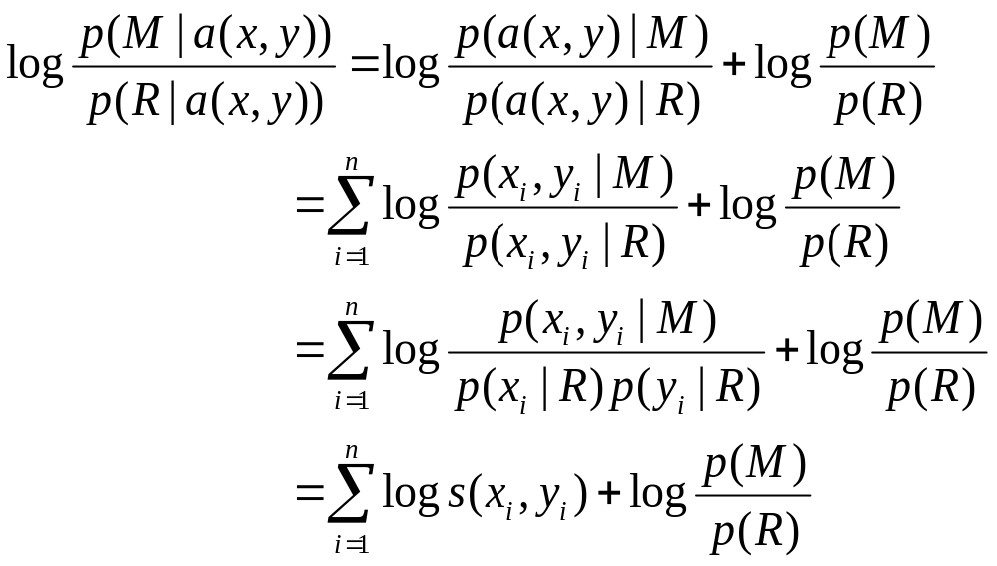
Bayesian approach: Model comparison (2)
Scoring
Prior

Slide 79
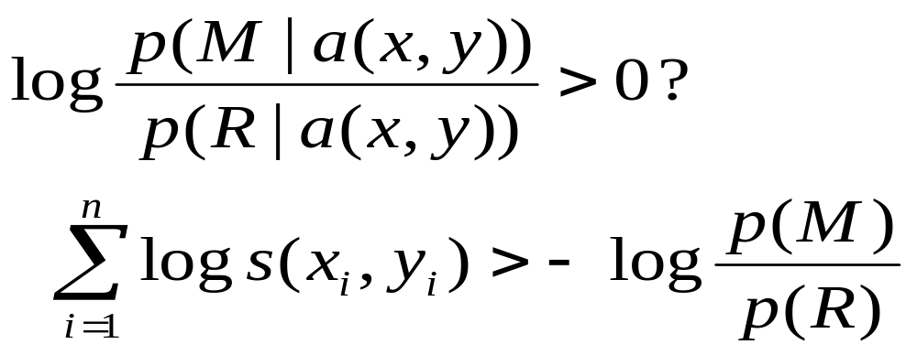
Bayesian approach: Model comparison (3)

Slide 80
Significance of Local Alignments
Significance of local alignments without gaps
  Theoretical work: Karlin-Altschul statistics: --> Extreme Value Distribution
Significance of local alignments with gaps
  Empirical studies: --> Extreme Value Distribution

Slide 81
Significance of Local Alignments without Gaps (1)
Analytical results (Karlin and Altschul, 1990)
Karlin and Altschul observed that in the framework of local alignments without gaps: the distribution of random sequence alignment scores follow an approximately Poisson distributed

Slide 82
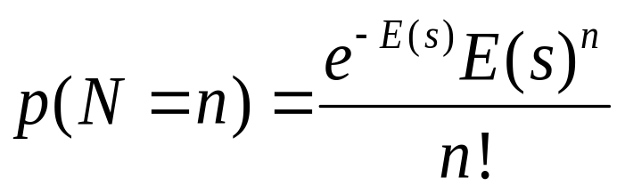
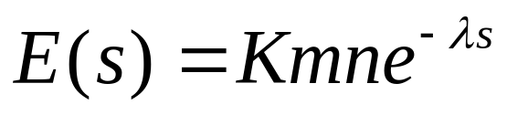
Significance of Local Alignments without Gaps (2)
The number of unrelated local matches with score higher than s is approximately Poisson distributed
where E(s) is the mean

Slide 83

Significance of Local Alignments without Gaps (3)
  K has little effect on the statistical significance of a similarity score
  􀈜 is closely related to the scoring matrix used and it takes into account that the scoring matrices do not contain actual probabilities of coccurrence, but instead a scaled version of those values
  n,m: the length of seqences

Slide 84
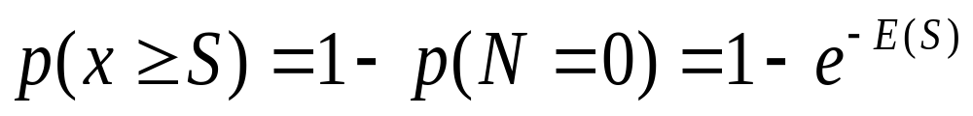
Significance of Local Alignments without Gaps (4)
P-value
  A kind of Gumbel distribution

Slide 85
Significance of Local Alignments with Gaps
No analytical theory
Simulation results to suggest that gapped alignment scores for random sequences follow the same form of extreme value distribution.

Slide 86

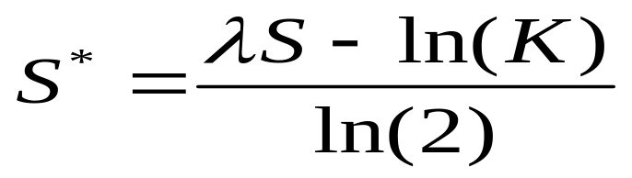
Bit Score (1)
Raw alignment scores have little meaning without knowledge of the scoring scheme used for the alignment, or equivalently of the parameters K and
Bit Score

Slide 87
Significance of global alignments
Not much is known!
Statistics based on Monte Carlo simulations
  － shuffle one sequence
  － recompute alignment to get a
  distribution of scores

Slide 88
4.9 从比对数据推出评分参数

Slide 89
PAM
PAM:
  Point Accepted Mutations
  Percent of Accepted Mutations
1978 Margaret Dayhoff: PAM
  examined 1572 accepted mutation between 71 super-families of closely related sequences of proteins
  noticed that the substitutions that occurred in families of closely related proteins were not random
  concluded that some amino acid substitutions occurred more readily than others

Slide 90
PAM
  Use PAM units to measure the amount of evolutionary distance between two amino acid sequences
  Evolutionary distance of one PAM , if sequence S has converted to sequence T with an average of one accepted point-mutation event per 100 amino acids
  ‘Accepted’ means a mutation that was incorporated into the protein and passed to its progeny
    either the mutation did not change the function of the
    protein or the change in the protein was beneficial to the organism

Slide 91
PAM matrices: amino acid substitution matrices that encode the expected evolutionary change at the amino acid level
Each PAM matrix is designed to compare two sequences which are a specific number of PAM units apart
  For example - PAM120 matrix :
    The score it gives a pair of sequences is the (log of the) probabilities of such sequences evolving during 120 PAM units of evolution

Slide 92

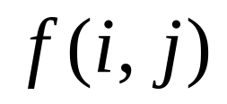
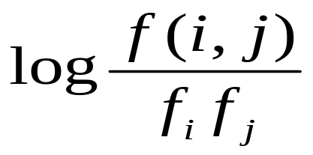
PAM
Align many proteins that are very similar
for each amino-acid i, estimate the natural frequency
For each pair of amino-acids i and j, estimate the frequency of alignment
(i, j) entry for ideal PAM matrix

Slide 93
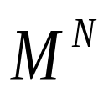
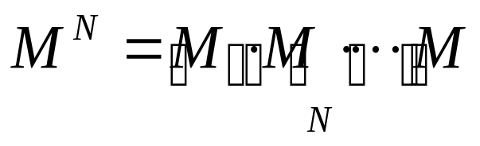
Let M(i, j) = frequency (= estimated probability) of amino acid i mutating into amino acid j during one PAM unit of evolutionary change
the matrix gives the probabilities of any amino acid mutating to any other during N PAM units

Slide 94
A matrix with an evolutionary distance of 0 PAMs would have ones on the main diagonal and zeros elsewhere
A matrix gives the probabilities of any amino acid mutating to any other during N PAM units
PAM-N matrix = PAM1 matrix multiplied by itself N times

Slide 95
Let M(i, j) = frequency (= estimated probability) of amino acid Ai mutating into amino acid Aj during one PAM unit of evolutionary change
the matrix gives the probabilities of any amino acid mutating to any other during N PAM units

Slide 96
A matrix with an evolutionary distance of 0 PAMs would have ones on the main diagonal and zeros elsewhere
A matrix gives the probabilities of any amino acid mutating to any other during N PAM units
PAM-N matrix = PAM1 matrix multiplied by itself N times

Slide 97
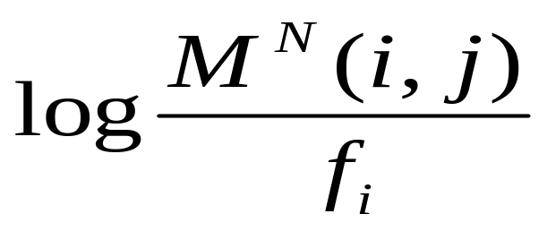
(i, j) entry of PAM N matrix

Slide 98
第四章 双序列比对: 串模型方法
本章结束

