Slide 2
⚠️
Duplication Problem
Isoform Problem

Slide 3
?
Quake 8/15
Sample | Percent_Duplication
SRR6481081 | 0.9315
SRR6481082 | 0.9706
SRR6481083 | 0.9159
SRR6481084 | 0.9445
SRR6481085 | 0.8255
SRR6481086 | 0.9101
SRR6481087 | 0.8177
SRR6481088 | 0.9146
dup
Read1 chr1 11111 ATCG …
Read2 chr1 22222 GCTA …
Read3 chr1 33333 AAAA …
Read4 chr1 33333 AAAA …
Read5 chr1 55555 CTAC …
de_dup
Read1 chr1 11111 ATCG …
Read2 chr1 22222 GCTA …
Read3 chr1 33333 AAAA …
Read5 chr1 55555 CTAC …
Percent_Duplication：1/5

Slide 4
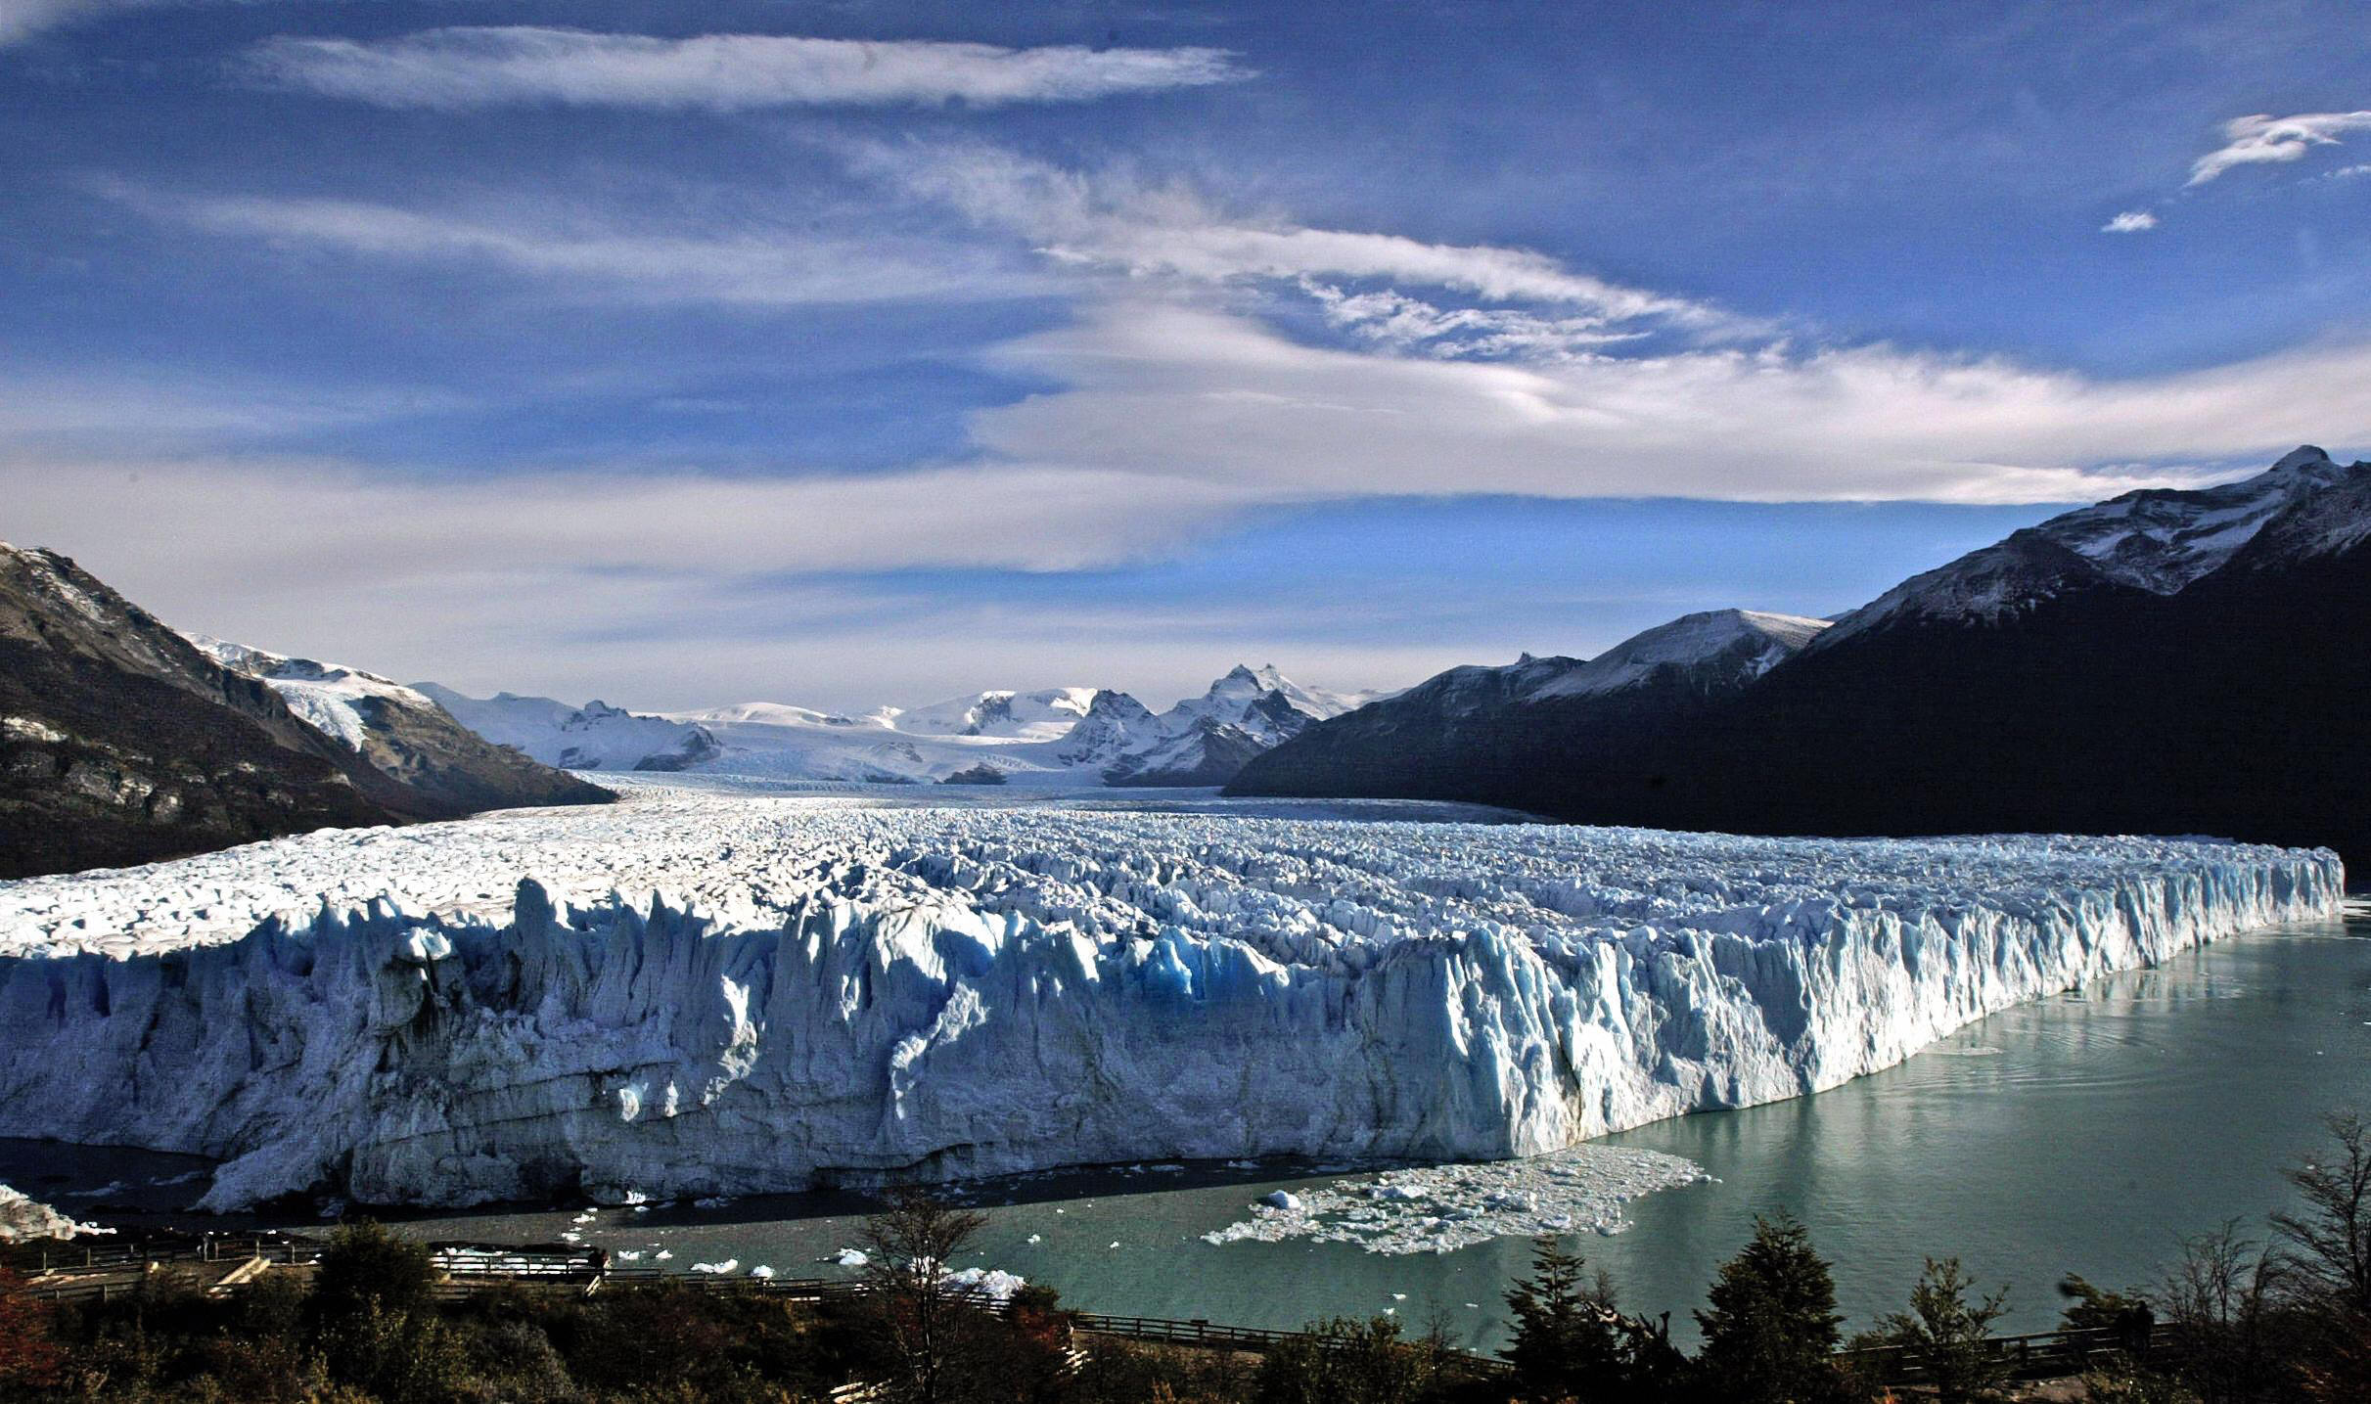


How to confirm it
check untrimmed reads if unique or not
have a detailed understanding of the de_dup process
Ice(solid) melting and flow water

Slide 5
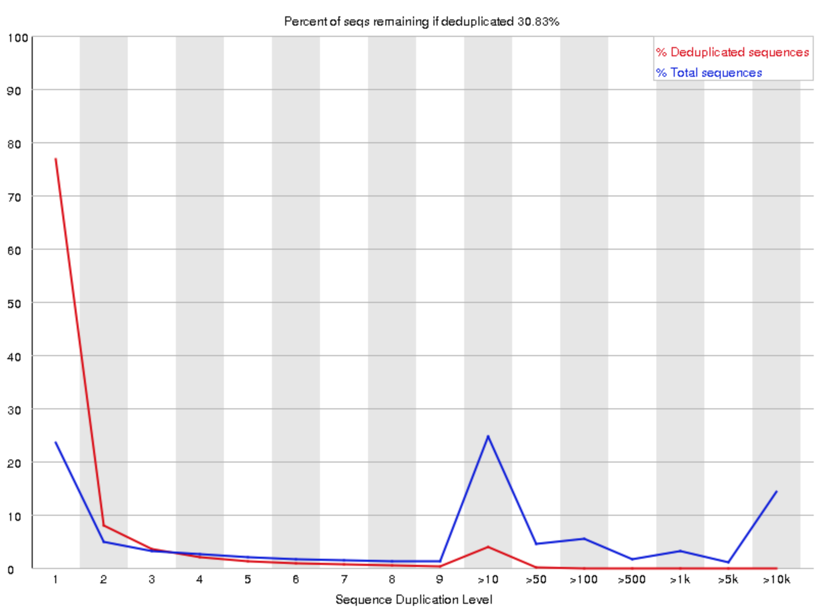
Seqs Duplication level
How to understand?

Slide 6
An example
Fastq: 10 unique reads + 1 read present 10 times
 | 1 | 10
Total | 10/20 | 10/20
Unique | 10/11 | 1/11
55% = 11/20 in the header

Slide 7
Check reads
How to understand?

Slide 8
Fastq file
ATCG …
GCTA …
…
AAAA …
…
AAAA …
CTAC …
…
TCAG …
~20%
Preliminary Conclusion
FASTQ files contain
duplicated reads

Slide 9

Abnormal
Sample | Percent_Duplication
SRR6481081 | 0.876976
1-0.8769 != 30.83%
But how the number 30.83% in the header is unequal to the number calculate by Picard MarkDuplicate

Slide 10
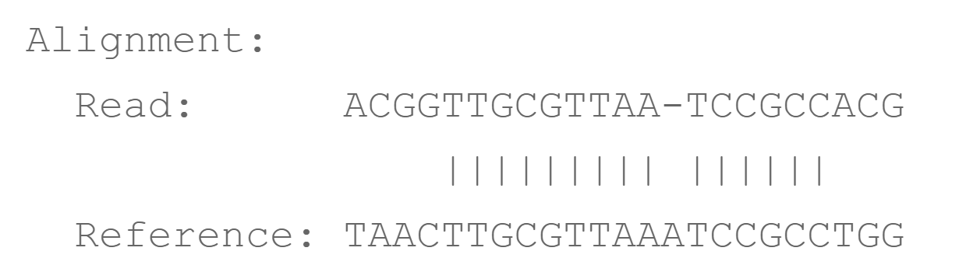
judging the read unique is not just relying on all its entire sequence？
Local alignment example
--sensitive-local

Slide 11
Comparison between --end-to-end mode with --local mode
mode | Percent_Duplication
--end-to-end | 0.88
--local | 0.9
The unique read judged as duplicated read hardly happen?

Slide 12
So why is duplication percentage sooo...so high, >1-30.83%
We perform de_dup operation
read | Chr_Num | location | flag
read1 | chr1 | 123 | 0
read2 | chr1 | 123 | 1
read2 | chr1 | 456 | 0
Count reads which are unique as flag equals to 0 when chr_num and location are same, dup profiling
Count reads when chr_num and location are same, de_dup profiling

Slide 13
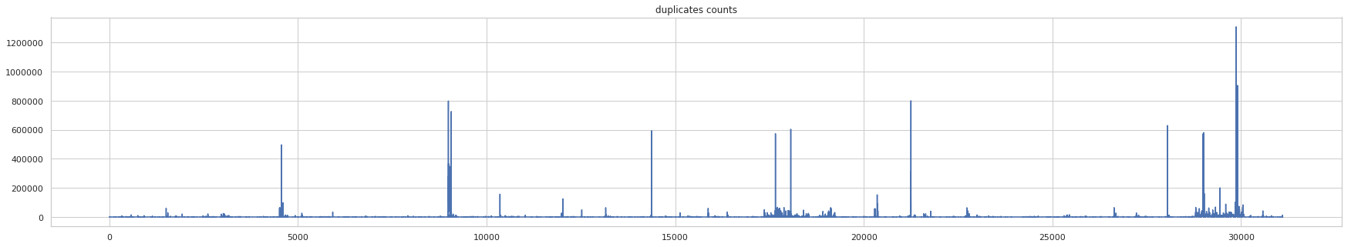
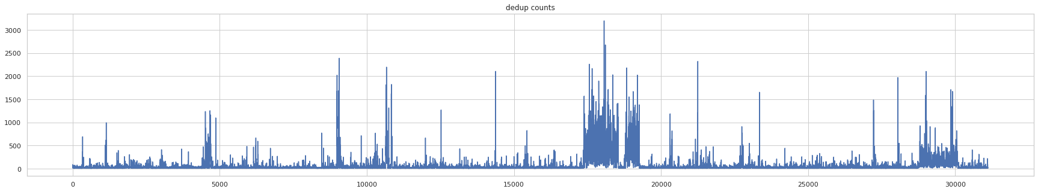
Genomic Duplication Profiling
dup profiling
de_dup profiling

Slide 14
To search for locus where de_dup to a large extend
locus | Read_count_dup | Read_count_dedup | Dedup_rate
123 | 6 | 1 | 5/6
456 | 7 | 1 | 6/7
789 | 8 | 2 | 6/8
Add a new columns, dedep_rate = (dup – dedup)/dedup
Actually, duplication percentage =
(dup.all – dedup.all)/dedup.all
dedep_rate represent refined duplication percentage
Notes:
打个比方，一家人花的钱有点多，但是不知道原因

Slide 15
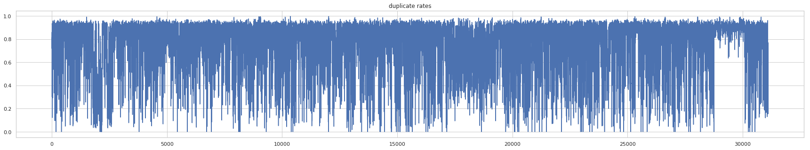

Slide 16
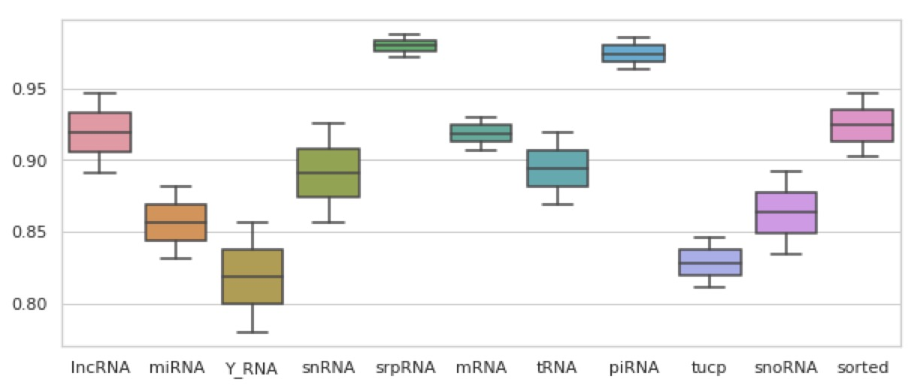
locus type Duplication Profiling

Slide 17
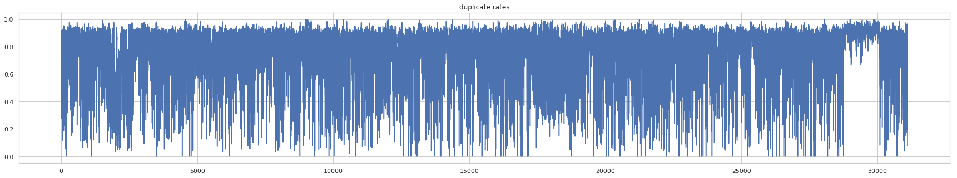
reproducibility
Sample 1
Sample 2

Slide 18
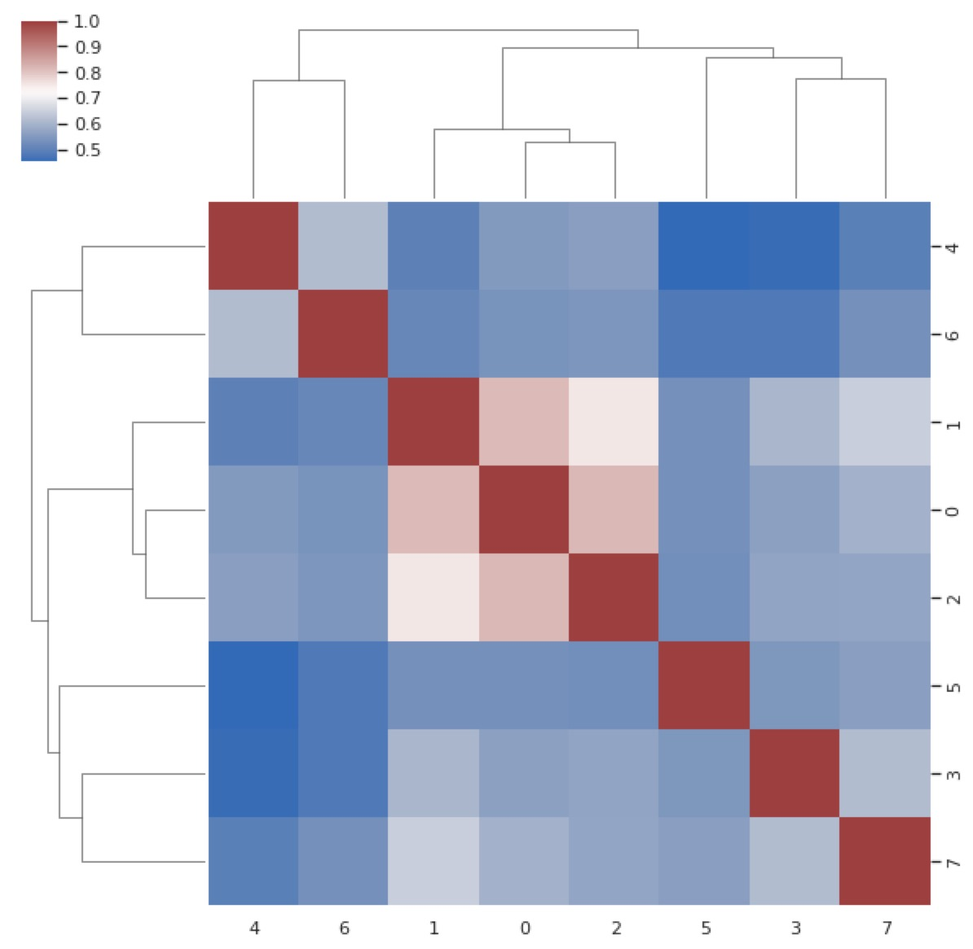
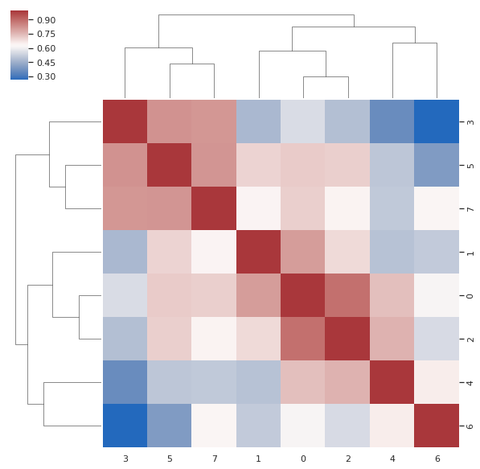
reproducibility

Slide 19
Review
Seqs Duplication contributes to high duplication percentage
Duplication percentage can be refined
The impact of Seqs Duplication on duplication percentage is unknown. Assuming Picard works well for aligned reads duplication, the impact is full.

