Slide 1




Cranberries and Heat Stress
Yield and Temperature Analysis
Group 5
STAT 628 Data Science Practicum Spring 2026

Slide 2
Yield Analysis: Long-Term Experiment
No significant heat effect on yield
Mullica Queen produces 280g more healthy fruit than Stevens (p = 0.002).
OTC heat treatment shows no significant effect on yield
(p = 0.19).
Only 4 biological replicates per group — limited statistical power.
Mullica Queen
Stevens
Healthy Fruit Weight (g)
1000
800
600
Control
OTC
Control
OTC
Model: Blocking ANOVA with set pair as fixed block + permutation test for robustness.
2 / 10

Slide 3
Yield Analysis: Acute Heat Reduces Healthy Fruit Weight
OTC reduces yield by 155g (p = 0.001)
OTC (orange) consistently yields less than Control (blue).
Mean reduction: 155g
per plot (p = 0.001).
No dose–response: 1 pulse causes the same damage as 4 pulses.
Mullica Queen
Stevens
1300
Healthy Fruit Weight (g)
1100
900
700
500
A
B C
D A B C
D
Treatment (A = 4 pulses, B = 3, C = 2, D = 1)
Control Heat Treatment (OTC)
Model: Healthy weight = 1011 − 155 × Heat − 69 × Stevens + ε, R² = 0.29
3 / 10

Slide 4
Yield Analysis: Acute Heat Increases Fruit Rot
OTC increases rotten odds by 3.8× (p < 0.001)
Control rotten rate:
1–5%.
OTC rotten rate:
5–37%.
OTC increases odds of rot by 3.8 times.
Mullica Queen
Stevens
Rotten Fruit (% by Weight)
30
20
10
0
A
B C
D A B C
D
Treatment (A = 4 pulses, B = 3, C = 2, D = 1)
Control Heat Treatment (OTC)
Model: Quasibinomial GLM on raw counts — appropriate for proportion data with varying denominators.
4 / 10

Slide 5
Yield Analysis: No Dose–Response
All treatments cause similar yield loss
Each dot = one OTC–Control pair.
Nearly all dots below zero: heat reduced yield.
Treatment A (4 pulses) ≈
D (1 pulse).
Suggests a threshold effect: even one 2-hour pulse at 35–40◦C is enough to cause damage.
Weight Difference: OTC − Control (g)
250
0
−250
−500
A
B
Treatment
C
D
Cultivar Mullica Queen Stevens

Slide 6
Yield Analysis: Summary
Finding | Detail | p-value
Long-term OTC | No detectable yield effect | 0.19
Acute OTC reduces yield | −155g healthy fruit per plot | 0.001
Acute OTC increases rot | Odds ratio = 3.8× | < 0.001
No dose–response | 1 pulse ≈ 4 pulses | All > 0.2
Cultivar matters | Mullica Queen yields more | 0.002

Slide 7
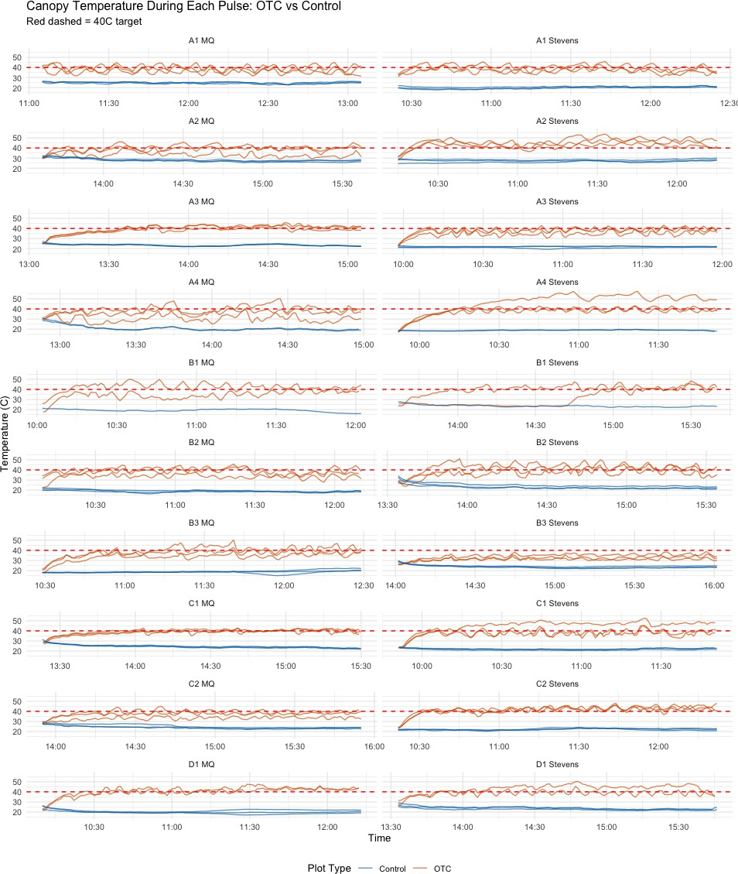
Temperature & Relative Humidity Analysis
OTC created real heat stress
Control plots stayed around 20–25◦C.
OTC plots often reached 35–45◦C.
The temperature gap was clear across all acute heat pulses.
This shows that the OTC treatment successfully created strong heat exposure.

Slide 8
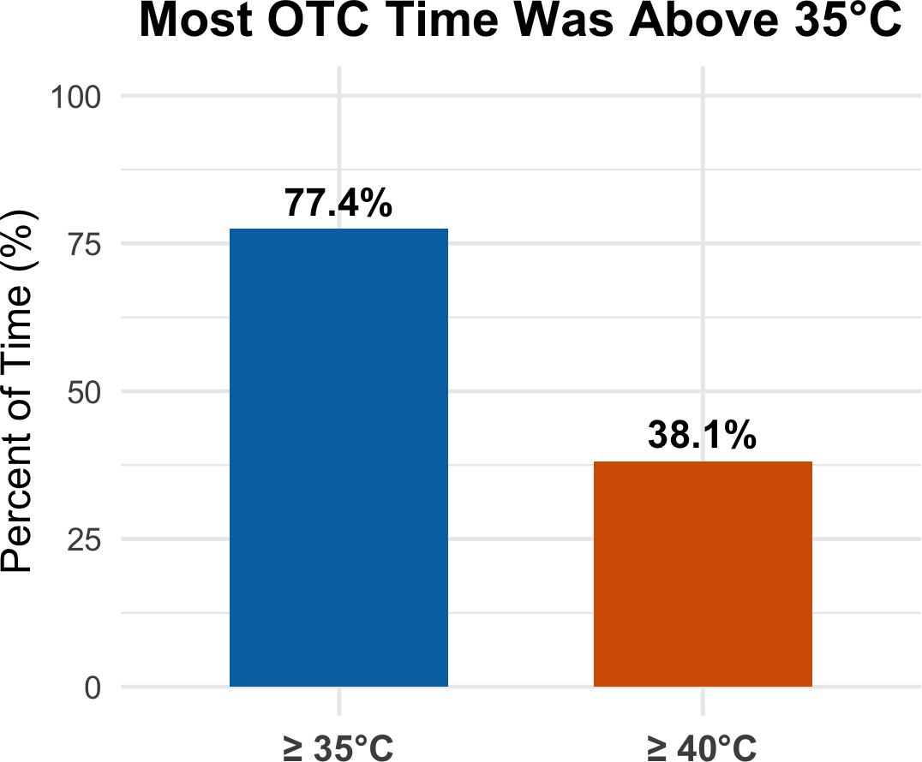
Temperature & Relative Humidity Analysis
Evidence for a temperature threshold
40◦C was the target, but it was not always maintained.
Even so, about 77% of OTC time was still above 35◦C.
This suggests that fruit damage may begin around 35◦C.
It also helps explain why treatments A–D showed similar yield results.

Slide 9
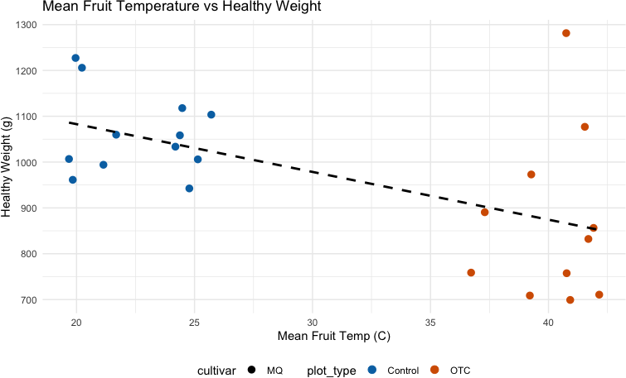
Temperature & Relative Humidity Analysis
Higher fruit temperature was linked to lower yield
Higher fruit temperature was associated with lower healthy fruit weight.
The pattern appears in both cultivars.
This links actual heat exposure to yield loss.
It supports the acute yield results shown earlier.

Slide 10
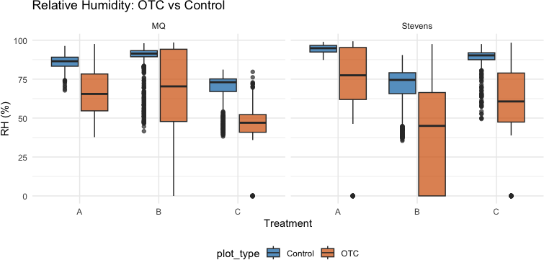
Temperature & Relative Humidity Analysis
OTC also created a hotter and drier environment
OTC plots had lower relative humidity than control plots.
This created a hotter and drier environment around the fruit.
Such conditions may increase fruit damage and rot risk.
This may help explain the higher rotten rate
under OTC.

Slide 11
Conclusions, Limitations, & Future Directions
Conclusions:
Long term heat experiment did not show significant results
Acute experiment significantly reduced yield and increased rot
Limitations:
Errors in sensors
Small number of bio replicates – limits power
Future Directions:
Increase N
Quality analysis based on gallic concentration

