Slide 1
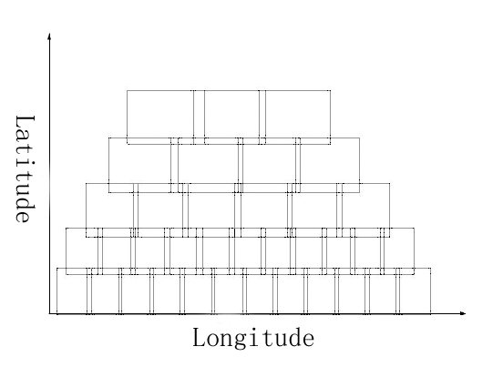
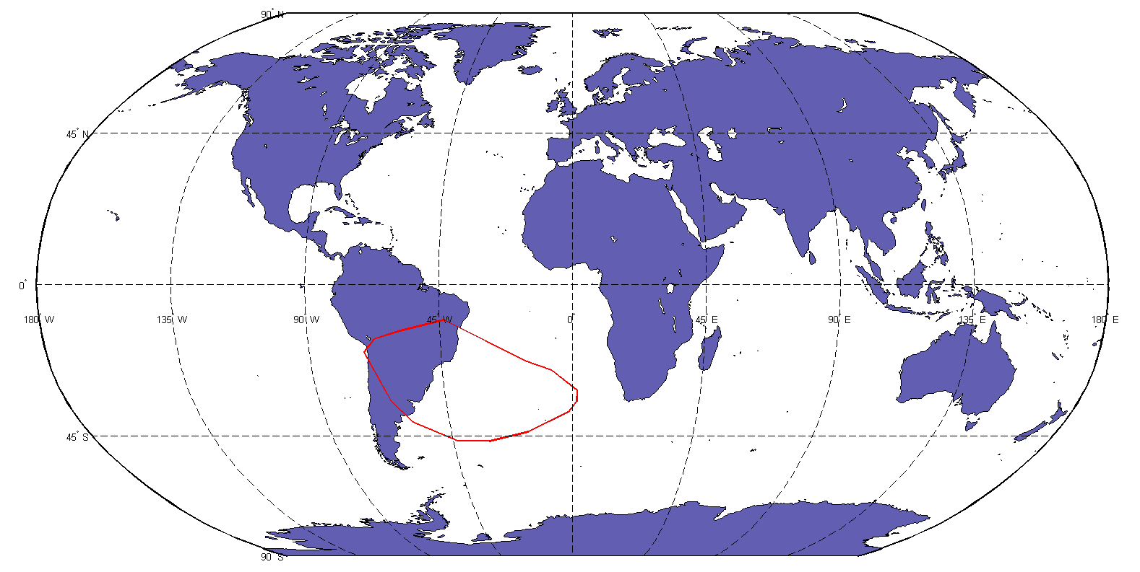
Operations Conditions
LOS to Sun ≥50°
LOS to Moon ≥40°
LOS to Earth limbs ≥70°/30°
Field stitching
Electricity balance
Slew rate & settling time
SAA standby, relay tracking, engineering down time, orbital adjust., docking for maintenance, …
SAA

Slide 2
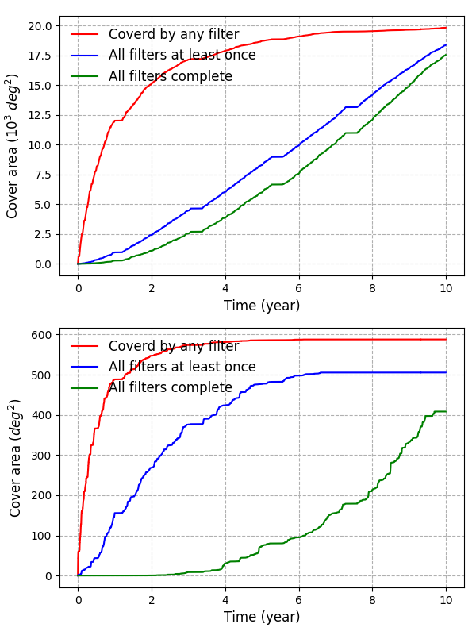
Operations Simulations
The Galactic plane & ecliptic plane can be observed!
Wide-Field: 17540 deg^2
Ultra-Deep: 408 deg^2

Slide 3
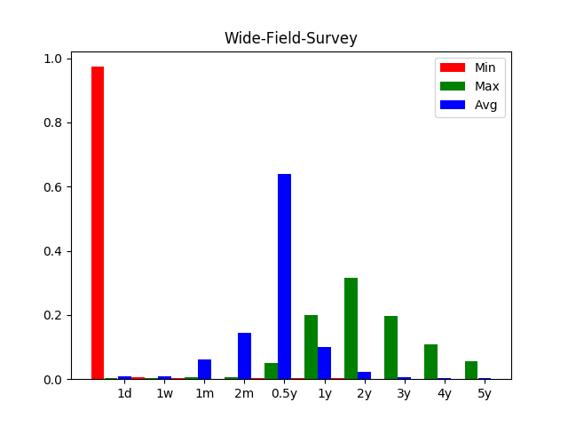
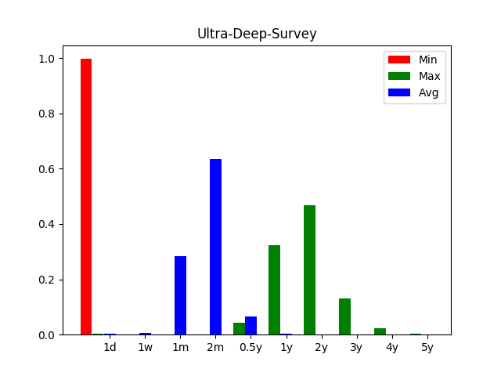
Operations Simulations
Time between two visits, regardless the filter.
Given that the CSS-OS is an LEO mission for large-area survey, it is difficult to schedule visits at a fixed cadence without impacting the survey efficiency. However, it has some time-domain capability, especially for investigations that are insensitive to color.

