Slide 1
Final Project Airliner_Safety_Analysis
Yuhan Xu
METCS777 O1

Slide 2
Data Descrption
The "Airline Safety" dataset provides a comprehensive overview of various safety metrics related to different airlines, with a particular focus on incidents, fatal accidents, and fatalities. The data spans over three decades, from 1985 to 2014, and is intended to facilitate an exploration into the historical safety records of airlines. This dataset was utilized in the analysis presented in the story "Should Travelers Avoid Flying Airlines That Have Had Crashes in the Past?".

Slide 3
Data Descrption
Source: https://www.kaggle.com/datasets/danoozy44/airline-safety
Key Features:
airline | avail_seat_km_per_week
incidents_85_99 | fatal_accidents_85_99
fatalities_85_99 | incidents_00_14
fatal_accidents_00_14 | fatalities_00_14
fatalities_per_fatal_accidents_85_99 | fatalities_per_fatal_accidents_00_14

Slide 4
Data Descrption
Potential Use-Cases:
1. Safety Analysis: Analyzing the safety performance of different airlines over the specified periods.
2. Risk Assessment: Evaluating the risk factors associated with various airlines based on historical incidents and fatalities.
3. Trend Analysis: Identifying trends in airline safety and incidents over time.
4. Comparative Analysis: Comparing the safety metrics of different airlines to determine relative safety standings.

Slide 5
Research Question
How do historical incidents, fatal accidents, and fatalities correlate with the size and extent of airline operations, and can we predict future safety metrics based on this historical data?

Slide 6
Machine Learning Model
Regression Analysis: Given that the dataset contains numerical and time-series data, a regression model will be apt to analyze the relationships between different safety metrics and the operational size of airlines. Additionally, regression analysis can help predict future safety metrics based on historical data, providing valuable insights into potential future trends or risks in airline safety.

Slide 7
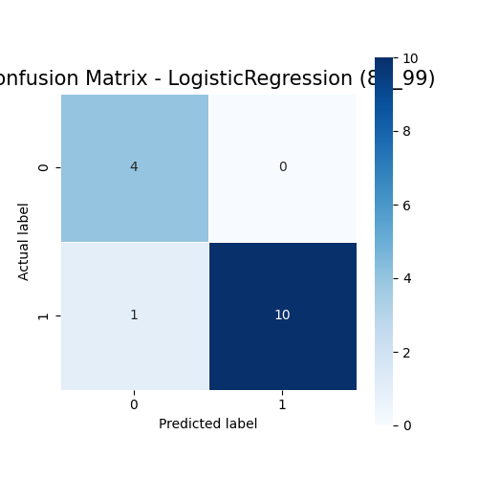
1:Logistic Regression
- Accuracy: 93.33%
- F1 Score: 93.54%
- Precision: 94.67%
- Recall: 93.33%
- AUC: 90.91%
- TP: 10, TN: 4, FP: 0, FN: 1
Model Performance(1985-1999)

Slide 8
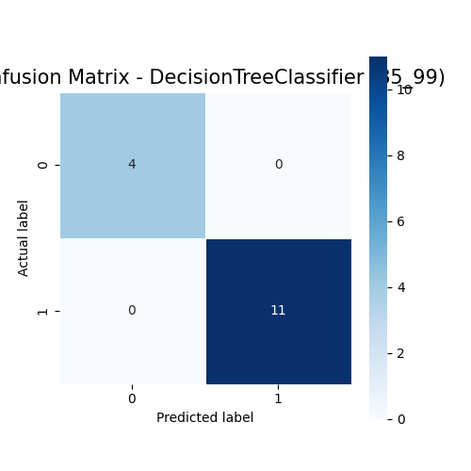
2: Decision Tree
- Accuracy: 100%
- F1 Score: 100%
- Precision: 100%
- Recall: 100%
- AUC: 100%
- TP: 11, TN: 4, FP: 0, FN: 0
Model Performance(1985-1999)

Slide 9
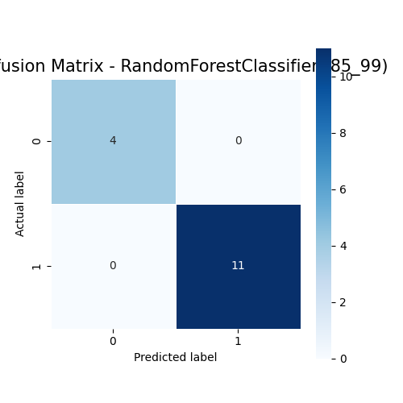
3: Random Forest
- Accuracy: 100%
- F1 Score: 100%
- Precision: 100%
- Recall: 100%
- AUC: 100%
- TP: 11, TN: 4, FP: 0, FN: 0
Model Performance(1985-1999)

Slide 10
Model Performance(1985-1999)
4: Baseline Model (Predict all as 1) Accuracy: 0.7333333333333333
5: Regression Model: Linear Regression R-Squared (R2) on test data = 1.0
Root Mean Squared Error (RMSE) on test data = 6.704864714241624e-15

Slide 11
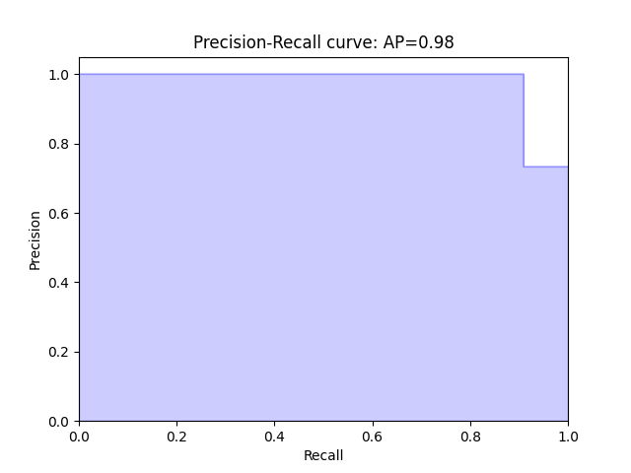
Model Performance(1985-1999)
Precision-Recall Curve

Slide 12
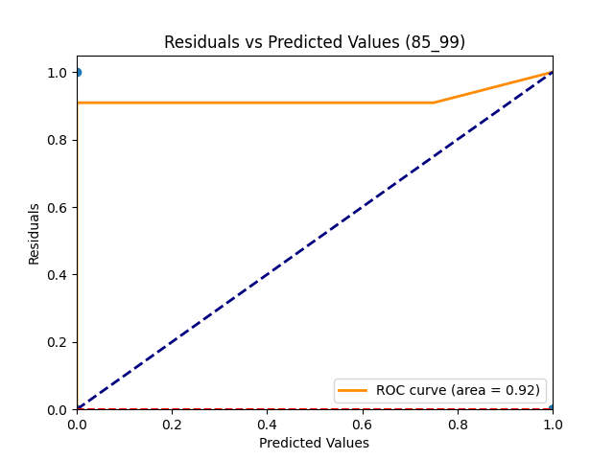
Model Performance(1985-1999)
Residuals Plot

Slide 13
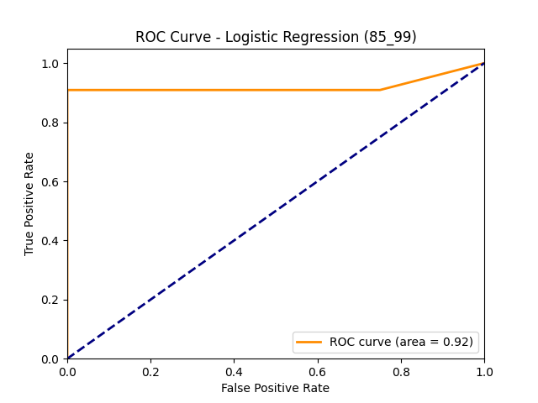
Model Performance(1985-1999)
ROC Curve

Slide 14
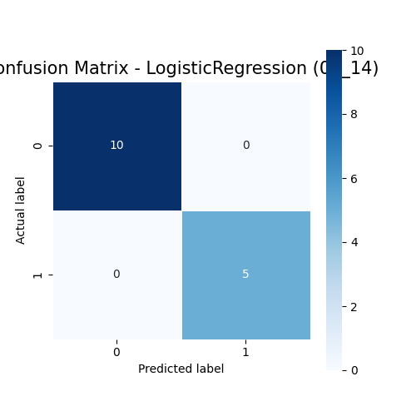
1:Logistic Regression
- Accuracy: 100%
- F1 Score: 100%
- Precision: 100%
- Recall: 100%
- AUC: 100%
- TP: 5, TN: 10, FP: 0, FN: 0
Model Performance(2000-2014)

Slide 15
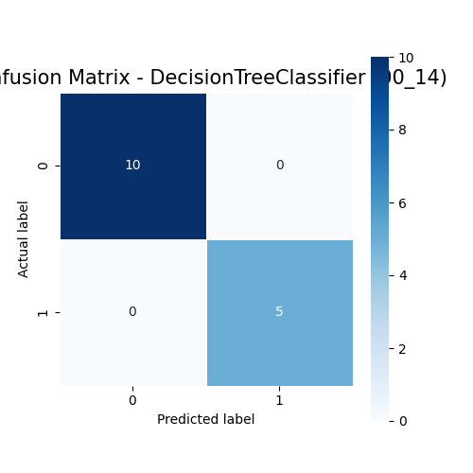
2:Decision Tree
- Accuracy: 100%
- F1 Score: 100%
- Precision: 100%
- Recall: 100%
- AUC: 100%
- TP: 5, TN: 10, FP: 0, FN: 0
Model Performance(2000-2014)

Slide 16

3:Random Forest
- Accuracy: 100%
- F1 Score: 100%
- Precision: 100%
- Recall: 100%
- AUC: 100%
- TP: 5, TN: 10, FP: 0, FN: 0
Model Performance(2000-2014)

Slide 17
Model Performance(2000-2014)
4: Baseline Model (Predict all as 0) Accuracy: 0.6666666666666666
5: Regression Model: Linear Regression R-Squared (R2) on test data = 1.0
Root Mean Squared Error (RMSE) on test data = 1.357864494910396e-15

Slide 18
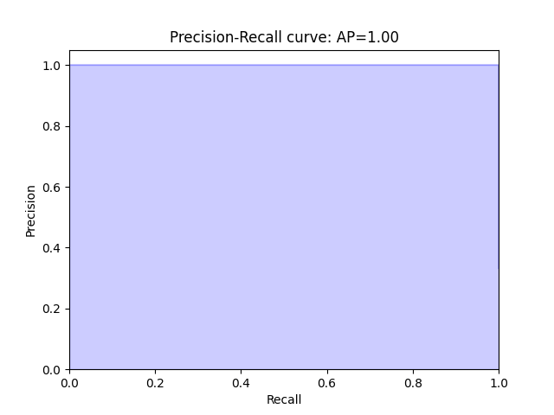
Model Performance(2000-2014)
Precision-Recall Curve

Slide 19
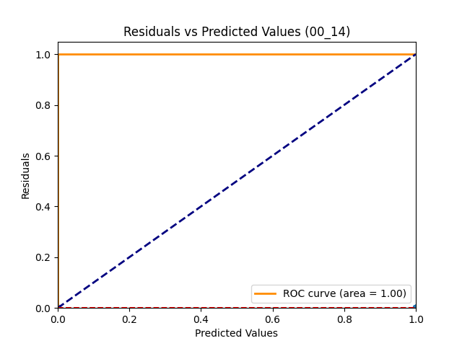
Model Performance(2000-2014)
Residuals Plot

Slide 20
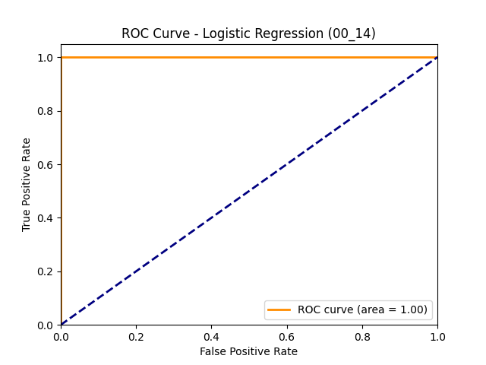
Model Performance(2000-2014)
ROC Curve

Slide 21
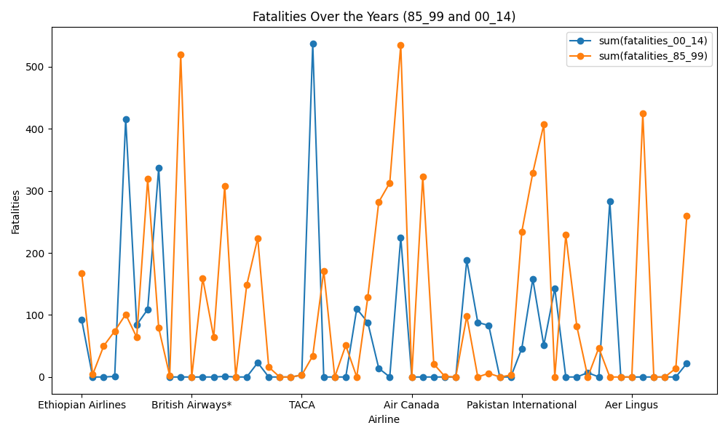
fatalities_over_years
Machine Learning Model

Slide 22
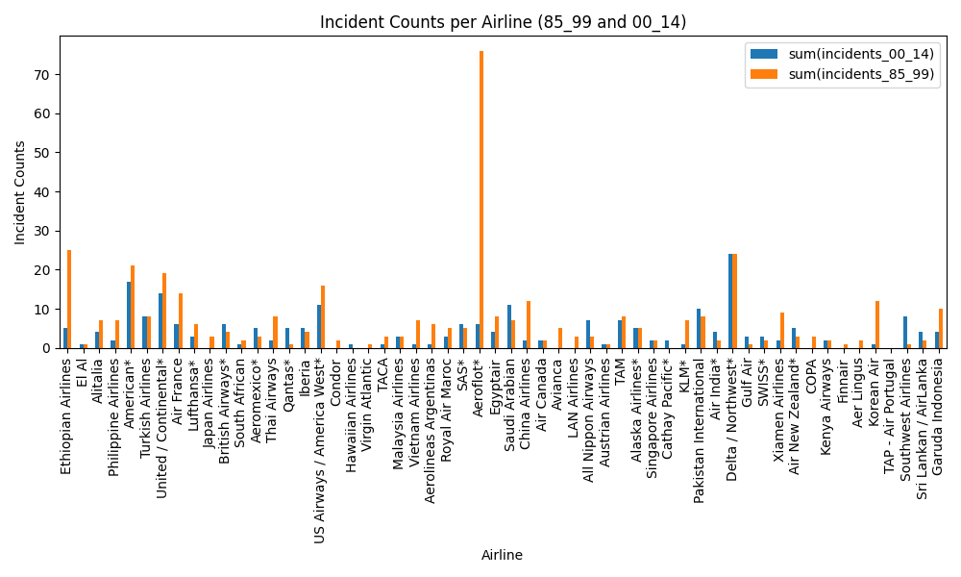
incident_counts_per_airline
Machine Learning Model

Slide 23
Machine Learning Model
The models demonstrated high accuracy and precision in predicting the safety metrics of airlines for both periods. Particularly noteworthy is the 100% accuracy achieved by the Decision Tree Classifier, Random Forest Classifier, and Linear Regression models, indicating a perfect fit to the test data. However, it's crucial to approach these results with caution as such high accuracy might indicate overfitting, especially in the context of the Decision Tree and Random Forest models.

Slide 24
Interpretation of Finding
The models, especially the Decision Tree and Random Forest classifiers, demonstrated impeccable performance across all metrics. However, the Logistic Regression model also showcased commendable predictive capabilities, particularly in the 1985-1999 period, with an accuracy of 93.33%. The Linear Regression model achieved an R2 value of 100% for both periods, indicating that the model explains all the variability of the response data around its mean.

Slide 25
Implications
The findings suggest that historical safety metrics can be predictive of future metrics, providing a valuable tool for regulatory bodies and airline operators in assessing and enhancing airline safety. However, the potential for overfitting in the models, especially those with 100% accuracy, necessitates further validation and refinement to ensure the models generalize well to new data.

Slide 26
Limitations and Challenges
The primary limitation is the potential overfitting of models, given the 100% accuracy in several instances. Additionally, the models were tested on historical data, and their predictive power for future metrics needs to be validated with more recent data.

Slide 27
Answer for Research Questions
Correlation:
The models show that there is a strong correlation between historical incidents, fatal accidents, fatalities, and future safety metrics, as evidenced by the high accuracy and F1 score in predictions. Predicting Future Safety Metrics:
Yes, we can predict future safety metrics based on this historical data. The models,especially the Decision Tree and Random Forest classifiers, have demonstrated high predictive power.
In conclusion, while the models show promising results, it's essential to approach the deployment of such models with caution, ensuring thorough validation and considering the ethical implications of their use.

Slide 28
Conclusion
The study successfully developed models to analyze and predict airline safety metrics, providing valuable insights into the correlations and trends within the data. While the models demonstrated high accuracy, further validation and refinement are necessary to ensure their reliability and applicability to future safety metrics prediction.

Slide 29
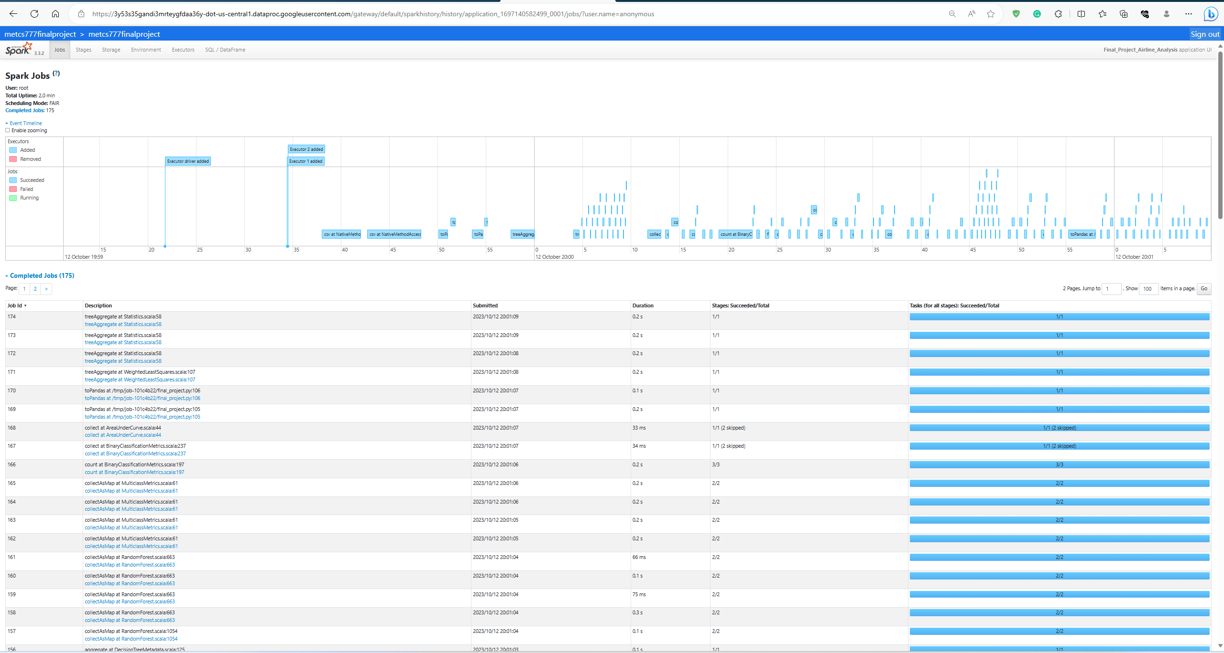
Spark History

Slide 30
Thank you

