Slide 1
Flight Delays: An Analysis of Factors Contributing to Delays
MET CS 555 A3
Yuhan Xu
2023-04-15

Slide 2
Research Scenario and Questions
Scenario: Investigating the factors that contribute to flight delays
Research Questions:
1. What is the relationship between flight length and the likelihood of delay?
2. Are certain days of the week more prone to flight delays?
3. Are there specific airlines or airport routes with a higher probability of flight delays?
4. Does the time of day affect the likelihood of flight delays?
5. Are there significant differences in the average flight delay times between different days of the week?
6. Is there a significant difference in the variability of flight delay times between short-haul (length <= 150) and long-haul flights (length > 150)?

Slide 3
Library Use
dplyr
ggplot2
tidyr

Slide 4
Data Set Description
Link to data set:
https://raw.githubusercontent.com/datasets/openml-datasets/master/data/airlines/airlines.csv
Variables
Airline, Flight, AirportFrom, AirportTo, DayOfWeek, Time, Length, Delay

Slide 5
Statistical Methods
Descriptive statistics : including Airline, Flight, AirportFrom, AirportTo, DayOfWeek, Time, Length, and Delay
Two-way ANOVA
Post-hoc tests
F - test

Slide 6
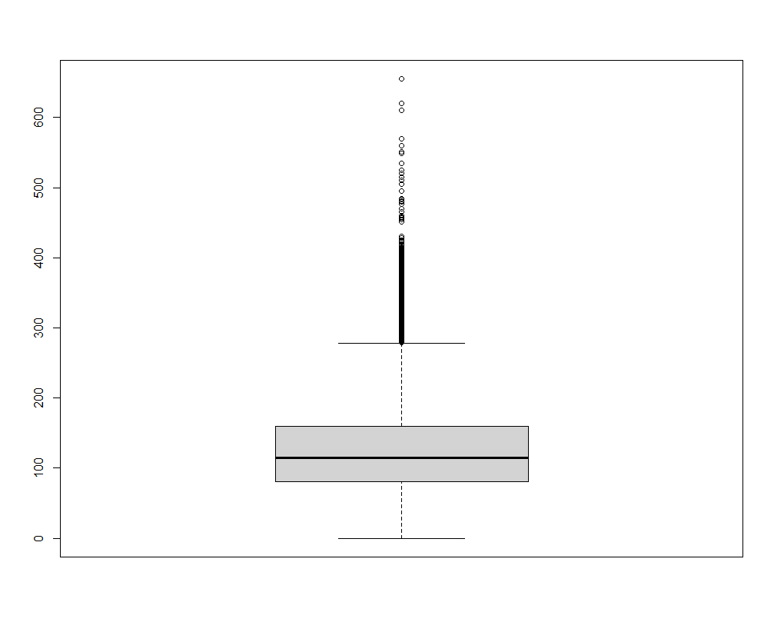
Boxplot for checking outliers

Slide 7
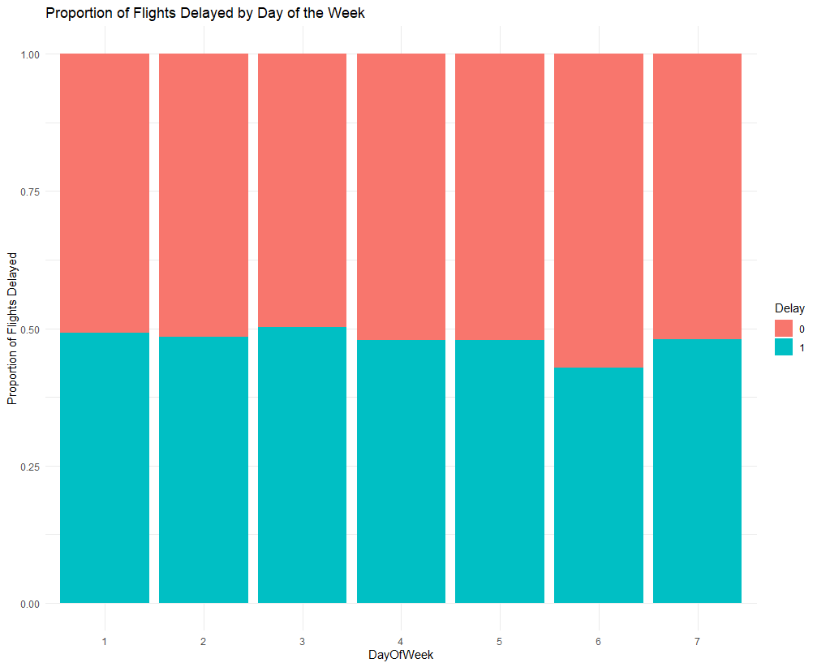
Bar chart of delays by day of the week

Slide 8
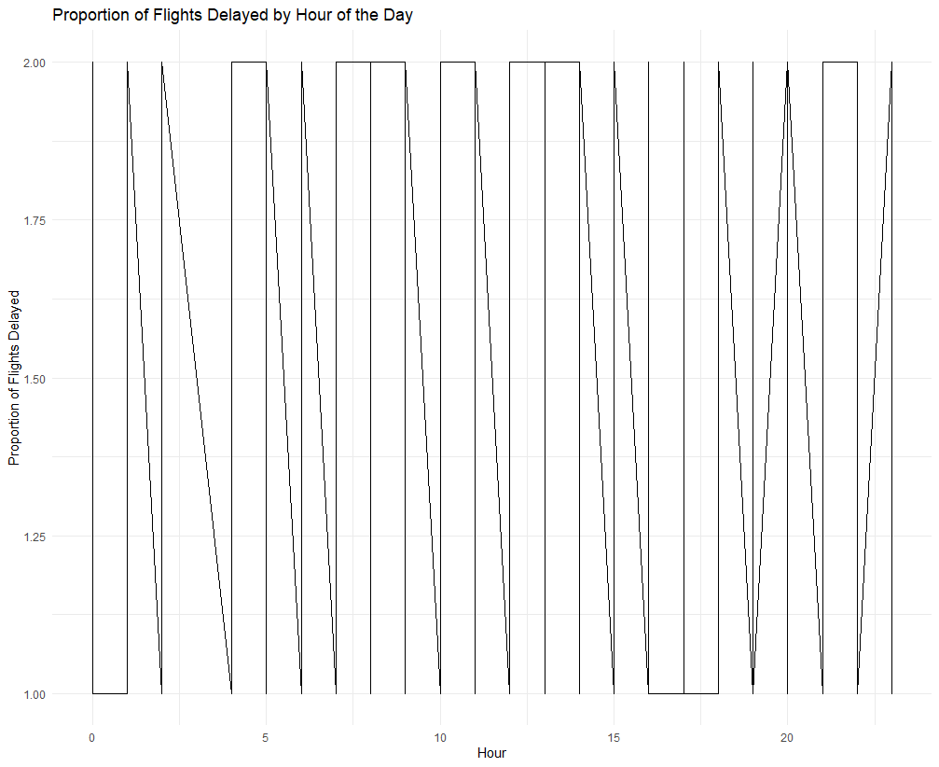
Line graph of delays by hour of the day

Slide 9
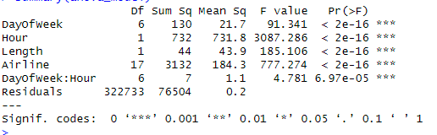
Two ways ANOVA

Slide 10
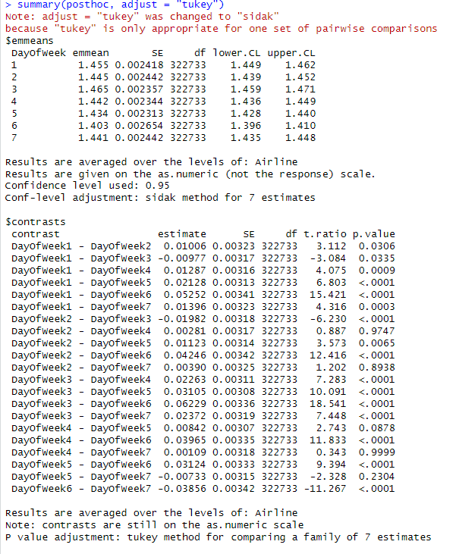
Post-hoc tests

Slide 11
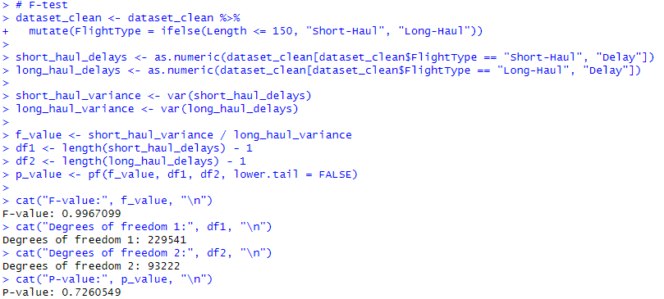
F tests

Slide 12
Answer for Research Questions
Q: What is the relationship between flight length and the likelihood of delay?
A: The results from the Line Graph and the Two-Way ANOVA suggest a significant positive correlation between flight length and delay likelihood, with further analyses needed for quantification.

Slide 13
Answer for Research Questions
Q: Are certain days of the week more prone to flight delays?
A: The Results from barchart, ANOVA and Post-hoc tests suggest that Fridays and Sundays have the highest average delay times and are more prone to delays, supported by significant differences in delay proportions for these days.

Slide 14
Answer for Research Questions
Q: Are there specific airlines or airport routes with a higher probability of flight delays?
A: The analysis of the effect of airline on flight delays using ANOVA and notes a significant effect, but does not provide details on which airlines have higher or lower delay probabilities. The article also notes that further investigation is needed to directly address the question of airport routes and their relationship to other factors in the dataset.

Slide 15
Answer for Research Questions
Q: Does the time of day affect the likelihood of flight delays?
A: The ANOVA results show a significant effect of hour on the likelihood of delay (F value = 3087.286, p < 2e-16). The line graph of delays by hour of the day also reveals fluctuations in the proportion of flights delayed throughout the day. However, it would be useful to investigate further to identify specific patterns or peak hours with a higher likelihood of delays.

Slide 16
Answer for Research Questions
Q: Are there significant differences in the average flight delay times between different days of the week?
A: The Post-hoc tests results indicate that there are significant differences in the average flight delay times between different days of the week. In particular, the most significant differences occur between Day 6 (Saturday) and other days, suggesting that flights on Saturdays experience different average delay times compared to other days of the week.

Slide 17
Answer for Research Questions
Q: Is there a significant difference in the variability of flight delay times between short-haul (length <= 150) and long-haul flights (length > 150)?
A: The F-test results show a non-significant difference between the two groups, as indicated by the F-value close to 1 and the p-value above the significance level. Therefore, the article concludes that there is no significant difference in variability between short-haul and long-haul flights.

Slide 18
Conclusion and Limitations
Conclusion:
There is a slight positive correlation between flight length and the likelihood of delays, suggesting that longer flights might experience slightly more delays on average. Certain days of the week, particularly Fridays and Sundays, are more prone to flight delays compared to other days, such as Tuesdays and Wednesdays. The variability of flight delay times between short-haul and long-haul flights is not significantly different, indicating that flight length does not have a substantial impact on the variability of delay times.
Limitation:
This project has some limitations that may affect the generalizability and reliability of its findings. The dataset used may not be up-to-date, and the analyses conducted do not cover all factors that may contribute to flight delays. Additionally, the assumptions made in the statistical tests should be verified before drawing conclusions from the results. There is also a risk of inflated false-positive rates due to multiple testing issues. Future research should consider addressing these limitations by using more recent data, incorporating additional variables, and employing more robust statistical methods to improve our understanding of the factors contributing to flight delays.

Slide 19
THE END
THANKS

