Slide 1
第五届包装技术与科学国际会议（ICPTS）
Resent Advances on the storage and preservation of
edible mushrooms
食用菌贮藏保鲜研究进展
Bingxin Sun（孙炳新）
Oct 14, 2019
Tianjin, China

Slide 2
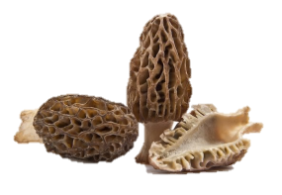
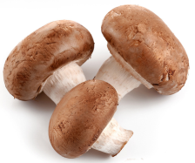
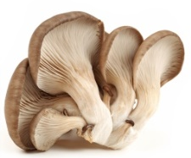
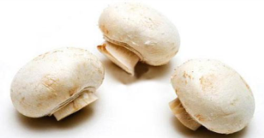
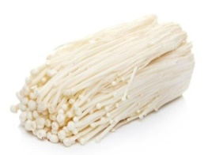
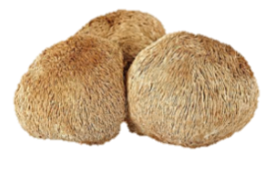
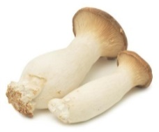
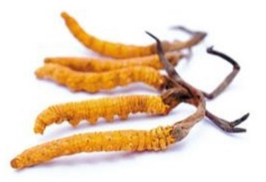
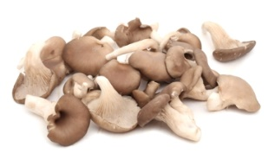
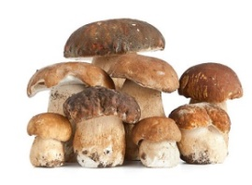
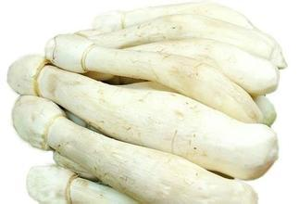
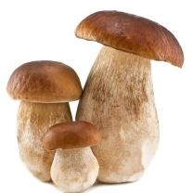
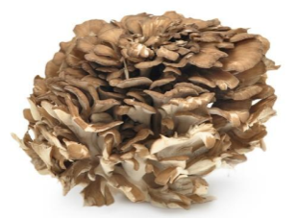
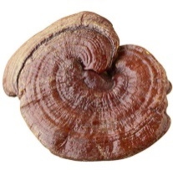
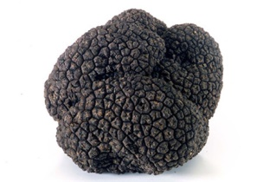
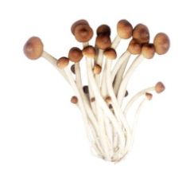
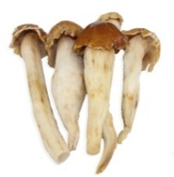
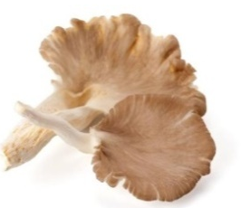
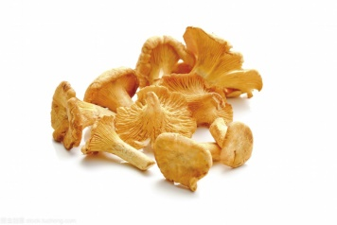
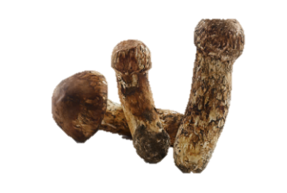
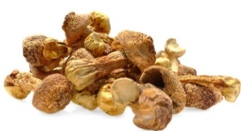
About mushrooms
Ascomycetes
(子囊菌)
Basidiomycotina
(担子菌)
Morchella esculanta
Lentinula edodes
Pleurotus ostreatus
Agaricus bisporus
Flammulina velutipes
Hericium erinacrus
Pleurotus ergyngii
Cophioordyceps
Pleurotus pulmonarius
Volvariella volvacea
Coprinus comatus
Ganoderma lucidum
Boletus edulis
Grilola frondosa
Tuber. Melanosporum
Agrocybe cylindracea
Termitomyces albuminosus
oyster mushrooms
Cantharelles cibarius
Agaricus brasiliensis
Tricholoma matsutake

Slide 3
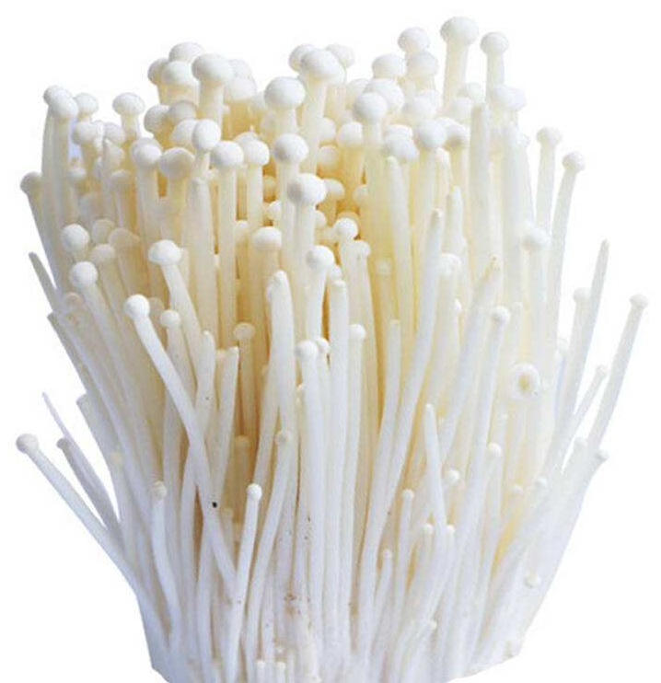
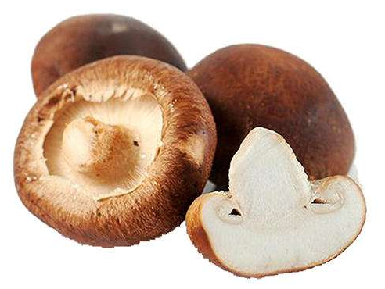
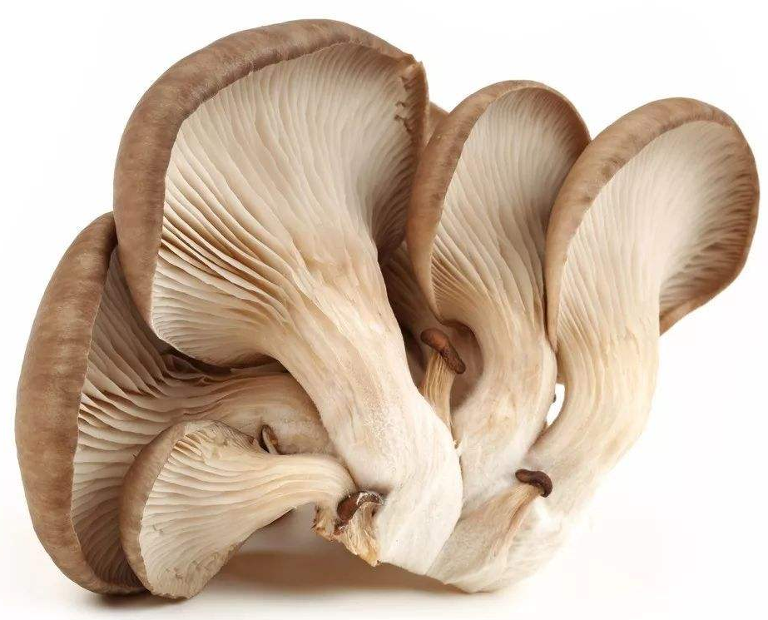
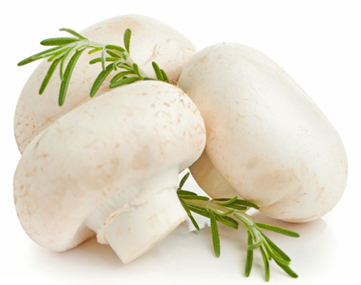

Slide 4
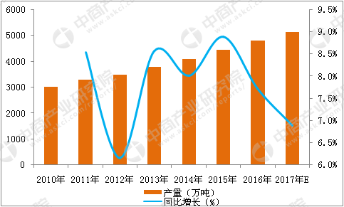
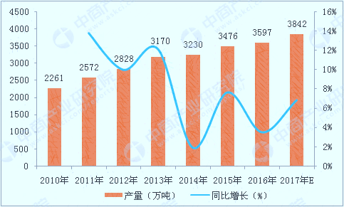
Global production from 2010 to 2017
2010-2017年世界食用菌产量
Domestic production from 2010 to 2017
2010-2017年国内食用菌产量

Slide 5
Contents
01
Quality degradation of mushrooms
02
Influential factors on mushrooms quality
03
Preservation methods
04
Some recent researches we are doing

Slide 6
01
Quality degradation of mushrooms

Slide 7
1.Moisture loss
Quality degradation occurs in mushrooms during the postharvest period. The most significant quality changes are moisture loss, discoloration, texture softening, nutrients and flavor loss.
4.Nutrients and flavour loss
Quality degradation of mushrooms
2.Discolo-ration
3.Texture changes

Slide 8
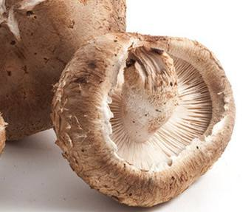
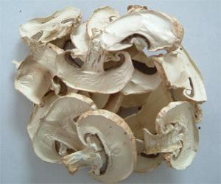
1.Moisture loss
The moisture content of fresh mushrooms is of 85%–95%. This moisture level continues to decrease during the postharvest storage due to mushrooms cell damage and internal water transfer. This physiological process speeds up mushrooms quality degradation, such as shrinkage and weight loss. Water holding capacity of mushrooms was influenced by the loss in cell membrane integrity and the changes in structural polymers of the cell wall. When the water loss reaches 5% of its fresh mass, mushrooms are regarded as perished.

Slide 9
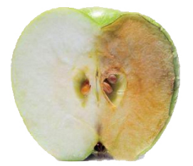
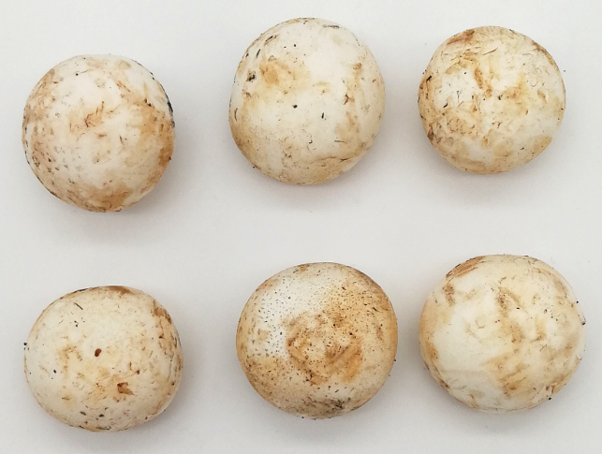
2.Discolouration
The surface of white mushrooms is prone to brown due to microbial contamination or enzymatic activities. Enzyme activities are main reason. PPO is considered to be the main contributor affecting postharvest browning on Agaricus bisporus. Among the PPO families, tyrosinase is the responsible enzyme for Agaricus bisporus browning because of its high content in mushrooms. Generally, the PPO catalyses the reaction of phenolic compounds in two steps: (1) hydroxylation of monophenols into diphenols, (2) oxidation of phenolic substance into quinones.

Slide 10
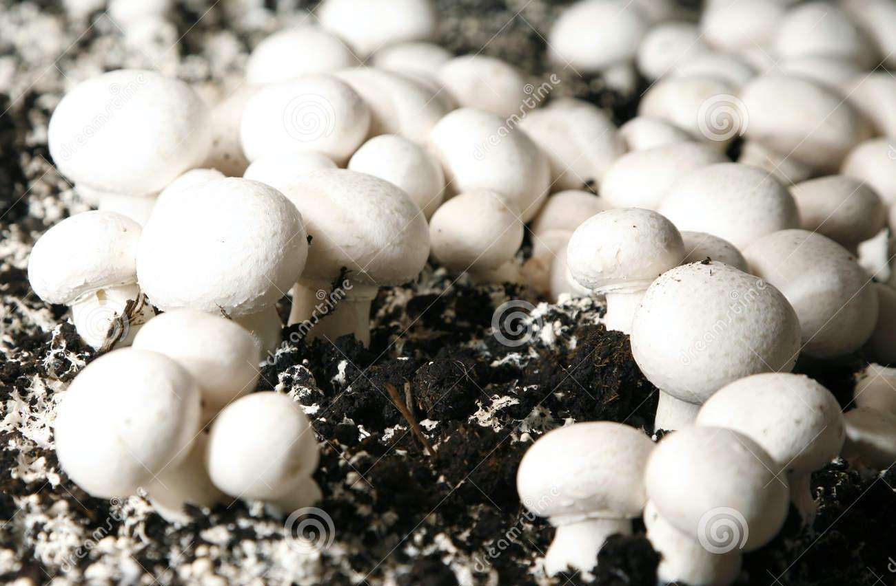
3.Texture changes
Mushrooms’ postharvest texture profile is affected by water loss, wound and mechanical injury, as well as heat treatments. Different from other fruits and vegetables, mushrooms lack a pectin structure. The cell wall of mushrooms mainly consists of glucans, chitin and protein. During the heat treatment, the chitin and β-1,4-acetyl-glucosamine homopolymer form a stiff microfibril structure, which enhances the strength of mushrooms cell wall. As a result, hardness and chewiness of mushrooms increased during drying.

Slide 11
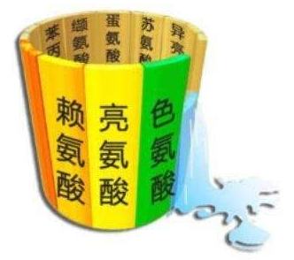
4. Nutrients and flavour loss
Mushrooms are rich in protein in their dry matter, containing many essential amino acids. In addition, mushrooms are low in fat and have a relatively high content of carbohydrates and fibre. There are 14.1% protein, 2.2% fat, 9.7% ash and 74%carbohydrates in Agaricus bisporus (dry basis). Special aroma and flavour are presented in mushrooms, including both volatile and non-volatile components such as soluble sugars, polyols, free amino acids, organic acids and 5′-nucleotides, and monosodium glutamate (MSG).

Slide 12
02
Influential factors on mushrooms quality

Slide 13
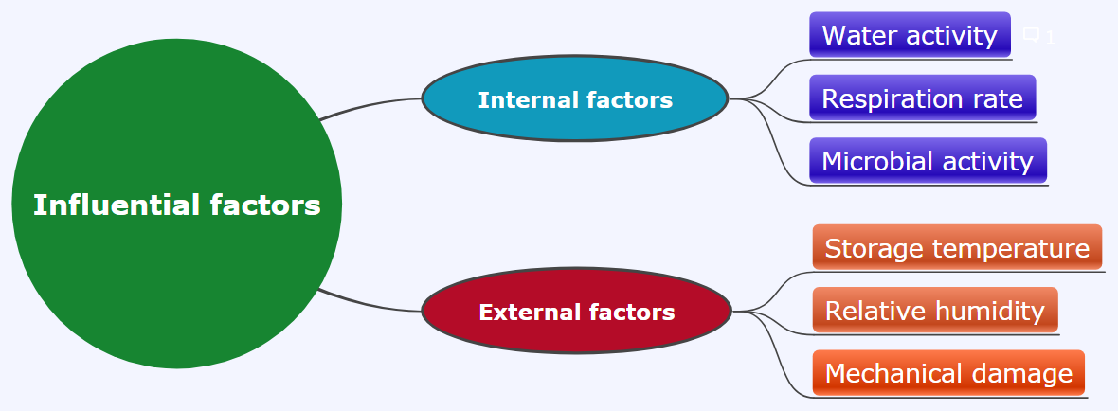

Slide 14
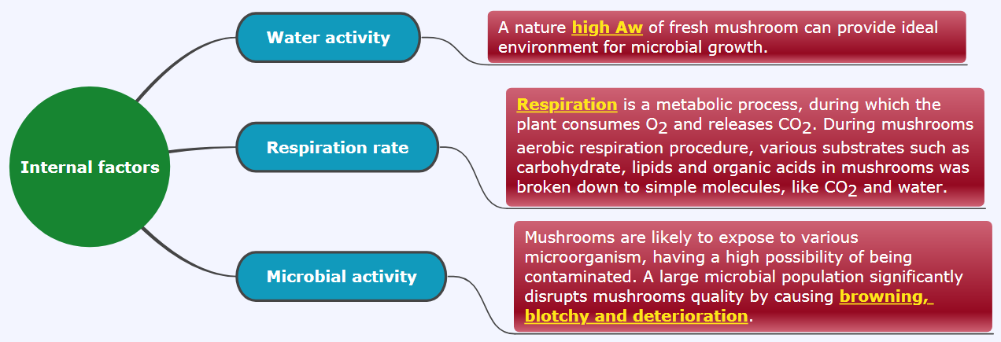

Slide 15
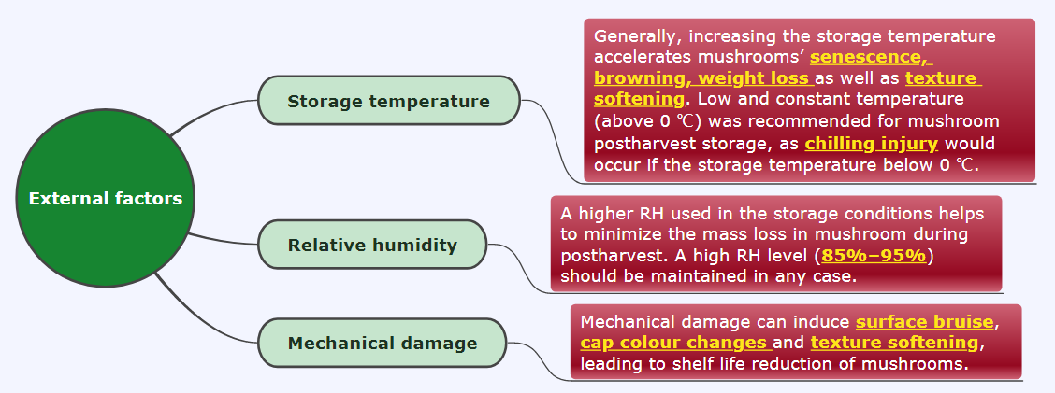

Slide 16
03
Preservation methods

Slide 17
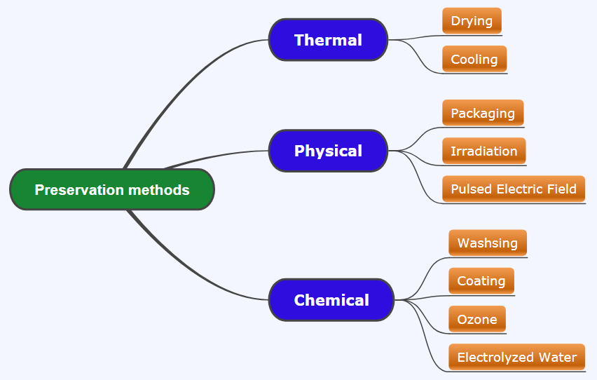

Slide 18
1.Thermal processes
1) Drying
Solar drying and hot air drying
Microwave drying
Freeze drying (FD)
Vacuum drying
Water is removed from the solid phase to vapour phase directly during the drying process. Heatsensitive properties of products such as vitamins could be maintained without heat damage.
Helped to produce more uniform dried products with a larger amount of tasteactive
amino acids residual.
The frequency range from 300 MHz to 300 GHz, can significantly reduce the drying time.

Slide 19
1.Thermal processes
2) Cooling
Cooling
At 0 ℃, mushrooms respiration rate is three times lower than that at 10 ℃.
Vacuum cooling
Compared to conventional cooling methods, vacuum cooling can reduce the mushroom cooling time significantly and can lower the microbial growth rate. The mass loss rate was about 5% in vacuum cooling and 9% in conventional cooling.

Slide 20
2.Physical processes
1) Packaging
Modified atmosphere packaging
A number of factors, such as the properties of the packaging materials, ambient gas composition, the surface area of the sample as well as storage temperature and humidity can influence the storage effect of MAP 。
Early study of Roy, Anantheswaran, and Beelman (1995) showed that the optimum inpackage O2 concentration that could reduce cap opening of mushrooms was 6%. When the O2 concentration in the package was lower than 2%, the growth of some anaerobic microorganisms。
The medium O2 level（50% O2 and 50% N2）and film with higher permeability (polyethylene films with 39 μm thickness) were found to be the optimum MAP condition to prolong mushrooms shelf-life.

Slide 21
2.Physical processes
2) Irradiation
Gamma irradiation
UV irradiation
Electron-beam
It have an effect on diminishing enzymatic browning by retarding the polyphenol oxidase activities in mushrooms. However, the use of gamma irradiation could cause variation in chemical composition of mushrooms.
For ultraviolet-C (UV-C) treatment, Guan et al. (2013) found that a dose of 0.45–3.15 kJm⁻² UV-C irradiation
resulted in 0.46–1.13 log CFU/g reduction of E. coli 0157:H7 and
0.63–0.89 log CFU/g reduction of total aerobic plate counts on the cap
of mushrooms.
Irradiation level of 1 kGy
have a positive effect on shelf-life extension of mushroom slices, by reducing aerobic and psychrotrophic populations.

Slide 22
2.Physical processes
3) Pulsed electric field and ultrasound
Pulsed electric field
Ultrasound
The use of short pulses of electricity in PEF treatment can inactivate microorganisms and enhance the mass transfer process. In PEF, the electric field strength creates
transient pores in biological membranes, leading to irreversible cell disruption.
Ultrasound assisted hot air drying can achieve high drying efficiency by enhancing water
transportation in fruits and vegetables
A combination of low concentration
acidic electrolyzed water and ultrasound are proved as an effective
method for retarding enzymatic browning and firmness maintenance
in fresh mushroom slices

Slide 23
3. Chemical processing
1) Washing with antimicrobial agents
Chemicals such as antimicrobial agents are generally added to the washing water to remove casing soil and to diminish mushrooms quality deterioration. Gupta and Bhat (2016) 2.5% citric acid was the most effective solution for mushroom quality preservation.
The use of 3% H2O2 as a washing agent on mushrooms before UV-C irradiation could achieve a microbial reduction of up to 0.85 log CFU/g and showed the best performance in inhibiting mushrooms lesion and browning, Guan et al. (2013)

Slide 24
3. Chemical processing
2) Coating
1. Alginate is a kind of edible coating substrate extracted from brown algae. Dipped mushrooms with 2% alginate for 2 min then stored the coated mushrooms in jars that were ventilated with 100% O2. This treatment helped to maintain the firmness of mushrooms, to delay discoloration and cap opening and to inhibit the loss of soluble solids concentration, total sugars and ascorbic acid of mushrooms. The shelf-life of mushrooms was successfully extended to 16 days.
2. Chitosan: As reported by Jiang, Feng, and Li (2012), treatment with chitosan-glucose complex coating maintained tissue firmness, reduced microbial counts and inhibited increase of respiration rate in mushroom (lentinus edodes) within 16 days of storage at 4 ℃.

Slide 25
3. Chemical processing
3) Ozone
Ozone, also called triatomic oxygen, is a powerful antimicrobial agent to extend shelf-life of food. Due to the strong oxidation capacity, ozone inactivates microorganisms rapidly after reacting with intercellular enzymes and cell components.

Slide 26
3. Chemical processing
4) Electrolyzed water
Electrolyzed water (EW) is another promising disinfectant generated by electrolysis of a salt solution. Compared to other disinfectants, EW treatment has less aggressive corrosion on food quality. The use of 25 mg L−1 EW had the best performance in maintaining mushrooms whiteness index and texture, and diminishing weight loss.

Slide 27
Challenges and future trends
Drying
Texture changes and discolouration
Vacuum cooling
High capital cost
Irradiation
Specified range
Packaging
Packaging materials
The application of some novel techniques and the combination of different techniques with a low capital cost or less processing time should be encouraged to further enhance mushrooms postharvest quality.

Slide 28
04
Some recent researches we are doing

Slide 29
(1) Effects of 1-MCP treatment on quality of mushrooms during storage or shelf life
(2) Effects of different MAPs on quality of button mushrooms (Agaricus bisporus) during storage or shelf life
(3) Effects of short-term anaerobic treatment on quality of fruits during storage or shelf life
(4) Quality changes of mushrooms under vibration stress

Slide 30

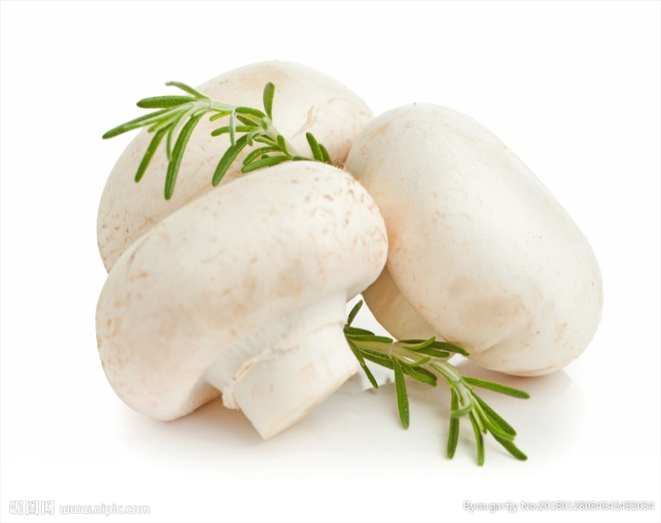
Thank you!
孙炳新 15566030901

