Slide 1



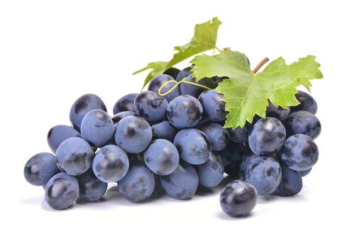

High CO2 alleviates cell ultrastructure damage in Autumn Royal table grapes by modulating fatty acid composition and membrane and cell oxidative status during long-term cold storage
高浓度二氧化碳通过调节脂肪酸组成以及膜和细胞的氧化状态，减轻葡萄细胞超微结构损害。
By： Tang Tianxin
Supervisor：Sun Bingxin
FOOD SCIENCE COLLEGE OF SYAU
食品学院

Slide 2
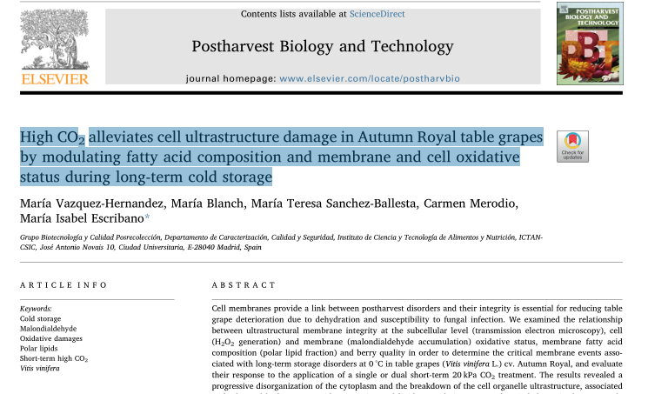
pastharvest Biology and Technonlogy ，4.43
Keywords:
Cold storage
Malondialdehyde
Oxidative damages
Polar lipids
Short-term high CO2
Vitis vinifera
FOOD SCIENCE COLLEGE OF SYAU
食品学院

Slide 3
Contents
01
Introduction
02
Materials and methods
03
Results and discussion
04
Conclusion

Slide 4
01
Introduction

Slide 5

Seedless table grapes (Vitis vinifera L. cv. Autumn Royal) were
harvested at mature stage (12.9 % total soluble solids, 0.46 % tartaric
acid) from a commercial farm in Abarán (Murcia, Spain), and trans-
ported to the laboratory in Madrid (Spain). Bunches without any phy-
sical or pathological defects were randomly divided into three lots
containing twenty bunches each and stored in the dark at 0 ± 0.5 °C
and 90–95 % relative humidity up to 41 d in three hermetically sealed
methacrylate containers of 1 m3capacity. One lot was stored in air
(untreated), a second lot was stored under a gas mixture containing
20 kPa CO2+ 20 kPa O2+ 60 kPa N2for 3 d at the beginning of cold
storage (CO2-treated), and a third lot was exposed to a second 3d 20 kPa
CO2treatment after 13 d of low temperature storage (CO2/CO2-
treated). After CO2treatments, bunches were transferred to air under
the same conditions as the untreated lot until the end of storage period.
Five clusters of grapes (approximately 400 g each cluster) were sampled
periodically and the skin and pulp were collected, frozen in liquid ni-
trogen, ground to a fine powder and stored at −80 °C until analysis.
postharvest low temperatures is a way to prolong fruit shelf life. Howerer , low temperatures can lead to cold cell damage, there are numbers of factors such as loss of integrity in membrane systems, lipoxygenase activity and membrane lipid peroxidation, study found that short intermittent exposures to high CO2 level atmospheres applied to Hass avocados were effective in delaying senescence, reducing chilling injury and controlling decay
采后低温是延长果蔬货架期的常用方法。然而，低温可导致冷细胞损伤，受许多因素如膜完整性丧失，脂氧合酶活性和膜脂质过氧化作用，研究发现，短时间高CO2处理可延缓衰老，减少冷害并控制衰变。
FOOD SCIENCE COLLEGE OF SYAU
食品学院

Slide 6
Seedless table grapes (Vitis vinifera L. cv. Autumn Royal) were
harvested at mature stage (12.9 % total soluble solids, 0.46 % tartaric
acid) from a commercial farm in Abarán (Murcia, Spain), and trans-
ported to the laboratory in Madrid (Spain). Bunches without any phy-
sical or pathological defects were randomly divided into three lots
containing twenty bunches each and stored in the dark at 0 ± 0.5 °C
and 90–95 % relative humidity up to 41 d in three hermetically sealed
methacrylate containers of 1 m3capacity. One lot was stored in air
(untreated), a second lot was stored under a gas mixture containing
20 kPa CO2+ 20 kPa O2+ 60 kPa N2for 3 d at the beginning of cold
storage (CO2-treated), and a third lot was exposed to a second 3d 20 kPa
CO2treatment after 13 d of low temperature storage (CO2/CO2-
treated). After CO2treatments, bunches were transferred to air under
the same conditions as the untreated lot until the end of storage period.
Five clusters of grapes (approximately 400 g each cluster) were sampled
periodically and the skin and pulp were collected, frozen in liquid ni-
trogen, ground to a fine powder and stored at −80 °C until analysis.
Therefore ,the aim of this work is :
to establish the relationship between postharvest ultrastructural membrane integrity, cellular and membrane oxidative state and changes in the profile of fatty acid composition
确立采后超微结构膜完整性，细胞和膜的氧化状态与极性脂质组分中脂肪酸组成的变化之间的关系。
2) to analyze the differences in the susceptibility to cell and membrane cold-oxidative stress in fruit pre-treated with 20 kPa of CO2 for 3 d;
分析用CO2预处理对细胞和膜的冷氧化应激敏感性的差异
FOOD SCIENCE COLLEGE OF SYAU
食品学院

Slide 7
02
Materials and methods

Slide 8
Seedless table grapes (Vitis vinifera L. cv. Autumn Royal) were
harvested at mature stage (12.9 % total soluble solids, 0.46 % tartaric
acid) from a commercial farm in Abarán (Murcia, Spain), and trans-
ported to the laboratory in Madrid (Spain). Bunches without any phy-
sical or pathological defects were randomly divided into three lots
containing twenty bunches each and stored in the dark at 0 ± 0.5 °C
and 90–95 % relative humidity up to 41 d in three hermetically sealed
methacrylate containers of 1 m3capacity. One lot was stored in air
(untreated), a second lot was stored under a gas mixture containing
20 kPa CO2+ 20 kPa O2+ 60 kPa N2for 3 d at the beginning of cold
storage (CO2-treated), and a third lot was exposed to a second 3d 20 kPa
CO2treatment after 13 d of low temperature storage (CO2/CO2-
treated). After CO2treatments, bunches were transferred to air under
the same conditions as the untreated lot until the end of storage period.
Five clusters of grapes (approximately 400 g each cluster) were sampled
periodically and the skin and pulp were collected, frozen in liquid ni-
trogen, ground to a fine powder and stored at −80 °C until analysis.
material : Seedless table grapes
Storage conditions : 0 ± 0.5 °C 、90–95 % 41 d in three hermetically sealed methacrylate containers of 1 m3capacity
Treatment:
①air (untreated)
②20 kPa CO2+ 20 kPa O2+ 60 kPa N2for 3 d at the beginning of cold storage (CO2-treated)
③a second 3d 20 kPa CO2treatment after 13 d of low temperature storage (CO2/CO2-treated)
FOOD SCIENCE COLLEGE OF SYAU
食品学院

Slide 9
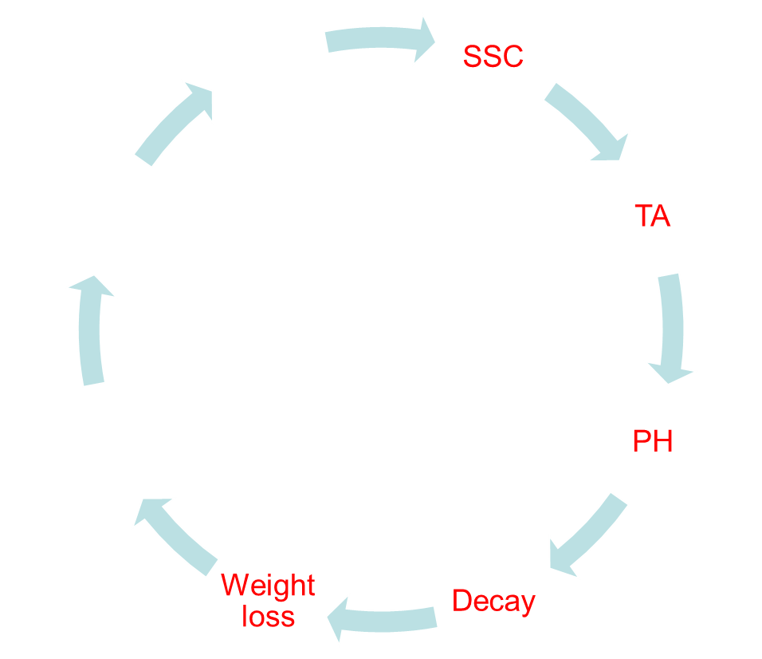
Quality assessments and total decay
Skin firmness
berry water loss
Berry quality parameters
Browning rachis index
FOOD SCIENCE COLLEGE OF SYAU
食品学院

Slide 10
Seedless table grapes (Vitis vinifera L. cv. Autumn Royal) were
harvested at mature stage (12.9 % total soluble solids, 0.46 % tartaric
acid) from a commercial farm in Abarán (Murcia, Spain), and trans-
ported to the laboratory in Madrid (Spain). Bunches without any phy-
sical or pathological defects were randomly divided into three lots
containing twenty bunches each and stored in the dark at 0 ± 0.5 °C
and 90–95 % relative humidity up to 41 d in three hermetically sealed
methacrylate containers of 1 m3capacity. One lot was stored in air
(untreated), a second lot was stored under a gas mixture containing
20 kPa CO2+ 20 kPa O2+ 60 kPa N2for 3 d at the beginning of cold
storage (CO2-treated), and a third lot was exposed to a second 3d 20 kPa
CO2treatment after 13 d of low temperature storage (CO2/CO2-
treated). After CO2treatments, bunches were transferred to air under
the same conditions as the untreated lot until the end of storage period.
Five clusters of grapes (approximately 400 g each cluster) were sampled
periodically and the skin and pulp were collected, frozen in liquid ni-
trogen, ground to a fine powder and stored at −80 °C until analysis.
Determination of malondialdehyde and hydrogen peroxide content
Microscopic analyses of pericarp cells
Fatty acid quantification in different lipid fractions
degree of unsaturation of the fatty acid in polar lipids:
①unsaturated/saturated fatty acids (UFA/SFA),
②index of unsaturated fatty acids (IUFA)
③ the degree unsaturation of 18-carbon fatty acids
④the ratio C18:3n3/C18:2n6c.
FOOD SCIENCE COLLEGE OF SYAU
食品学院

Slide 11
03
Results and discussion

Slide 12
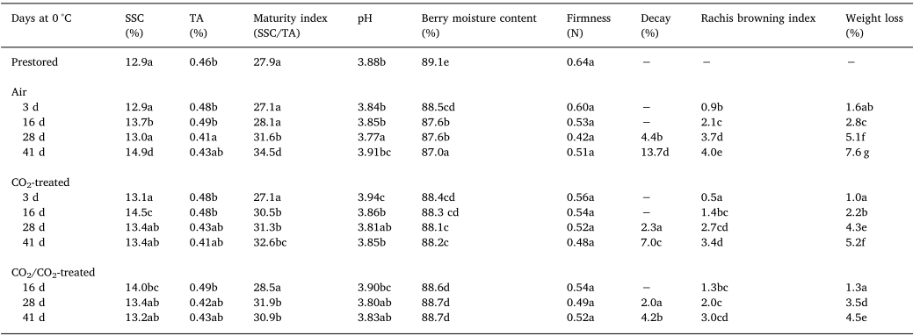
①Evaluation on quality parameters and total decay
FOOD SCIENCE COLLEGE OF SYAU
食品学院

Slide 13
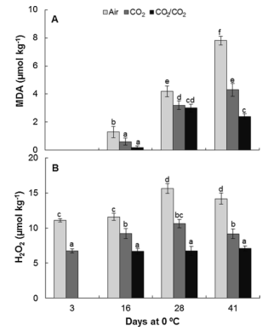
②Effect on prevention against membrane and cellular oxidative damage
1.8-fold
MDA:
CO2treatments restrain the level of oxidative stress
H2O2:
two-time CO2treatment was significantly lower these H2O2levels and restrain the level of oxidative stress
3.3-fold
2.3-fold
1.6-fold
FOOD SCIENCE COLLEGE OF SYAU
食品学院

Slide 14
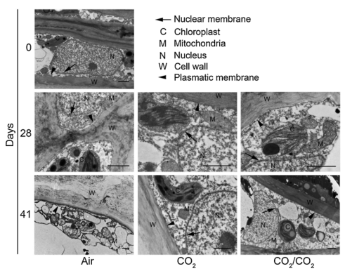
③Effect on cell ultrastructure
MDA:
CO2treatments restrain the level of oxi-
dative stress
H2O2:
two-time CO2treatment was significantly lower these H2O2levels and restrain the level of oxi-
dative stress
FOOD SCIENCE COLLEGE OF SYAU
食品学院

Slide 15
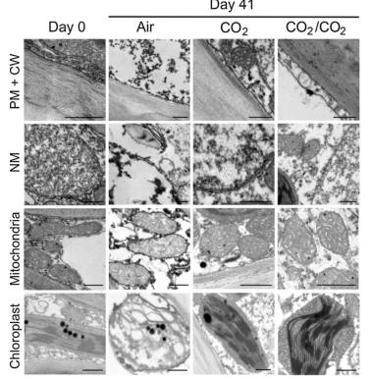
41 d:
untreated grapes: swollen shape, the thylakoid architecture had disappeared and the integrity of the outer membrane was compromised.
细胞器肿胀，类囊体结构消失，外膜的完整性严重受损
CO2-treated /CO2/CO2-treated :no cold damage, morphology of the chloroplasts （叶绿体）maintained, the correct distribution of the thylakoids（类囊体） and the nonappearance of disruptions in their outer membrane。
prestored grapes: membranes without disruption
41 d:
untreated grapes : the outer the mitochondria became osmiophilic and mitochondrial cristae loss,
causing defined matrix space disappears
外膜渗透性增强，线粒体嵴丧失，基质空间消失CO2-treated /CO2/CO2-treated :structured no damage and morphology siimars in freshly harvested fruit
结构无损伤。 与新鲜收获的果实形态相似。
prestored grapes: the nuclei appeared mainly in the euchromatin form
41 d:
① untreated grapes: intense condensation of the chromatin in heterochromatin as well asirreversible symptoms of caryolysis.
染色质凝结，细胞核溶解。
②CO2-treated /CO2/CO2-treated :the bilayer nuclear membrane remained intact in all the samples analyzed
Cell wall :untreated and treated no significant alteration.
41d:
①untreated grapes: a cell wall-plasma membrane separation.
②CO2-treated :a lesser extent,
③CO2/CO2-treated :the membrane remained completely fixed to the cell wall
FOOD SCIENCE COLLEGE OF SYAU
食品学院

Slide 16
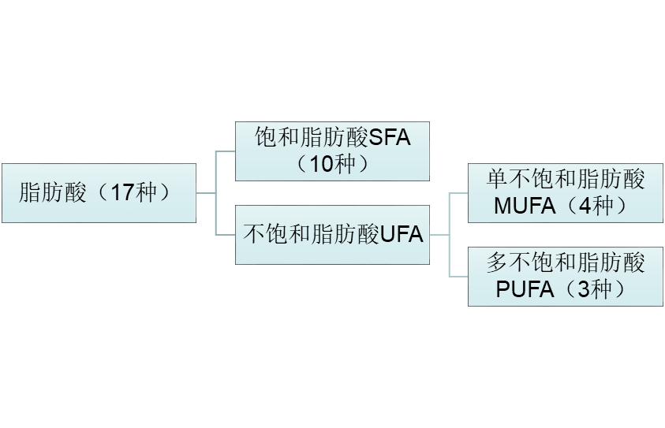
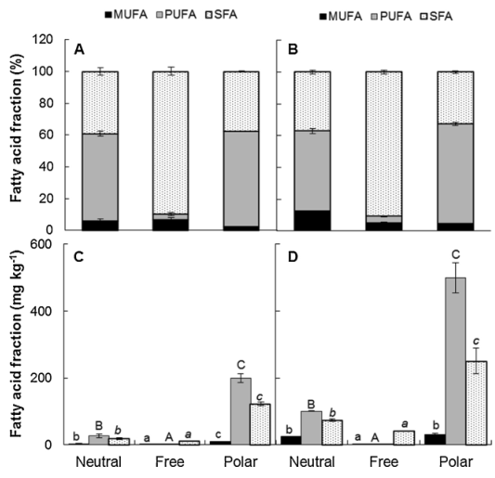
④Effect on lipid fatty acid composition
棕榈酸C16，75.5%
亚油酸C18:2n6c，61%
Neutral and polar lipid fractions：PUFA
Free lipid fractions：SFA
FOOD SCIENCE COLLEGE OF SYAU
食品学院

Slide 17
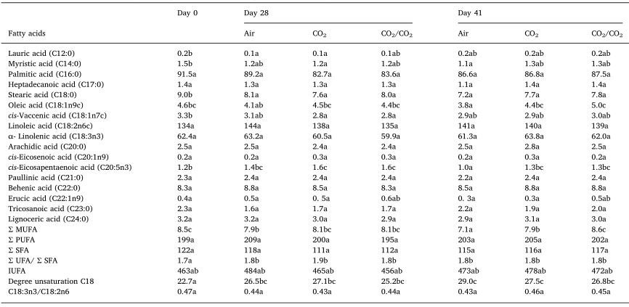
Pulp
棕榈酸
硬脂酸
油酸
亚油酸
单不饱和脂肪酸
多不饱和脂肪酸
饱和脂肪酸
不饱和脂肪酸指数
A-亚油酸/亚油酸
FOOD SCIENCE COLLEGE OF SYAU
食品学院

Slide 18
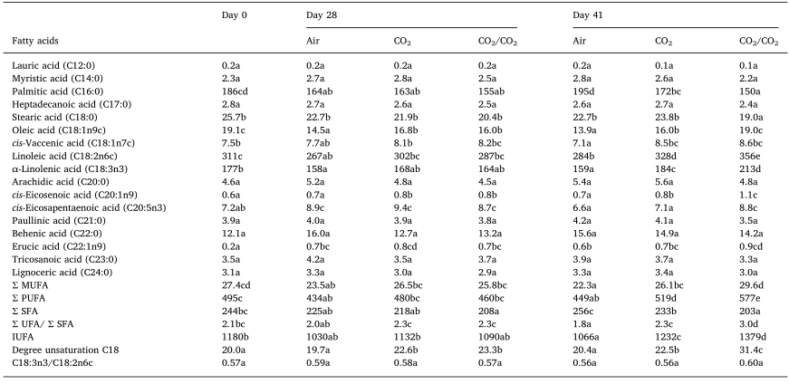
Skin
棕榈酸
硬脂酸
油酸
亚油酸
W-3-脂肪酸二十碳五烯酸
单不饱和脂肪酸
多不饱和脂肪酸
饱和脂肪酸
不饱和脂肪酸指数
A-亚油酸/亚油酸
FOOD SCIENCE COLLEGE OF SYAU
食品学院

Slide 19
04
Conclusion

Slide 20

Cell wall :untreated and treated no significant alteration.
41d: untreated grapes: a cell wall-plasma
membrane separation.
CO2-treated :a lesser extent,
CO2/CO2-treated :the membrane remained completely fixed to the cell wall
①a second treatment with 20 kPa CO2 for 3 d was very effective in delaying the decline in harvested cluster quality caused by senescence and long term postharvest cold-storage disorders in term of cluster weight loss, rachis browning, maturation index, berry water loss and decay incidence.
二次使用20kpa co2处理3d对延缓因衰老和长期冷库失调引起的采后质量下降具有显著效果，表现在减少重量下降、穗轴褐变、成熟指数、浆果失水和腐烂发生率方面。
FOOD SCIENCE COLLEGE OF SYAU
食品学院

Slide 21

Cell wall :untreated and treated no significant alteration.
41d: untreated grapes: a cell wall-plasma
membrane separation.
CO2-treated :a lesser extent,
CO2/CO2-treated :the membrane remained completely fixed to the cell wall
②a second short-term high CO2 treatment can enhance fruit tolerance to long-term cold storage disorders and counteract ultrastructural cell damage such as the disorganization of cytoplasm and the breakdown of cell organelle ultrastructure, leading to cellular biotic and abiotic stress defense gene transcription and the energy status essential for membrane integrity and control of metabolic damage repair.
二次短期高co2处理可以提高果实耐冷性，在微观结构水平上，可以减少细胞超微结构损伤，如细胞质的紊乱和细胞器超微结构的破坏，导致细胞生物和非生物胁迫防御基因的转录以及膜完整性和代谢损伤修复控制所必需的能量状态。
FOOD SCIENCE COLLEGE OF SYAU
食品学院

Slide 22
Cell wall :untreated and treated no significant alteration.
41d: untreated grapes: a cell wall-plasma
membrane separation.
CO2-treated :a lesser extent,
CO2/CO2-treated :the membrane remained completely fixed to the cell wall
③At the metabolic level, short-term CO2treatments significantly reduced the severity of long-term cold damage in pericarp tissues, restraining intracellular oxidative stress and lipid peroxidation, and leading to lipid metabolic adjustment improving the polar fatty acid lipid unsaturation levels responsible for maintaining the integrity and physiology of berry cell membranes.
在代谢水平上，短期CO2处理可显著降低果皮组织长期冷损伤程度，抑制细胞内氧化应激和脂质过氧化，并调整脂质代谢，提高极性脂肪酸脂质不饱和度水平，维持浆果细胞膜的完整性和生理性。
FOOD SCIENCE COLLEGE OF SYAU
食品学院

Slide 23

THANK YOU !
FOOD SCIENCE COLLEGE OF SYAU
食品学院

