Slide 1


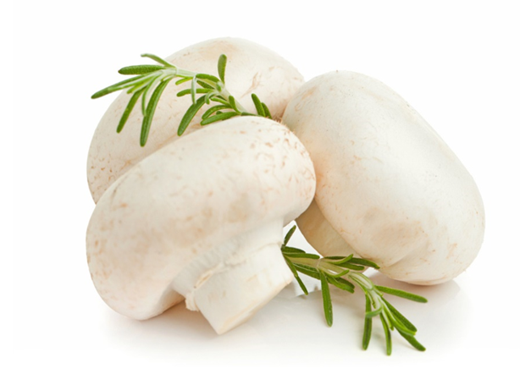

Effect of 1-MCP and gas modification combined treatment on color
By：Ying Limei
Supervisor：Sun Bingxin
FOOD SCIENCE COLLEGE OF SYAU
食品学院

Slide 2

1.① After Agaricus bisporus harvesting, the most intuitive(直观的) effect on quality is the change of color and it is the first perception(感知) for consumer acceptability (接受度).This directly affects the consumer’s purchasing tendency(倾向).Fresh Agaricus bisporus has a white appearance, but gradually changes brown as the storage time increases.Therefore, color can be an indicator for evaluating(评估) the freshness of Agaricus bisporus.The main cause of mushroom browning is enzymatic browning and microbial infection.
FOOD SCIENCE COLLEGE OF SYAU
食品学院

Slide 3

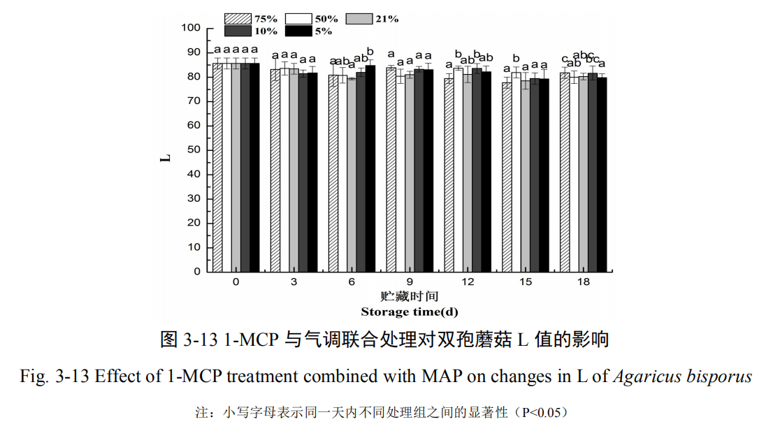
②. The effect of 1-MCP combined with high-oxygen atmosphere on the L *value of Agaricus bisporus is shown in Figure 3-13.
FOOD SCIENCE COLLEGE OF SYAU
食品学院

Slide 4
The L *value of each treatment group decreased(下降) slightly(轻微的) during storage, but the overall remained at around 80.This may be due to the fact that 1-MCP fumigation(熏蒸) protects the cap color of the mushroom, while the high-barrier PA/PE film inhibits enzymatic browning.Studies have shown that when L*>80, Agaricus bisporus has good quality and is acceptable to both consumers and sellers; but when 69<L*<79, the mushroom flavor is still good but the appearance has not reached to a state acceptable to consumers (Briones GL et al., 1992).The results showed that the brightness of the mushrooms was maintained in each treatment group, and it was found that the 50% group at 15 days and the 75% treatment group at 18 days were significantly different from the other groups (P<0.05).
FOOD SCIENCE COLLEGE OF SYAU
食品学院

Slide 5

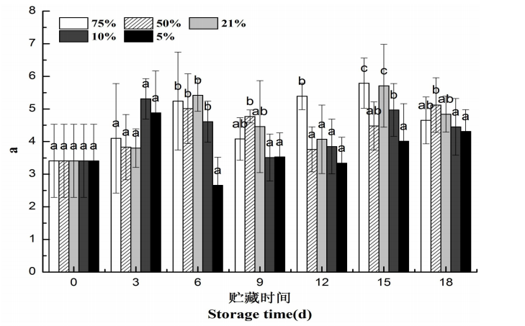
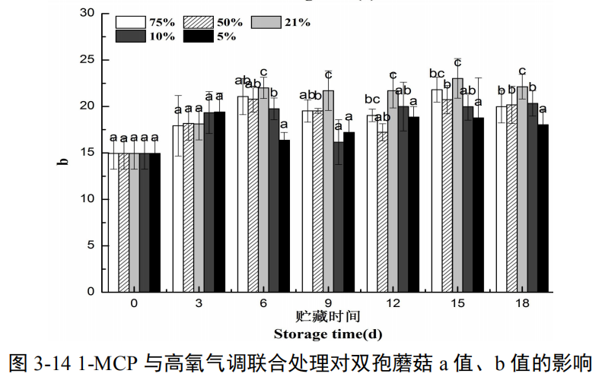
2.① The effect of 1-MCP combined with high-oxygen atmosphere on the a*and b* values of Agaricus bisporus is shown in Figure 3-14, both of which show an upward(上升) trend.
FOOD SCIENCE COLLEGE OF SYAU
食品学院

Slide 6
The hypoxic(低氧) group decreased(降低) after reaching the maximum at 3 days, while the control and hyperoxia(高氧) groups increased at 0-6 days, then decreased, and reached the maximum at 15 days.
②On the whole, the higher the initial oxygen content, the higher the a *value is, the more it is red. This may be because the high concentration(浓度) of oxygen remains in the box with the prolongation(延长) of storage time, thus maintaining the activity of some enzymes,phenolic substances are decomposed(分解).The b* value is basically the same as that in the hypoxic group and the hyperoxia group, while the
b *value of the control group is significantly higher than the other treatment groups after 6 days.This also shows that the color of the control mushroom is more yellow.
FOOD SCIENCE COLLEGE OF SYAU
食品学院

Slide 7
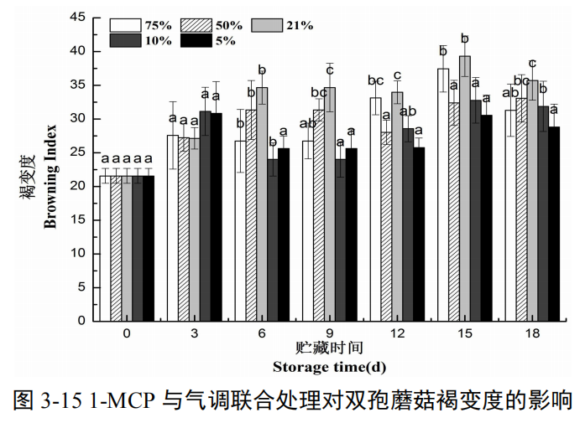
3
①As shown in the figure, the browning is on the rise, and the trend of each group is basically consistent with the change trend of a* and b* values, which indicates that the browning of the mushroom toward red and yellow overall.
②The browning degree of hypoxia group was slightly higher than that of the other three groups during 0-3 days. The order of browning in each group was air group > hyperoxia group > hypoxia group during 3-18 days.
FOOD SCIENCE COLLEGE OF SYAU
食品学院

Slide 8
THANK YOU !
FOOD SCIENCE COLLEGE OF SYAU
食品学院

