Slide 1
Welcome to
CSC331 Fall 2025
Data Structures
Professor Kevin Byron (kbyron@bmcc.cuny.edu)
Department of CIS, Room F-1030-I
Office hours: Mon 2pm-5pm (in-person and Zoom)
Office phone: 212-220-1490
Borough of Manhattan Community College/CUNY

Slide 2
CSC331 Fall 2025
Data Structures
Week 4:
Stack data structure
Polish notation for arithmetic expression
Program #3 assignment
User-defined vs Standard Template Library (STL) stack class definition
Professor Kevin Byron
Department of CIS
Borough of Manhattan Community College/CUNY

Slide 3
Reminders
Program 1 due date
  1159pm Fri 9-19-2025
  late submission receives no credit
No class Mon 9-22-2025 thru Wed 9-24-2025, Wed 10-1-2025, Thu 10-2-2025
Exam 1
  Section 501 Tue 9-30-2025 – Zoom 630pm-730pm
  Section 172 Wed 10-8-2025 – In person room M-1001 630pm-730pm
    Closed book, closed notes, no devices
  Section 500 Wed 10-8-2025 – In person room N-453 1010am-1110am
    Closed book, closed notes, no devices
Program 2 due date
  1159pm Fri 10-10-2025
  late submission receives no credit
Program 3 due date
  1159pm Fri 10-31-2025
  late submission receives no credit
Posted on Brightspace
  Week 4 lecture slides, C++ stack with user defined class (chap1a.cpp), C++ stack with STL (chap1c.cpp), program 3 specifications, stack331.h header file, practice quiz 1

Slide 4
Stacks
A stack is a list of elements in which the addition and deletion of elements occurs only at one end, called the top of the stack.
In a cafeteria, the second tray in a stack of trays can be removed only if the first tray has been removed.
The elements at the bottom of the stack have been in the stack the longest.
The top element of the stack is the last element added to the stack.
A stack is called a Last In First Out (LIFO) data structure.

Slide 5
Stacks
The add operation, called push, adds an element onto a stack.
The top operation retrieves the top element of the stack.
The pop operation removes the top element from the stack.

Slide 6
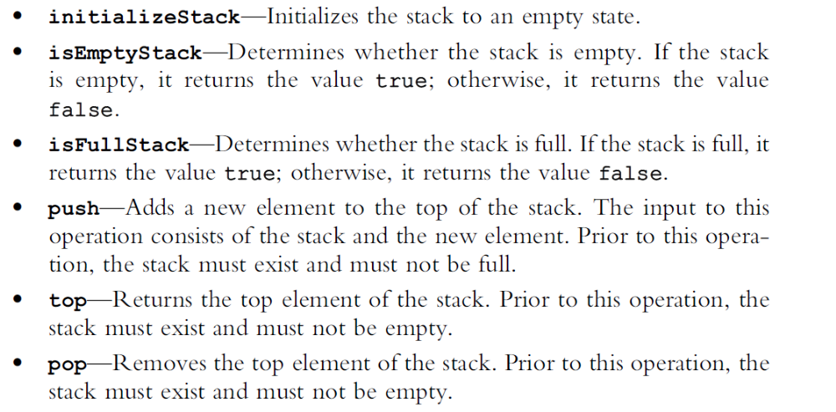
Stacks
To implement a a stack these operations are used:

Slide 7
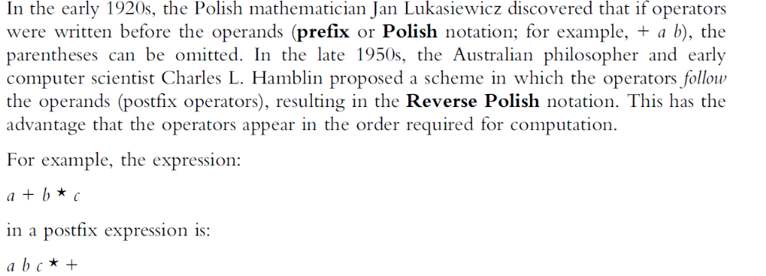
Stacks
Application of stacks: expression evaluation

Slide 8
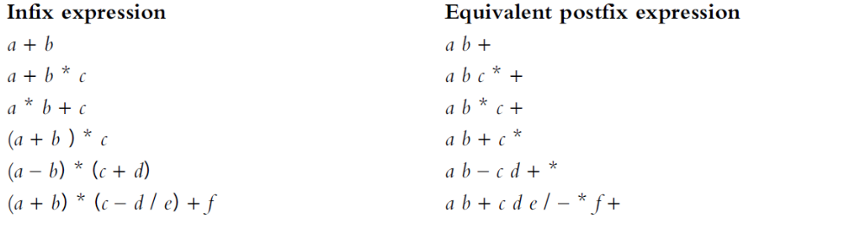
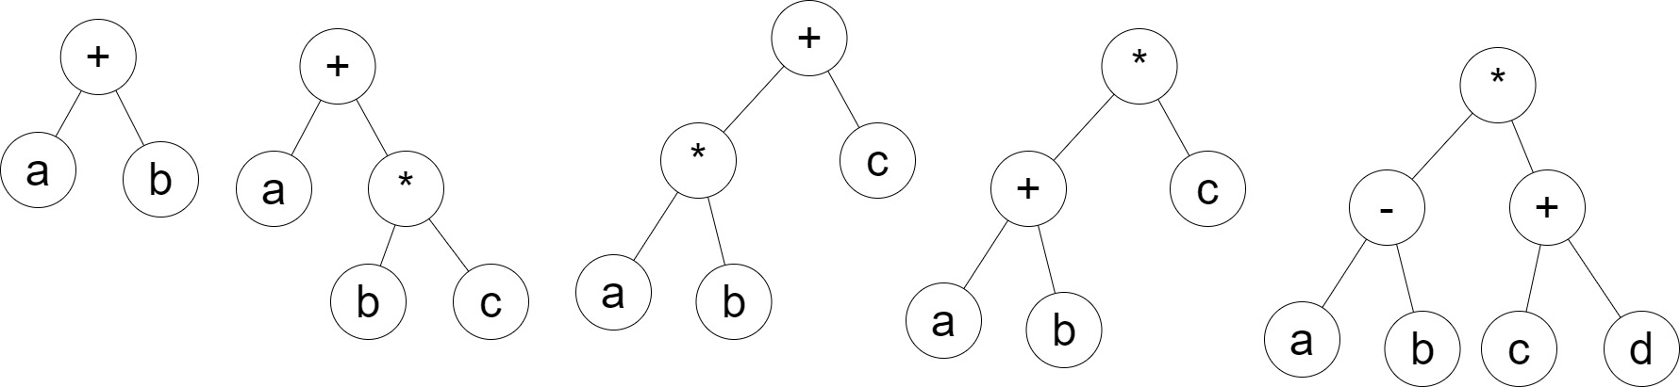
Stacks
Expression examples
Equivalent binary tree models of first 5 above

Slide 9
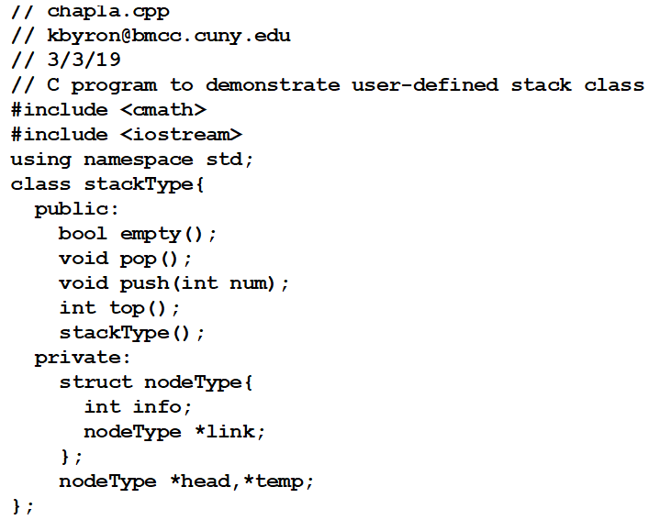
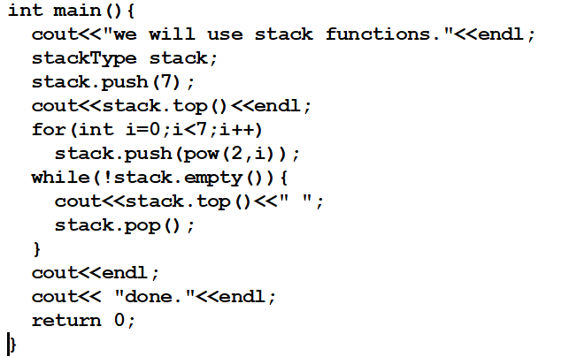
Stacks
Stack processing with user defined class

Slide 10
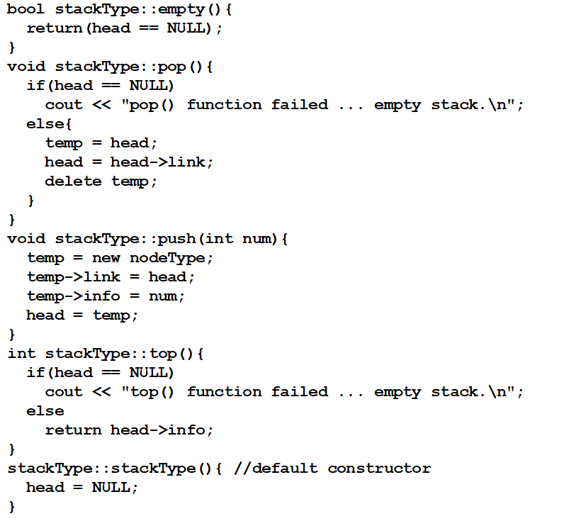
Stacks
Stack processing with user defined class

Slide 11
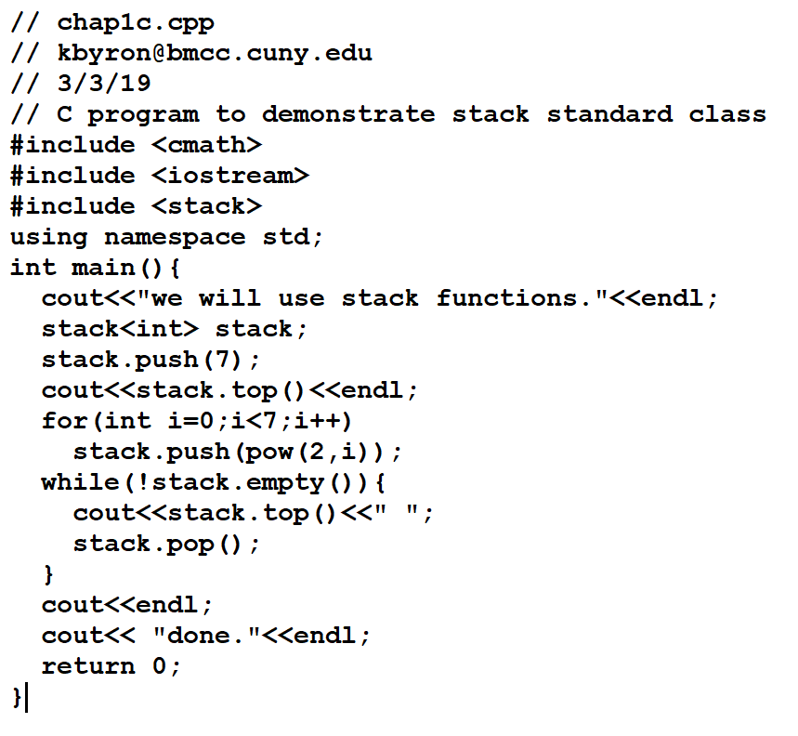
Stacks
Stack processing with standard class

Slide 12
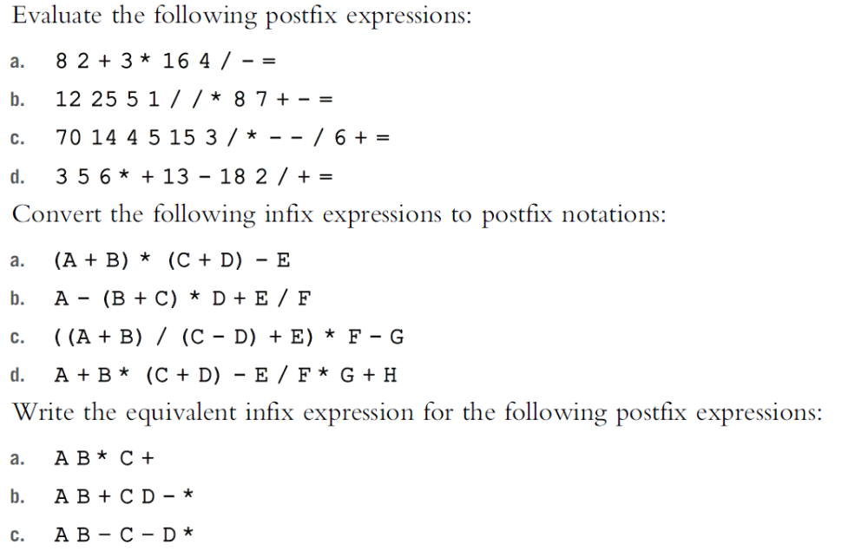
Stacks

Slide 13
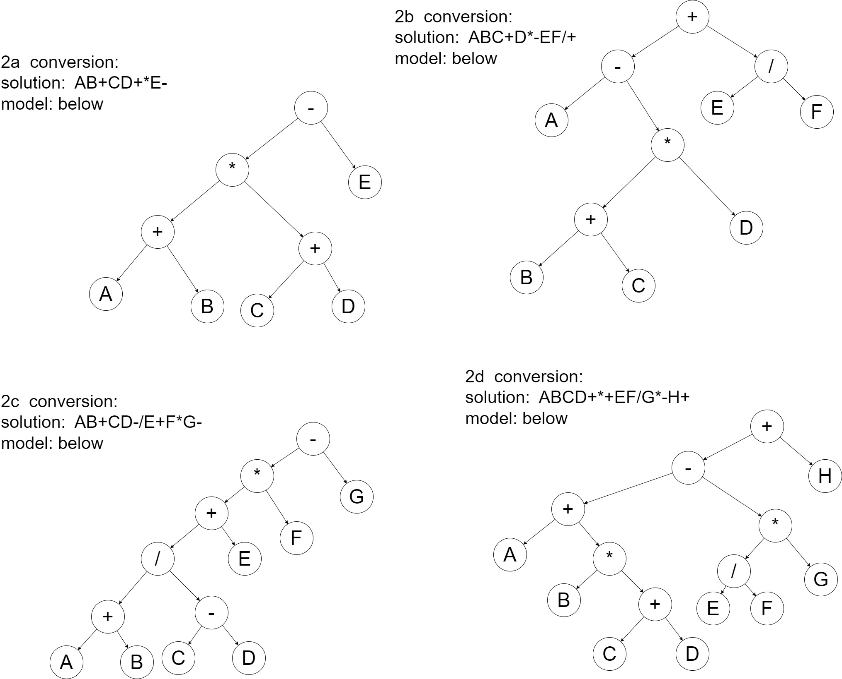
Stacks – Infix to Postfix Solutions

Slide 14
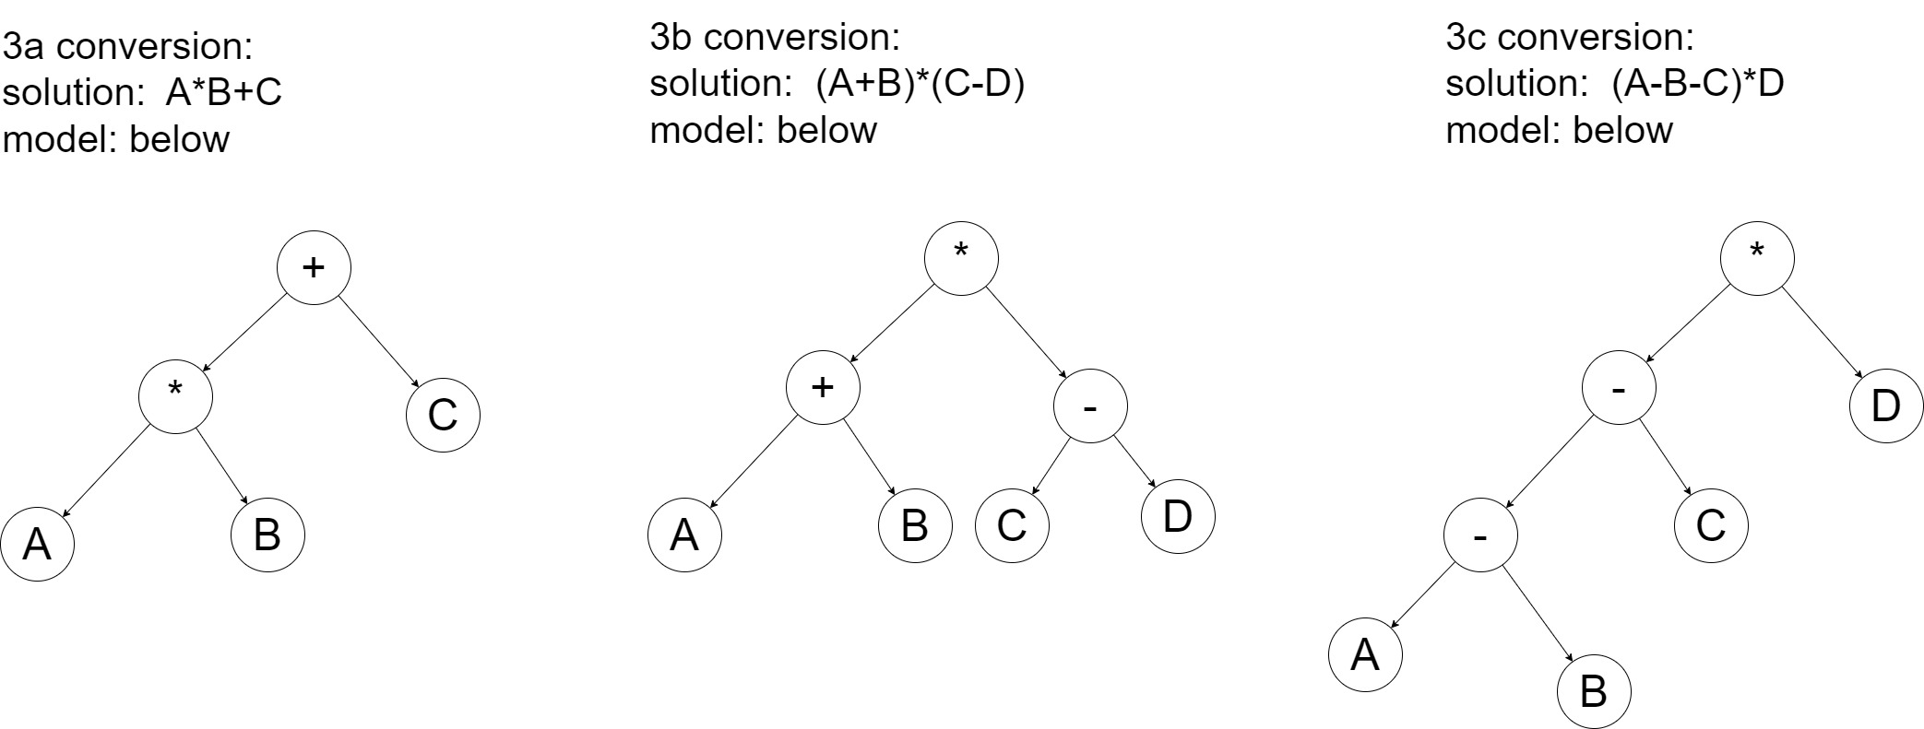
Stacks – Postfix to Infix Solutions

Slide 15
Assignment
Read Malik chapter 7 - stacks

