Slide 1

Chapter 12: Project Procurement Management
Information Technology Project Management, Sixth Edition
Note: See the text itself for full citations.

Slide 2
Announcements
10/27 - Chapter 7, then team breakouts
11/3 - Chapter 8, then team breakouts
11/10 - Chapter 9, then team breakouts
11/17 - Chapter 10 & 11
11/24 - No Class Happy Thanksgiving
12/1 - Chapter 12
12/8 - Final Demo presented; Final reports due
12/15 - Final Exam

Slide 3
Learning Objectives
Understand the importance of project procurement management
Describe the work involved in planning procurements for projects, including determining the proper type of contract, preparing a procurement management plan, statement of work, source selection criteria, and make-or-buy analysis
Discuss what is involved in conducting procurements and strategies for obtaining seller responses, selecting sellers, and awarding contracts

Slide 4
Learning Objectives (continued)
Understand the process of administering procurements by managing procurement relationships and monitoring contract performance
Describe the process of closing procurements

Slide 5
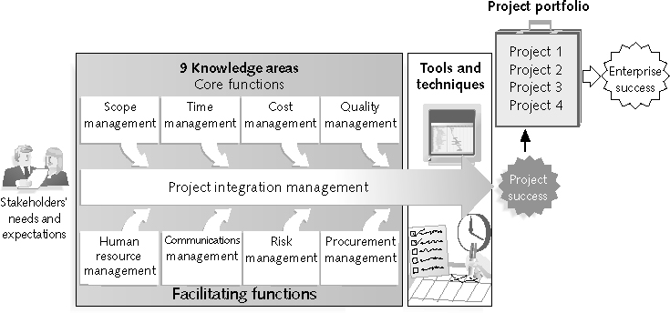
REVIEW: Project Management Framework – 9 Knowledge Areas

Slide 6
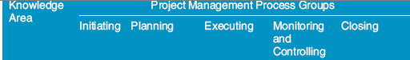
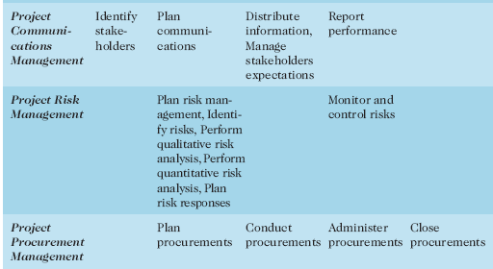
REVIEW:(continued)

Slide 7
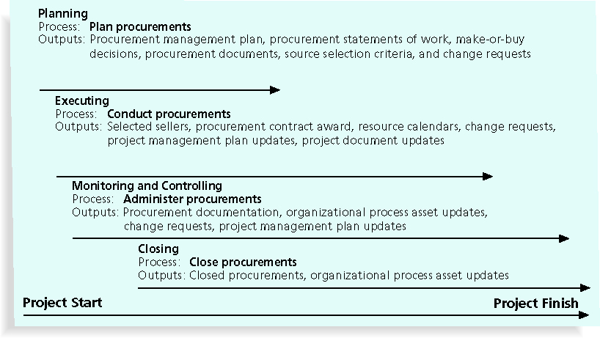
Figure 12-1. Project Procurement Management Summary

Slide 8
Project Procurement Management Processes
Project procurement management: acquiring goods and services for a project from outside the performing organization
Processes include:
Planning procurements: determining what to procure, when, and how
Conducting procurements: obtaining seller responses, selecting sellers, and awarding contracts
Administering procurements: managing relationships with sellers, monitoring contract performance, and making changes as needed
Closing procurements: completing and settling each contract, including resolving of any open items

Slide 9
Importance of Project Procurement Management
Procurement means acquiring goods and/or services from an outside source
Other terms include purchasing and outsourcing

Slide 10
Planning Procurements
Identifying which project needs can best be met by using products or services outside the organization
If there is no need to buy any products or services from outside the organization, then there is no need to perform any of the other procurement management processes

Slide 11
Tools and Techniques for Planning Purchases and Acquisitions
Build-or-buy analysis: general management technique used to determine whether an organization should make or perform a particular product or service inside the organization or buy from someone else
Often involves financial analysis
Experts, both internal and external, can provide valuable inputs in procurement decisions

Slide 12
Build-or-Buy Example
Build the website yourself
Pro’s: take your time, change things around, no cost for changes, you own code.
Con’s: are it could take longer, maybe you don’t have the skillset, you will have to maintain
Have someone build it for you
Pro’s– quicker, they have skillset.
Con’s: have to be clear in what they are building, changes cost money, they might own the code, changes/maintenance might cost more in the long run.

Slide 13
Key Terms : Contracts
A contract is a mutually binding agreement that obligates the seller to provide the specified products or services and obligates the buyer to pay for them
Contracts can clarify responsibilities and sharpen focus on key deliverables of a project
Because contracts are legally binding, there is more accountability for delivering the work as stated in the contract
A recent trend in outsourcing is the increasing size of contracts

Slide 14
Types of Contracts
Different types of contracts can be used in different situations:
Fixed price or lump sum contracts: involve a fixed total price for a well-defined product or service
Cost reimbursable contracts: involve payment to the seller for direct and indirect costs
Time and material contracts: hybrid of both fixed price and cost reimbursable contracts, often used by consultants
Unit price contracts: require the buyer to pay the seller a predetermined amount per unit of service
A single contract can actually include all four of these categories if it makes sense for that particular procurement

Slide 15
Contract Clauses
Contracts should include specific clauses that take into account issues that are unique to the project
Can require various educational or work experience for different pay rights
A termination clause is a contract clause that allows the buyer or supplier to end the contract

Slide 16
Procurement Management Plan
Describes how the procurement processes will be managed, from developing documentation for making outside purchases or acquisitions to contract closure
Contents vary based on project needs

Slide 17
Contract Statement of Work (SOW)
A statement of work is a description of the work required for the procurement
If a SOW is used as part of a contract to describe only the work required for that particular contract, it is called a contract statement of work
A SOW is a type of scope statement
A good SOW gives bidders a better understanding of the buyer’s expectations

Slide 18
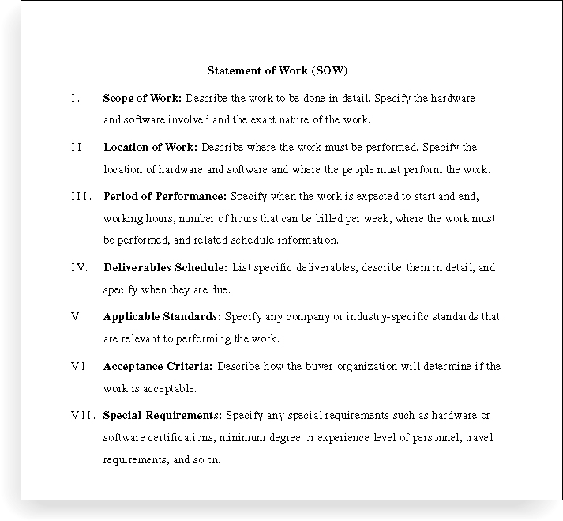
Figure 12-3. Statement of Work (SOW) Template

Slide 19
Procurement Documents
Request for Proposals: used to solicit proposals from prospective sellers
A proposal is a document prepared by a seller when there are different approaches for meeting buyer needs
Requests for Quotes: used to solicit quotes or bids from prospective suppliers
A bid, also called a tender or quote (short for quotation), is a document prepared by sellers providing pricing for standard items that have been clearly defined by the buyer

Slide 20
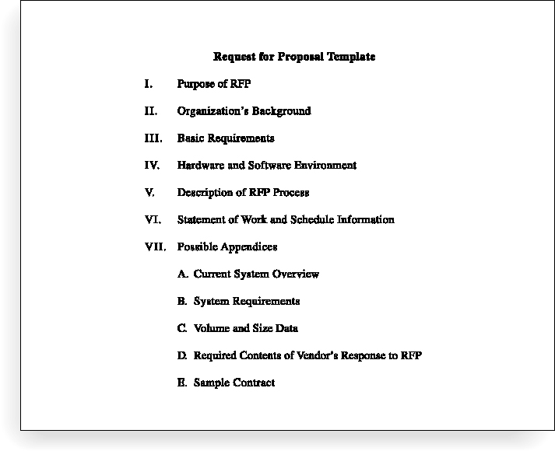
Figure 12-4. Request for Proposal (RFP) Template

Slide 21
Evaluation Criteria
It’s important to prepare some form of evaluation criteria, preferably before issuing a formal RFP or RFQ
Beware of proposals that look good on paper; be sure to evaluate factors, such as past performance and management approach
Can require a technical presentation as part of a proposal

Slide 22
Conducting Procurements
Deciding whom to ask to do the work
Sending appropriate documentation to potential sellers
Obtaining proposals or bids
Selecting a seller
Awarding a contract

Slide 23
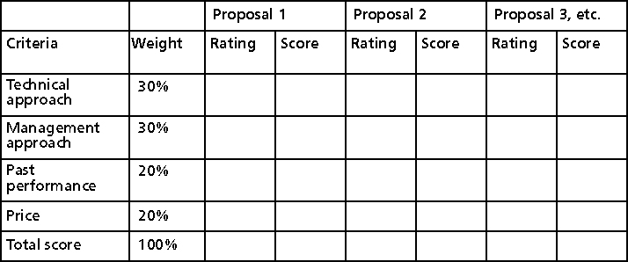
Figure 12-5. Sample Proposal Evaluation Sheet

Slide 24
Seller Selection
Organizations often do an initial evaluation of all proposals and bids and then develop a short list of potential sellers for further evaluation
Sellers on the short list often prepare a best and final offer (BAFO)
Final output is a contract signed by the buyer and the selected seller

Slide 25
Administering Procurements
Ensures that the seller’s performance meets contractual requirements
Contracts are legal relationships, so it is important that legal and contracting professionals be involved in writing and administering contracts
It is critical that project managers and team members watch for constructive change orders, which are oral or written acts or omissions by someone with actual or apparent authority that can be construed to have the same effect as a written change order

Slide 26
Suggestions for Change Control in Contracts
Changes to any part of the project need to be reviewed, approved, and documented by the same people in the same way that the original part of the plan was approved
Evaluation of any change should include an impact analysis; how will the change affect the scope, time, cost, and quality of the goods or services being provided?
Changes must be documented in writing; project team members should also document all important meetings and telephone phone calls

Slide 27
Suggestions for Change Control in Contracts (continued)
Project managers and teams should stay closely involved to make sure the new system will meet business needs and work in an operational environment
Have backup plans
Use tools and techniques, such as a contract change control system, buyer-conducted performance reviews, inspections and audits, and so on

Slide 28
Best Practice
Accenture developed a list of best practices from experienced outsourcers throughout the world:
Build in Broad Business Outcomes Early and Often
Hire a Partner, Not Just a Provider
It’s More Than a Contract, It’s a Business Relationship
Leverage Gain-Sharing
Use Active Governance
Assign a Dedicated Executive
Focus Relentlessly on Primary Objectives

Slide 29
Closing Procurements
Involves completing and settling contracts and resolving any open items
The project team should:
Determine if all work was completed correctly and satisfactorily
Update records to reflect final results
Archive information for future use
The contract itself should include requirements for formal acceptance and closure

Slide 30
Tools to Assist in Contract Closure
Procurement audits identify lessons learned in the procurement process
Negotiated settlements help close contracts more smoothly
A records management system provides the ability to easily organize, find, and archive procurement-related documents

Slide 31
Chapter Summary
Project procurement management involves acquiring goods and services for a project from outside the performing organization
Processes include:
Plan procurements
Conduct procurements
Administer procurements
Close procurements

