Slide 1

Chapter 7: Project Cost Management
Information Technology Project Management, Sixth Edition
Note: See the text itself for full citations.

Slide 2
Announcements
8/25 – Chapter 1, Syllabus and Class Overview
9/1 – Chapter 2, Term Project Guidance, Team Breakouts
9/8 – Chapter 3, Team Breakouts
9/15 – Chapter 4, Team Breakouts
9/22 – Chapter 5, Team Breakouts
9/29 – No Class, Thursday follows Monday schedule….
10/6 – Chapter 6, Team Breakouts
10/13 – Midterm (chapters 1-6)
10/20 – 1st Team Presentations, due and presented
10/27 Chapter 7

Slide 3
Learning Objectives for Today!
Understand the importance of project cost management
Explain basic project cost management principles
Discuss different types of cost estimates and methods
Understand the processes involved in cost budgeting

Slide 4
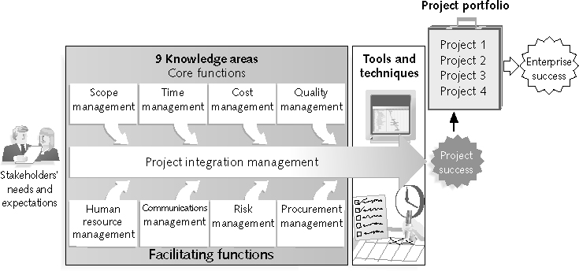
REVIEW: Project Management Framework – 9 Knowledge Areas

Slide 5
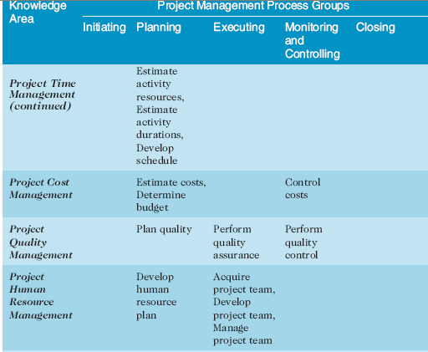
REVIEW:(continued)

Slide 6
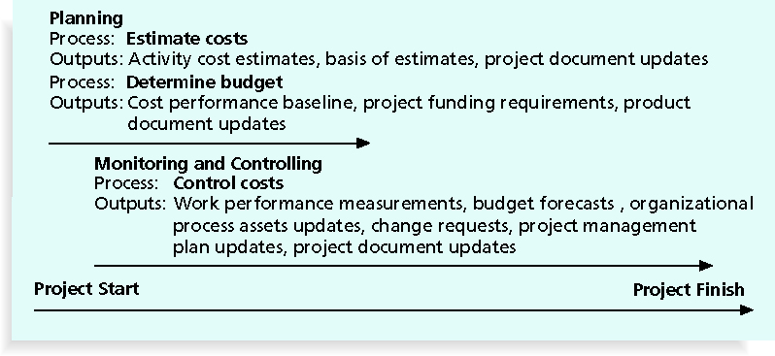
Figure 7-1. Project Cost Management Summary

Slide 7
What is Cost and Project Cost Management?
What is Cost and Project Cost Management?
Cost is a resource sacrificed to achieve a specific objective or something given up in exchange. Ex: I’m going to spend 200k on a storage systems because it will help us store and compress our data more efficiently
Project cost management includes the processes required to ensure that the project is completed within an approved budget

Slide 8
Project Cost Management Processes
Cost Mgmt. Processes:
Estimating costs: developing an approximation or estimate of the costs needed to complete a project
Determining the budget: allocating the overall cost estimate to individual work items to establish a baseline for measuring performance
Controlling costs: controlling changes to the project budget

Slide 9
Basic Principles of Cost Management
Most members of a board or senior leaders better understand and are more interested in financial terms than IT terms, so IT project managers must speak their language
Profits are revenues minus expenditures
Profit margin is the ratio of revenues to profits
Life cycle costing considers the total cost of ownership (TCO), or development plus support costs, for a project
Cash flow analysis determines the estimated annual costs and benefits for a project and the resulting annual cash flow
cost overrun -the additional percentage or dollar amount by which actual costs exceed estimates

Slide 10
Basic Principles of Cost Management
Tangible costs or benefits are those costs or benefits that an organization can easily measure in dollars
Intangible costs or benefits are costs or benefits that are difficult to measure in monetary terms
Direct costs are intended costs that can be directly related to producing the products and services of the project
Indirect costs are unintended costs that are not directly related to the products or services of the project,
Sunk cost is money that has been spent in the past and will not give any benefit to the project, could be you picked the wrong vendor, wrong software, changed direction

Slide 11
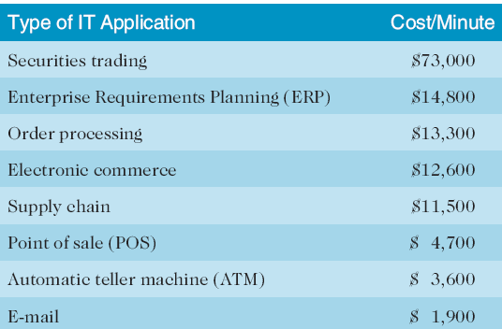
Table 7-1. Cost of Downtime for IT Applications

Slide 12
Basic Principles of Cost Management
Learning curve theory states that when many items are produced repetitively, the unit cost of those items decreases in a regular pattern as more units are produced
Reserves are dollars included in a cost estimate to mitigate cost risk by allowing for future situations that are difficult to predict:
Contingency reserves allow for future situations that may be partially planned for (sometimes called known unknowns) and are included in the project cost baseline
Management reserves allow for future situations that are unpredictable (sometimes called unknown unknowns)

Slide 13
Estimating Costs
Project managers must take cost estimates seriously if they want to complete projects within budget
It’s important to know:
the types of cost estimates,
how to prepare cost estimates,
and typical problems associated with IT cost estimates
What type of estimate are you doing? Rough? Budgetary? Definitive?

Slide 14
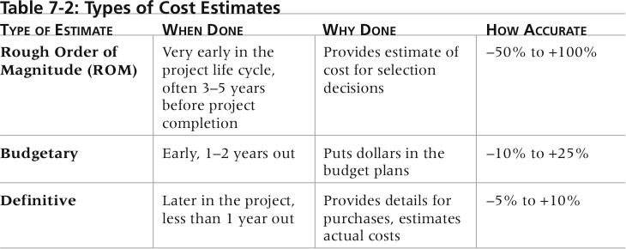
Table 7-2. Types of Cost Estimates

Slide 15
Cost Management Plan
A cost management plan is a document that describes how the organization will manage cost variances on the project
ex: touch base and forecast during project, on budget? Need more/less?
A large percentage of total project costs are often labor costs, so project managers must develop and track estimates for labor

Slide 16
Cost Estimation Tools and Techniques
Basic tools and techniques for cost estimates:
Analogous or top-down estimates: use the actual cost of a previous, similar project as the basis for estimating the cost of the current project
Bottom-up estimates: involve estimating individual work items or activities and summing them to get a project total
Developer @ 80hr * 165/hr = 13.2k
Servers = 20.3k
Storage = 10.5k
Licensing = 5k
Total = $49k

Slide 17
Typical Problems with IT Cost Estimates
Estimates are done too quickly
Lack of estimating experience
Human beings are biased toward underestimation
Estimates done without knowledge of outside factors

Slide 18
Determining the Budget
Cost budgeting involves allocating the project cost estimate to individual work items over time
The WBS is a required and helps the cost budgeting process since it defines the work items
Important goal is to produce a cost baseline
A time-phased budget that project managers use to measure and monitor cost performance

Slide 19
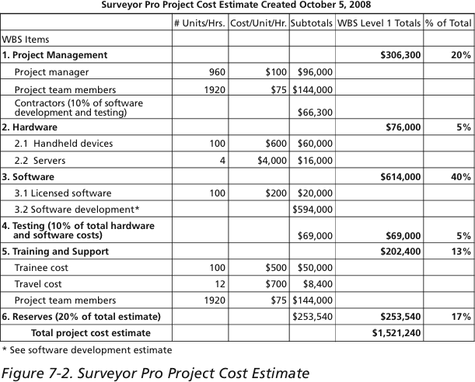
Figure 7-2. Surveyor Pro Project Cost Estimate

Slide 20
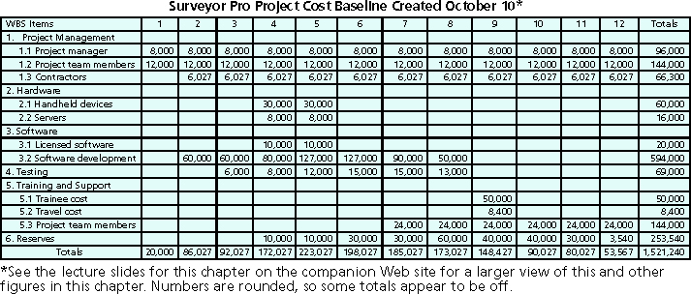
Figure 7-4. Surveyor Pro Project Cost Baseline

Slide 21
Controlling Costs
Project cost control includes:
Monitoring cost performance
Ensure bills and invoices are correct during the project
Ensure appropriate project changes are included in a revised cost baseline
Inform project stakeholders of authorized changes to the project that will affect costs,
both increase and decrease….
This is not easy! Many organizations around the globe have problems with cost control

Slide 22
Chapter Summary
Project cost management is a traditionally weak area of IT projects, and project managers must work to improve their ability to deliver projects within approved budgets
Main processes include:
Estimate costs
Determine the budget
Control costs

