Slide 1

Chapter 4: Project Integration Management
Information Technology Project Management, Sixth Edition
Note: See the text itself for full citations.

Slide 2
Announcements
8/25 – Chapter 1, Syllabus and Class Overview
9/1 – Chapter 2, Term Project Guidance, Team Breakouts
9/8 – Chapter 3, Team Breakouts
9/15 – Chapter 4, Team Breakouts
9/22 – Chapter 5, Team Breakouts
9/29 – No Class, Thursday follows Monday schedule….
10/6 – Chapter 6, Team Breakouts
10/13 – Midterm (chapters 1-6)
10/20 – 1st Team Presentations, due and presented.
Information Technology Project Management, Sixth Edition

Slide 3
Learning Objectives
Describe an overall framework for project integration management as it relates to the other PM knowledge areas and the project life cycle
Explain the strategic planning process and apply different project selection methods
Project Financials….

Slide 4
A Key to Overall Project Success: Project Integration Management
Project managers (the good ones) coordinate all knowledge areas throughout a project’s life cycle
Many new and seasoned project managers have trouble looking at the “big picture” and want to focus on
There are too many details at times, time, scope, cost, resources etc… remember not to get too focused on one as your project can fail if you neglect the other KA’s
Note: Project integration management is not the same thing as software integration

Slide 5
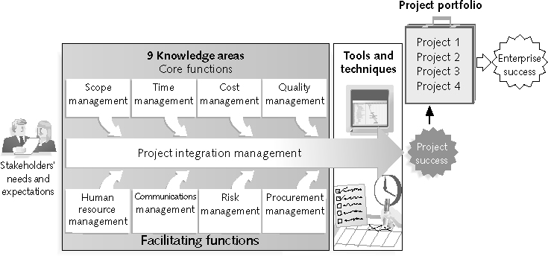
Project Management Framework – 9 Knowledge Areas

Slide 6
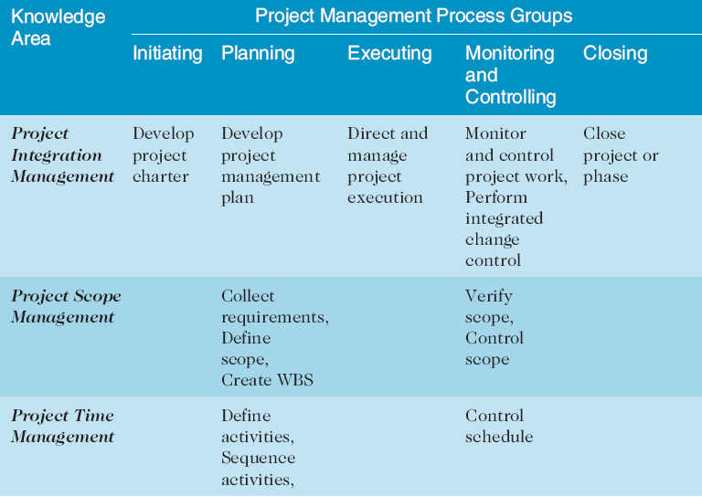
Project Management Process Groups and Knowledge Area Mapping*

Slide 7
Project Integration Management Processes (6 of them)
Develop the project charter
Develop the project management plan
Direct and manage project execution
Monitor and control the project work
Perform integrated change control
Close the project or phase

Slide 8
Project Integration Management Processes
Develop the project charter: working with stakeholders to create the document that formally authorizes a project : the charter
Develop the project management plan: coordinating all planning efforts to create a consistent, coherent document
Note: the project management plan is different from a Gantt Chart
Direct and manage project execution: carrying out the project management plan by performing the activities included in it

Slide 9
Project Integration Management Processes (continued)
Monitor and control the project work: overseeing project work to meet the OVERALL performance objectives of the project
Perform integrated change control: coordinating changes that affect the project’s deliverables and organizational process assets
Close the project or phase: finalizing all project activities to formally close the project or phase

Slide 10
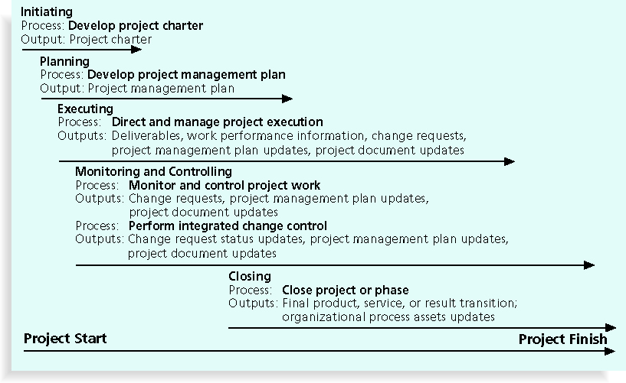
Figure 4-1. Project Integration Management Summary

Slide 11
Project Charters
After deciding what project to work on, it is important to let the rest of the organization know
A project charter is a document that formally recognizes the existence of a project and provides direction on the project’s objectives and management
Key project stakeholders should sign a project charter to acknowledge agreement on the need and intent of the project; a signed charter is a key output of project integration management

Slide 12
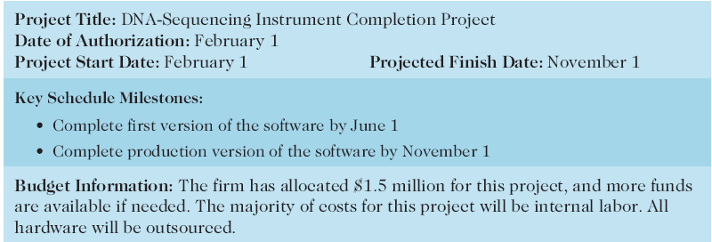
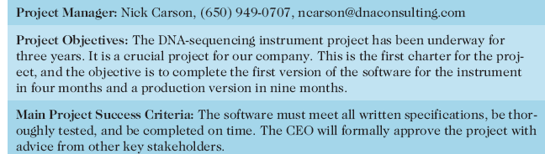
Table 4-1. Project Charter for the DNA-Sequencing Instrument Completion Project

Slide 13
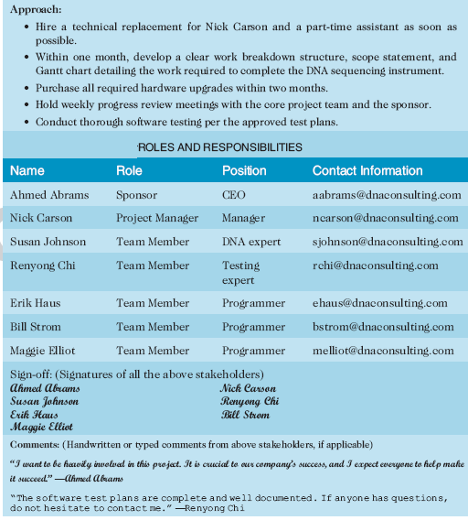
Table 4-1. Charter (continued)

Slide 14
Project Management Plans
A project management plan is a document used to coordinate all the project planning documents and help guide execution and control
Think of it as the master plan, taking all 9-knowledge area plans into account and having a master document, cost plan, time plan, risk plans etc…
Plans created in the other knowledge areas are subsidiary parts of the overall project management plan

Slide 15
Common Elements of a Project Management Plan
Introduction or overview of the project
Description of how the project is organized
Management and technical processes used on the project
Work to be done, schedule, and budget information

Slide 16
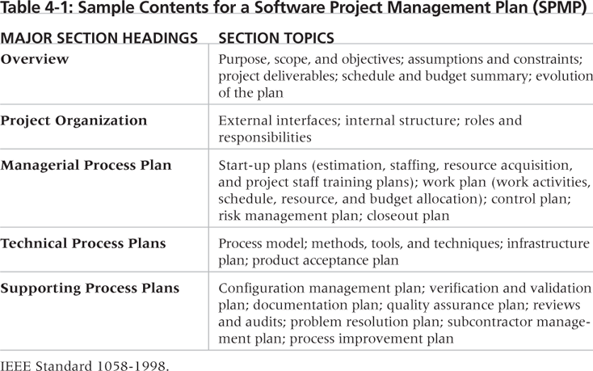
Table 4-2. Sample Contents for a Software Project Management Plan (SPMP)

Slide 17
Project Execution
Project execution involves managing and performing the work described in the project management plan
The majority of time and money is usually spent on execution

Slide 18
Coordinating Planning and Execution
Project planning and execution are intertwined and inseparable activities
Key: Those who will do the work should help to plan the work
Key: Project managers must solicit input from the team to develop realistic plans

Slide 19
Important Skills for Project Execution
General management skills like leadership, communication, and political skills
Product, organization, and business area skills and knowledge are needed
Use of specialized tools and techniques can be helpful to move work/execution along

Slide 20
Project Execution Tools and Techniques
Expert judgment: experts can help project managers and their teams make many decisions related to project execution
Project management information systems:
there are hundreds of project management software products available on the market today
many organizations are moving toward powerful enterprise project management systems that are accessible via the Internet and mobile
They aim to give centralized view of a project (all project artifacts in one place)
And a portfolio view of all your programs/projects (in the same place etc…)

Slide 21
Monitoring and Controlling Project Work
Changes are inevitable on most projects, so it’s important to develop and follow a process to monitor and control changes
Monitoring project work includes collecting, measuring, and disseminating performance information
A baseline is the initial approved project management plan

Slide 22
Integrated Change Control
Three main objectives are:
1) Identify and validate the change, and if the change is needed
If so
2) Manage the actual changes as they occur (plan, notify, execute, close it out)
3)Determine if the change has occurred and report on if it made the impact or fix as intended

Slide 23
Change Control on Information Technology Projects
Former view: the project team should strive to do exactly what was planned on time and within budget
Problem: stakeholders rarely agreed up-front on the project scope, and time and cost estimates were inaccurate
Modern view: project management is a process of constant communication, negotiation and flexibility
Solution: changes are often beneficial, and the project team should plan and control them and most of all communicate them early / often

Slide 24
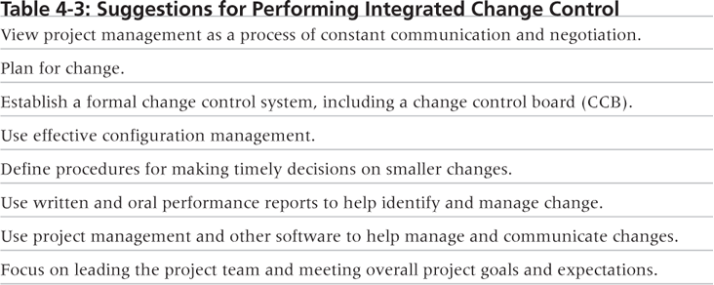
Table 4-3. Suggestions for Performing Integrated Change Control

Slide 25
Change Control Board (CCB)
A formal group of people responsible for reviewing and approving or rejecting changes to a project
CCBs provide guidelines for preparing change requests, evaluate change requests, and manage the implementation of approved changes
Can include stakeholders from the entire organization
Also sometimes called a CAB – Change Advisory Board

Slide 26
Closing Projects and Phases
To close a project or phase, you must finalize all activities and transfer the completed or cancelled work to the appropriate people
Main outputs include:
Final product, service, or result transition
Organizational process asset updates

Slide 27
Strategic Planning and Project Selection
Strategic planning involves determining long-term objectives, predicting future trends, and projecting the need for new products and services
Organizations often perform a SWOT analysis
Analyzing Strengths, Weaknesses, Opportunities, and Threats
As part of strategic planning, organizations:
Identify potential projects
Use realistic methods to select which projects to work on
Formalize project initiation by issuing a project charter

Slide 28
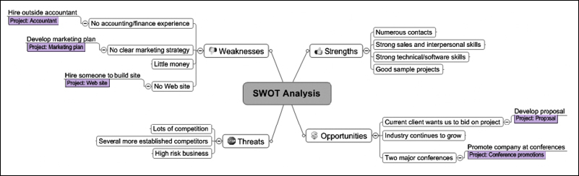
Figure 4-2. Mind Map of a SWOT Analysis to Help Identify Potential Projects

Slide 29
Methods for Selecting Projects
There are usually more projects than available time and resources to implement them
Methods for selecting projects include:
Focusing on broad organizational needs
Categorizing information technology projects
Performing net present value or other financial analyses
Using a weighted scoring model
Implementing a balanced scorecard

Slide 30
Focusing on Broad Organizational Needs
It is often difficult to provide strong justification for many IT projects, but everyone agrees they have a high value
“It is better to measure gold roughly than to count pennies precisely”
Three important criteria for projects:
There is a need for the project
There are funds available
There’s a strong will to make the project succeed

Slide 31
Categorizing IT Projects
One categorization is whether the project addresses:
A problem
An opportunity, or
A directive
Another categorization is how long it will take to do and when it is needed
Complex
And overall priority of the project

Slide 32
Financial Analysis of Projects
Financial considerations are often an important consideration in selecting projects
Three primary methods for determining the projected financial value of projects:
Net present value (NPV) analysis
Return on investment (ROI)
Payback analysis

Slide 33
Net Present Value Analysis
Net present value (NPV) analysis is a method of calculating the expected net monetary gain or loss from a project by discounting all expected future cash inflows and outflows to the present point in time
Simply put would I rather spend money today vs in the future, what's the time value of money worth to a company….
Projects with a positive NPV should be considered if financial value is a key criterion,
The higher the NPV, the better

Slide 34
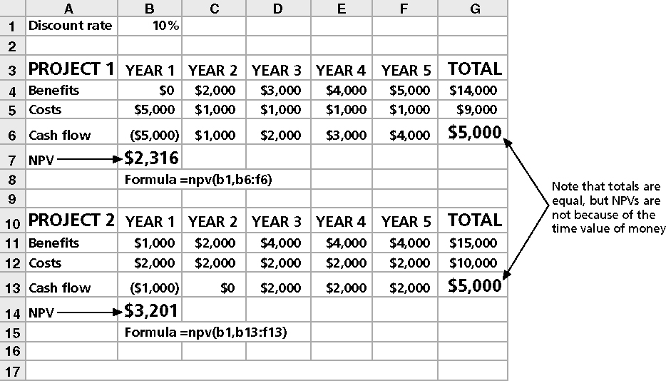
Figure 4-4. Net Present Value Example

Slide 35
Return on Investment
Return on investment (ROI) is calculated by subtracting the project costs from the benefits and then dividing by the costs
ROI = (total discounted benefits - total discounted costs) / discounted costs
The higher the ROI, the better
Many organizations have a required rate of return or minimum acceptable rate of return on investment for projects

Slide 36
Payback Analysis
Another important financial consideration is payback analysis
This is the payback period or the amount of time it will take to recoup invested money.
Payback occurs when the net cumulative discounted benefits equals the costs
Many organizations want IT projects to have a fairly short payback period, WHY?

Slide 37
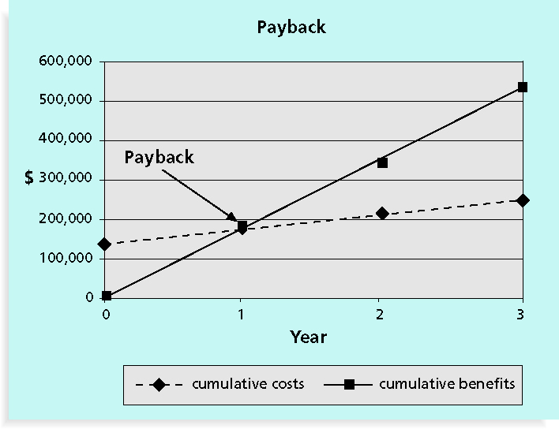
Figure 4-6. Charting the Payback Period

Slide 38
Weighted Scoring Model
A weighted scoring model is a tool that provides a systematic process for selecting projects based on many criteria
Identify criteria important to the project selection process
Assign weights (percentages) to each criterion so they add up to 100%
Assign scores to each criterion for each project
Multiply the scores by the weights and get the total weighted scores
The higher the weighted score, the better

Slide 39
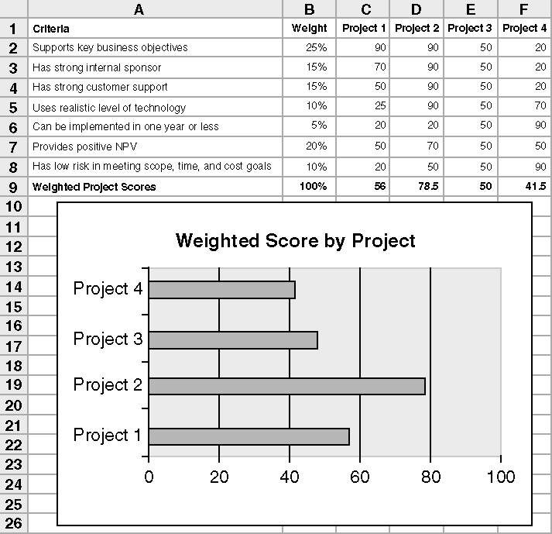
Figure 4-7. Sample Weighted Scoring Model for Project Selection

