Slide 1

Chapter 1: Introduction to Project Management
Information Technology Project Management, Sixth Edition
Note: See the text itself for full citations.

Slide 2
Announcements
Aug 25th – Class Begins, Chapter 1 Slides
Get the book: Information Technology Project Management, Revised, 6th Edition (includes
Kathy Schwalbe, ISBN-13: 9781111221751
Read the syllabus posted on BB
Chapter 1 slides posted
Teams ( I will pick) for the final group project

Slide 3

Introduction Prof. Thomas Licciardello
23+ years in the Technology & Cybersecurity industry
VP, CIO, CTO leadership roles held…
CISSP, MCSE, A+, ITIL certifications
Pace University - BS Computer Science
Columbia University - MS Executive Technology Management
Drexel University – in progress Doctorate in Business Administration
I work full-time, teach part-time. 10 years at Baruch, also taught at Pace, and Rider University…..
My goal is to bring classroom content and corporate experiences together, to give you a well-rounded view of life in the workplace……

Slide 4
What this course is about!
Information Technology Project Design and Management is the CIS capstone project course for the CIS major wherein you will apply concepts and techniques from prior course work, to design, develop, and create an implementable application for a working information system of an actual business.
The course focuses students to the fundamentals of IT project management required for the successful implementation of IT-based systems.
The course presents tools and technologies for project definition, work breakdown, estimating, planning and scheduling resources as well as monitoring and control of project execution.
Students utilize knowledge gained from prior coursework, and work in groups to design and manage an Information Technology project.
We’ll meet on-line, in person, and in team settings when needed.
We’ll take advantage of “team independent” study (towards your final project).

Slide 5
Your main deliverables!
Get to know your team - I will distribute
Pick your project idea
Submit it for approval
Start work on your project idea
Submit case study/ assignments as assigned
Do an initial team presentation – status check
Take a midterm
Develop your working prototype
Take a final
Present your final report and demo your product!

Slide 6
Chapter 1 Learning Objectives
Understand the growing need for better project management
Explain what a project is, provide examples of information technology projects
Describe project management and discuss key elements of the project management framework, including project stakeholders, the project management knowledge areas, common tools and techniques, and project success

Slide 7
Learning Objectives (continued)
Discuss the relationship between project, program, and portfolio management and the contributions they each make to enterprise success
Understand the role of the project manager by describing what project managers do, what skills they need, and what the career field is like for information technology project managers

Slide 8
Introduction (continued)
Many organizations today have a new or renewed interest in project management
Computer hardware, software, networks, and the use of interdisciplinary and global work teams have radically changed the work environment – more complex
The world as a whole spends nearly $10 trillion of its $40.7 trillion gross product on projects of all kinds
More than 16 million people regard project management as their profession

Slide 9
Why be a Project Manager?
Total global spending on technology goods, services, and staff was projected to reach $3.4 trillion in 2018, an 8 percent increase from 2017
In the U.S. the size of the IT workforce topped 4 million workers in 2008, today its around 15 Million
In 2018 the total compensation for the average senior project manager in U.S. dollars was $120K per year in the United States,
The number of people earning their Project Management Professional (PMP) certification continues to increase

Slide 10
Advantages of Using Formal Project Management
Better control of financial, physical, and human resources
Improved customer relations
Shorter development times
Lower costs
Higher quality and increased reliability
Higher profit margins
Improved productivity
Better internal coordination
Higher worker morale

Slide 11
What Is a Project?
A project is “a temporary endeavor undertaken to create a unique product, service, or result”
Projects end when their objectives have been reached or the project has been terminated
Projects can be large or small and take a short or long time to complete

Slide 12
Examples of IT Projects
A technician replaces ten laptops for a small department
A small software development team adds a new feature to an internal software application for the finance department
A college campus upgrades its technology infrastructure to provide wireless Internet access across the whole campus

Slide 13
Project Attributes
A project:
Has a unique purpose
Is temporary
Is developed using elaboration - requirements
Requires resources, often from various areas
Should have a primary customer or sponsor
The project sponsor usually provides the direction and funding for the project
Projects do have varying degrees of uncertainty

Slide 14
Project and Program Managers
Project managers work with project sponsors, the project team, and other people involved in a project to meet project goals
Program: group of related projects managed in a coordinated way to obtain benefits and control not available from managing them individually
Program managers oversee programs; often act as bosses for project managers

Slide 15
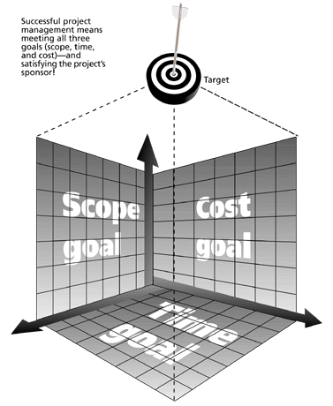
Figure 1-1 The Triple Constraint of Project Management
Successful project management means managing effectively all three goals (scope, time, and cost) + satisfying the project sponsor – WHY?
- Quality?

Slide 16
What is Project Management?
Project management is “the application of knowledge, skills, tools and techniques to meet project requirements”
Project managers strive to meet the triple constraint by balancing project scope, time, and cost goals

Slide 17
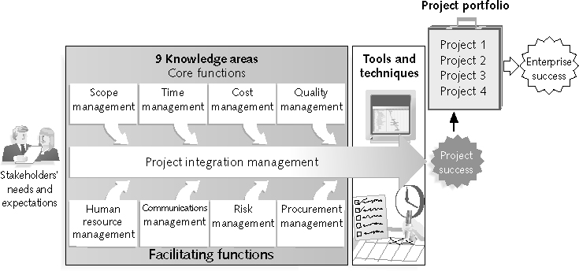
Figure 1-2 Project Management Framework
CORE!
FACILITATING!

Slide 18
Project Stakeholders
Stakeholders are the people involved in or affected by project activities
Stakeholders include:
The project sponsor
The project manager
The project team
Support staff
Customers
Users
Suppliers
Opponents to the project

Slide 19
9 Project Management Knowledge Areas
Knowledge areas describe the key competencies that project managers must develop
4 core knowledge areas lead to specific project objectives (scope, time, cost, and quality)
4 facilitating knowledge areas are the means through which the project objectives are achieved (human resources, communication, risk, and procurement management
1 knowledge area (project integration management) affects and is affected by all of the other knowledge areas
All knowledge areas are important!

Slide 20
Project Management Tools and Techniques
Project management tools and techniques assist project managers and their teams in various aspects of project management
Some specific ones include:
Project charter, scope statement, and WBS (scope)
Gantt charts, network diagrams, critical chain scheduling (time)
Cost estimates and earned value management (cost)

Slide 21
Project Success
There are several ways to define project success:
The project met scope, time, and cost goals
What is this called?
The project satisfied the customer/sponsor
The results of the project met its main objective
making or saving a certain amount of money
providing a good return on investment
or simply making the sponsors happy

Slide 22
Table 1-2: What Helps Projects Succeed?*
1. Executive support
2. User involvement
3. Experienced project
manager
4. Clear business objectives
5. Minimized scope
6. Standard software
infrastructure
7. Firm basic requirements
8. Formal methodology
9. Reliable estimates
10. Other criteria, such as
small milestones, proper
planning, competent
staff, and ownership
*The Standish Group, “Extreme CHAOS,”

Slide 23
What the Winners Do…
Recent research findings show that companies that excel in project delivery capability:
Use an integrated project management toolbox (use standard/advanced PM tools, lots of templates)
Grow project leaders, emphasizing business and soft skills
Develop a streamlined project delivery process
Measure project health using metrics, like customer satisfaction or return on investment

Slide 24
Program and Project Portfolio Management
A program is “a group of related projects managed in a coordinated way to obtain benefits and control not available from managing them individually” (PMBOK® Guide, Fourth Edition, 2008, p. 9)
A program manager provides leadership and direction for the project managers heading the projects within the program
Examples of common programs in the IT field include infrastructure, applications development, and user support

Slide 25
Project Portfolio Management
As part of project portfolio management, organizations group and manage projects and programs as a portfolio of investments that contribute to the entire enterprise’s success
Portfolio managers help their organizations make wise investment decisions by helping to select and analyze projects from a strategic perspective

Slide 26
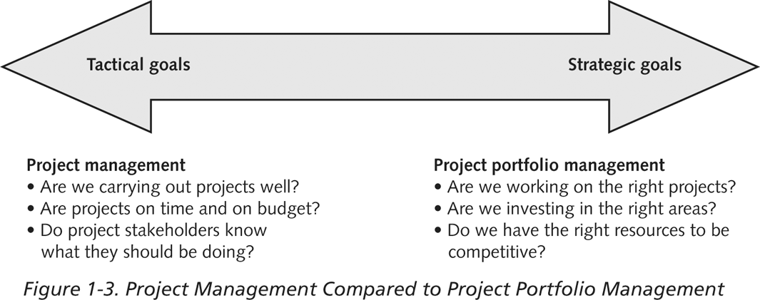
Figure 1-3. Project Management Compared to Project Portfolio Management

Slide 27
Best Practice
A best practice is “an optimal way recognized by industry to achieve a stated goal or objective”*
Robert Butrick suggests that organizations need to follow basic principles of project management,
Make sure your projects are driven by your strategy; be able to demonstrate how each project you undertake fits your business strategy, and screen out unwanted projects as soon as possible
Engage your stakeholders; ignoring stakeholders often leads to project failure; be sure to engage stakeholders at all stages of a project, and encourage teamwork and commitment at all times
*Project Management Institute, Organizational Project Management Maturity Model
(OPM3) Knowledge Foundation (2003), p. 13.

Slide 28
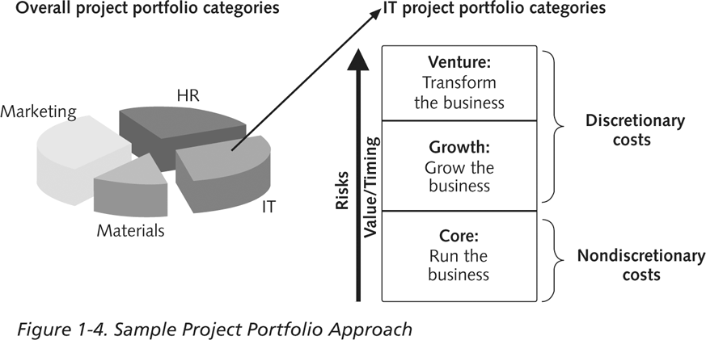
Figure 1-4. Sample Project Portfolio Approach

Slide 29
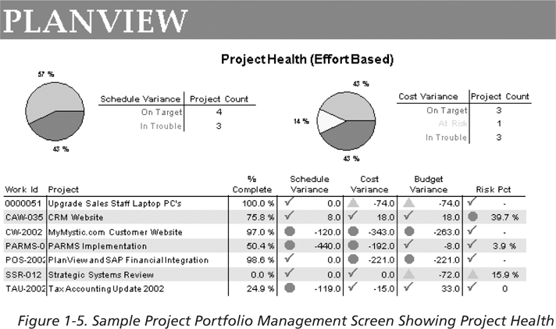
Figure 1-5. Sample Project Portfolio Management Screen Showing Project Health

Slide 30
Suggested Skills for Project Managers
Project managers need a wide variety of skills
They should:
Be comfortable with change
Understand the organizations they work in and with
Be able to lead teams to accomplish project goals

Slide 31
The Role of the Project Manager
Job descriptions vary, but most include responsibilities like planning, scheduling, coordinating, and working with people ”Together” to achieve project goals
Remember that 97% of successful projects were led by experienced project managers, who can often help influence success factors

Slide 32
Suggested Skills for Project Managers
The Project Management Body of Knowledge
Application area knowledge, standards, and regulations
Project environment knowledge
General management knowledge and skills
Soft skills or human relations skills

Slide 33
Table 1-3. Ten Most Important Skills and Competencies for Project Managers
1. People skills
2. Leadership
3. Listening
4. Integrity, ethical behavior, consistent
5. Strong at building trust
6. Verbal communication
7. Strong at building teams
8. Conflict resolution, conflict management
9. Critical thinking, problem solving
10. Understands, balances priorities

Slide 34
Different Skills Needed in Different Situations
Large projects: leadership, relevant prior experience, planning, people skills, verbal communication, and team-building skills were most important
High uncertainty projects: risk management, expectation management, leadership, people skills, and planning skills were most important
Very novel projects: leadership, people skills, having vision and goals, self confidence, expectations management, and listening skills were most important

Slide 35
Importance of Leadership Skills
Effective project managers provide leadership by example
A leader focuses on long-term goals and big-picture objectives while inspiring people to reach those goals
A manager deals with the day-to-day details of meeting specific goals
Project managers often take on the role of both leader and manager

Slide 36
The Project Management Profession
The profession of project management is growing at a very rapid pace
It is helpful to understand the history of the field, the role of professional societies like the Project Management Institute, and the growth in project management software

Slide 37
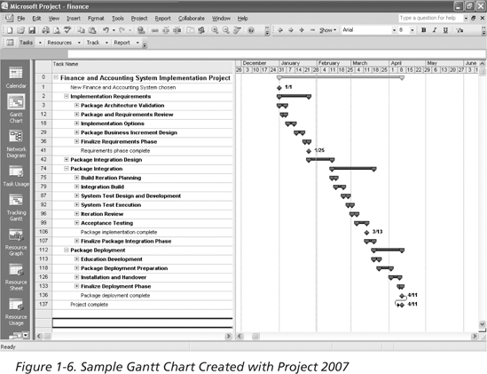
Figure 1-6. Sample Gantt Chart Created with Project 2007

Slide 38
The Project Management Institute
The Project Management Institute (PMI) is an international professional society for project managers founded in 1969
PMI has continued to attract and retain members, reporting 277,221 members worldwide by August 31, 2008
There are specific interest groups in many areas, like engineering, financial services, health care, IT, etc.
Project management research and certification programs continue to grow
Students can join PMI at a reduced fee (see www.pmi.org for details)

Slide 39
Project Management Certification
PMI provides certification as a Project Management Professional (PMP)
A PMP has documented sufficient project experience, agreed to follow a code of ethics, and passed the PMP exam
The number of people earning PMP certification is increasing quickly
PMI and other organizations offer additional certification programs (see Appendix B)

Slide 40
Ethics in Project Management
Ethics, loosely defined, is a set of principles that guide our decision making based on personal values of what is “right” and “wrong”
Project managers often face ethical dilemmas
In order to earn PMP certification, applicants must agree to PMI’s Code of Ethics and Professional Conduct
Several questions on the PMP exam are related to professional responsibility, including ethics

Slide 41
Project Management Software
There are hundreds of different products to assist in performing project management Three main categories of tools:
Low-end tools: handle single or smaller projects well, cost under $200 per user
Midrange tools: handle multiple projects and users, cost $200-600 per user, Project 2007 most popular
High-end tools: also called enterprise project management software, often licensed on a per-user basis, like VPMi Enterprise Online (www.vcsonline.com) – see front cover for trial version information
See the Project Management Center Web site or Top Ten Reviews for links to many companies that provide project management software

Slide 42
Chapter Summary
A project is a temporary endeavor undertaken to create a unique product, service, or result
Project management is the application of knowledge, skills, tools, and techniques to project activities to meet project requirements
A program is a group of related projects managed in a coordinated way
Project portfolio management involves organizing and managing projects and programs as a portfolio of investments
Project managers play a key role in helping projects and organizations succeed
The project management profession continues to grow and mature

