Slide 1

Chapter 2: The Project Management and Information Technology Context
Information Technology Project Management, Sixth Edition
Note: See the text itself for full citations.

Slide 2
Announcements
Term Project Info
Term project guidelines posted
Teams formed (you should have received an email form bb on your teams, let me know if you are not in a team)
Team submission for ideas due Friday 9/9/22
Team submission assignment/form created in BB
Chapter 2 Lecture, then:
Team Breakouts
read your guidelines
understand them and start thinking about your idea
Ask questions by email if you need to,
Nominate a person to upload your project idea by 9/9

Slide 3
Learning Objectives
Describe the systems view of project management and how it applies to information technology projects
Understand organizations, including the four frames, organizational structures, and organizational culture
Explain why stakeholder management and top management commitment are critical for a project’s success

Slide 4
Learning Objectives (continued)
Understand the concept of a project phase and the project life cycle and distinguish between project development and product development
Discuss the unique attributes and diverse nature of information technology projects
Describe recent trends affecting IT project management, including globalization, outsourcing, and virtual teams

Slide 5
Projects Cannot Run in Isolation
Projects must operate in a broad organizational environment
Project managers need to use systems thinking:
Taking a holistic view of carrying out projects within the context of the organization
Must support current business needs

Slide 6
A Systems View of Project Management
A systems approach is a more analytical approach to management and problem solving
3 parts include:
Systems philosophy:
Systems analysis:
Systems management:

Slide 7
A Systems View of Project Management
3 parts explained!
Systems philosophy: an overall model for thinking about things as systems – i.e. the body, a technology, a way things work together like a car or an endocrine system
Systems analysis: problem-solving approach – the way you approach a situation, what questions, what problems need to be addressed
Systems management: Once you have systems, you need to manage it - and think in terms of:
Business
Technological
and Organizational
This is the 3 sphere model of systems management!

Slide 8
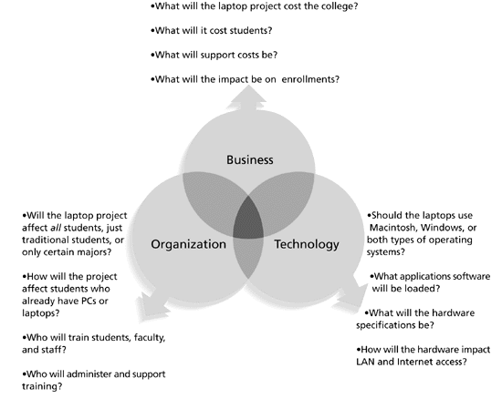
Figure 2-1. Three Sphere Model for Systems Management

Slide 9
Understanding “Organizational Dynamics” – 4 frames
Structural frame: Focuses on roles and responsibilities, coordination and control. Organization charts help define this frame.
Human resources frame: Focuses on providing harmony between needs of the organization and needs of people.
Political frame: Assumes organizations are coalitions composed of varied individuals and interest groups. Conflict and power are key issues.
Symbolic frame: Focuses on Culture: meanings, symbols, cadence for meetings, dress, punctuality, tone, how the org works etc…

Slide 10
“Organizational Structures”
3 basic organization structures
Functional: functional managers report to the CEO
Project: program managers report to the CEO
Matrix: middle ground between functional and project structures; personnel often report to two or more bosses; structure can be weak, balanced, or strong matrix

Slide 11
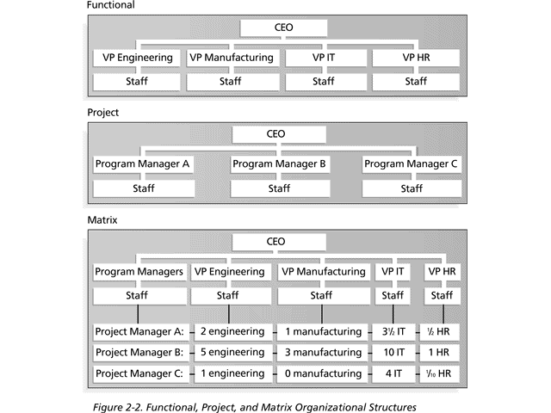
Figure 2-2. Functional, Project, and Matrix Organizational Structures

Slide 12
Table 2-1. Organizational Structure and Influence on Projects

Slide 13
Organizational Culture
Organizational culture is a set of shared assumptions, values, and behaviors that characterize the functioning of an organization
Many experts believe the underlying causes of many companies’ problems are not the structure, but a negative or unbalanced culture

Slide 14
What Went Wrong?
Many enterprise resource planning (ERP) projects fail due to organizational issues, not technical issues. For example, Sobey’s Canadian grocery store chain abandoned its two-year, $90 million ERP system due to organizational problems.
“The problem of building an integrated system that can accommodate different people is a very serious challenge. You can’t divorce technology from the sociocultural issues. They have an equal role.”
Sobey’s ERP system shut down for five days, and employees were scrambling to stock potentially empty shelves in several stores for weeks. The system failure cost Sobey’s more than $90 million and caused shareholders to take an 82-cent after-tax hit per share.

Slide 15
Stakeholder Management
Project managers must take time to identify, understand, and manage relationships with all project stakeholders
Using the four frames, knowing your org structure (sphere of influence) and understanding the culture in organizations can help meet stakeholder needs and expectations!!!

Slide 16
The Importance of Top Management Commitment
People in top management positions are key stakeholders in projects
A very important factor in helping project managers successfully lead projects is the level of commitment and support they receive from top management
Without top management commitment, many projects will fail
Some projects have a senior manager called a champion who acts as a key proponent for a project

Slide 17
How Top Management Can Help Project Managers
Providing adequate resources
Approving unique project needs in a timely manner
Getting cooperation from other parts of the organization
Mentoring and coaching on leadership issues

Slide 18
Project Phases and the Project Life Cycle
A project life cycle is a collection of project phases that defines:
What work will be performed in each phase
What deliverables will be produced and
When it will be produced
Who is involved in each phase
How management will control and approve work produced in each phase
A deliverable is a product or service produced or provided as part of a project

Slide 19
More on Project Phases
In early phases of a project life cycle:
Resource needs are usually lowest
The level of uncertainty (risk) is highest
Project stakeholders have the greatest opportunity to influence the project
In middle phases of a project life cycle:
The certainty of completing a project improves
It can become clearer if you need to terminate as well
More resources are needed
The final phase of a project life cycle focuses on:
Ensuring that project requirements were met
The sponsor approves completion of the project

Slide 20
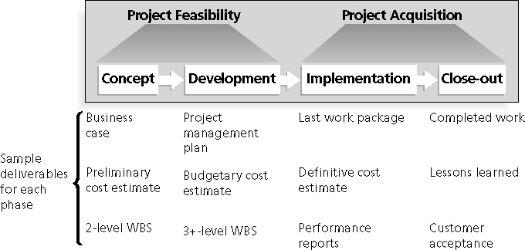
Figure 2-3. Phases of the Traditional Project Life Cycle

Slide 21
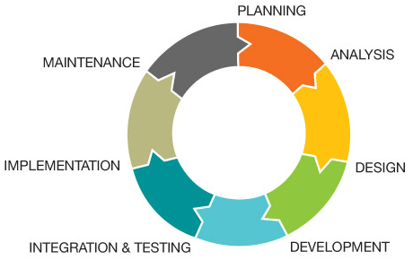
SDLC – more advanced then traditional
The Systems Development Life Cycle (SDLC):
is a framework, it contains phases involved in developing and maintaining information systems

Slide 22
The Importance of Project Phases and Management Reviews
A project should successfully pass through each of the project phases in order to continue on to the next
Management reviews, also called phase exits or kill points, should occur after each phase to evaluate the project’s progress, likely success, and continued compatibility with organizational goals

Slide 23
What Went Right?
"The real improvement that I saw was in our ability to, in the words of Thomas Edison “know when to stop beating a dead horse” Edison's key to success was that he failed fairly often; but as he said, he could recognize a dead horse before it started to smell...
In information technology we tend to ride dead horses, or we stick with a project way to long (if it is failing). We need to be able to recognize a failure in order to reduce cost and time overruns.
Many organizations, use an executive steering committee to help keep projects on track and avoid over spend or wasted time on doomed projects.

Slide 24
Predictive Life Cycle Models
Waterfall model: has well-defined, linear stages of systems development and support – predictive model!
Prototyping model: used for developing prototypes to clarify user requirements, build and change as you go……
Rapid Application Development (RAD) model: used to produce systems quickly without sacrificing quality, uses tools, proven methods, reusable code/architecture etc…

Slide 25
Agile Software Development
Agile software development has become popular to describe new approaches that focus on close collaboration between programming teams and business experts
Scrum
Sprints
Iterative
Informed
Continuous

Slide 26
Things to keep in mind: IT Projects
Keep this in minds when working in project mgmt:
IT projects can be very diverse in terms of size, complexity, products produced, application area, and resource requirements
IT project team members often have diverse backgrounds and skill sets
IT projects use diverse technologies that change rapidly; even within one technology area, people must be highly specialized

Slide 27
Project Management & Globalization
Issues that can arise from crossing time zones:
Communications
Trust
Common work practices
Tools
Suggestions
Employ greater project discipline
Think global but act local
Keep project momentum going (across time zones)
Use newer tools and technology

Slide 28
Chapter Summary
Project managers need to take a systems approach when working on projects
Organizations have four different frames: structural, human resources, political, and symbolic
The structure and culture of an organization have strong implications for project managers

Slide 29
Chapter Summary
Projects should successfully pass through each phase of the project life cycle
Project managers need to consider several factors due to the unique context of information technology projects
Recent trends affecting IT project management include globalization, outsourcing, and virtual teams

