Slide 1

Chapter 3: The Project Management Process Groups: A Case Study
Information Technology Project Management, Sixth Edition
Note: See the text itself for full citations.

Slide 2
Announcements
Term project submission due 9/9 10 pm.
First Half Semester breakdown
8/25 – Chapter 1, Syllabus and Class Overview
9/1 – Chapter 2, Term Project Guidance, Team Breakouts
9/8 – Chapter 3, Team Breakouts
9/15 – Chapter 4, Team Breakouts
9/22 – Chapter 5, Team Breakouts
9/29 – No Class, Thursday follows Monday schedule….
10/6 – Chapter 6, Team Breakouts
10/13 – Midterm (chapters 1-6)
10/20 – 1st Team Presentations, due and presented.
Information Technology Project Management, Sixth Edition

Slide 3
Learning Objectives
We’ll describe the five project management (PM) process groups
And the typical level of activity for each, and the interactions among them
We’ll go over how the PM process groups relate to the PM knowledge areas
We’ll discuss how organizations develop information technology PM methodologies to meet their needs
Information Technology Project Management, Sixth Edition

Slide 4
Learning Objectives (continued)
For each process group, we’ll describe outputs of each process group;
And go over the contribution that effective project
initiating,
planning,
executing,
monitoring,
and closing make to project success!

Slide 5
Project Management Process Groups
To understand the 5 PM Process Groups, you must know what a process is.
A process is a series of actions or steps directed toward a particular result.
Example: this is my process for making jam!
Step 1 blah blah blah
Step 2 blah blah blah
Etc……

Slide 6
The 5 Project Management Process Groups
The project management process groups include:
1) Initiating processes – defining or authorizing a project or phase
2) Planning processes – devising a workable initial scheme cost plans, resource plans, procurement plans. – Note: planning can also happen in other processes as things might change, adjust….
3) Executing processes – coordinating people and other resources to carry out activities, actually doing the work – did you make that order?
4) Monitoring and controlling processes – measure progress and changes against the plans
5) Closing processes – formal signoff, lessons learned, close out contracts

Slide 7
Movie / Technology Analogy of the 5 PM Process Groups
Processes involved in making movies might include:
screenwriting (initiating)
producing (planning)
acting and directing (executing)
editing (monitoring and controlling)
releasing the movie to theaters (closing)
Project managers in any field know how important it is to follow a good process.

Slide 8
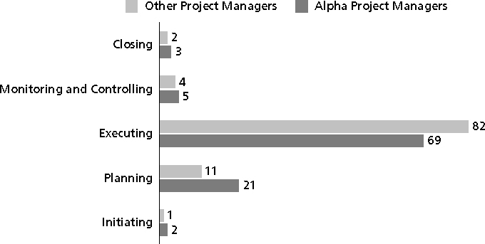
Figure 3-1. Percentage of Time Spent on Each Process Group

Slide 9
Mapping the Process Groups to the Knowledge Areas
Lets map the main activities of each PM process group into the nine knowledge areas

Slide 10
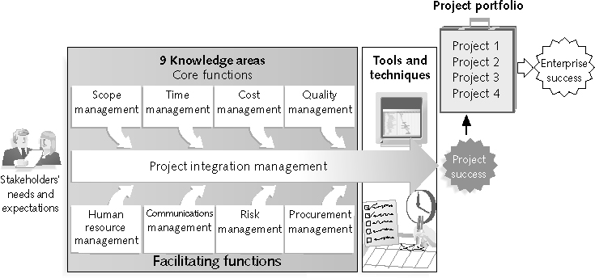
Figure 1-2 Project Management Framework
CORE!
FACILITATING!

Slide 11
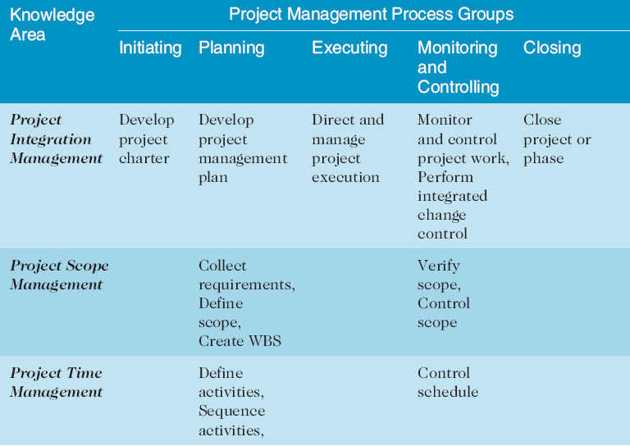
Table 3-1. Project Management Process Groups and Knowledge Area Mapping*
*Source: PMBOK® Guide, Fourth Edition, 2008.

Slide 12
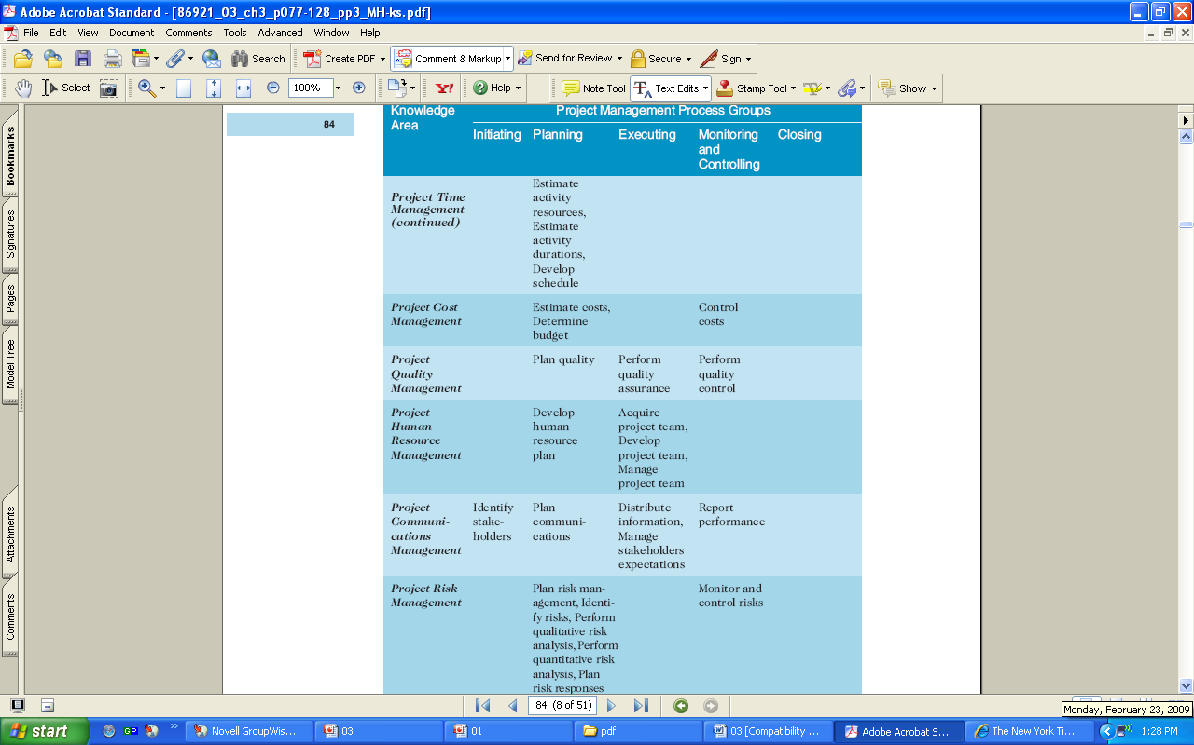
Table 3-1. (continued)

Slide 13
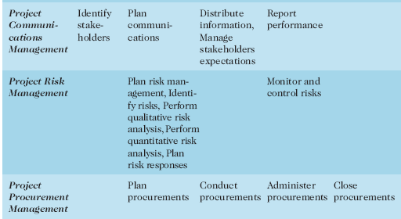
Table 3-1 (continued)

Slide 14
Developing an IT Project Management Methodology
Just as projects are unique, so are approaches to project management. Many organizations develop their own project management methodologies for what works for them
A methodology describes how things should be done. What processes, forms, intake etc…
PMBOK is based on the 5 processes groups, fancy way of saying, here is a framework we like to follow.

Slide 15
What Went Right?
AgênciaClick, an interactive advertising and online communications company based in São Paulo, Brazil, made PMI’s list of outstanding organizations in project management.
The company saw revenues jump 132 percent, primarily due to their five-year emphasis on practicing good project management across the entire company

Slide 16
Project Pre-initiation
It is good practice to lay the groundwork for a project before it officially starts!
Senior managers often perform several pre-initiation tasks, including the following:
Determine High Level scope, time, and cost constraints for the project
Identify the project sponsor
Select the project manager
Develop a business case for a project (see Table 3-2 for an example)
Meet with the project manager to review the process and expectations for managing the project

Slide 17
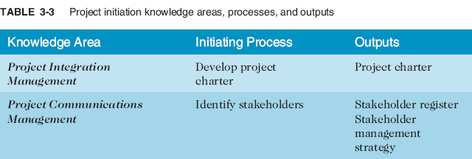
Project Initiation
Initiating a project includes recognizing and starting a new project or project phase
The main goal is to formally select and start off projects

Slide 18
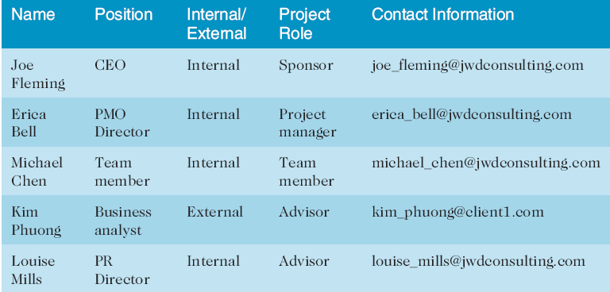
Table 3-4. Stakeholder Register

Slide 19
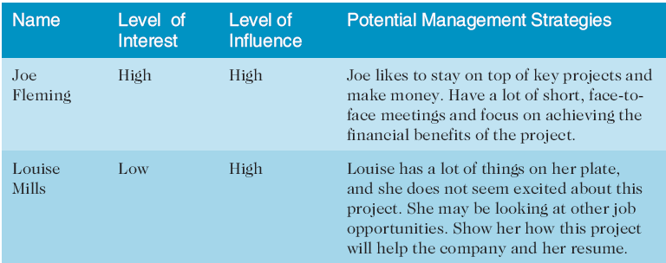
Table 3-4. Stakeholder Management Strategy
Contents are often sensitive, so do not publish this document.

Slide 20
Project Charters and Kick-off Meetings
See Table 3-6 for an example of a charter
Charters are normally short and include key project information and stakeholder signatures
It’s good practice to hold a kick-off meeting at the beginning of a project so that stakeholders can meet each other, review the goals of the project, and discuss future plans

Slide 21
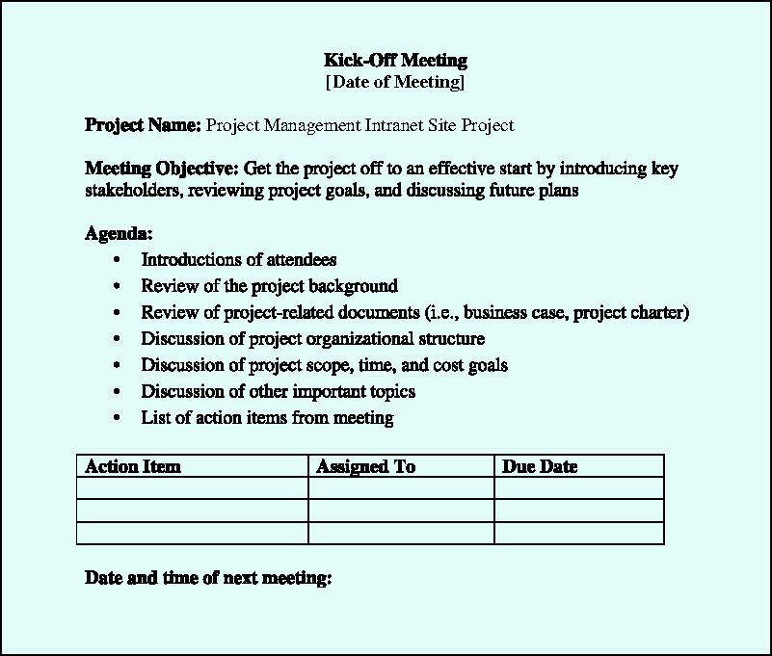
Figure 3-2. Kick-off Meeting Agenda

Slide 22
Project Planning
The main purpose of project planning is to guide execution
Every knowledge area includes planning information (see Table 3-7 on pages 97-98)
Key outputs included in projects include:
A team contract
A project scope statement
A project schedule, in the form of a Gantt chart with all dependencies and resources entered
A list of prioritized risks (part of a risk register)
See sample documents on pages 100-107

Slide 23
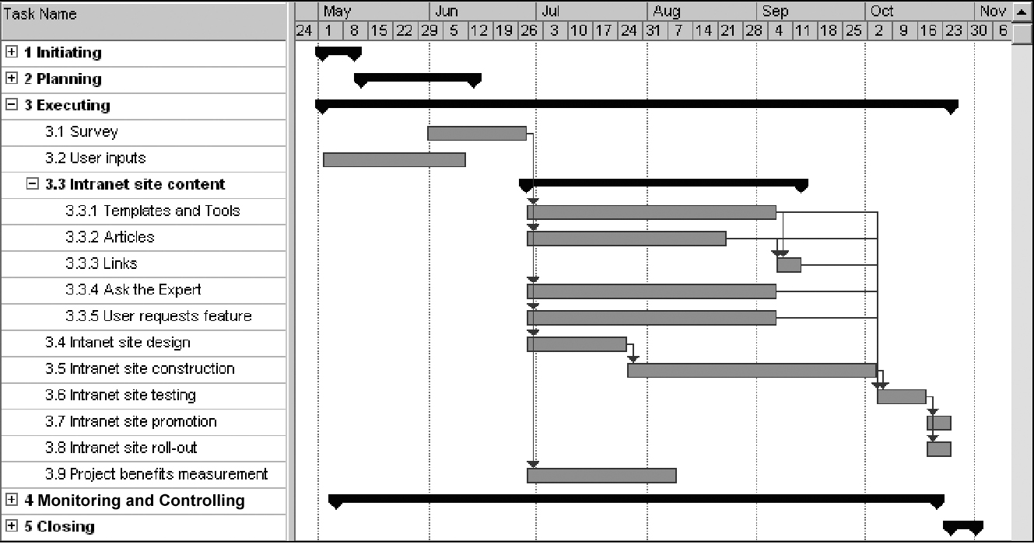
Figure 3-4. JWD Consulting Intranet Site Project Baseline Gantt Chart

Slide 24
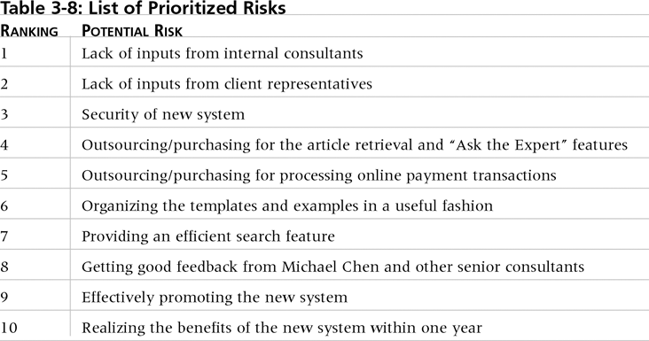
Table 3-10. List of Prioritized Risks

Slide 25
Project Executing
Usually takes the most time and resources to perform project execution
Project managers must use their leadership skills to handle the many challenges that occur during project execution
Table 3-11 on p. 108 lists the executing processes and outputs; many project sponsors and customers focus on deliverables related to providing the products, services, or results desired from the project
A milestone report (example on pp. 109-110) can help focus on completing major milestones

Slide 26
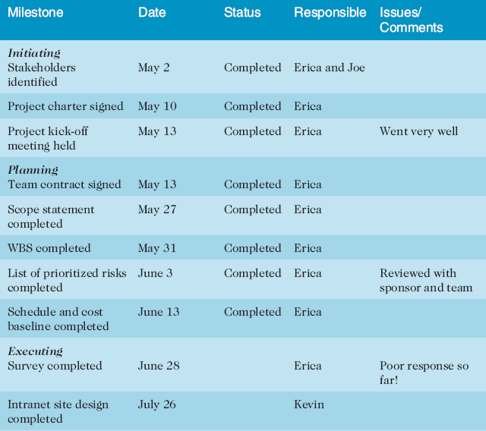
Part of Milestone Report (Table 3-12)

Slide 27
Project Monitoring and Controlling
Project Monitoring - involves measuring progress toward project objectives, monitoring deviation from the plan, and taking correction actions
Affects all other process groups and occurs during all phases of the project life cycle
Outputs include performance reports, change requests, and updates to various plans
See Table 3-13

Slide 28
Project Closing
Project Closure - involves gaining stakeholder and customer acceptance of the final products/services
Even if projects are not completed (killed), they should be closed out to learn from the past
Outputs include project archives and lessons learned, part of organizational process assets
Most projects include a final report and presentation

Slide 29
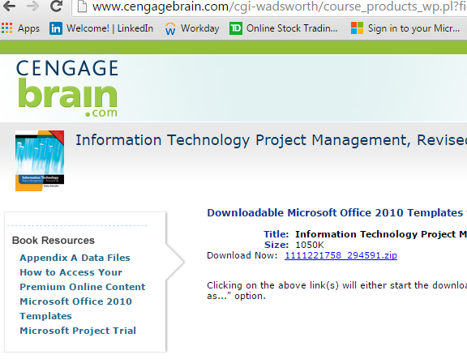
Templates
Table 3-18 on pp. 118-121 lists the templates available on the companion Web site, the author’s site (www.kathyschwalbe.com)
Use this link to view all templates: http://www.cengagebrain.com/cgi-wadsworth/course_products_wp.pl?fid=M20b&product_isbn_issn=9781111221751&token=

