Slide 1

Chapter 6: Project Time Management
Information Technology Project Management, Sixth Edition
Note: See the text itself for full citations.

Slide 2
Announcements
8/25 – Chapter 1, Syllabus and Class Overview
9/1 – Chapter 2, Term Project Guidance, Team Breakouts
9/8 – Chapter 3, Team Breakouts
9/15 – Chapter 4, Team Breakouts
9/22 – Chapter 5, Team Breakouts
9/29 – No Class, Thursday follows Monday schedule….
10/6 – Chapter 6, Team Breakouts
10/13 – Midterm (chapters 1-6)
10/20 – 1st Team Presentations, due and presented

Slide 3
Learning Objectives
Understand the importance of project schedules
Define activities as the basis for developing project schedules
Describe how project managers use network diagrams and dependencies to assist in activity sequencing
Understand the relationship between estimating resources and project schedules

Slide 4
What Went Wrong?
At the U.S. Federal Bureau of Investigation (FBI), poor time management was one of the reasons behind the failure of Trilogy, a “disastrous, unbelievably expensive piece of vaporware, which was more than four years in the (un)making. The system was supposed to enable FBI agents to integrate intelligence from isolated information silos within the Bureau.”*
In May 2006, the Government Accounting Agency said that the Trilogy project failed at its core mission of improving the FBI’s investigative abilities and was plagued with missed milestones and escalating costs

Slide 5
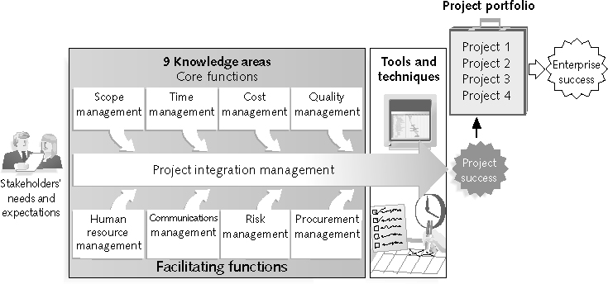
REVIEW: Project Management Framework – 9 Knowledge Areas

Slide 6
REVIEW: The 5 Project Management Process Groups
The project management process groups include:
1) Initiating processes – defining or authorizing a project or phase
2) Planning processes – devising a workable scheme (plan) can happen is all process groups, cost plans, resource plans, procurement plans.
3) Executing processes – coordinating people and other resources to carry out activities – did you make that order?
4) Monitoring and controlling processes – measure progress and changes against the plans
5) Closing processes – formal signoff, lessons learned, close out contracts etc…

Slide 7
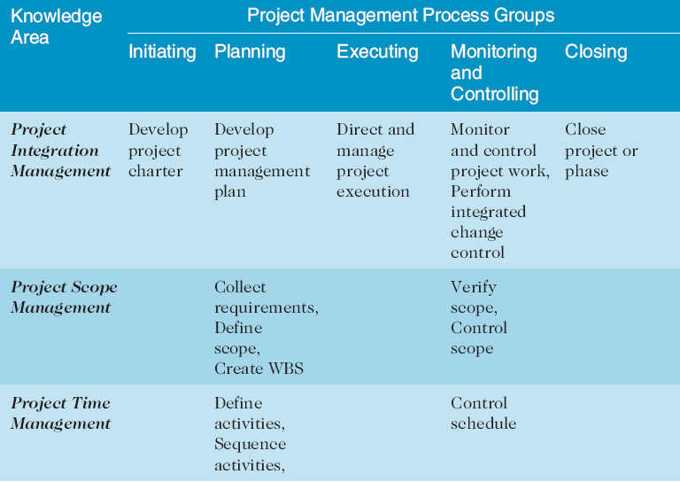
REVIEW: Project Management Process Groups and Knowledge Area Mapping*

Slide 8
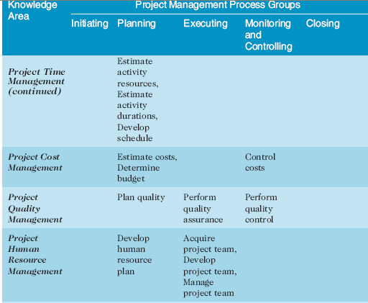
REVIEW:(continued)

Slide 9
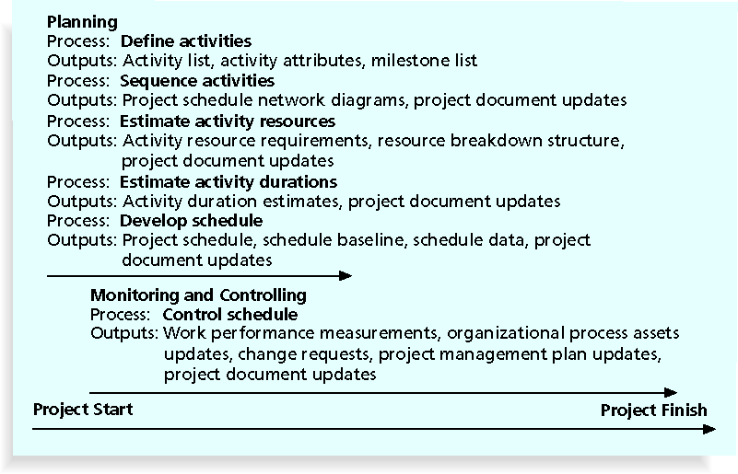
Figure 6-1. Project Time Management Summary

Slide 10
Project Time Management Processes
Defining activities: identifying the specific activities that the project team members must perform to produce deliverables
Sequencing activities: identifying and documenting the relationships between project activities
Estimating activity resources: estimating how many resources a project team should use to perform project activities
Estimating activity durations: estimating the number of work periods that are needed to complete individual activities (time)
Developing the schedule: analyzing activity sequences, activity resource estimates to create the project schedule
Our good friend - Controlling the schedule: controlling and managing changes to the project schedule

Slide 11
Defining Activities
An activity or task is an element of work that normally has an:
expected duration
a cost
and resource requirements
**** you need to understand your activities in order to come up with cost, resource, and time estimates

Slide 12
Milestones
A milestone is a significant event that normally has no duration, but tells us something major in the project has happened worth noting~!
Examples : we’ve finished building out all the electrical circuits for our new data center

Slide 13
Sequencing Activities
Involves reviewing activities and determining dependencies
A dependency or relationship helps you sequence project activities or tasks
Example: We need to finish the electrical circuits before we install our server racks and plug in the UPS’s

Slide 14
Three types of Dependencies
Mandatory dependencies: inherent in the nature of the work being performed on a project, sometimes referred to as hard logic Ex: the electrical example
Discretionary dependencies: sometimes referred to as soft logic and should be used with care since they may limit later scheduling options Ex: We need to build in training for our engineers to support this new system
External dependencies: involve relationships between project and non-project activities : Ex: new compliance or regulations etc…. Competitor came out with new features…

Slide 15
Network Diagrams
Network diagrams are the preferred technique for showing activity sequencing
A network diagram is a schematic display of the logical relationships among project activities
Two main formats are the arrow and precedence diagramming methods

Slide 16
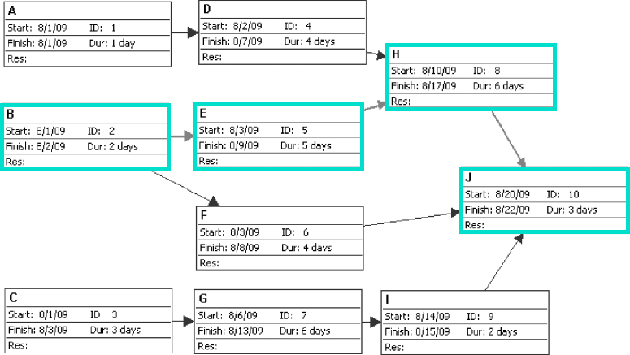
Figure 6-4. Sample PDM Network Diagram

Slide 17
Estimating Activity Resources
Before estimating activity durations, you must have a good idea of the quantity and type of resources that will be assigned to each activity; resources are people, equipment, and materials
Consider important issues in estimating resources
How difficult will it be to do specific activities on this project?
What is the organization’s history in doing similar activities?
Are the required resources available?

Slide 18
Activity Duration Estimating
Duration includes the actual amount of time worked on an activity plus elapsed time
Effort is the number of workdays or work hours required to complete a task
Effort does not normally equal duration, it might take you 10 hrs to develop something(effort), but the duration could be marked as a week due to other dependencies, waiting on people, Friday- then Monday….
People doing the work should help create estimates, and an expert should review them

Slide 19
Three-Point Estimates
Instead of providing activity estimates as a discrete number, such as four weeks, it’s often helpful to create a three-point estimate
An estimate that includes an:
Optimistic (3 weeks)
most likely (4 weeks)
and pessimistic estimate (5 weeks)

Slide 20
Developing the Schedule
Uses results of the other time management processes to determine the start and end date of the project
Ultimate goal is to create a realistic project schedule that provides a basis for monitoring project progress for the time dimension of the project

Slide 21
Gantt Charts
Gantt charts provide a standard format for displaying project schedule information by listing project activities and their corresponding start and finish dates in a calendar format
Standard Symbols include:
Black diamonds: milestones
Thick black bars: summary tasks
Lighter horizontal bars: durations of tasks
Arrows: dependencies between tasks

Slide 22
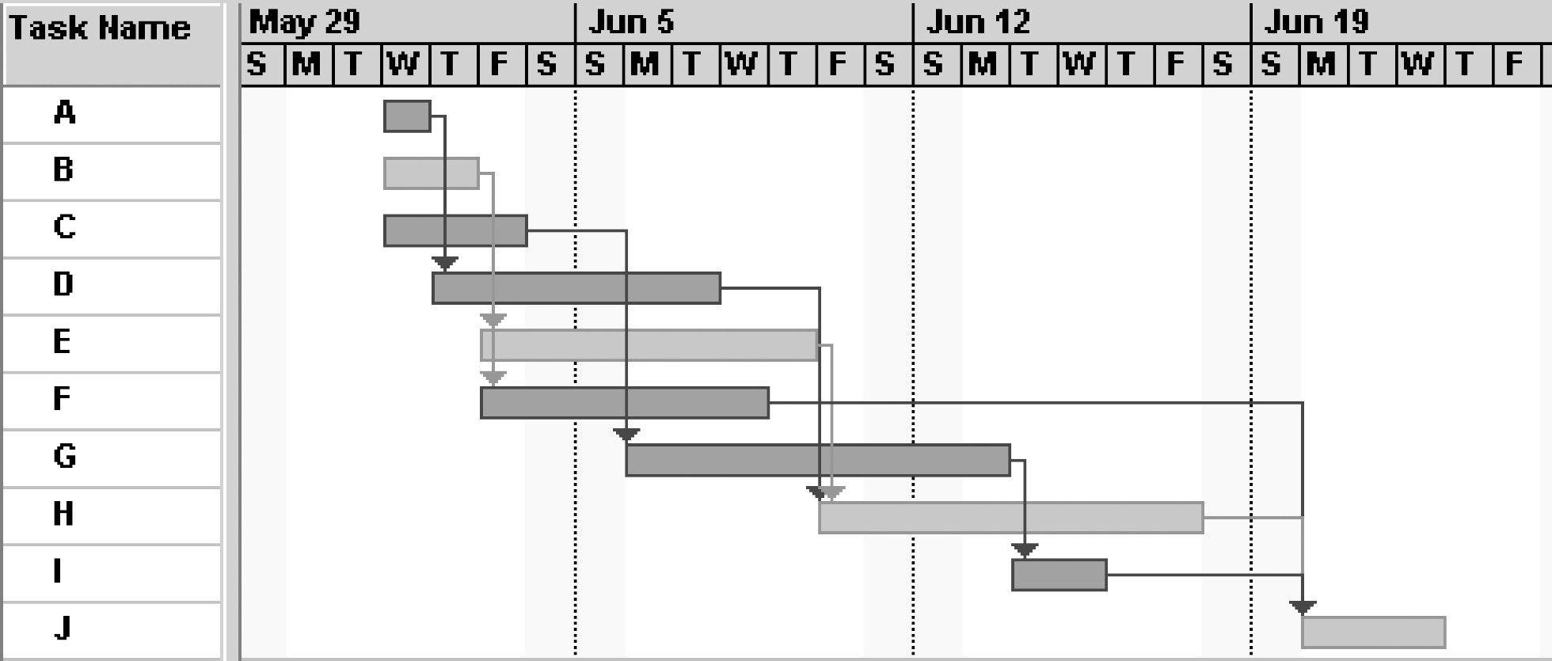
Figure 6-5. Gantt Chart for Project X
Note: Darker bars would be red in Project 2007 to represent critical tasks.

Slide 23
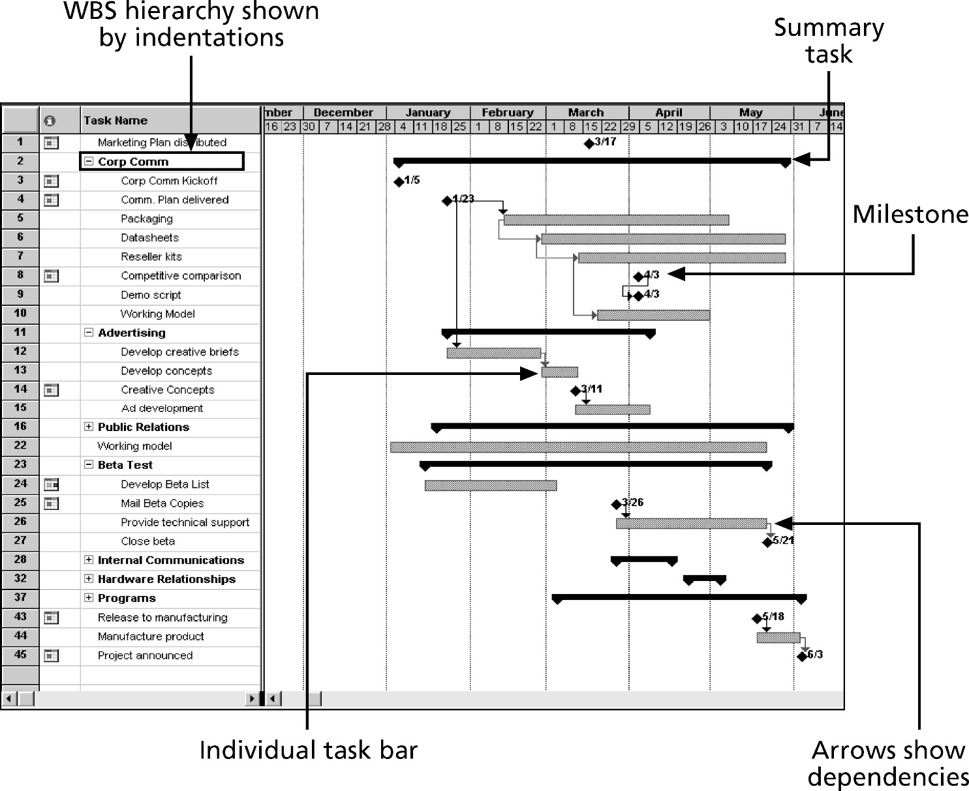
Figure 6-6. Gantt Chart for Software Launch Project

Slide 24
Adding Milestones to Gantt Charts
Many people like to focus on meeting milestones, especially for large projects
Milestones emphasize important events or accomplishments on projects
Normally create milestone by entering tasks with a zero duration, or you can mark any task as a milestone

Slide 25
SMART Criteria
Milestones should be:
Specific
Measurable
Assignable
Realistic
Time-framed

Slide 26
Buffers and Critical Chain
A buffer is additional time to complete a task
Murphy’s Law states that if something can go wrong, it will, and why pm’s or estimators add buffers!!!!
In traditional estimates, people often add a buffer to each task
Critical chain scheduling removes buffers from individual tasks and instead creates:
Project buffers or additional time added before the project’s due date (we’ll finish june 1, when really done may 1)
Feeding buffers or additional time added before tasks on the critical path (task a should finish in 2 weeks, but is really done in a week – but appears to start early.)
(protects project with limited resources)

Slide 27
Program Evaluation and Review Technique (PERT)
PERT is a network analysis technique used to estimate project duration when there is a high degree of uncertainty about the individual activity duration estimates
PERT uses probabilistic time estimates
Duration estimates based on using optimistic, most likely, and pessimistic estimates of activity durations, or a three-point estimate

Slide 28
PERT Formula and Example
PERT weighted average =
optimistic time + 4X most likely time + pessimistic time
6
Example:
PERT weighted average =
8 workdays + 4 X 10 workdays + 24 workdays = 12 days 6
where optimistic time = 8 days
most likely time = 10 days, and
pessimistic time = 24 days
Therefore, you’d use 12 days on the network diagram instead of 10 when using PERT for the above example
Best way to explain, is your taking an educated guess based on peoples expertise and averaging out based on low to high execution.

Slide 29
Schedule Control Suggestions
Perform reality checks on schedules
Allow for contingencies
Don’t plan for everyone to work at 100% capacity all the time
Hold progress meetings with stakeholders and be clear and honest in communicating schedule issues

Slide 30
Chapter Summary
Project time management is often cited as the main source of conflict on projects, and most IT projects exceed time estimates
Main processes include:
Define activities
Sequence activities
Estimate activity resources
Estimate activity durations
Develop schedule
Control schedule

