Slide 1

Chapter 5: Project Scope Management
Information Technology Project Management, Sixth Edition
Note: See the text itself for full citations.

Slide 2
Announcements
8/25 – Chapter 1, Syllabus and Class Overview
9/1 – Chapter 2, Term Project Guidance, Team Breakouts
9/8 – Chapter 3, Team Breakouts
9/15 – Chapter 4, Team Breakouts
9/22 – Chapter 5, Team Breakouts
9/29 – No Class, Thursday follows Monday schedule….
10/6 – Chapter 6, Team Breakouts
10/13 – Midterm (chapters 1-6)
10/20 – 1st Team Presentations, due and presented.

Slide 3
Learning Objectives
Understand the importance of good project scope management
Discuss methods for collecting and documenting requirements in order to meet stakeholder needs and expectations
Explain the scope definition process and describe the contents of a project scope statement

Slide 4
Learning Objectives (continued)
Discuss the process for creating a work breakdown structure (WBS)
Explain the importance of verifying scope and how it relates to defining and controlling scope
Understand the importance of controlling scope and approaches for preventing scope-related problems

Slide 5
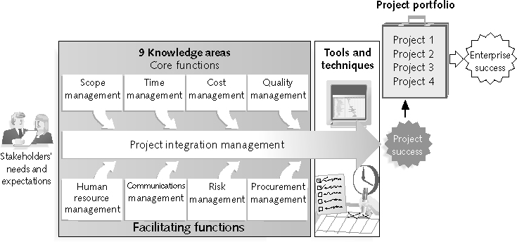
Project Management Framework – 9 Knowledge Areas

Slide 6
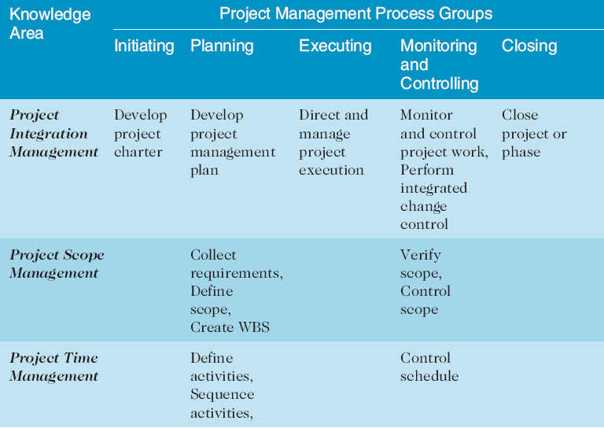
Project Management Process Groups and Knowledge Area Mapping*
*Source: PMBOK® Guide, Fourth Edition, 2008.

Slide 7
What is Project Scope Management?
Scope refers to all the work involved in creating the products of the project and the processes used to create them
A deliverable is a product produced as part of a project, such as hardware or software, planning documents, or meeting minutes
Project scope management includes the processes involved in defining and controlling what is or is not included in a project

Slide 8
Processes for Project Scope Management:
Collecting requirements: defining and documenting the features and functions of the products produced during the project as well as the processes used for creating them
Defining scope: reviewing the project charter, requirements documents, and organizational process assets to create a scope statement
Creating the WBS: subdividing the major project deliverables into smaller, more manageable components
Verifying scope: formalizing acceptance of the project deliverables
Controlling scope: controlling changes to project scope throughout the life of the project

Slide 9
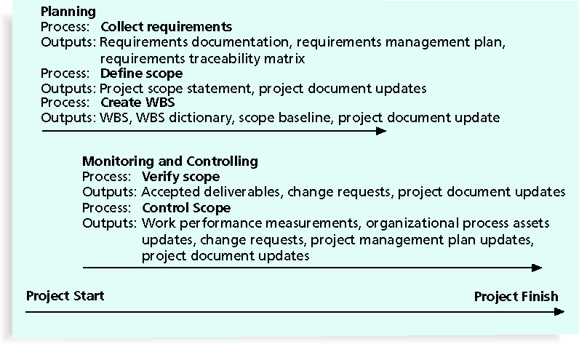
Figure 5-1. Project Scope Management Summary

Slide 10
Collecting Requirements
A requirement is a condition or capability that you “must meet” or possess to satisfy a contract, standard, specification, or other formal document
For some IT projects, it is helpful to divide requirements gathering into categories:
Elicitation – get it
Analysis – study it
Specification – specify it
Validation – test it
It is important to use an iterative approach to defining requirements since they are often unclear early

Slide 11
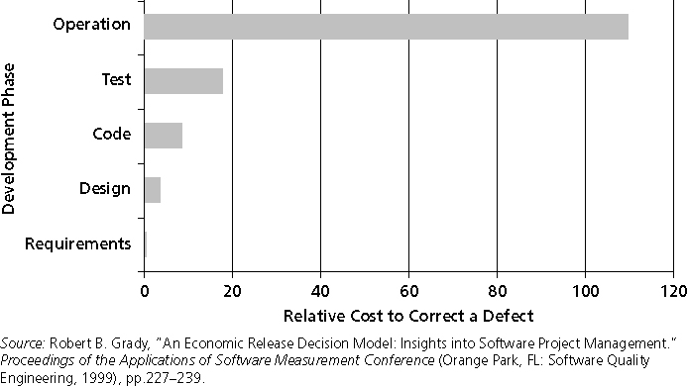
Figure 5-2. Relative Cost to Correct a Software Requirement Defect
Why are defining requirements important?

Slide 12
Methods for Collecting Requirements
How to effectively collect requirements:
Interviewing
Focus groups and facilitated workshops
Using group creativity and decision-making techniques
Questionnaires and surveys
Observation
Prototyping
Software tools

Slide 13
Documenting Requirements
Requirement documents are often generated by software and include text, images, diagrams, videos, and other media; they are often broken down into different categories such as functional, service, performance, quality, training requirements, and so on
What do you think a functional or performance requirements are?
A requirements management plan describes how project requirements will be analyzed, documented, and managed
A requirements traceability matrix (RTM) is a table that lists requirements, various attributes of each requirement, and the status of the requirements to ensure that all requirements are addressed

Slide 14
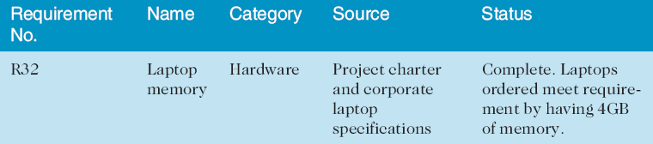
Table 5-1. Sample Requirements Traceability Matrix - RTM

Slide 15
Defining Scope
Key inputs for preparing project scope statements include; the project charter, requirements documentation, and organizational process assets such as policies and procedures.
As time progresses, the scope of a project should become more clear and specific

Slide 16
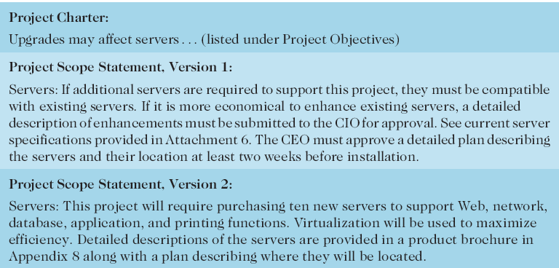
Table 5-3. Further Defining Project Scope

Slide 17
Creating the Work Breakdown Structure (WBS)
A WBS is a deliverable-oriented grouping of the work involved in a project that defines the scope of the project
You can use a Gantt chart for the WBS
WBS is a foundation document that provides the basis for planning and managing schedules, costs, resources
Decomposition is subdividing project deliverables into smaller pieces
A work package is a task at the lowest level of the WBS

Slide 18
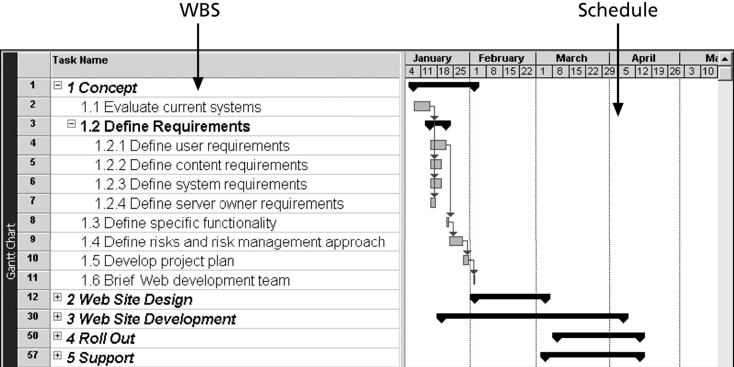
Figure 5-5. Intranet WBS and Gantt Chart in Microsoft Project

Slide 19
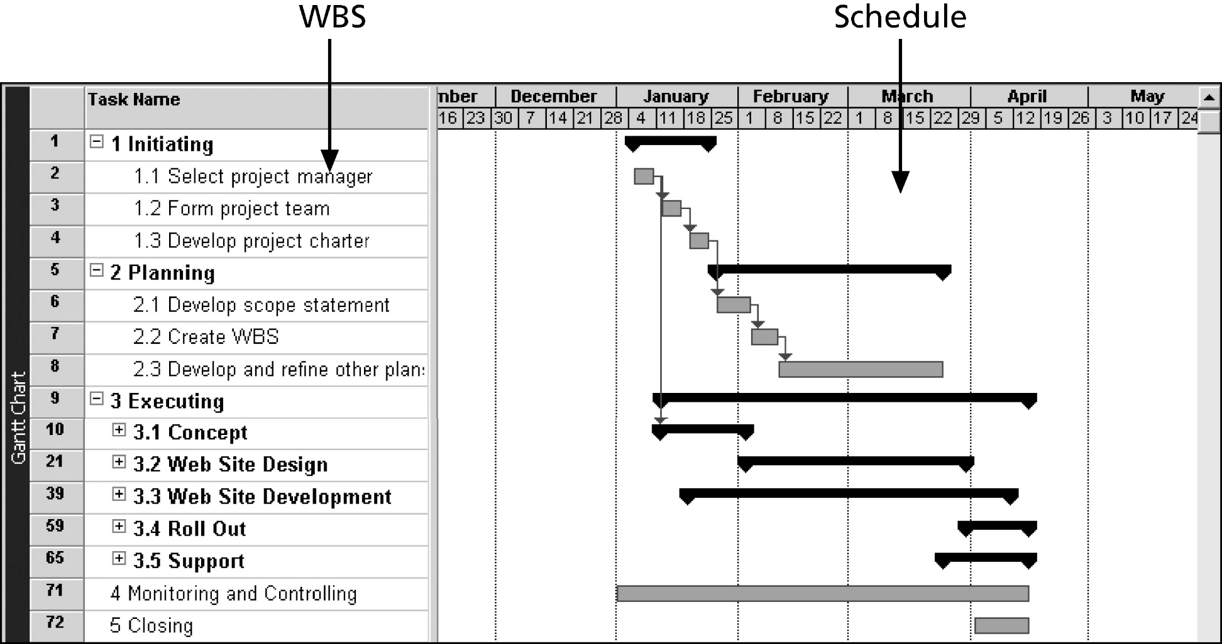
Figure 5-6. Intranet Gantt Chart Organized by Project Management Process Groups

Slide 20
Verifying Scope
Scope verification involves formal acceptance of the completed project scope by the stakeholders
Acceptance is often achieved by a customer inspection and then sign-off on key deliverables

Slide 21
Controlling Scope
Scope control involves controlling changes to the project scope
Goals of scope control are to:
Influence - the factors that cause scope changes
Assure - changes are processed according to procedures developed as part of integrated change control
Manage - changes when they occur
Variance is the difference between planned and actual performance

Slide 22
Best Practices for Avoiding Scope Problems
1. Keep the scope realistic. Don’t make projects so large that they can’t be done.
2. Involve users in scope management. Assign key users to the project team and give them ownership of requirements and scope verification.
3. Use off-the-shelf hardware and software whenever possible. Many IT people enjoy using the latest and greatest technology, but business needs, not technology trends, must take priority.
4. Follow good project management processes. As described in this chapter and others, there are well-defined processes for managing project scope and others aspects of projects.

Slide 23
Suggestions for Improving User Input
Develop a good project selection process and insist that sponsors are from the user organization
Have users on the project team in important roles
Have regular meetings with defined agendas, and have users sign off on key deliverables presented at meetings
Deliver something to users and sponsors on a regular basis
Don’t promise to deliver when you know you can’t
Co-locate users with developers (sometimes very helpful to aid in communication)

Slide 24
Suggestions for Reducing Incomplete and Changing Requirements
Develop and follow a requirements management process
Use techniques such as prototyping, use case modeling, and JAD to get more user involvement
Put requirements in writing and keep them current
Create a requirements management database for documenting and controlling requirements

Slide 25
Suggestions for Reducing Incomplete and Changing Requirements (continued)
Provide adequate testing and conduct testing throughout the project life cycle
Review changes from a systems perspective
Emphasize completion dates to help focus on what’s most important
Allocate resources specifically for handling change requests

Slide 26
Chapter Summary
Project scope management includes the processes required to ensure that the project addresses all the work required, and only the work required, to complete the project successfully
Main processes include:
Collect requirements
Define scope
Create WBS
Verify scope
Control scope

