Slide 1

Chapter 10: Project Communications Management
Information Technology Project Management, Sixth Edition
Note: See the text itself for full citations.

Slide 2
Announcements
10/27 - Chapter 7, then team breakouts
11/3 - Chapter 8, then team breakouts
11/10 - Chapter 9, then team breakouts
11/17 - Chapter 10 & 11
11/24 - No Class Happy Thanksgiving
12/1 - Chapter 12
12/8 - Final Demo presented; Final reports due
12/15 - Final Exam

Slide 3
Learning Objectives
Understand the importance of good communications in projects
Explain the elements of project communications planning and how to create a communications management plan
The greatest threat to many projects is a failure to communicate
List various methods for improving project communications, such as managing conflicts, running effective meetings, using e-mail etc…

Slide 4
Importance of Good Communications
IT Employees get a rep for being poor communicators
Research shows that IT professionals must be able to communicate effectively to succeed in their positions
Strong verbal skills are a key factor in career advancement for IT professionals

Slide 5
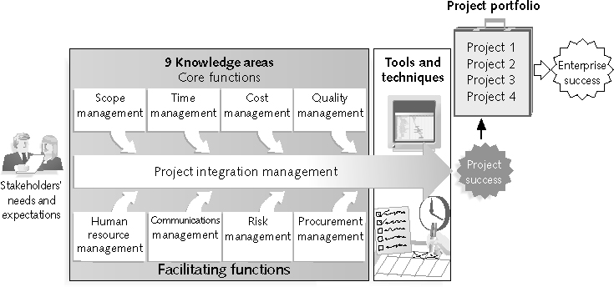
REVIEW: Project Management Framework – 9 Knowledge Areas

Slide 6
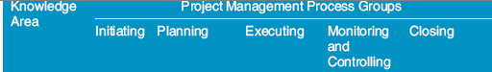
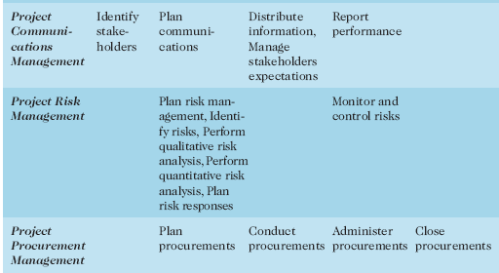
REVIEW:(continued)

Slide 7
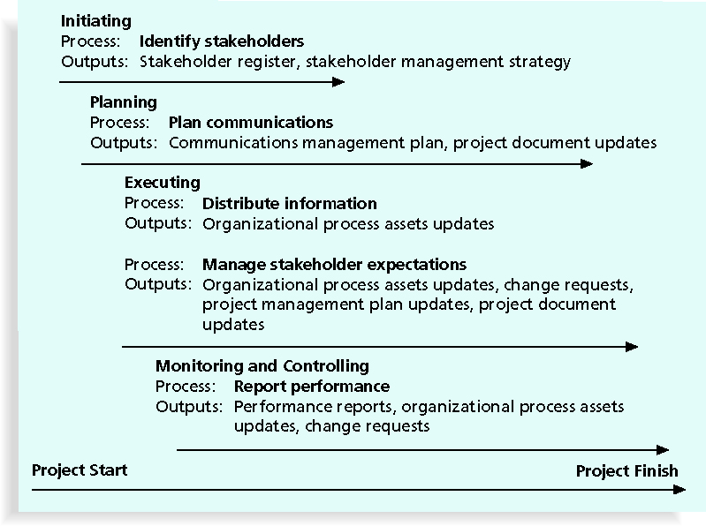
Figure 10-1. Project Communications Management Summary

Slide 8
Project Communications 5 Management Processes
Identifying stakeholders: identifying everyone involved in or affected by the project and determining the best ways to manage relationships with them
Planning communications: determining the information and communications needs of the stakeholders
Distributing information: making needed information available to project stakeholders in a timely manner
Managing stakeholder expectations: managing communications to satisfy the needs and expectations of project stakeholders and to resolve issues
Reporting performance: collecting and disseminating performance information, including status reports, progress measurement, and forecasting

Slide 9
Identifying Stakeholders
Who’s your audience!
Recall that the ultimate goal of project management is to meet or exceed stakeholder needs and expectations from a project, so you must first identify who your particular project stakeholders are

Slide 10
Planning Communications
Every project should include some type of communications management plan, a document that guides project communications
Creating a stakeholder analysis for project communications also aids in communications planning (see Table 10-2 for an example)

Slide 11
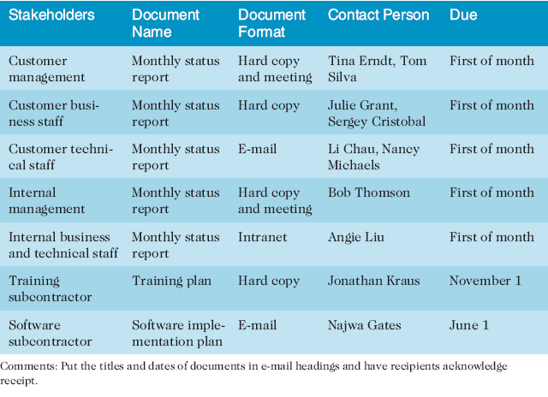
Table 10-2. Sample Stakeholder Analysis for Project Communications

Slide 12
Communications Management Plan Contents
Stakeholder communications requirements
Information to be communicated, including format, content, and level of detail
The people who will receive the information and who will produce it
Suggested methods or technologies for conveying the information

Slide 13
Communications Management Plan Contents (continued)
Frequency of communication
Escalation procedures for resolving issues
Revision procedures for updating the communications management plan
A glossary of common terminology

Slide 14
Distributing Information
Getting the right information to the right people at the right time and in a useful format is just as important as developing the information in the first place
Important considerations include:
Will you use technology to distribute?
How formal or informal do you need to be and at what times?

Slide 15
Distributing Information in an Effective and Timely Manner
Don’t bury crucial information
Don’t be afraid to report bad information - (frame it and have mitigation plans)
Oral communication via meetings and informal talks helps bring important information—good and bad—out into the open
Visual Aids help explain the issues, data, graphs, options…..

Slide 16
Other Communication Considerations
Keep this in mind! Rarely does the receiver interpret a message exactly as the sender intended
Geographic location and cultural background can affect the complexity of project communications
Different working hours
Language barriers
Different cultural norms

Slide 17
Determining the Number of Communications Channels
As the number of people involved increases, the complexity of communications increases because there are more communications channels or pathways through which people can communicate
Number of communications channels = n(n-1)
2 where n is the number of people involved

Slide 18
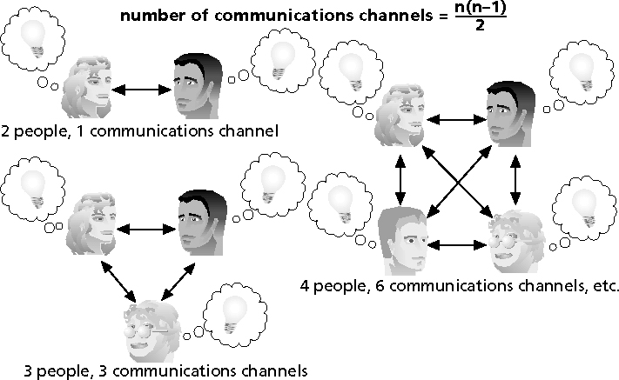
Figure 10-2. The Impact of the Number of People on Communications Channels

Slide 19
Communicating Performance
Performance reporting keeps stakeholders informed about how resources are being used to achieve project objectives:
Status reports describe where the project stands at a specific point in time
Progress reports describe what the project team has accomplished during a certain period of time
Forecasts predict future project status and progress based on past information and trends

Slide 20
Suggestions for Improving Project Communications
Manage conflicts effectively
Develop better communication skills
Run effective meetings
Use e-mail and other technologies effectively
Use templates for project communications

Slide 21
Conflict Handling Modes
Confrontation: directly face a conflict using a problem-solving approach
Compromise: use a give-and-take approach
Smoothing: de-emphasize areas of difference and emphasize areas of agreement
Forcing: the win-lose approach
Withdrawal: retreat or withdraw from an actual or potential disagreement
Collaborating: decision makers incorporate different viewpoints and insights to develop consensus and commitment

Slide 22
Running Effective Meetings
Determine if a meeting can be avoided
Define the purpose and intended outcome of the meeting
Determine who should attend the meeting
Provide an agenda to participants before the meeting
Prepare handouts and visual aids, and make logistical arrangements ahead of time
Run the meeting professionally
Build relationships

Slide 23
Using E-Mail, Instant Messaging, and Collaborative Tools Effectively
Make sure that e-mail, instant messaging, or collaborative tools are an appropriate medium for what you want to communicate
Be sure to send information to the right people
Use meaningful subject lines, limit the content of e-mails to one main subject, and be as clear and concise as possible
Be sure to authorize the right people to share and edit your collaborative documents

Slide 24
Using Templates for Project Communications
Many technical people are afraid to ask for help
Providing examples and templates for project communications saves time and money
Organizations can develop their own templates, use some provided by outside organizations, or use samples from textbooks
Recall that research shows that companies that excel in project management make effective use of templates

Slide 25
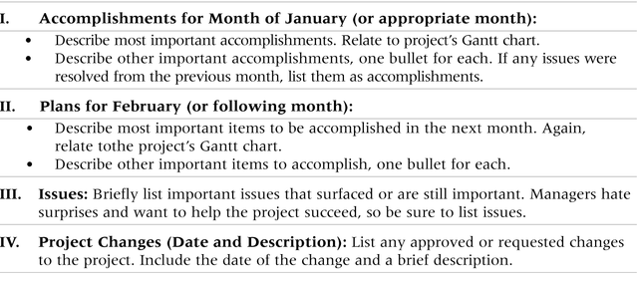
Table 10-5. Sample Template for a Monthly Progress Report

Slide 26
Project Web Sites
Many project teams create a project Web site to store important product documents and other information
Can create the site using various types of software, such as enterprise project management software

Slide 27
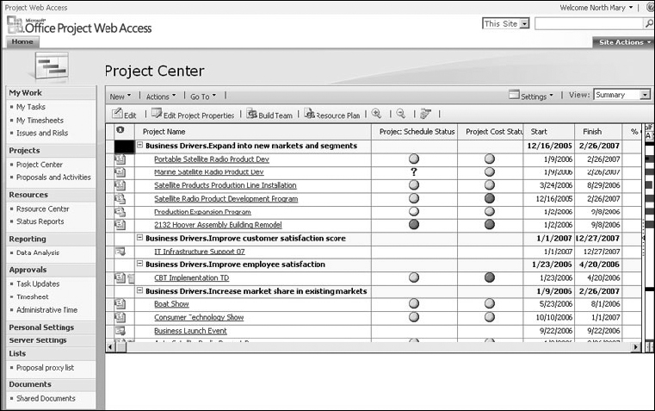
Figure 10-4. Microsoft Office Enterprise Project Management (EPM) Solution

Slide 28
Chapter Summary
The goal of project communications management is to ensure timely and appropriate generation, collection, dissemination, storage, and disposition of project information
Main processes include:
Identify stakeholders
Plan communications
Distribute information
Manage stakeholder expectations
Report performance

