Slide 1


Representing Higher-order Dependencies in Networks:
Hands-on Tasks
KDD 2018 Tutorial
Beyond Graph Mining: Higher-Order Data Analytics for Temporal Network Data
Jian Xu
Data Strategies Group
Citadel LLC
i@jianxu.net
Nitesh Chawla
Department of Computer Science and Engineering
University of Notre Dame
nchawla@nd.edu
Aug 22nd, 2018
Notes:
Good afternoon, my name is Jian, I’m from University of Notre Dame.
Today I will discuss an approach to represent higher-order dependencies in networks.

Slide 2
Overview of hands-on tasks
Synthesizing trajectories with known variable orders of dependencies
Use BuildHON+ (parameter-free) to extract variable orders of dependencies and build HON
Use HONVis to visualize and interactively explore the higher-order network of NYC taxi data

Slide 3
Synthesizing trajectories with known variable orders of dependencies

Slide 4
Synthesizing trajectories
Why synthetic? We know exactly when, where, and what types of higher-order dependencies exist. We inject 1st, 2nd, 3rd orders to trajectories. Details illustrated in the appendix.
Initial setup:
10,000 users navigating through 100 web pages.
Web pages are organized as a 10x10 grid and numbered from 00 to 99.
Every page has two out-links to the neighboring pages, one pointing right and one pointing down, with wrapping.
Every user clicks through 100 pages by moving right or moving down, resulting in 1,000,000 records.

Slide 5
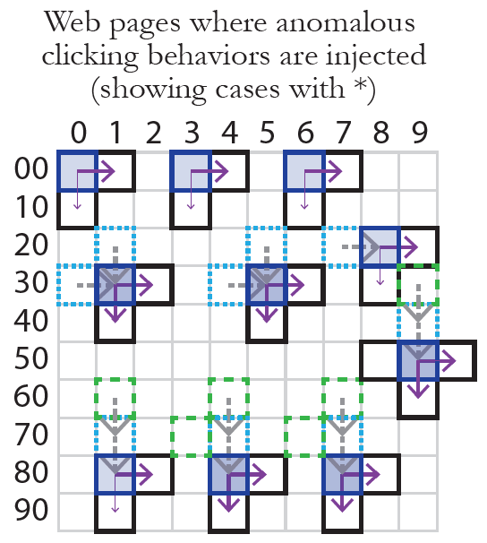
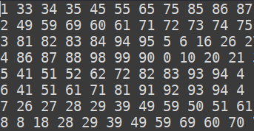
Synthesizing trajectories
Why synthetic? We know exactly when, where, and what types of higher-order dependencies exist. We inject 1st, 2nd, 3rd orders to trajectories. Details illustrated in the appendix.
./data/SyntheticTrajectoriesVariableOrders.csv
1 million web clickstream synthetic data
User# Website1 Website 2 Website3…

Slide 6
Use BuildHON+ to extract variable orders of dependencies and build HON

Slide 7
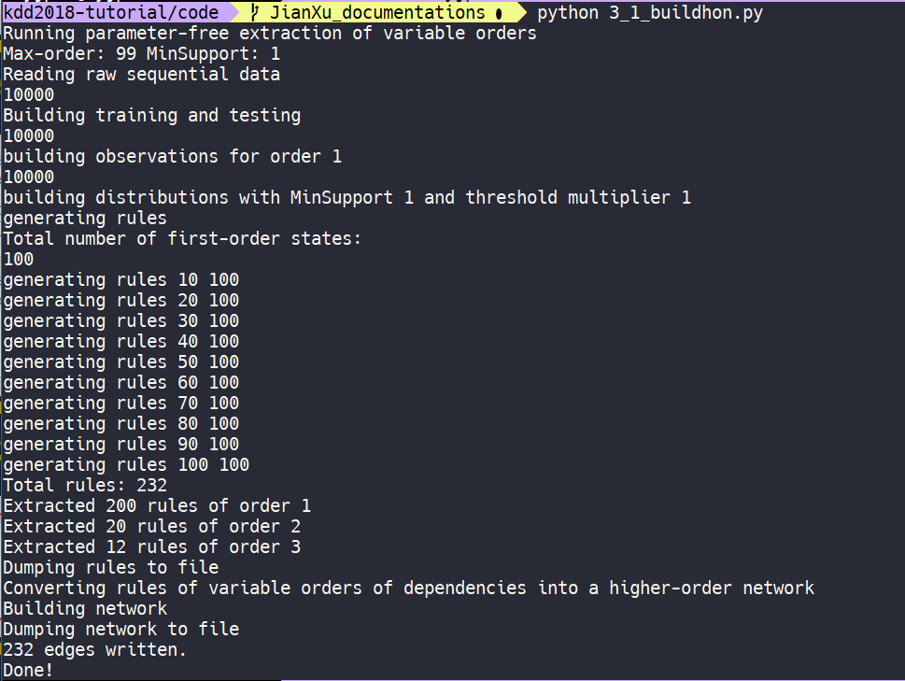
BuildHON+ how to run

Slide 8
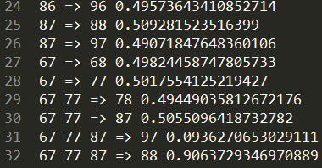
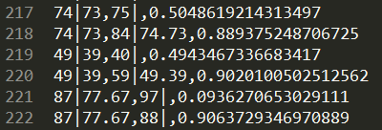
BuildHON+ extracted higher-order rules
data/SyntheticTrajectoriesVariableOrders_rules.csv
Example of 3rd order rule extracted
data/SyntheticTrajectoriesVariableOrders_network.csv
Example of 3rd order network edges

Slide 9
Use HONVis to visualize and interactively explore the higher-order network of NYC taxi data

Slide 10
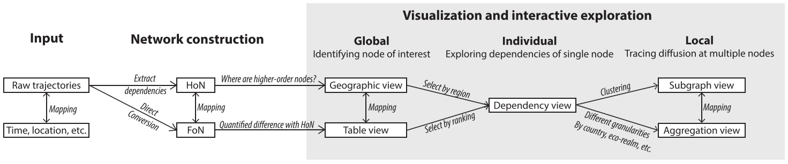
HoNVis framework
Notes:
Given the networks, we provide three levels of exploration, including the global level to identify nodes of interest, individual level, and local level

Slide 11
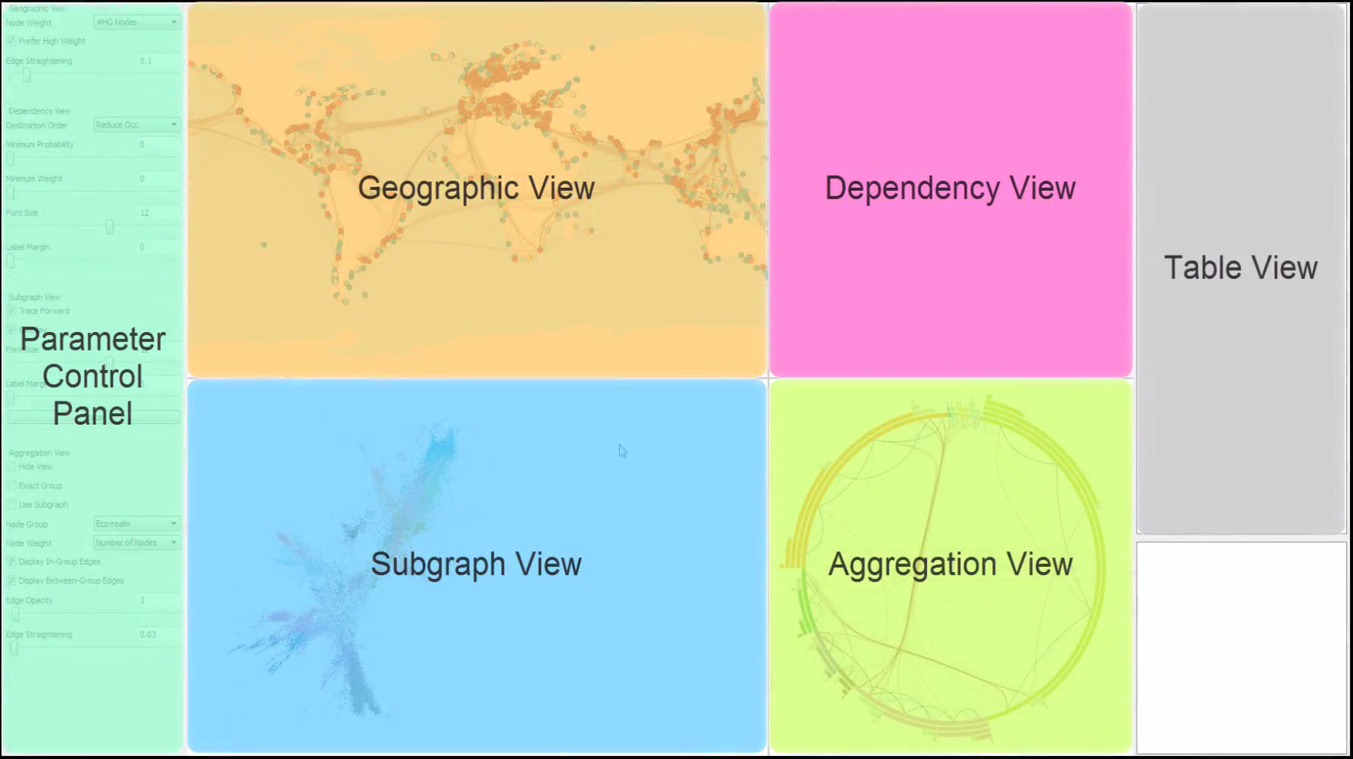
HoNVis interface
Notes:
Design the interface based on five different views

Slide 12
HONVis: how to run
How to run:
Windows: run HONVis_NYC_Taxi_Case_Jul_Aug.exe
Mac and Linux: run ./Jul_Aug in Terminal
Video tutorial of case studies:
Please follow the steps starting from 4:52 in the video HONVis_KDD2018.mp4
Please also refer to Section 7 in the attached paper for more explanation of the discoveries.
Also refer to website http://www.higherordernetwork.com/

Slide 13
Appendix

Slide 14
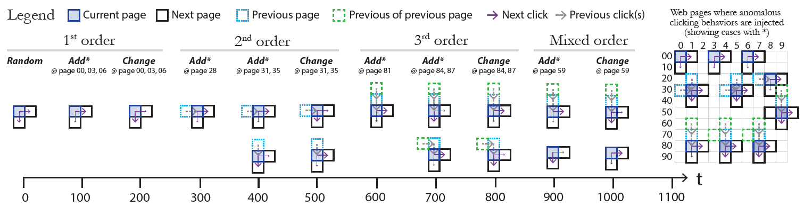
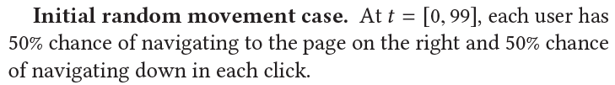
Synthesizing trajectories

Slide 15
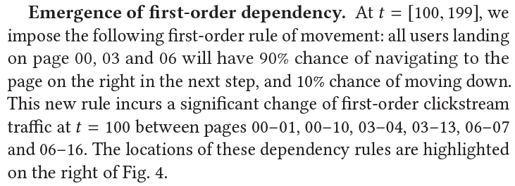
Synthesizing trajectories

Slide 16
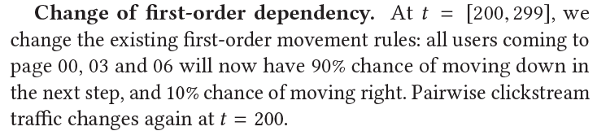
Synthesizing trajectories

Slide 17
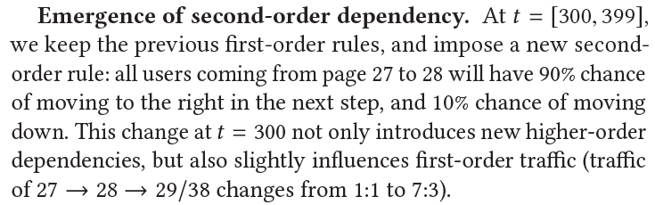
Synthesizing trajectories

Slide 18
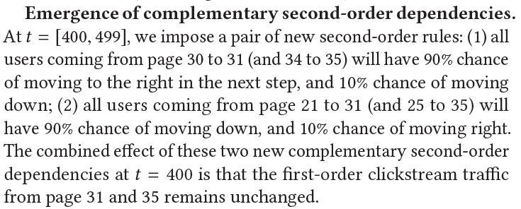
Synthesizing trajectories

Slide 19
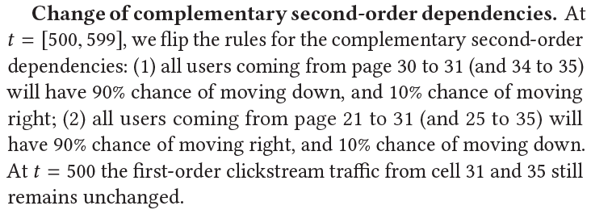
Synthesizing trajectories

Slide 20
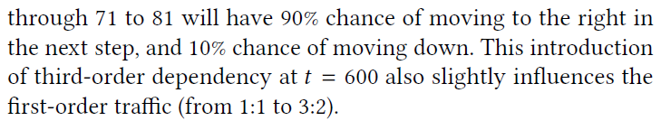
Synthesizing trajectories

Slide 21
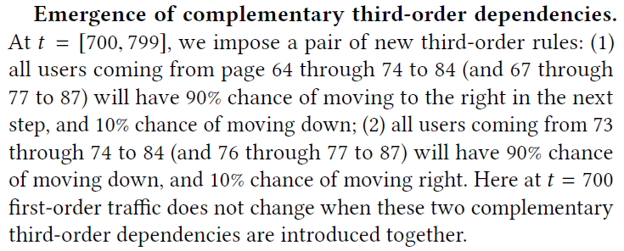
Synthesizing trajectories

Slide 22
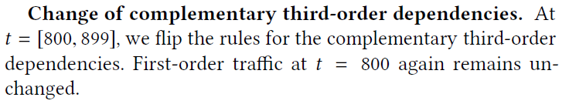
Synthesizing trajectories

Slide 23
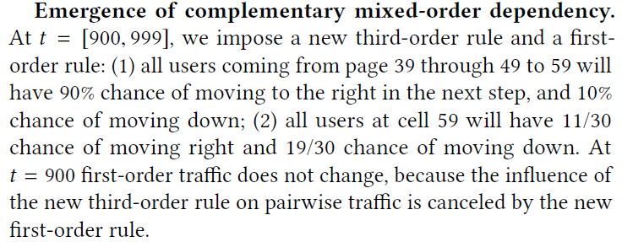
Synthesizing trajectories

Slide 24
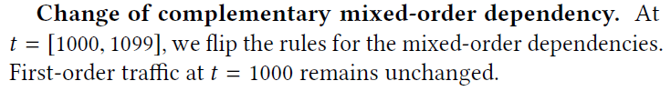
Synthesizing trajectories

Slide 25
Synthesizing trajectories
By t=1099, we have 200 first-order rules, 20 second-order rules, 12 third-order rules

