Slide 1
AFO Imagery Extraction
What we learned testing zero-shot detection on real NAIP imagery
GEO-ANOM | Task Tracker #2 | Umesh | 7/20/2026

Slide 2
What we did
• Question going in: does zero-shot detection actually work on the AFO feature classes that matter — poultry houses and manure lagoons — or do we need to invest in fine-tuning first?
• Selected the 10 highest-headcount AFO permits from the MDE registry (315K–595K birds each) — the sites most likely to have large, obvious poultry houses and lagoons.
• Downloaded a fresh 1m-resolution NAIP tile for each site from Maryland's public iMAP ImageServer (no auth needed — all 10 succeeded).
• Ran the existing YOLO-World zero-shot detector, prompted directly for: “poultry house,” “chicken barn,” “manure lagoon,” “feedlot,” “grain silo,” “agricultural pond.”
GEO-ANOM — Task Tracker #2 — 7/20/2026

Slide 3
The result
0 / 10
sites with a poultry house or lagoon detected
• 3 detections total across all 10 tiles — all mislabeled “grain silo,” at 1.2–1.7% confidence (noise-level).
• Zero poultry houses, zero chicken barns, zero manure lagoons found — despite these being broiler operations with 300K+ birds.
• We visually checked the raw tiles ourselves: poultry houses are clearly, unmistakably visible to the eye at every site inspected.
• Conclusion: this is not a data problem. The signal is in the imagery — the off-the-shelf model just isn’t finding it.
GEO-ANOM — Task Tracker #2 — 7/20/2026

Slide 4
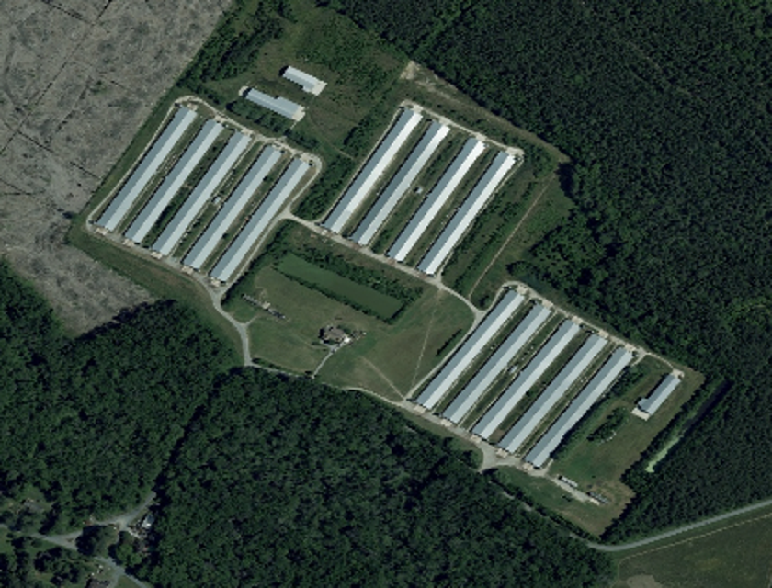
The imagery is fine — the model isn't finding it
Minh Vinh farm (595,000 birds) — 12 poultry houses across 3 clusters, clearly visible. YOLO-World: 0 detections here.

Slide 5
So we tried something else — and it works
• Poultry houses and lagoons both have very distinctive, consistent visual signatures — bright elongated roofs, teal/turquoise water.
• Instead of fine-tuning a model, we tried plain color + shape filtering (OpenCV) — no training data required.
122
poultry houses found across all 10 tiles (vs. 0 from zero-shot)
Plus 2 correctly-identified water bodies. Known limits: occasionally boxes bright roads too (precision, not perfect); lagoon detector is conservative — likely misses darker/murkier lagoons rather than false-alarming.
GEO-ANOM — Task Tracker #2 — 7/20/2026

Slide 6
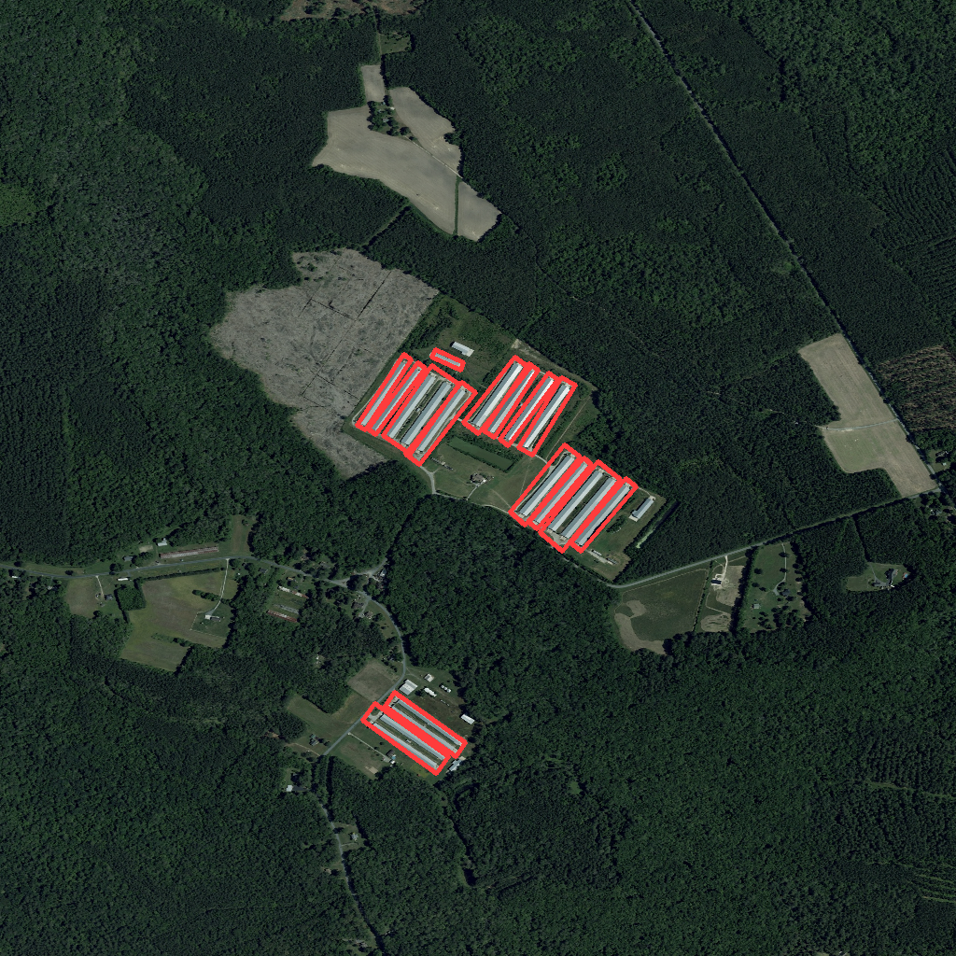
Every visible poultry house, correctly boxed
Minh Vinh farm — all 15 detected boxes (3 clusters) land on real structures, including a small farm not part of this permit.

Slide 7
A flag on the existing dashboard data
• While investigating why the prior 70-detection dataset skewed toward silos/feedlots/ponds instead of poultry houses, we traced it to configs/maryland.yaml:
yolo_world: confidence_threshold: 0.01
• A 1% confidence floor lets essentially random noise through as a “detection.”
• The existing 70 “detections” currently shown in the pipeline/dashboard are not reliable signal — worth flagging before those numbers get used or cited anywhere.
GEO-ANOM — Task Tracker #2 — 7/20/2026

Slide 8
Verdict & recommended next step
Off-the-shelf zero-shot ML doesn't work here — but a simple, trainable-data-free classical CV detector already does.
• Option A — harden the classical CV detector: filter out road false-positives, check recall on more sites. No training data needed, fastest path to something usable.
• Option B — fine-tune YOLOv8 for a more general, learned solution: the 122 classical-CV boxes are themselves a usable first-pass label set, cutting most of the manual labeling work.
• Either way: “continue extraction work” now has working output and a concrete next step — not just a negative result.
GEO-ANOM — Task Tracker #2 — 7/20/2026

Slide 9
Where to find everything
• Zero-shot ML script: scripts/top_headcount_imagery_test.py
• Classical CV detector: scripts/classical_cv_detector.py
• Detections: data/processed/detections/top10_yolo_world_detections.geojson and top10_classical_cv_detections.geojson
• Annotated previews: docs/imagery_experiment_assets/
• Full write-up: docs/imagery_extraction_experiment_2026-07-20.md
• Repo: github.com/xylem-lab/GEO-ANOM-dashboard
GEO-ANOM — Task Tracker #2 — 7/20/2026

