Slide 1
Photo Sharing Project
By Yilang Xuan

Slide 2
What is this project about?

Slide 3
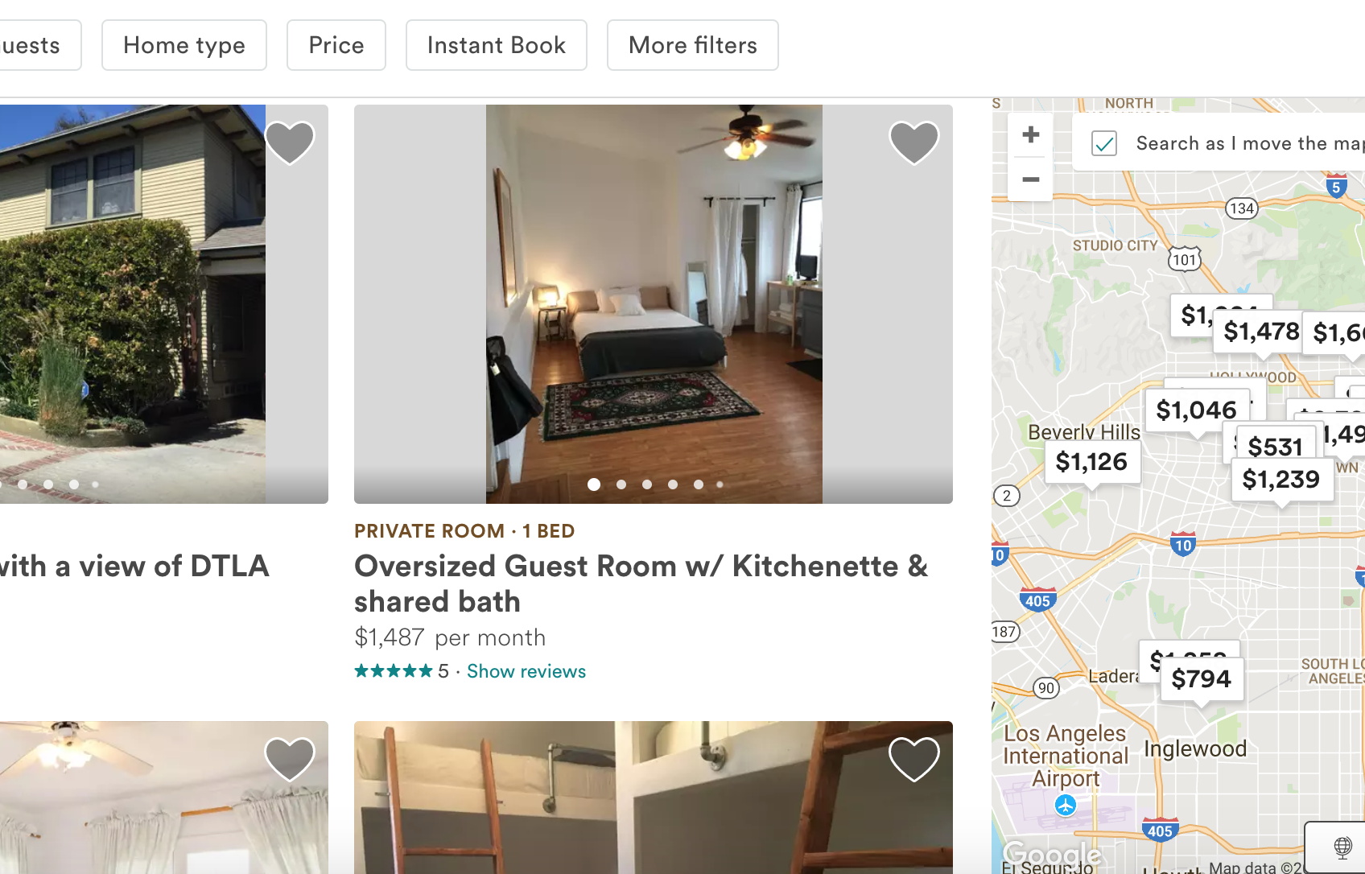
Clone of Airbnb?

Slide 4
Four Basic Part
Setting up Node,React &Redux
Google Map
Uplodaing Images, User Registration & Login
Geo Spatial Queries, Theme Intergration, Deployment

Slide 5
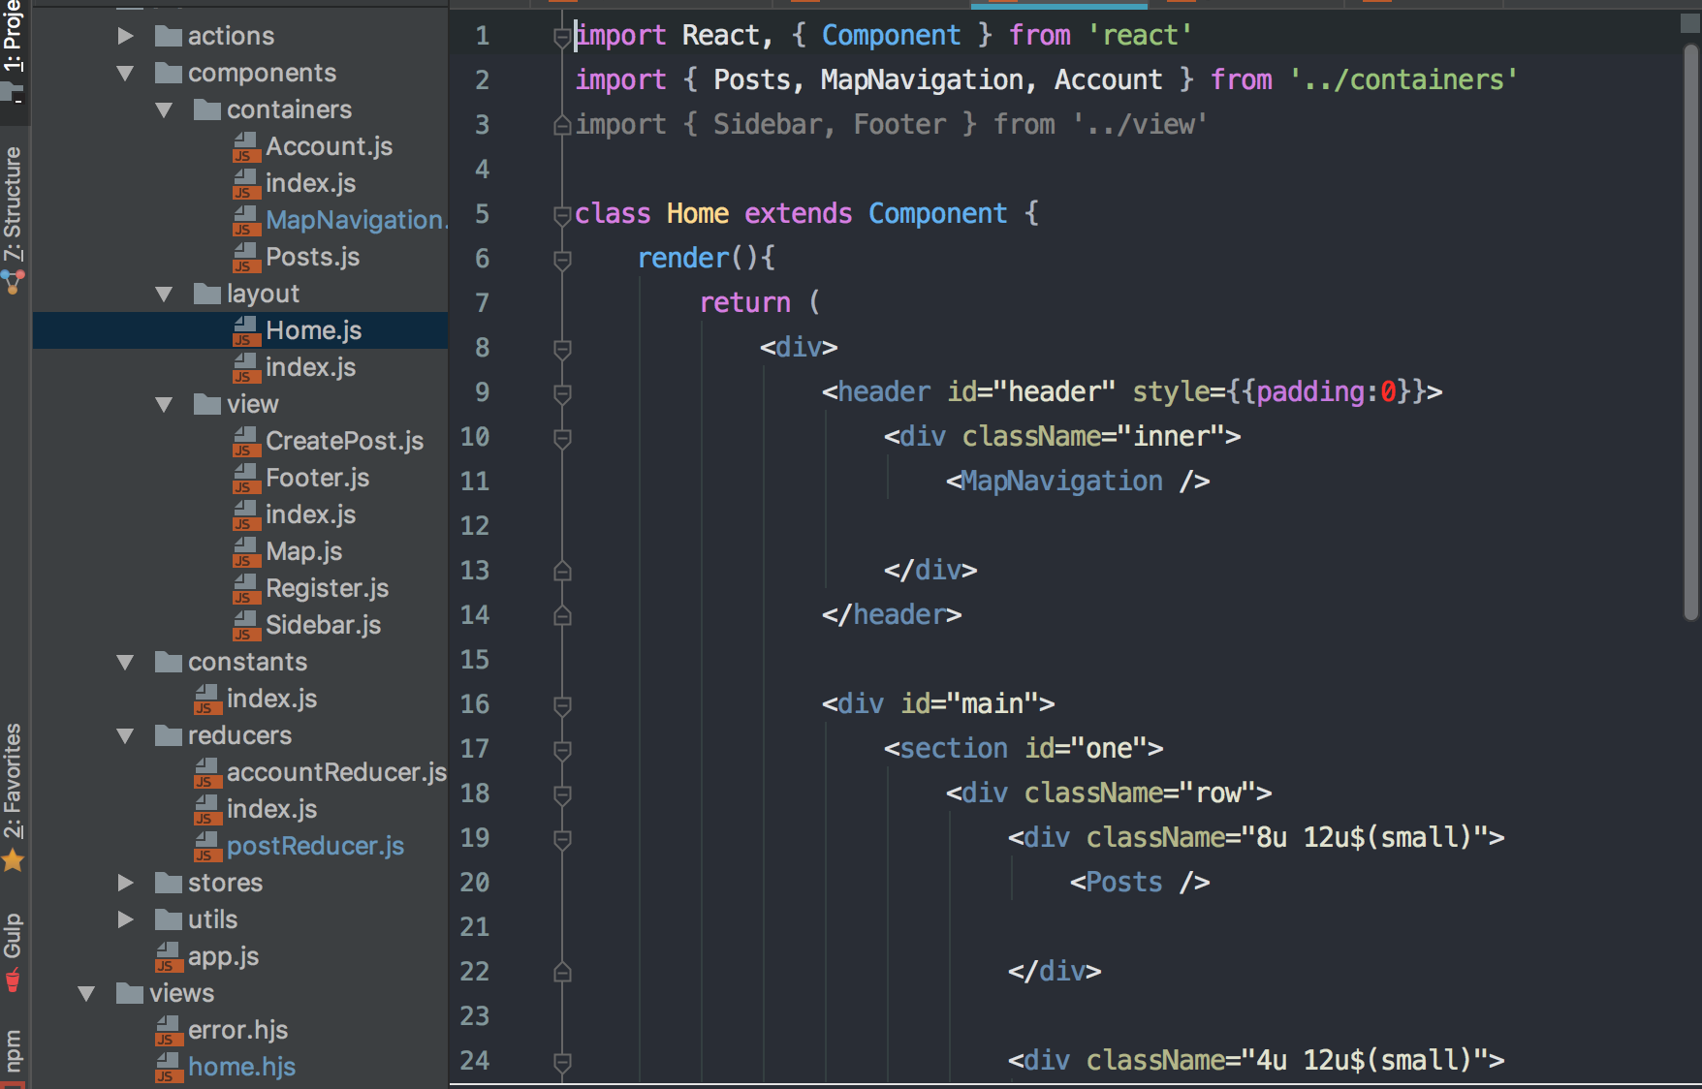
Setting up Node,React &Redux

Slide 6
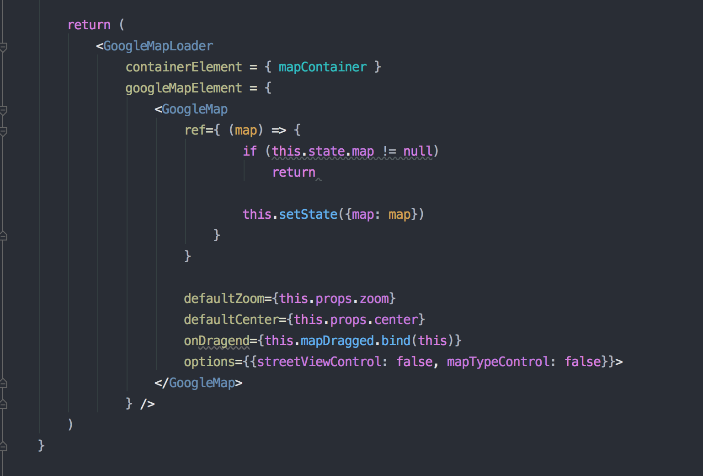
Google Map Setting Up

Slide 7
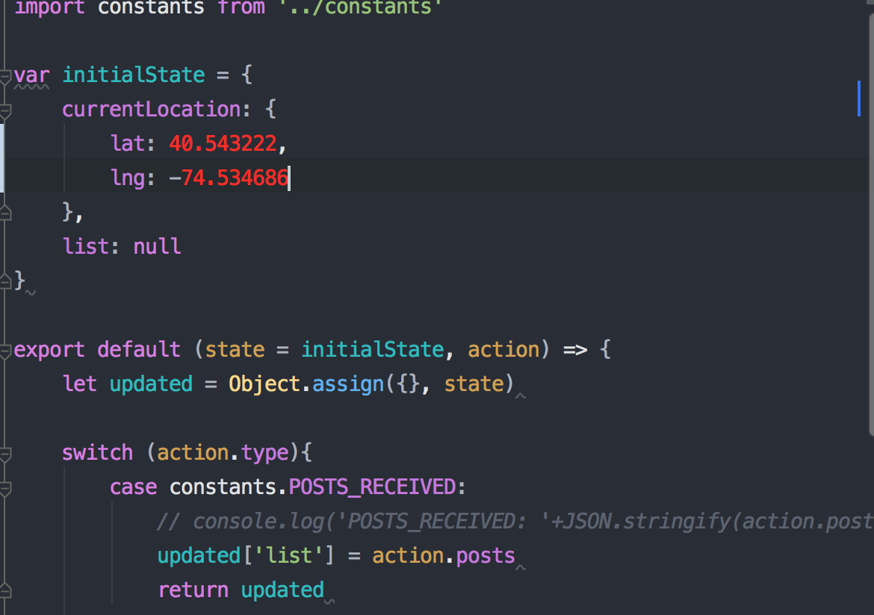
Google Map Specify Locations

Slide 8
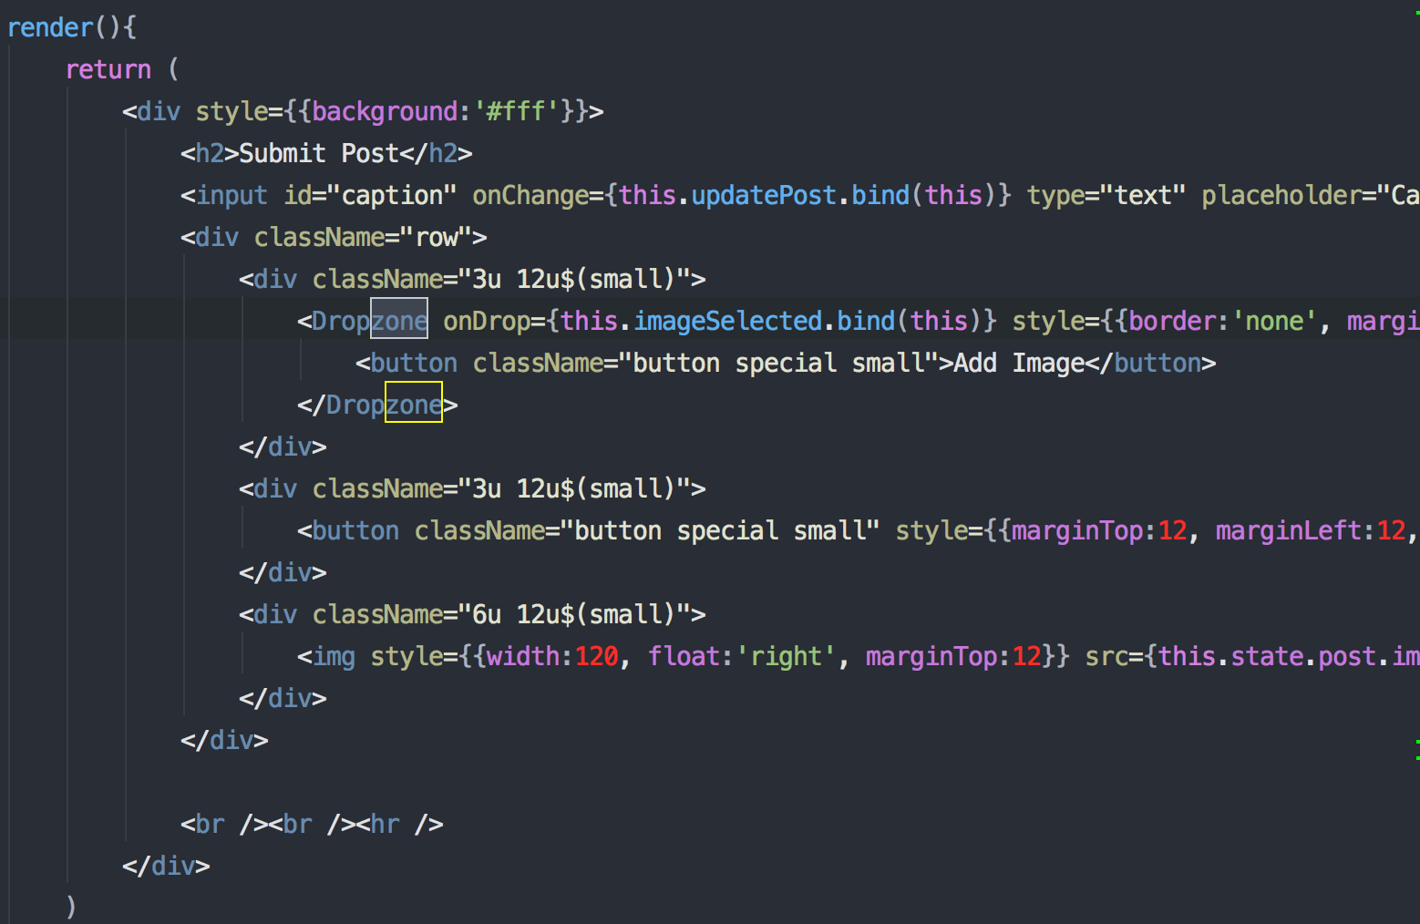
Post Image Using Dropzone

Slide 9
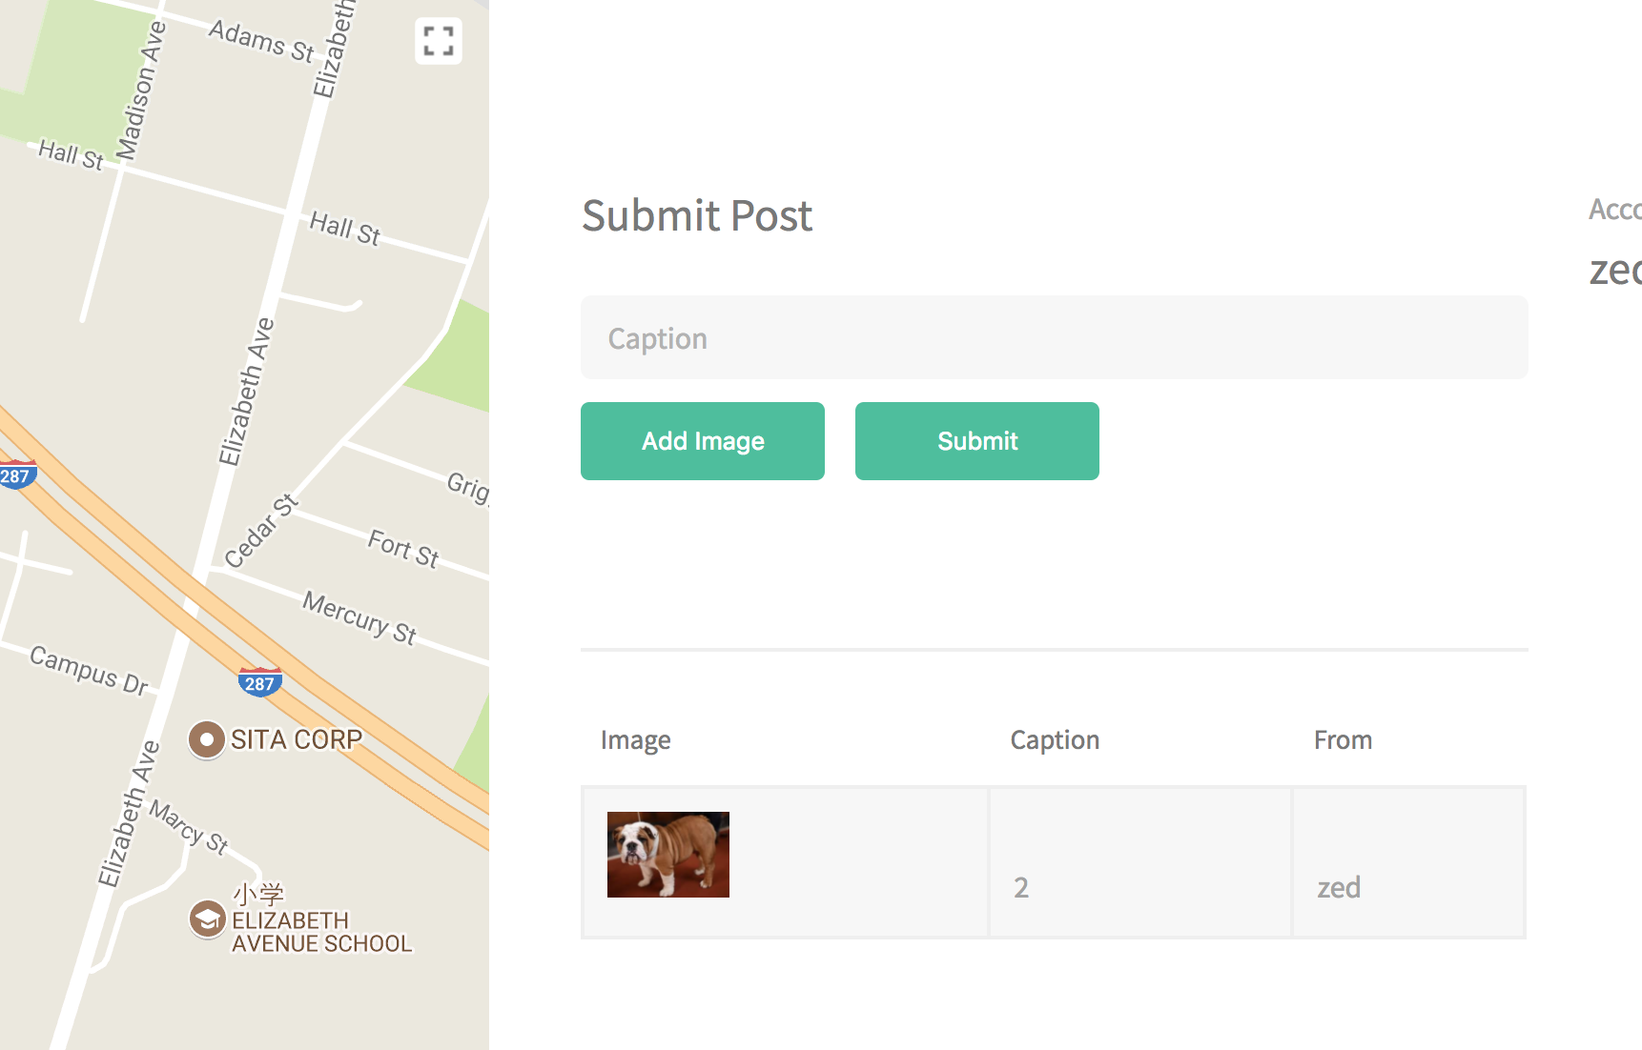
Demo

