Slide 1
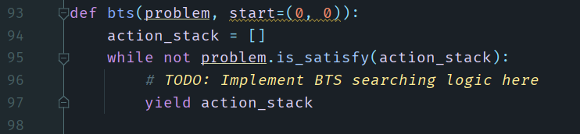
Backtracking Search for CSP
Problem Description:
Given an empty n * n chess board, find a position allocation for n queens such that any two of the queens not in the same row, column or slants.
You need complete the bts function by finishing the TODO

Slide 2
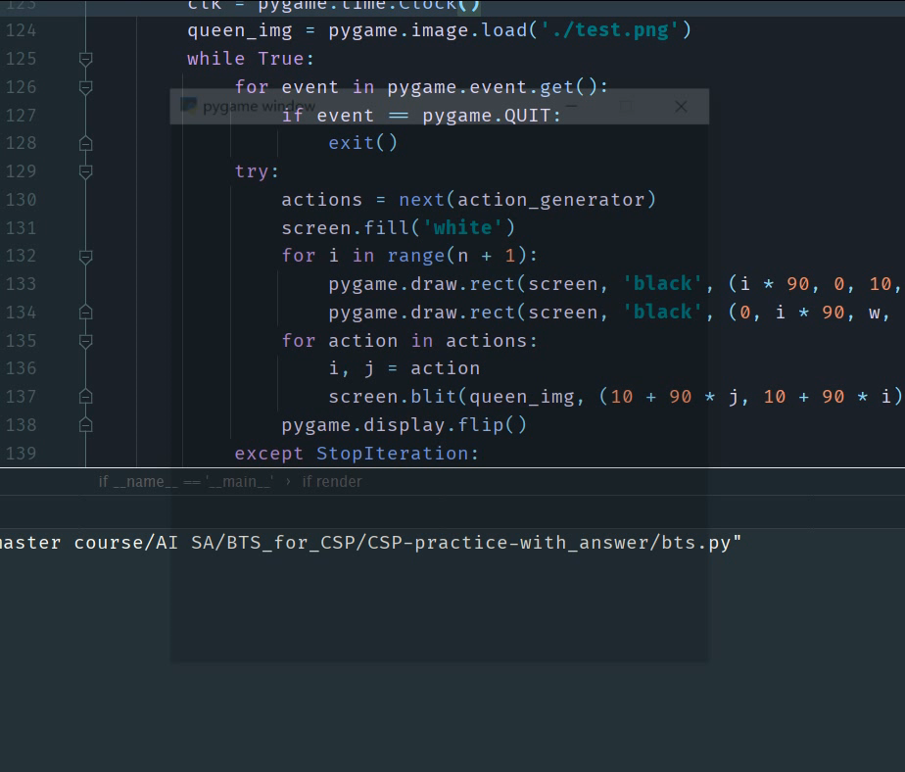
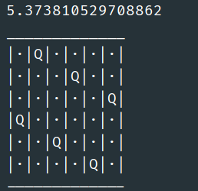
Backtracking Search for CSP
Preparation:
Instal pygame (Run pip install pygame in cmd)
Check instructions:
Modify n into 5, then run the code. The expected performance is shown in the video.
Modify n into 6, then run the code. The expected output (no render) is:
The number is time consumed by your program. If your algorithm is correct, it shouldn’t larger than the number shown here too much

