Slide 1
Lab 10 Histogram of oriented gradients (HOG)
Zongwei Li, Teng Wang

Slide 2
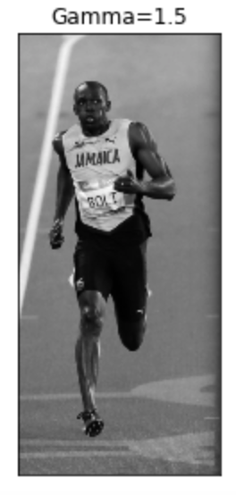
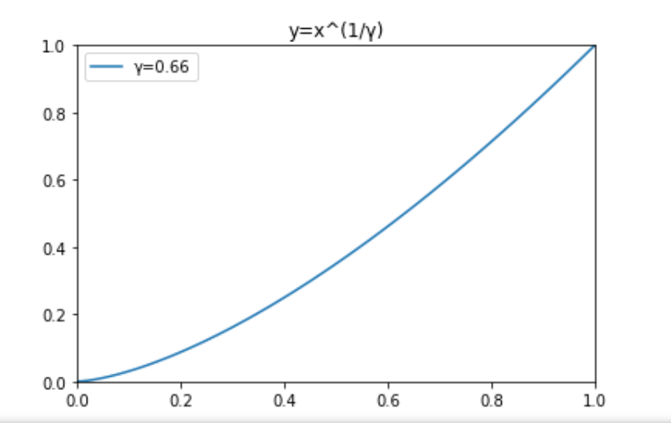
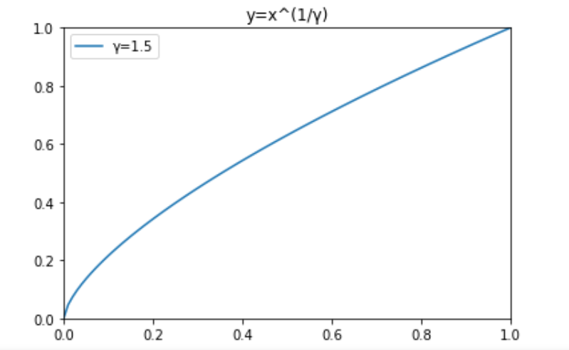
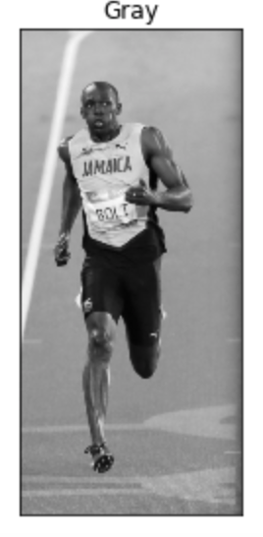
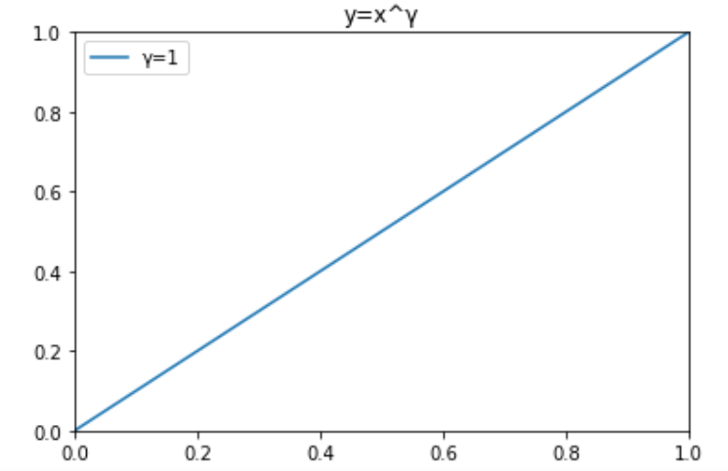
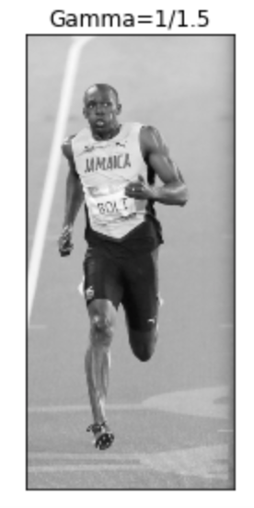
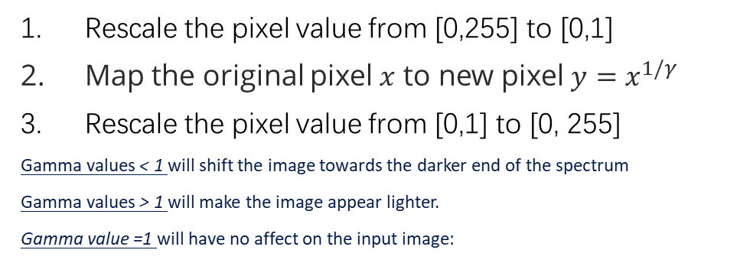
Gamma Correction
gamma=1/1.5
Rescale the pixel value from [0,255] to [0,1]
Map the original pixel $x$ to new pixel $y=x^{1/γ}$
Rescale the pixel value from [0,1] to [0, 255]
Gamma values < 1 will shift the image towards the darker end of the spectrum
Gamma values > 1 will make the image appear lighter.
Gamma value =1 will have no affect on the input image:
gamma= 1.5
Notes:
Gamma变换就是用来图像增强，其提升了暗部细节，简单来说就是通过非线性变换，让图像从暴光强度的线性响应变得更接近人眼感受的响应，即将漂白（相机曝光）或过暗（曝光不足）的图片，进行矫正。

Slide 3
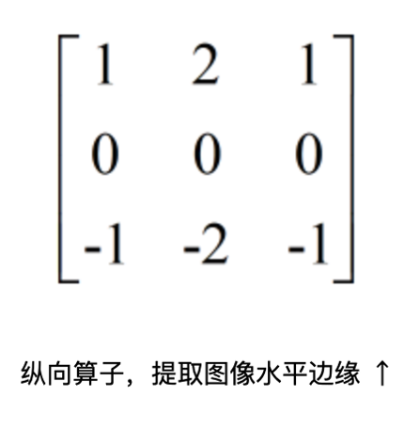
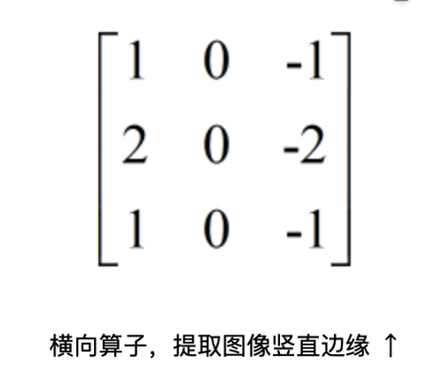
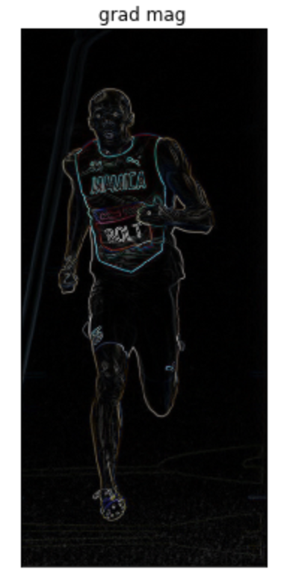
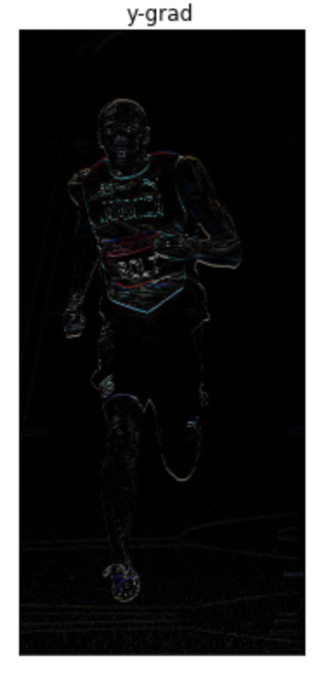
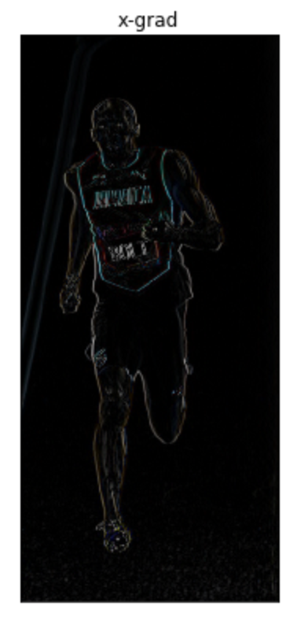
Sobel filtering

Slide 4
HOG
计算图像像素点梯度值，得到梯度图(尺寸和原图同等大小)
图像划分多个cell，统计cell内梯度直方向方图
将2×2个cell联合成一个block，对每个block做块内梯度归一化

Slide 5
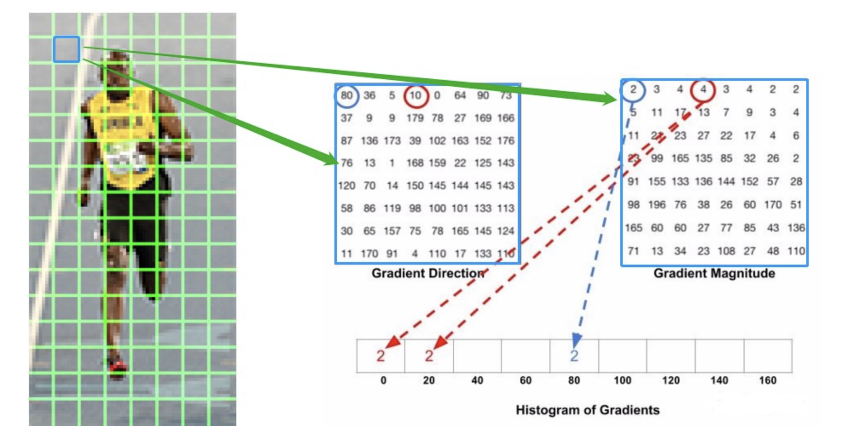
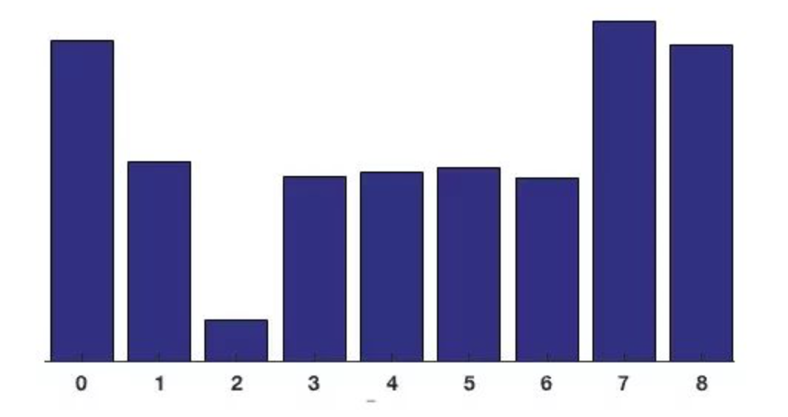
HOG
计算图像像素点梯度值，得到梯度图(尺寸和原图同等大小)
图像划分多个cell，统计cell内梯度直方向方图

Slide 6
HOG
3. 将2×2个cell联合成一个block，对每个block做块内梯度归一化

Slide 7
Steps
1. Gamma correction
3. Calculate the gradient image (magnitude)
4. For all cells in an image:
4.1 Calculate the Gradient orientation
4.2 Histogram of a cell
4.3 Block Normalization
5. Concatenate all the HOG features of all cells

