Slide 1
Lab3 histogram equalization and filtering
Zongwei Li

Slide 2
Outline
histogram equalization
Gaussian filtering
Sobel filtering
Image pyramid

Slide 3

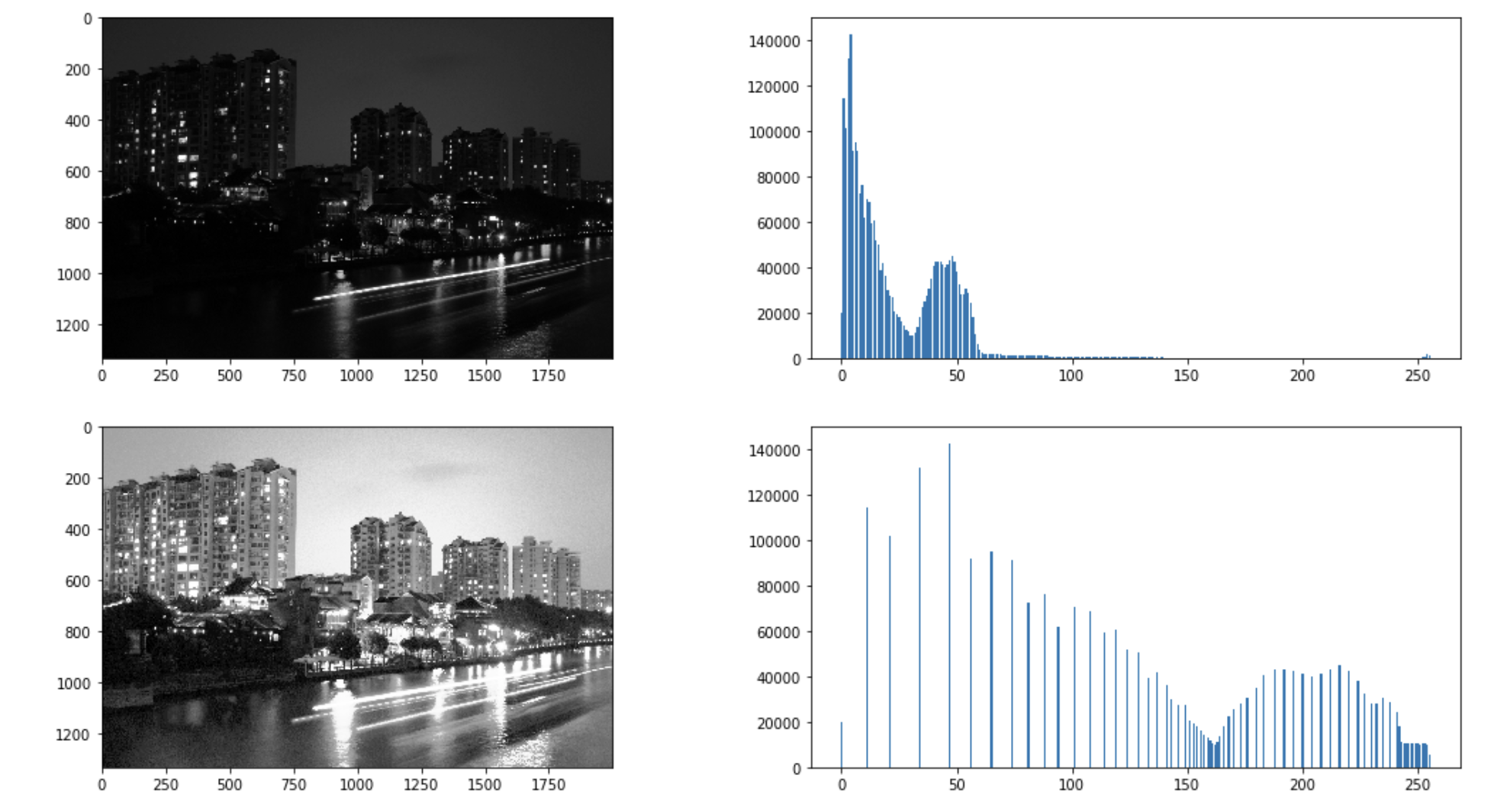
histogram equalization

Slide 4
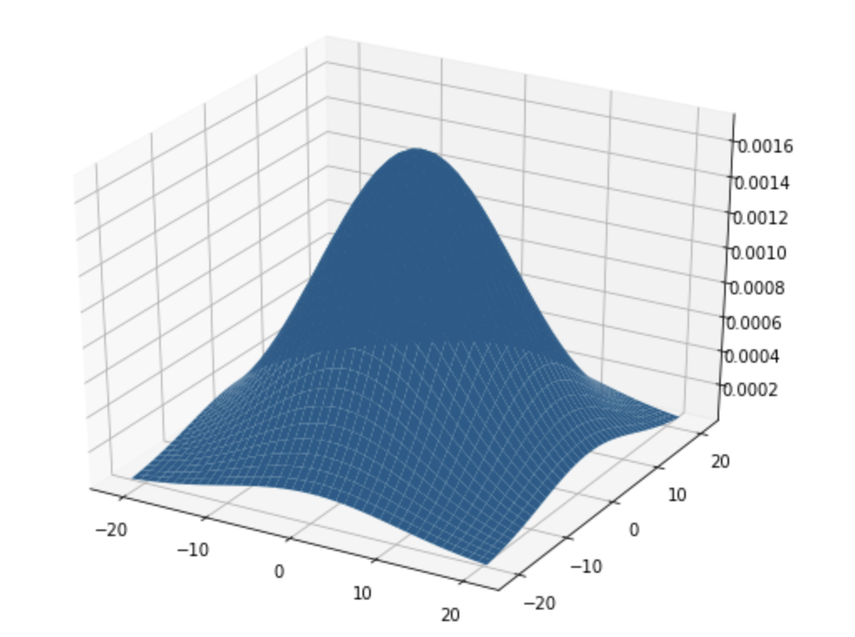
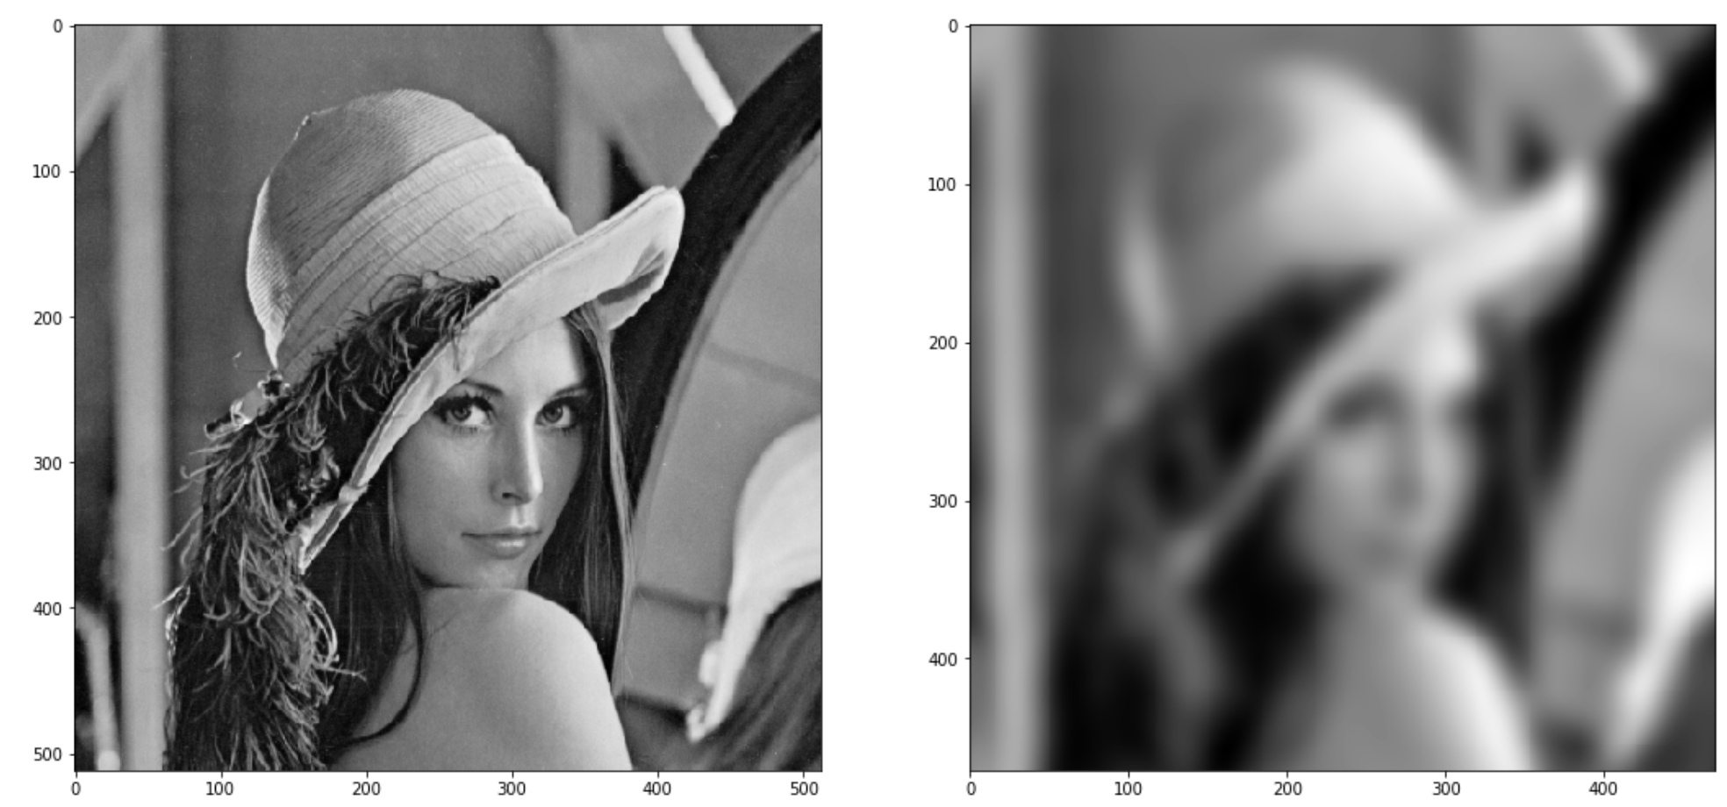
Gaussian filtering

Slide 5
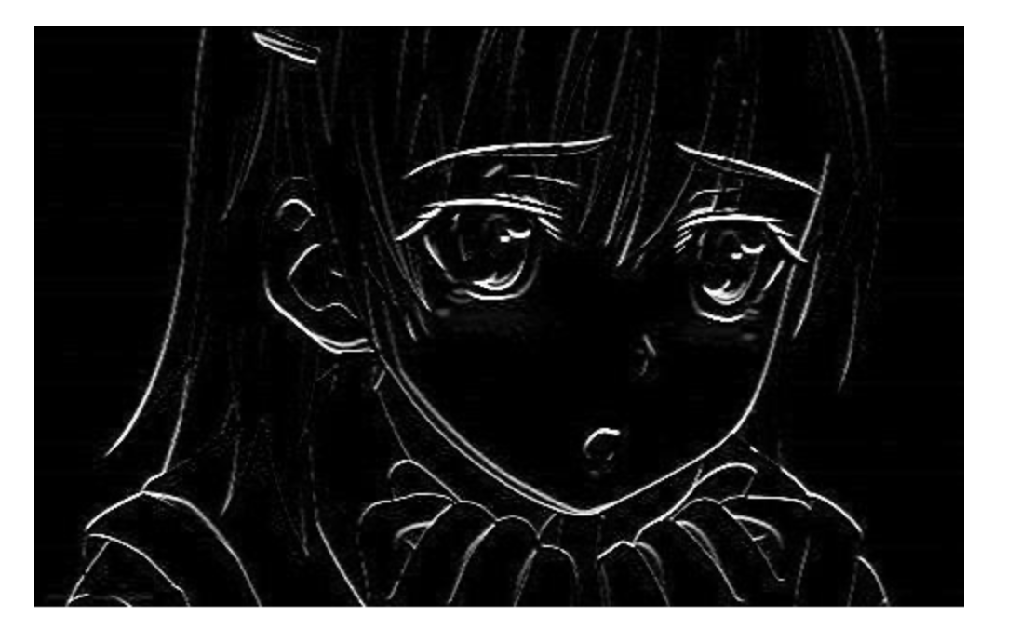
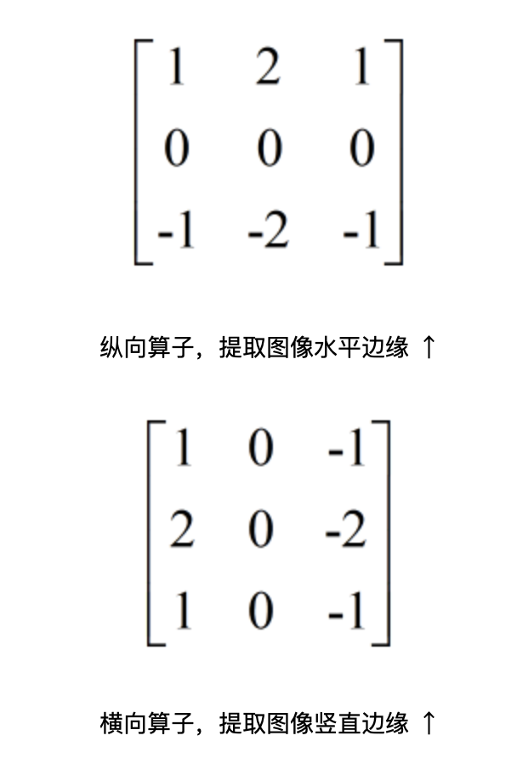
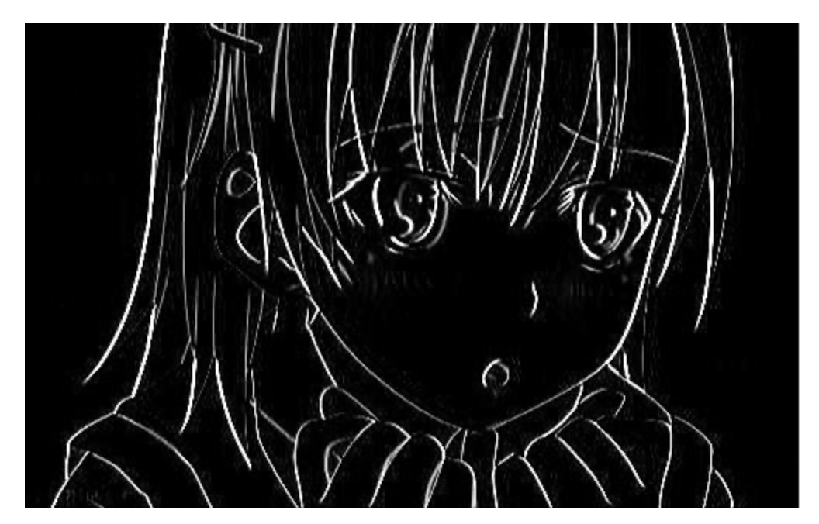
Sobel filtering

Slide 6
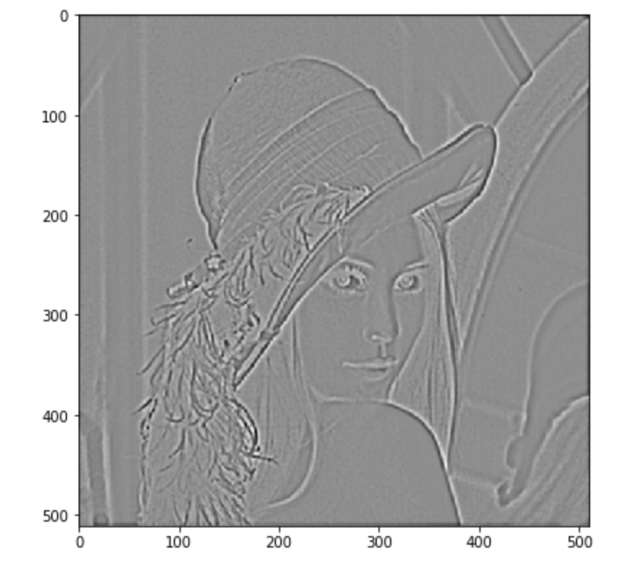
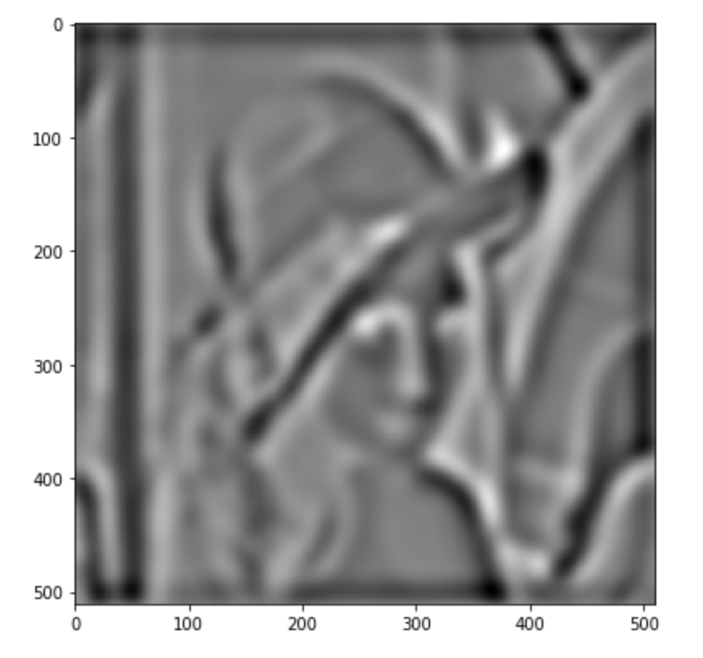
Image pyramid
Larger kernel std

