Slide 1
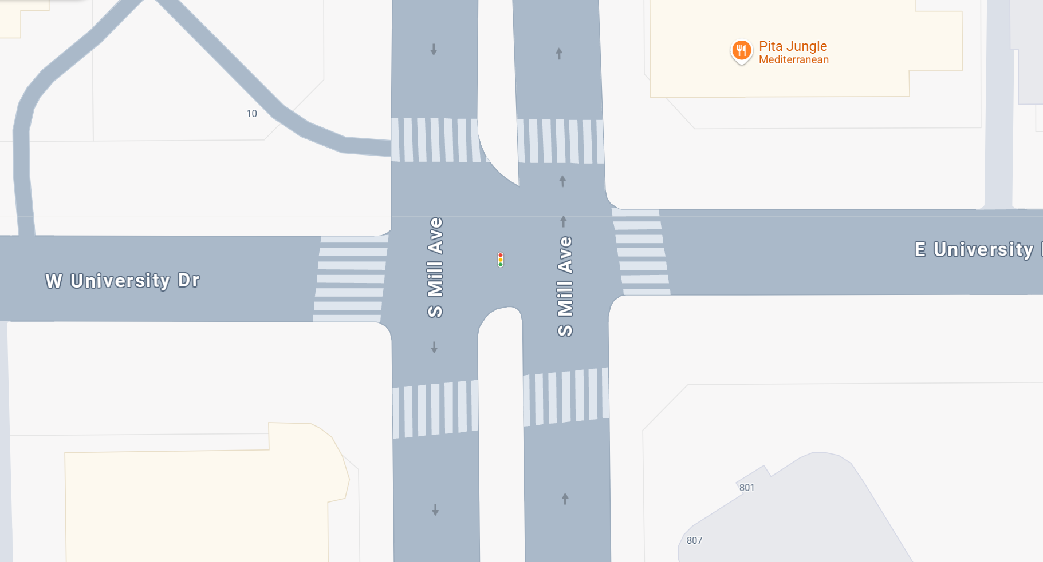
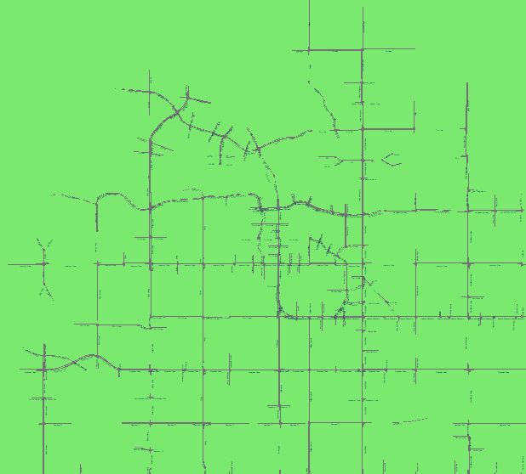
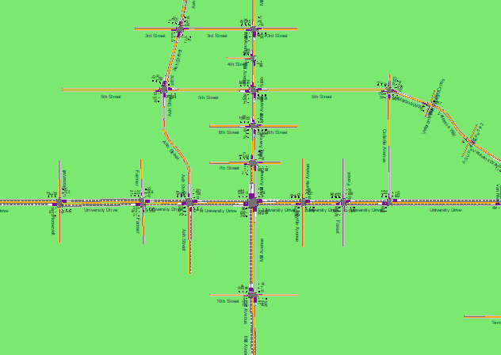
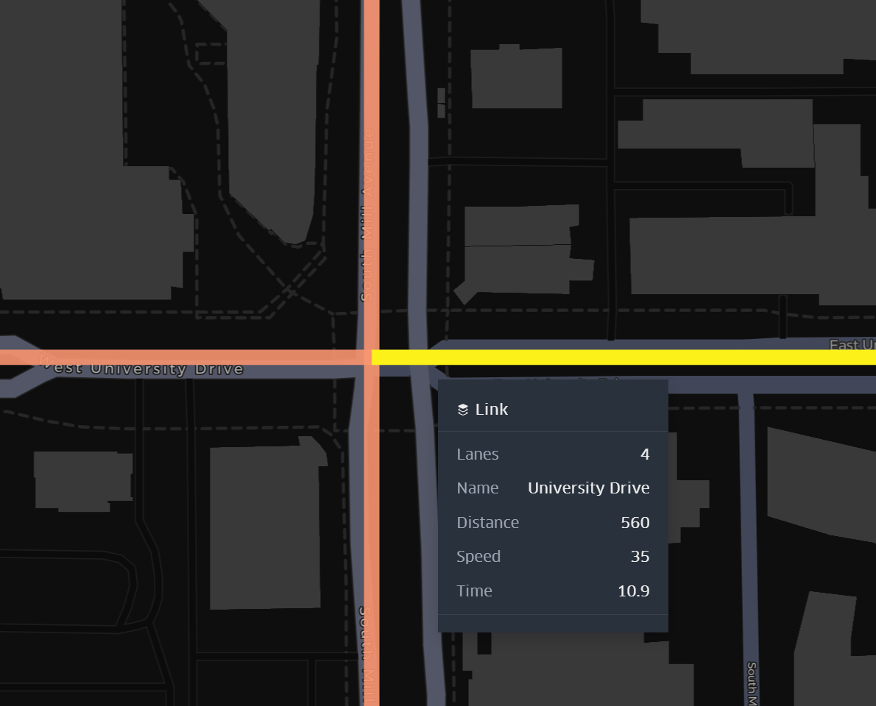
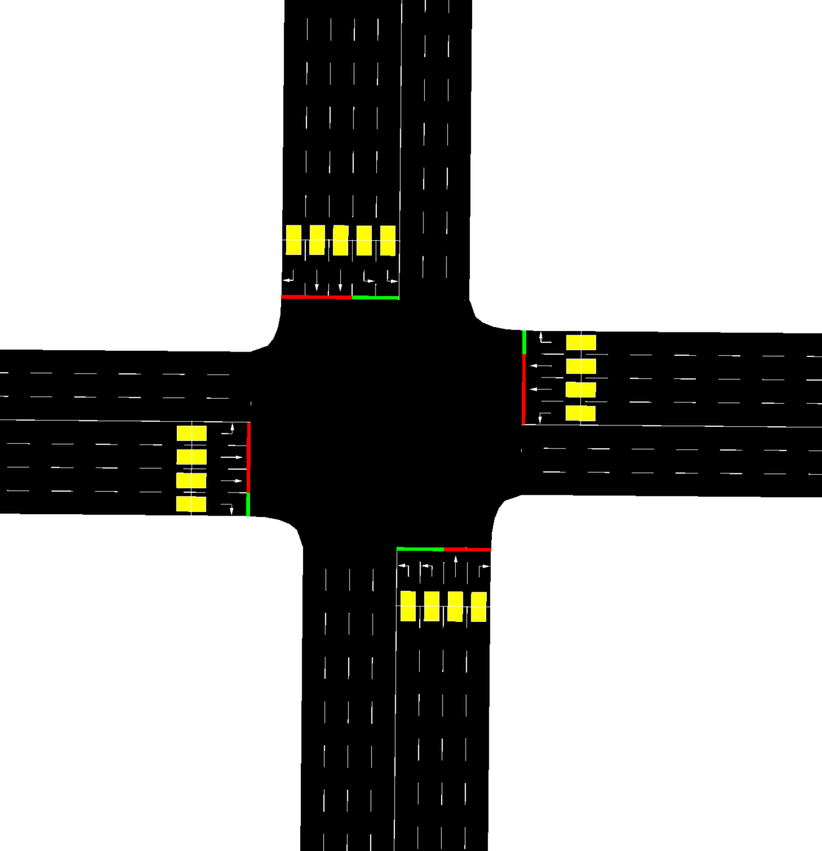
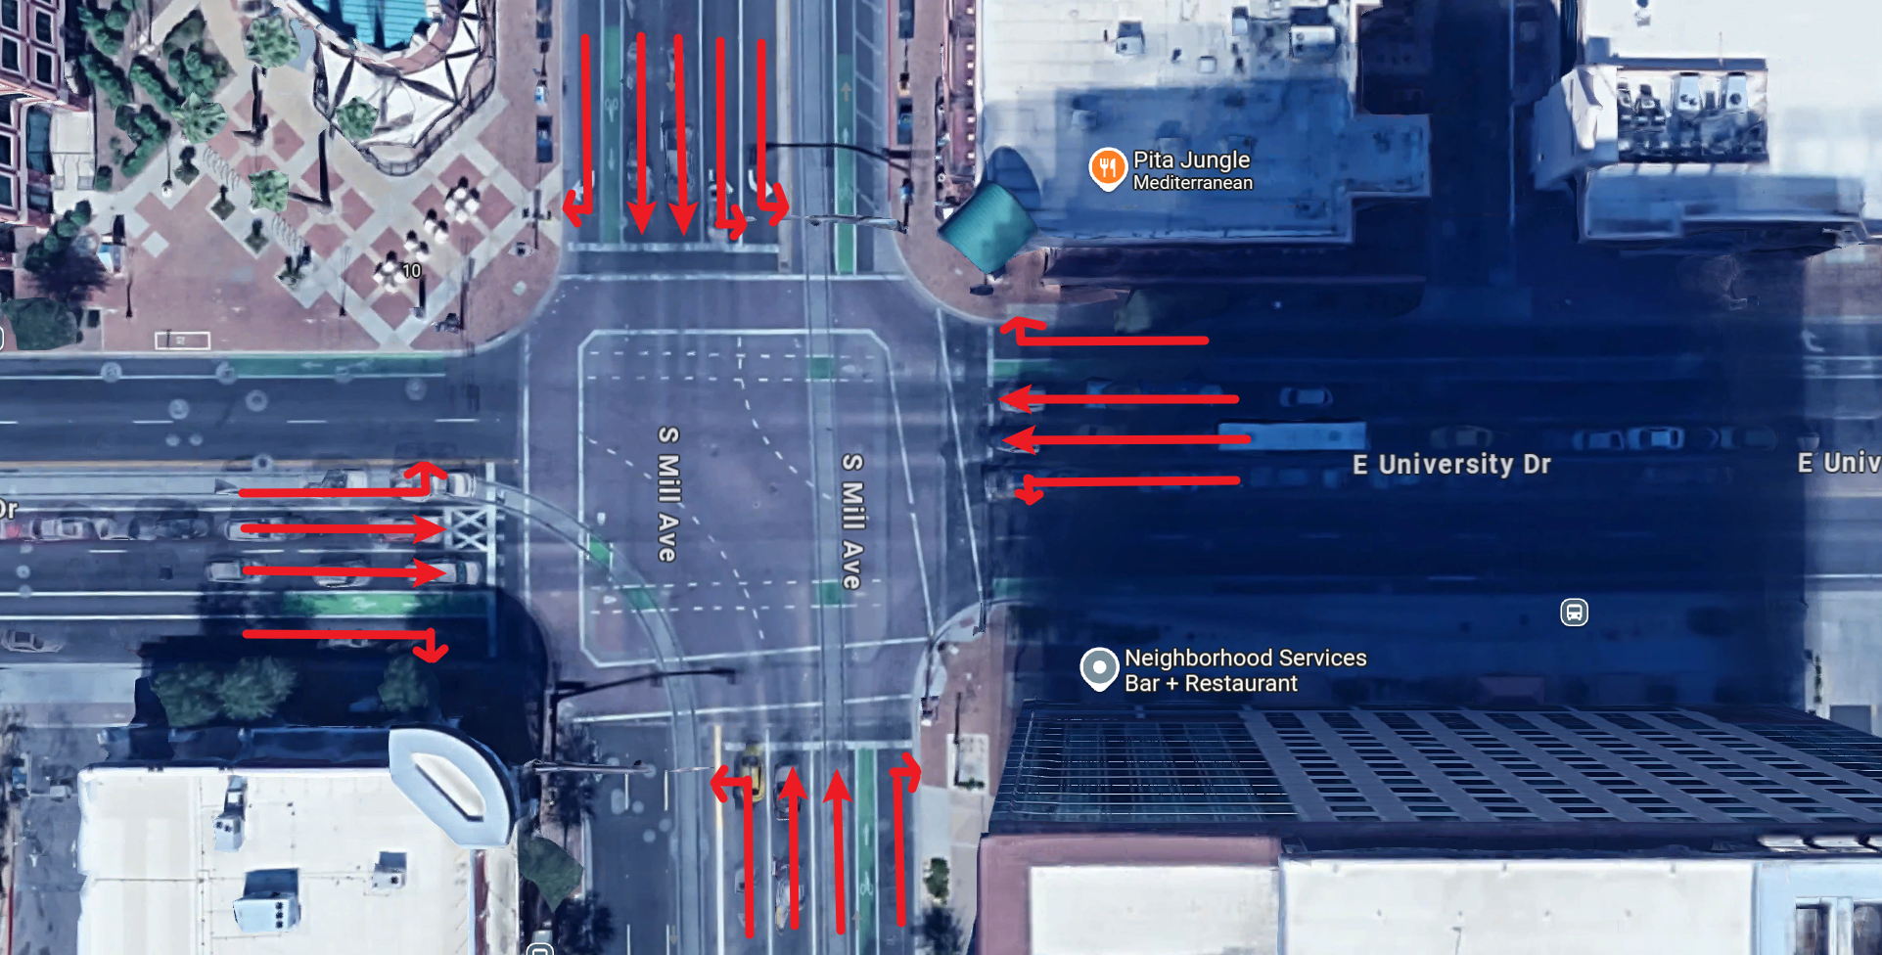
GMNS View
SUMO View
Google Map Street View
Intersection: University Dr & Mill Dr
Google Map 3D View

Slide 2
Intersection: University Dr & Mill Dr

Slide 3
Google Map Street View
Google Map 3D View

Slide 4
GMNS View
SUMO View

