Slide 1
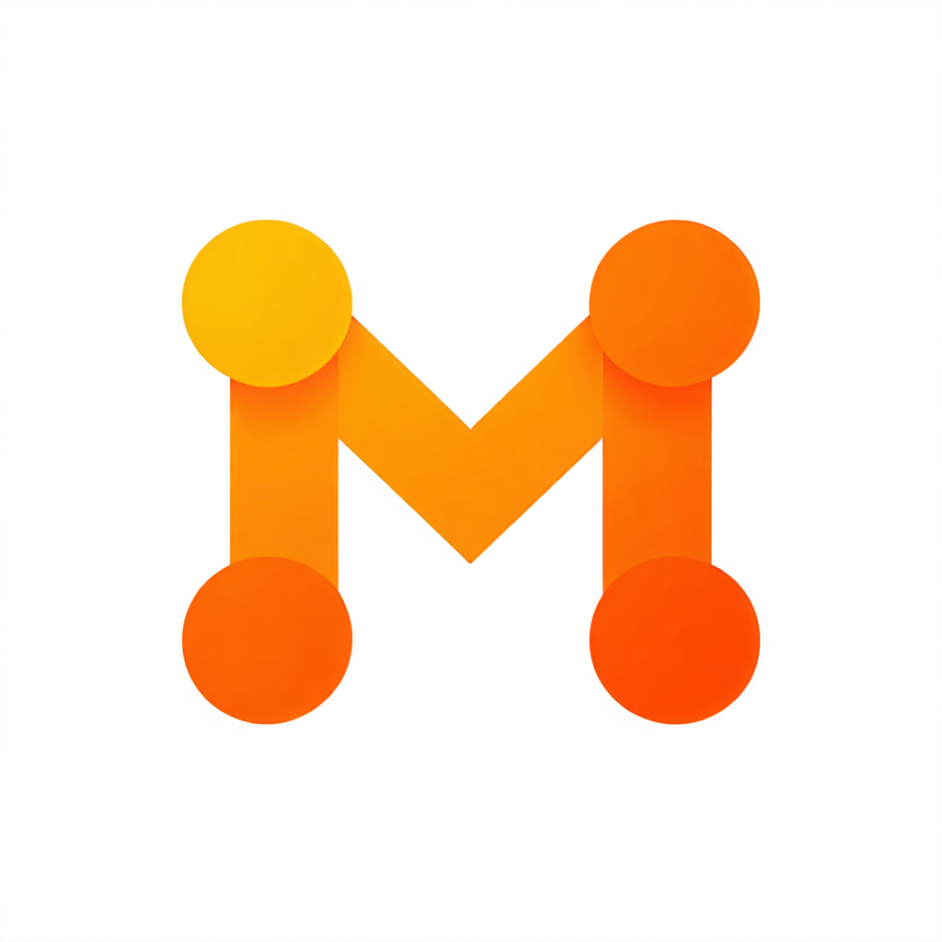
marshal.build
Build · Govern · Deploy
Describe an AI agent in plain English. Get a governed specification, a validated serverless agent, and a live deployment in an isolated AWS account — with every decision on the record.
Open source · self-hostable · built in the open since July 2026
Notes:
Thirty seconds. The tagline is the product: three stages, one platform, nothing hidden.

Slide 2
2 · The gap
Everyone can prompt a model into writing an agent. Almost nobody can deploy one their security team will sign off on.
What's missing between the prompt and production: a specification someone approved, code that was checked rather than trusted, a blast-radius boundary, a risk decision with a name on it, an audit trail of every model call and every click.
Today that gap is filled by shadow AI, or by six weeks of platform work per team.
marshal.build
2
Notes:
Name the audience's pain before the product. The security reviewer is the real customer.

Slide 3
3 · What marshal does — one picture
Chat / Guided wizard / Studio
(PDF · DOCX · pasted specs as grounding)
Spec set: requirements.md · design.md · tasks.md
versions · diff · rollback · comments
Code generation
deterministic validation gate
spec-conformance review
(allowlist · packaging · auth contract · guardrail patterns)
Risk scoring (7-factor rubric)
auto-approve / maker-checker review
Enclave: a vended AWS account per deployment · TTL · budget · health · teardown
marshal.build
3
Notes:
Build is the top half, Govern is the middle, Deploy is the bottom. Every arrow is a seam with a test behind it.

Slide 4
4 · Build — from conversation to specification
Three ways in: guided wizard (business users — server-owned state machine, ≤3 clarification rounds), freeform chat, and the Studio for power users (shows the exact prompt context and effective parameters after clamps — display cannot drift from enforcement).
Brownfield grounding: attach a PDF, a Word document, or an existing spec set; extraction is deterministic and local (no model, no OCR).
Output: requirements, design (with a Mermaid architecture), implementation plan — structurally validated, one model repair pass, then append-only versions with diff and rollback.
Templates with rails: model allowlists, token ceilings, temperature bounds, architecture rules, allowed capabilities — enforced server-side on every call.
marshal.build
4
Notes:
Demo beat #2 lives here. Emphasise "rails, not suggestions".

Slide 5
5 · Build — from specification to a validated agent
Profiles: inline-cfn (zero toolchain), packaged-cfn (real Lambda package, S3 asset, exact-pinned deps with an SBOM), cdk-app (a TypeScript CDK repository you can take away — experimental).
The gate is deterministic and blocking: AWS service allowlist, packaging shape, API-key contract on every route, forbidden patterns (hard-coded credentials, public DB exposure), deploy contract. Any finding fails the build — no "deploy anyway".
Spec conformance: literal/field contracts extracted from the requirements are checked in the generated code; violations block, model review is advisory.
Self-correcting: compaction retry for oversized handlers; automatic escalation to packaged when code outgrows CloudFormation's 4 KB inline limit — without adding dependencies the spec never declared.
Handoff bundle: specs + generated code + build manifest — run it outside marshal.
marshal.build
5
Notes:
The gate is the thing competitors don't have. "Checked, not trusted."

Slide 6
6 · Govern — the risk gate and maker-checker
Every deployable build is scored against the current content hash: 7 weighted factors (data sensitivity, external reach, capability reach, …), rubric v3, deterministic per content — scored once, reread forever.
Low auto-approves. Medium/high route to reviewers — groups, escalation, SLA queue, resubmission lineage; the decision is recorded with the reviewer's identity and comment.
Tightened policy means the next deploy re-scores; approvals under a superseded policy don't open the gate. Running deployments are never retro-blocked.
Admins tune weights, bands and auto-approve policy — versioned, every change audited.
marshal.build
6
Notes:
Demo beat #5: show a medium verdict, switch to the admin, approve with a comment, show it in the audit log.

Slide 7
7 · Govern — policies, controls, evidence
Deployment policy: concurrency per user / platform, TTL default and max, per-deployment budget, region, endpoint-auth posture (always). Enforced before scoring — refusals never spend a model call.
Model controls: allowlist from a governed catalog, parameter bounds, per-user / per-project / platform monthly caps (block or alert), rate limits with queue-then-429.
Audit: every action (before/after, request id, IP) and every model invocation (prompt/response hashes, tokens, cost, stop reason) in one timeline; 180-day hot, then S3 archive. Reasoning tokens suppressed so spend is honest.
Security: Cognito + TOTP MFA, admin-MFA gate (fail-closed), PII-redaction guardrail in synchronous streaming mode, WAF, body/rate guards, supply-chain gate on every image build.
marshal.build
7
Notes:
Don't claim certifications — there are none. Describe the controls; let the reviewer map them.

Slide 8
8 · Deploy — Enclaves
A deployment gets its own AWS account, vended by AWS Innovation Sandbox: lease, budget cap, recycling. The account boundary is the blast-radius control for model-written code.
Lifecycle on the record: pre-flight → lease → stack → health probes → active; TTL with 48 h/24 h warnings; owner-extend within policy; automatic teardown through the standard path; in-place updates with CloudFormation rollback semantics.
Keyed by default: API key + usage plan on every route; optional self-contained web test console; "Reveal key" for the owner only.
Fleet view across projects; dependents block teardown; connector and dependency secrets copied into the Enclave and deleted with it.
marshal.build
8
Notes:
Demo beat #6. If the live deploy is slow, narrate the lease phases — they're the point.

Slide 9
9 · The capability ladder (each rung spec-declared, gate-enforced)
Phrase in the requirements | What the platform builds
"SHALL keep conversation memory" | per-agent DynamoDB memory table + verbatim helpers
"SHALL use tools: a, b" | platform-assembled tool loop; model writes only tool bodies
"SHALL plan multi-step responses" | bounded planning loop, rail-capped iterations
"SHALL use connector <slug>" / MCP tools | registered connectors, copy custody, MCP tool loop
"SHALL call agent <slug>" / orchestrate | composable agents with a resolved dependency graph
"SHALL use packaged dependencies" | exact-pinned package with SBOM
Templates decide which rungs a project may declare. Nothing is chosen silently.
marshal.build
9

Slide 10
10 · Architecture
Browser
CloudFront + WAF
Next.js
FastAPI
Postgres
DynamoDB (chat, shared state)
Bedrock seam (clamps · redaction · recording)
Codegen (in-process, or the CodeBuild workspace runner)
Risk gate + review
Innovation Sandbox (Enclave vending)
Amazon Bedrock
S3 workspace/artifacts
Enclave account running the CloudFormation stack
Two backend tasks, shared state in DynamoDB, Postgres LISTEN/NOTIFY event relay, elected schedulers.
Every enforcement point is a seam: resolve_models, the Bedrock seam, the audit route registry, the deployment pre-flight, SandboxProvider, CodegenProvider.
marshal.build
10
Notes:
Render this as boxes and arrows.

Slide 11
11 · Built in the open — engineering discipline
616 backend tests · 95-check headless-browser smoke against production on every deploy · TypeScript strict · cdk synth in CI.
Supply-chain gate on every image build (pip-audit + npm audit, SBOM evidence) — it refused a deploy this week over 14 fixable advisories; we upgraded instead of allowlisting.
29 recorded delivery waves: every defect, root cause, drill and decision written down with the evidence — the recent entries ship publicly as docs/ENGINEERING_LOG.md.
Live since 25 July 2026; Multi-AZ Postgres with PITR; zero-downtime Alembic migrations; every wave live-verified before it's called done.
marshal.build
11
Notes:
This slide earns trust with engineers. Read one ENGINEERING_LOG.md entry aloud if time allows.

Slide 12
12 · What's open today and how to run it
One edition, everything included under Apache-2.0. A hosted/commercial edition is planned; nothing here is crippled.
You need: an AWS account, Bedrock model access for the default models, Node.js 22 + Python 3.12 + uv + AWS CLI v2 + CDK. Two tiers:
Evaluate — direct mode: deploys agents into the installation account. One account, no Innovation Sandbox.
Operate — Enclave mode: install AWS Innovation Sandbox (guide included), get an account per deployment.
./scripts/deploy-cloud.sh — seven steps, fail-closed smoke at the end. Honest monthly floor in the README: ≈ $120–125/month (evaluate) · ≈ $190–195/month (production).
Docs: in-app user guide (7 pages), ARCHITECTURE.md, ROADMAP.md, CHANGELOG.md, docs/ENGINEERING_LOG.md.
marshal.build
12
Notes:
Say the price. Say the prerequisites. Nobody forgives a surprise NAT bill.

Slide 13
13 · Honest limits and roadmap
Not a KIRO API integration. The external codegen engine is our own S3/CodeBuild workspace runner behind a published workspace contract; a real engine can replace the image.
Single organisation per installation today (multi-org tenancy groundwork exists; activation is roadmap).
Chat stalls are bounded to ~45 s with automatic retry when the model provider stalls.
cdk-app profile needs the runner provider enabled; treat as experimental.
Roadmap: multi-org, event/hackathon mode, container artifact profile, commercial edition, KIRO API when one exists.
marshal.build
13
Notes:
Limits stated by us beat limits discovered by them.

Slide 14
14 · Live demo
Expense Receipt Triage Agent — 12 minutes, Build → Govern → Deploy, ending with a real curl against a real Enclave.
marshal.build
14

Slide 15
15 · Get involved
Repo: github.com/xyme/marshal.build · CONTRIBUTING.md · SECURITY.md
Good first contributions: a template, a marketplace sample, a connector adapter (the SharePoint adapter is the reference shape), a doc fix found during your install.
Hosted beta: private, by invitation — the code is the product today.
marshal.build
15

