Slide 1
Puzzling Out Intelligence
8-Sampaguita

Slide 2

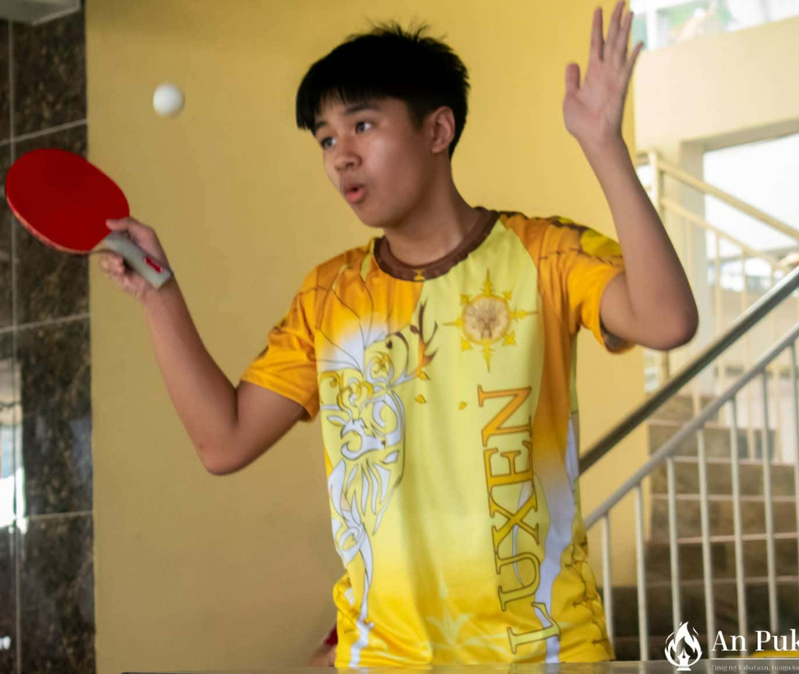
Members:
Cuddy Esmeres
Xymon Malquisto

Slide 3
Problem Statement
PSHS’s rigorous academic environment often leads students to compare test scores, causing stress, discouragement, and unnecessary competition. Puzzling Out Intelligence aims to reduce this pressure by using puzzles that highlight Gardner’s Multiple Intelligences, showing students that intelligence is diverse and not limited to academic grades.

Slide 4
Objectives:
1. To identify the user’s strengths across
the 8 Multiple Intelligences.
2. To reduce academic-grade pressure by showing that intelligence comes in many forms
3. To allow users to see which intelligences they can improve
4. To provide a simple, user-friendly puzzle test
5. To show that being “smart” is not just about grade, to make students feel more confident by letting them see their strengths, and to lessen stress, and pressure among them.

Slide 5
Why?
According to Howard Gardner (1983, as cited in Cherry, 2025), intelligence is not a one-size-fits-all concept. Gardner explained that people have multiple intelligences, meaning individuals solve problems and learn in different ways, not just through logic, math, or traditional academic skills.
This idea connects well with the PSHS STEM curriculum because students are expected to use different kinds of thinking. They analyze problems, think creatively, design experiments, communicate ideas, collaborate with others, and apply knowledge to real situations. Different students are strong in different areas, and PSHS encourages growth in all of these skills.

Slide 6
How?
Our project will create a program where the user can take a puzzle-based test. Each puzzle is designed to measure a specific type of intelligence based on Gardner’s theory. For example, logical puzzles measure logical mathematical skills, visual patterns measure spatial intelligence, word-based riddles measure linguistic intelligence, and so on.
As the user answers each puzzle, the system records their performance. After the session, the program calculates the user’s scores across all the different intelligences. This allows the system to identify which areas are the person’s strongest and which areas may need improvement.
The goal is to give students a clearer picture of their abilities, showing that their strengths may appear in many forms and are not limited to traditional academic scores.

Slide 7
Flowchart:

Slide 8
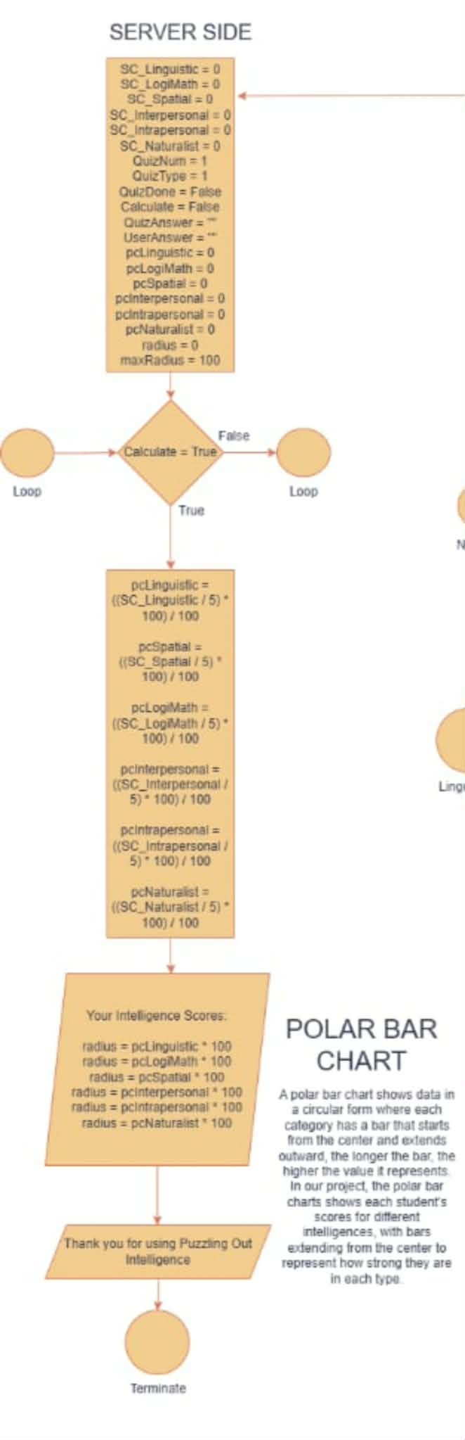

Slide 9
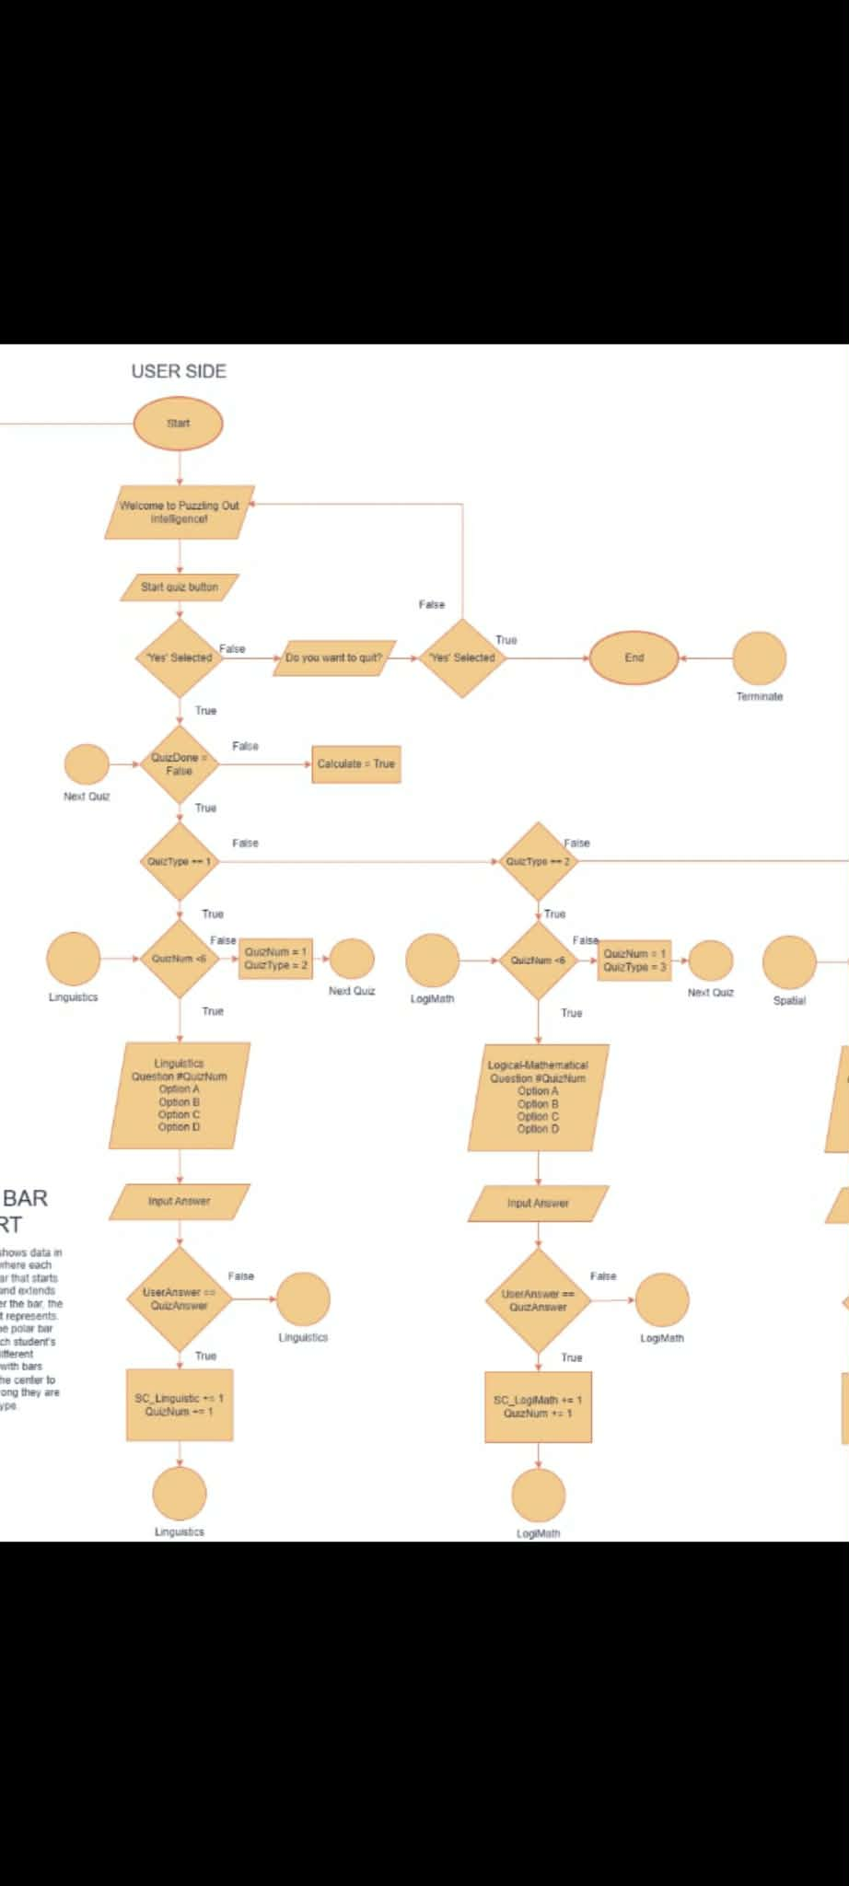

Slide 10
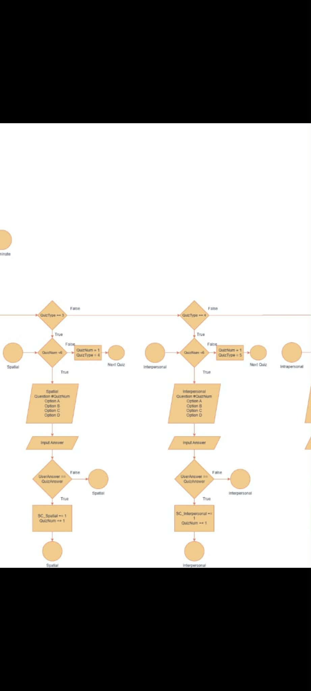

Slide 11
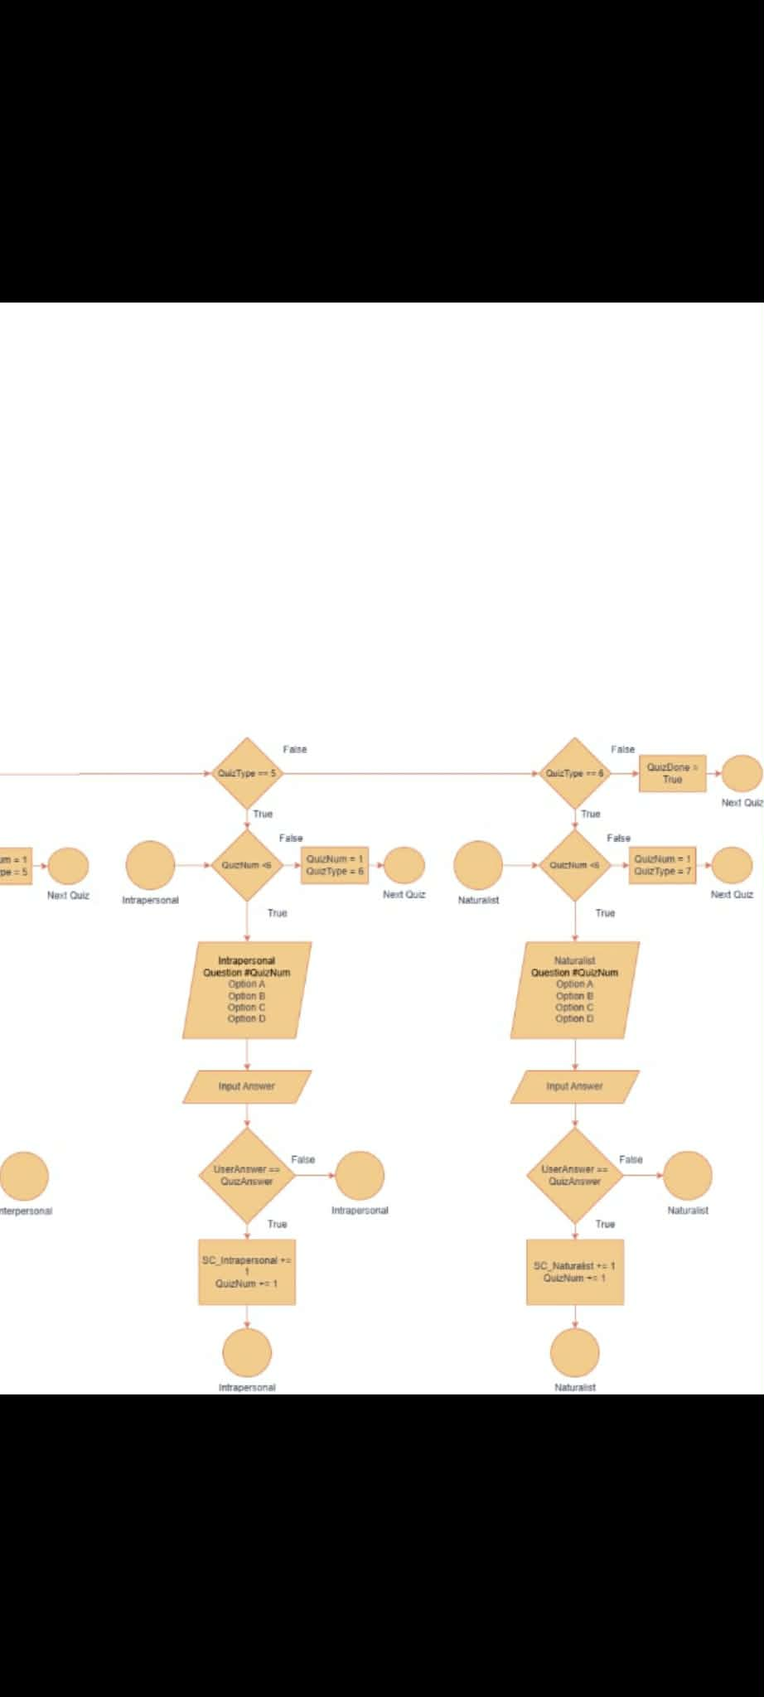

Slide 12
Example flow:
Title: Puzzling Out Intelligence
Username: Cuddy Esmeres
Date(MM/DD/YYYY): 11/26/2025
Puzzle 1 – Bodily-Kinesthetic Intelligence
Question: Which activity requires the most coordination? (A. Typing, B. Dancing, C. Sitting)
User Input: B
Correct!
...

Slide 13
Example Output:
Summary:
User: Cuddy Esmeres
Date: 11/26/2025
Results:
Logical-Mathematical Intelligence: 7/10
Linguistic Intelligence: 6/10
Spatial Intelligence: 9/10
Musical Intelligence: 4/10
Bodily-Kinesthetic Intelligence: 8/10
Interpersonal Intelligence: 5/10
Intrapersonal Intelligence: 6/10
Naturalistic Intelligence: 3/10
Thank you!

Slide 14
Sources:
Cherry, K. (2025). Gardner’s Theory of Multiple Intelligences. Verywell Mind.
Retrieved from: https://www.verywellmind.com/gardners-theory-of-multiple-intelligences-2795161
Philippine Science High School System. (2024). PSHS Curriculum 2024.
Retrieved from: https://pshs.edu.ph/pshs-curriculum2024/

