Slide 1
Strategic Interplay: Independent vs. Cooperative Multi-Agent Reinforcement Learning in 2-on-2 Soccer
Nelson Lin (nl2873)
Notes:
Welcome to my project where I will exploring how reinforcement learning algorithms are extended into the multi agent environment of 2-on-2 Soccergames

Slide 2
Overview
Multi-agent reinforcement learning (MARL) explores how interactions between coexisting agents affects their policies and behavior
Closely resembles real-world dilemmas, where there can be multiple actors in play at any point
i.e. autonomous vehicles, sports, economic markets, networks
Independent algorithms (i.e. DQN) tend to not perform well in multi-agent settings.
So implementing strategies (i.e. joint actions) to account for these complex interactions between dynamic actors is vital
Notes:
Multi-agent reinforcement learning (MARL) explores how interactions between coexisting agents affects their policies and behavior.
Multi agent environment closely resemble real-world dilemmas, such as autonomous vehicles, sports, economic markets, networks where there can be multiple actors working together or against one another at any stage.
Independent algorithms, such as the ones we have learnt in class tend to not perform well in multi-agent settings, since there are additional factors at play between cooperating and competing with the other agents in the environment.
Thus, implementing strategies to account for these complex interactions between dynamic actors is vital to improve learning.

Slide 3
Problem Statement
This project aims to discern the differences between single-agent algorithms (i.e. Deep Q-Learning), and multi-agent algorithms (i.e. Joint Action Learning).
Notes:
This leads to my project topic, applying deep reinforcement learning on a multi-agent scale. Specifically, through the research I aimed to experiment between single agent vs multi agent algorithms in MARL environments (i.e. SoccerTwos), discerning the differences in approach and how the policies of these agents evolve.

Slide 4
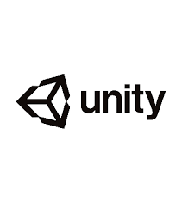
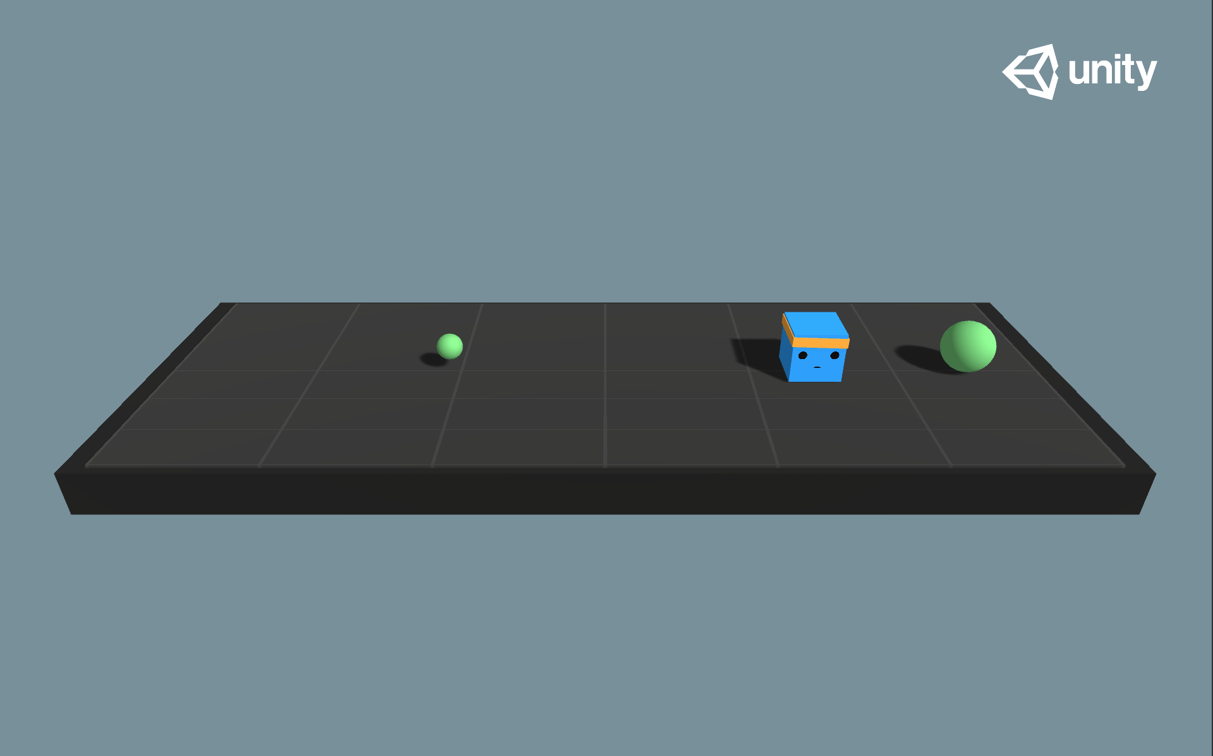
Project Environment: ML-Agents
Open-source project developed by Unity Technologies
Set within Unity’s game engine environment
Offers a set of pre-built environments and example projects to help developers get started quickly.
Tools for training, testing, and evaluating AI agents
Python API for integrating custom training algorithms
Notes:
The environment setting I used for this project is called ML-agents, which uses the Unity game engine library to create realistic simulations. The python API provides training and evaluation modules, as well as prebuilt trainers and visualizations for both single and multi-agent environments. The API also allows for integrating custom environments and training algorithms.

Slide 5
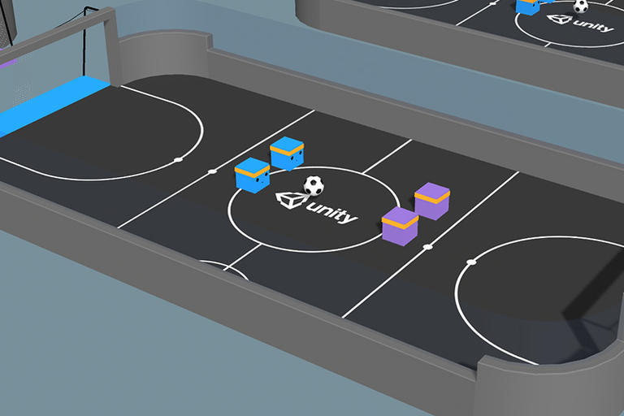
Project Environment: SoccerTwos
Set-up: Four agents competing in a 2 vs 2 soccer game.
Objective: Score the ball through opponent's goal while preventing them from scoring on own goal
https://github.com/Unity-Technologies/ml-agents/blob/develop/docs/Learning-Environment-Examples.md#soccer-twos
Notes:
The specific environment i will be using is called SoccerTwos, an example environment provided with the ML-Agents package. The set up is simple: 2 competing teams of 2 agents with an objective to score the ball in their opponents goal, while preventing conceding in their own goal.

Slide 6
SoccerTwos: Parameters
Observation Space
336 total units, that can represent 6 objects as well as object distances
264 forward-facing units, 11 ray-casts, spanning 120 degrees of rotation
72 backward, 3 ray-casts, spanning 90 degree
Action Space
Discrete actions
3 directions: forwards-backwards, sideways and rotation
Each agent originally had 8 distinct action branches, but was simplified for project
Reward:
Issued after every goal scored or episode end to each team
If goal scored: (1 - accumulated time penalty)
If goal conceded: -1
Other Parameters / Information
Ball scale, gravity
Notes:
The environment specifications are as follows: an agent has 336 observation values, with 254 of them representing forward-facing observations (or what each agent sees in front of them), and 72 backward-facing observations (or what they can see behind them)
The action space is discrete, meaning there are a finite number of values for each branch of actions. Each agent can choose between 3 options in each direction (forwards-backwards, sideways, rotation). Each direction is independent of the other. Initially, the environment allows for 8 distinct branches of actions, where an action constituted a shape of (8,3) which the environment would evaluate. But I chose to simplify this to ease the overall complexity, so the action tensor was shrunk to a shape of (1,3) instead.
The reward function is assigned after every scored goal or environment reset, with the goal scoring team receiving a varying reward dependent on how quickly the team was able to score, while the conceding team receiving a -1 reward
Then, there are also adjustable environment parameters such as ball size and gravity

Slide 7
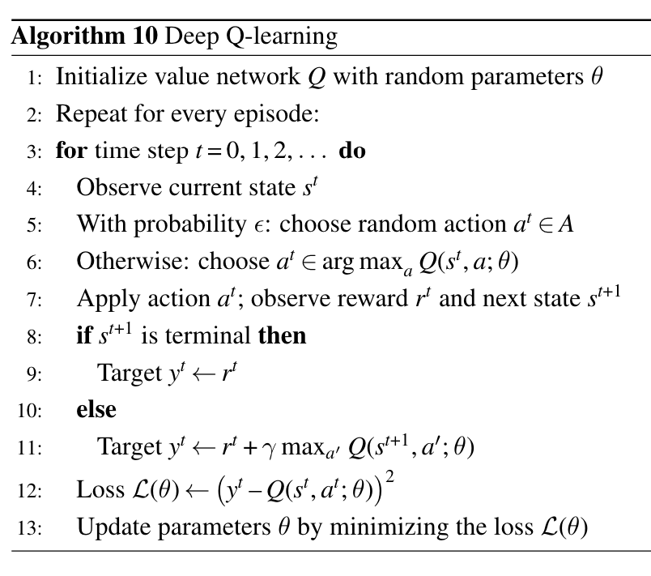

Algorithms: Deep Q Learning (IDQN)
Utilization of neural network (DQN) for value function approximation:
Experience replay
Epsilon-greedy exploration strategy
Goal: minimize loss function between Q value and expected reward
Loss Function:
DQN Pseudocode [2]
Notes:
Now, for the algorithms that I chose to implement and experiment with in this project
First, is independent Deep Q Learning, which we have learnt in class. As we are familiar with, DQNs are used to approximate the value function, Q. And using strategies such as experience replay and epsilon-greedy exploration, we apply gradient ascent on the loss function to improve the convergence to the optimal policy.

Slide 8
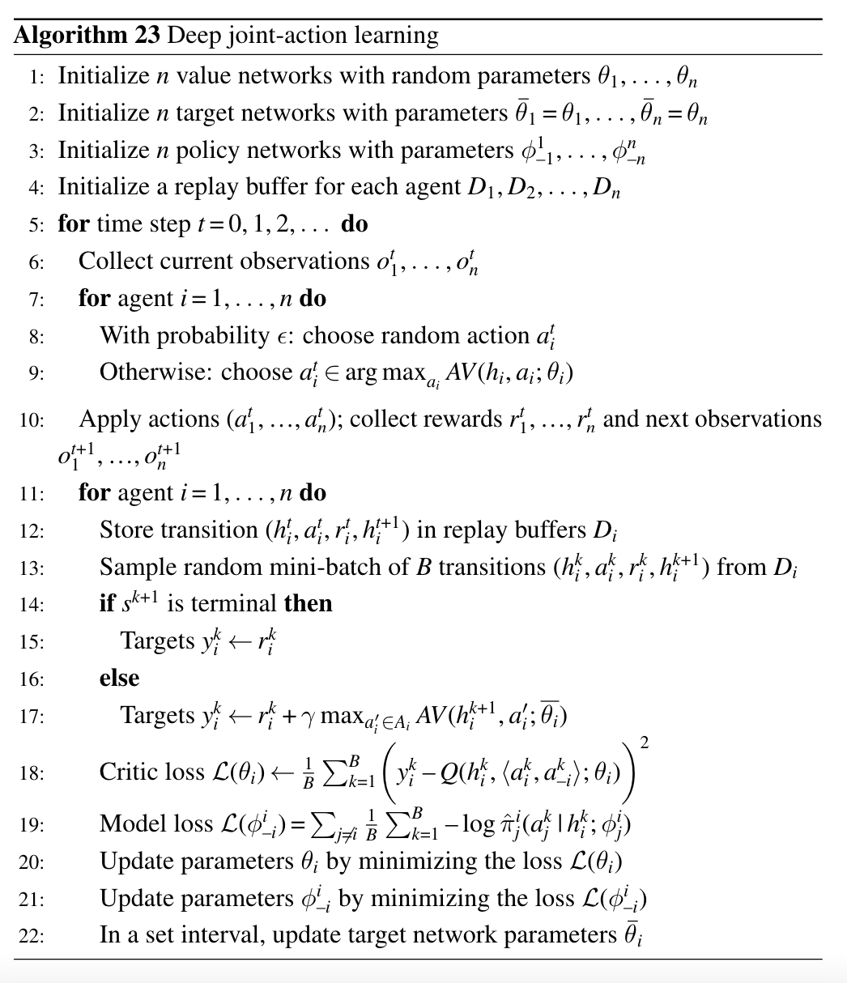
Algorithms: Joint Action Learning (JAL)
Similar approach to DQN
Uses experience replay and epsilon-greedy
But, value function is not based solely off actions of the current agent
Instead it attempts to learn a joint-action value function conditioned on the actions taken by every agent at a given time step
JAL Pseudocode [2]
Notes:
But, as I mentioned before, independent learners struggle in multiagent environments, since it is harder for them to grasp the dynamics of having multiple profit-maximizing agents in the environment.
Thus, as a proposed solution was introduced, which procedurally, follows similarly to DQN, such that it also utilizes experience replay and exploration strategy in learning.
But the key difference, is its ability to model the value function with respect to the policies of other agents in the environment, as opposed to just its own.
This concept of conditioned learning on a combination of agent actions, is called Joint Action Learning

Slide 9

Joint Actions
Each agent, i, estimates the policy of the other agents, j, parametrized as:
This can be done by modelling each policy, with parameters,
Then, we can generate a probability distribution of each agent’s action at any given state, and using that to evaluate a greedy action:
Notes:
In theory, a joint action learner of agent, i, models the policies of each of the relevant agents, j, in the environment, creating a set of model parameters phi(i of j). This model represents the action probabilities of agent j given state.
Then, the target model is expanded to include values for all combinations of joint actions at a state, and evaluates an expected Q-value using these probabilities.
Then the agent is able to greedily select its own action, and perform gradient ascent as normal.

Slide 10

Joint Actions
But, a problem arises: this method scales poorly as the number of agents (or even the action space) increases
A solution was found where the general probability distributions can be bootstrapped by using actions from history
Sample a fixed number K joint actions, and compute the expected Q values:
[2]
In some cases, this converges faster and performs better than the original [2]
Notes:
But, a problem arises, where this method does not scale well as the agent or action spaces increase, since the model’s parameters would increase exponentially.
Instead, we can bootstrap a general probability distribution by randomly sampling from the environment’s action history (or from experience replay).
In some applications, this method actually performs better than the directly calculating the probability distribution, due to the model learning a generalized distribution and additional noise lead to more robust learning

Slide 11
Methodology
IDQN
Each agent has a unique replay history
Allowing them to learn their own Q-values
The environment gets an action from every agent before taking a step
Then individual transitions and rewards are distributed to each agent
JAL
Each agent has a unique replay history
But, this buffer also includes actions of other agents as well.
For this project, only the actions of agent’s teammates are added to the buffer
So, each agent only explicitly learns to cooperate
Evolutionary strategy: updates each agent to the best performing one at defined intervals
Notes:
Now, for the implementation of the algorithms.
For DQN, each agent maintains its own model and replay buffer, allowing them to learn their own unique Q-values. Then, at every time step, the environment queries each agent for an action before transitioning. Finally, individual transitions and rewards are distributed to each agent.
JAL follows mostly the same procedure, except the replay history now also includes the action histories of other agents as well. In this project, I only included on actions of the agent’s teammates, to improve the efficiency of the algorithm. So each agent is tasked with learning to cooperate and not compete
Lastly, in addition to these algorithms, I also included an evolutionary strategy in both algorithms, which updates the models of all agents to the best performing one at a defined interval

Slide 12
Methodology: Hyperparameter Setting
episodes: 50000
epsilon strategy: adaptive decaying epsilon from 1 to 0.001
learning_rate: 0.0005
gamma: 0.99
model updates: every 256 actions
target model updates: every 1000 actions
generation updates: every 100 episodes
replay batch size: 128
replay max. memory: 10000
state done penalty: 0
Notes:
These are the hyperparameters chosen for both algorithms. I chose to fix these settings between both to ensure a control during training, which would help with analysis during evaluations

Slide 13
Methodology: Experiments
IDQN
Trained for 4502 episodes, 580000 time steps
JAL
Trained for 11233 episodes, 1367000 time steps
IDQN vs JAL
Tested against each other for 100 episodes
Notes:
In terms of training, the independent DQN was trained for 4502 epochs while the JAL was trained for 11233. I allowed the JAL agent to train for longer to see if it would converge to better results.
For testing, I deployed teams of each agent to compete against the other for 100 episodes, and collated the rewards.

Slide 14
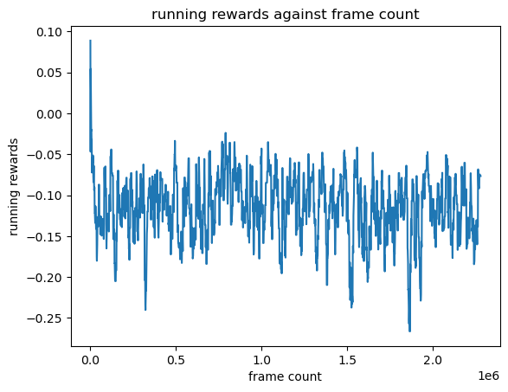
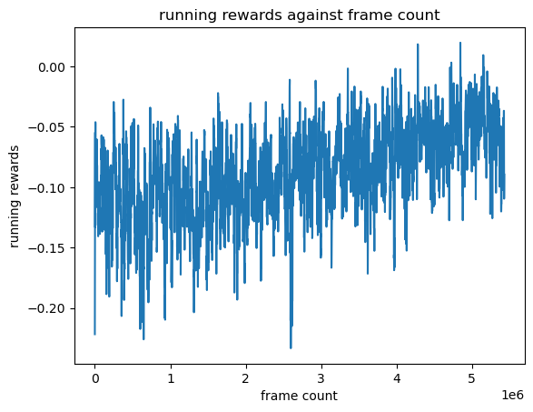
Results: Running Rewards
IDQN
JAL
Notes:
30s

Slide 15
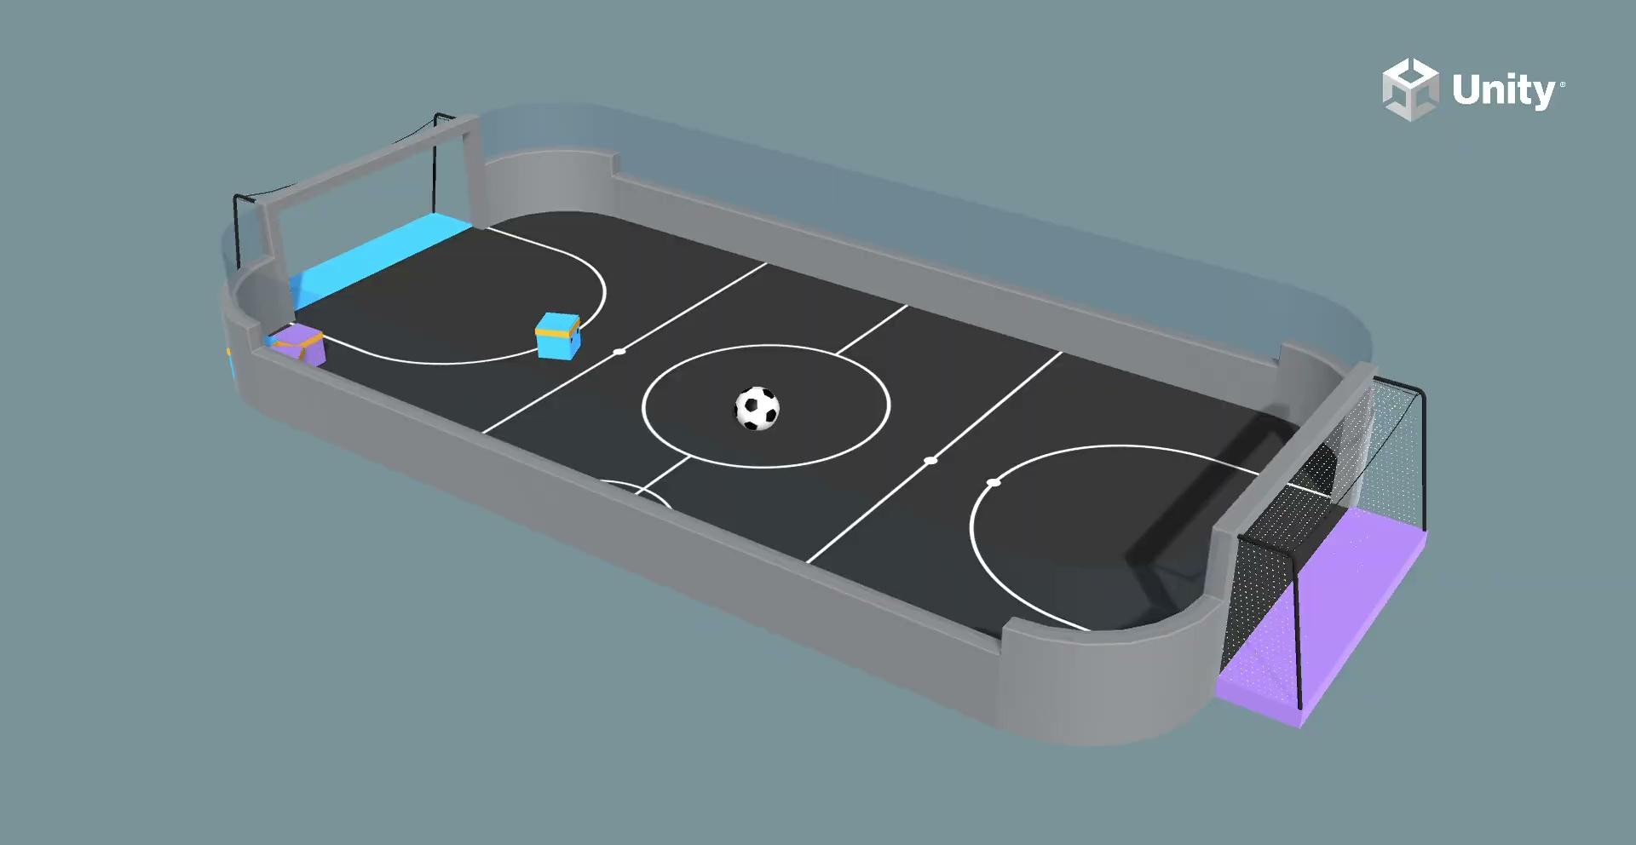
Results: DQN vs JAL
Notes:
30s

Slide 16
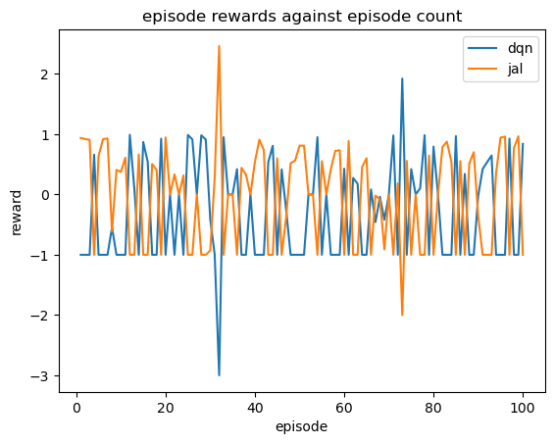
Results: DQN vs JAL
Total Rewards (over 100 episodes):
DQN = -29.311
JAL = -4.717
Notes:
Over the 100 episodes of testing, JAL was able to accrue a more rewards than DQN, but, as it can be seen in the demo, that may not explain the whole story,

Slide 17
Discussion: Analysis
Visually, the movements of the JAL agent are more controlled, while DQN’s are more erratic
JAL quantitatively performed better both in a standalone test and head-to-head against DQN
Could be attributed to the learning of joint actions between teammates
Yet, both models still exhibit random movements for a majority of testing.
Notes:
When examining the testing process, the JAL agents looked to be more controlled, while DQN’s were stronger and more erratic
While JAL performed better quantitatively in terms of training rewards and the competition against DQN, visually, the majority of movements exhibited by both agents were random and noisy. This could indicate a failure of convergence to optimal policies

Slide 18
Discussion: Improvements
Longer training time: since positive rewards are very sparse, it might benefit the model to train for longer
Removing simplifications made to environment and models
Using other (or all) agents in Joint Action approximation
Utilizing full range of actions
More comprehensive hyperparameter search
Experiment with improving the existing algorithms: Double-DQN
Exploring more complex NN architectures: RNNs [1]
Notes:
To solve this, I believe that a longer training time could benefit both learning agents, to allow the models to converge. This is due to the fact that rewards are so sparse, due to only being assigned at the end of episodes, the agent needs more time exploring to better learn an appropriate policy.
In the same reasoning, using Recurrent Neural Network would also improve learning, since this would allow for multiple time steps to be passed into the model for a more comprehensive output.
Other improvements I would perform would be to remove the simplifications I modified within the environment, such as using joint actions of all agents (to learn both cooperation and competition), as well as allowing for full range of actions. This would allow the agent to learn a more complex policy which could lead to better performance. The only limitation for these is that they would require more processing power
Finally, using a unique hyperparameter search for each algorithm, and involving improvements to each, such as Double-DQN, would also help to improve performance.

Slide 19
Discussion: Future Steps
Comparing other single vs multi-agent algorithms: Actor-Critic
Exploring other multi-agent algorithms: V-Learning, Value-Decomposition Networks
Exploring single agent algorithms: PPO (has shown promise in MARL)
Notes:
I have learnt a great deal on the topic of multi-agent learning and how strategies can be executed to extend single agent algorithms into a multi-agent space.
In terms of future steps I would like to take past this project, are comparing other algorithms and strategies between the single and multi-agent worlds, such as Actor-Critics.
Also, researching into multi-agent algorithms such as V-Learning and Value Decomposition Networks would be incredibly enticing.
Finally, there is also promise in single agent strategies such as Proximal policy optimization, which could also extend my learning in the field.

Slide 20
References
[1] J. Posor, L. Belzner, A. Knapp. "Joint Action Learning for Multi-Agent Cooperation using Recurrent Reinforcement Learning," in *Digitale Welt*, vol. 4, pp. 79-84, 2020.
[2] S. Albrecht, C. Filippos, L. Schäfer, *Multi-Agent Reinforcement Learning: Foundations and Modern Approaches.* MIT Press, 2024.
[3] Mnih, V., et al, "Playing Atari with Deep Reinforcement Learning," 2013.
[4] Wong, A., et al, "Deep Multiagent Reinforcement Learning: Challenges and Directions," 2022.
[5] A. Hafiz, G. Bhat, "Deep Q-Network Based Multi-agent Reinforcement Learning with Binary Action Agents," 2020.

