Slide 1
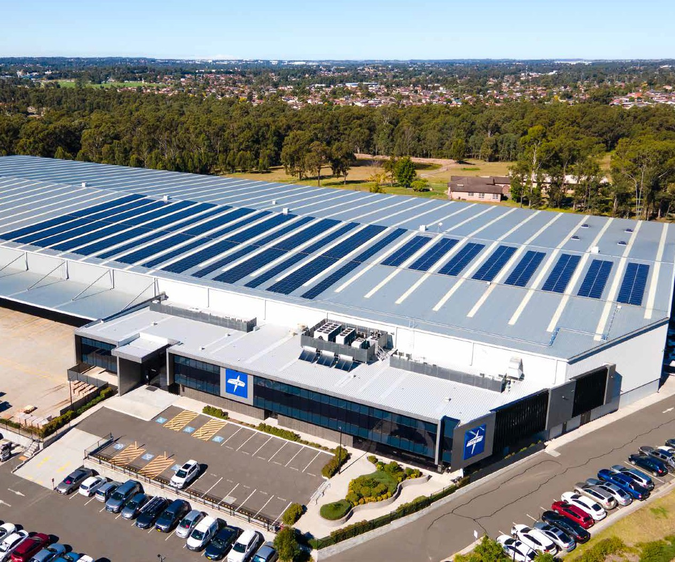

2,000.0 kWp SOLAR
PROPOSAL
CUSTOMISED FOR
PREPARED BY
Etex Australia Pty Ltd
290 Bushmead Road, HAZELMERE, WA 6055, Australia
Clement Doudet
+61410569860
DATE PREPARED
26/08/2025

Slide 2


OUR STORY
In a world where rising energy costs and tightening margins are pressuring businesses, Kuga Energy is leading a revolution. Like the relentless cougar, we’ve spent years pushing the boundaries of energy innovation, business optimisation and vertical integration to deliver unmatched value to our clients.
Driven by a passion for renewable energy, our team is committed to making a real impact on the businesses we work with everyday. This fierce pursuit of performance and exceptional service has fueled Kuga’s growth into one of Australia’s largest independently owned commercial energy companies.
With a strong presence across Australia, New Zealand, Philippine's and China, we perfected our value proposition, streamlining every aspect of our operations to deliver powerful results every time.
At Kuga Energy, we go beyond sustainability; we give businesses the power to take control of their energy future, embrace cutting edge technology, reduce costs and reinvest in their growth. Our commitment to energy innovation is a commitment to your success.
That’s why, in an era where market volatility is present with rising costs and energy transformation pressures, Kuga Energy ensures your business not only remains competitive but leads the pack.
01

Slide 3











YOUR GO-TO ENERGY PARTNER, WITH PROVEN RECORDS
5000+ Commercial Projects!
top
5
Top 5 Volume Retailer 3 Years in a Row in C&I Market
Multi Award Winning Company
Industry-Leading Safety, Environmental and Quality Management System
Global Access to Supply Chains
ISO Certified Management System
02

Slide 4
SOLAR PROPOSAL | KUGA ENERGY
EXECUTIVE SUMMARY
FINANCIAL SUMMARY
2,000.0 kWp DC Solar
1,600 kW Solar Inverter
This proposed solar solution offers the below est. key metrics:
Energy Independence: 31.4%
First Year Earnings: $473,542
Net Upfront Costs: -$2,400,000
Simple payback period: 5 years
Your cutting-edge solar and battery configuration will offset a remarkable 1,470.6 tonnes of CO2 emissions per year – a feat equivalently impactful as 3,382.4 unburned barrels of oil and growing 24,265.0 tree seedlings for 10 years.
RECOMMENDATIONS
The rooftop has the capacity to host up to 5 MW (subject to structural assessment).
However, based on your load profile, the optimal system size is around 2,000 kW DC, which allows most of the energy to be consumed on-site, with only about 14% exported to the grid, primarily during summer.
The price provided is a ballpark estimate, calculated at $1,200 per kWp.
NEXT STEPS
We would recommend that early works is undertaken to confirm:
* Structural suitability
* Grid connection cost and timeline.
* Onsite connection point(s)
03

Slide 5


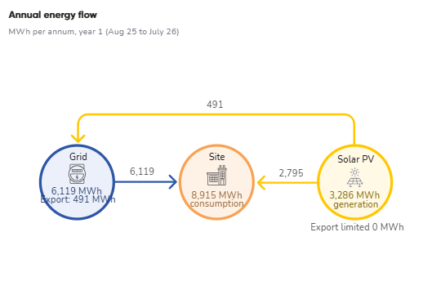
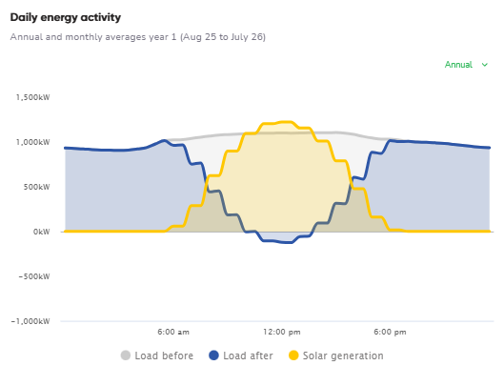
SOLAR PROPOSAL | KUGA ENERGY
SYSTEM PERFORMANCE
SOLAR
07

Slide 6

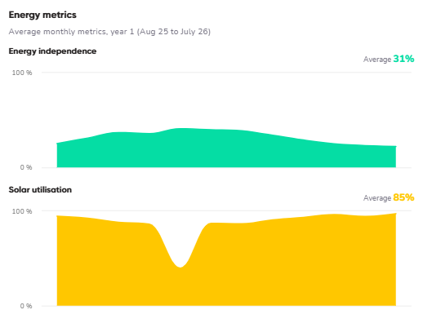
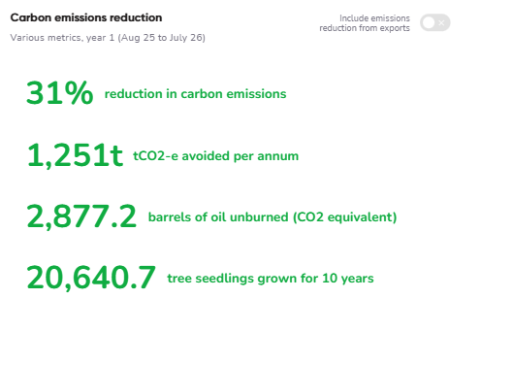
SOLAR PROPOSAL | KUGA ENERGY
ENERGY CONSUMPTION
ENERGY INDEPENDENCE
CARBON REDUCTION
08

Slide 7
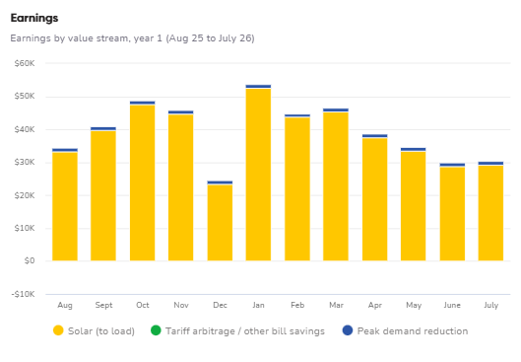
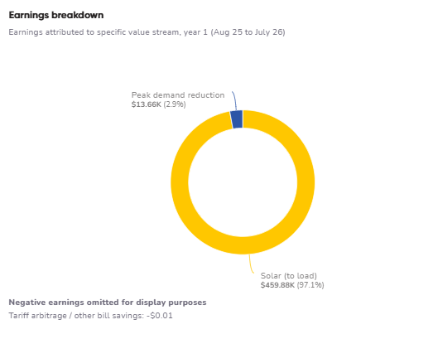
SOLAR PROPOSAL | KUGA ENERGY
EARNINGS
EARNINGS
$
EARNINGS BREAKDOWN
$
13KUGA.COM.AU
09

Slide 8

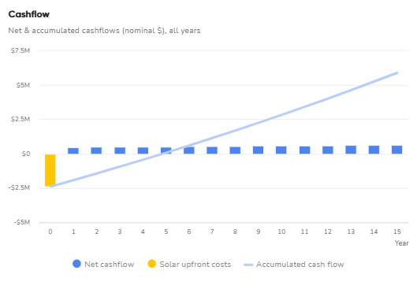
SOLAR PROPOSAL | KUGA ENERGY
FINANCIAL SUMMARY
$ OUTRIGHT PURCHASE
ROI
SAVINGS PER YEAR
RETURN OF INVESTMENT
$473,542
5 years
11

Slide 9
SOLAR PROPOSAL | KUGA ENERGY
PROJECT COST
QUOTE ID
4958805
DATE
26/08/2025
AUTHORISED PERSON
Etex
QUOTATION
Procurement, delivery, installation, commissioning and monitoring of 2,000.0 kWp / 1,666.7 kW Solar for Etex Australia Pty Ltd at 290 Bushmead Road, HAZELMERE, WA 6055, Australia.
Item description | Total (ex GST)
Solar panels, inverter, wiring, installation | $2,400,000
Siteworks | Included
Total | $2,400,000
THIS QUOTE IS VALID TILL
Company Name:
Etex Australia Pty Ltd
Company Address:
290 Bushmead Road, HAZELMERE, WA 6055, Australia
10

Slide 10
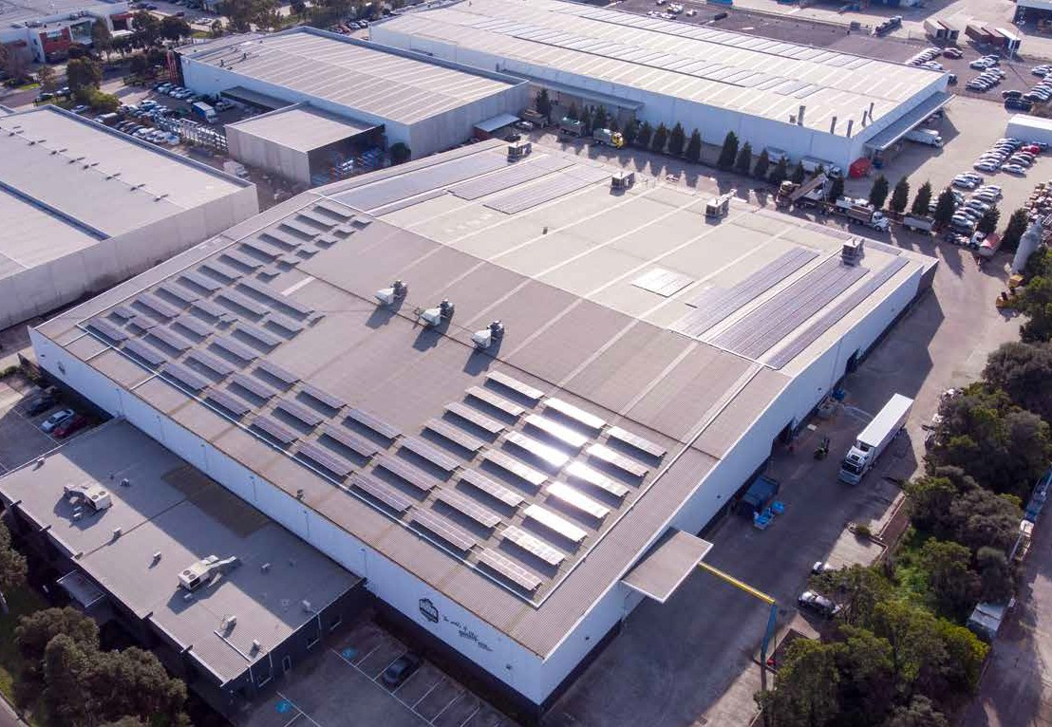



SOLAR PROPOSAL | KUGA ENERGY
RECENT INSTALLS
525 kW
DELLA ROSA FRESH FOODS
This commitment earned the company the prestigious 2019 "Energy Efficiency Project of the Year" award from Master Electricians. An annual performance review revealed that actual production exceeded estimates by 2%, enabling the company to save nearly $13,000 in energy costs each month.
The facility boasts state-of-the-art production systems, featuring cold storage and chilling units that operate 24/7, ensuring uninterrupted service. Their extensive product offerings include dairy, fresh meats, deli items, seafood, and branded grocery products.
Their energy-efficient installations generate an average of 606.204 MWh daily, leading to an impressive reduction of 673.879 tonnes of carbon dioxide emissions annually.
Annual Solar Generation
606.204 MWh
CO2 Savings
673.879 Tonnes
13

Slide 11
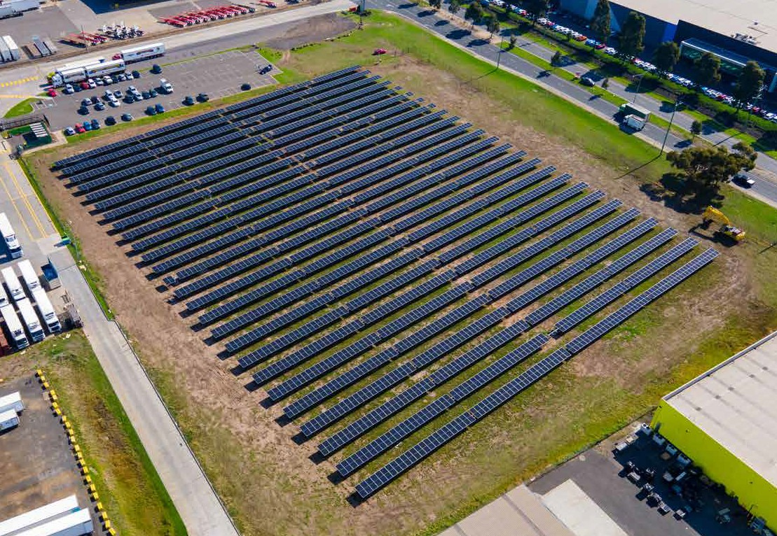
SOLAR PROPOSAL | KUGA ENERGY
RECENT INSTALLS
1.56 MW
AMERICOLD LAVERTON
Americold chose Kuga Energy as their Engineering, Procurement, and Construction (EPC) partner to address the challenge of expanding solar capacity by utilizing the vacant land adjacent to the main road. The primary objective was to maximize solar production while maintaining peak efficiency. Furthermore, tomeet the energy demands of Americold operations, a solution was needed that could susbstantially enhance solar yield.
KUGA’s solution was to develop a cutting-edge 1.56MW singl-axis tracking ground mounted system, which significantly enhances solar by approximately 30%. This solar installation is projected to deliver a 2608MWh of clean energy annually to the site, significantly reducing 2597 tonnes of carbon footprint. By completing all elements of the civil, electrical and mechanical works in-house and with KUGA’s own assets, the return of the project was able to hit the metrics set by Americold.
Annual Solar Generation
606.204 MWh
CO2 Savings
673.879 Tonnes
14

Slide 12
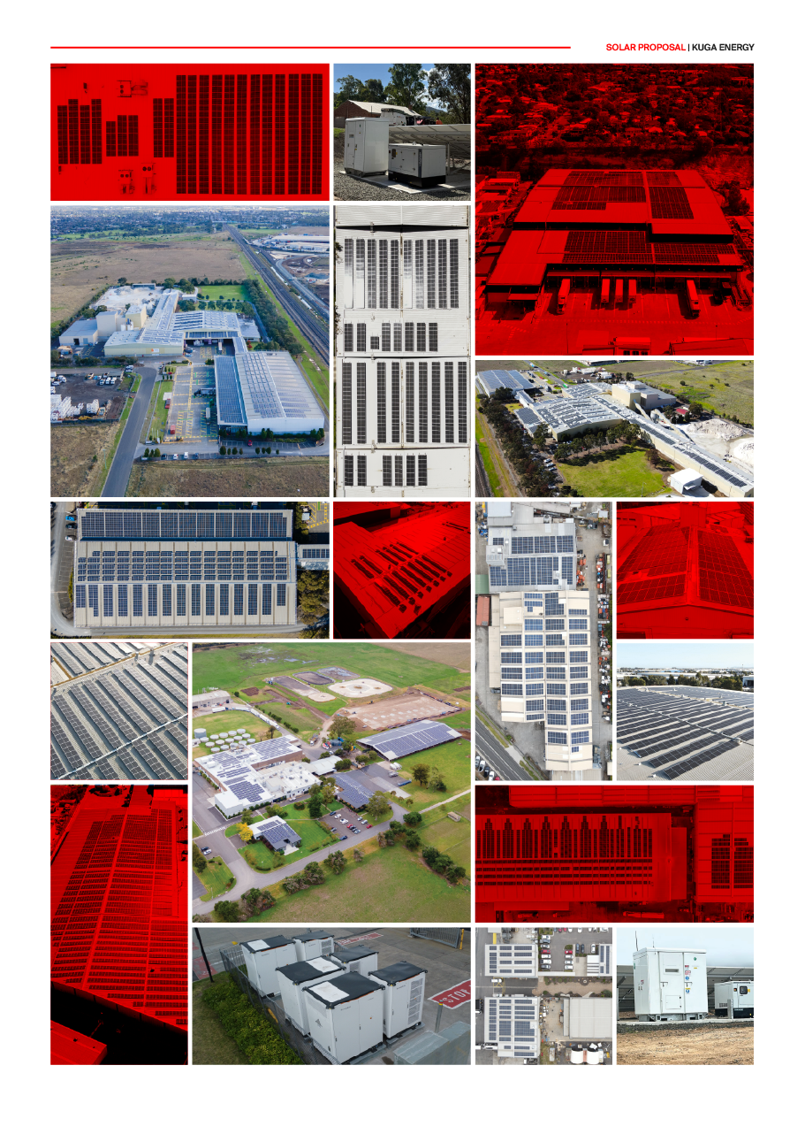
SOLAR PROPOSAL | KUGA ENERGY
15

Slide 13
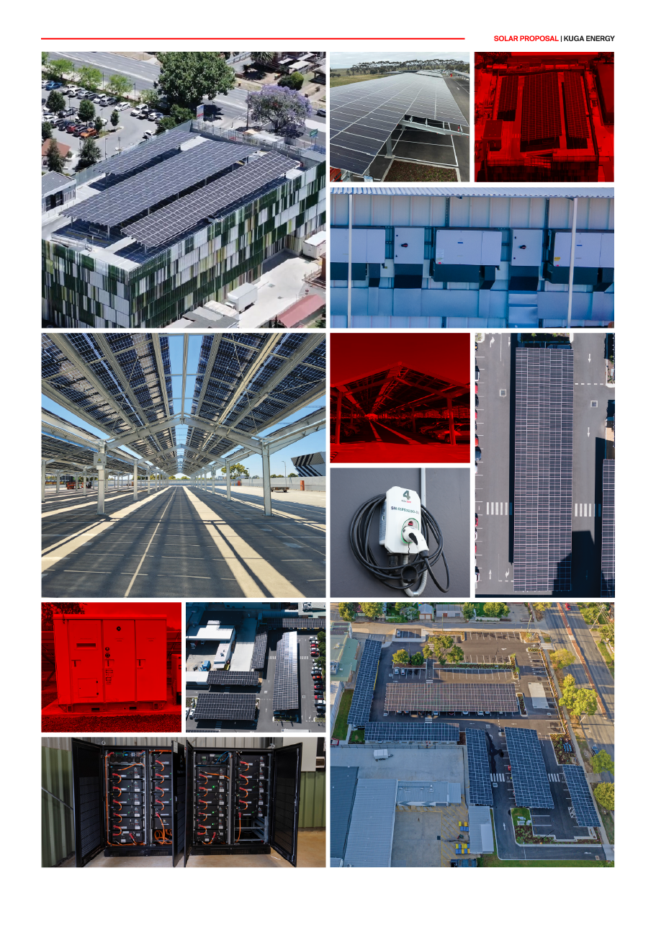
SOLAR PROPOSAL | KUGA ENERGY
16

Slide 14












SOLAR PROPOSAL | KUGA ENERGY
KUGA ENERGY AWARDS
17

Slide 15
13 58 42
13KUGA.COM.AU

