Slide 1
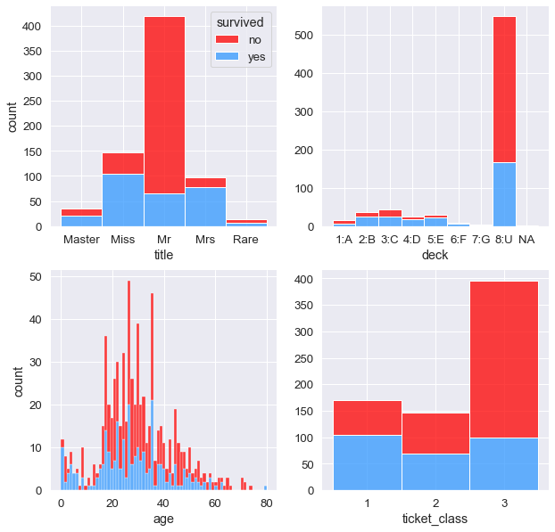
title : most of the passengers were men (dominant Mr. + Master) and most of the Mr. class died.
deck: deck 8:U, which is the level that could not be parsed from the original data’s Cabin number, dominates the death count.
age: most passengers aged 60 or above perished while many children, 6 years or younger, survived.
ticket class: travelers with a 1st or 2nd class ticket had a much better chance for survival than did those with 3rd class tickets.

