Slide 1
An AI Assistant Plugin for IntelliJ IDEA — MyPilot
陈艺龙-2352359 徐云鹏-2353583 李雪菲-2354093
2025/11/11

Slide 2
Agenda
1.
Team Member Particulars
2.
System Functionalities and Features
3.
System Technical Details and Design
4.
Simple User Manual

Slide 3
Team Member Particulars

Slide 4
Team Composition and Roles
Xu Yunpeng (2353583)
Focused on core architectural design and implementation for EditService;
Chen Yilong (2352359)
Focused on infrastructure layer implementation for RagService;
Li Xuefei (2354093)
Led UI design, view-layer components, and user manual documentation;

Slide 5
System Functionalities and Features
F0 + F2

Slide 6
Core Functionality: Teaching Assistant Q&A (F0)
A retrieval-augmented generation(RAG) system enabling accurate, context-aware, and traceable responses based on course materials
1
  Support for Multiple File Formats
3
  Coexistence of Two Knowledge Base Sources
5
  Persistent Multi-round Dialogue Management
pptx, ppt, doc, docx, txt, pdf, md
Static materials embedded in the JAR package and user-uploaded files
Maintains full dialogue history within sessions, enabling multi-turn interactions
2
  Multiple Embedding Service Options
4
  Top-k Most Relevant Knowledge Fragment Retrieval
6
  Context-aware Questioning via Editor Menu
Alibaba Cloud DashScope&
Zhipu AI embedding services
Enables customizable retrieval parameters (relevance threshold and top-k)
Right-click to select code in editor and ask questions directly
Notes:
Accepts diverse input formats including pptx, ppt, doc, docx, txt, pdf, and md, allowing flexible uploading of various course documents
Enables customizable retrieval parameters (relevance threshold and top-k); enforces maximum threshold of 0.5 to ensure high-quality results
Combines static materials embedded in the JAR package (automatically parsed on first launch) and user-uploaded files

Slide 7
Extended Feature: Professional Code Modification (F2)
LLM-Driven Code Refactoring & Remediation
Atomic Operation Enforcement via JSON Output
Executes complex tasks like design pattern application and bug fixing based on user-provided natural language commands
Requires LLM to return modifications in strict JSON format with defined action types (REPLACE, INSERT, DELETE), enabling reliable parsing and execution
Advanced AI-driven functionality
Structured Code & Dialogue Context Engine
Cross-File and New File Creation Capability
Analyzes selected code and project context (class, method, path) and integrates it with dialogue history into a structured prompt for precise understanding
Facilitates creation of new classes or files by specifying virtual URLs and full content in "newCode" field during INSERT operations
Boundary Integrity and Syntax Safety Rules
Built-in Diff Viewer Approval Workflow
Ensures generated code does not break existing logic or syntax, maintaining program correctness and compilation integrity post-modification
Enforces mandatory line-by-line review using IntelliJ IDEA's built-in Diff Viewer before any change is applied, ensuring safety and transparency

Slide 8
RAG Data Storage and Structures
DocumentChunk Data Model
ChatMessage and ChatSession Models
Fundamental unit containing text content, embedding vector, source metadata, page number, and similarity score for retrieval ranking
ChatMessage holds individual message content, type, timestamp; ChatSession aggregates messages and code contexts for session continuity
1
2
FileInfo Metadata Structure
Document Processing Architecture
Definition of key data entities
Stores file-level metadata including name, source type, and chunk count, used for UI display and deletion operations
Format-specific processors (PPT, PDF, DOC, TXT, Markdown) implement common interface for unified ingestion pipeline
4
3
CodeContext Object Design
Vector Database Storage Using Lucene
Captures filename, language, selected code text, and line numbers to provide precise code context for AI processing
Employs Apache Lucene as vector database with KnnFloatVectorField for efficient KNN search and TextField for auxiliary full-text lookup

Slide 9
Key Algorithms and Supporting Techniques
Algorithmic implementations critical to performance, accuracy, and reliability of the system
Document Chunking Algorithm
Asynchronous Request Processing Pipeline
Splits documents by structural units: slides (PPT), pages (PDF), paragraphs (DOC), lines (TXT), headings (Markdown)
Parallelizes time-consuming operations (retrieval, context building) while synchronizing final assembly for consistency
Vector Retrieval Algorithm
Dynamic Template Selection Strategy
Uses cosine similarity and KNN search in Lucene to find top-k most relevant document chunks given a query vector
Chooses appropriate prompt template branch based on presence of code context, knowledge chunks, and session history
Similarity Threshold Filtering Logic
Structured 6D Context Compression Algorithm
Filters out low-relevance results (< threshold, default 0.3, capped at 0.5) to prevent noise in answer generation
When context exceeds limit, delegates summarization to LLM using six dimensions: Context, Decision, User Goal, Results, Unsolved, Plan

Slide 10
System Technical Details and Design

Slide 11
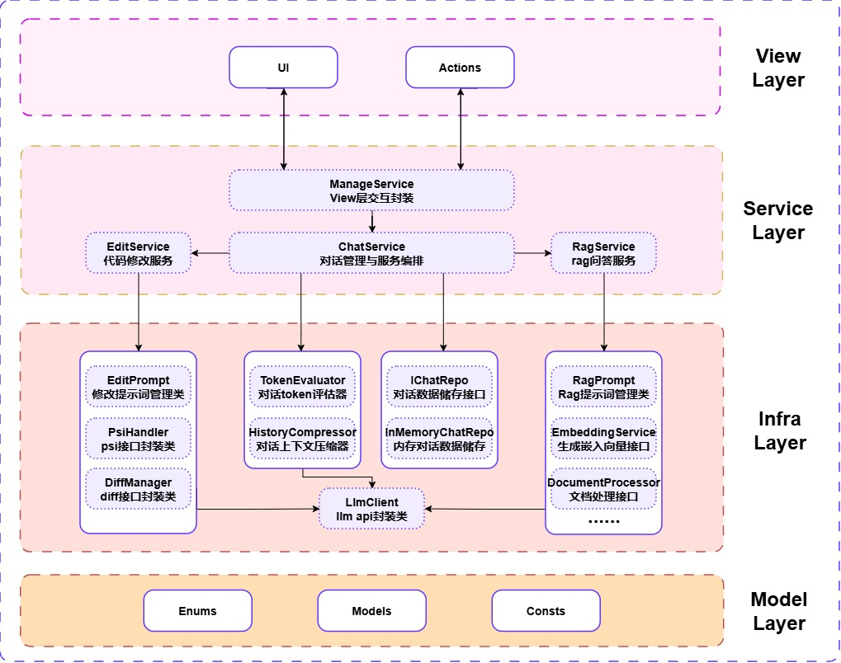
System Architecture and Components
The project adopts a Four-Layered Architecture design, ensuring robust modularity, clear separation of concerns, and high maintainability.
Notes:
ManageService Acts as the bridge between the View and Service Layers, handling complex UI state management, coordinating services, and routing Action requests to the correct business service.
ChatService The core of this layer
(1)create update read delete chat session by ChatRepoInterface, so that manage the life cycle of multi-turn dialogues
(2)Based on the provided Chat Option, it will choose whether to invoke RAG or the Edit Service, and provide necessary code context, chat context and user instruction for them
(3)use TokenEvaluater to evaluate current token usage, when it reach the token threshold, History Compressor will be invoked to compress the chat context into 6-dimension summary
RagService Implements the RAG pipeline, which contains many rag infrastructure
EditService Implements the core logic for the F2 Extended Feature.

Slide 12
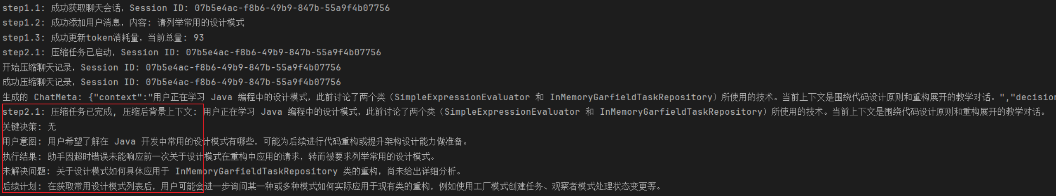
General Workflow for Rag
Trigger and Routing
Structured Extraction
1
User inputs a question via the chat UI or uses the right-click context menu with selected code. ManageService receives the request and routes it to ChatService.
ChatService calls PsiHandler to extract the complete structured context of the current code (class, method, path, etc.).
2
Coordinated by the central
ChatService
Result Presentation
Context Evaluation&Compression
6
Upon LLM response, ChatService adds source citation information and updates the UI via ManageService, achieving an asynchronous non-blocking display .
ChatService retrieves history via IChatRepo and triggers TokenEvaluator to check context token usage. HistoryCompressor executes the Structured 6D Compression as required.
3
Asynchronous LLM Call
Knowledge Augmentation
ChatService sends the final prompt to LLMClient. LLMClient executes a CompletableFuture-driven asynchronous API call
ChatService delegates the query to RagService. RagService calls EmbeddingService to retrieve Top-K knowledge chunks and dynamically constructs the RAG prompt using RagPrompt.
5
4

Slide 13
General Workflow for Edit
Trigger and Instruction
Structured Evaluation
1
User initiates the code modification process via an Action, inputting instructions. ManageService routes the request.
ChatService calls PsiHandler to extract the complete structured context of the current code (class, method, path, etc.).
2
Coordinated by the central
ChatService
Code Application&Presentation
Context Evaluation&Compression
6
Only after user approval, EditService calls the IDEA API to atomically apply the modifications
(Same as Rag)ChatService evaluates and compresses dialogue history.
3
Mandatory Review Mechanism
LLM Request&Parsing
EditService sends the operation list to DiffManager. DiffManager calls the IntelliJ IDEA Built-in Diff Viewer, mandating user review and approval
EditService embeds the instruction, dialogue context, and code context into EditPrompt, and sends it to LLM，then it returns a JSON response containing an atomic operation list
5
4

Slide 14
LLM Integration and Prompt Engineering
Sophisticated strategies for interacting with large language models
6
5
Role-Based Prompt Personalization
4
Six Core Execution Rules for Safe Code Changes
Assigns different personas: “Professional Java Teaching Assistant” for RAG, “Experienced Java Developer” for code editing
3
Enforced JSON Output Schema
Includes exact line matching, character-level old code replication, newline formatting, atomic operations, file path handling, and boundary integrity
2
1
Edit Service Prompt Structure
Mandates specific schema including `explanation`, `actions` array with `type`, `filePath`, `startLine`, `endLine`, `oldCode`, `newCode`
RAG Service Prompt Construction
LlmClient API Wrapper Design
Enforces highly constrained format requiring LLM to return only valid JSON patches
Composes prompts dynamically with system role, knowledge chunks, code context, session history, and user question
Provides unified asynchronous interface (`chatAsync`)

Slide 15
Simple User Manual
Step-by-step guide for installing, configuring, and operating the MyPilot plugin

Slide 16
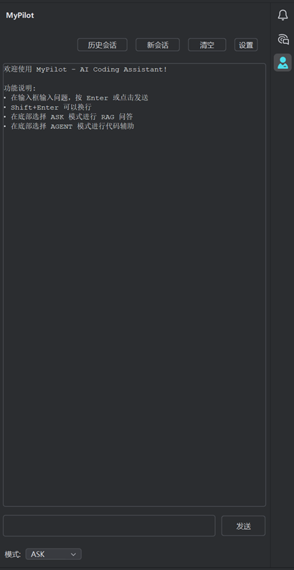
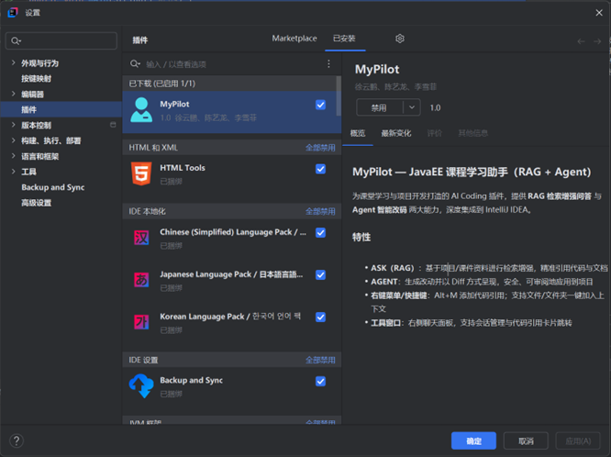
Plugin Overview
Integration in IntelliJ IDEA
Accessible via right-side tool window, editor right-click menu, and settings panel (Settings → Tools → MyPilot)
Core Capabilities
Offers two primary modes:
ASK (RAG-based Q&A)
EDIT (AI-assisted code modification),
both integrated natively into the IDE environment
How to Use
Users can interact through chat interface, context menus for a seamless development experience
Notes:
ASK:Designed for retrieving precise information from course materials such as API usage explanations, code examples, and concept clarifications.
EDIT:Intended for performing significant code changes like refactoring, debugging, and optimization with full review capability before application.

Slide 17
Installation & Environment Requirements
Required IDE Version
IntelliJ IDEA 2023.1 or later
Required JDK Version
Require
Env.
Requires JDK 21 to run due to library dependencies used in the implementation
Network Connectivity Requirement
Needs internet access to reach configured LLM and embedding service endpoints (e.g., DeepSeek, DashScope, Zhipu)

Slide 18
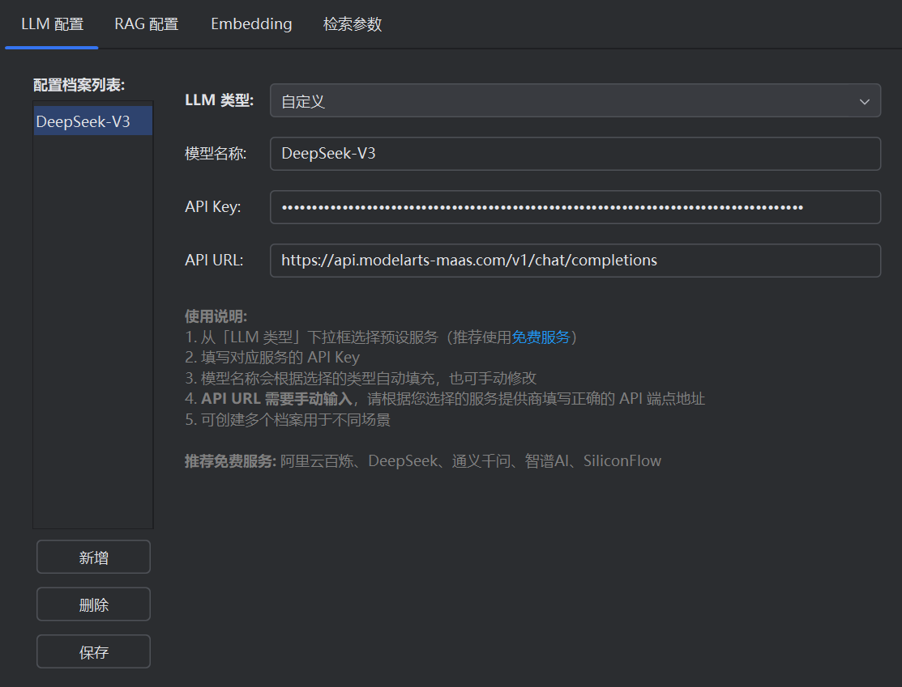
First-Time Configuration
Several instructions for initial setup before using MyPilot
LLM Configuration
Requires entry of API Base URL, API Key, and Model Name;

Slide 19
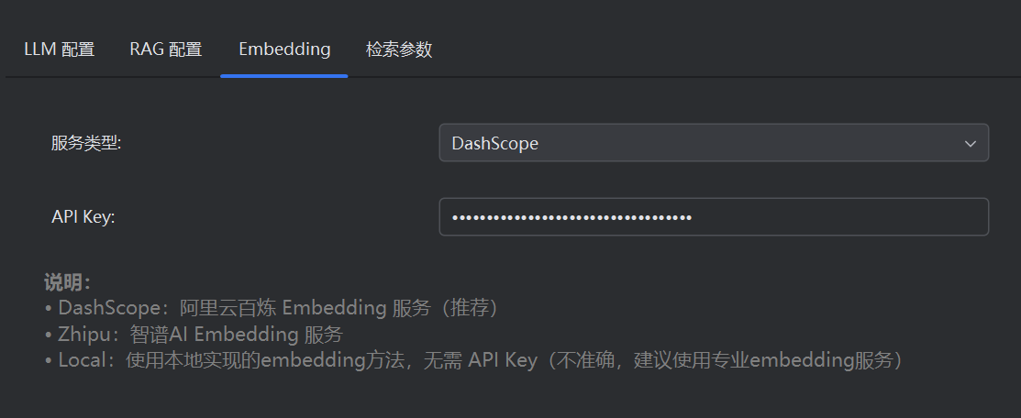
First-Time Configuration
Several instructions for initial setup before using MyPilot
Embedding Configuration
for ASK Mode
Must configure Embedding Type and API URL (DashScope/Zhipu/Local);

Slide 20
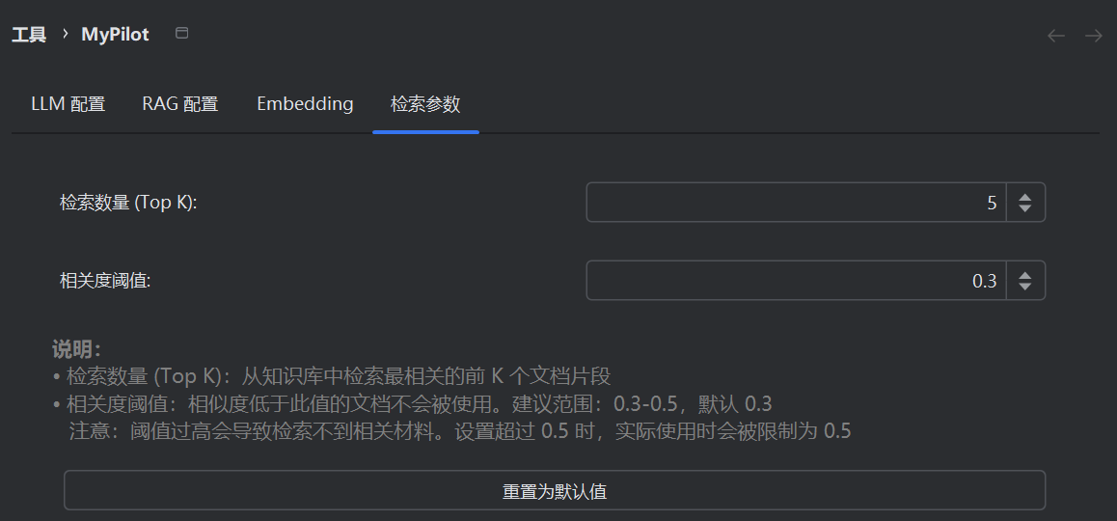
First-Time Configuration
Several instructions for initial setup before using MyPilot
Customize Embedding Settings
retrievalTopk:Retrieves the most relevant document from the knowledge base
relevanceThreshold:documents with similarity below this value will not be used. Recommended range: Too high a threshold may result in missing relevant material.

Slide 21
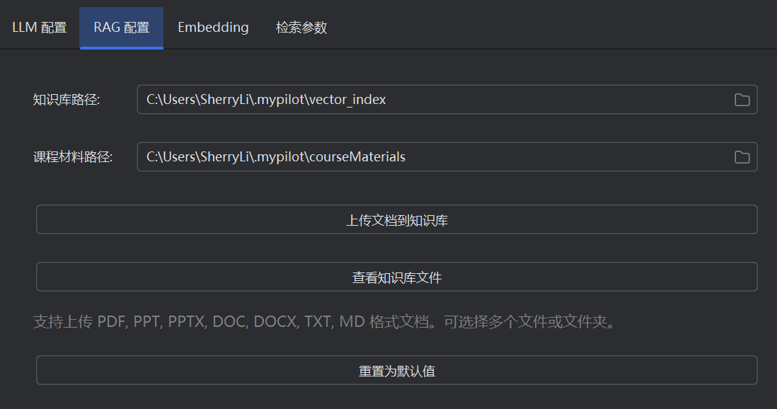
First-Time Configuration
Several instructions for initial setup before using MyPilot
Knowledge Base Configuration
Users can select directories or file types (PDF, PPT, DOC, code files, etc.) to include in the searchable knowledge base

Slide 22
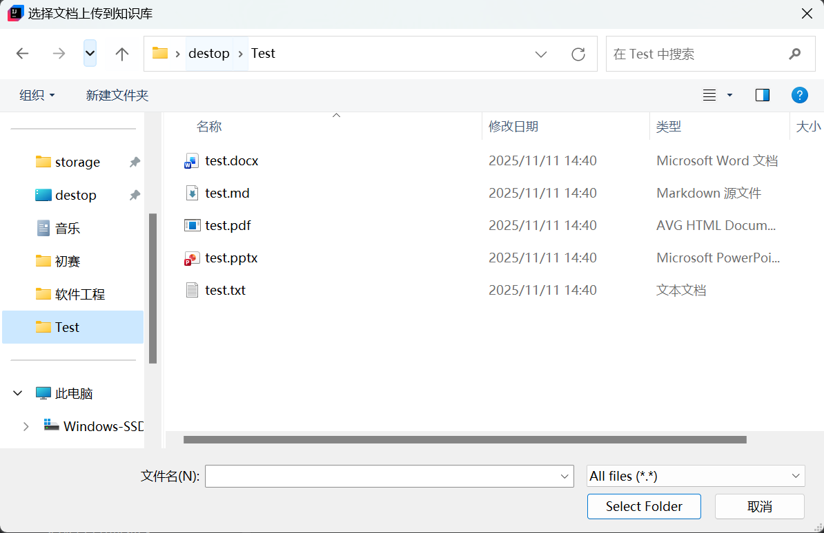
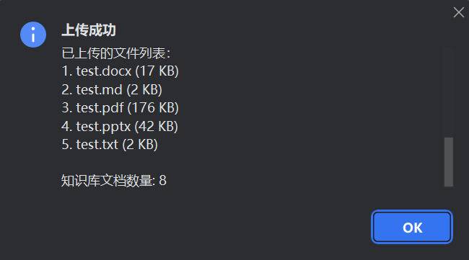
First-Time Configuration
Several instructions for initial setup before using MyPilot
Knowledge Base Configuration
Users can select directories or file types (PDF, PPT, DOC, code files, etc.) to include in the searchable knowledge base

Slide 23
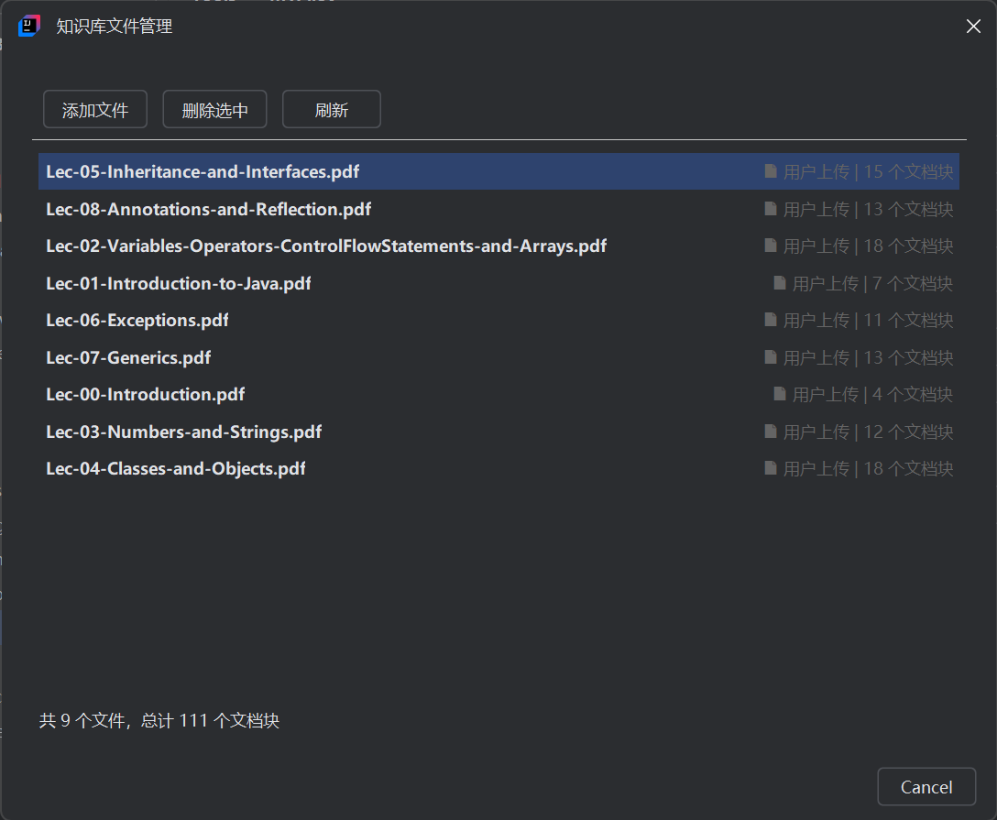
First-Time Configuration
Several instructions for initial setup before using MyPilot
Knowledge Base File Manage
1. Add files
2. Delete files
3. Refresh knowledge database
4. Count files and file blocks

Slide 24

First-Time Configuration
Missing configuration will trigger a warning

Slide 25
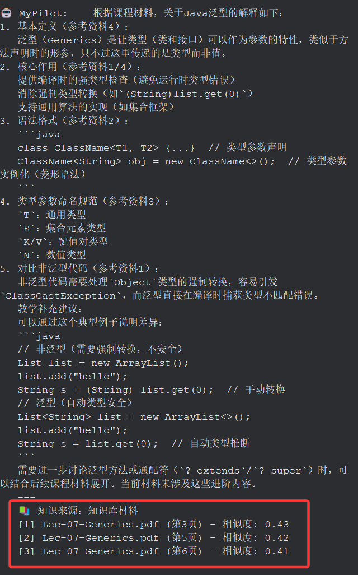
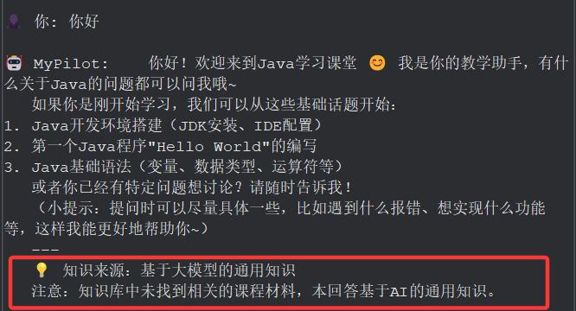
ASK Mode Workflow
1. Select ASK mode at the bottom
2. (Optional) Add related code/documents to the Code Reference Bar
3. Enter your question and send it — the system will perform retrieval and generation
Source of knowledge
LLM Knowledge
Knowledge base materials

Slide 26
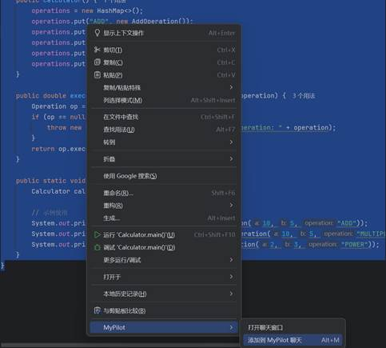
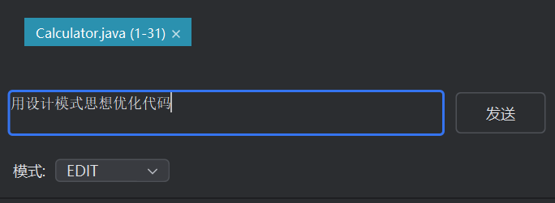
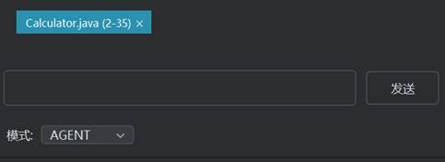
EDIT Mode Workflow
1
1. Select AGENT mode at the bottom
2. Add related code/documents to the Code Reference Bar
3. Describe your goal in natural language
4. While waiting, you’ll see a “thinking…” indicator;
once ready, the Diff window opens automatically showing suggested modifications
5. You can review the Diff and choose to apply or reject some or all of the changes
3
2

Slide 27
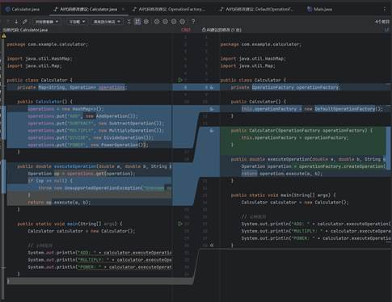
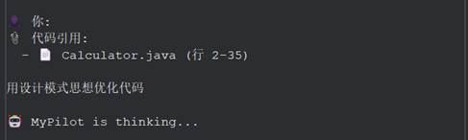
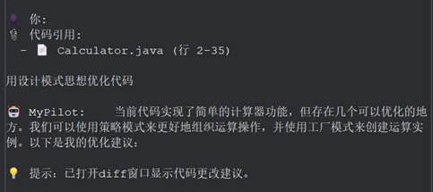
EDIT Mode Workflow
1. Select AGENT mode at the bottom
2. Add related code/documents to the Code Reference Bar
3. Describe your goal in natural language
4. While waiting, you’ll see a “thinking…” indicator;
once ready, the Diff window opens automatically showing suggested modifications
5. You can review the Diff and choose to apply or reject some or all of the changes
5
4
MyPilot is thinking...
Completed!

Slide 28
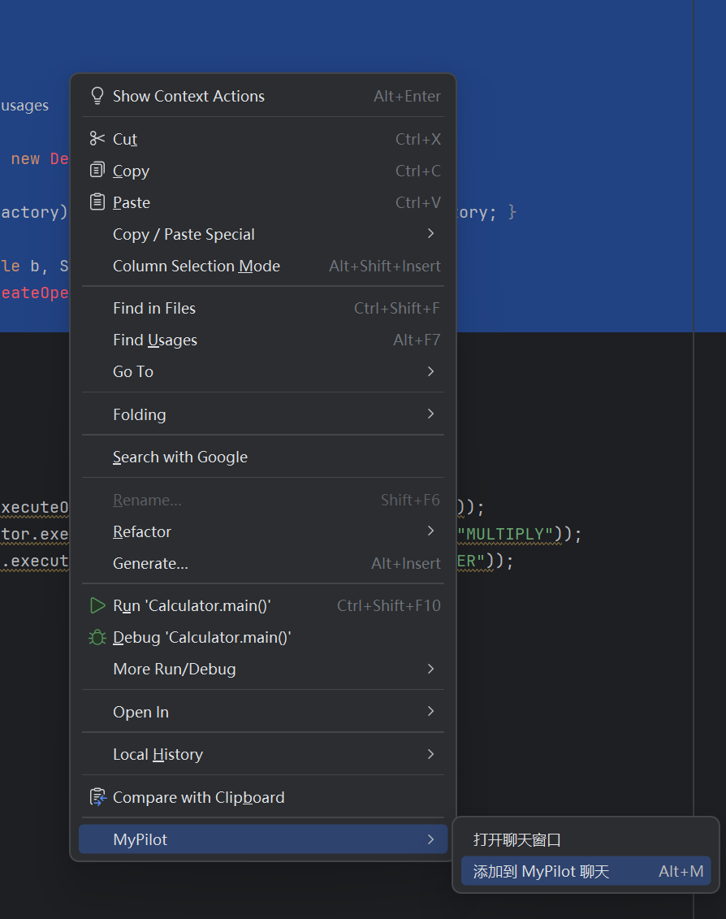
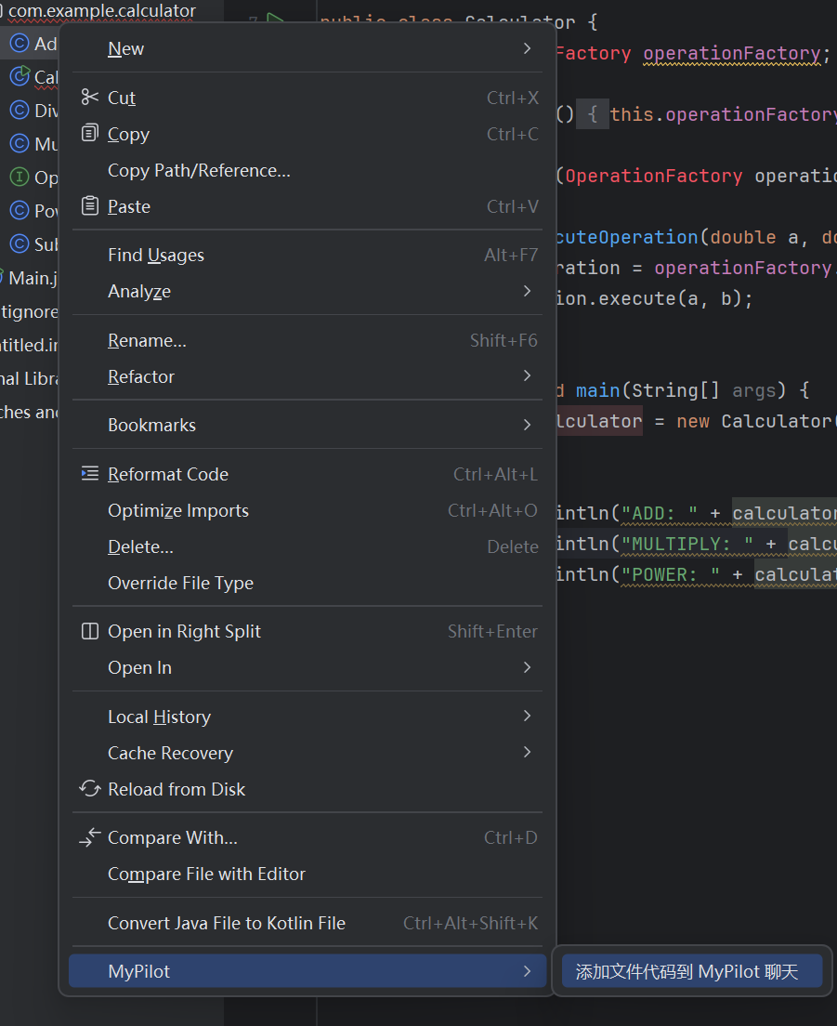
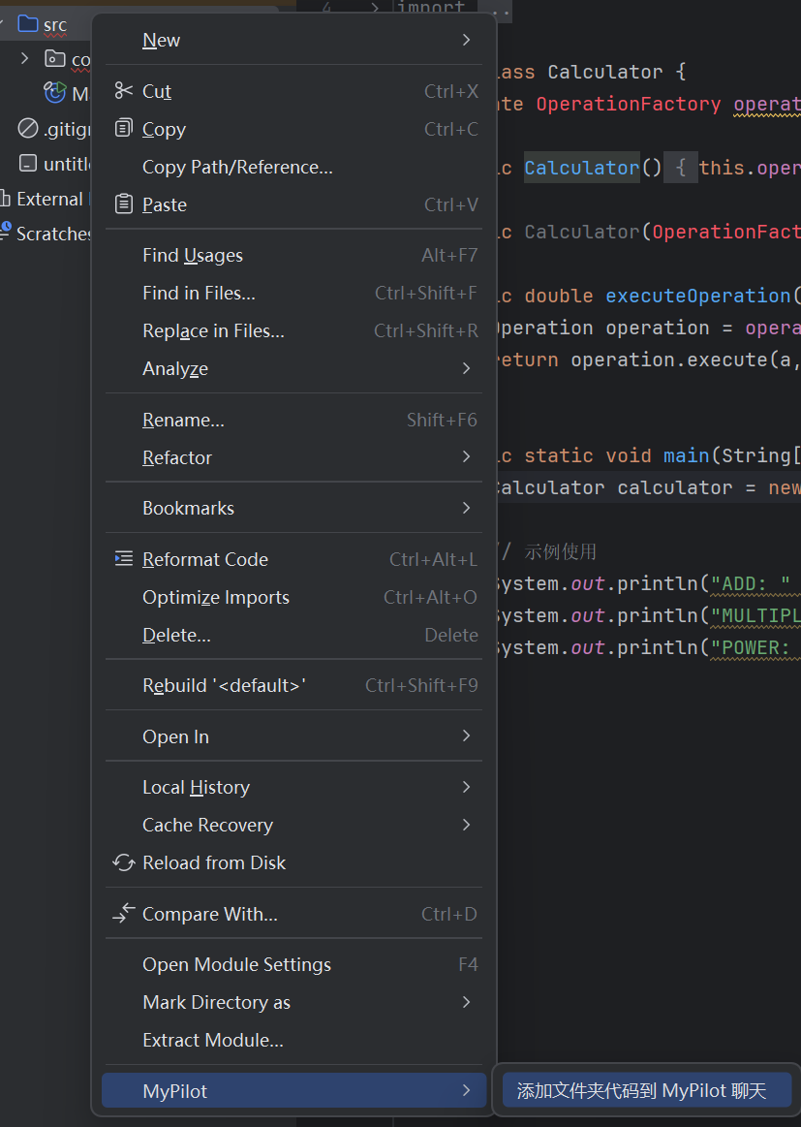
Code Reference
Add related code/file/folder to the Code Reference Bar
1
Action: Select Code
2
Action: Select File
3
Action: Select Folder

Slide 29

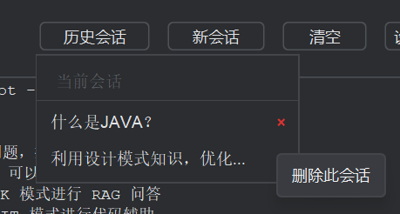
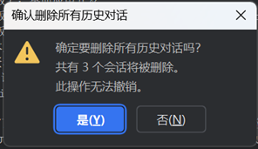
Session Management
Functions related to managing conversation history and state persistence
Creating a New Session
1
Clicking “New Session” initializes a fresh conversation thread, clearing prior context for a clean slate
Viewing Historical Sessions
2
Past dialogues are stored and displayed chronologically, preserving all messages and associated code contexts
Clearing All Sessions
3
Option to permanently delete all saved chat histories, useful for privacy or starting over

Slide 30
Thank You
Guided by Dr. FAN
陈艺龙-2352359 徐云鹏-2353583 李雪菲-2354093

