Slide 1
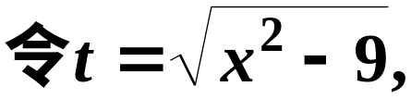
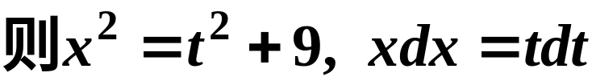
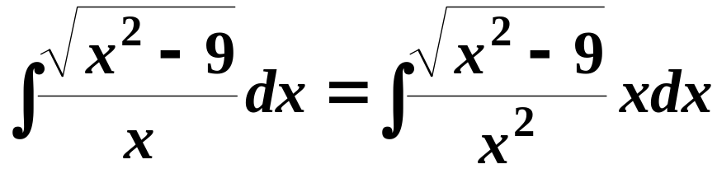
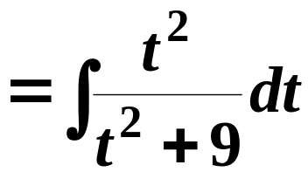
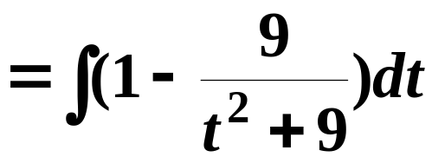
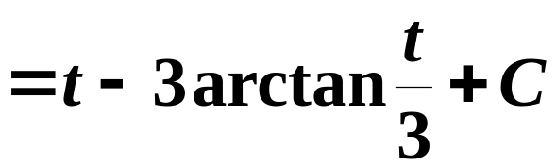
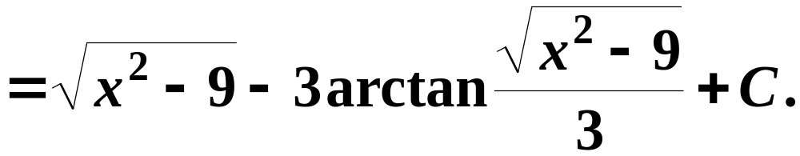
习题3.1/P211/12(2)

Slide 2
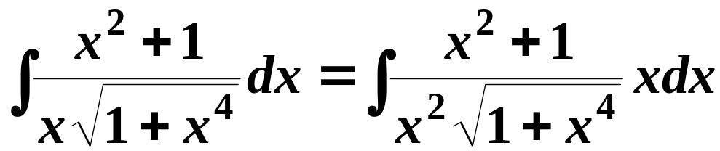
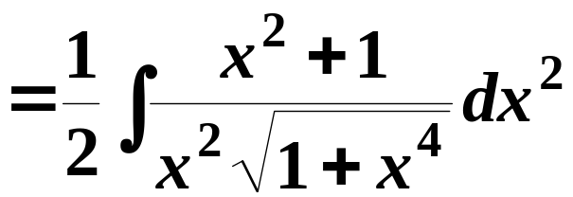
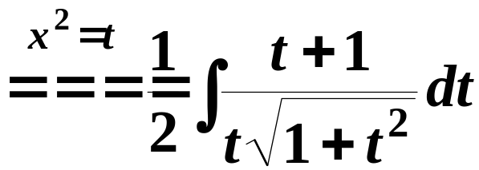
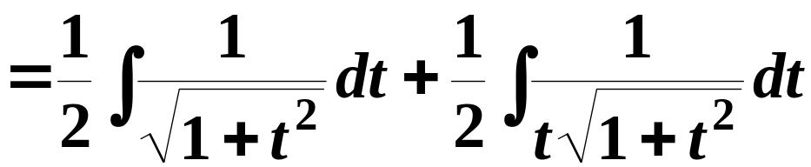
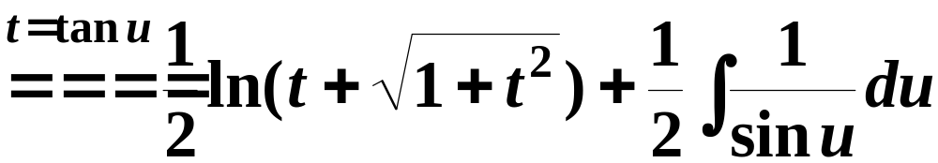
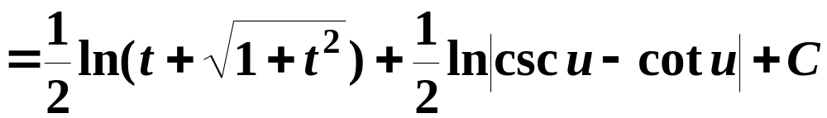
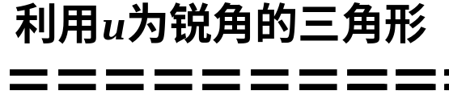
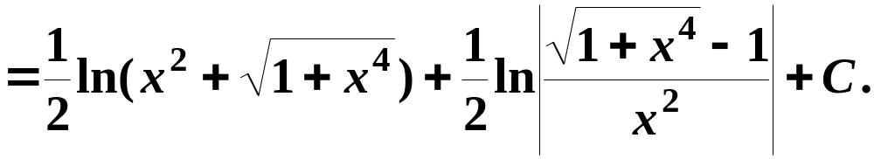
习题3.1/P211/12(5)

Slide 3
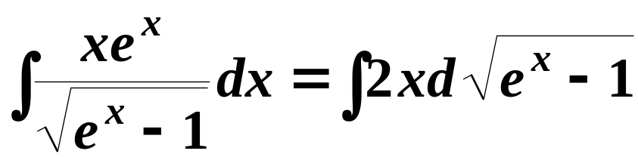
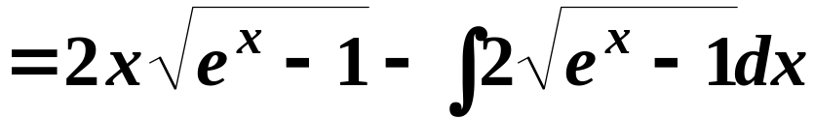
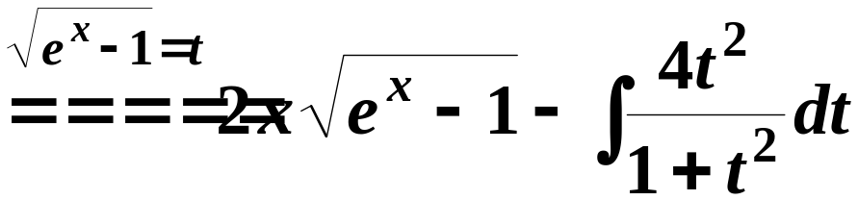
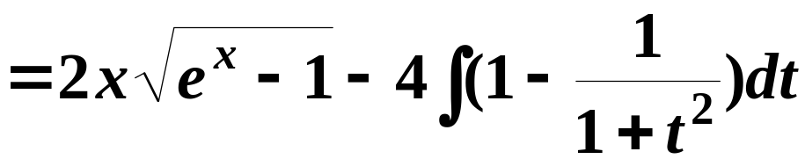
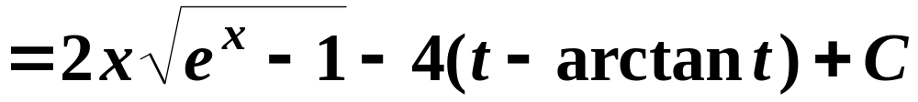
习题3.1/P211/13(3)

Slide 4
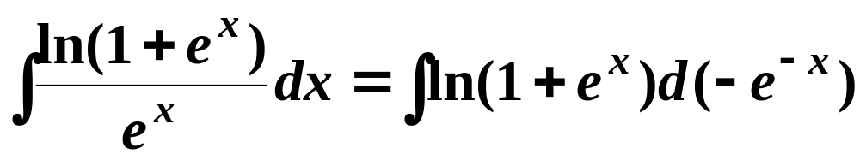
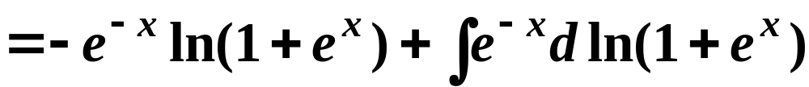
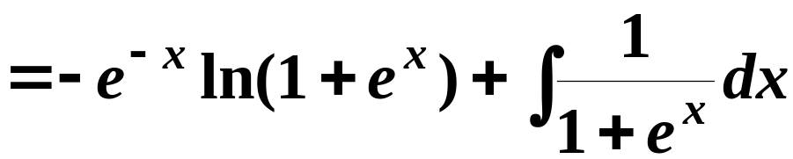
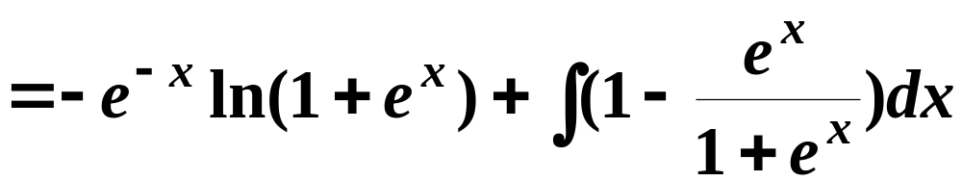
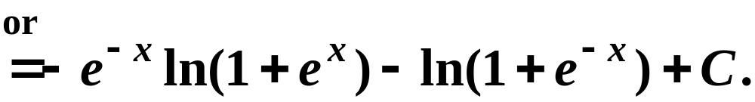
习题3.1/P211/13(8)

Slide 5
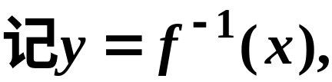

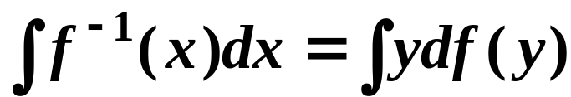
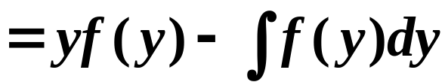

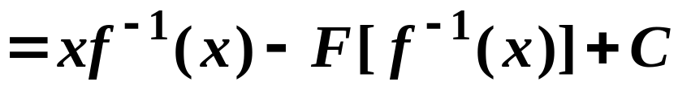
习题3.1/P211/15

Slide 6
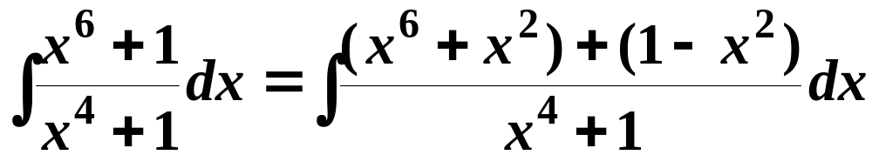
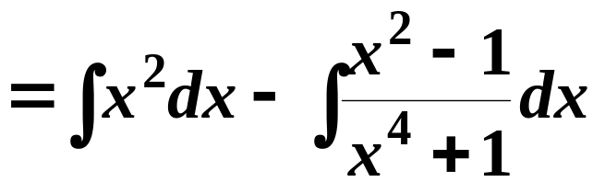
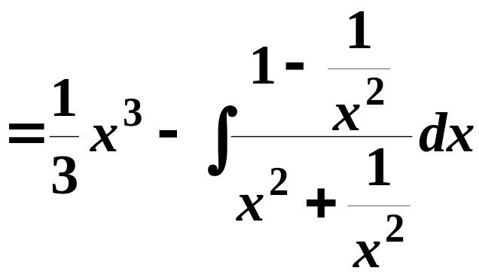
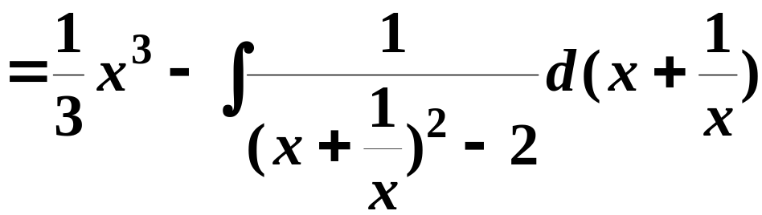
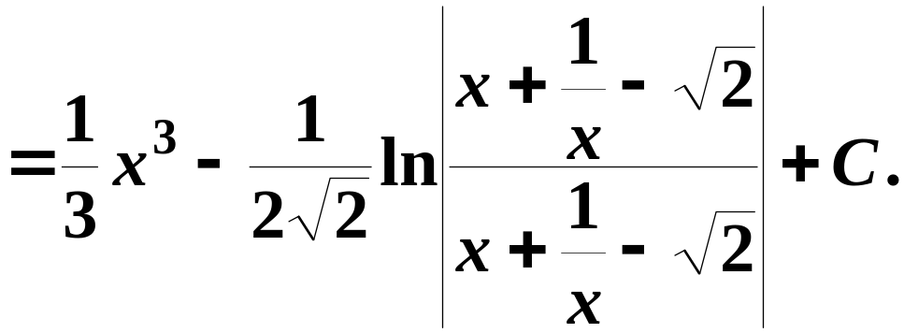
习题3.1/P211/16(3)

Slide 7
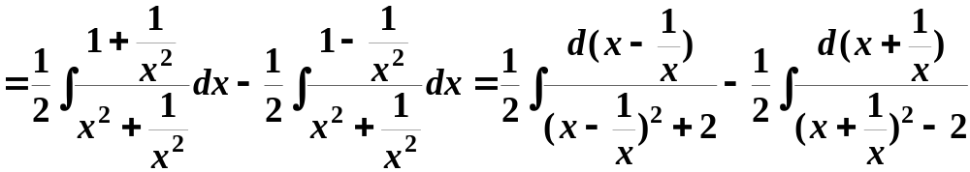
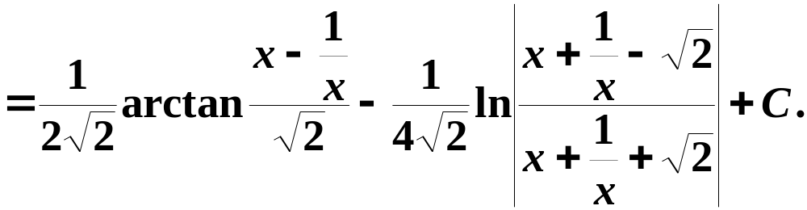
习题3.1/P211/16(4)解法1

Slide 8
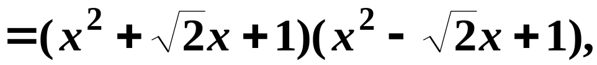
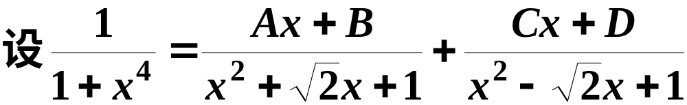
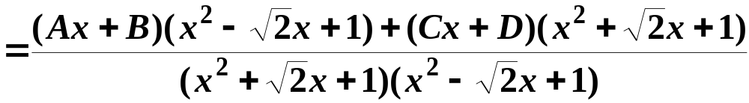
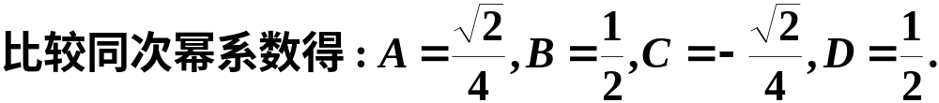
习题3.1/P211/16(4)解法2

Slide 9
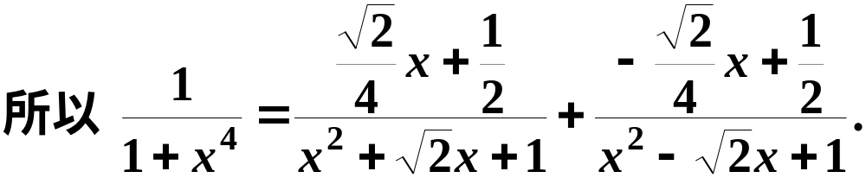
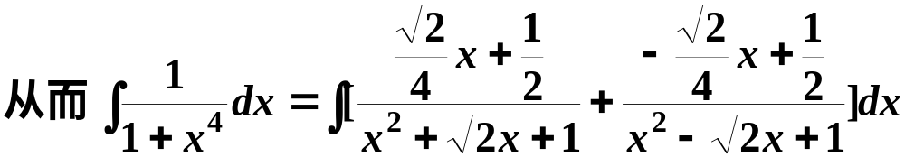
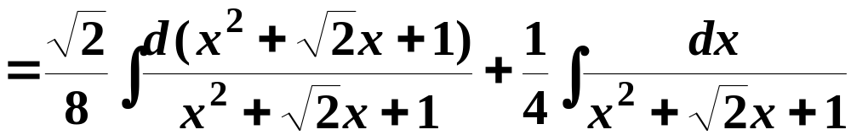
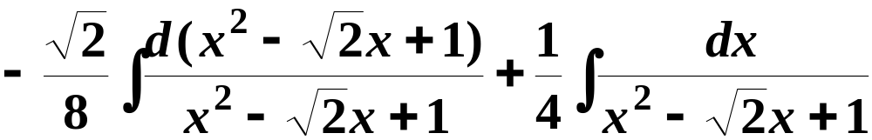

Slide 10
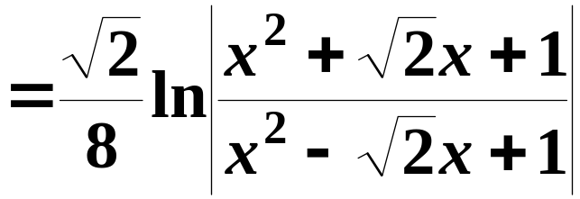
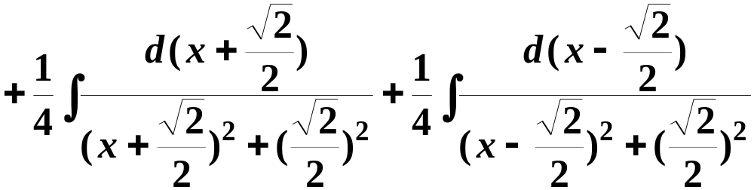
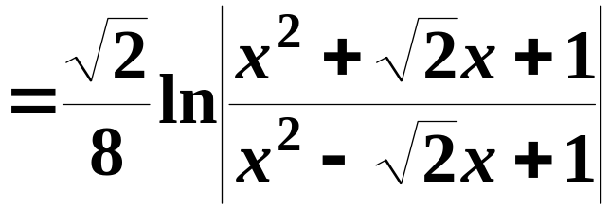
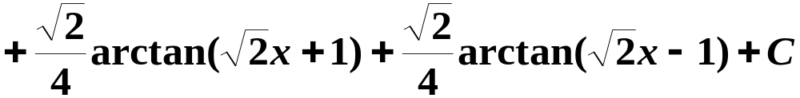

Slide 11
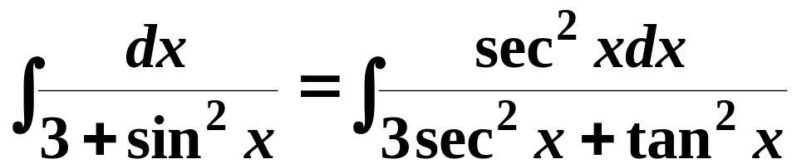
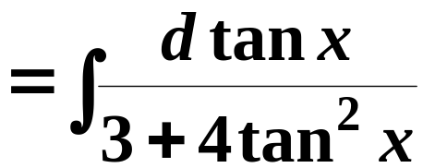


习题3.1/P211/17(3)

Slide 12





习题3.1/P211/17(5)

Slide 13





习题3.1/P211/17(8)

Slide 14






Slide 15




习题3.2/P242/6

Slide 16




习题3.2/P243/15

Slide 17





习题3.2/P243/19

Slide 18






习题3.2/P243/21

Slide 19








习题3.2/P244/22

Slide 20






习题3.2/P244/27

Slide 21






Slide 22





Slide 23




习题3.2/P244/29(1)

Slide 24



习题3.2/P244/29(2)解法1

Slide 25



Slide 26




习题3.2/P244/29(2)解法2

Slide 27









Slide 28






习题3/P260/1(8)

Slide 29





习题3/P260/2(9)

Slide 30







习题3/P261/3(2)

Slide 31






习题3/P261/3(4)

Slide 32






习题3/P261/3(6)

Slide 33








或者

Slide 34








习题3/P261/3(7)

Slide 35







习题3/P261/3(8)

Slide 36





习题3/P261/5

Slide 37







习题3/P261/6

Slide 38






Slide 39




习题3/P261/7(2)

Slide 40






习题3/P261/7(3)

Slide 41




习题3/P261/7(5)

Slide 42





习题3/P261/9

Slide 43






Slide 44










习题3/P261/10

Slide 45



习题3/P261/11

Slide 46





习题3/P261/12
证一:

Slide 47






Slide 48




证二:

Slide 49






证三:
曲线是凸的,
两边取极限即可得结论!

Slide 50








习题3/P261/13

