Slide 1

强化学习 (Reinforcement Learning)
梁毅雄
yxliang@csu.edu.cn
Machine Learning
Some materials from Hong-yi Lee, Andrew Ng and others

Slide 2
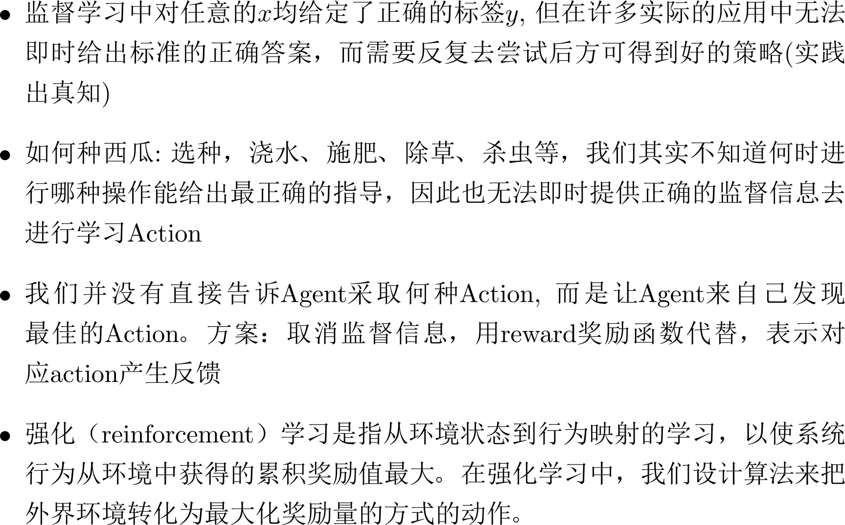
强化学习

Slide 3




强化学习
Observation
State
Action
Change the environment
Agent
Don’t do
that
Reward
Environment

Slide 4




强化学习
Agent learns to take actions maximizing expected reward.
Observation
State
Action
Change the environment
Agent
Thank you.
Reward
Environment

Slide 5


Machine Learning
≈ Looking for a Function
Actor/Policy
Observation
Action
Action =
π( Observation )
Function input
Function output
Used to pick the best function
Reward
Environment

Slide 6
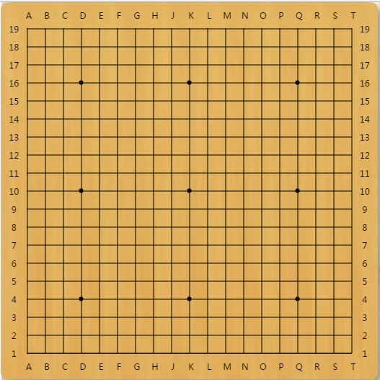

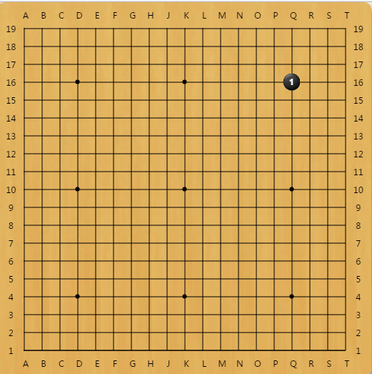
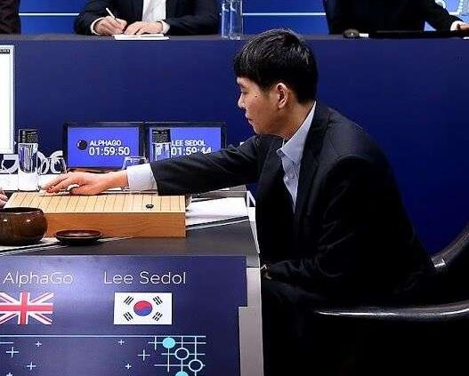



Learning to play Go
Observation
Action
Reward
Next Move
Environment

Slide 7



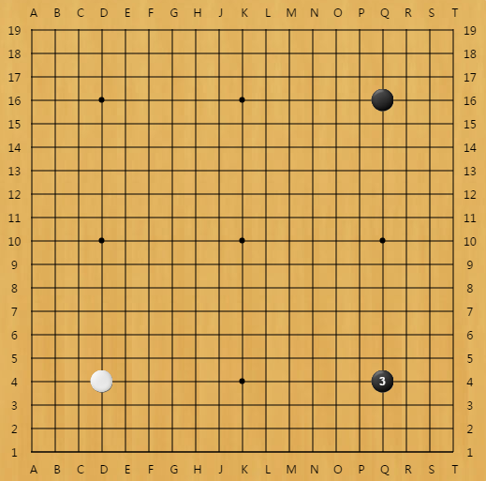
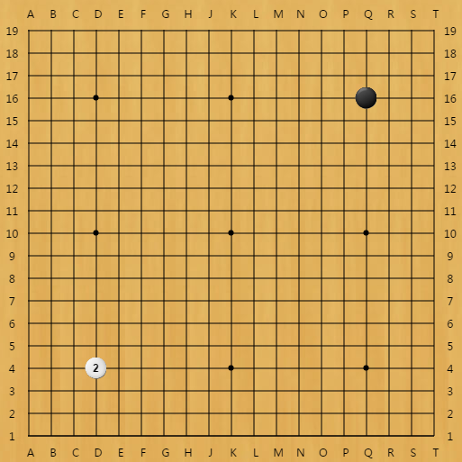








Learning to play Go
Agent learns to take actions maximizing expected reward.
Observation
Action
Reward reward = 0 in most cases
If win, reward = 1 If loss, reward = -1
Environment

Slide 8



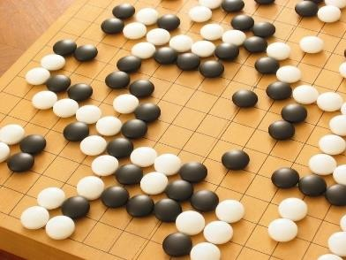
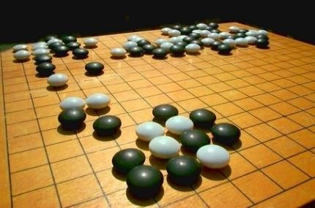



Learning to play Go
Supervised:
Learning from teacher
Next move:
“5-5”
Next move:
“3-3”
Reinforcement Learning
Learning from experience
First move …… many moves ……
(Two agents play with each other.)
Win!
Alpha Go is supervised learning + reinforcement learning.

Slide 9











Learning a chat-bot
https://image.freepik.com/free-vector/variety-of-human- avatars_23-2147506285.jpg
http://www.freepik.com/free-vector/variety-of-human- avatars_766615.htm
Machine obtains feedback from user
How are you?
Hello
Bye bye ☺
Hi ☺
-10 3
Chat-bot learns to maximize the expected reward

Slide 10

Learning a chat-bot
Let two agents talk to each other (sometimes generate good dialogue, sometimes bad)
How old are you?
How old are you?
See you.
I am 16.
See you.
I though you were 12.
See you.
What make you think so?

Slide 11


Learning a chat-bot
By this approach, we can generate a lot of dialogues.
Use some pre-defined rules to evaluate the goodness of a dialogue
Dialogue 1
Dialogue 2
Dialogue 3
Dialogue 4
Dialogue 5
Dialogue 6
Dialogue 7
Dialogue 8
Machine learns from the evaluation
Deep Reinforcement Learning for Dialogue Generation https://arxiv.org/pdf/1606.01541v3.pdf

Slide 12



Learning a chat-bot
Supervised
“Hello”
Say “Hi”
“Bye bye”
Say “Good bye”
Reinforcement
……
…….
…….
Bad
Hello ☺
……
Agent
Agent

Slide 13
More applications
Flying Helicopter
  https://www.youtube.com/watch?v=0JL04JJjocc
Driving
  https://www.youtube.com/watch?v=0xo1Ldx3L5Q
Robot
  https://www.youtube.com/watch?v=370cT-OAzzM
Google Cuts Its Giant Electricity Bill With DeepMind- Powered AI
  http://www.bloomberg.com/news/articles/2016-07-19/google-cuts-its- giant-electricity-bill-with-deepmind-powered-ai
Text generation
  https://www.youtube.com/watch?v=pbQ4qe8EwLo

Slide 14

Example: Playing Video Game
Widely studies:
  Gym: https://gym.openai.com/
  Universe: https://openai.com/blog/universe/
Machine learns to play video games as human players
    What machine observes is pixels
    Machine learns to take proper action itself

Slide 15

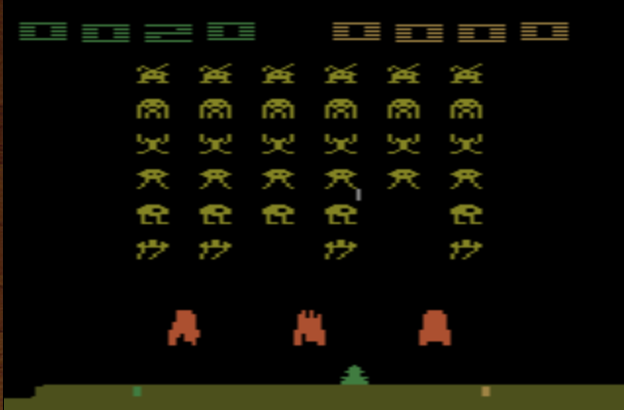
Example: Playing Video Game
Space invader
Termination: all the aliens are killed, or your spaceship is destroyed.
Score (reward)
Kill the aliens
shield
fire

Slide 16
Example: Playing Video Game
Space invader
  Play yourself: http://www.2600online.com/spaceinvaders.htm l
  How about machine: https://gym.openai.com/evaluations/eval_Eduo zx4HRyqgTCVk9ltw

Slide 17
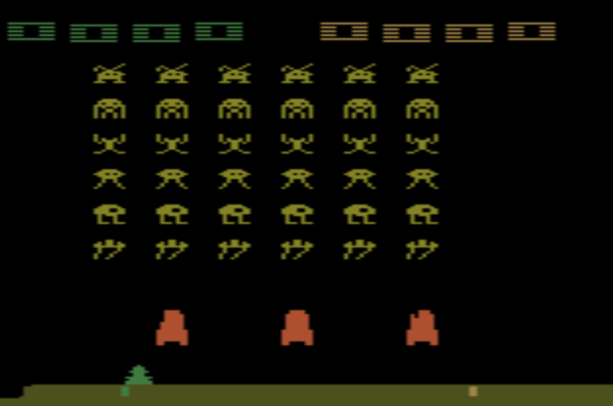
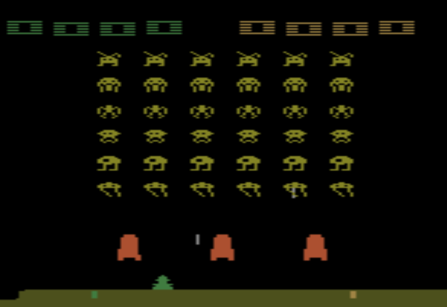
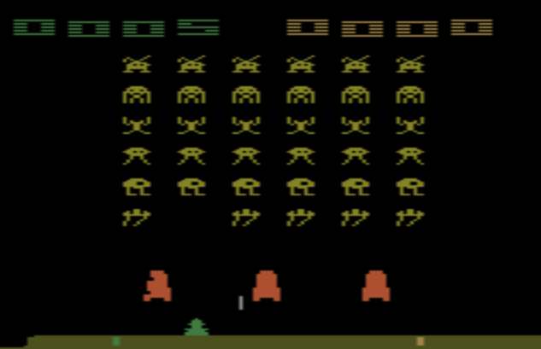



Example: Playing Video Game
Start with
observation 𝑠₁ Observation 𝑠₂
Observation 𝑠₃
Obtain reward
𝑟₁ = 0
Obtain reward
𝑟₂ = 5
Action 𝑎₂ : “fire”
(kill an alien)
Usually there is some randomness in the environment
Action 𝑎₁: “right”

Slide 18
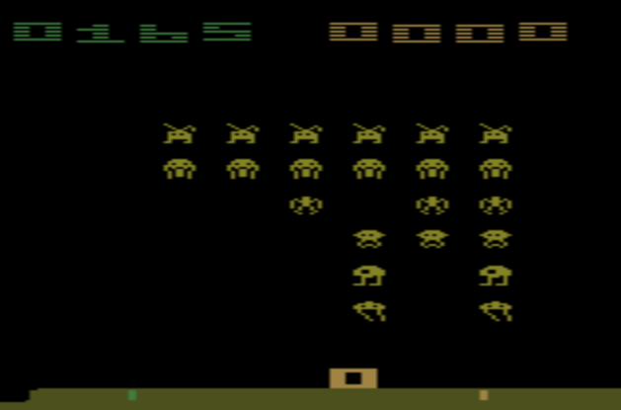





Example: Playing Video Game
Start with
observation 𝑠₁ Observation 𝑠₂
Observation 𝑠₃
This is an episode.
After many turns
Game Over (spaceship destroyed)
Learn to maximize the expected cumulative reward per episode
Obtain reward 𝑟_{𝑇}
Action 𝑎_{𝑇}

Slide 19
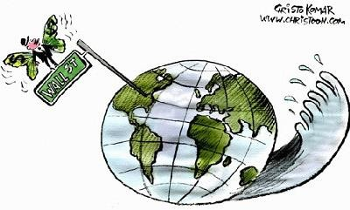
Properties of Reinforcement Learning
Reward delay
  In space invader, only “fire” obtains reward
    Although the moving before “fire” is important
  In Go playing, it may be better to sacrifice immediate reward to gain more long-term reward
Agent’s actions affect the subsequent data it receives
  E.g. Exploration

Slide 20


Outline
Alpha Go: policy-based + value-based
+ model-based
Model-free Approach
Policy-based
Value-based
Learning an Actor Actor + Critic
Model-based Approach
Learning a Critic

Slide 21
Policy-based Approach
Learning an Actor

Slide 22
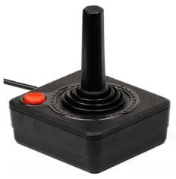




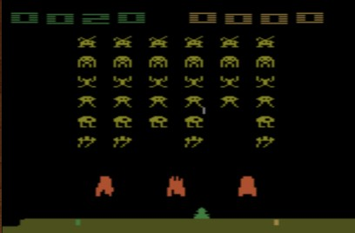










Neural network as Actor
Input of neural network: the observation of machine represented as a vector or a matrix
Output neural network : each action corresponds to a neuron in output layer
NN as actor
…
0.7
0.2
…
left
Probability of taking the action
right
fire
0.1
pixels
What is the benefit of using network instead of lookup table?
generalization

Slide 23


















Goodness of Actor
Total Loss:
Review: Supervised learning
Training Example
𝑁
𝐿 = ෍ 𝑙_{𝑛}
𝑛=1
“1”
x₁
……
y₁
y₂
^{y}10
1
As close as possible
x₂
Given a set …of… parameters 𝜃
Softmax
0
target
……
……
……
……
……
Loss
𝑙
^{x}256
……
0

Slide 24


Goodness of Actor
Given an actor 𝜋_{𝜃} 𝑠 with network parameter 𝜃
Use the actor 𝜋_{𝜃} 𝑠 to play the video game
Start with observation 𝑠₁
Machine decides to take 𝑎₁
Machine obtains reward 𝑟₁
Machine sees observation 𝑠₂
Machine decides to take 𝑎₂
Machine obtains reward 𝑟₂
Machine sees observation 𝑠₃
……
Machine decides to take 𝑎_{𝑇}
Machine obtains reward 𝑟_{𝑇}
Total reward: 𝑅
= σ^{𝑇} 𝑟
𝜃 𝑡=1 𝑡
Even with the same actor,
𝑅_{𝜃} is different each time
Randomness in the actor and the game
We define 𝑅^{ത} as the
𝜃
END
expected value of R_{θ}
𝑅^{ത}_{𝜃} evaluates the goodness of an actor 𝜋_{𝜃} 𝑠

Slide 25




Goodness of Actor
We define 𝑅^{ത}_{𝜃} as the
expected value of R_{θ}
𝑟 = 𝑠₁, 𝑎₁, 𝑟₁, 𝑠₂, 𝑎₂, 𝑟₂, ⋯ , 𝑠_{𝑇}, 𝑎_{𝑇}, 𝑟_{𝑇}
𝑃 𝑟|𝜃 =
𝑝 𝑠₁
𝑝 𝑎₁|𝑠₁, 𝜃 𝑝 𝑟₁, 𝑠₂|𝑠₁, 𝑎₁ 𝑝 𝑎₂|𝑠₂, 𝜃 𝑝 𝑟₂, 𝑠₃|𝑠₂, 𝑎₂ ⋯
𝑇
𝖦 𝑝 𝑎_{𝑡}|𝑠_{𝑡}, 𝜃 𝑝 𝑟_{𝑡}, 𝑠_{𝑡+1}|𝑠_{𝑡}, 𝑎_{𝑡}
𝑡=1
𝑝 𝑎_{𝑡} = "𝑓𝑖𝑟𝑒"|𝑠_{𝑡}, 𝜃
= 0.7
= 𝑝 𝑠₁
left right
Actor
𝜋_{𝜃}
0.1
not related to your actor
Control by your actor 𝜋_{𝜃}
𝑠
0.2
0.7
𝑡
fire

Slide 26
Goodness of Actor
An episode is considered as a trajectory 𝑟
𝑟 = 𝑠₁, 𝑎₁, 𝑟₁, 𝑠₂, 𝑎₂, 𝑟₂, ⋯ , 𝑠_{𝑇}, 𝑎_{𝑇}, 𝑟_{𝑇}
𝑅 𝑟 = σ^{𝑇} 𝑟_{𝑡}
𝑡=1
If you use an actor to play the game, each 𝑟 has a probability to be sampled
  The probability depends on actor parameter 𝜃:
𝑃 𝑟|𝜃
1 | 𝑁
𝑁 𝑛=1
Use 𝜋_{𝜃} to play the game N times, obtain 𝑟¹, 𝑟², ⋯ , 𝑟^{𝑁}
Sampling 𝑟 from 𝑃 𝑟|𝜃
N times
_{𝑅}ത_{𝜃}
෍
𝑐
=
𝑅 𝑟 𝑃 𝑟|𝜃 ≈
෍ 𝑅 𝑟^{𝑛}
Sum over all possible trajectory

Slide 27
Gradient Ascent
Problem statement
𝜃∗ = 𝑎𝑟𝑔 max 𝑅^{ത}_{𝜃}
𝜃
Gradient ascent
  Start with 𝜃⁰
  𝜃¹ ← 𝜃⁰ + 𝜂❑𝑅^{ത} 0
𝜃 = 𝑤₁, 𝑤₂, ⋯ , 𝑏₁, ⋯
𝜕𝑅^{ത}_{𝜃}Τ𝜕𝑤₁
𝜃
ത
2 1
𝜕𝑅^{ത} Τ𝜕𝑤
𝜃 ← 𝜃 + 𝜂❑𝑅_{𝜃}1
……
𝜃 2
❑𝑅^{ത}_{𝜃} =
⋮
𝜕𝑅^{ത}_{𝜃}Τ𝜕𝑏₁
⋮

Slide 28
Policy Gradient
_{𝑅}ത_{𝜃}
= ෍ 𝑅 𝑟 𝑃 𝑟|𝜃
𝑐
❑𝑅^{ത}_{𝜃} =?
= ෍ 𝑅 𝑟 ❑𝑃 𝑟|𝜃
𝑐
= ෍ 𝑅 𝑟 𝑃 𝑟|𝜃
𝑐
❑𝑃 𝑟|𝜃
❑𝑅^{ത}
𝜃
𝑃 𝑟|𝜃
𝑅 𝑟 do not have to be differentiable It can even be a black box.
෍
𝑐
𝑑𝑙𝑜𝑔 𝑓 𝑥
𝑑𝑥
1 𝑑𝑓 𝑥
=
𝑓 𝑥 𝑑𝑥
=
𝑅 𝑟
𝑃 𝑟|𝜃
❑𝑙𝑜𝑔𝑃 𝑟|𝜃
𝑁
1
≈ ෍ 𝑅 𝑟^{𝑛}
Use 𝜋_{𝜃} to play the game N times, Obtain 𝑟¹, 𝑟², ⋯ , 𝑟^{𝑁}
❑𝑙𝑜𝑔𝑃 𝑟^{𝑛}|𝜃
𝑁
𝑛=1

Slide 29
Policy Gradient
❑𝑙𝑜𝑔𝑃 𝑟|𝜃 =?
𝑟 = 𝑠₁, 𝑎₁, 𝑟₁, 𝑠₂, 𝑎₂, 𝑟₂, ⋯ , 𝑠_{𝑇}, 𝑎_{𝑇}, 𝑟_{𝑇}
𝑇
𝑃 𝑟|𝜃 = 𝑝 𝑠₁ 𝖦 𝑝 𝑎_{𝑡}|𝑠_{𝑡}, 𝜃 𝑝 𝑟_{𝑡}, 𝑠_{𝑡+1}|𝑠_{𝑡}, 𝑎_{𝑡}
𝑡=1
𝑙𝑜𝑔𝑃 𝑟|𝜃
𝑇
+ ෍ 𝑙𝑜𝑔𝑝 𝑎_{𝑡}|𝑠_{𝑡}, 𝜃
𝑡=1
𝑇
= 𝑙𝑜𝑔𝑝 𝑠₁
+ 𝑙𝑜𝑔𝑝 𝑟_{𝑡}, 𝑠_{𝑡+1}|𝑠_{𝑡}, 𝑎_{𝑡}
= ෍ ❑𝑙𝑜𝑔𝑝 𝑎_{𝑡}|𝑠_{𝑡}, 𝜃
𝑡=1
Ignore the terms not related to 𝜃
❑𝑙𝑜𝑔𝑃 𝑟|𝜃

Slide 30

Policy Gradient
❑𝑙𝑜𝑔𝑃 𝑟|𝜃
𝑇
= ෍ ❑𝑙𝑜𝑔𝑝 𝑎_{𝑡}|𝑠_{𝑡}, 𝜃
𝑡=1
𝜃^{𝑛𝑒𝑤} ← 𝜃^{𝑜𝑙𝑑} + 𝜂❑𝑅^{ത}
𝜃
𝑜𝑙𝑑
𝑁
𝑁 𝑇_{𝑛}
1
= ෍ 𝑅 𝑟^{𝑛} ෍ ❑𝑙𝑜𝑔𝑝 𝑎^{𝑛}|𝑠^{𝑛}, 𝜃
❑𝑅^{ത} ≈ ¹ ෍ 𝑅 𝑟^{𝑛} ❑𝑙𝑜𝑔𝑃 𝑟^{𝑛}|𝜃
𝜃
𝑁 𝑁
𝑡 𝑡
𝑛=1
𝑛=1 𝑡=1
𝑁 𝑇_{𝑛}
1
= ෍ ෍ 𝑅 𝑟^{𝑛} ❑𝑙𝑜𝑔𝑝 𝑎^{𝑛}|𝑠^{𝑛}, 𝜃
What if we replace
𝑁
𝑡 𝑡
𝑅 𝑟^{𝑛} with 𝑟^{𝑛} ……
𝑛=1 𝑡=1
𝑡
If in 𝑟^{𝑛} machine takes 𝑎^{𝑛} when seeing 𝑠^{𝑛} in
𝑡
is positive
is negative
𝑡
𝑅 𝑟^{𝑛}
𝑅 𝑟^{𝑛}
Tuning 𝜃 to increase 𝑝 𝑎^{𝑛}|𝑠^{𝑛}
𝑡 𝑡
Tuning 𝜃 to decrease 𝑝 𝑎^{𝑛}|𝑠^{𝑛}
𝑡 𝑡
It is very important to consider the cumulative reward 𝑅 𝑟^{𝑛} of
the whole trajectory 𝑟^{𝑛} instead of immediate reward 𝑟^{𝑛}
𝑡

Slide 31
Policy Gradient
Update Model
Given actor parameter 𝜃
𝑟¹:
𝑠¹, 𝑎¹
𝑅 𝑟¹
𝑅 𝑟¹
𝜃 ← 𝜃 + 𝜂❑𝑅^{ത}_{𝜃}
❑𝑅^{ത}_{𝜃} =
1 1
𝑠¹, 𝑎¹
2 2
……
……
1
𝑁
𝑁 𝑇_{𝑛}
𝑟²:
𝑠², 𝑎²
𝑅 𝑟²
𝑅 𝑟²
෍ ෍ 𝑅 𝑟^{𝑛} ❑𝑙𝑜𝑔𝑝 𝑎^{𝑛}|𝑠^{𝑛}, 𝜃
1 1
𝑡 𝑡
𝑠², 𝑎²
𝑛=1 𝑡=1
2 2
……
……
Data Collection

Slide 32



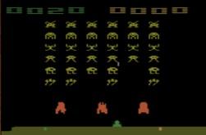


Policy Gradient
3
Minimize: − ෍ 𝑦ො_{𝑖}𝑙𝑜𝑔𝑦_{𝑖}
𝑖=1
Considered as Classification Problem
𝑦_{𝑖}
𝑦ො_{𝑖}
1
0
…
…
left
right
s
fire
0
𝑙𝑜𝑔𝑦_{𝑖} =
𝑙𝑜𝑔𝑃 "𝑙𝑒𝑓𝑡"|𝑠
Maximize:
𝜃 ← 𝜃 + 𝜂❑𝑙𝑜𝑔𝑃 "𝑙𝑒𝑓𝑡"|𝑠

Slide 33






𝜃 ← 𝜃 + 𝜂❑𝑅^{ത}_{𝜃}
Policy Gradient
❑𝑅^{ത}_{𝜃} =
𝑁 𝑇_{𝑛}
෍ ෍
𝑛=1 𝑡=1
1
𝑁
𝑅 𝑟^{𝑛}
❑𝑙𝑜𝑔𝑝 𝑎^{𝑛}|𝑠^{𝑛}, 𝜃
Given actor parameter 𝜃
𝑡 𝑡
𝑟¹:
𝑠¹, 𝑎¹
𝑅 𝑟¹
𝑅 𝑟¹
1 1
𝑎¹ = 𝑙𝑒𝑓𝑡
𝑠¹, 𝑎¹
1
2 2
NN
left
right
fire
1
0
0
……
……
_{𝑠}1
1
𝑟²:
𝑠², 𝑎²
𝑅 𝑟²
𝑅 𝑟²
1 1
𝑠², 𝑎²
…
𝑎² = 𝑓𝑖𝑟𝑒
2 2
1
……
……
NN
left
right
fire
0
0
1
_{𝑠}2
1

Slide 34




𝜃 ← 𝜃 + 𝜂❑𝑅^{ത}_{𝜃}
Policy Gradient
❑𝑅^{ത}_{𝜃} =
1
𝑁
𝑁 𝑇_{𝑛}
෍ ෍ 𝑅 𝑟^{𝑛} ❑𝑙𝑜𝑔𝑝 𝑎^{𝑛}|𝑠^{𝑛}, 𝜃
Given actor parameter 𝜃
𝑡 𝑡
𝑛=1 𝑡=1
𝑟¹:
𝑠¹, 𝑎¹
𝑅 𝑟¹
𝑅 𝑟¹
2
1 1
Each training data is weighted by 𝑅 𝑟^{𝑛}
𝑠¹, 𝑎¹
2
2 2
……
……
_{𝑠}1
NN
𝑎¹ = 𝑙𝑒𝑓𝑡
𝑟²:
𝑅 𝑟²
𝑅 𝑟²
1
1
𝑠², 𝑎²
1
1 1
_{𝑠}1
𝑠², 𝑎²
NN
𝑎¹ = 𝑙𝑒𝑓𝑡
2 2
1
1
1
……
……
…
_{𝑠}2
NN
𝑎² = 𝑓𝑖𝑟𝑒
1
1

Slide 35



Add a Baseline
It is possible that 𝑅 𝑟^{𝑛}
is always positive.
𝜃^{𝑛𝑒𝑤} ← 𝜃^{𝑜𝑙𝑑} + 𝜂❑𝑅^{ത}_{𝜃}𝑜𝑙𝑑
𝑁 𝑇_{𝑛}
𝑁 𝑇_{𝑛}
¹ 𝑛 𝑛
෍ ෍ 𝑅 𝑟^{𝑛} ❑𝑙𝑜𝑔𝑝 𝑎_{𝑡} |𝑠_{𝑡} , 𝜃
𝑁
𝑛=1 𝑡=1
1
෍ ෍ 𝑅 𝑟^{𝑛} − 𝑏
❑𝑅^{ത} ≈
❑𝑙𝑜𝑔𝑝 𝑎^{𝑛}|𝑠^{𝑛}, 𝜃
𝜃
𝑁
𝑡 𝑡
𝑛=1 𝑡=1
It is probability …
Ideal case
a Not
b c
a b c
The probability of the actions not sampled will decrease.
sampled
Sampling
……
a
b c
a b c

Slide 36
Value-based Approach
Learning a Critic

Slide 37


Critic
A critic does not determine the action.
Given an actor π, it evaluates the how good the actor is
An actor can be found from a critic.
e.g. Q-learning
http://combiboilersleeds.com/picaso/critics/critics-4.html

Slide 38
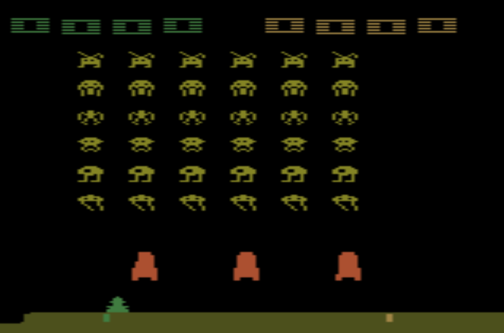
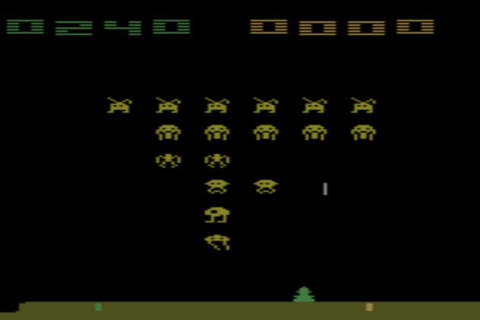


Critic
State value function 𝑉^{𝜋} 𝑠
  When using actor 𝜋, the cumulated reward expects to be obtained after seeing observation (state) s
_{𝑉}𝜋
_{𝑉}𝜋
s
𝑠
scalar
_{𝑉}𝜋
𝑠 is large
_{𝑉}𝜋
𝑠 is smaller

Slide 39


How to estimate 𝑉^{𝜋} 𝑠
Monte-Carlo based approach
  The critic watches 𝜋 playing the game
After seeing 𝑠_{𝑎},
Until the end of the episode, the cumulated reward is 𝐺_{𝑎}
_{𝑉}𝜋
𝑠_{𝑎}
_{𝑉}𝜋
𝑠_{𝑎}
𝐺_{𝑎}
After seeing 𝑠_{𝑏},
Until the end of the episode, the cumulated reward is 𝐺_{𝑏}
_{𝑉}𝜋
𝑠_{𝑏}
_{𝑉}𝜋
𝑠_{𝑏}
𝐺_{𝑏}

Slide 40



How to estimate 𝑉^{𝜋} 𝑠
Temporal-difference approach
⋯ 𝑠_{𝑡}, 𝑎_{𝑡}, 𝑟_{𝑡}, 𝑠_{𝑡+1} ⋯
_{𝑉}𝜋
𝑠_{𝑡}
_{𝑉}𝜋 _{𝑉}𝜋
_{𝑉}𝜋
𝑠_{𝑡}
+ 𝑟_{𝑡} =
^{𝑠}𝑡+1
𝑠_{𝑡}
_{𝑉}𝜋
𝑠_{𝑡}
− 𝑉^{𝜋}
𝑟_{𝑡}
-
^{𝑠}𝑡+1
_{𝑉}𝜋
_{𝑉}𝜋
^{𝑠}𝑡+1
^{𝑠}𝑡+1
Some applications have very long episodes, so that delaying all learning until an episode's end is too slow.

Slide 41





MC v.s. TD
…
_{𝑉}𝜋
𝑠_{𝑎}
Larger variance unbiased
_{𝑉}𝜋
𝑠
𝐺
𝑎
𝑎
_{𝑉}𝜋
_{𝑉}𝜋
𝑠_{𝑡}
_{𝑉}𝜋
𝑠_{𝑡}
𝑟 + 𝑉^{𝜋}
^{𝑠}𝑡+1
𝑠
𝑡+1
Smaller variance
May be biased

Slide 42
MC v.s. TD
[Sutton, v2, Example 6.4]
The critic has the following 8 episodes
  𝑠_{𝑎}, 𝑟 = 0, 𝑠_{𝑏}, 𝑟 = 0, END
  𝑠_{𝑏}, 𝑟 = 1, END
_{𝑉}𝜋
_{𝑉}𝜋
𝑠_{𝑏} = 3/4
𝑠_{𝑎}
𝑠_{𝑏}, 𝑟 = 1, END
𝑠_{𝑏}, 𝑟 = 1, END
𝑠_{𝑏}, 𝑟 = 1, END
𝑠_{𝑏}, 𝑟 = 1, END
𝑠_{𝑏}, 𝑟 = 1, END
𝑠_{𝑏}, 𝑟 = 0, END
=? 0?
3/4?
_{𝑉}𝜋
𝑠_{𝑎} = 0
Monte-Carlo:
Temporal-difference:
_{𝑉}𝜋
𝑠_{𝑏} + 𝑟 = 𝑉^{𝜋} 𝑠_{𝑎}
3/4
0 3/4
(The actions are ignored here.)

Slide 43




Another Critic
State-action value function 𝑄^{𝜋} 𝑠, 𝑎
  When using actor 𝜋, the cumulated reward expects to be obtained after seeing observation s and taking a
_{𝑄}𝜋
_{𝑄}𝜋
_{𝑄}𝜋
𝑠, 𝑎 = 𝑙𝑒𝑓𝑡
𝑠, 𝑎 = 𝑟𝑖𝑔ℎ𝑡
𝑠, 𝑎 = 𝑓𝑖𝑟𝑒
s
_{𝑄}𝜋
_{𝑄}𝜋
_{𝑄}𝜋
𝑠, 𝑎
s
scalar
a
for discrete action only

Slide 44




Q-Learning
𝜋 interacts with the environment
𝜋 = 𝜋′
TD or MC
Find a new actor
𝜋′ “better” than 𝜋
Learning 𝑄^{𝜋}
𝑠, 𝑎
?

Slide 45
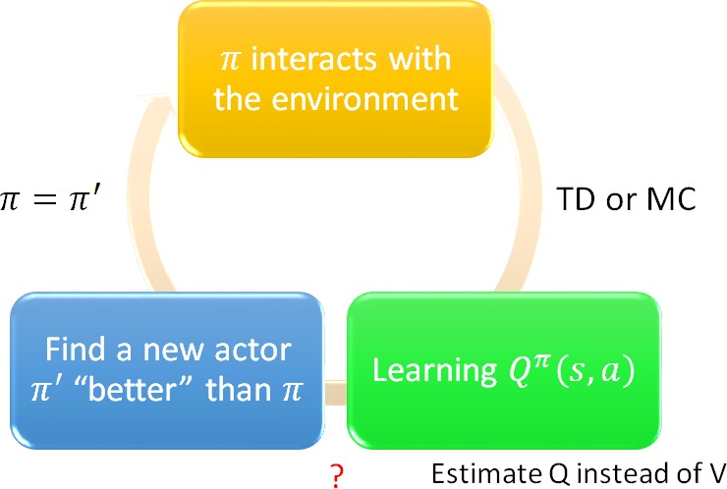
Q-Learning
Given 𝑄^{𝜋} 𝑠, 𝑎 , find a new actor 𝜋′ “better” than 𝜋
  “Better”: 𝑉^{𝜋𝘍} 𝑠 ≥ 𝑉^{𝜋} 𝑠 , for all state s
_{𝜋}′
𝑠 = 𝑎𝑟𝑔 max 𝑄^{𝜋} 𝑠, 𝑎
𝑎
𝜋′ does not have extra parameters. It depends on Q
Not suitable for continuous action a

Slide 46
Deep Reinforcement Learning
Actor-Critic

Slide 47



Actor-Critic
𝜋 interacts with the environment
𝜋 = 𝜋′
TD or MC
Update actor from
𝜋 → 𝜋’ based on
Learning
𝑠, 𝑎 , 𝑉^{𝜋} 𝑠
_{𝑄}𝜋
_{𝑄}𝜋
𝑠, 𝑎 , 𝑉^{𝜋} 𝑠

Slide 48



Actor-Critic
Tips
  The parameters of actor 𝜋 𝑠 and critic 𝑉^{𝜋} 𝑠
can be shared
Network
left
Network
right
𝑠
fire
Network
_{𝑉}𝜋
𝑠

Slide 49
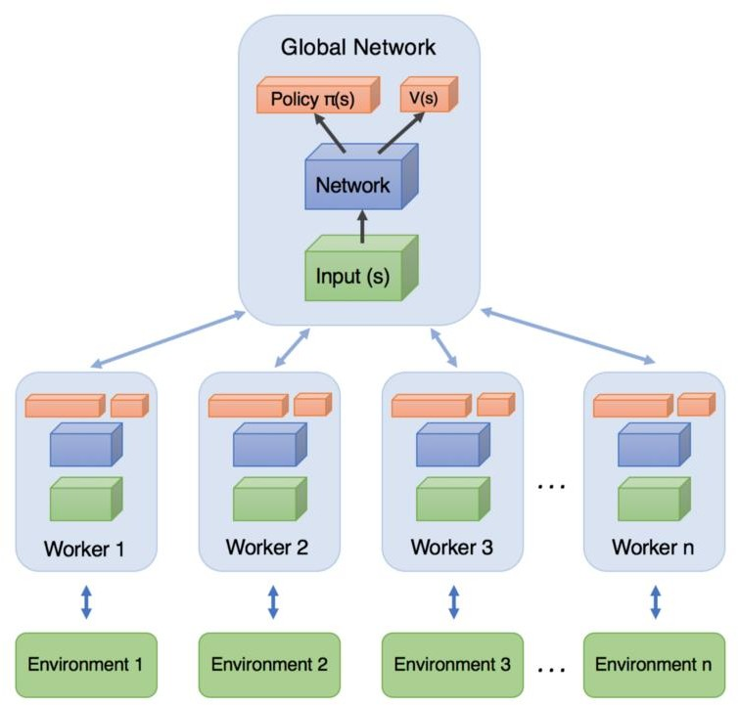
Asynchronous
Source of image: https://medium.com/emergent- future/simple-reinforcement-learning-with- tensorflow-part-8-asynchronous-actor-critic- agents-a3c-c88f72a5e9f2#.68x6na7o9
Copy global parameters
Sampling some data
𝜃¹ +𝜂∆𝜃
_{𝜃}2
(other workers also update models)
Compute gradients
Update global models
∆𝜃
_{𝜃}1
_{𝜃}1
∆𝜃

Slide 50
Concluding Remarks
Model-free Approach
Policy-based
Value-based
Learning an Actor Actor + Critic
Model-based Approach
Learning a Critic

Slide 51
Thanks!
Any questions?

