Slide 1

系统设计与应用 (System Structuring & Applications)
梁毅雄
yxliang@csu.edu.cn
Machine Learning
Some materials from Andrew Ng, Hongyi Lee and others

Slide 2
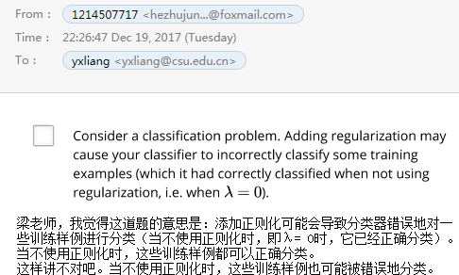
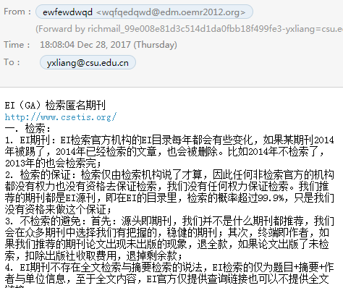
机器学习系统设计
垃圾邮件分类器：

Slide 3
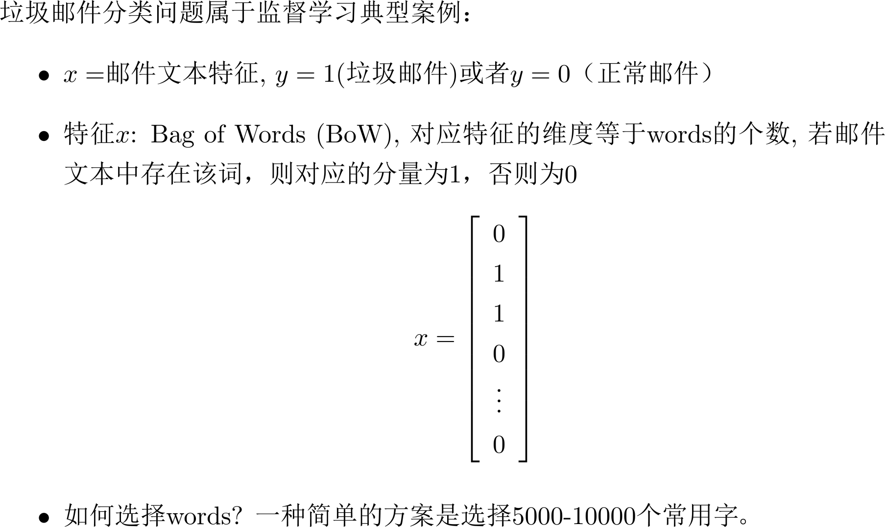
机器学习系统设计

Slide 4
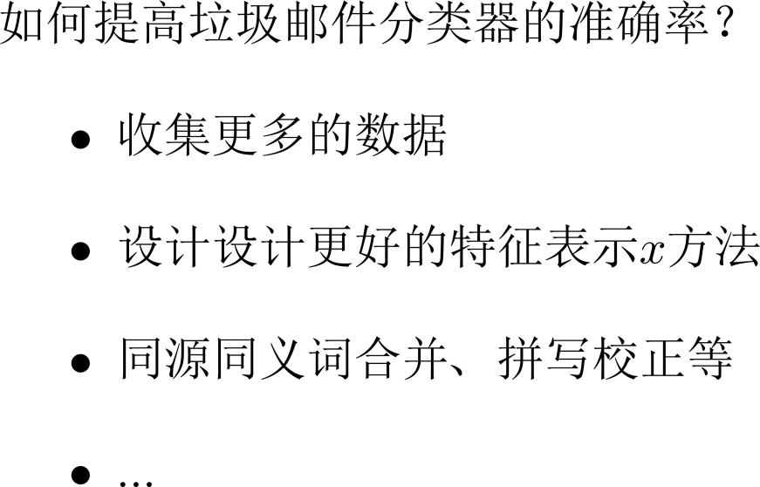
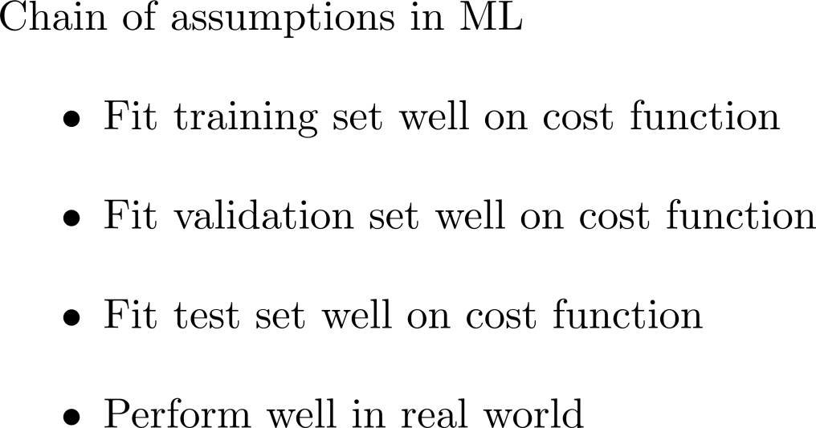
机器学习系统设计

Slide 5
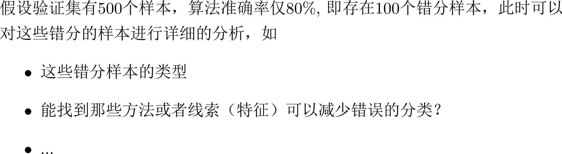
错误分析

Slide 6
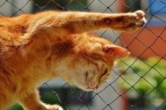
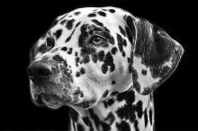
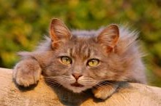
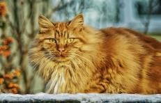
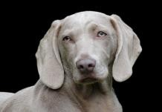
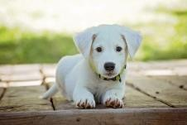
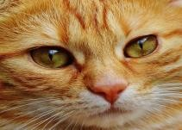
错误分析
Incorrectly labeled examples
x
y
1
0
1
1
0
1
1
Image | Dog | Great Cat | Blurry | Incorrectly labeled | Comments
…
98 |  |  |  | ✓ | Labeler missed cat in background
99 |  | ✓
100 |  |  |  | ✓ | Drawing of a cat; Not a real cat.
% of total | 8% | 43% | 61% | 6%

Slide 7
算法评估
尽量采用单值评估指标：如平均准确率/错误率 等
Algorithm | US | China | India | Other
A | 3% | 7% | 5% | 9%
B | 5% | 6% | 5% | 10%
C | 2% | 3% | 4% | 5%
D | 5% | 8% | 7% | 2%
E | 4% | 5% | 2% | 4%
F | 7% | 11% | 8% | 12%
Average
6%
6.5%
3.5%
5.25%
3.75%
9.5%

Slide 8
算法评估
对于癌症分类这类样本分布极为不平衡的 二分类问题，是否仍然采用（平均）准确 率进行评估？
  假设采用Logistic Regression来处理癌症分类， 发现测试集上的错误率为1%
  但若实际癌症只有0.5%，若一简单分类器把 所有的样本都判别为正常，则错误率只有 0.5%，是否该选择这一简单分类器？

Slide 9
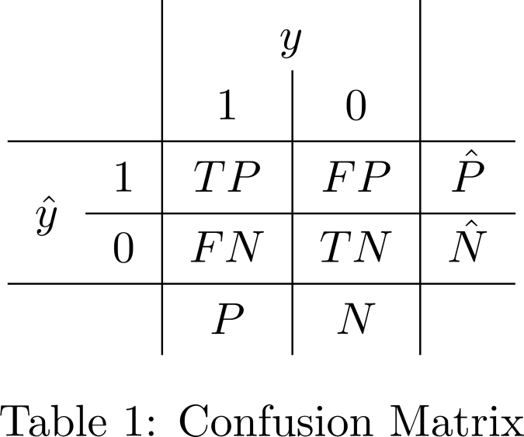
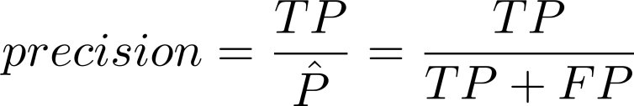
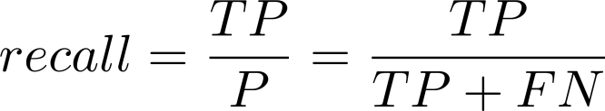
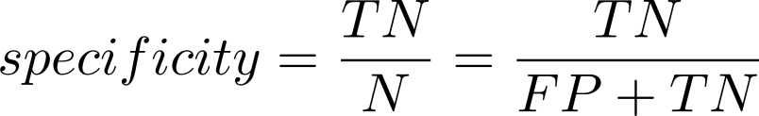
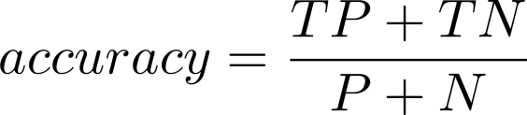
算法评估

Slide 10
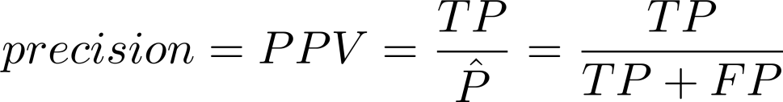
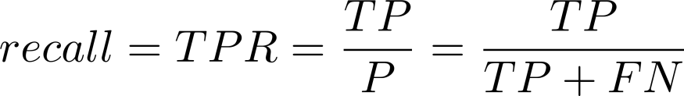

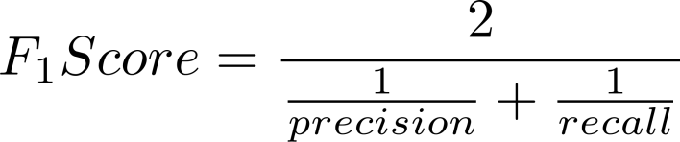
算法评估
Idea
Classifier | Precision | Recall
A | 95% | 90%
B | 98% | 85%
F1 Score
92.4%
91.0%
Experiment
Code

Slide 11
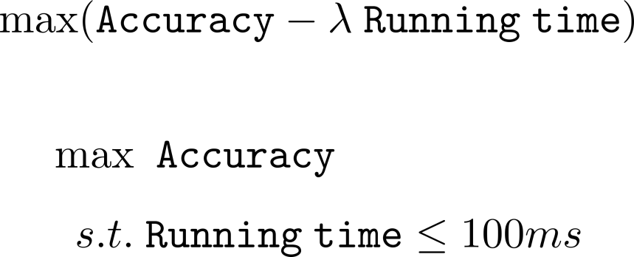
算法评估
Classifier | Accuracy | Running time
A | 90% | 80ms
B | 92% | 95ms
C | 95% | 1,500ms

Slide 12

训练集、验证集与测试集
Regions:
Idea
US
UK
Other Europe
South America
验证集
India
China
Other Asia
Australia
测试
_{集} Experiment
Code

Slide 13
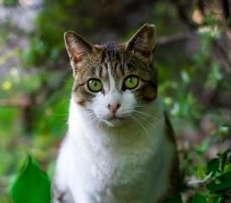
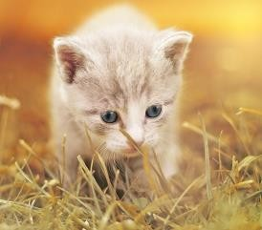
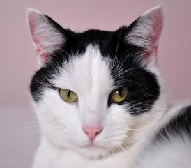

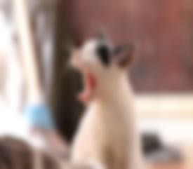
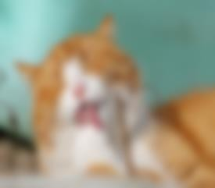
训练集、验证集
Data from webpages
Data from mobile app
如何选择训练集与验证集？

Slide 14
验证集与测试集
如何选择训练集、验证集和测试集？
要确保你在训练集上的训练、在验证集上调参、 模型选择等工作真正发挥了作用
Choose a validation set and test set to reflect data you expect to get in the future and consider important to do well on.

Slide 15
快速迭代: Speech recognition example
Noisy background
Café noise
Car noise
Accented speech
Far from microphone
Young children’s speech
Stuttering
Set up dev/test set and metric
Build initial system quickly
Use Bias/Variance analysis & Error analysis to prioritize next steps.
…
Guideline:
Build your first system quickly, then iterate

Slide 16






迁移学习
自然图像分类
x
𝑦ො
When transfer learning makes sense
𝑦ො 医学图像分类
Task A and B have the same input x.
You have a lot more data for Task A than Task B
Low level features from A could be helpful for learning

Slide 17
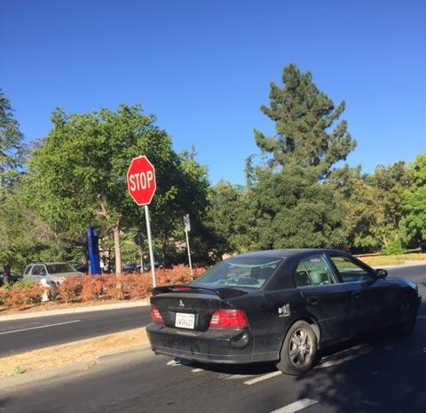







多任务学习
𝑦ො
𝑦ො
x

Slide 18
多任务学习
When multi-task learning makes sense
  Training on a set of tasks that could benefit from having shared lower-level features.
  Usually: Amount of data you have for each task is quite similar
  Can train a big enough model to do well on all the tasks

Slide 19

应用
异常检测
Machine Learning

Slide 20
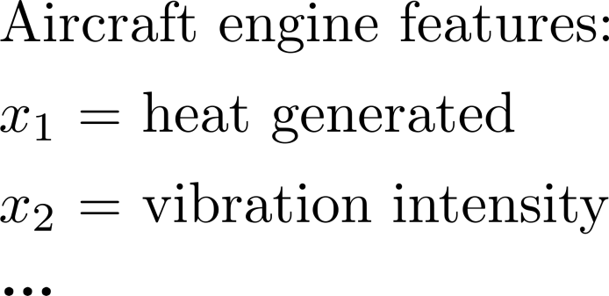




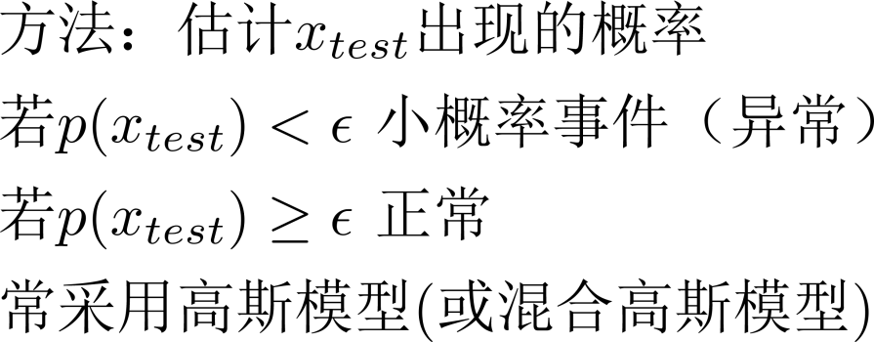











异常检测
(vibration
)
(heat)

Slide 21
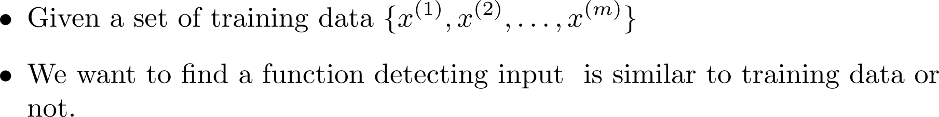
Problem Formulation
𝑥 similar to training data
Anomaly Detector
normal
outlier, novelty, exceptions anomaly
𝑥 different from training data
Anomaly Detector

Slide 22
Applications
Fraud Detection
  Training data: 正常刷卡行为, 𝑥: 盗刷？
  Ref: https://www.kaggle.com/ntnu-testimon/paysim1/home
  Ref: https://www.kaggle.com/mlg-ulb/creditcardfraud/home
Network Intrusion Detection
  Training data: 正常连接, 𝑥: 攻击行为？
  Ref: http://kdd.ics.uci.edu/databases/kddcup99/kddcup99.html
Cancer Detection
  Training data: 正常细胞, 𝑥: 癌细胞
  Ref: https://www.kaggle.com/uciml/breast-cancer-wisconsin- data/home

Slide 23
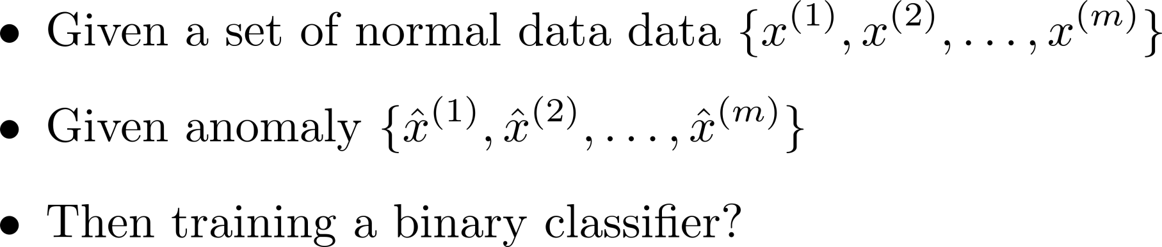
Binary Classification?

Slide 24
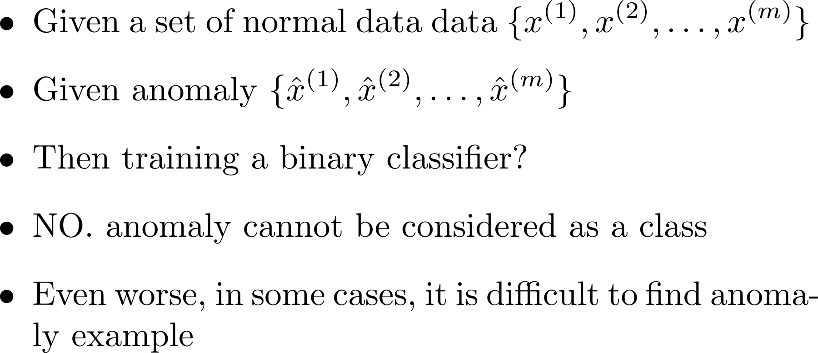
Binary Classification?

Slide 25
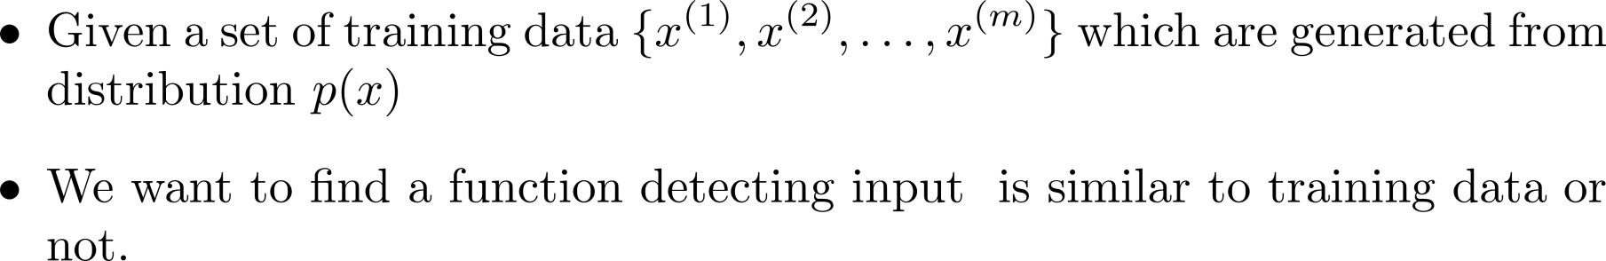


Problem Formulation
𝑥 similar to training data
Anomaly Detector
normal
𝑃 𝑥 ≥ ε
outlier, novelty, exceptions anomaly
𝑥 different from training data
Anomaly Detector
𝑃 𝑥 < ε
ε is decided by developers

Slide 26
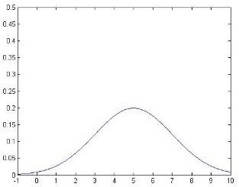

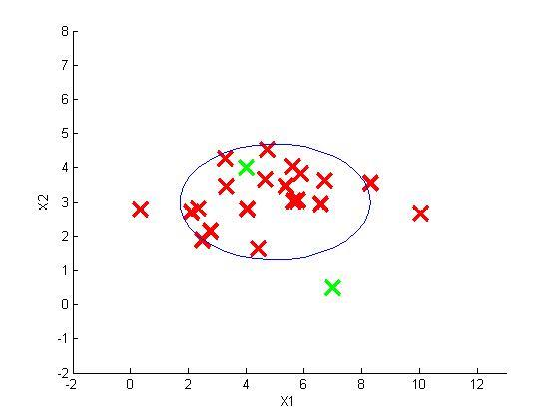
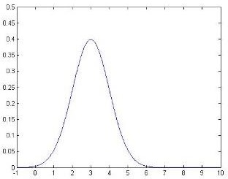



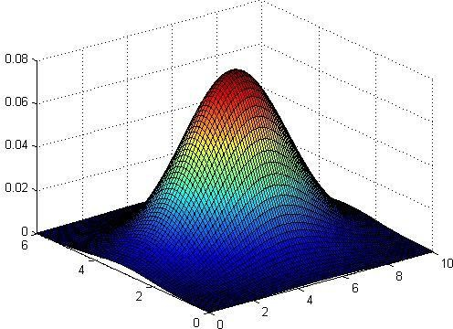



异常检测
Anomaly detection example

Slide 27
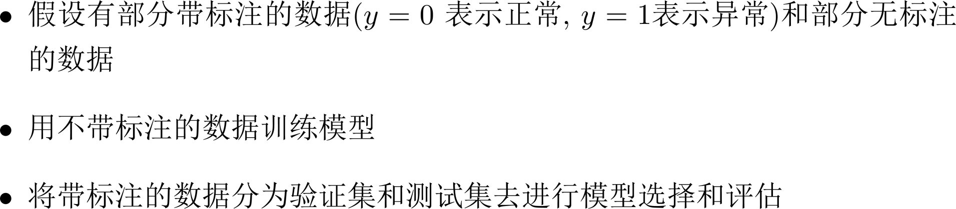
异常检测

Slide 28
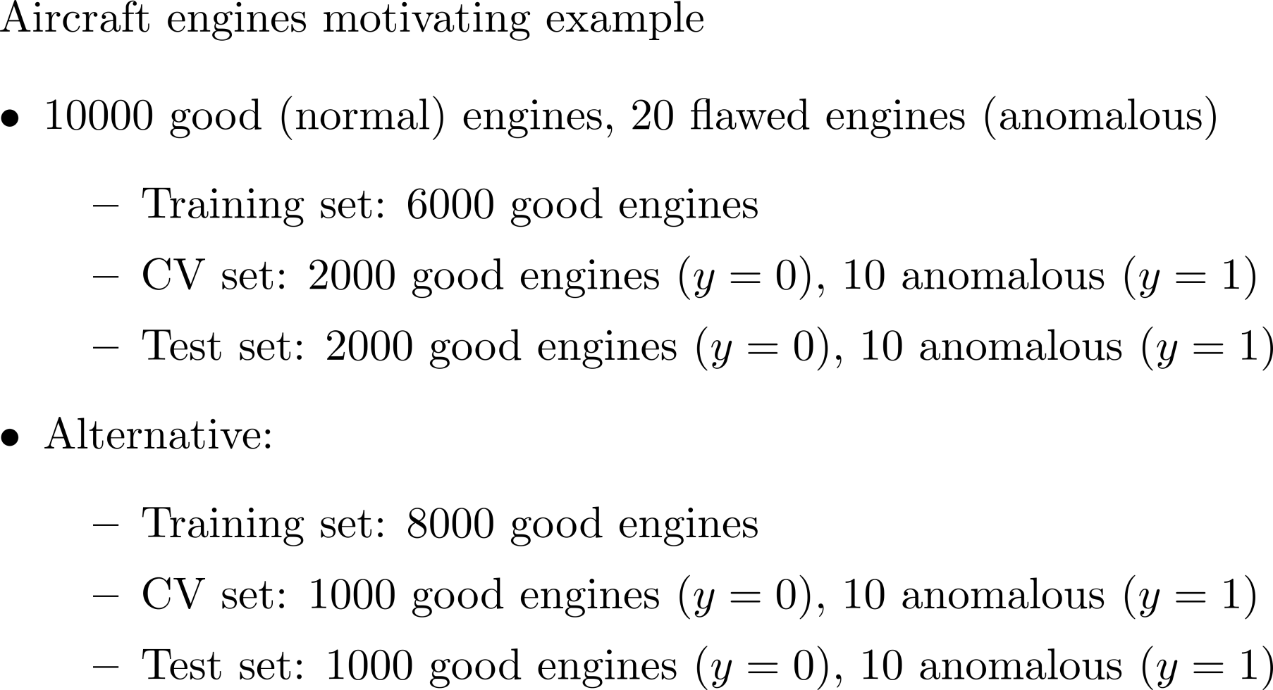
异常检测

Slide 29
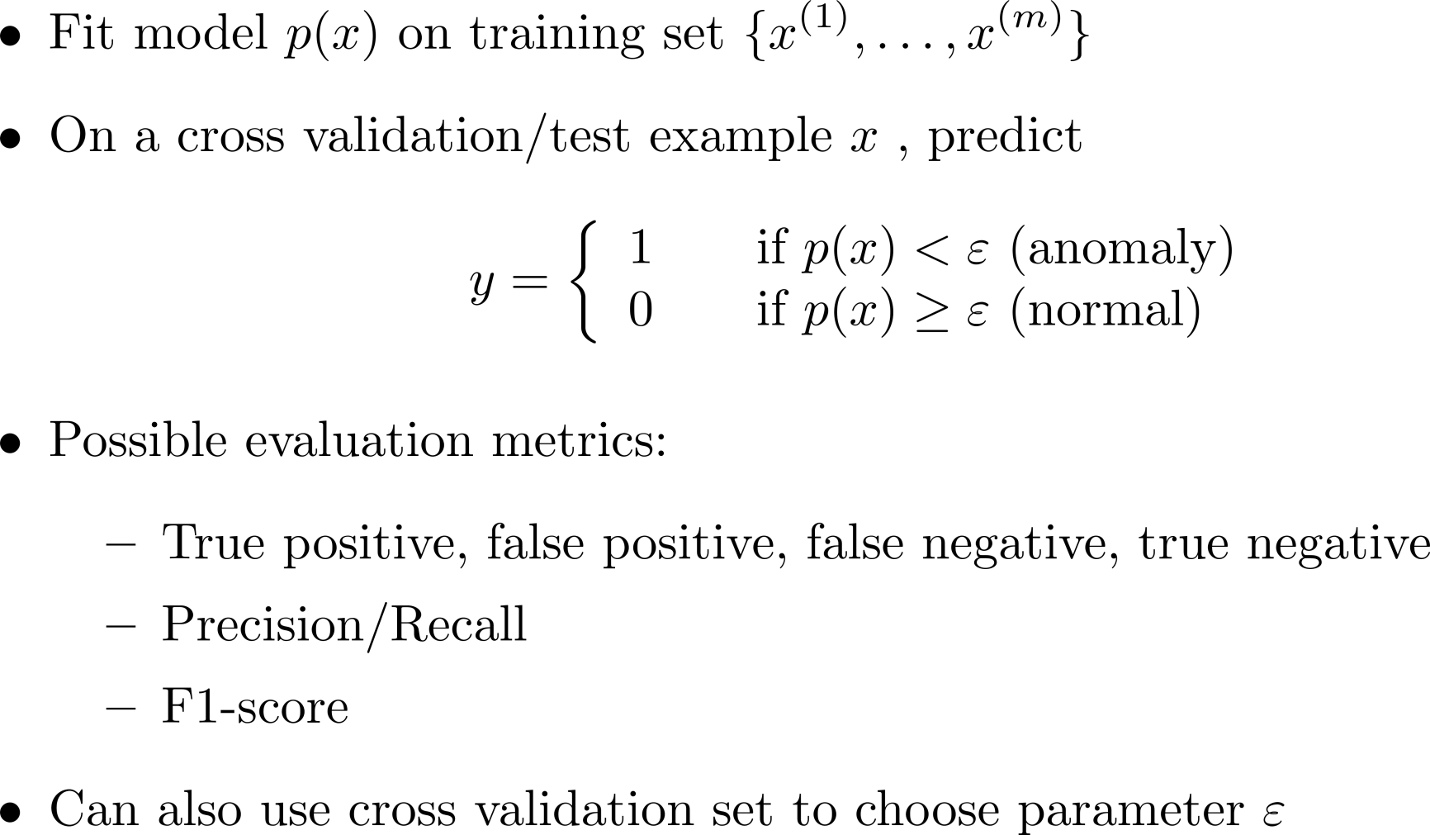
异常检测

Slide 30
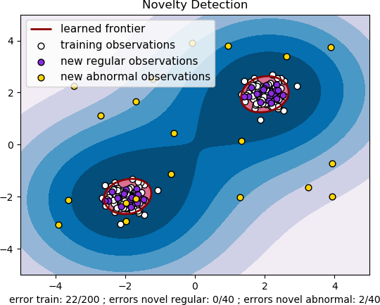
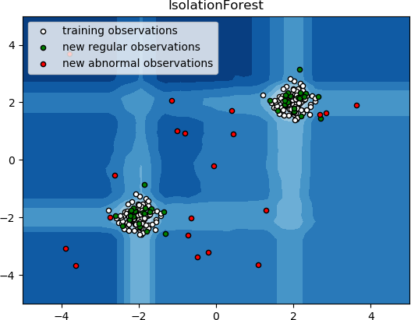
More …
Source of images: https://scikit- learn.org/stable/modules/outlier_detectio n.html#outlier-detection
One-class SVM
Isolated Forest
Ref: https://papers.nips.cc/paper/1723- support-vector-method-for-novelty- detection.pdf
Ref: https://cs.nju.edu.cn/zhouzh/zhouzh.fil es/publication/icdm08b.pdf

Slide 31
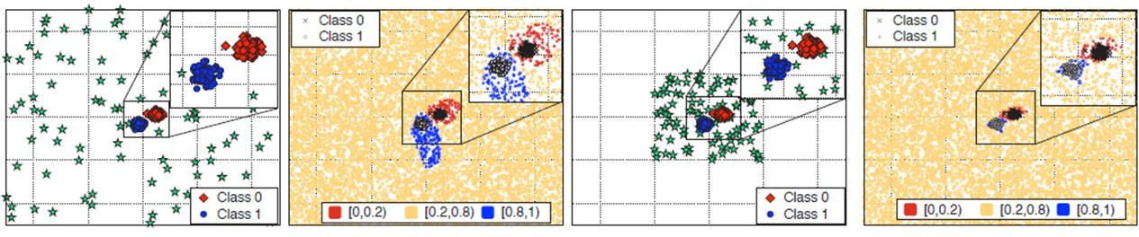
More ……
Learn a classifier giving low confidence score to anomaly
Kimin Lee, Honglak Lee, Kibok Lee, Jinwoo Shin, Training Confidence- calibrated Classifiers for Detecting Out-of-Distribution Samples, ICLR 2018
How can you obtain anomaly?
Generating by Generative Models?
Mark Kliger, Shachar Fleishman, Novelty Detection with GAN, arXiv, 2018

Slide 32


异常检测 vs. 监督学习
Very small number of positive examples ( ). (0-20 is common).
Large number of negative ( examples.
Many different “types” of anomalies. Hard for any algorithm to learn from positive examples what the anomalies look like; future anomalies may look nothing like any of the anomalous examples we’ve seen so far.
Large number of positive and negative examples.
)
Enough positive examples for algorithm to get a sense of what positive examples are like, future positive examples likely to be similar to ones in training set.

Slide 33
应用
推荐系统
Machine Learning

Slide 34
基于内容的推荐系统
Movie | Alice (1) | Bob (2) | Carol (3) | Dave (4)
Love at last | 5 | 5 | 0 | 0
Romance forever | 5 | ? | ? | 0
Cute puppies of love | ? | 4 | 0 | ?
Nonstop car chases | 0 | 0 | 5 | 4
Swords vs. karate | 0 | 0 | 5 | ?
(romanc (action)
e)
0.9 0
1.0 0.01
0.99 0
0.1 1.0
0 0.9

Slide 35
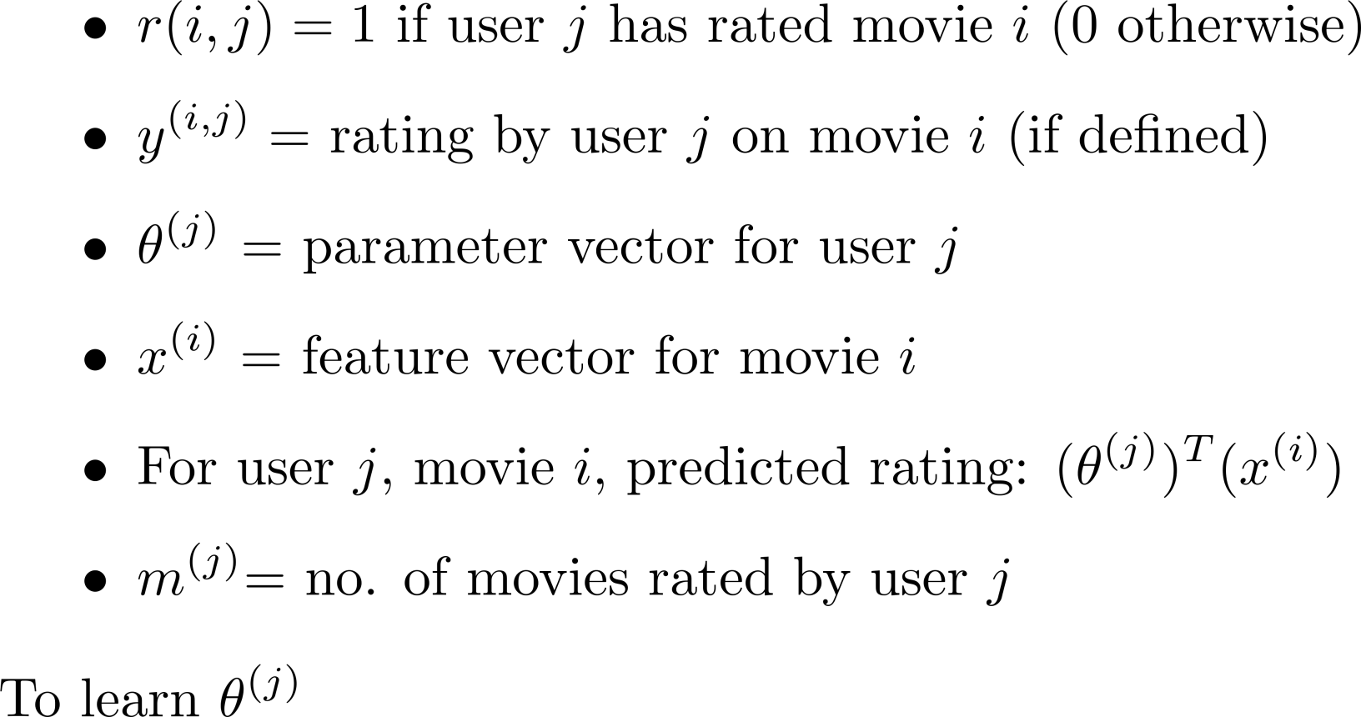
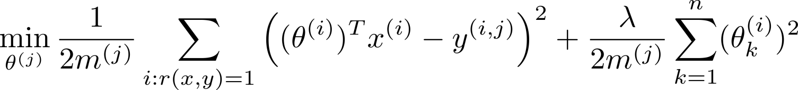
基于内容的推荐系统

Slide 36
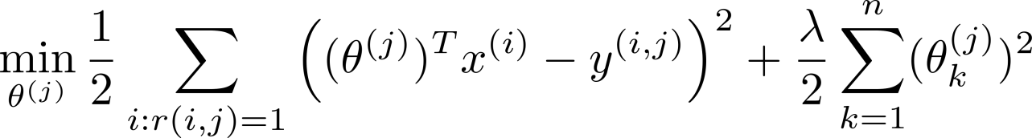
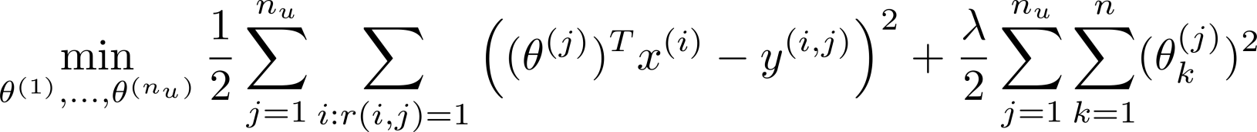
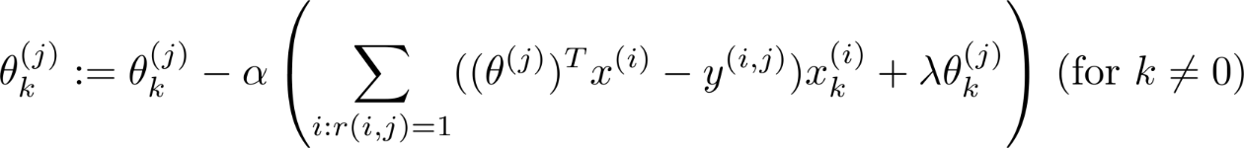
基于内容的推荐系统
Gradient descent update:

Slide 37
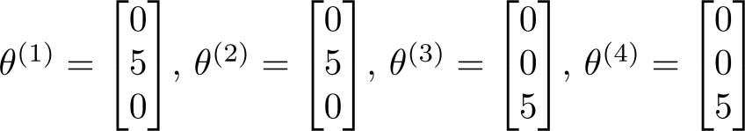
协同滤波(Collaborative filtering)
Movie | Alice (1) | Bob (2) | Carol (3) | Dave (4) | (romance) | (action)
Love at last | 5 | 5 | 0 | 0 | ? | ?
Romance forever | 5 | ? | ? | 0 | ? | ?
Cute puppies of love | ? | 4 | 0 | ? | ? | ?
Nonstop car chases | 0 | 0 | 5 | 4 | ? | ?
Swords vs. karate | 0 | 0 | 5 | ? | ? | ?

Slide 38

协同滤波(Collaborative filtering)

Slide 39

协同滤波(Collaborative filtering)

Slide 40

协同滤波(Collaborative filtering)

Slide 41

协同滤波(Collaborative filtering)
算法

Slide 42




协同滤波(Collaborative filtering):
矢量化
Movie | Alice (1) | Bob (2) | Carol (3) | Dave (4)
Love at last | 5 | 5 | 0 | 0
Romance forever | 5 | ? | ? | 0
Cute puppies of love | ? | 4 | 0 | ?
Nonstop car chases | 0 | 0 | 5 | 4
Swords vs. karate | 0 | 0 | 5 | ?
Predicted ratings:

Slide 43

协同滤波(Collaborative filtering)
对于每部电影，都会学习到一个特征表示
思考：
  如何找到与某部电影最相关的电影？
  如何找到与某部电影最相关的5部电影？

Slide 44


协同滤波： Mean normalization
Users who have not rated any movies
Movie Alice (1) Bob (2) Carol (3) Dave (4)
Eve (5)
Love at last Romance forever
Cute puppies of love
Nonstop car chases Swords vs. karate
5
5
?
5
? 4
0
? 0
0
0
?
?
?
?
?
0
0
0
0
5
5
4
?
?

Slide 45





协同滤波： Mean normalization
For user
, on movie
predict:
User 5 (Eve):

Slide 46
应用
Large Scale Machine Learning
Machine Learning

Slide 47




Recap: Linear Regression with Gradient Descent

Slide 48

Recap: Linear Regression with Gradient Descent

Slide 49


Stochastic gradient descent

Slide 50


Stochastic gradient descent
Batch gradient descent Stochastic gradient descent

Slide 51


Mini-batch gradient descent

Slide 52

Map-reduce and data parallelism

Slide 53

Map-reduce and data parallelism
Computer 1
Training set
Computer 2
Combine results
Computer 3
Computer 4

Slide 54

Map-reduce and data parallelism
Core 1
Training set
Core 2
Combine results
Core 3
Core 4

Slide 55
Thanks!
Any questions?

