Slide 1

神经网络与深度学习 (Neural Networks & Deep Learning )
梁毅雄
yxliang@csu.edu.cn
Machine Learning
Some materials from Andrew Ng, Hung-yi Lee, Fei-Fei Li and others

Slide 2
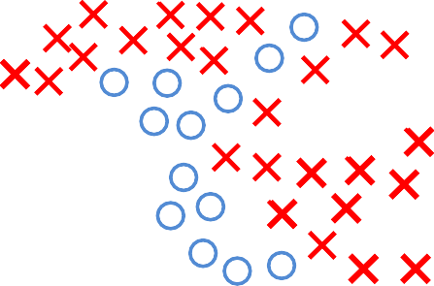
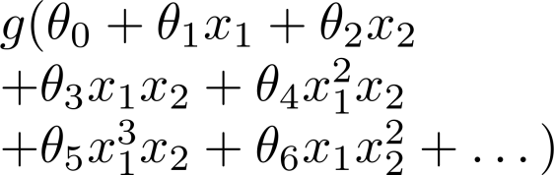


非线性分类
x₂
x₁
size
# bedrooms
# floors age

Slide 3

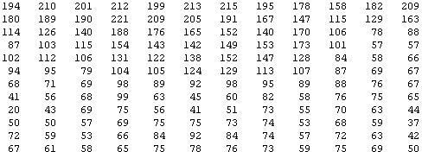
非线性分类
What is this?
You see this:
But the camera sees this:

Slide 4










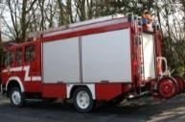

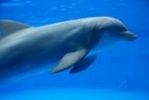

Computer Vision: Car detection
Cars
Not a car
Testing:
What is this?

Slide 5





Learning Algorithm
pixel 1
pixel 2
pixel 2
Cars
“Non”-Cars
pixel 1

Slide 6
Learning Algorithm
pixel 1
pixel 2
pixel 2
Cars
“Non”-Cars
pixel 1

Slide 7


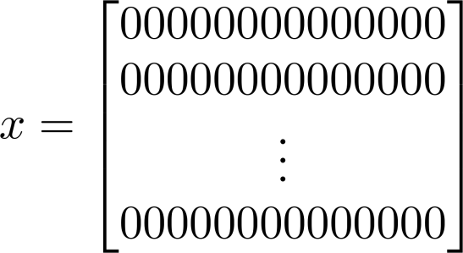

Learning Algorithm
pixel 1
pixel 2
50 x 50 pixel images→ 2500 pixels
(7500 if RGB)
pixel 2
pixel 1 intensity
pixel 2 intensity
pixel 2500 intensity
pixel 1
Quadratic features ( ): ≈ 3 million
features
Cars
“Non”-Cars

Slide 8
神经网络发展史
1958: Perceptron (linear model)
1969: Perceptron has limitation
1980s: Multi-layer perceptron
  Do not have significant difference from DNN today
1986: Backpropagation
  Usually more than 3 hidden layers is not helpful
1989: 1 hidden layer is “good
enough”, why deep?
2006: RBM initialization
2009: GPU
2011: Start to be popular in speech recognition
2012: win ILSVRC image competition
2015.2: Image recognition surpassing human-level performance
2016: Alpha GO beats human
2016: Speech recognition system as good as humans

Slide 9
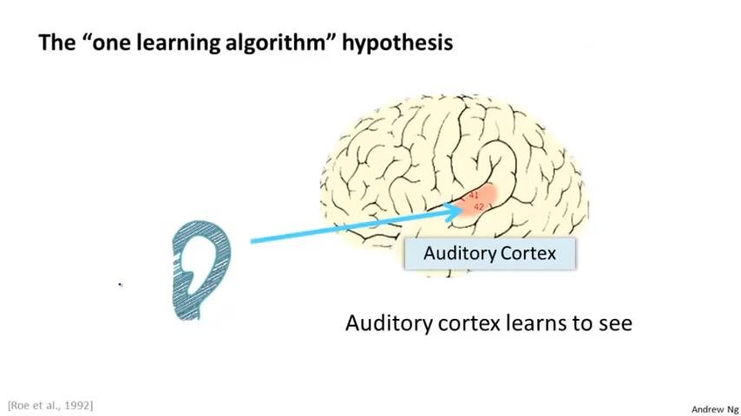

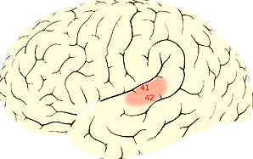

The “one learning algorithm”
hypothesis
Auditory Cortex
Auditory cortex learns to see

Slide 10

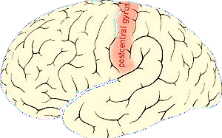

The “one learning algorithm”
hypothesis
Somatosensory Cortex
Somatosensory cortex learns to see

Slide 11
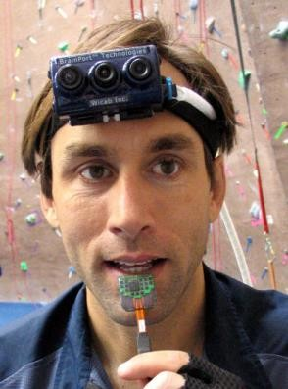
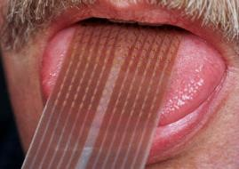
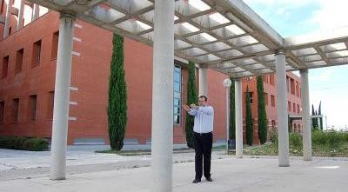
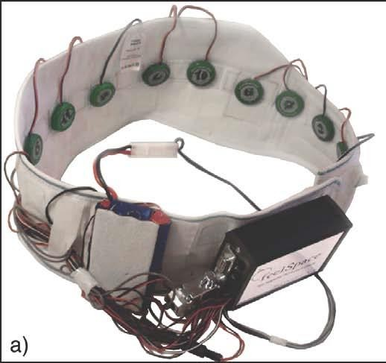

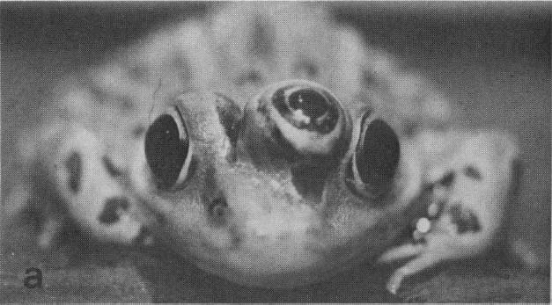
Sensor representations in the brain
Seeing with your tongue
Human echolocation (sonar)
Haptic belt: Direction sense
Implanting a 3rd eye

Slide 12
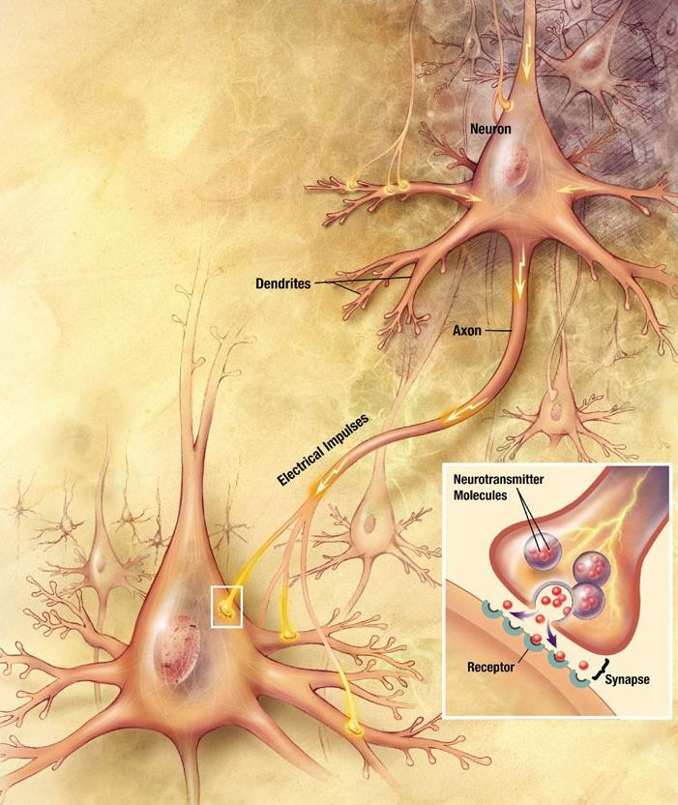
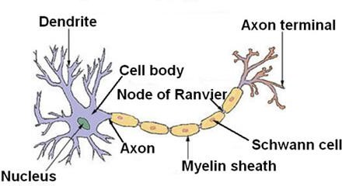
Neuron in the brain

Slide 13
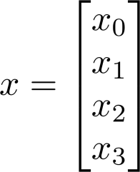
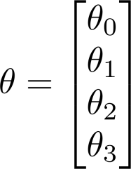


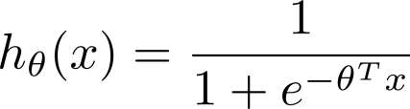





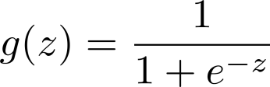
神经元模型: Logistic unit
偏置单元
激活函数
Sigmoid (logistic) activation function.

Slide 14

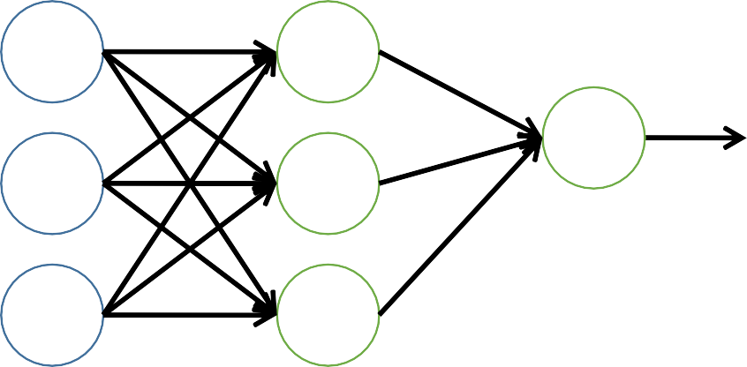







全连接前馈网络(Fully Connect Feedforward Network)
偏置单元
Layer 1
Layer 2
Layer 3

Slide 15




全连接前馈网络(Fully Connect Feedforward Network)
“activation” of unit in layer
matrix of weights controlling function mapping from layer to layer

Slide 16












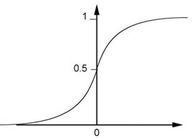

全连接前馈网络(Fully Connect Feedforward Network)
1
4
0.98
1
-
2
1
-1
-2
0.12
-
1
1
0
Sigmoid Function
z

Slide 17


















全连接前馈网络(Fully Connect Feedforward Network)
1
4
0.98
2
0.86
3
0.62
1
-
-
-
2
1
1
0
1
-
0.12
2
-1
-2
-2
0.11
-1
0.83
-
1
1
-1
4
0
0
2

Slide 18
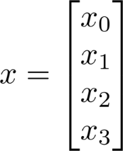
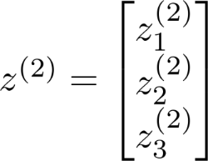






前向传播：矩阵表示
Add
.

Slide 19

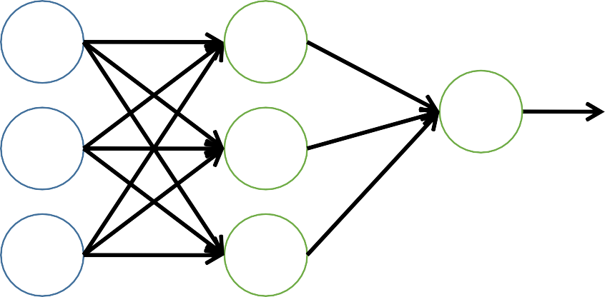
特征学习
Layer 1
Layer 2
Layer 3

Slide 20
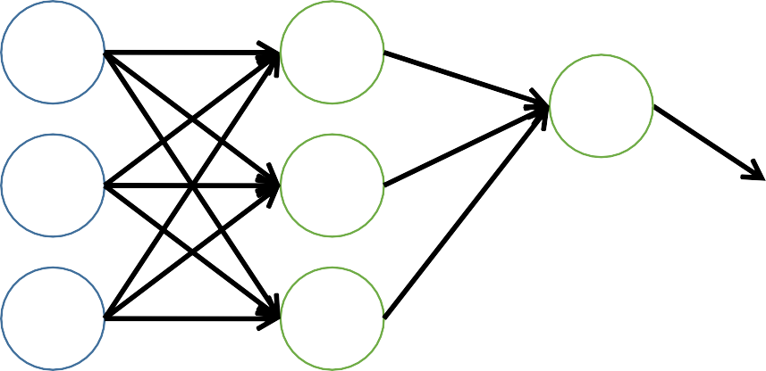
多层神经网络
Layer 1
Layer 2
Layer 3
Layer 4
输入层
隐藏层
输出层

Slide 21
























用神经网络求解XOR/XNOR问题
, are binary (0 or 1).
x₂
x₂
x₁
x₁

Slide 22
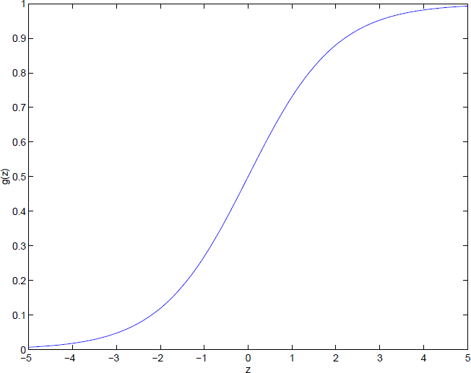




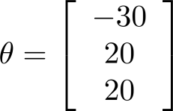




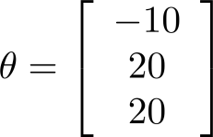

0 | 0
0 | 1
1 | 0
1 | 1
0 | 0
0 | 1
1 | 0
1 | 1

Slide 23



0
1

Slide 24









-30 | 10 | -10
20 | -20 | 20
20 | -20 | 20
-30 | -10 | 0 | 0 | 0 | 1 | 1
20 | 20 | 0 | 1 | 0 | 0 | 0
20 | 20 | 1 | 0 | 0 | 0 | 0
 |  | 1 | 1 | 1 | 0 | 1
10
-20
-20

Slide 25
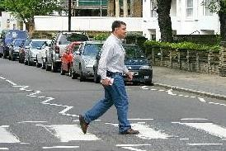

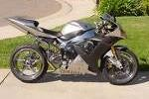
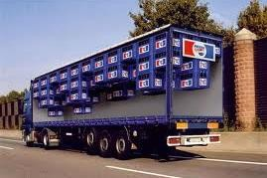
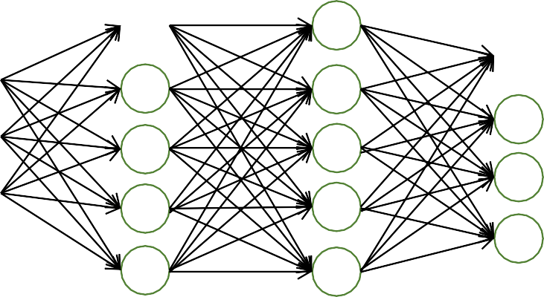

处理多分类问题
Pedestrian
Car
Motorcycle
Truck
Softmax

Slide 26
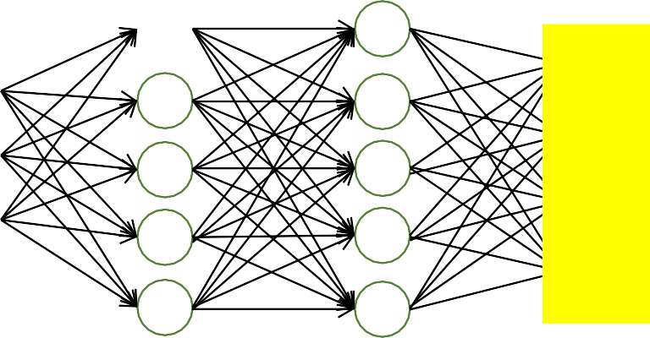
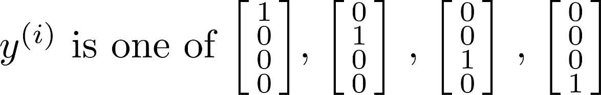
处理多分类问题
Softmax
pedestrian
car motorcycle truck

Slide 27
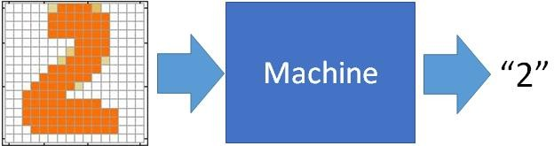


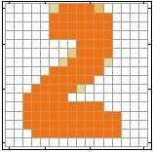










手写数字识别
Input
Output
0.1
is 1
x₁
y₁
x₂
0.7
is 2
y₂
The image
is “2”
……
……
……
0.2
is 0
^{x}256
^{y}10
16 x 16 = 256
Ink → 1
No ink → 0
Each dimension represents the confidence of a digit.

Slide 28









手写数字识别
x₁
^{x}256
y₁
y₂
^{y}10
is 1
x₂
is 2
M^{N}a^{e}c^{u}h^{r}in^{al}e Network
……
“2”
…
…
What is needed is a
function ……
is 0
Input: 256-dim vector
output:
10-dim vector

Slide 29


















手写数字识别
Input
Layer 1
Layer 2
Layer L
Output
x₁
……
y₁
y₂
^{y}10
is 1
x₂
A function set c…o…ntaining the candidates for
Handwriting Digit Recognition
is 2
……
……
……
……
“2”
…
……
x_{N}
……
is 0
Input Layer
Output Layer
Hidden Layers
You need to decide the network structure to let a good function in your function set.

Slide 30
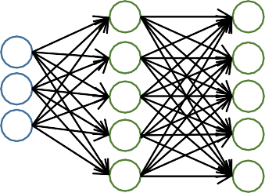
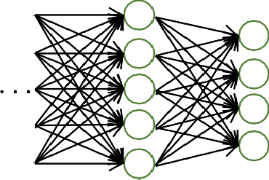
网络结构
不同的网络结构对应不同的假设函数
  多少层？
  每层多少个神经元？
  神经元类型？
  层之间的连接关系
  …

Slide 31
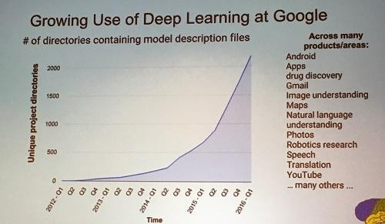
Deep Learning: Many hidden layers
Deep learning trends at Google. Source: SIGMOD 2016/Jeff Dean

Slide 32
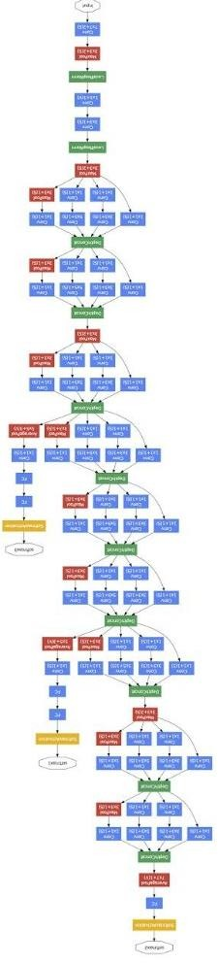


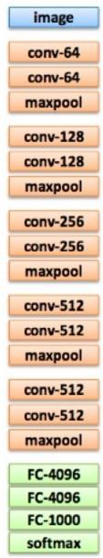




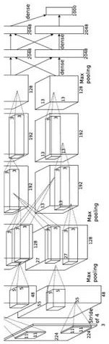
Deep: Many hidden layers
22 layers
19 layers
8 layers
6.7%
7.3%
16.4%
AlexNet (2012)
VGG (2014)
GoogleNet (2014)

Slide 33


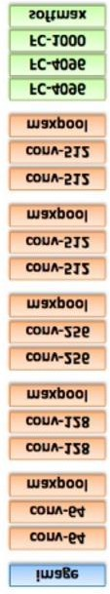
Deep: Many hidden layers
152 layers
Special structure
3.57%
7.3%
6.7%
16.4%
AlexNet (2012)
VGG (2014)
GoogleNet (2014)
Residual Net (2015)

Slide 34
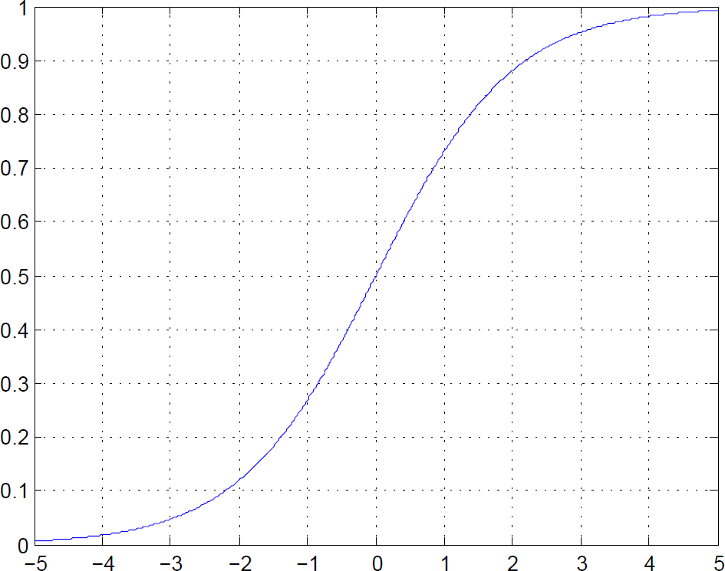

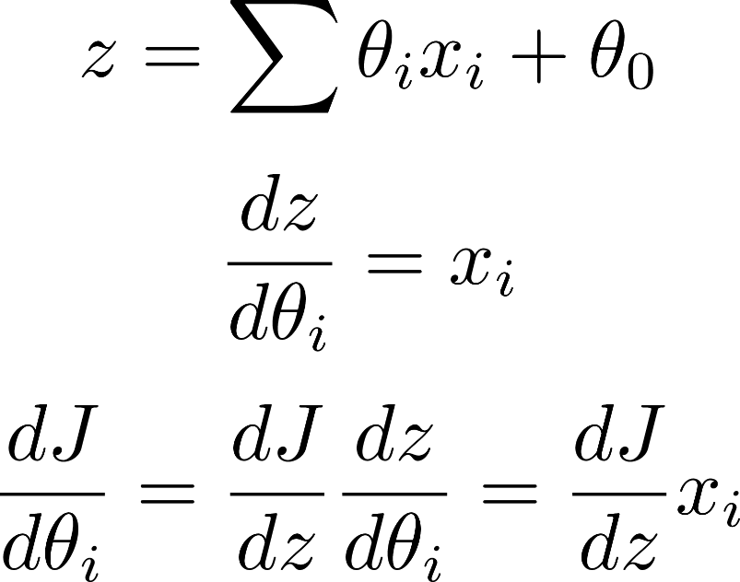
激活函数
Saturated neurons “kill” the gradients
Sigmoid outputs are not zero- centered
exp() is a bit compute expensive

Slide 35
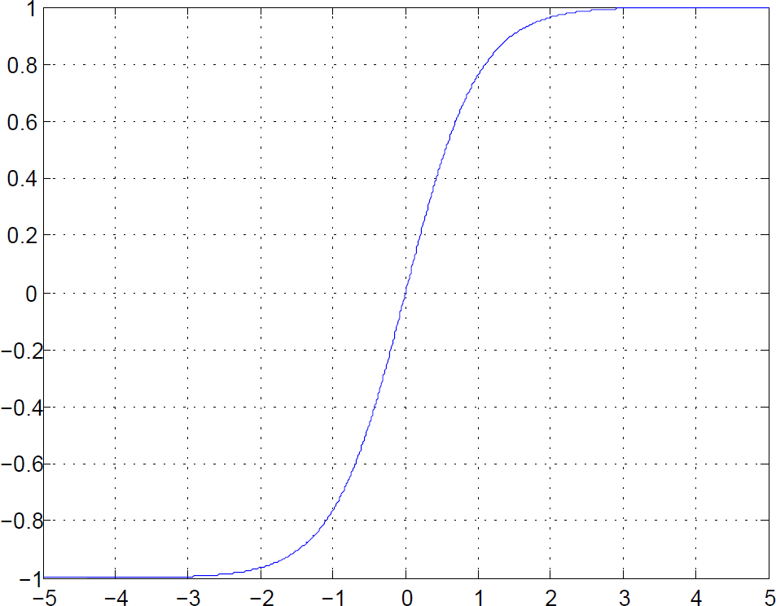

激活函数
Saturated neurons “kill” the gradients
Sigmoid outputs are not zero- centered
exp() is a bit compute expensive
Zero centered (nice)
“kill” the gradients
exp() is a bit compute expensive

Slide 36
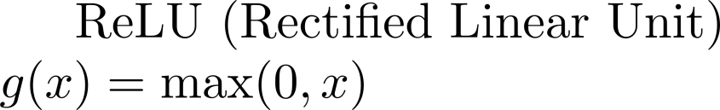
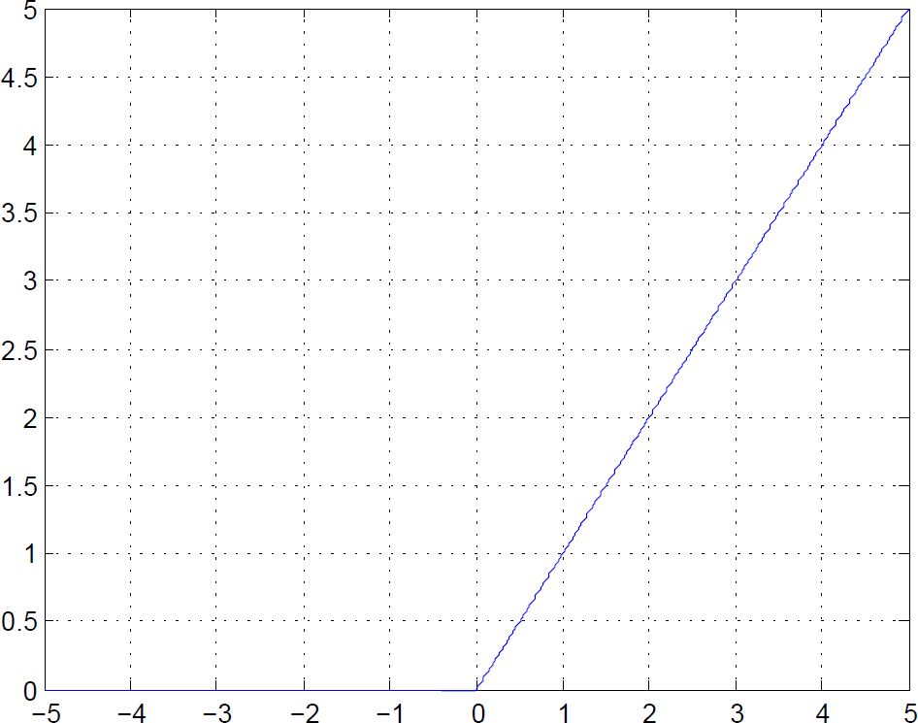
激活函数
Does not saturate (in +region)
Very computationally efficient
Converges much faster than sigmoid/tanh in practice (e.g. 6x)
Actually more biologically plausible than sigmoid
Not zero-centered output
x<0: dead ReLU will never activate
=> never update

Slide 37
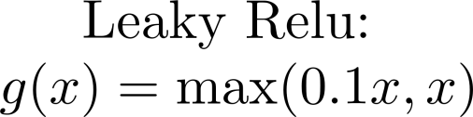


激活函数
Does not saturate (in +region)
Very computationally efficient
Converges much faster than sigmoid/tanh in practice (e.g. 6x)
Actually more biologically plausible than sigmoid
Not zero-centered output
Will not “die”

Slide 38













损失函数
target
“1”
x₁
……
𝑦ො₁
y₁
y₂
^{y}10
1
x₂
Given a set o…f… parameters
Softmax
𝑦ො₂
0
……
……
……
……
Cross Entrop y
……
……
x
……
𝑦ො₁₀
0
256
𝑦ො
𝑦
𝑙 𝑦 , 𝑦ො
= − σ¹⁰
𝑦_{𝑖}log(𝑦ෝ_{𝑖})
𝑖=1

Slide 39























损失函数
Total Loss:
𝑚
𝐿 = ෍ 𝑙^{(𝑖)}
𝑖=1
For all training data …
_{x}(1)
NN
_{𝑦ො}(1) _{y}(1)
_{𝑙}(1)
_{x}(2)
NN
_{𝑦ො}(2)
_{y}(2)
Find a function in function set that minimizes total loss L
_{𝑙}(2)
_{x}(3)
NN
_{𝑦ො}(3) _{y}(3)
_{𝑙}(3)
……
……
……
……
Find the network parameters 𝜽∗ that minimize total loss L
NN
_{𝑦ො}(𝑚)
_{y}(m)
_{x} (m)
_{𝑙}(𝑚)

Slide 40










目标函数
Logistic regression:
Neural network (with softmax loss):
Cross Entropy
L2 Regularization (Weight Decay)

Slide 41



梯度下降法
仍采用梯度下降法：Alpha Go
Need code to compute:
-
-

Slide 42












梯度计算：反向传播
(Backpropagation, BP)

Slide 43
链式法则
Case 1
y = g(x)
z = h(y)
dz ₌ dz dy
Δx → Δy → Δz
dx dy dx
Case 2
x = g(s) y = h(s)
Δx
Δs
Δy
z = k(x, y)
Δz
dz ₌ ∂z dx ₊ ∂z dy
ds ∂x ds ∂y ds

Slide 44


Slide 45


Slide 46


Slide 47


Slide 48


Slide 49


Slide 50


Slide 51


Slide 52






Slide 53


Slide 54


Slide 55





Slide 56
梯度矢量化表示
(x,y,z are now vectors)
This is now the Jacobian matrix (derivative of each element of z w.r.t. each element of x)

Slide 57


梯度矢量化表示
雅可比矩阵(Jacobian matrix)
思考：
雅可比矩阵的大小是？
对于上图Relu激活函数，对应的雅可比矩阵具有什么特点？

Slide 58


Slide 59


Slide 60


Slide 61


Slide 62

Batch gradient descent vs. Stochastic gradient descent

Slide 63

Batch gradient descent vs. Stochastic gradient descent
http://pages.cs.wisc.edu/~spehlmann/cs760/_site//project/2017/05/04/intro.html

Slide 64

Mini-batch gradient descent
Ruder, Sebastian. "An overview of gradient descent optimization algorithms." arXiv preprint arXiv:1609.04747(2016).

Slide 65


Batch gradient descent
Stochastic gradient descent
Mini-batch gradient descent
Ruder, Sebastian. "An overview of gradient descent optimization algorithms." arXiv preprint arXiv:1609.04747(2016).

Slide 66



Stepsize vs. Gradient

Slide 67

Adaptive 学习率

Slide 68




AdaGrad: Motivation
Larger 1st order derivative means far from the minima
Do not cross parameters
a > b
a
b
𝜃
1
𝜃₂
c
c > d
d
𝜃₁
𝜃₂

Slide 69











AdaGrad
Divide the learning rate of each parameter by the root mean square of its previous derivatives
Vanilla Gradient descent
𝜃 is one parameters
Adagrad
𝜎^{𝑡}: root mean square of the previous derivatives of parameter 𝜃
Parameter dependent

Slide 70










AdaGrad
𝜎^{𝑡}: root mean square of the previous derivatives of parameter 𝜃
… …

Slide 71




AdaGrad
思考：What happens to the step size over long time?

Slide 72

AdaGrad
𝜃₂
𝜃₁
思考：What happens with AdaGrad?

Slide 73


RMSProp
思考：What happens to the step size over long time?
Ruder, Sebastian. "An overview of gradient descent optimization algorithms." arXiv preprint arXiv:1609.04747(2016).

Slide 74


























AdaDelta
Zeiler, Matthew D. "Adadelta: an adaptive learning rate method." arXiv preprint arXiv:1212.5701 (2012).

Slide 75



Momentum
基本思想：引入速度（前面梯度的加权均值）
Ruder, Sebastian. "An overview of gradient descent optimization algorithms." arXiv preprint arXiv:1609.04747(2016).

Slide 76



Nesterov Momentum (Nesterov accelerated gradient, NAG)
Ruder, Sebastian. "An overview of gradient descent optimization algorithms." arXiv preprint arXiv:1609.04747(2016).

Slide 77


Adam
思考：What happens at first timestep?
Ruder, Sebastian. "An overview of gradient descent optimization algorithms." arXiv preprint arXiv:1609.04747(2016).

Slide 78


Adam
Ruder, Sebastian. "An overview of gradient descent optimization algorithms." arXiv preprint arXiv:1609.04747(2016).

Slide 79



Adam
思考：Adam可以看成是RMSProp + Momentum,
可否换成Nesterov Momentum?
YES. Nadam
Ruder, Sebastian. "An overview of gradient descent optimization algorithms." arXiv preprint arXiv:1609.04747(2016).

Slide 80
































AdaBelief
Zhuang, Juntang, et al. "AdaBelief Optimizer: Adapting Stepsizes by the Belief in Observed Gradients." NeruIPS 2020

Slide 81





AdaBelief
Zhuang, Juntang, et al. "AdaBelief Optimizer: Adapting Stepsizes by the Belief in Observed Gradients." NeruIPS 2020

Slide 82

各种梯度下降法可视化
http://imgur.com/a/Hqolp

Slide 83

各种梯度下降法可视化
http://imgur.com/a/Hqolp

Slide 84

各种梯度下降法可视化
http://imgur.com/a/Hqolp

Slide 85

AdaBelief
Zhuang, Juntang, et al. "AdaBelief Optimizer: Adapting Stepsizes by the Belief in Observed Gradients." NeruIPS 2020

Slide 86
Which optimizer to use?
Compared to the SGD family, adaptive methods typically converge fast in the early training phases, but have poor generalization performance
Insofar, Adam or AdaBelief might be the best overall choice.
SGD
  usually achieves to find a minimum, but it might take significantly longer
  is much more reliant on a robust initialization and annealing schedule
  may get stuck in saddle points rather than local minima

Slide 87
Additional strategies for optimizing SGD
Shuffling and Curriculum Learning
  It is often a good idea to shuffle the training data after every epoch
  On the other hand, for some cases where we aim to solve progressively harder problems, supplying the training examples in a meaningful order may actually lead to improved performance and better convergence
Early stopping: Early stopping (is) beautiful free lunch (Geoff Hinton)
Gradient noise: add noise to each gradient update
Ruder, Sebastian. "An overview of gradient descent optimization algorithms." arXiv preprint arXiv:1609.04747(2016).

Slide 88


二阶方法：牛顿法
假设采用牛顿法求解方程 f(θ) = 0 的解，迭代规则如下：

Slide 89





牛顿法
与梯度下降法相比：
Faster convergence
More expensive
No learning rate! 4. …
思考：如何从泰勒展开去推导牛顿法?

Slide 90






牛顿法
Best step:
𝑏
|𝑥 + |
|2𝑎𝑥₀ + 𝑏|
0
2𝑎
2𝑎
𝑏
−
2𝑎
𝑥₀
𝑦 = 𝑎𝑥² + 𝑏𝑥 + 𝑐
|2𝑎𝑥₀ + 𝑏|
𝜕𝑦
𝑥₀
= |2𝑎𝑥 + 𝑏|
𝜕𝑥
𝜕²𝑦
_{𝜕𝑥2} = 2𝑎
|First derivative|
Second derivative
The best step is

Slide 91
一阶方法
由于二阶方法需要计算Hessian 矩阵，在参数数目较多的情况 下计算复杂，目前主要仍采用 一阶方法，如
优点:
共轭梯度
Quasi-Newton methods(BFGS)
不用人为选择学习率
比梯度下降算法要快.
Approximate inverse Hessian with rank 1 updates
缺点:
- 更复杂
L-BFGS (Limited memory BFGS)
  Does not form/store the full inverse Hessian

Slide 92



Gradient checking
(E.g.
is “unrolled” version of
)

Slide 93





Zero initialization?
初始化

Slide 94
初始化
Random initialization (Gaussian with zero mean and 1e-2 standard deviation)?
Works ~okay for small networks, but problems with deeper networks Xavier initialization [Glorot et al., 2010]
He initialization [He et al., 2015]

Slide 95
初始化
Understanding the difficulty of training deep feedforward
neural networks by Glorot and Bengio, 2010 (Xavier initialization )
Exact solutions to the nonlinear dynamics of learning in deep linear neural networks by Saxe et al, 2013
Random walk initialization for training very deep feedforward networks by Sussillo and Abbott, 2014
Delving deep into rectifiers: Surpassing human-level
performance on ImageNet classification by He et al., 2015 (He initialization )
Data-dependent Initializations of Convolutional Neural Networks by Krähenbühl et al., 2015
All you need is a good init, Mishkin and Matas, 2015
…

Slide 96
Putting it together

Slide 97

数据预处理

Slide 98



网络结构选择与设计

Slide 99
训练网络
Initialize weights
Implement forward propagation
Implement code to compute cost function
Implement backpropagation code to compute gradient
Implement numerical gradient check (disable your gradient checking code before training)
Double check that the loss is reasonable
Make sure that you can overfit very small portion of the training data
Start with small regularization and find learning rate that makes the loss go down

Slide 100
Thanks!
Any questions?

