Slide 1

聚类
(Clustering)
梁毅雄
yxliang@csu.edu.cn
Machine Learning
Some materials from Andrew Ng, Eric Xing, Andrew W. Moore and others

Slide 2
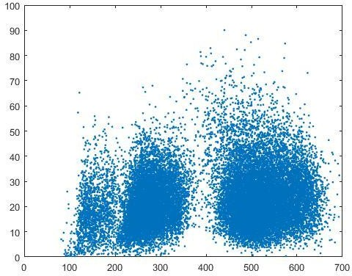

聚类(Clustering)
What is clustering
  Are there any “grouping” them ?
  What is each group ?
  How many ?
  How to identify them?
  …

Slide 3
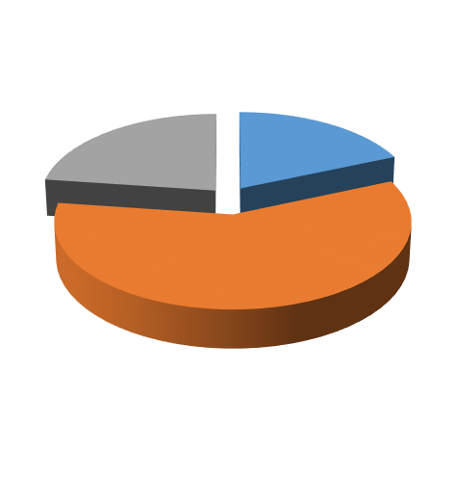





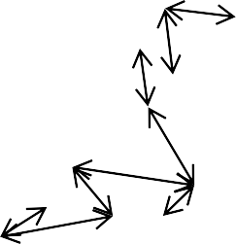





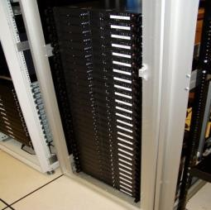
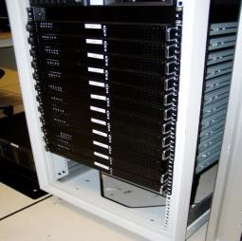
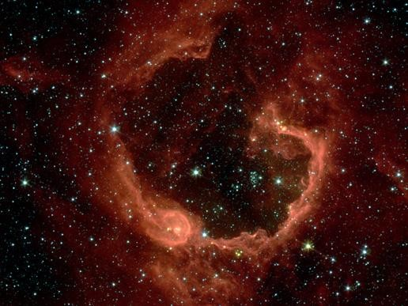
聚类(Clustering)
Applications of clustering
聚类：
  the process of grouping a set of objects into classes of similar objects
  同一簇中的样本尽可能的 相似，而不同簇中的样本 尽可能不同
  高类内相似性(high intra- class similarity)
  低类间相似性(low inter- class similarity)
  属于最典型的非监督学习 方法
Market segmentation
Social network analysis
Organize computing clusters
Image credit: NASA/JPL-Caltech/E. Churchwell (Univ. of Wisconsin, Madison)
Astronomical data analysis

Slide 4
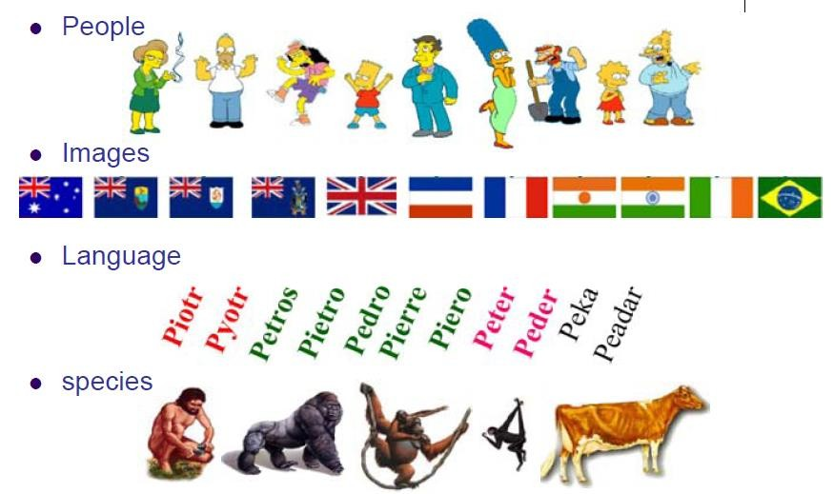


聚类
Market segmentation
Social network
analysis
Image credit: NASA/JPL-Caltech/E. Churchwell (Univ. of Wisconsin, Madison)
Organize computing clusters
Astronomical data analysis

Slide 5
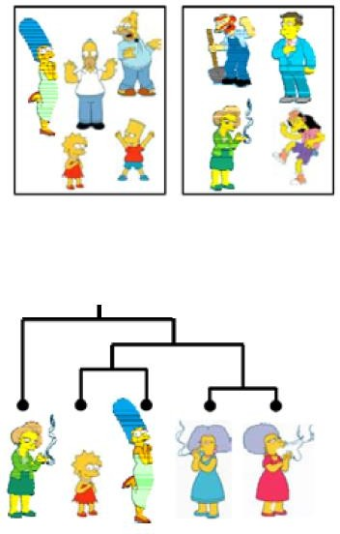
聚类的应用
聚类方法大致可分为：
  Partitional algorithms: 划分 为互不相交的簇
    基于原型的聚类：K-Means, GMM等
    基于密度的聚类：DBSCAN, MeanShift等
  Hierarchical algorithms
    Bottom-up, agglomerative
    Top-down, divisive

Slide 6







Recap:监督学习 vs.非监督学习
非监督学习： learning from raw (unlabeled, unannotated, etc) data, as opposed to supervised data where a classification of examples is given
Training set:
Training set:

Slide 7
聚类需要考虑的问题
What is a natural grouping among these objects?
  Definition of "groupness"
What makes objects “related”?
  Definition of "similarity/distance"
How many clusters?
  Fixed a priori?
  Completely data driven?
如何评价聚类算法的有效性？

Slide 8
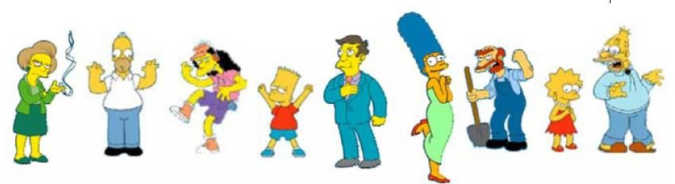
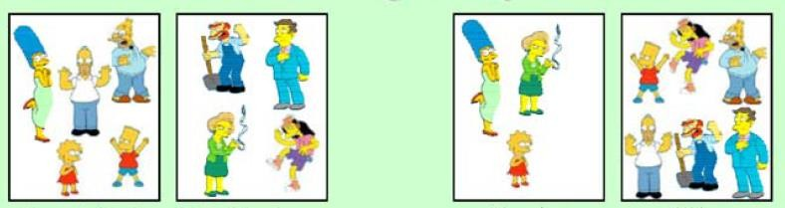
聚类的依据
Simpson’s Family School Employees Females Males
聚类是主观的

Slide 9
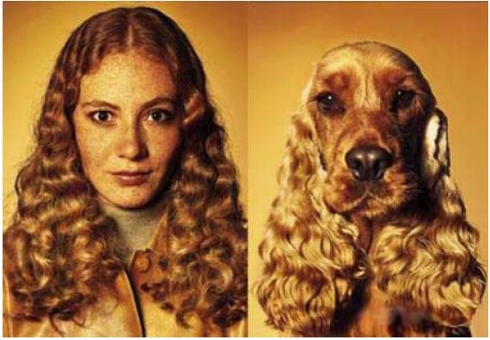
如何定义相似性(或距离)
Hard to define! But we know it when we see it

Slide 10
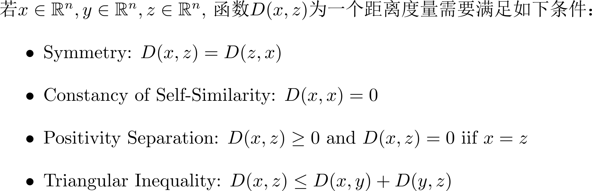
Recap: 距离

Slide 11
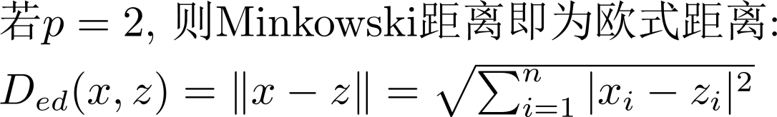
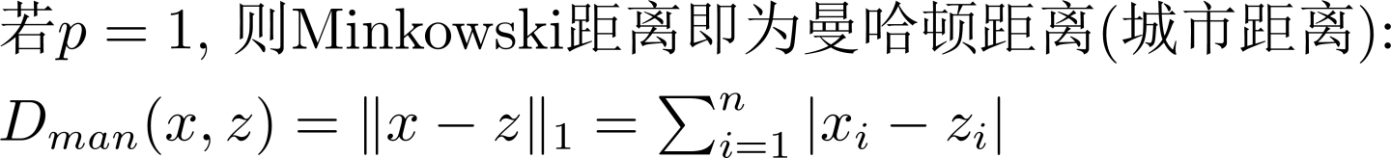
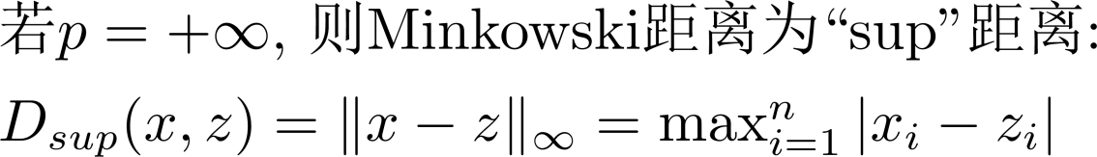
Recap: Minkowski距离

Slide 12
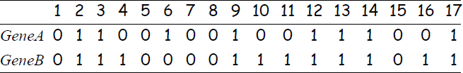
Recap: Hamming距离
当特征为二值特征时， Minkowski 距离称为
Hamming距离
如： Gene Expression Levels Under 17 Conditions (1-High,0-Low)
Hamming Distance = ?

Slide 13
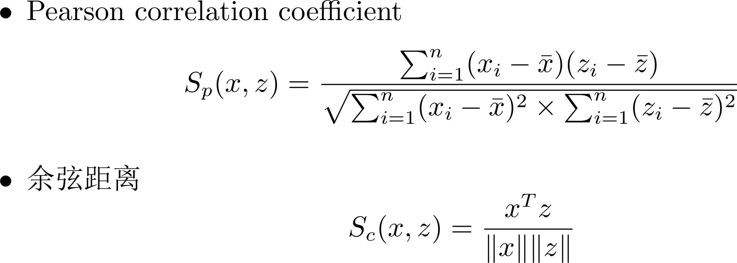
Recap: 相似性度量

Slide 14

Clustering
K-means algorithm
Machine Learning

Slide 15
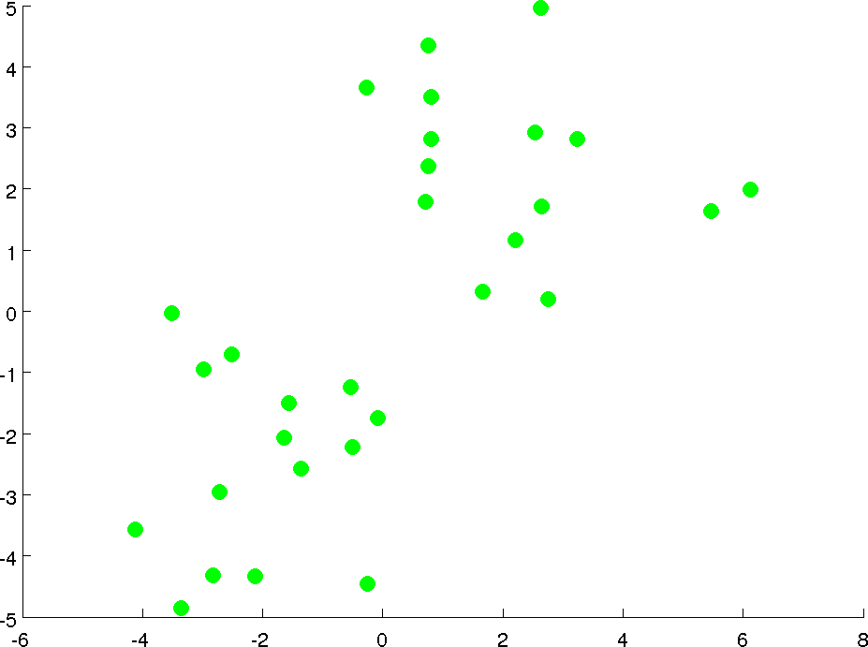

Slide 16
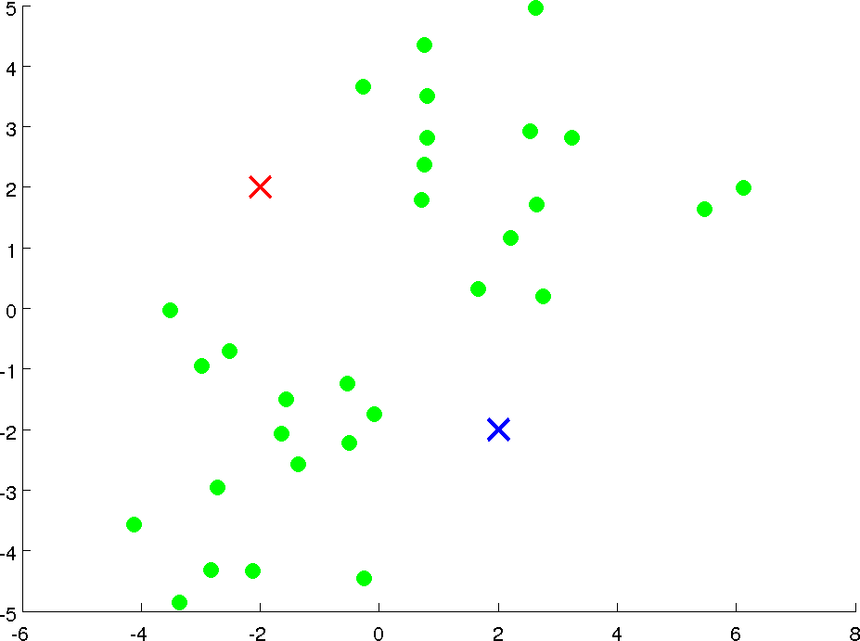



Slide 17
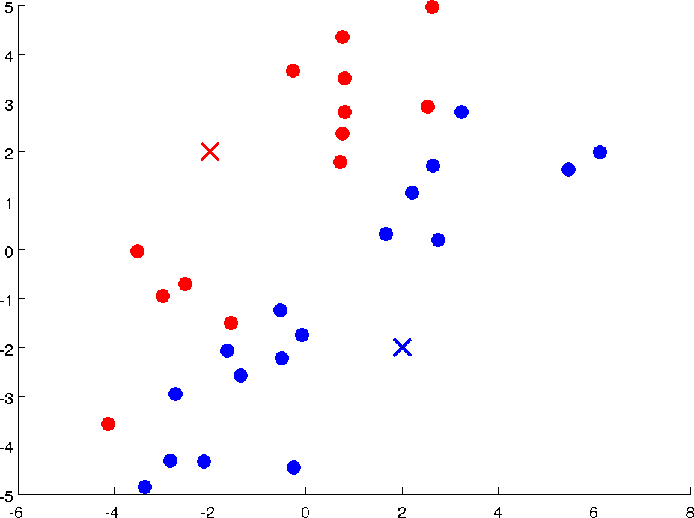

Slide 18
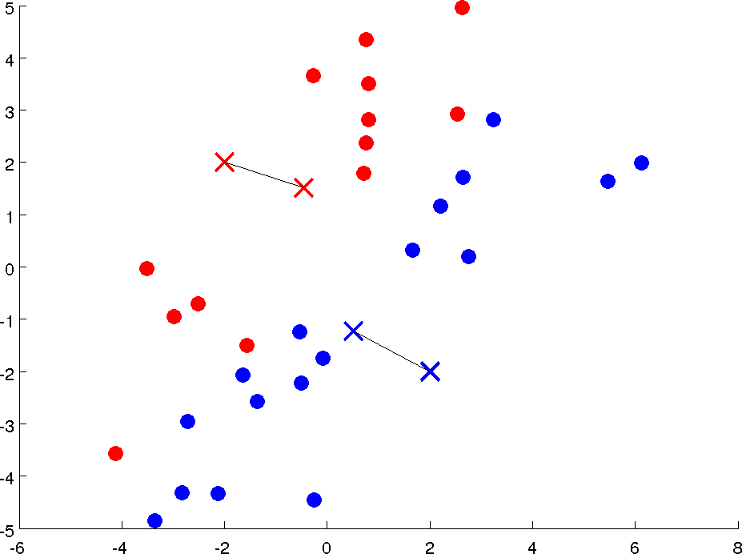



Slide 19
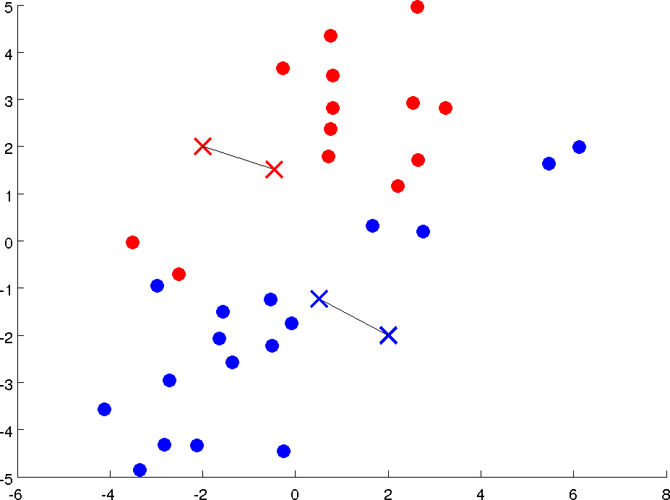

Slide 20
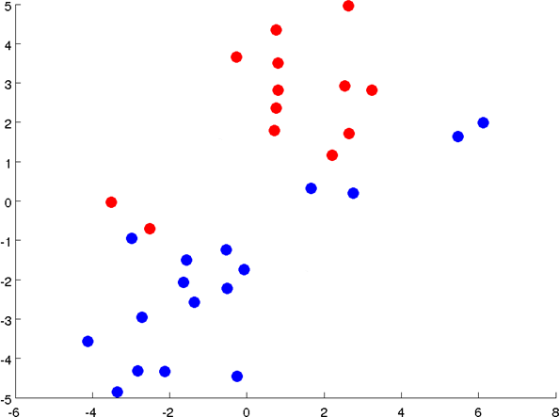



Slide 21
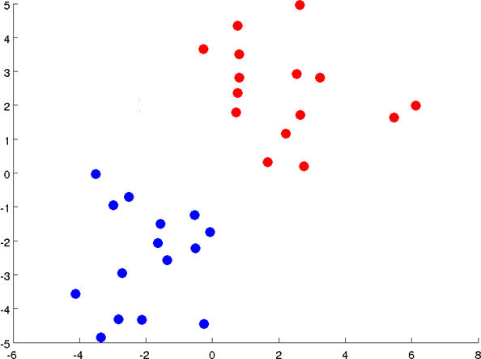

Slide 22



Slide 24
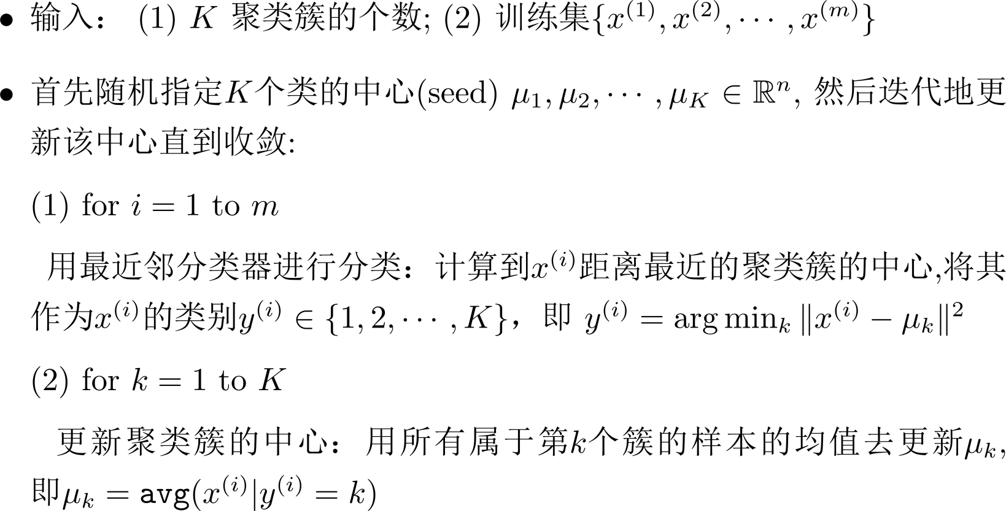
K-means algorithm

Slide 25
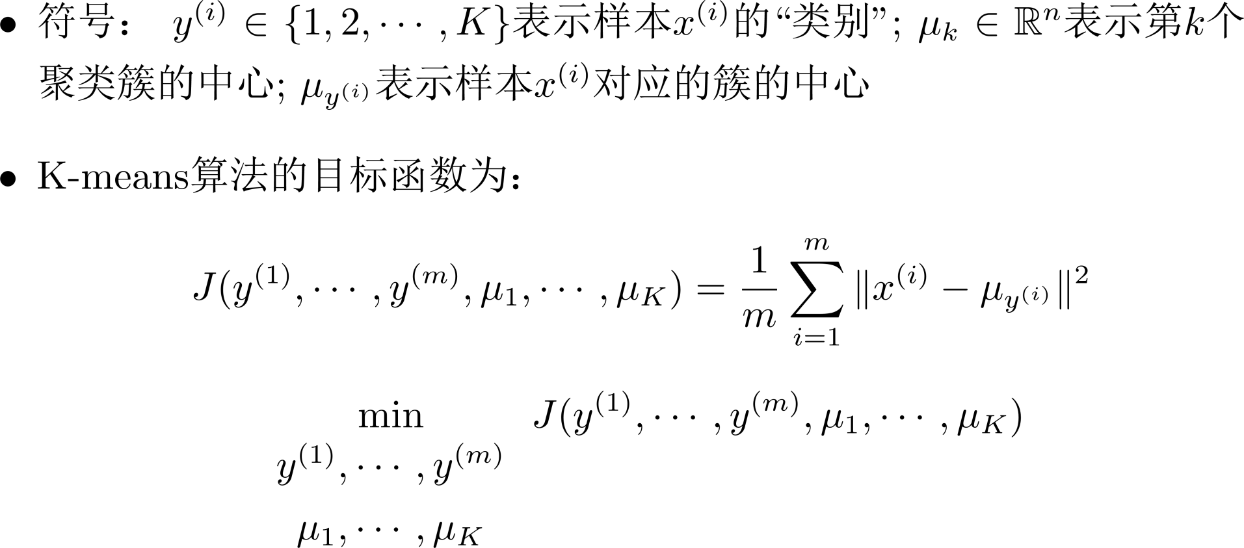
K-means algorithm

Slide 26
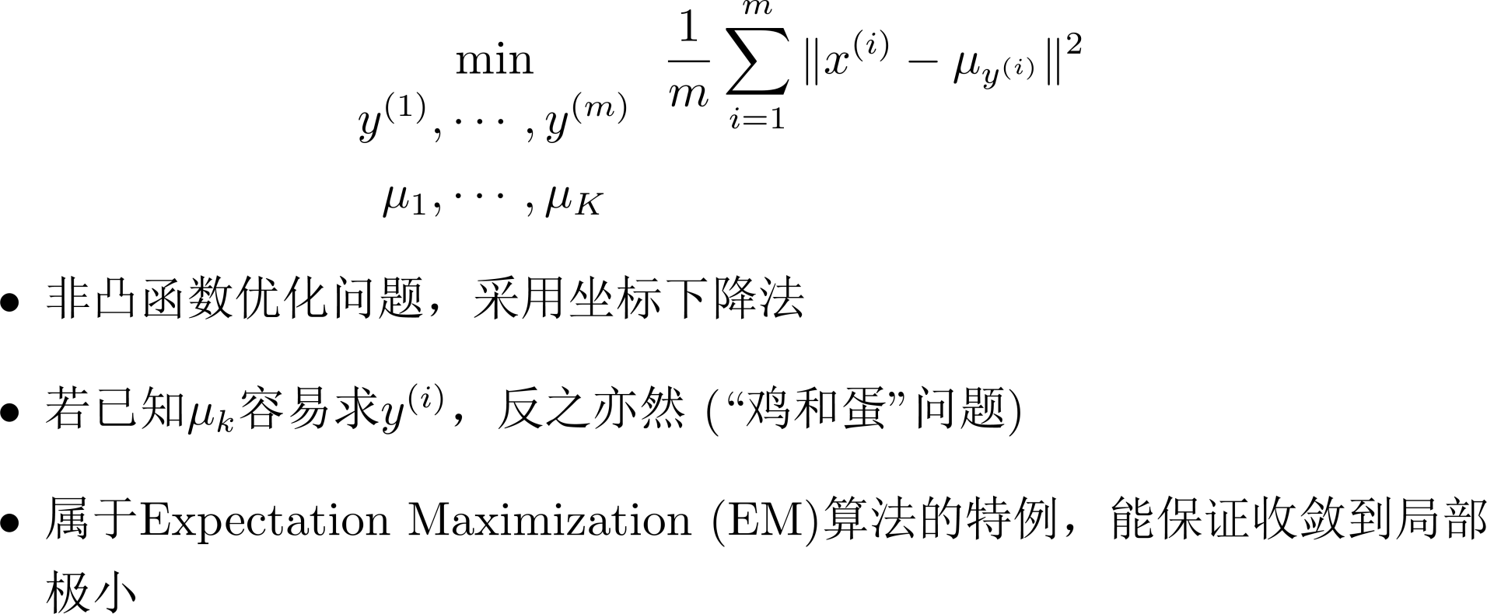
K-means algorithm

Slide 27
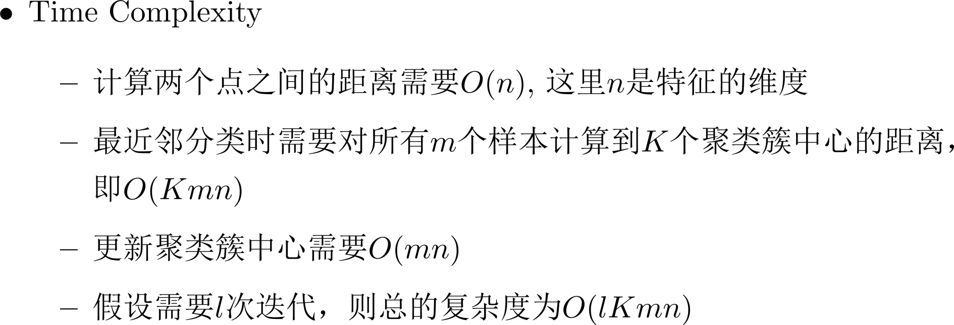
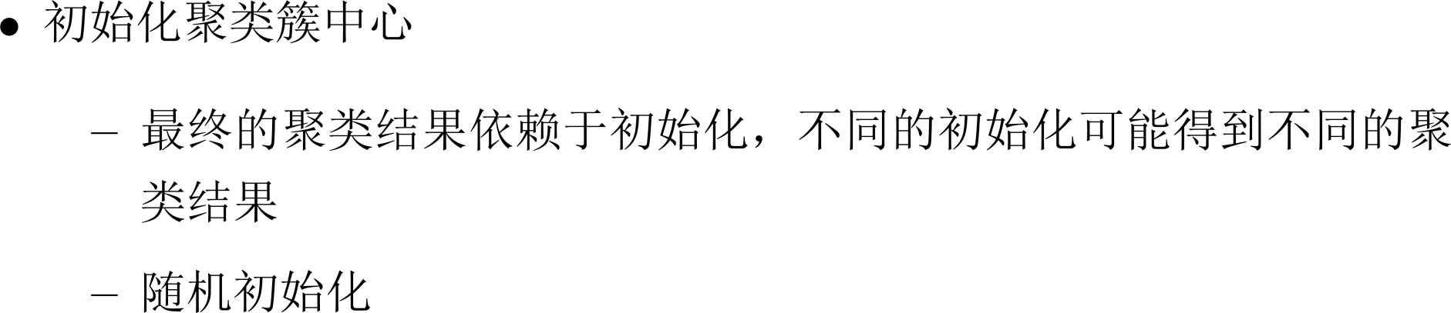
K-means algorithm

Slide 28
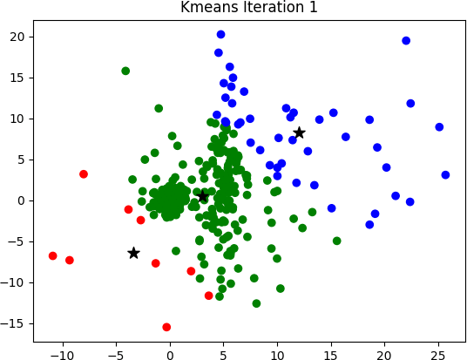
https://sandipanweb.wordpress.com/2017/03/19/hard-soft-clustering-with-k-means-weighted-k-means-and-gmm-em/

Slide 29





K-means algorithm
Random initialization
Should have
Randomly pick examples.
training
Set
examples.
equal to these

Slide 30
K-means algorithm
Local optima

Slide 31

K-means algorithm
Random initialization
For i = 1 to 100 {
Randomly initialize K-means. Run K-means. Get
Compute cost function (distortion)
}
Pick clustering that gave lowest cost

Slide 32
K-means algorithm
如何选择聚类个数K？

Slide 33
K-means algorithm
Choosing the value of K
Elbow method:
Elbow
Cost function
Cost function
1 2 3 4 5 6 7 8
(no. of clusters)
1 2 3 4 5 6 7 8
(no. of clusters)

Slide 34
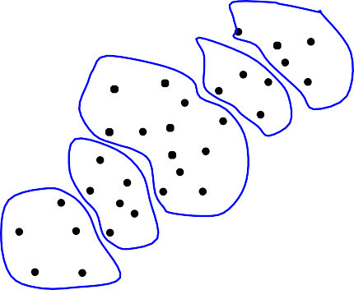
K-means algorithm
Choosing the value of K
很多情况下K-means只是一个复杂任务的前处理步骤（如经典的Bag of Words分类方法），因此可能需要结合最终任务的性能来调整对 应的K
E.g.
T-shirt sizing T-shirt sizing
L
XL
M
M
L
Weight
Weight
S
S
XS
Height
Height

Slide 35
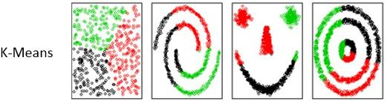
Kernel K-means
K-means算法依赖于距离度量的选择
  常采用欧式距离
  Distance Metric Learning
  Kernel K-means: 通过隐式映射ϕ将数据变换到某 个空间后，再用欧式距离度量

Slide 36
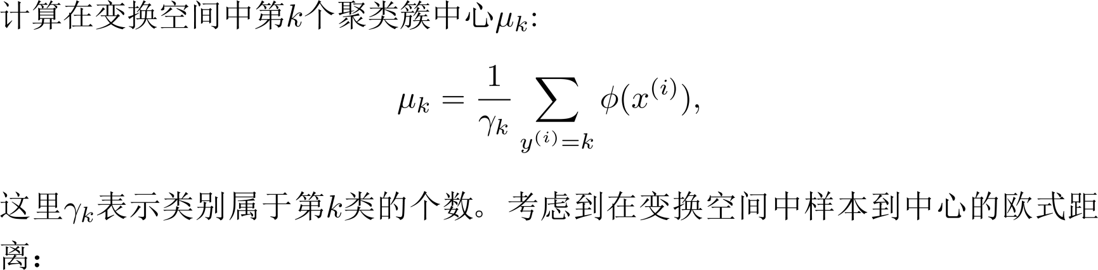
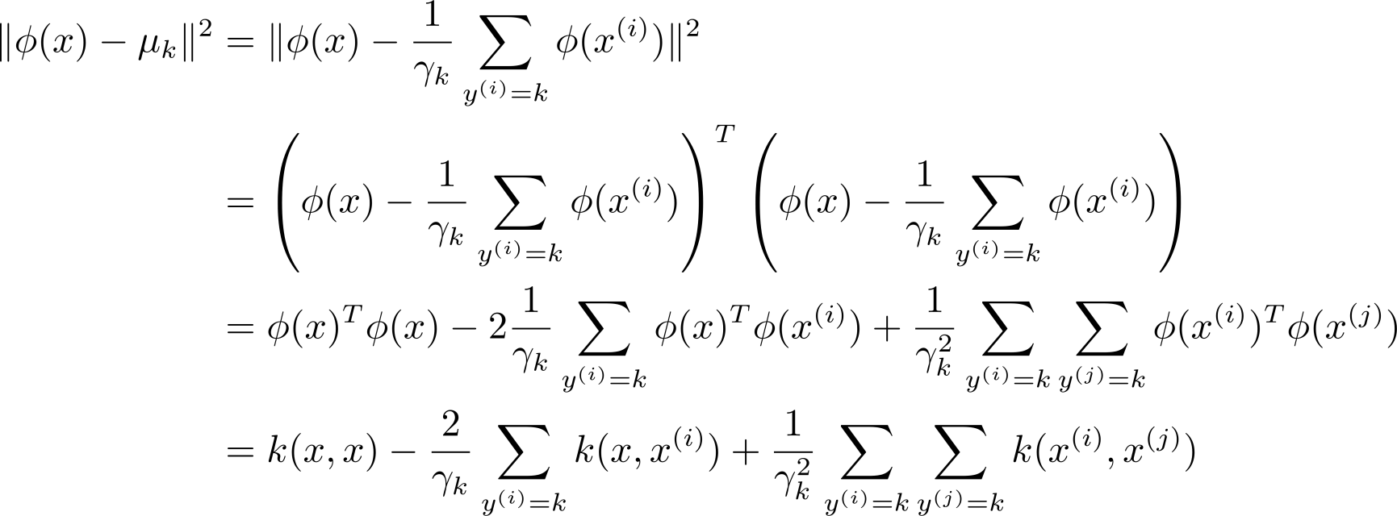
Kernel K-means

Slide 37
Clustering
Gaussian Mixture Model, GMM
Machine Learning

Slide 38
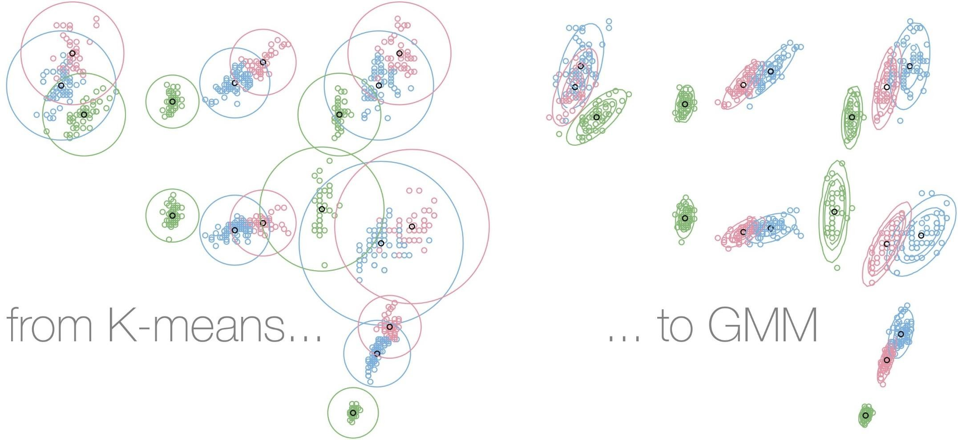
https://towardsdatascience.com/mixture-modelling-from-scratch-in-r-5ab7bfc83eef

Slide 39
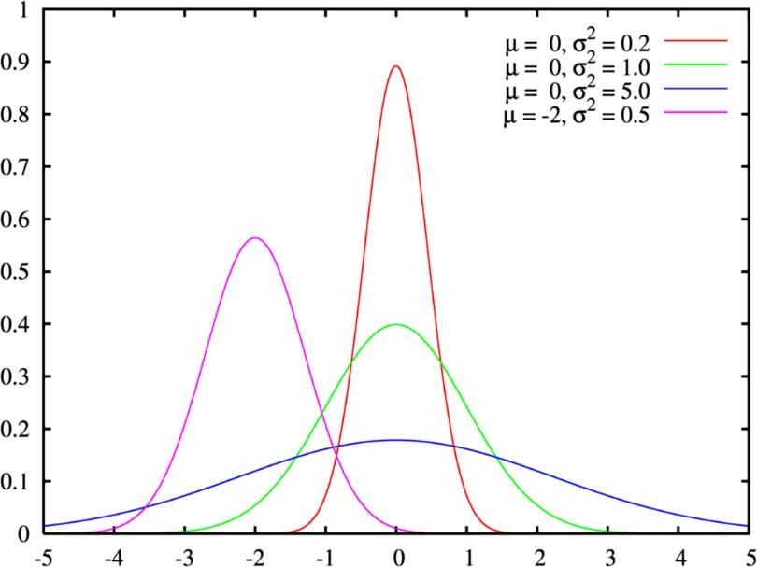
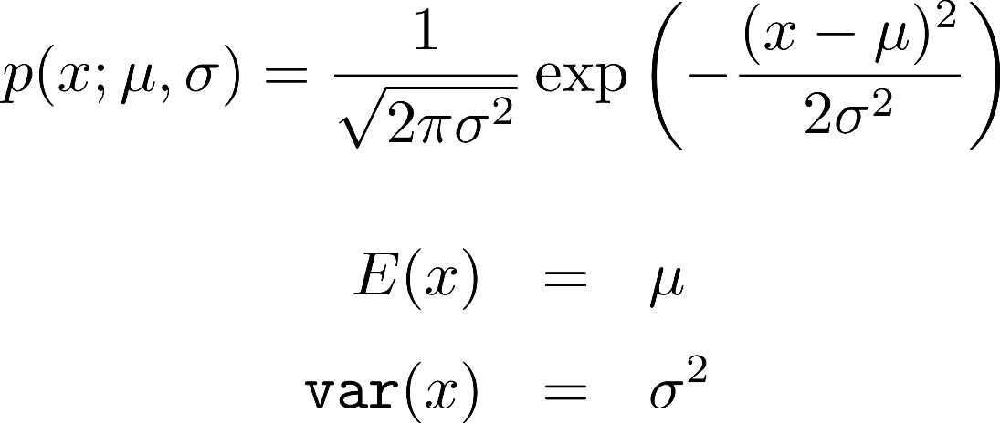
Recap: Gaussian Distribution

Slide 40
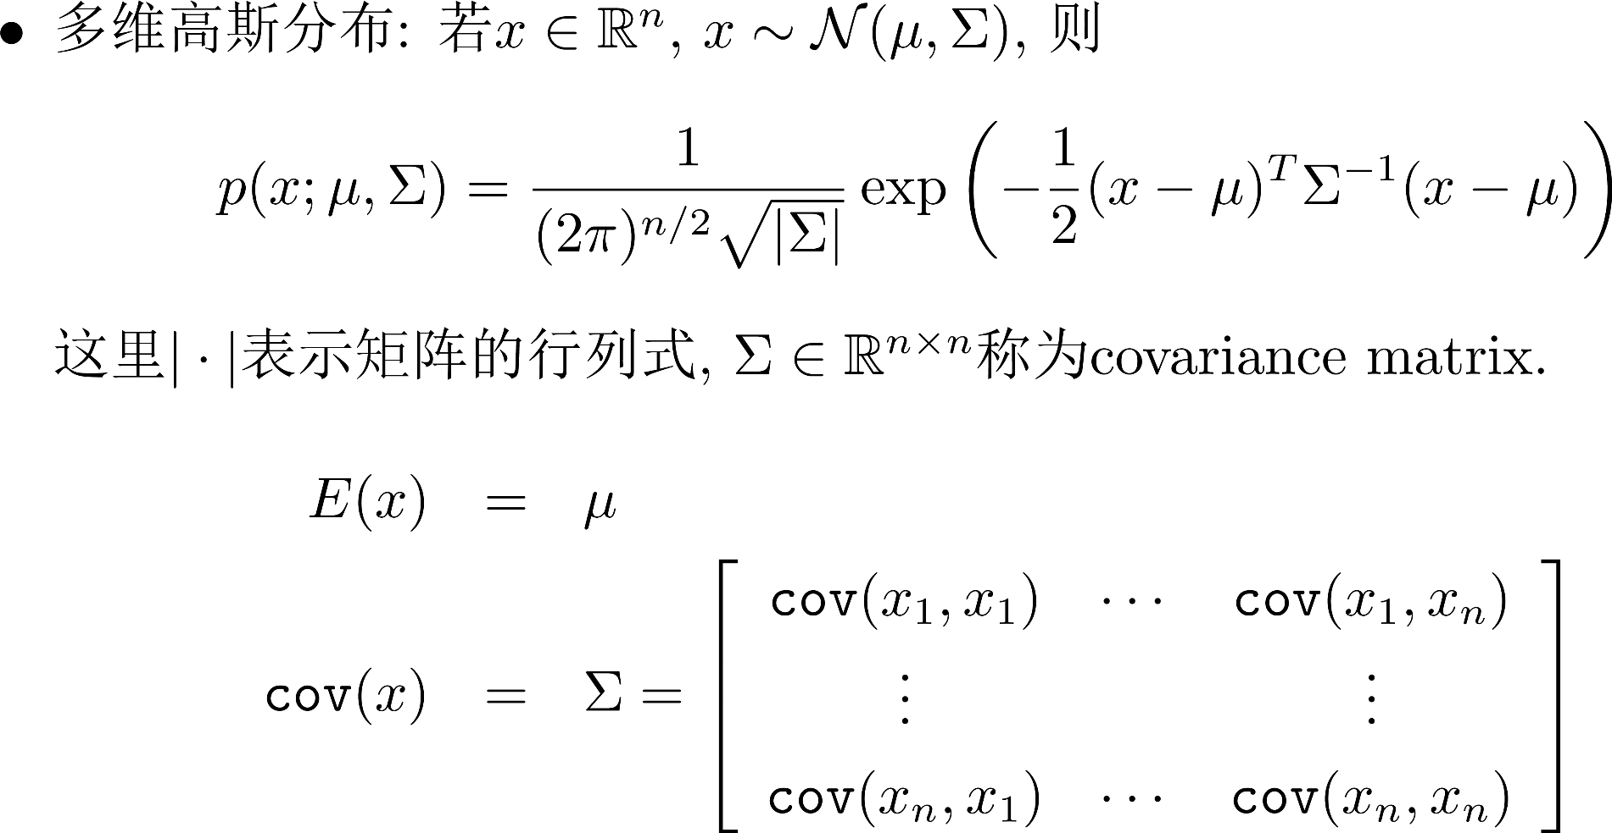
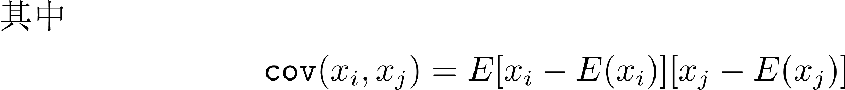
Recap: Gaussian Distribution

Slide 41
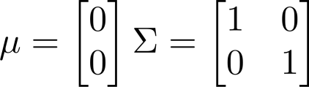
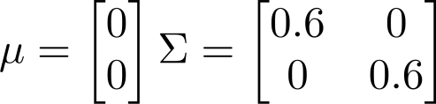
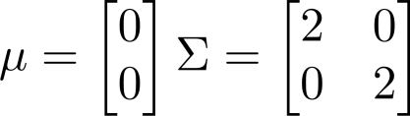
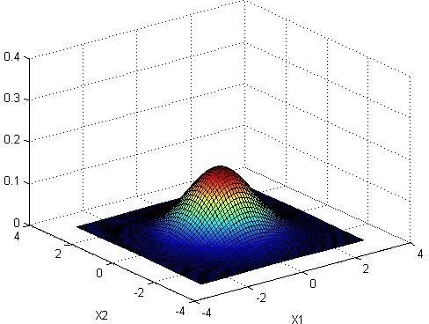
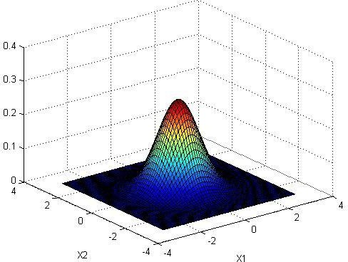
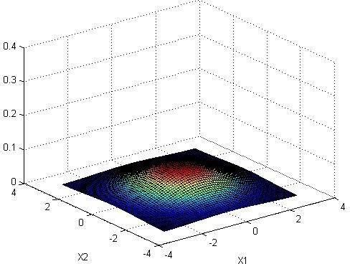
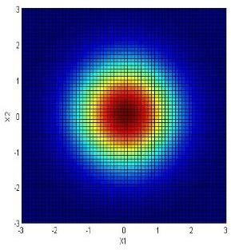
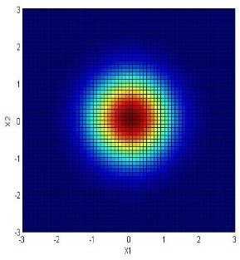
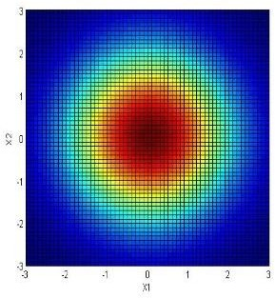
Recap: Gaussian Distribution
Multivariate Gaussian (Normal) examples

Slide 42
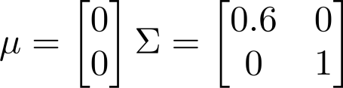
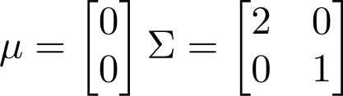




Recap: Gaussian Distribution
Multivariate Gaussian (Normal) examples

Slide 43






Recap: Gaussian Distribution
Multivariate Gaussian (Normal) examples

Slide 44






Recap: Gaussian Distribution
Multivariate Gaussian (Normal) examples

Slide 45






Recap: Gaussian Distribution
Multivariate Gaussian (Normal) examples

Slide 46






Recap: Gaussian Distribution
Multivariate Gaussian (Normal) examples

Slide 47

Bayes Decision
似然
先验概率
后验概率

Slide 48


Bayes Decision

Slide 49

Bayes Decision

Slide 50

高斯混合模型(Gaussian Mixture
Model, GMM)
μ₂
μ₁
μ₃

Slide 51

高斯混合模型(Gaussian Mixture Model, GMM)

Slide 52




高斯混合模型(Gaussian Mixture Model, GMM)

Slide 53


高斯混合模型(Gaussian Mixture Model, GMM)

Slide 54

高斯混合模型(Gaussian Mixture Model, GMM)
Petersen, Kaare Brandt, and Michael Syskind Pedersen. "The matrix cookbook." Technical University of Denmark 7, no. 15 (2008): 510.

Slide 55

高斯混合模型(Gaussian Mixture Model, GMM)

Slide 56

高斯混合模型(Gaussian Mixture Model, GMM)

Slide 57

高斯混合模型(Gaussian Mixture Model, GMM)

Slide 58

高斯混合模型(Gaussian Mixture Model, GMM)

Slide 59

GMM聚类

Slide 60

GMM聚类
After first iteration

Slide 61

GMM聚类
After 2nd iteration

Slide 62

GMM聚类
After 3rd iteration

Slide 63

GMM聚类
After 4th iteration

Slide 64

GMM聚类
After 5th iteration

Slide 65

GMM聚类
After 6th iteration

Slide 66

GMM聚类
After 20th iteration

Slide 67

https://sandipanweb.wordpress.com/2017/03/19/hard-soft-clustering-with-k-means-weighted-k-means-and-gmm-em/

Slide 68


https://sandipanweb.wordpress.com/2017/03/19/hard-soft-clustering-with-k-means-weighted-k-means-and-gmm-em/

Slide 69
Expectation Maximization (EM)
Machine Learning

Slide 70

Recap: Convex Function

Slide 71


Aside: Jensen’s Inequality

Slide 72

期望最大化(EM)

Slide 73





































期望最大化(EM)

Slide 74

期望最大化(EM)

Slide 75

期望最大化(EM)

Slide 76


GMM Revisited

Slide 77

GMM Revisited

Slide 78

GMM Revisited

Slide 79

GMM Revisited

Slide 80
Thanks!
Any questions?

