Slide 1

维数约简 (Dimensionality Reduction)
梁毅雄
yxliang@csu.edu.cn
Machine Learning
Some materials from Andrew Ng, Jure Leskovec, Hong-yi Lee and others

Slide 2

维数约简
Introduction
Machine Learning

Slide 3
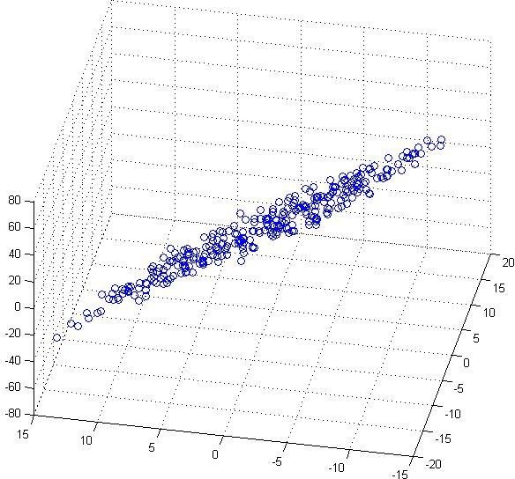
维数约简
(inches)
(cm)

Slide 4
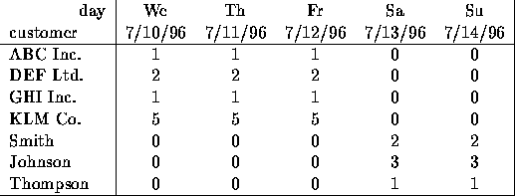
维数约简
上表中每行表示一个样本，每个样本有5个特征
但实际上无需用5维空间来表示这些样本，而只 需要？维的空间即可

Slide 5
Why Reduce Dimensions?
Discover hidden correlations/topics
  Words that occur commonly together
Remove redundant and noisy features
  Not all words are useful
Easier storage and processing of the data
Interpretation and visualization

Slide 6
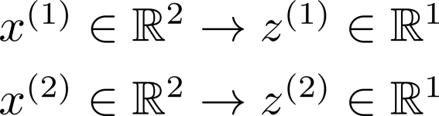
数据压缩
(inches)
将数据从二维降到一 维
(cm)

Slide 7
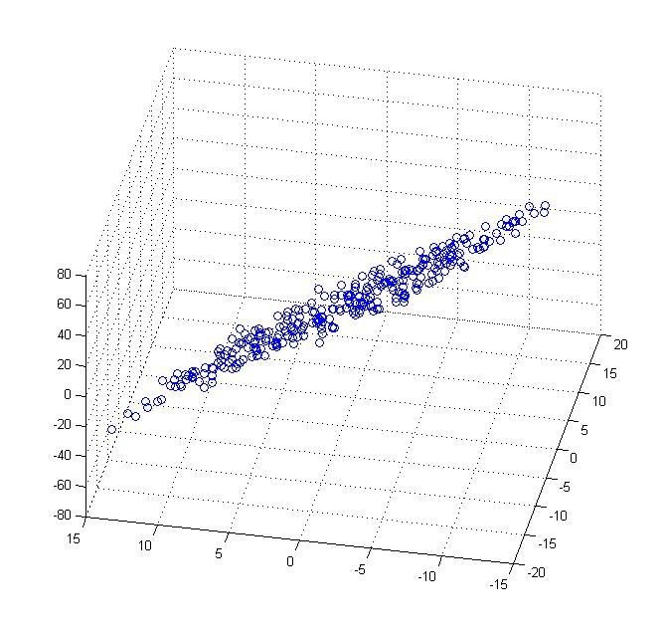
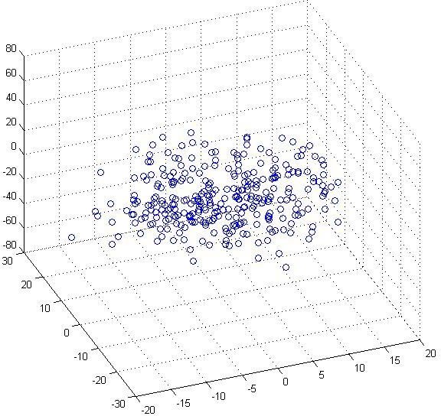
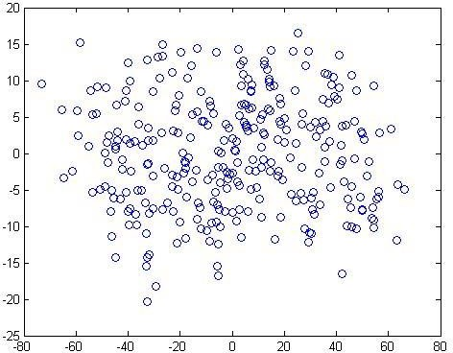
数据压缩
将数据从三维降到二维

Slide 8
数据可视化
Country | GDP (trillions of US$) | Per capita GDP (thousands of intl. $) | Human Develop- ment Index | Life expectanc y | Poverty Index (Gini as percentage) | Mean household income (thousands of US$) | …
Canada | 1.577 | 39.17 | 0.908 | 80.7 | 32.6 | 67.293 | …
China | 5.878 | 7.54 | 0.687 | 73 | 46.9 | 10.22 | …
India | 1.632 | 3.41 | 0.547 | 64.7 | 36.8 | 0.735 | …
Russia | 1.48 | 19.84 | 0.755 | 65.5 | 39.9 | 0.72 | …
Singapore | 0.223 | 56.69 | 0.866 | 80 | 42.5 | 67.1 | …
USA | 14.527 | 46.86 | 0.91 | 78.3 | 40.8 | 84.3 | …
… | … | … | … | … | … | …

Slide 9


数据可视化
Country
Canada | 1.6 | 1.2
China | 1.7 | 0.3
India | 1.6 | 0.2
Russia | 1.4 | 0.5
Singapore | 0.5 | 1.7
USA | 2 | 1.5
… | … | …

Slide 10
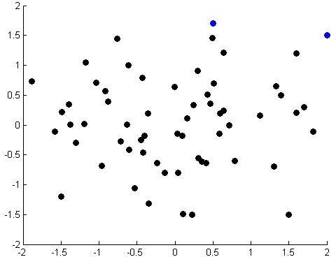
数据可视化

Slide 11
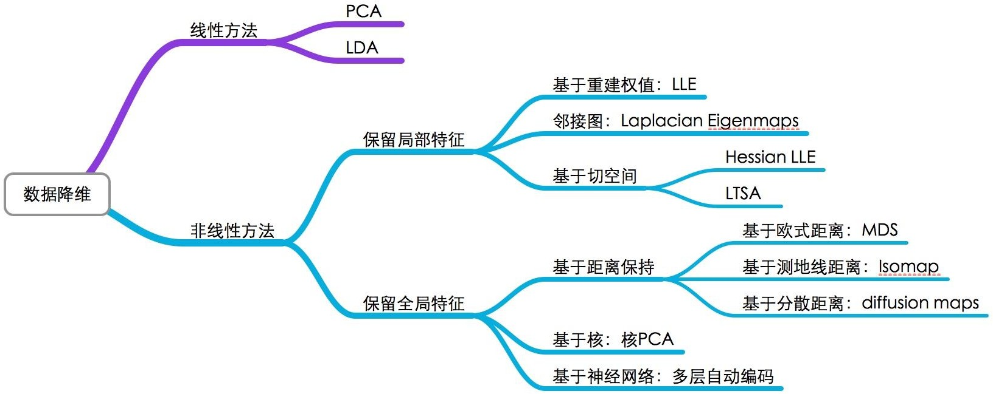
维数约简
http://www.jianshu.com/p/9b23902f01e0

Slide 12
维数约简
主成分分析
(Principal Component Analysis, PCA )
Machine Learning

Slide 13





主成分分析

Slide 14

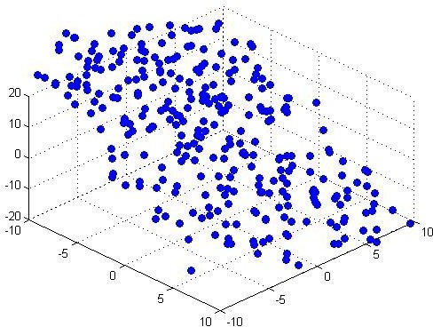

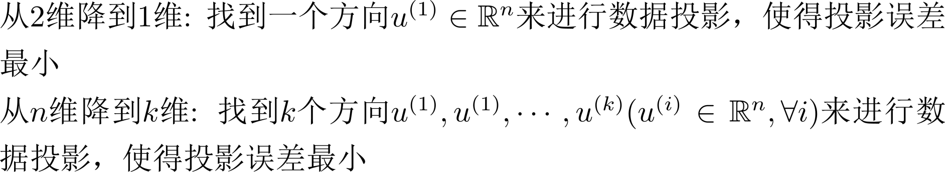
主成分分析

Slide 15
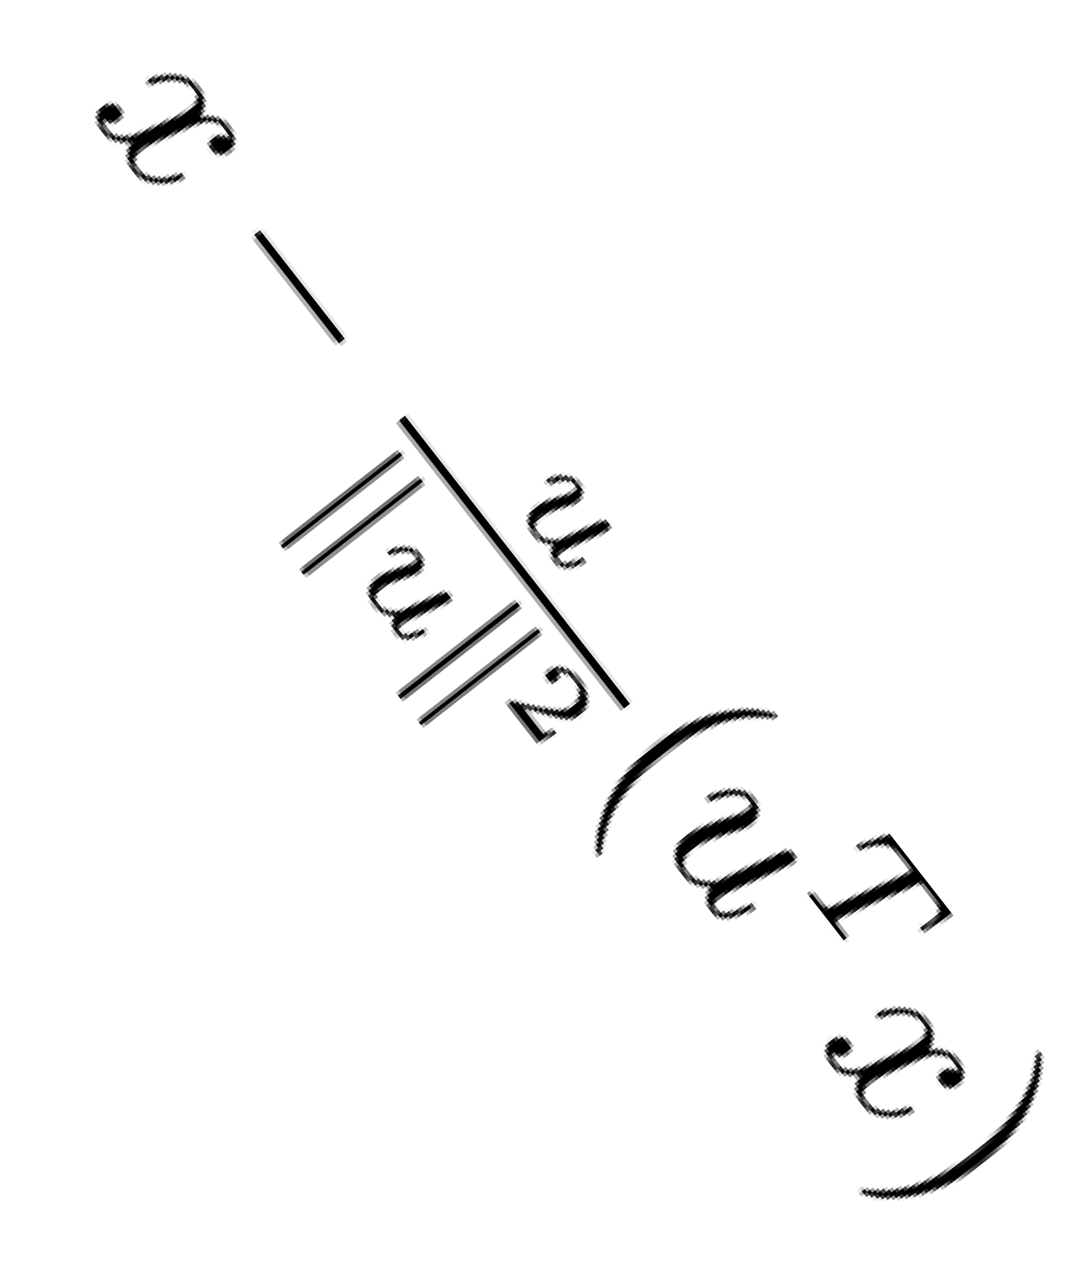
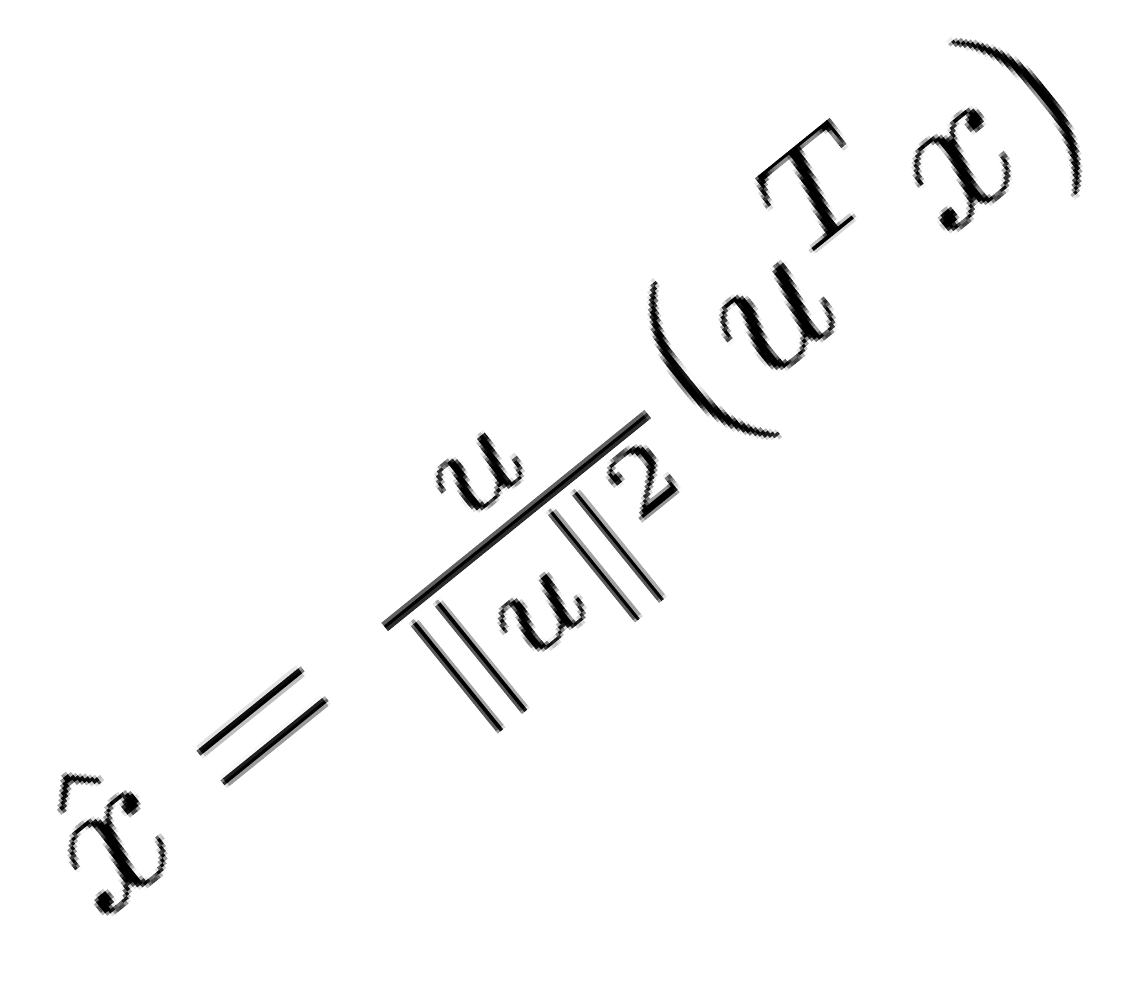
Recap: 投影与投影误差

Slide 16
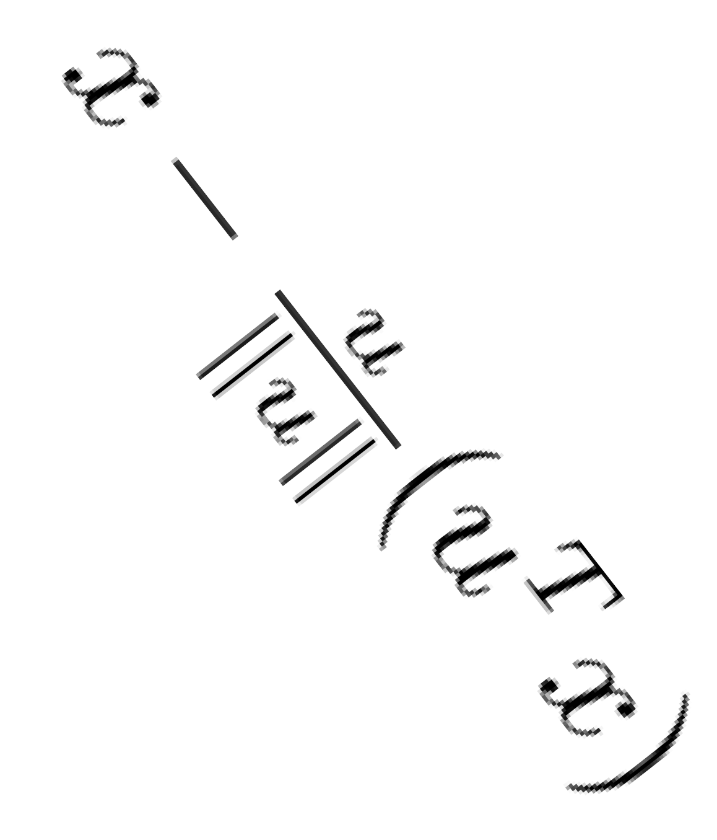
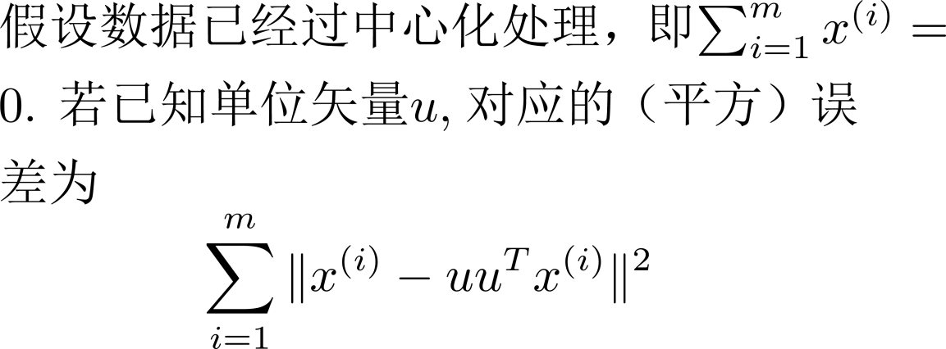
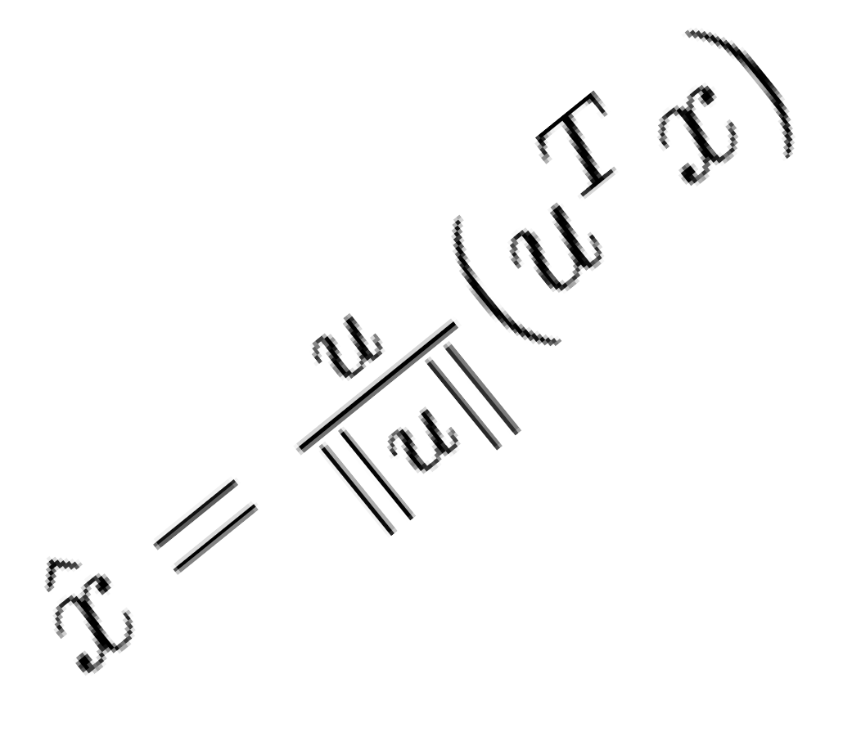
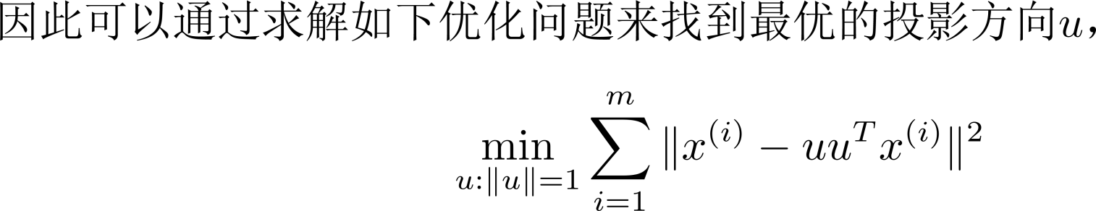
主成分分析

Slide 17
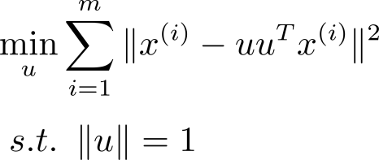
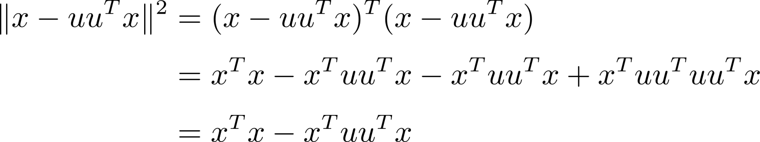

主成分分析

Slide 18
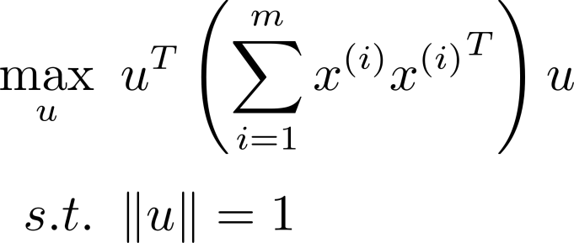
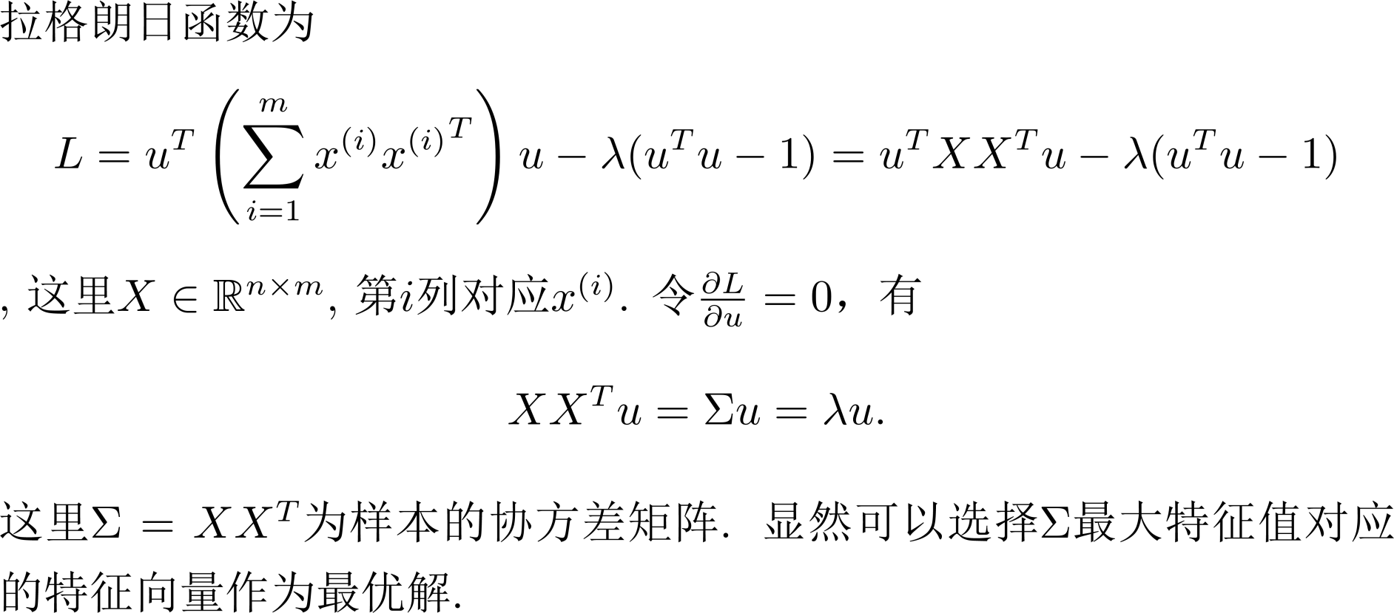
主成分分析

Slide 19
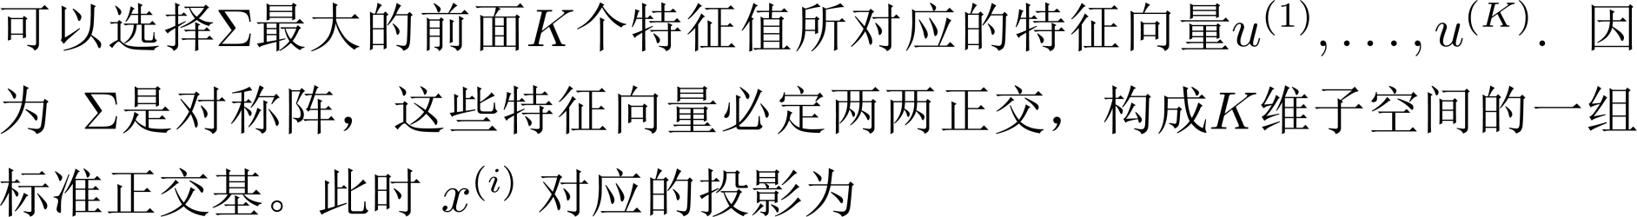
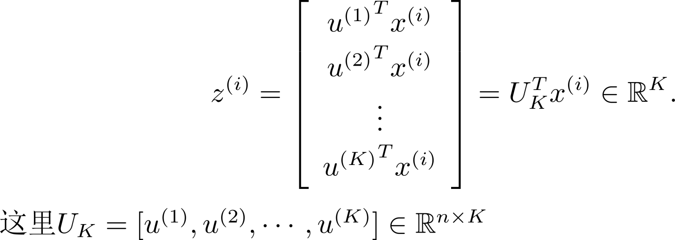
主成分分析

Slide 20
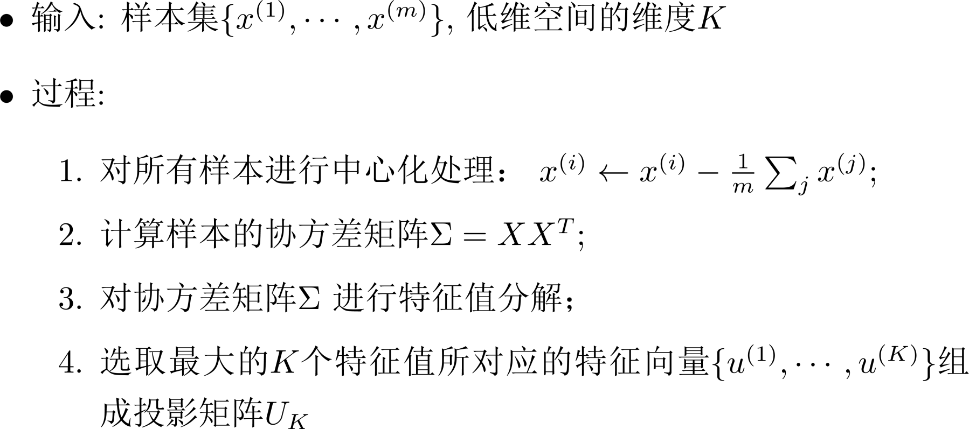
主成分分析

Slide 21
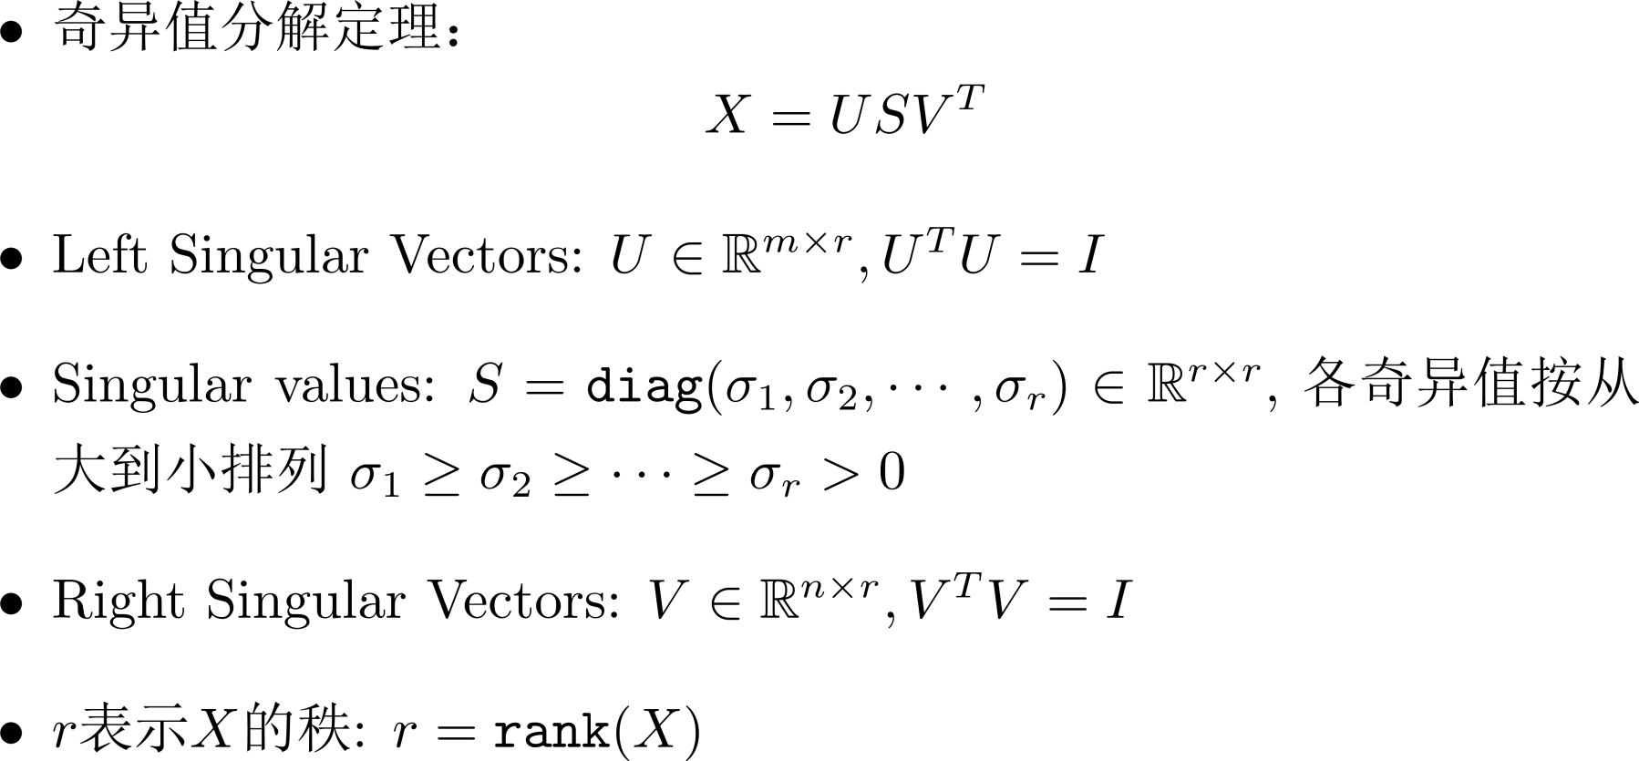
奇异值分解(Singular Value Decomposition, SVD)

Slide 22
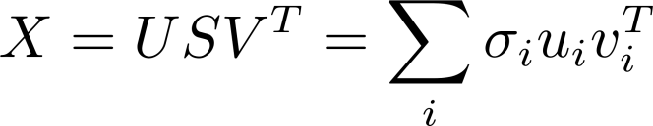


奇异值分解(Singular Value Decomposition, SVD)
n
n
X
X
≈
S
_{V}T
m
m
≈
+
m
U

Slide 23
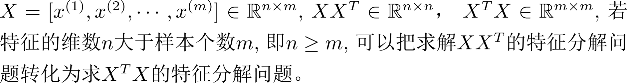

主成分分析

Slide 24
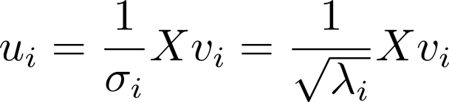
主成分分析

Slide 25
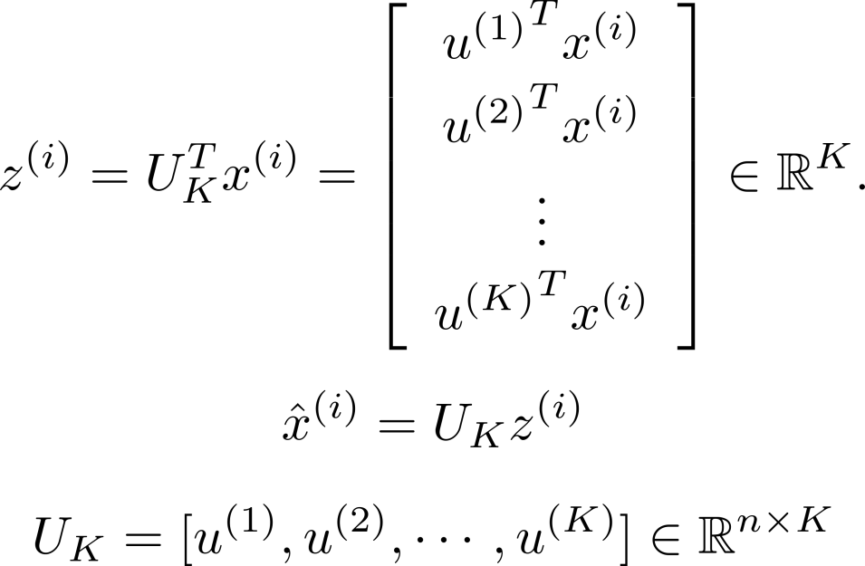
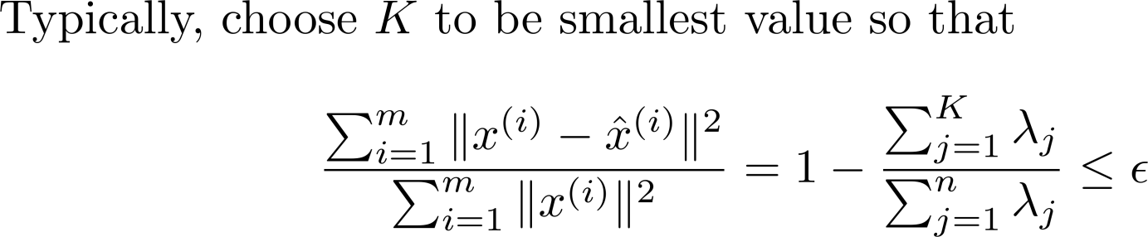

主成分分析
如何证明？

Slide 26
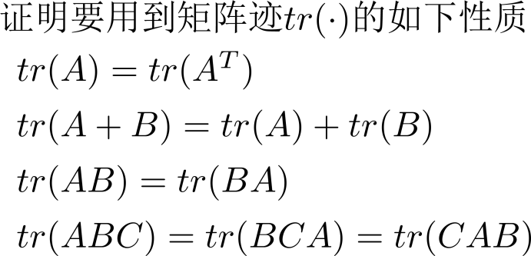
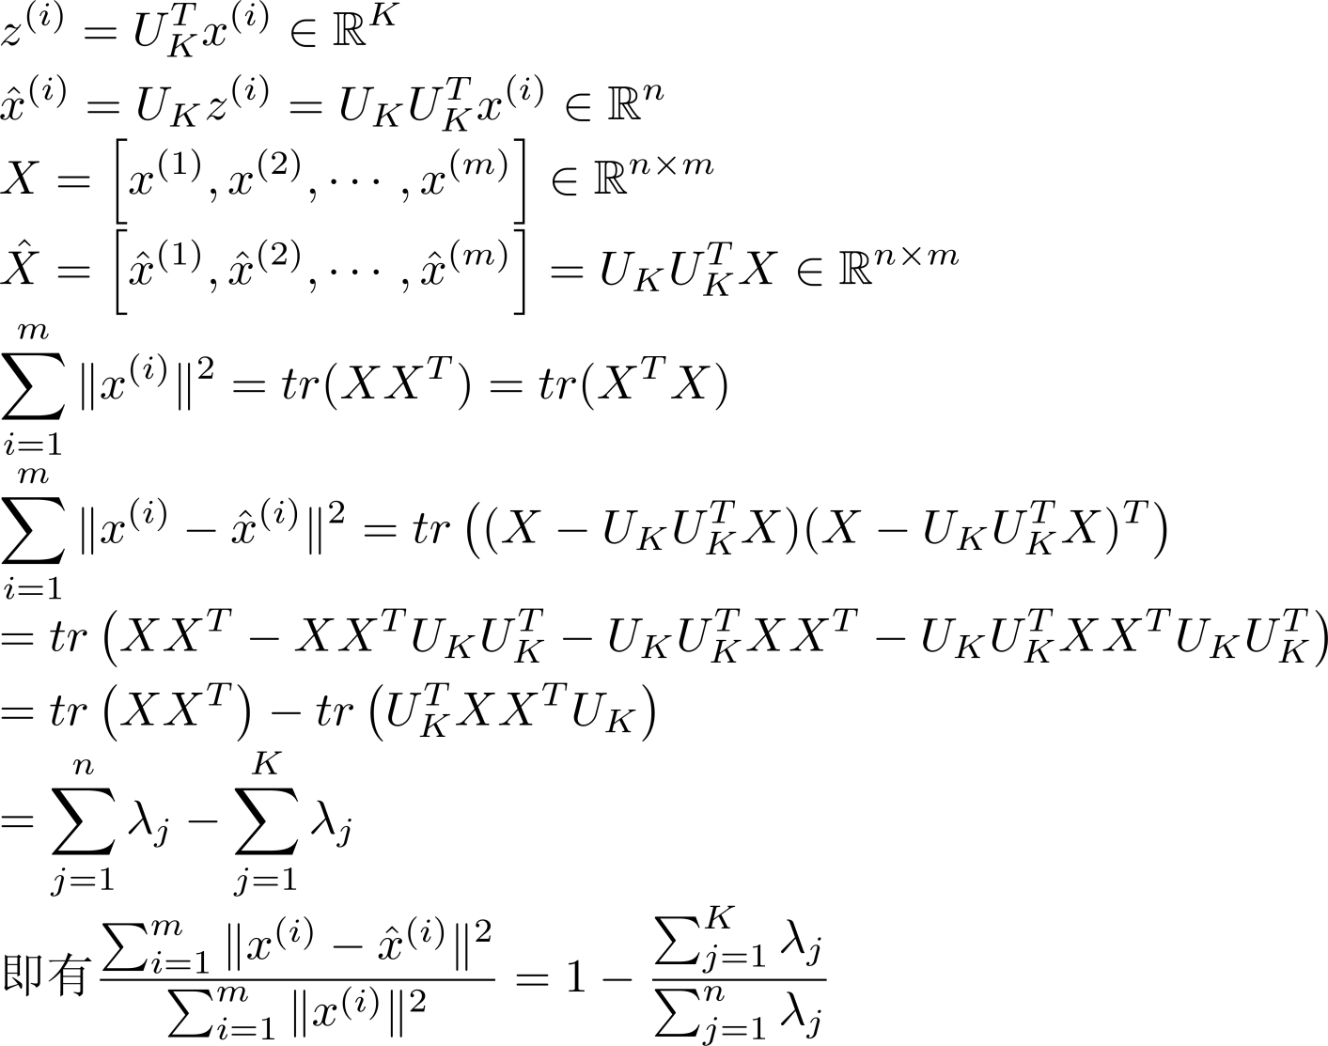
主成分分析

Slide 27
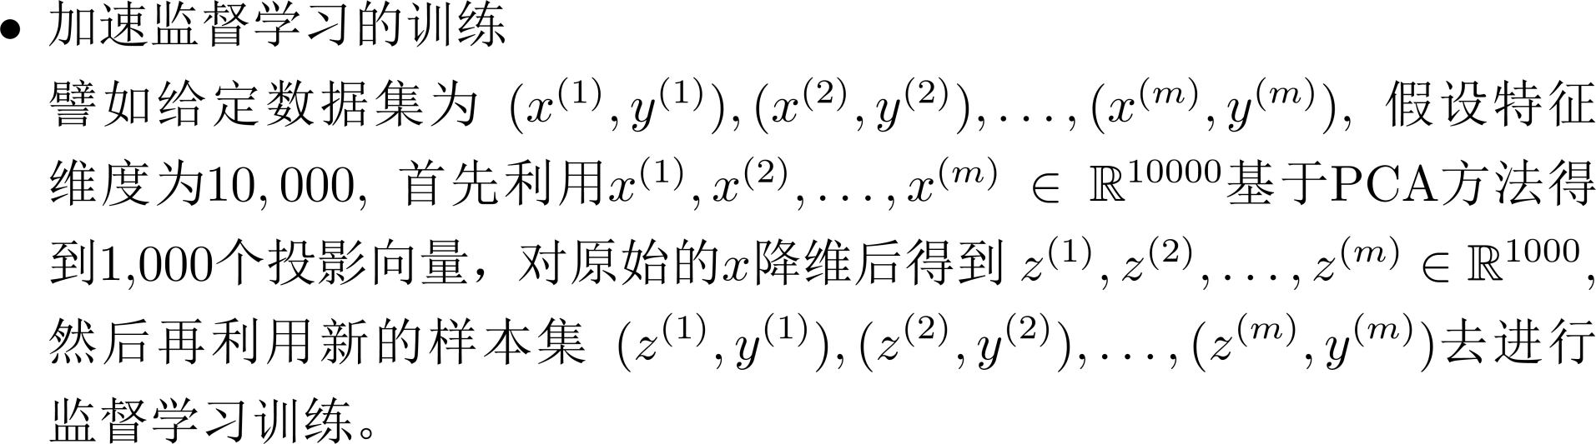
主成分分析的使用

Slide 28
主成分分析的使用
Compression
  Reduce memory/disk needed to store data
  Speed up learning algorithm
Visualization

Slide 29
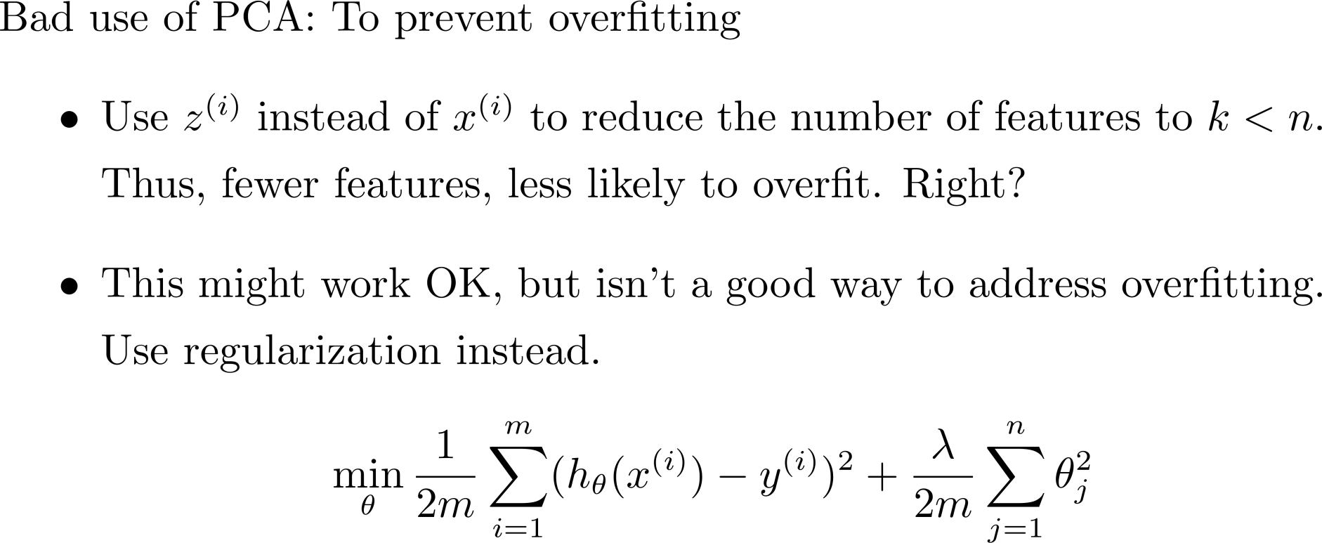
主成分分析的使用

Slide 30
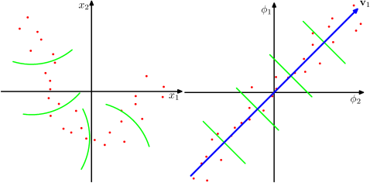
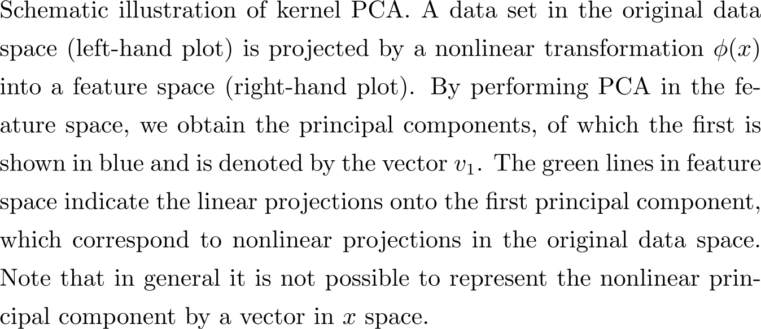
Kernel PCA

Slide 31
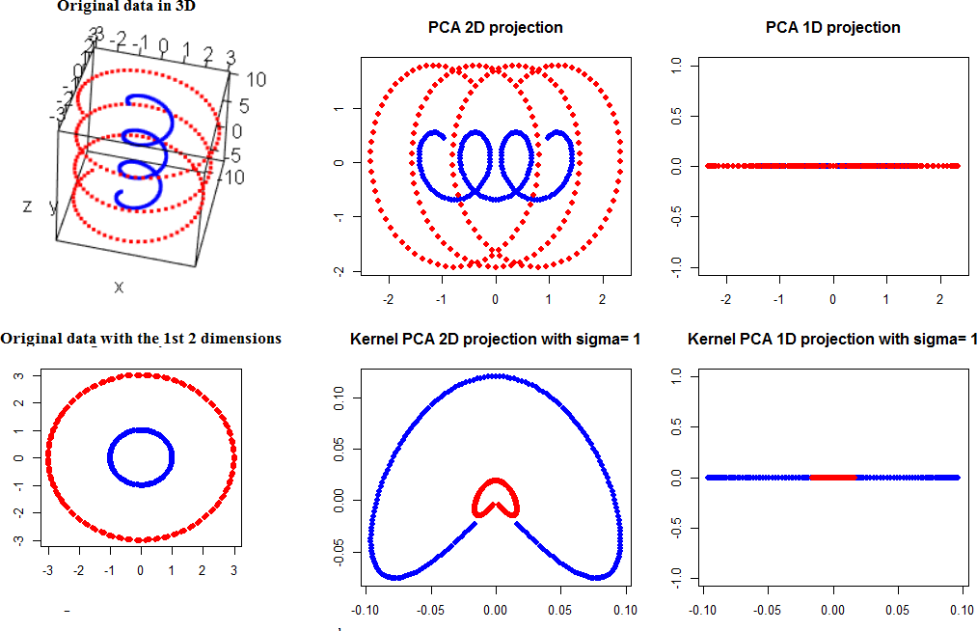
Kernel PCA

Slide 32
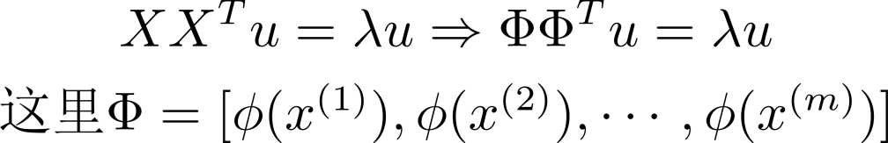
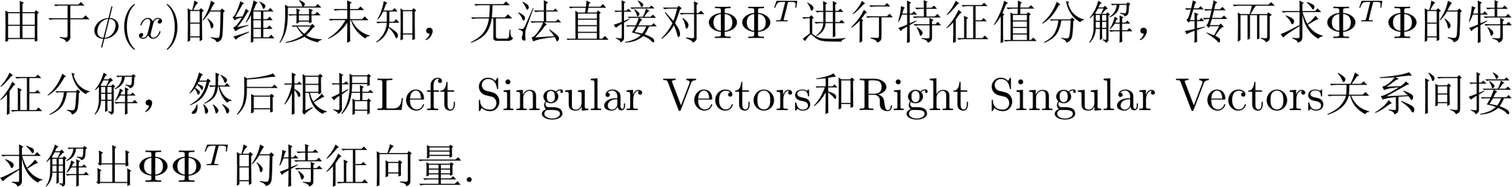
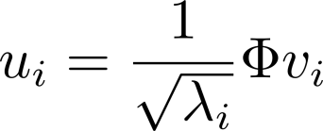
Kernel PCA

Slide 33
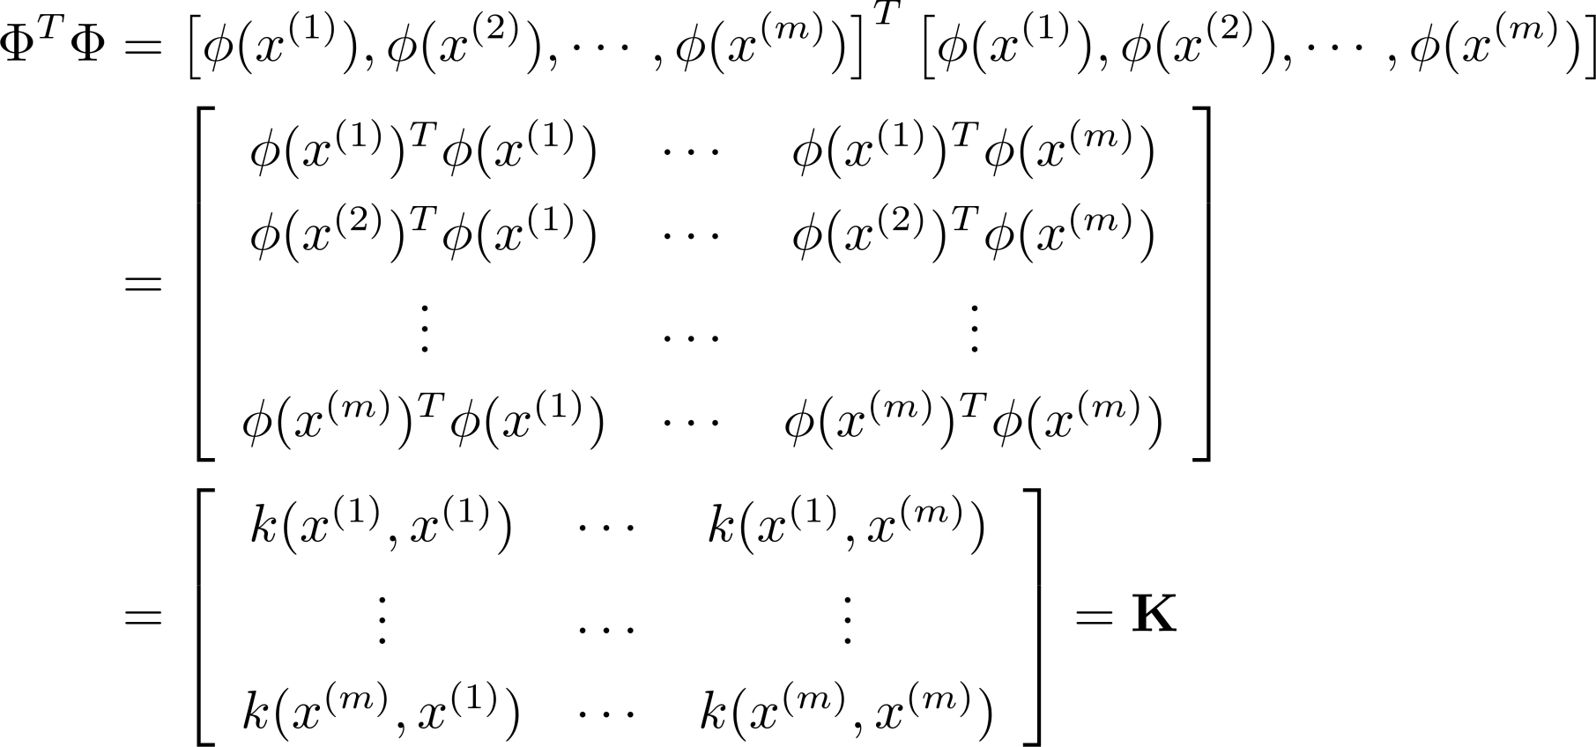
Kernel PCA

Slide 34
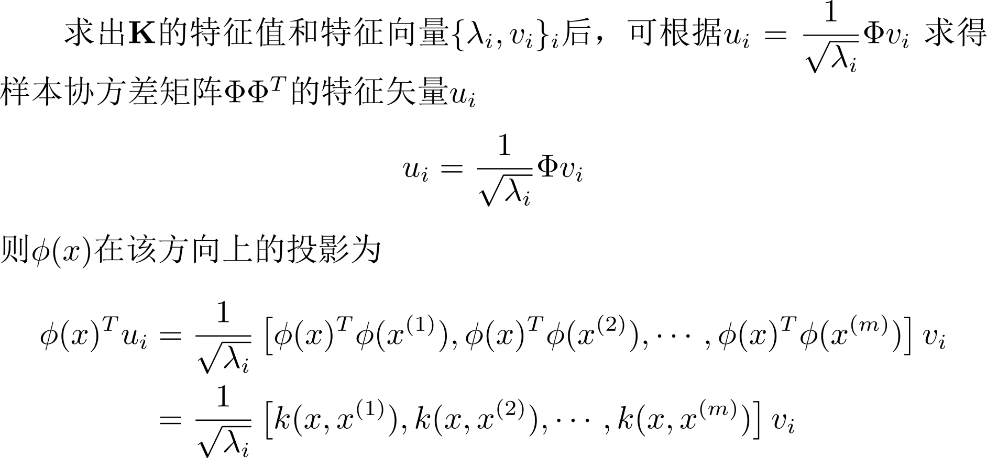
Kernel PCA

Slide 35
维数约简
线性鉴别分析
(Linear Discriminant Analysis, LDA )
Machine Learning

Slide 36
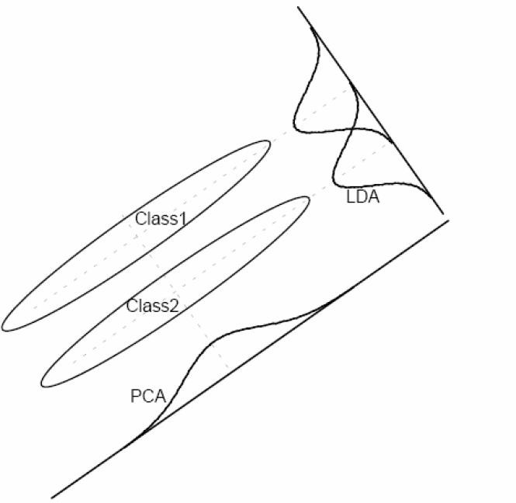
PCA vs. LDA
PCA是根据样本投影后 数据的方差来选择投 影方向的（最优重构）
但对于分类问题而言， 这样的投影反而有可 能使得数据更加无法 划分
例: 识别字母“O”和 “Q”
Which one is best for classification?

Slide 37
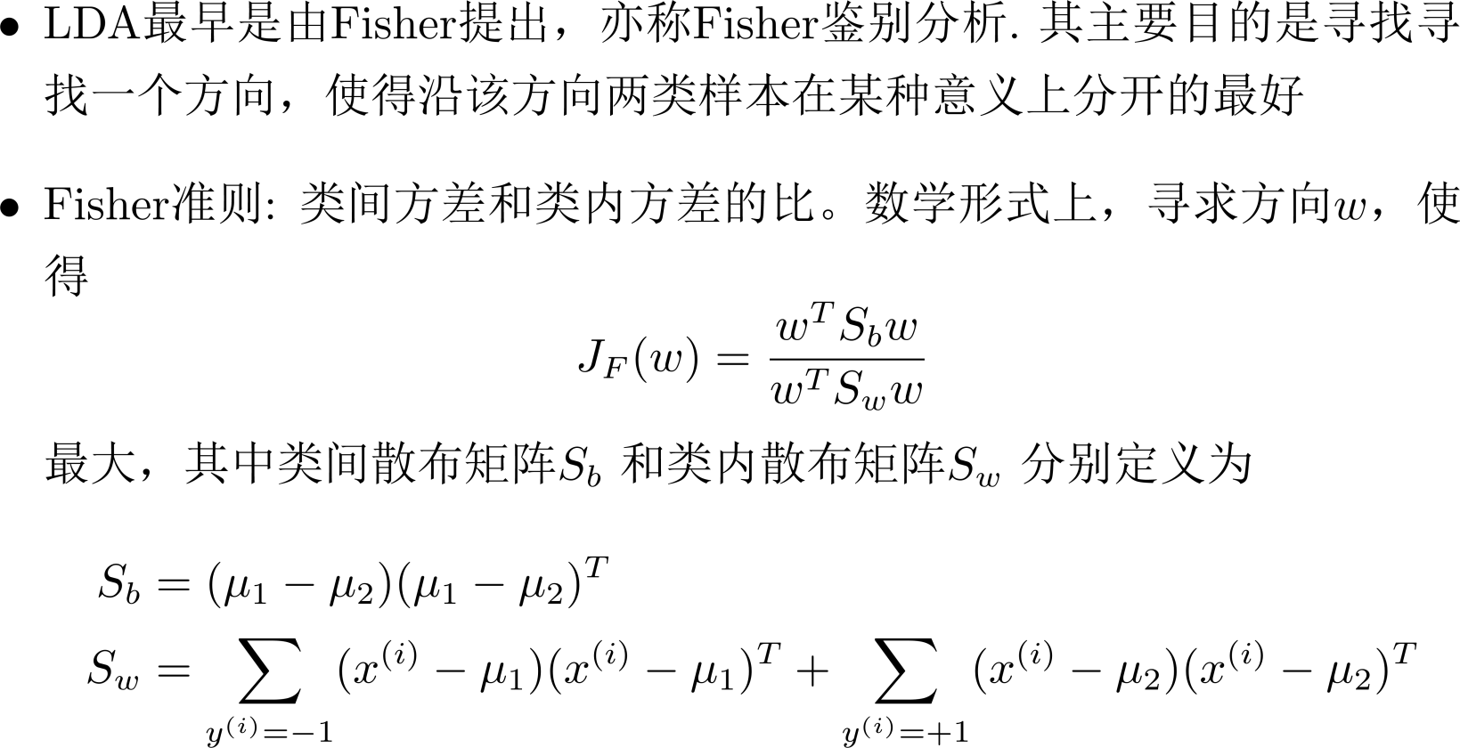
Linear Discriminant Analysis

Slide 38
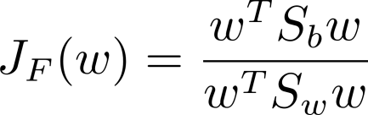
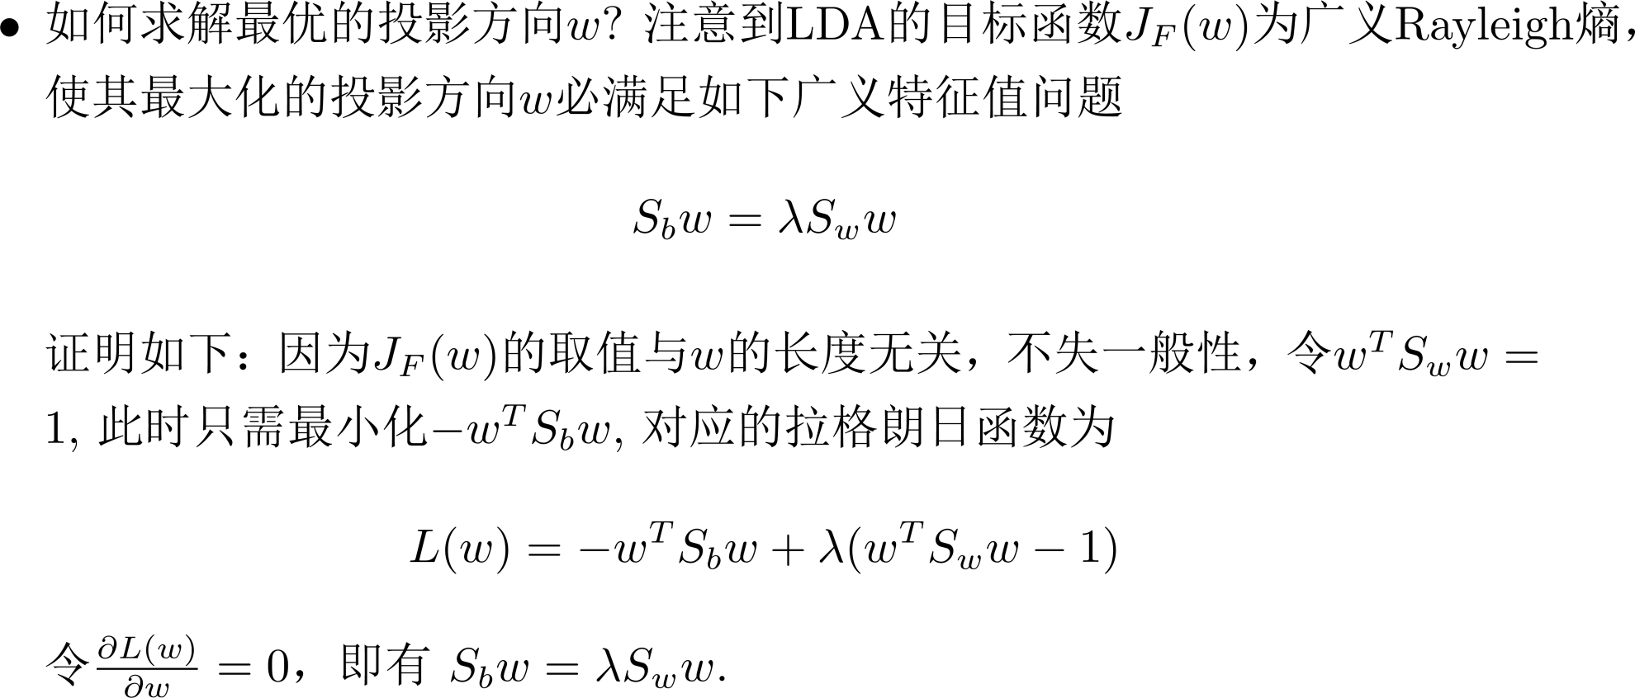
Linear Discriminant Analysis

Slide 39
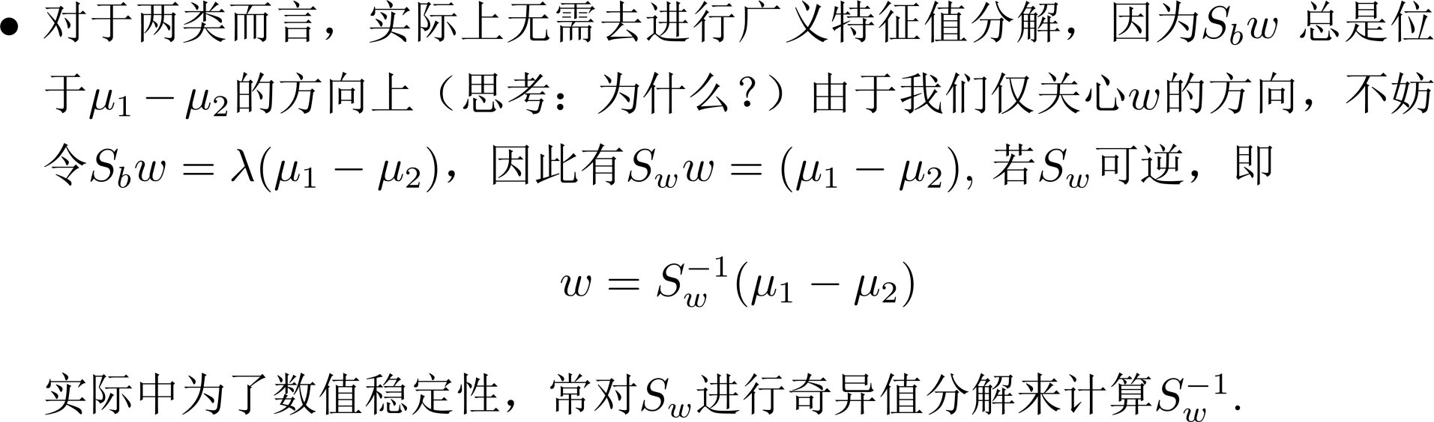
Linear Discriminant Analysis

Slide 40
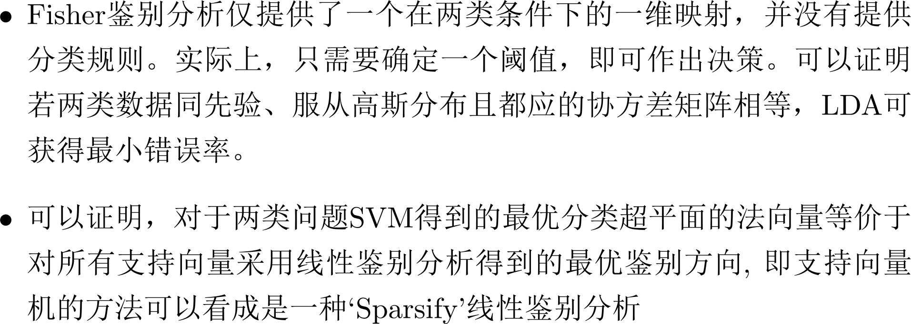
Linear Discriminant Analysis

Slide 41
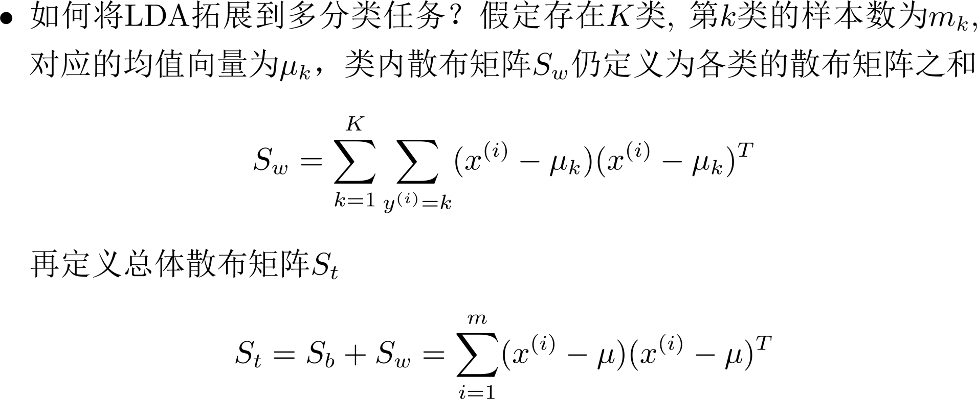
Linear Discriminant Analysis

Slide 42
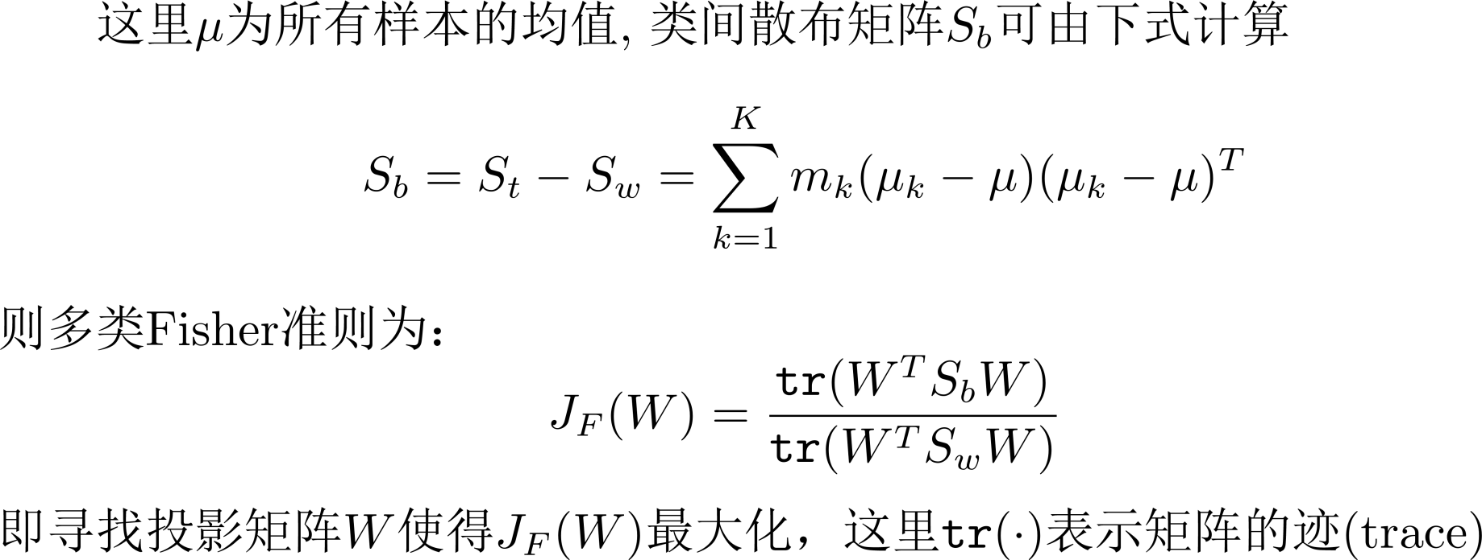
Linear Discriminant Analysis

Slide 43
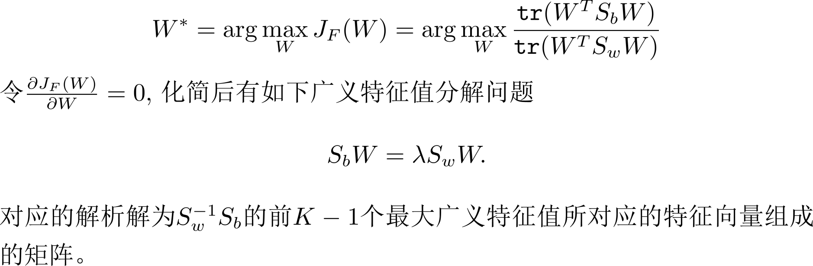

Linear Discriminant Analysis

Slide 44


Linear Discriminant Analysis

Slide 45
维数约简
流形学习
(Manifold Learning)
Machine Learning

Slide 46

Manifold Learning
Manifold Learning (or non-linear dimensionality reduction) embeds data that originally lies in a high dimensional space in a lower dimensional space, while preserving characteristic properties.
a manifold is a topological space that locally resembles Euclidean space
near each point.
Suitable for clustering or following supervised learning

Slide 47












Locally Linear Embedding (LLE)
Roweis, Sam T., and Lawrence K. Saul. "Nonlinear dimensionality reduction by locally linear embedding." Science 290, no. 5500 (2000): 2323-2326.

Slide 48






















LLE
^{𝑤}𝑖𝑗
Original Space New (Low-dim) Space
Roweis, Sam T., and Lawrence K. Saul. "Nonlinear dimensionality reduction by locally linear embedding." Science 290, no. 5500 (2000): 2323-2326.

Slide 49

LLE
Lawrence K. Saul, Sam T. Roweis, “Think Globally, Fit Locally: Unsupervised Learning of Low Dimensional Manifolds”, JMLR, 2013

Slide 50

LLE
Visualization of a subset of MNIST dataset after LLE
https://blog.paperspace.com/dimension-reduction-with-lle/

Slide 51

Laplacian Eigenmaps
Graph-based approach
Distance defined by graph approximate the distance on manifold
Construct the data points as a graph
Belkin, Mikhail, and Partha Niyogi. "Laplacian eigenmaps for dimensionality reduction and data representation." Neural computation 15, no. 6 (2003): 1373-1396.

Slide 52

Laplacian Eigenmaps
Belkin, Mikhail, and Partha Niyogi. "Laplacian eigenmaps for dimensionality reduction and data representation." Neural computation 15, no. 6 (2003): 1373-1396.

Slide 53

ISOMAP
Constructing neighbourhood graph G
For each pair of points in G, Computing shortest path distances ---- geodesic distances
Use Classical MDS with geodesic distances
  Euclidean distance→ Geodesic distance
Tenenbaum, Joshua B., Vin De Silva, and John C. Langford. "A global geometric framework for nonlinear dimensionality reduction." Science 290.5500 (2000): 2319-2323.

Slide 54

ISOMAP

Slide 55

ISOMAP

Slide 56

ISOMAP
Visualization of a subset of MNIST dataset after ISOMAP

Slide 57


T-distributed Stochastic Neighbor Embedding (t-SNE)
Problem of the previous approaches
  Similar data are close, but different data may collapse
LLE on MNIST
LLE on COIL-20

Slide 58

t-SNE

Slide 59





t-SNE –Similarity Measure

Slide 60


t-SNE
Good at visualization
t-SNE on MNIST
t-SNE on COIL-20

Slide 61
t-SNE

Slide 62
Thanks!
Any questions?

