Slide 1
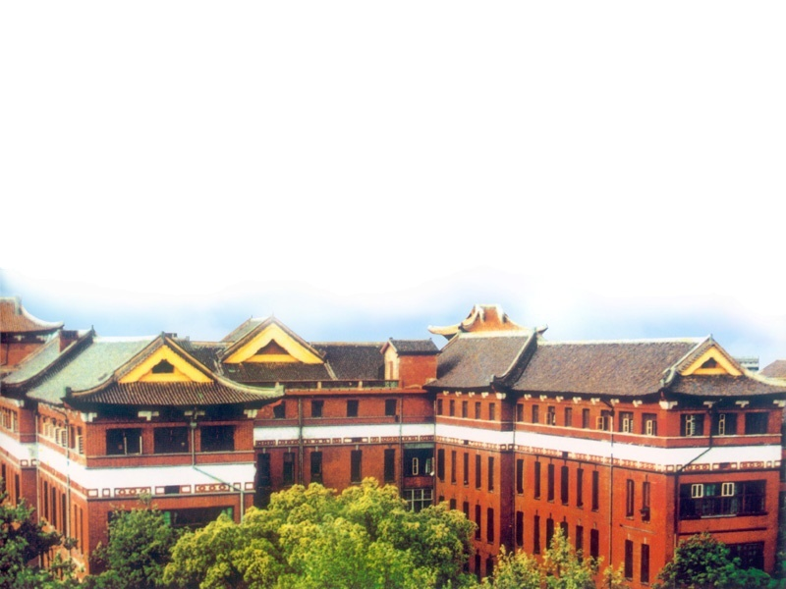
Oral and maxillofacial surgery anesthesia
中南大学湘雅医院麻醉科
周艳平

Slide 2
一、Characteristics of the patients and the operation. Anesthesia management.
(一)Anatomy and physiolosy
(1)Congenital lip and palate cleft
Infants—anesthetic endurance
—compensation function
—respiration system is special
Coexistent diseases —VSD ASD etc
Oral-nose connected —difficulty in getting food
respiration system infection.

Slide 3
(2)Bilateral temporomandibular joints rigidity
Difficulty in opening the mouth
—Chronic hypoxaemia
—Poor oral sanitation
—Malnutrition
—fluid and electrolytes unbalance

Slide 4
(3)Oral tumor
Difficulty in opening the mouth, pharyngeal obstruction
—Tracheal intubation is difficult
Old age patients—coexistent diseases (hypertension,
chronic bronchial inflammation. coronary heart
disease, diabetic

Slide 5
(4)Trauma
If the soft palate、peripharynx、 base of the tongue are
involved, tissue swelling, pharyngeal cavity is narrowed.
Fracture dislocation stifle (suffocate)
Bleeding, secretions aspiration.
(5)Mandible-thorax, mandible-neck adherence, scar formation
and contractions around the mouth.
—Head-neck is fixed, head is extremely bent
—Trachea is shifted to one side
—Tracheal intubation and tracheostomy are difficult

Slide 6
(6)Congenital maxillofacial deformity
Pierre-Robin syndrome, Treacher-
Collins syndrome
—Tracheal Intubation is difficult
Anesthesia endurance is decreased.

Slide 7
（二）Characteristics of the surgery
(1)Premedication（Atropine. Sod-luminal Morphine. Midazolum etc.）
The objectives of premedication are to：
—Allay anxiety and fear
—Reduce secretions
—Enhance the hypnotic effect of general anesthetic agents
—Reduce postoperative nausea and vomiting
—Reduce the volume and increase the PH of gastric contents
—Attenuate vagal reflexes
—Attenuate sympathoadrenal responses
If the preoperation airway obstrution is existed, don’t use any premedications that will suppress the respiration (e.g morphine)

Slide 8
(2)Anesthetic induction and tracheal intubation maybe difficult.
—temporomandibular joints rigidity
—Huge tumor
—Severe trauma
(3)Shared airway
—Observation and management are limited.
—Blood、secretions and debris may contaminate the lartynx.
—Gag and operation apparatus may compress the tracheal tube,
cause partial airway obstruction

Slide 9
(4)Heamorrhage
—The surgeon cann’t operate clearly
—Large quantity blood losses may result in shock.
(5)Prolonged plastic operation
—more anesthetic complications.
(6)Resuscitation
—We hope the postoperative recovery is quick and smooth.
(7)Different age ranges
—For infants and old age patients, the anesthesia management is difficult.

Slide 10
(三)How to deal with the mentioned problems
(1)For the patients with airway obstruction, donn’t use
respiration suppressive drugs as premedications.
(2)To ensure the airway, we should administer tracheal
intubation or tracheostomy.

Slide 11
(3)To fix the tracheal tube and connecting tube in position;
protect the anaesthetic tubing from dislodgement.
(4)Choose an appropriate intubation route
—nasal intubution
—Oral intubution

Slide 12
(5)Hypotension technique
Use this technique in important procedure.
The hypotensive duration should be short.
SBP>90mmHg, MBP>60mmHg.
(6)To fulfil respiration self-regulation,
the postoperative resuscitation should be quick.
(7)Prevent postoperative nausea and vomiting
—related to pharyngeal stimulation, postoperative pain,
anesthetic drugs etc.

Slide 13
二、The anesthetic choices and common anesthetic methods
According to the patient’s condition,
surgery’s requirements, surgeon’s experience
and the anesthetist’s preference,
the anesthetic method is different

Slide 14
(一)Local anesthesia
—Administration is simple,
disturbance to the body enviroment is small,
postoperative recovery is quick.
—For infants and mental or physical disability,
local anesthesia combined with base anesthesia is necessary.
—During the operation, if the local anesthesia need to be
changed to general anesthesia, tracheal intubation is necessary.

Slide 15
（二）Base anesthesia
Ketamine, pethidine-droperidol, midazolum.
KTM:5-10mg/kg im, 3min-5min go to sleep, maintain time 25min-36min , Midazolum 0.1-0.2mg/kg iv or im.

Slide 16
（三）General anesthesia
（1）Induction and intubation
—Rapid induction
—Slow induction:light anesthesia +local anesthetic spray
—Laryngoscopic intubation, awake intubcotion,
awake fibreoptic intubation.,Tracheostomy.

Slide 17
(2)Anesthetic maintenance
—Inhalation (enflurane, isoflurane, sevoflurane,
desoflurane, N₂O)
—Combined intravenous (valume, midazolum,
fentanyl, norcuron, etc)
—Intravenous-inhalation combined
General enesthesia combined with
local anesthesia is important.
(3)Postoperative resuscitation

Slide 18
三、Management during and after anesthesia
(一)During anesthesia
(1)Ensure the airway
—Causes of airway obstructions are:
Tongue falling down, laryngo spasm,
bronchiospasm ,secretions、blood、
debris drain into larynx, tracheal tube kinking
(2)Maintain statisfied ventilation
Inadequate ventilation may result in hypoxaemia , hypercapnia.

Slide 19
Causes of hypoxaemia during anesthesia
Hypoxic inspired gas mixture Equipment | Oxygen supply(cylinder/pipeline failure, misconnection) Flowmeters (inaccurate settings, leak) Breathing system (obstruction, leak)
Hypoventilation Equipment | Ventilator failure Breathing systen (obstruction, leak, disconnection) Tracheal tube (obstruction, oesophageal intubation)
Patient | Respiratory depression in spontaneously breathing patients Obstruction
V/Q mismatch Patient | Inadequate ventilation Endobronchial intubation Secretions Pneumothorax Bronchospasm Pulmonary aspiration Pulmonary edema Inadequate perfusion Embolus (gas, thrombus) Low cardiac output
Other | Methaemoglobinaemia, Malignant hyperthermia

Slide 20
Intraoperative hypercapnia is caused by inadequate
carbon dioxide removal or excessive carbon dioxide production,
Inadequabe carbon dioxide removal is most commonly caused
by hypoventilation.

Slide 21
The criteria of satisfied ventilation:
Spo₂ 98-100% PEt CO₂ 30-45mmHg Blood-gas analysis.
TV 8-10ml/kg (Neonate 6-7ml/kg)
Rf 12/min (Neonate Rf )

Slide 22
(3)Circulation management
—Insertion of an I.V cannula
—Fluid therapy
Normal maintenance requirements
Restore TBW after a period of fasting
Replace small blood losses, loss of ECF into the “third space”
and losses of water from the skin, gut and lungs.
Blood losses in excess of 15% of blood volume in the adult are
replaced usually by infusion of stored blood.
Smaller blood losses may be replaced by a crystalloid electrolyte solution and a colloid solution.
—Maintain steady BP.HR

Slide 23
(二)Management after anesthesia
(1)Airway management
—Extubation conditions:
①Completely awake.
②normal ventilation,
③SPO₂>96% (air inhalation)
④Normal muscle tonicity, smooth respiration.
—Prevent laryngeal edema after extubation

Slide 24
—Delayed extubation:
①Pharyngeal damage due to tracheal intubation.
②The involved operation range is large.
③Restrictive dressings applied after surgery.
④Narrowed pharyngeal cavity due to trauma.

Slide 25
(2)Prevent postoperative nausea and vomiting.
—5-HT3 RB
—Suction
(3)Prevent the complications related to anesthesia
—Nasal-pharyngeal mucosal haemorrhage
Nasal-pharyngeal mucosal fall off
Pharyngeal edema
Postoperative maxilla sinus inflammation.
—Choose appropriate size tracheal tube.
Use tracheal tube lubricant.
Apply humidification of inspired gases.
High-volume, low-pressure cuffs may be preferred for long-term intubation.

Slide 26
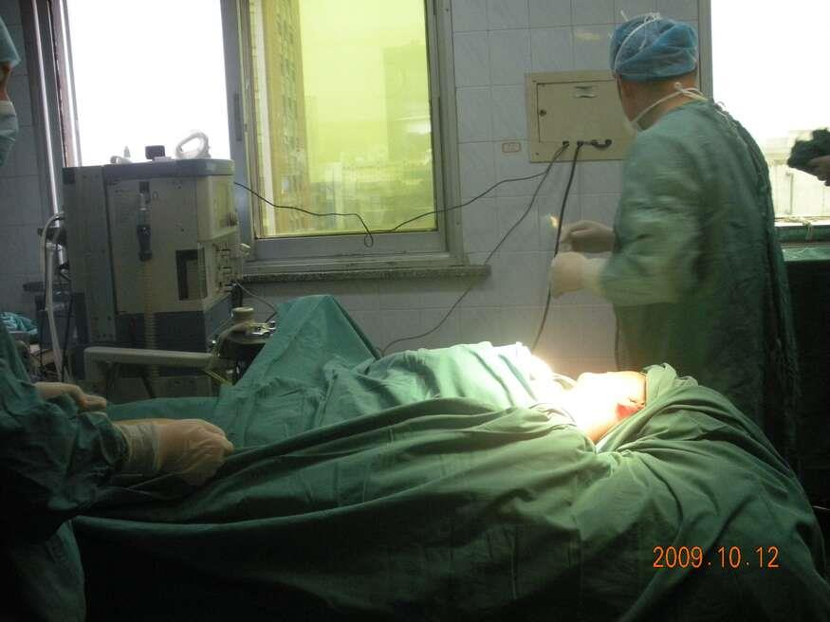

Slide 27
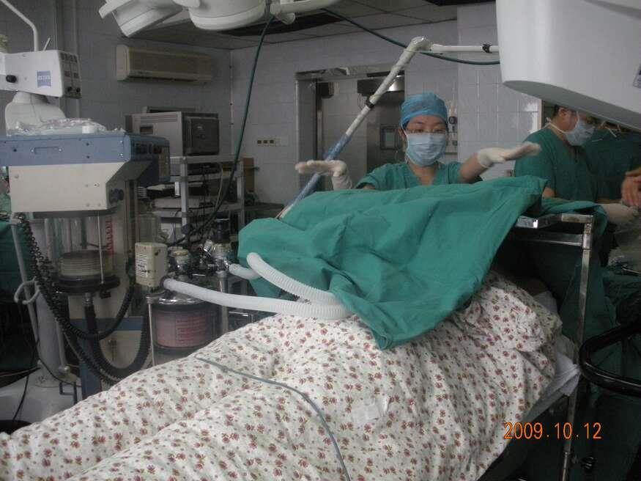

Slide 28
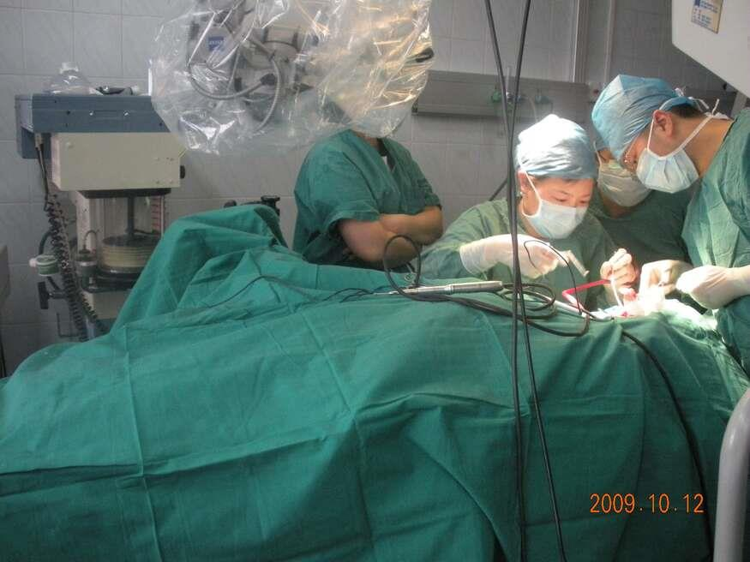

Slide 29
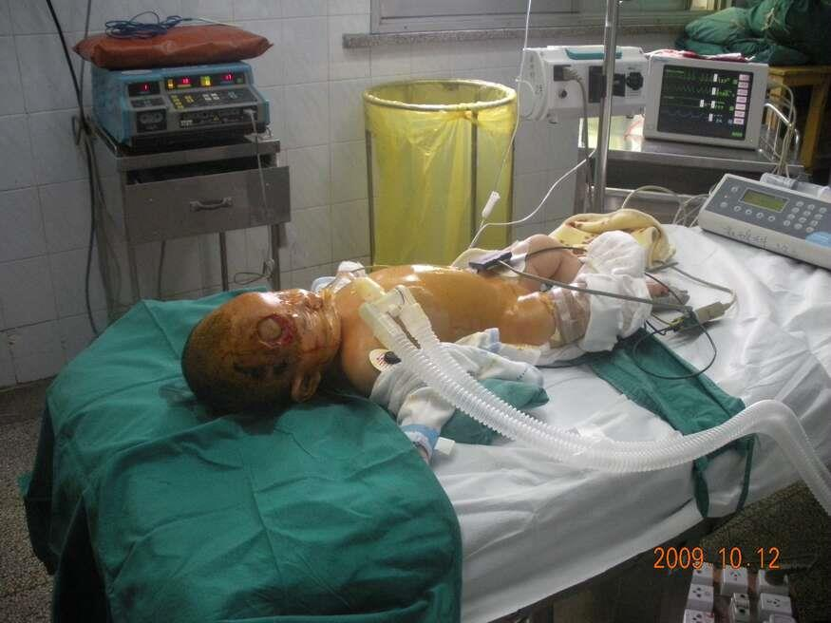

Slide 30
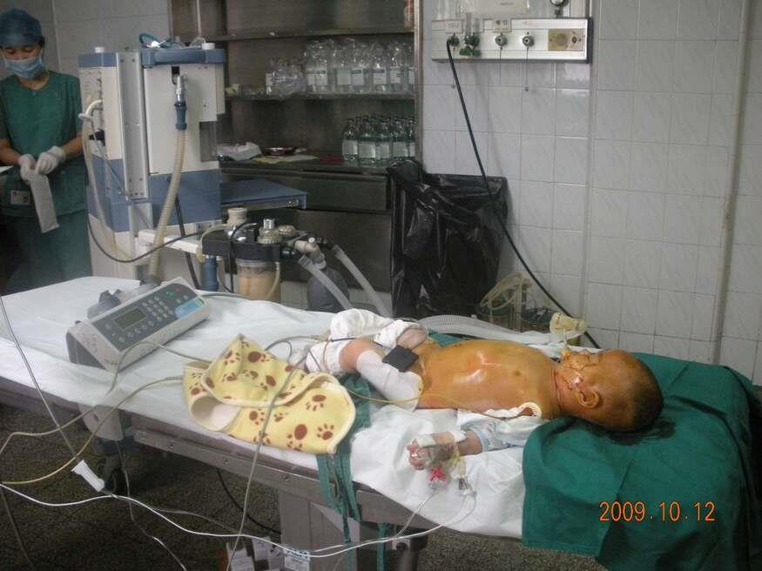

Slide 31
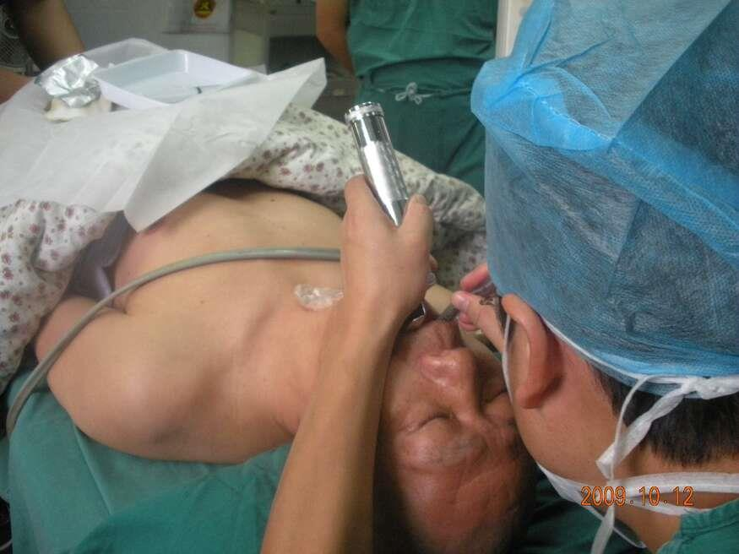

Slide 32
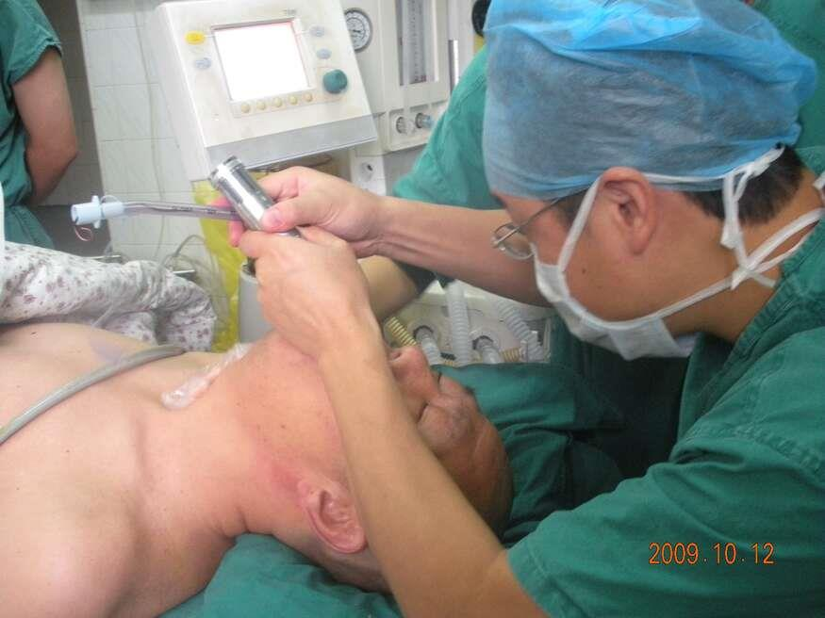

Slide 33
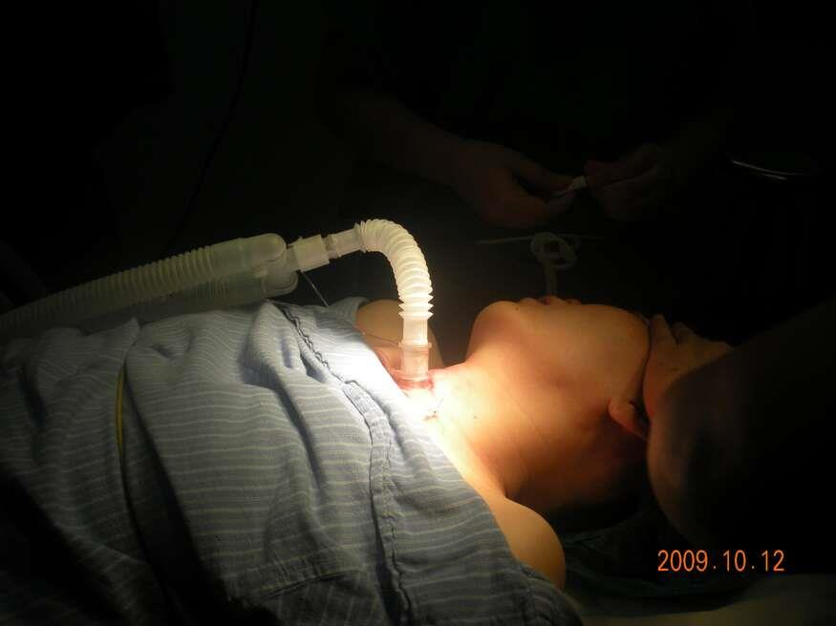

Slide 34
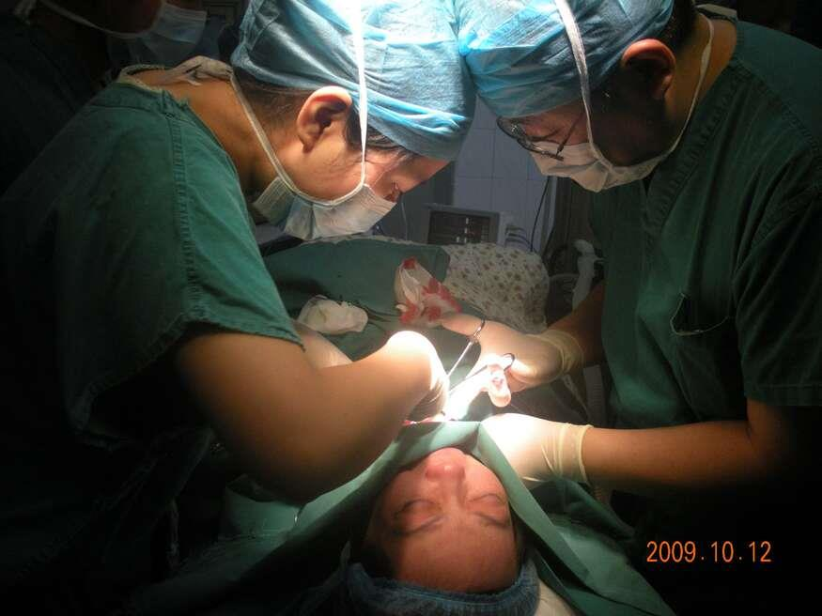

Slide 35
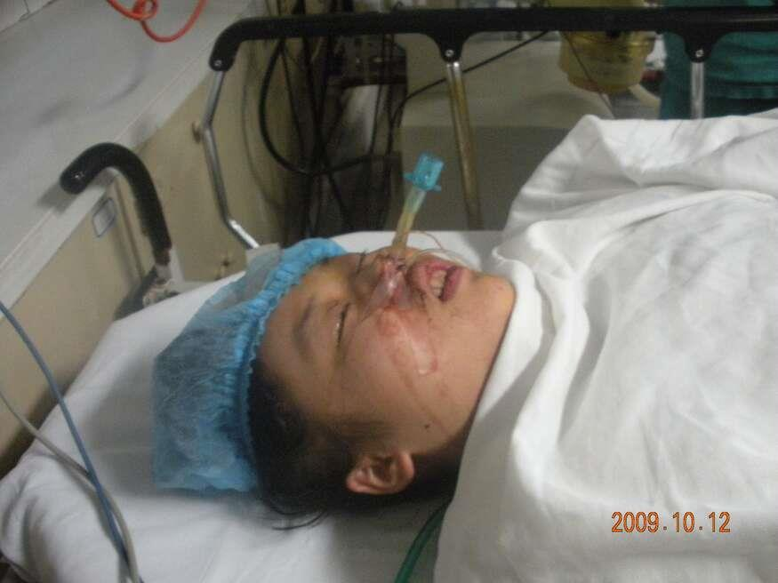

Slide 36
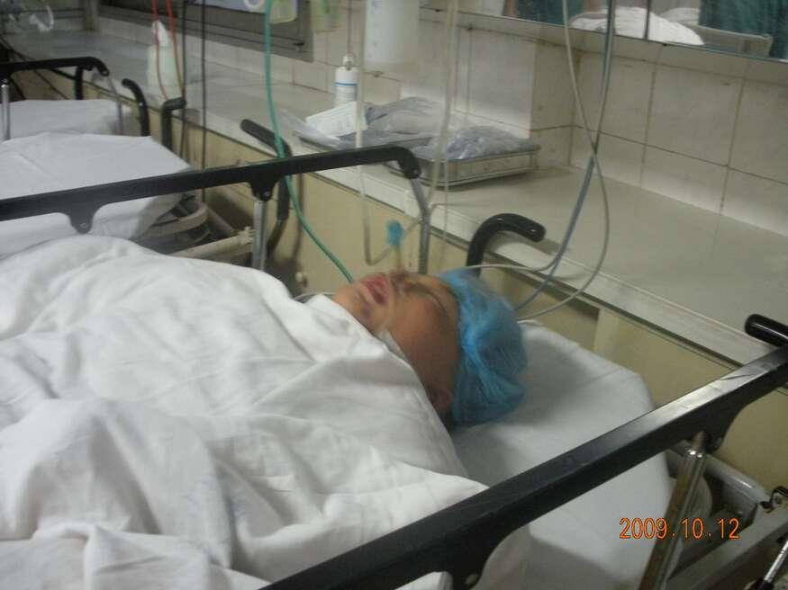

Slide 37
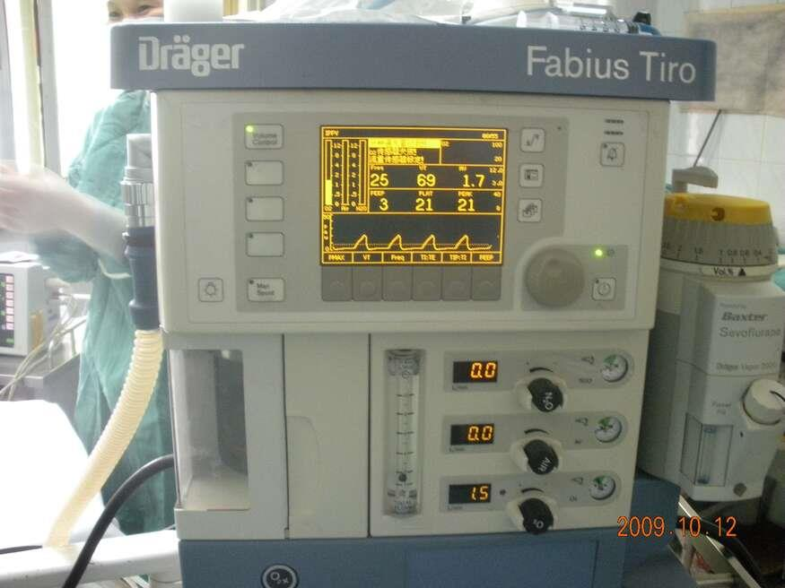

Slide 38
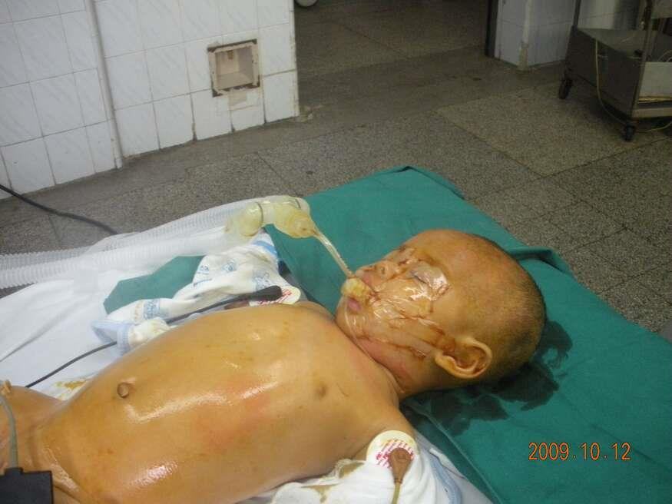

Slide 39
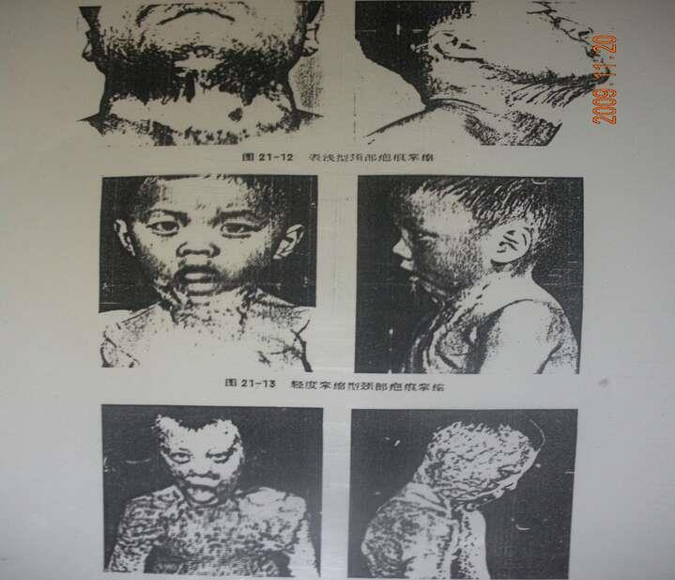

Slide 40
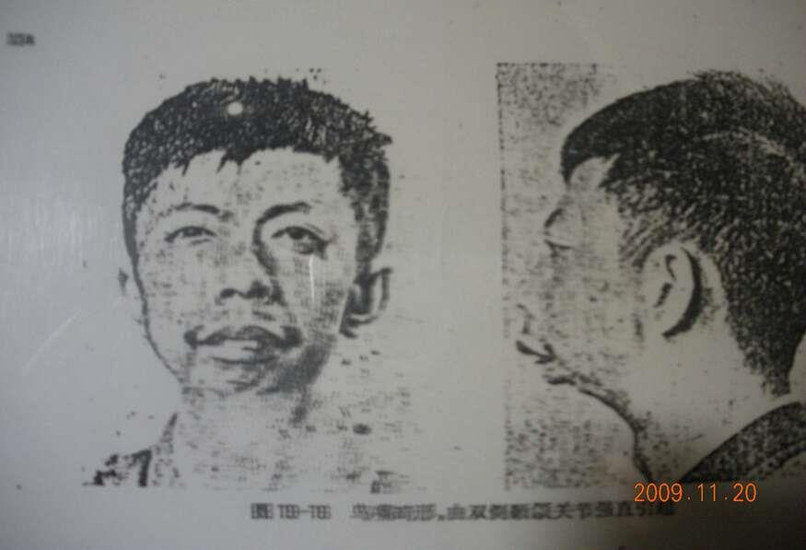

Slide 41
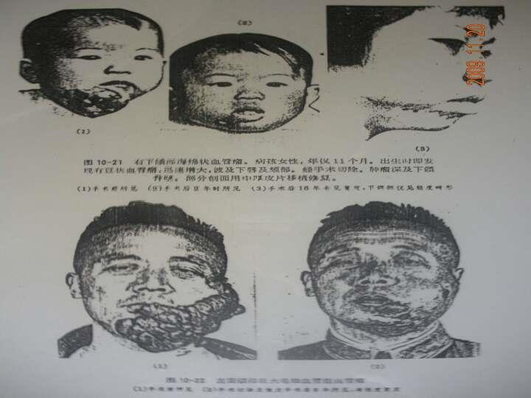

Slide 42
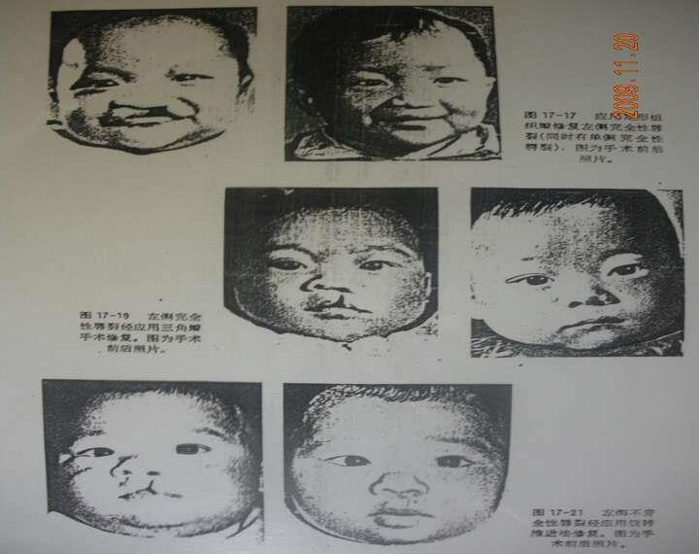

Slide 43
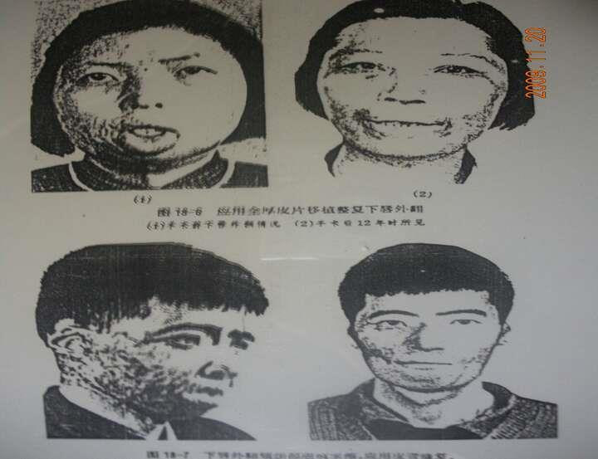

Slide 44


谢谢

